Slide 1



Managing Nebraska’s Roads and Streets
Standards for Highways, Roads and Streets
Statutes Chapter 39 Article 21
NBCS Regulation 428 NAC 2
Tab 8.2
Notes:
9/11/2022 Updated Slide 1 with 3-ring binder Tab number. Deleted Slide 17 (municipal extensions) – moved slide to slides group 301 (Functional Classification). Added clarifications to the two Cost Effective Analysis slides (24 and 25 in the 2/24/2022 version and now slides 23 and 24. Deleted slides 33 (Johnson SE exercise) and 34 (Wayne NW exercise). Revamped exercises slides 31 (Friend South), 32 (In McCook), and 33 (Petersburg NE). Now a total of 35 slides.
2/24/2022 Updated Slide 10 (3R Thresholds). Hid slides that were numbered 30-35 in the 10/11/2021 version, numbered 31-36 in the current version; each showed a project to assign for an exercise. Inserted new slide 30 to indicate it is time for exercises.
10/11/2021 Re-did slide 25 because it wasn’t printing properly in the Notes Pages layout.
9/9/2021 Hid Slides 2 and 17
8/13/2021 Deleted slides 5-7 (Plickers)
6/23/2021 Added slides 10, 11 and 12 and added a bullet to slide 4
5/21/2021 Updated several slides with references to exam questions.
2/3/2020 Updated. Slide 4 minor clarification. Added Wayne NW slide 13 as a hands-on class exercise. Slide 14 Petersburg NE will be time permitting. Previous version 8/14/2019.
8/14/2019 Updated. Previous version 2/2/2019. Deleted three slides. Deleted Slides 3 and 5 (of 2/2/2019 version) – status of 428 NAC 2 already covered in Session 400. Deleted Slide 8 because FHWA archived Mitigation Strategies for Design Exceptions – July 2007.
16 total slides, 2 hidden, makes 14 slides for presentation.
Pre-Workshop Course on Nebraska’s Standards for Highways, Roads and Streets
198 minutes (3 hours 18 minutes)

Slide 2
General Outline
Your Questions
Quick Review of Standards
Examples
AGENDA
Notes:
9/9/2021 Deleted
8/14/2019 Updated, deleted first bullet (status of 428 NAC 2, already covered in session 400).
2 min
Will sometimes work in teams

Slide 3
Standards – What Standards?
Design
Construction
Maintenance
What?
Notes:
1 min

Slide 4
Why do you Need to Know the Standards?
As a good start to building a quality road or street, and
To request a relaxation of standards for work that will be done
  if applying a standard is a hardship due to unique, peculiar circumstances
Managing consultants
Importance
Notes:
6/23/2021 Added third bullet (managing consultants)
2/1/2020 Updated by changing the sub-bullet at the bottom to “is a hardship due to unique, peculiar circumstances.”
2 min
Some sets of plans

Slide 5
Why Have Standards?
Safety
Efficiency
Driver expectation
Quality
Why?
Notes:
1 min
Efficiency: costs down, traffic flow good

Slide 6
2016 Design Standards
Apply only to works and projects!
Notes:
1 min

Slide 7

Standards
Are These True?
Nebraska County Highway and City Street Superintendents Workshop
If the project meets standards, it’s safe
If the project doesn’t meet standards, it isn’t safe
If a design exception is needed, it’s a real negative
If it is not in the standards, it’s not important/allowable
If the project meets standards, we can’t be sued
Boards - Liaison Services Section
Notes:
5/22/2021 Added notes relating to exam questions.
Standards are NOT safety surrogates!
You are not REQUIRED to build to the MDS, as long as you are granted a relaxation of standards by the NBCS.
You are not REQUIRED to build exactly to the MDS values. You can be more conservative. Or less than the MDS but need a relaxation.
PIQ4 Remember, “lanes” in the standards refers to through travel lanes, or auxiliary lanes that act like travel lanes. ‘Lanes does NOT include such features as bicycle lanes or parking lanes.
PIQ14 if a county road OR municipal street is posted 50 mph or greater, rural area design standards must be used. Refer to Note 2.
PVQ6 lots of things the standards DO NOT cover: barrier crashworthiness, flood events, ADA standards, and much more.

Slide 8

State Areas vs. National Areas
State System
Various State Statutes
Municipal
Corporate Limits
National System
23 U.S.C. 101(a), 23 CFR 470.105
Federal Aid Policy Guide Chapter 4
Urban
  Dense development
  Determined by census
  Populations 5,000 and more
  Local and State officials decide, US Secretary of Transportation approves
Slide 8
Notes:
Municipal is defined by corporate limits
For the National system, however, the term Urban is used, and it means something slightly different that the State’s Municipal area.
Therefore, Urban applies only in and around Cities of the First Class, and the Lincoln and Omaha areas.
If your highway, road or street of interest is in one of these cities, it is in an Urban area
and if it is near the corporate limits of any one of these then you need to verify if it is in the Urban area.
31 cities in Nebraska have more than 5,000 within their corporate limits.
For Municipal area, refer to State Statutes §14-101, §14-117, §15-101, §16-101, §17-201, §19-2201, etc. - key words territorial boundaries and corporate limits

Slide 9
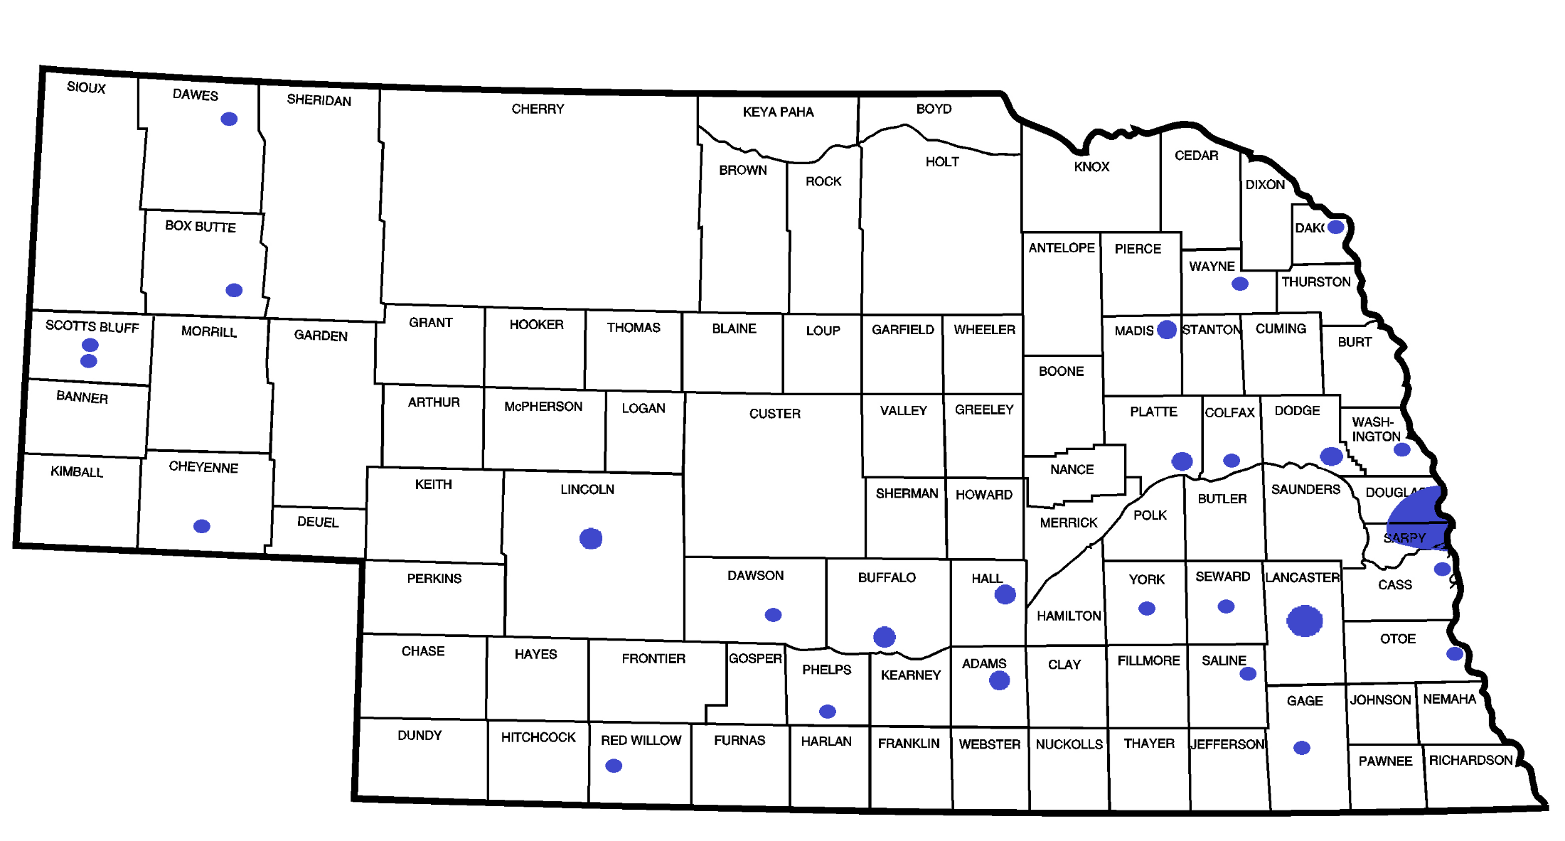
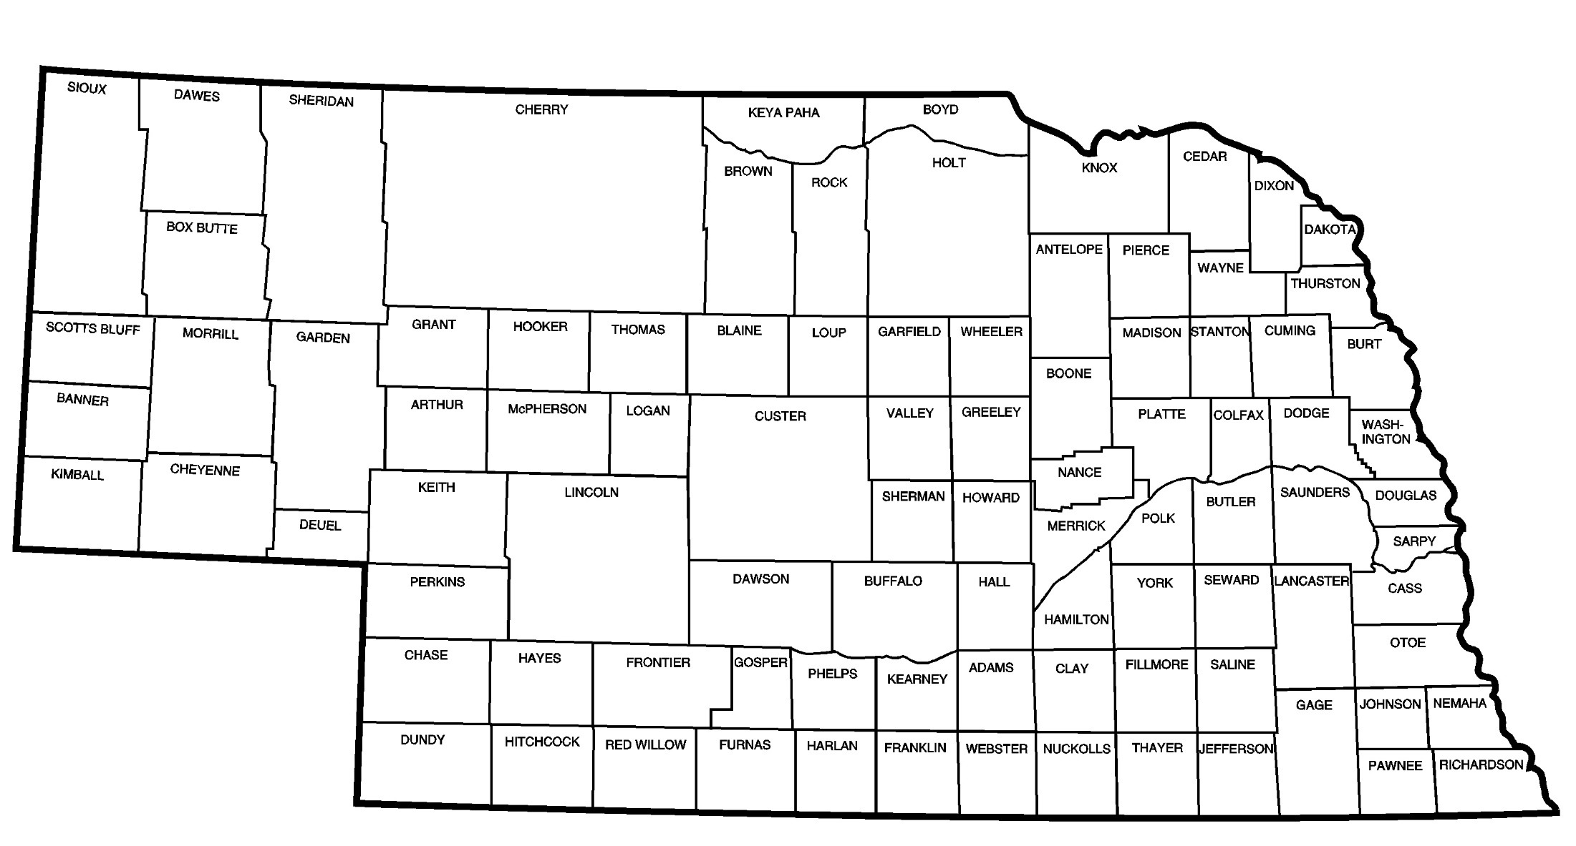
Urban Areas (National System) as of 2016
Notes:
27 URBAN areas in Nebraska – consisting of Omaha, Lincoln and all cities of the first class.
The Omaha urban area includes Bellevue, Papillion, La Vista, and Ralston (all cities of the first class) as well as Gretna and Boys Town (a village).
All of the white space within the Nebraska is RURAL. That includes 501 cities of the second class and villages.
31 cities have a certified (Nebraska Dept of Revenue) population of more than 5,000 population.
Omaha Lincoln Bellevue Grand Island Kearney Fremont Hastings North Platte Norfolk Columbus Papillion La Vista Scottsbluff South Sioux Beatrice Lexington Gering Alliance Blair York McCook Nebraska City Seward Crete Sidney Plattsmouth Schuyler Ralston Chadron Wayne Holdrege
Gretna (close to 5,000 in its own right, and the urban area is actually over 5,000 according to US Census Bureau) and Boys Town are also included in MAPA

Slide 10
3R Thresholds
------------------------------------------------------------------------------------------
Defined By Scope of Work for:
3R Thresholds
Base
Pavement Strategy (thickness)
Bridges and Structures*
Unpaved Roads
* Covered later in the Bridges and Structures Video
Slide 10
428 NAC 2-001.03A1d, Pages 39-40
Notes:
2/24/2022 Changed “Boundaries” in headline and left side banner to “Thresholds”
PIIIQ3 show table with scope of work in the leftmost column, the other columns being Maintenance, 3R and N&R
PIIIQ2 cost effective analysis discussed in video B07 (slides 46-52) and also in 428NAC2 pg 41 – What is the purpose of doing a CB analysis? (let the class answer). Class should also answer What are typical costs to include? What are typical benefits to include?
There are four ways the design standards distinguish a 3R scope of work from the other types of work.
READ THEM
The following screens discuss each of these.
Except Bridges and Structures, which are addressed in a separate video
Typically, maintenance is defined, and reconstruction is defined, so 3R usually ends up being whatever scope is in between.
That is a simplification, but it generally holds true.

Slide 11

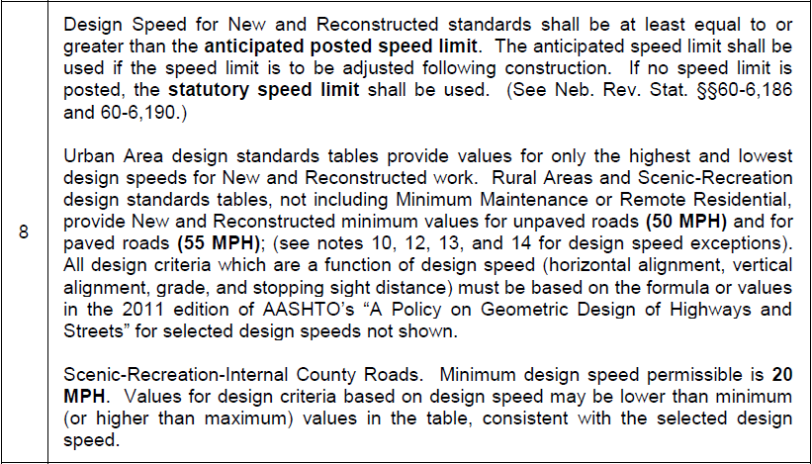
Design Speed
Note 8
Slide 11
428 NAC 2-001.03B Note 8, Page 48
Notes:
Note 8 covers the first design criteria: design speed. Some consider design speed to be the most important design criteria; several other design criteria are a function of design speed.
In the first paragraph, design speed is required to be equal to or greater than the speed limit that is anticipated to be posted following construction, or the statutory speed limit in statutes 60-6,186 and 60-6,190.
The second paragraph addresses the different design speeds and how they are presented in the standards tables.
The first sentence points out that, in the Urban Area standards tables, the minimum (lowest allowed) design speed is listed along with the maximum (highest allowed) design speed.
The last sentence says that any design criterion that is a function of design speed must be based on the applicable AASHTO formula or value. The values for the minimum and maximum deign speeds are shown in design standards tables,. For design speeds in between the lowest and highest, designers need to, for any criteria that is a function of design speed, refer to the AASHTO Green Book and calculate or look up the appropriate value.
Let’s look at an example.
NOT FOR AUDIO
Same requirements, with additional information and guidance. Stopping sight distance is included as a criteria in the proposed tables. Like 001.16(4), Note 8 refers to Neb. Rev. Stat. §60-6,190.
Key Controlling Criteria
Many criteria calculated based on design speed
Urban Tables
Design speed between values shown in table
Rural and Scenic-Recreation Tables
50 MPH and 55 MPH
ADT < 50 VPD, Constrained Situations
ROW and Environmental Impacts, Terrain and Costs
Refer to notes 12, 13 and 14

Slide 12
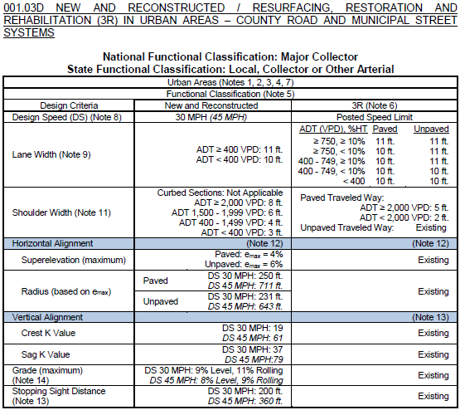
Design Speed
Note 8 – Example – Table D
428 NAC 2-001.03B Note 8, Page 48
428 NAC 2-001.03D, Pages 57-58
Slide 12
Notes:
This screen shows Table D, Urban Area design standards table, on pages 57 and 58. It is for the National Functional Classification of Major Collector.
30 MPH is the minimum design speed, and 45 MPH is the maximum design speed allowed for this set of standards.
45 MPH is the maximum allowed for all four of the Urban Area design standards tables.
Standards criteria that are a function of design speed are shown on this screen.
The values associated with the lowest design speed are in regular font,
The values associated with the highest design speed are in italics font.
Each table provides all of the values for the lowest design speed and the highest design speed. If the design speed is in between, the values that are a function of design speed will also be in between the values shown in the table for their respective criterion.
Let’s do an example.
Assume the street is paved, will have a superelevation of 4%, and the design speed is 35 MPH.

Slide 13
CONSTRAINED SITUATIONS
A Constrained Situation is defined on page 42 of the MDS (428 NAC 2-001.03A1h) as a site-specific condition such as terrain, right-of-way, social impact, environmental impacts, and/or cost that may make meeting a design standard impractical.
Relates to Notes 12, 13 and 14 (next slides)
Notes:
5/22/2021 Added notes related to exam question
7/25/2020 Updated slide – added “(next slides)”
PIIIQ4 What reason does the MDS give that would allow design speeds in rural areas to be reduced to as low as 40 mph? Also, to what roads would this apply to? Class should be able to answer these questions

Slide 14
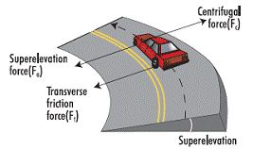
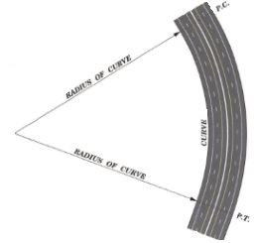
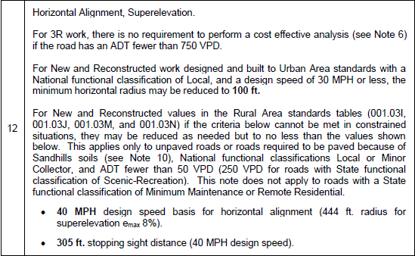
Horizontal Alignment
Note 12
428 NAC 2-001.03B, Note 12, Page 50
428 NAC 2-001.03A1h, Constrained Situation, Page 42
Slide 14
Notes:
Note 12 addresses Horizontal Alignment and Superelevation standards for roads and streets.
The first sentence says that, for 3R work, a cost effective analysis is not a minimum requirement if the traffic volume is less than 750 VPD.
Where Urban Area standards apply, the second sentence allows a minimum horizontal radius of 100 ft under the following conditions:
The National Functional Classification is Local, and
The design speed is 30 MPH or less.
The bottom part of the note allows some design flexibility, under certain conditions, if a constrained situation occurs when and where Rural Area standards are applied.
A Constrained Situation is defined on page 42 as a site-specific condition such as terrain, right-of-way, social impact, environmental impacts, and/or cost that may make meeting a design standard impractical.
A horizontal curve is allowed a design speed as low as 40 MPH under these conditions:
Rural Area standards apply, and
The road is not paved (or paved because Note 10 allowed it), and
National Functional Classification of Minor Collector or Local (not including those that have the optional SFC of Minimum Maintenance or Remote Residential), and
The traffic volume is less than 50 VPD (or, in the case of Scenic-Recreation roads, 250 VPD).
The lower design speed applies also to stopping sight distance.

Slide 15
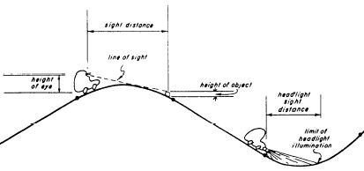
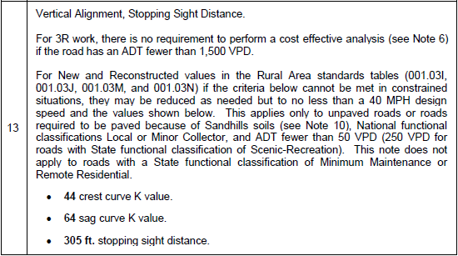
Vertical Alignment
Note 13
428 NAC 2-001.03B, Note 13, Page 50
428 NAC 2-001.03A1h, Constrained Situation, Page 42
Slide 15
Notes:
Note 13 addresses Vertical Alignment standards for roads and streets.
The first sentence says that, for 3R work, a cost effective analysis is not a minimum requirement if the traffic volume is less than 1,500 VPD.
The bottom part of the note allows some design flexibility, under certain conditions, if a constrained situation occurs when and where Rural Area standards are applied.
A vertical curve is allowed lower K values – 44 for a crest curve and 64 for a sag curve under these conditions:
Rural Area standards apply, and
The road is not paved (or paved because Note 10 allowed it), and
National Functional Classification of Minor Collector or Local (not including those that have the optional SFC of Minimum Maintenance or Remote Residential), and
The traffic volume is less than 50 VPD (or, in the case of Scenic-Recreation roads, 250 VPD).
The lower design speed applies also to stopping sight distance.

Slide 16

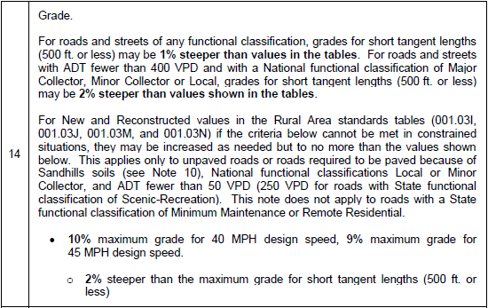
Maximum Grade
Note 14
428 NAC 2-001.03B, Note 14, Page 51
428 NAC 2-001.03A1h, Constrained Situation, Page 42
Slide 16
Notes:
Note 14 addresses Maximum Grade standards for roads and streets.
The first paragraph allows slightly steeper grades for short tangent lengths of a road or street.
The bottom part of the note allows some design flexibility, under certain conditions, if a constrained situation occurs when and where Rural Area standards are applied.
Steeper grades, as shown, are allowed under these conditions:
Rural Area standards apply, and
The road is not paved (or paved because Note 10 allowed it), and
National Functional Classification of Minor Collector or Local (not including those that have the optional SFC of Minimum Maintenance or Remote Residential), and
The traffic volume is less than 50 VPD (or, in the case of Scenic-Recreation roads, 250 VPD).

Slide 17
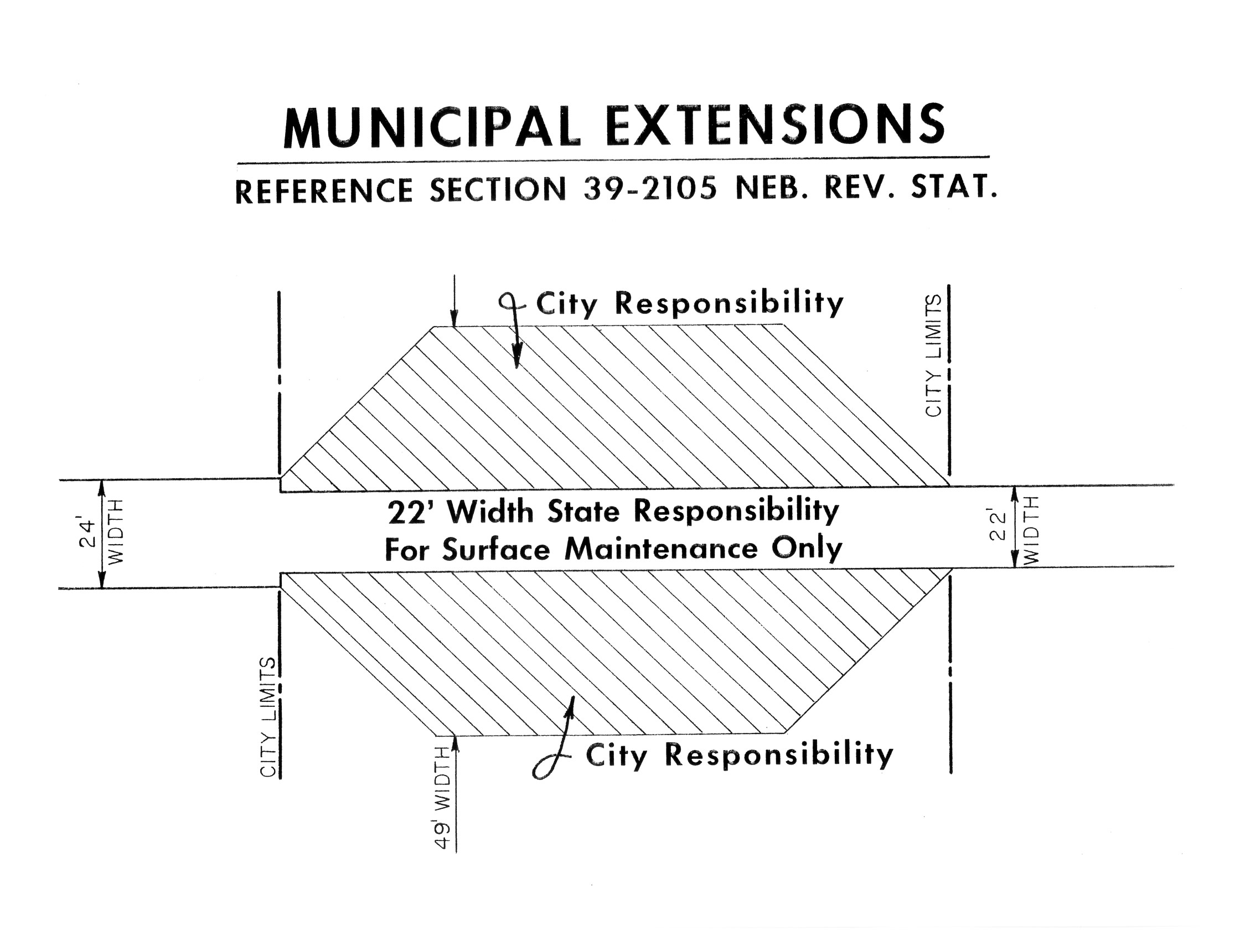


(Blue Sheet in Notebook)
State Law
http://www.nebraskalegislature.gov/laws/browse-chapters.php?chapter=39
Expressway or
Major Arterial
Interlocal agreements with NDOT (for mowing, snow removal, etc.)
Slide 17
Notes:
PIQ20 Don’t forget about municipal extensions. Except Interstates, the State is NOT responsible for that portion of a municipal extension which exceeds the design of the rural state highway leading into a municipality. Refer to video B02 Functional Classification Basics.
The Municipality is responsible for that portion that exceeds the design of the rural highway that leads into the municipality.
This applies only to municipal extensions of state highways with a State functional classification of Expressway or Major Arterial.
State Statute 39-2105 reads: When the design of a rural highway differs at the different points where it leads into the municipality, the state's responsibility for the municipal extension thereof shall be limited to the lesser of the two designs.
This screen shows an example of what this means. On the right side of the screen the rural State highway entering corporate limits is 22 ft wide. On the left side of the screen the rural highway leaving corporate limits is 24 ft wide. According to State Statute 39-2105, the municipality has jurisdictional responsibility for that portion which exceeds the design of the rural portion. If the two rural portions are different, which they are in the example, the municipality is responsible for that portion which exceeds the lesser of the two designs. So, in this example, the State is responsible for the 22 ft width and the municipality is responsible for that portion which exceeds 22 ft width..
For works or projects on a State highway, there may be some cost sharing required for the Municipality. Usually, this affects only cities with a population of over 5,000, and is a function of the number of thru traffic lanes. For further information, you may request a copy of Department of Transportation Instruction 60-11, Municipal Sharing.
And also note that there are usually interlocal agreements between the municipality and the Nebraska Department of Transportation for mowing, snow removal and other activities.
NOT FOR AUDIO
39-2105. Functional classifications; jurisdictional responsibility.
Jurisdictional responsibility for the various functional classifications of public highways and streets shall be as follows:
(1) The state shall have the responsibility for the design, construction, reconstruction, maintenance, and operation of all roads classified under the category of rural highways as interstate, expressway, and major arterial, and the municipal extensions thereof, except that the state shall not be responsible for that portion of a municipal extension which exceeds the design of the rural highway leading into the municipality. When the design of a rural highway differs at the different points where it leads into the municipality, the state's responsibility for the municipal extension thereof shall be limited to the lesser of the two designs. The state shall be responsible for the entire interstate system under either the rural or municipal category and for connecting links between the interstate and the nearest existing state highway system in rural areas, except that if such a connecting link has not been improved and a sufficient study by the Department of Transportation results in the determination that a link to an alternate state highway would provide better service for the area involved, the department shall have the option of providing the alternate route, subject to satisfactory local participation in the additional cost of the alternate route;
(2) The various counties shall have the responsibility for the design, construction, reconstruction, maintenance, and operation of all roads classified as other arterial, collector, local, minimum maintenance, and remote residential under the rural highway category;
(3) The various incorporated municipalities shall have the responsibility for the design, construction, reconstruction, maintenance, and operation of all streets classified as expressway which are of a purely local nature, that portion of municipal extensions of rural expressways and major arterials which exceeds the design of the rural portions of such systems, and responsibility for those streets classified as other arterial, collector, and local within their corporate limits; and
(4) Jurisdictional responsibility for all scenic-recreation roads and highways shall remain with the governmental subdivision which had jurisdictional responsibility for such road or highway prior to its change in classification to scenic-recreation made pursuant to this section and sections 39-2103, 39-2109, and 39-2113.
Source: Laws 1969, c. 312, § 5, p. 1121; Laws 1971, LB 738, § 1; Laws 1980, LB 873, § 2; Laws 1983, LB 10, § 4; Laws 2008, LB1068, § 5.
DORI 60-11, July 2005, Page F-15, Municipal Cost Sharing (non-Interstate projects), Projects determined by NDOT to be economic development projects are negotiated on a case-by-case basis.
Section 4 – Municipalities with a Population of 5,000 or less. Generally, no financial participation is required. Constructing parking areas at the request of the Municipality is paid 100% by the Municipality. Federal-aid Safety projects off the State Highway System requires 20% matching funds from the Municipality. On 3R projects, if Municipality requests reconstruction of sidewalks, it pays 100% of sidewalks, but the NDOT pays for ADA ramps and blending back to the sidewalk.
Section 5 – Municipalities with a Population over 5,000. May require participation. Depends on the number of thru traffic lanes. No cost if only two thru traffic lanes. 20% if there are four thru traffic lanes. And more if there are more than four thru traffic lanes.

Slide 18
Horizontal Clear Zone (HCZ)
Minimum Design Standards
Roadside Design
Purpose: Recovery area for errant vehicles
Minimum Width in Tables apply to New and Reconstructed work
Width starts at edge of Traveled Way (or auxiliary lane that functions as a thru travel lane)
  See Tables - New and Reconstructed Work
428 NAC 2-001.03A6k, Page 46
428 NAC 2-001.03B Note 16, Page 52
Slide 18
Notes:
There are minimum HCZ widths that apply to New and Reconstructed work.
The width starts at the edge of the Traveled Way.
NOT FOR AUDIO
Replaces 2010 standards Fixed Obstacle Clearance

Slide 19
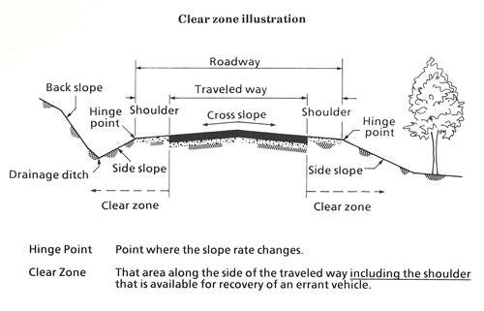
Minimum Design Standards
Horizontal Clear Zone (HCZ)
Roadside Design
Obstacles
Trees
Utility Poles
Culverts
Steep slopes
etc.
Tab 14-11 handout
428 NAC 2-001.03A6k, Page 46
428 NAC 2-001.03B Note 16, Page 52
Notes:
This screen shows a common cross section, Showing the horizontal clear zone is relation to other components of the facility
The HCZ provides space from the edge of the traveled way to obstacles such as trees, utility poles, drainage culverts, steep side slopes, and other obstacles.
NOT FOR AUDIO
Bill Gulick (KY DOT)

Slide 20
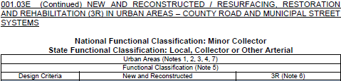

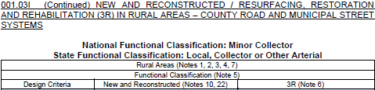

Horizontal Clear Zone
Note 16 - HCZ
428 NAC 2-001.03E Pages 59-60
428 NAC 2-001.03B, Note 16, Page 52
428 NAC 2-001.03I Pages 67-68
Slide 20
Notes:
P1Q49, PVQ3
All curbed sections have the same HCZ requirement: 2 ft from back-of-curb or 6 ft from the edge-of-traveled way whichever is greater.
To demonstrate how HCZ widths are expressed in the tables,
This screen shows two examples, which are excerpts from the standards –
the top is Table E, Urban Minor Collector, from page 60
The bottom is Table I, Rural Minor Collector, from page 68
In the URBAN TABLE, There are values for
A Curbed section: 2 ft from the back-of-curb, or 6 ft from the edge of the traveled way, whichever is greater from the edge of the traveled way.
A Non-curbed section: 8 ft. from the edge of the traveled way, for roads and streets with a traffic volume of 400 VPD and greater,
and the Nominal Shoulder Width for roads and streets with fewer than 400 VPD.
The Nominal Shoulder Width is the shoulder width presented in the standards table for the road or street. If you turn back one page to page 59, for an ADT less than 400 VPD, you will see that the value for this Urban example is 3 ft.
Regarding curbed sections, let’s quickly review some relevant information previously mentioned in this video:
The Traveled Way is defined on page 43 of the standards, as the portion of the roadway for the movement of vehicles, and it doesn’t include shoulders or bicycle lanes. You can see the traveled way in the cross section at the upper left.
What about Curbed Sections?
Note 9, says that lane width is measured from the gutter line, which is defined as one ft inside the back-of-curb.
Assuming the lane adjacent to the curb is a through lane, the gutter line is therefore one ft. inside the back-of-curb, and that becomes the Edge of Traveled Way for a curbed section.
If there is an auxiliary lane – such as a parking lane or a bicycle lane – adjacent to the curb, the auxiliary lane is part of the horizontal clear zone. That is a case when the 2 ft back-of-curb requirement may govern HCZ width for a curbed section.
At the bottom of the screen, In the RURAL TABLE, from page 68 of the design standards, The New & Reconstructed HCZ values are a function of design speed, traffic volume and side slope. The table provides two values, depending on the design side slope.
You need to know the traffic volume – refer to Note 7 for details – and the design speed, then enter the table and find the two minimum values for HCZ.
For example, let’s say the design speed is 50 MPH and the traffic volume is 1,000.
The values provided in the table are 14 ft – in the event the design slope is 1V:6H – and 16 ft – in the event the design slope is 1V:4H.
In the event the side slope is between 1V:6H and 1V:4H it is recommended to use to the minimum width required for 1V:6H.
If the design speed is 55 MPH instead of 50 MPH, the standard HCZ width would be wider – 16 ft for 1V:6H or 20 ft for 1V:4H.

Slide 21
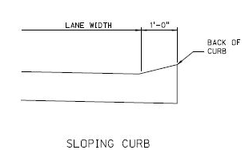
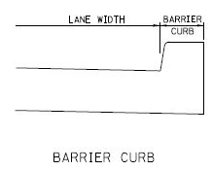
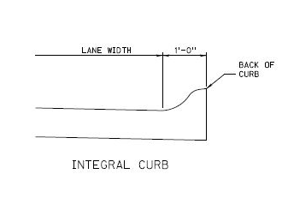
Note 9
Lane Width – Curbed Sections
THROUGH
THROUGH
Gutter Line
Could be Curb and Gutter
= Edge of Traveled Way
THROUGH
Slide 21
428 NAC 2-001.03B, Note 9, Page 49
Notes:
P1Q49
This screen depicts the gutter line as defined in Note 9.
It is one foot from the back-of-curb. It could be any kind of curb – sloping, barrier or integral.
The gutter line, assuming the lane is a through travel lane, is the edge of the Traveled Way [PAUSE A LITTLE HERE SO THE VIEWER CAN ABSORB IT]

Slide 22
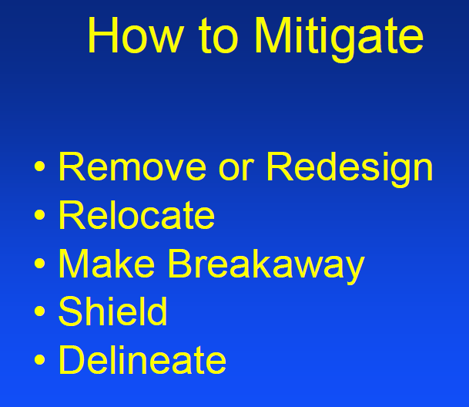
Minimum Design Standards
Roadside Design
Obstacles
428 NAC 2-001.03A6k, Page 46
428 NAC 2-001.03B Note 16, Page 52
Notes:
It is best to simply remove obstacles within the HCZ
Or redesign them
Relocating them farther away from the traveled way is the next best option
If the obstacle needs to remain within the HCZ, it could be designed to be breakaway and therefore provide much less resistance to a vehicle coming into contact with it
Shielding an obstacle is a possibility, realizing that the shielding itself becomes an obstacle, hopefully a relatively safer obstacle
Delineation of an obstacle would be a last resort, but better than nothing.
NOT FOR AUDIO
Bill Gulick (KY DOT)

Slide 23
3R Standards
Safety Conscious Design
Definition
Safety is an integral part of design, not a secondary objective
Systematically consider safety improvements (remove obstacles, add warning signs, add rumble strips, etc.)
Slide 23
428 NAC 2-001.03A1f, Page 41
Notes:
Safety Conscious Design is defined on page 41 of the design standards.
It goes hand-in-hand with 3R design work, requiring Cost Effective Analyses and potentially requiring safety improvements to be added to the scope of 3R works or projects.
Cost Effective Analysis is also defined on page 41 of the standards. A review of crash history is part of a cost effective analysis.
Highway designers must deliberately seek opportunities specific to each project and
apply sound safety and traffic engineering principles.
Designers of RRR projects work with existing roads and streets whose design and operational characteristics
can be observed and measured;
yet not all counties and municipalities take advantage of these favorable circumstances.
Greater attention to safety, along with greater documentation of the design process improves design decisions.
NOT FOR AUDIO
From TRB SR-214 page 5:
Highway designers must deliberately seek opportunities specific to each project and
apply sound safety and traffic engineering principles. Designers of RRR
projects work with existing highways whose design and operational characteristics
can be observed and measured; yet not all highway agencies take
advantage of these favorable circumstances. Greater attention to safety, along
with greater documentation of the design process improves design decisions.

Slide 24

Cost Effective Analysis when considering safety improvements
3R Design Standards
Cost Effective Analysis
1st Step: Review of Crash History
  “Significant” – number and severity
  “Relevant” – linked to a criterion
2nd Step: Identify Safety Improvement
Slide 24
428 NAC 2-001.03A1g, Page 41
Notes:
9/11/2022 – added “When considering safety improvements”, added “1st Step:” prior to “Review of Crash History” and added 2nd Step.
As part of a Cost Effective analysis
The significance of crashes is evaluated – considering the number of crashes and their severity
And the relevance of crashes to design criteria
Example:
A county determined that a significant number of crashes, three, within the past five years occurred on a vertical crest curve with poor sight distance.
One was fatal and two were serious-injury type crashes; the county judged their severity as significant.
And that the crashes were relevant to Vertical alignment, Crest K Value.
The county proposed a safety improvement, and estimated the Benefit/Cost ratio of that improvement to see if it should be included in the 3R project’s scope of work.

Slide 25


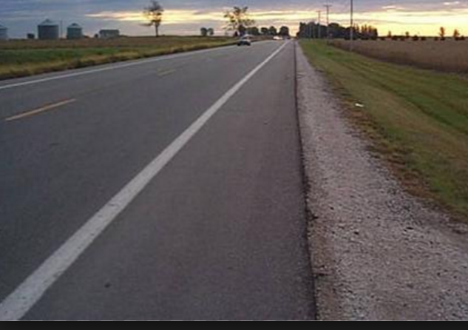
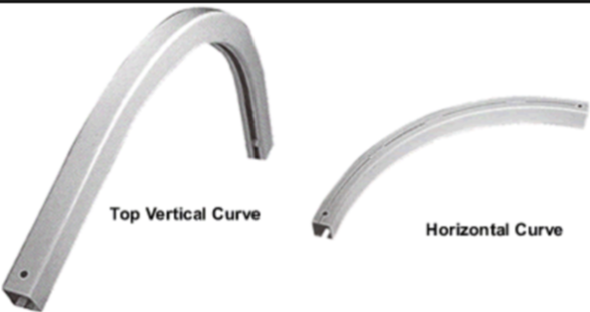
Cost Effective Analysis (cont’d)
3R Design Standards
Cost Effective Analysis
3rd Step: Benefit/Cost (B/C) Analysis
What do crashes cost our community (our society))?
What is the cost of a safety improvement to reduce those crashes?
A Benefit/Cost (B/C) Analysis compares the cost benefits of reducing crashes to the costs of installing the safety improvement.
Notes:
9/11/2022 changed title to “3rd Step: Benefit/Cost (B/C) Analysis
10/11/2021 slide revised
Cost Effective Analyses are an integral part of the 3R design process.
The definition is on page 41 of the design standards.
The purpose is to determine if a safety improvement should be added to the scope of work
It involves a review of crash history in, and possibly near, the work or project
For some situations, a benefit-cost analysis is required to evaluate the need and justification for a safety improvement

Slide 26
Crash History Duration
Cost Effective Analysis
3 Years minimum is customary for many roads, mostly higher traffic volumes
5 years or even 10 years may be more appropriate
  Lower volume roads
  Some spot locations (bridge icing, etc)
MDS is silent on crash history duration
Slide 26
428 NAC 2-001.03A1g
Notes:
The Duration – how many years – of crash history –depends on the principles of statistics.
The Minimum Design Standards are silent on the number of years to use for crash history evaluations.
Some segments, such as a heavily traveled city street, may yield significant statistics by doing a two-year study.
Typical rural area crash studies are at least three years duration, although there may be locations when more than three years may be needed.
Low-volume roads likely need a longer duration such as five to ten years to collect statistically significant information.
NOT FOR AUDIO
Higher traffic volumes: 1,500 to 2,000 and above

Slide 27
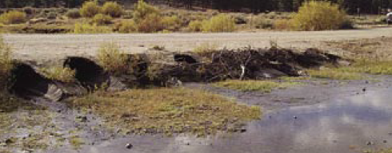
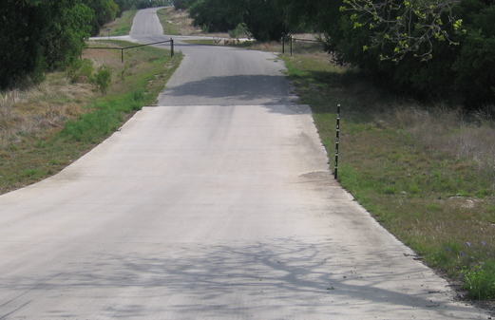
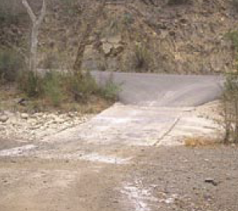
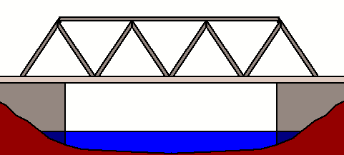
Low Water Stream Crossings and Fords
Note 21
Structures
structure
natural
Low Water Stream crossings convey normal stream flow below the driving surface but are normally overtopped at least once annually
428 NAC 2-001.03A5d, Page 44
Slide 27
428 NAC 2-001.03B, Note 21, Page 54
Notes:
PIVQ5
Note 21 on page 54 of the standards addresses Low Water Stream Crossings and Fords.
These are defined on page 44 of the standards. A low-water stream crossing passes normal stream flow below the driving surface but is normally overtopped with water at least once annually.
Low Water Stream Crossings are man-made structures, as shown in the photo,
Stream Fords are considered mostly a natural phenomenon.
NOT FOR AUDIO (it is for an unused photo, which is underneath the photo that is shown)
This photo shows a low-water stream crossing, with water height meter post and a gate to prevent entry during high water events.

Slide 28
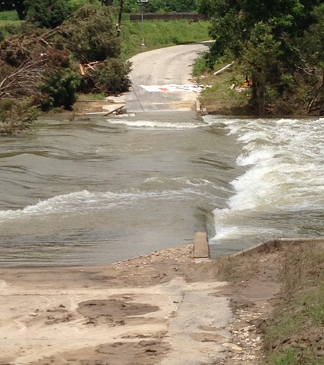
Low Water Stream Crossings and Fords
Some Considerations
Note 21
Structures
Ephemeral stream or low base flow
Low Traffic Use
Traffic Delays are Acceptable
Broad Flat Channel
Least Cost Alternative
428 NAC 2-001.03A5d, Page 44
428 NAC 2-001.03B, Note 21, Page 54
428 NAC 2-001.03O, Page 79
Slide 28
Notes:
PIVQ5
Low Water stream crossings and fords may be used in certain circumstances, in particular when
CON flows are “flashy” meaning that they come and go relatively quickly, such as intermittent or ephemeral streams, or the stream has a low base flow CON liability
PRO traffic volumes are very low PRO access most of the time
CON delays are acceptable CON no access sometimes
the stream channel is broad and flat and
PRO it is the least cost alternative PRO cost
There are many considerations, including the passage of aquatic organisms
CON trash collectors CON maintenance, trash needs to be cleaned and
For rivers and streams that convey large flows, bridges and large culverts are better-suited.
Low-water stream crossings and fords are not appropriate for many situations and their application is limited.

Slide 29
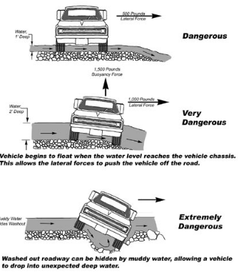
Low Water Stream Crossings and Fords
Risks
Note 21
Structures
Caution:
These types of crossings don’t come without risk – and liability
Generally - should be discouraged
Slide 29
428 NAC 2-001.03B, Note 21, Page 54
Notes:
5/22/2021 Added some verbiage to the notes field.
PIVQ5 A low water stream crossing can’t be the only access to an occupied dwelling.
Because Low water stream crossings and fords may be frequently overtopped by flooding they have a certain amount of risk and are generally not recommended and are discouraged. That is why any low-water stream crossing or ford MUST to be brought to the Board of Public Roads and be granted a relaxation of standards prior to construction. That’s not to say the Board will not grant the project, because there are appropriate applications of low water stream crossings and fords.
Exam Part IV Q4

Slide 30
Exercises
Find Standards
Notes:
9/11/2022 Changed “Hands On” to “Find Standards”
2/24/2022 New Slide to indicate its time for the class to do some hands-on exercises.
Instructor Demo(s) (15 to 20 minutes – usually one county project and one municipality project) followed by hands-on exercises. Hands-on exercises can be assigned to individuals or teams; 20 to 30 minutes each. Time permitting, instructor can choose to have teams identify relaxation of standards needs for
Hand out plan sets as needed
Instructor live demonstration (using the Standards Compare worksheet) of finding the functional classification, finding the right table, determining the right values, and starting to fill out the W/P form.
Follow along on your laptop or device if you want
PI-Q3 Horizontal Clear Zone HCZ – curbed/non-curbed section – it makes a difference which it is – curbed can be from the EOTW or it can be from back-of-curb.

Slide 31
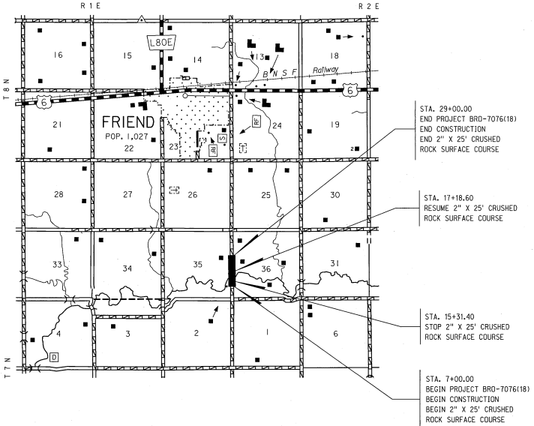
Friend South Project (Saline Co)
1. Rural area or Urban?
2. SFC and NFC?
TASK 1: Find MDS
Instructor Demo
Scope: replace bridge.
3. Type of Work?
TASK 2: Identify values for design criteria
Use standards compare worksheet
Notes:
20 min
Hand out the plan set for Friend South
Instructor live demonstration (using the Standards Compare worksheet) of finding the functional classification, finding the right table, determining the right values, and starting to fill out the W/P form.
Follow along on your laptop or device
SFC=Local, NFC=Local
MDS Table J pg. 69
Type of Work = Reconstructed

Slide 32
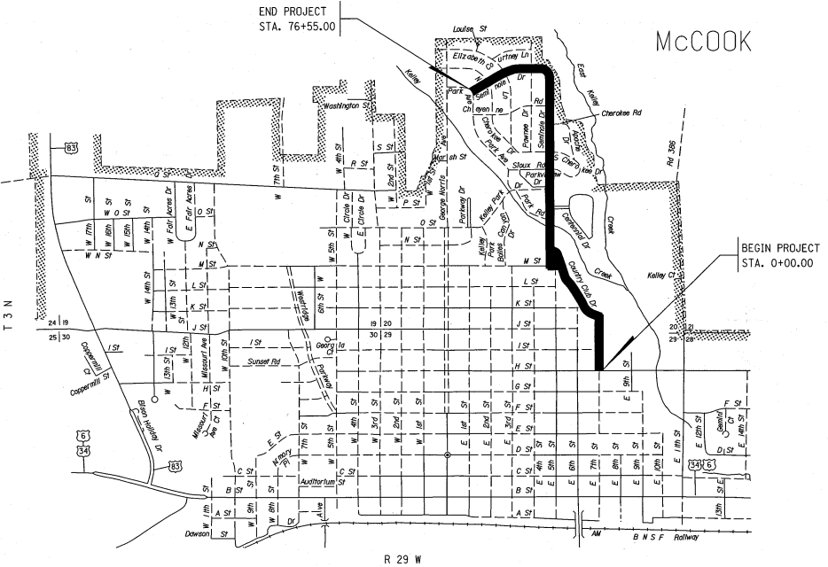
In McCook
1. Rural area or Urban?
2. SFC and NFC?
3. Scope of Work: cold milling, prep subgrade, pave 4 inches asphalt, replace c/g.
TASK 1: Find MDS
3. Type of Work?
Instructor Demo
TASK 2: Identify values for design criteria
Use standards compare worksheet
Notes:
20 min
Hand out the plan set for McCook
Hand out the relaxation of standards for McCook
Instructor live demonstration (using the Standards Compare worksheet) of finding the functional classification, finding the right table, determining the right values, and starting to fill out the W/P form.
Follow along on your laptop or device
SFC=Collector, NFC=Major Collector
MDS Table D pg. 57
Type of Work = Reconstructed

Slide 33
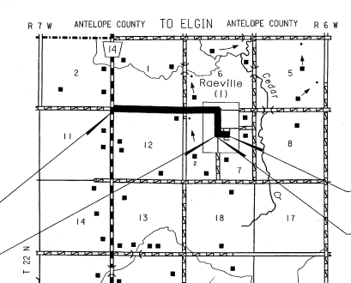
Petersburg Northeast (Boone Co)
1. Rural area or Urban?
2. SFC and NFC?
TASK 1: Find MDS
110th St
Hands On
Scope: Replace base, place 3 inches asphalt.
3. Type of Work?
225th St
TASK 2: Identify values for design criteria
Use standards compare worksheet
Notes:
75 min (45 min for teams, 30 min for class review)
Teams Exercise
Discuss Relaxation of Standards
County and Municipality
Hand out plan sets
Hand out relaxation of standards requests
110st St SFC=Other Arterial, NFC=Major Collector, Table H pg. 65, Reconstructed Work
225th St SFC=Local, NFC=Local, Table J pg. 69, Reconstructed Work
Urban Area SFC=Local, NFC=Local, Table F pg. 61, Reconstructed Work

Slide 34
Your Road or Street?
Suggest a road or street and we will find the standards that apply
Hands On
Notes:
15 min

Slide 35
Classification and Standards
Wrap Up
Questions?
Notes:
3 min
Reminder: not all plans will show all of the values necessary to determine if standards are met – recommend getting a report from the design engineer detailing the MDS values compared to design values.

