Slide 1



Basic Construction Plan Reading

Slide 2
Learning Objectives
Become familiar with project construction plans.
Be able to locate specific items on the plans related to the project.
Be able to write a narrative on why it is important that a County Highway or City Street Superintendent can read and interpret a set of construction plans.
Notes:
Here are the Learning Objectives for this class.
I will discuss the third bullet point further in the next two slides.

Slide 3
Reading & Understanding Construction Plans
Fulfills your job duties
Professionalism to your position
Interpret the project information
Answer questions from public, contractor and governing body
Monitor material quantities
Act as a liaison between the contractor and the governing body and the public
Explain and obtain Right of Way from landowners
Monitor progress
Notes:
Here are some examples why it is important that a City Street or County Highway Superintendent be able to read and understand a set of construction plans.
These are not all the reasons, there are many more.
As part of this class I would recommend that you write a brief narrative, 2 or 3 paragraphs, that addresses the question.
You may email your answer to me, I will look it over and return it with any comments.

Slide 4
Topics
  Definitions & Abbreviations
  Parts of a Contract
  Legal Descriptions
  Stationing
  Title Sheet
  General Notes
  Summary of Quantities
  Construction Plan Views
  Drainage Structures
  Bridge Plans
  Right-of-Way
  Traffic Control
  Plan Reading Resources
  Additional Information
Notes:
Here are the topics we will cover in this video.
The 9 exercises will cover most of the topics presented.
However, all the topics are important to the outcome of this class.

Slide 5
Definitions
Grade Beam A concrete support on piling which supports approach slab
Longitudinal Parallel to project centerline or length of bridge
Pier Supports between abutments
Substructure Below girder bearing devices or below slab
Superstructure Above & including girder bearing devices
Transverse Perpendicular to project centerline or across bridge

Slide 6
Construction Plan Abbreviations
Study Guide Page 4
Centerline
R. or R.P. Radius or Radius Point
4 : 1 Slope
  Ratio of "rise" to "run", or as a fraction, "rise over run“, in which run is the horizontal distance and rise is the vertical distance
W Width
H Height
No. 4 Bar 1/2” Diameter Concrete Reinforcing Bar
Sec. Section
Twp. Township
Rg. Range
Notes:
The next 2 slides have abbreviations commonly found on Construction Plans.
Again, take your time to learn these abbreviations.

Slide 7
Construction Plan Abbreviations
R.O.W. Right of Way
D.A. Drainage Area
L.F. Linear Feet
Curve Data
  D. - Degree of Curve
  L. - Length of Curve
  T. - Tangent Length of Curve
EOF End of Floor
ADT Average Daily Traffic: The total traffic volume during a given time period, ranging from 2 to 364 consecutive days, divided by the number of days in that time period, and expressed in VPD (vehicles per day).

Slide 8
Construction Plan Abbreviations
AADT Annual Average Daily Traffic: Average daily traffic on a roadway link for all days of the week during a period of one year, expressed in VPD (vehicles per day).
B.M. Bench Mark: A relative permanent object, natural or artificial bearing a marked point whose elevation is known
  “PBM” – Permanent bench mark
  “TBM” – Temporary bench mark

Slide 9

Plan Contents
Title Block
Sheet Numbers
General Notes
Legend
Details
Typical Sections
Typical vs. Site Specific

Slide 10
Plan Reading Method
Always ensure you have the correct plan by reading the title block
Read the notes first
Identify the devices used in the legend
Look at any Details or Typical Sections
Start at one end of the plan and look at every item on the plan from end to end

Slide 11
SESSION 1
  Parts of a Contract
  Legal Descriptions
  Stationing
Notes:
Session 1

Slide 12
Parts of the Construction Contract Documents
Study Guide Page 2
CONTRACT
Proposal Forms
  Includes items of work
  Unit prices
  Bidders signature
Contract Agreement
  Specifies the completion date
  Guarantee provisions, if any
Special Provisions
  Modify the Standard Specifications
Notes:
We begin with the parts of the Construction Contract Documents.
There are 3 main parts starting with the Contract.
The contract is made up of the Proposal Forms, Contract Agreement and Special Provisions

Slide 13
Parts of the Construction Contract Documents
Study Guide Page 2
2. PLANS
Construction Drawings
  Plan and profile sheets
  Grade sheets
  Utility sheets
Special Plans
  Detailed items unique to the project
Standard Plans
  Typical construction details
Notes:
Second, the Plans.
The Plans consist of the Construction Drawings, Special Plans and Standard Plans.
This part of the Construction Contract Documents is what we will focus on today.

Slide 14
Parts of the Construction Contract Documents
Study Guide Page 2
3. SPECIFICATIONS
General Requirements
  Describe and define terms and conditions of contract
Construction Details
  Describe the work to be performed
  The basis for payment
Material Specifications
  Provide detailed technical descriptions of all material
Notes:
And the third part of the Contract Documents are the Specifications.
The Specifications include the General Requirements, the Construction Details and Material Specifications.

Slide 15
Project Location Descriptions
Study Guide Page 3
  Municipal Projects
    Use street names/numbers for location description.
      Example “1234 Main St., Lincoln, NE
  County Projects
    Use Section, Township and Range.
      Example “Between Sec. 15 and 22, Twp. 15 North, Rg. 47 West.”
Notes:
All construction projects, whether County or Municipal, have a specific location.
Describing the location of Municipal projects is relatively easy by using street names, numbers, etc.
Describing the location for County projects can be more difficult, unless you’re familiar with Townships, Ranges and Sections.

Slide 16
Townships & Ranges
TOWNSHIP measures the distance NORTH or SOUTH from the BASE LINE
  A township USUALLY measures SIX MILES by SIX MILES
  Township lines “run” East – West
RANGE measures EAST or WEST from the PRINCIPAL MERIDIAN
  A range USUALLY measures SIX MILES by SIX MILES
  Range lines “run” North – South
Notes:
TOWNSHIPS measure the distance NORTH or SOUTH from the BASE LINE
A township USUALLY measures SIX MILES by SIX MILES
RANGES measure EAST or WEST from the PRINCIPAL MERIDIAN
A range USUALLY measures SIX MILES by SIX MILES

Slide 17
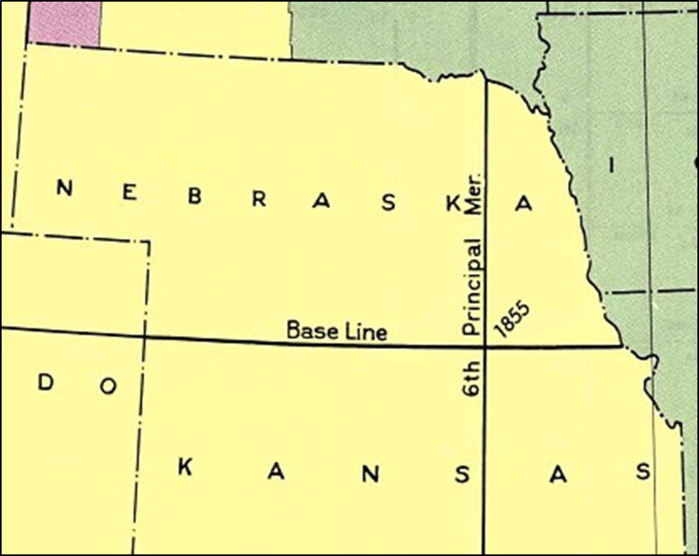
Townships & Ranges
In Nebraska:
  Base Line is the 40th Parallel, the Nebraska-Kansas border
  The Meridian is the 6th Principal Meridian (PM)

Slide 18
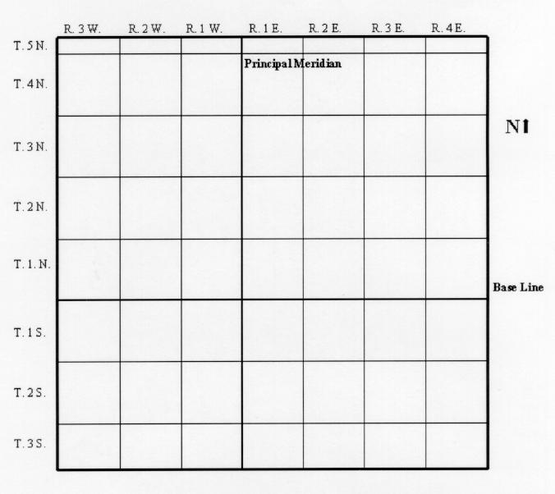
Townships & Ranges
The “X” below is in:
Township 2N
  Township 2, North of the Base Line
Range 2E
  Range 2, East of the Principal Meridian
X
Notes:
The red “X” shows the location of Township 2 North, Range 2 East.
In other words, it is the 2nd Township NORTH of the Base Line in the 2nd Range East of the Principal Meridian.

Slide 19
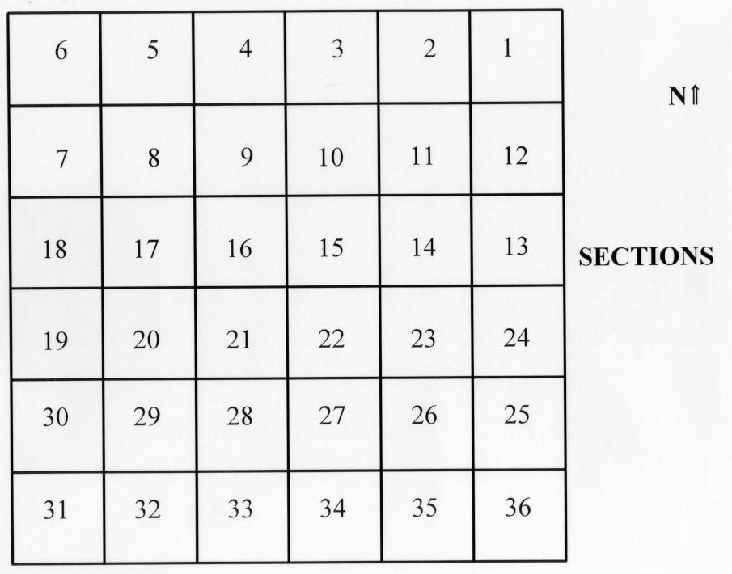
Sections
Townships are subdivided into SECTIONS
Since each township is six miles by six miles, townships USUALLY contain 36 square miles, each one forming a section
Notes:
Townships are subdivided into SECTIONS.
Since each township is six miles by six miles, townships USUALLY contain 36 square miles, each one forming a section.

Slide 20
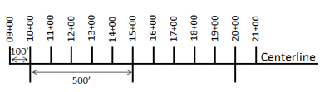
Stationing
Study Guide Page 4
A station is a unit of horizontal measurement
Stations always follow along the centerline of the project
Think of it in this way:
  Just as 12 inches makes 1 foot, so 100 feet makes 1 station
It is 100 feet from Station 1 to Station 2
Notes:
In the past, understanding Stationing has been difficult for some students in the pre-exam class.
During this portion of the class, I will explain how to use stationing to find any point or construction feature on a set of construction plans.
As shown on the slide a station is a unit of horizontal measurement along the centerline of a project.
Whether your project has a length of 50 feet or 50 miles, stationing is used.
A “Station” is a length of 100 feet.
From Sta. 1 to Sta. 2 it is 100 feet.

Slide 21
Stationing
Study Guide Page 5
50 feet is halfway from one station to the next
To show this location, write +50 after the station number
+00 after a station number shows that a point is exactly on a “whole” station
Example, Sta. 30+00 means Station 30 plus zero, exactly on Station 30
Notes:
Halfway between Sta. 1 and Sta. 2 is written as Sta. 1+50
If you are on a “whole” Station, you simply write “plus” zero, zero after that whole station number.
The example shows station 30 beginning written as Sta. 30 plus zero, zero.

Slide 22
Stationing
Study Guide Page 5
50 feet is halfway from one station to the next
Notes:
Here is a diagram showing halfway between station 5+00 and Sta. 6+00, which is Sta. 5+50.

Slide 23
Stationing
Study Guide Page 5
2 feet ahead of Sta. 30 is written Sta. 30+02
Ninety-nine feet ahead of Sta. 30 is written 30+99
2.75 feet ahead of Sta. 30 is written 30+02.75
To convert stationing to feet, drop the plus sign
  Sta. 30+02 = 3,002 feet
  Sta. 1+50 = 150 feet
Example: Length of project =
  Ending Station minus Beginning Station
Notes:
Here are a few more examples of how to correctly write Station numbers.
To treat Station numbers as numbers we can add or subtract, simply drop the “plus” sign.
The last example shows how to find the length of a project.
You subtract the beginning station from the ending station.
The beginning station number will always be smaller than the ending station number.
This leads us to the next slide…

Slide 24
Stationing
To find the distance between any two stations (on the same project)
  Simply subtract the smaller station number from the larger one, ignoring the plus sign.
  The resulting answer is in feet.

Slide 25
Stationing
Study Guide Page 5
On a project, AHEAD means moving in the direction of increasing stationing
  Station numbers get larger
BACK means going in the direction of decreasing stationing
  Station numbers get smaller
Notes:
If you say you’re moving AHEAD along the centerline of the project, the station numbers get larger.
If you say you’re moving BACK along the centerline of the project, the station numbers get smaller.

Slide 26
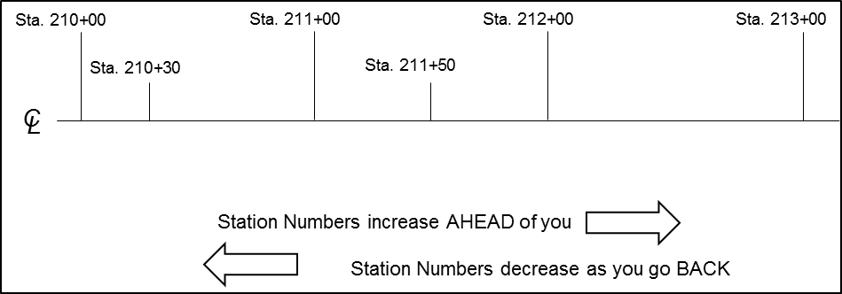
Stationing
Study Guide Page 5
AHEAD = Station numbers get larger
BACK = Station numbers get smaller
Notes:
Beginning at Sta. 210+00 you will move AHEAD to Sta. 213+00
Beginning at Sta. 213+00 you will move BACK to Sta. 210+00

Slide 27
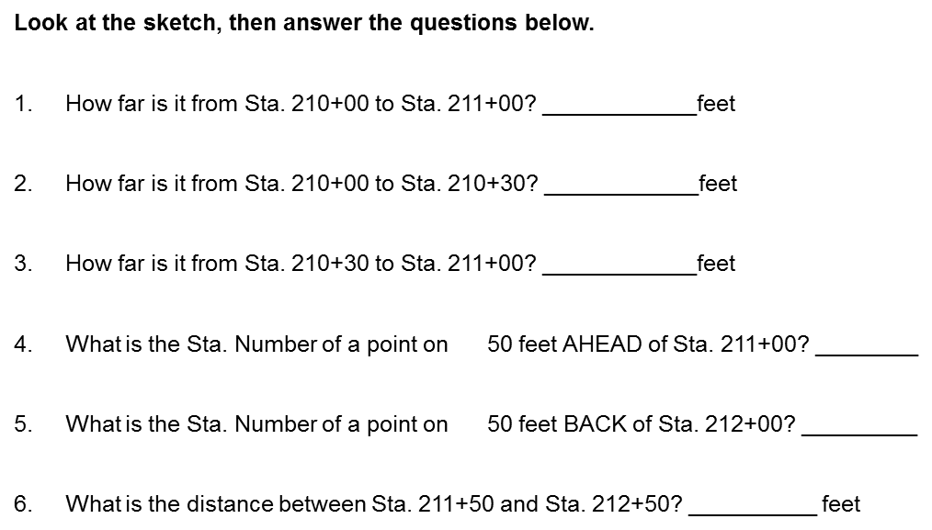
Exercise #1
Notes:
Exercise #1.
Answer the 6 questions on the Exercise 1 worksheet.
Use the diagram to answer the questions.
PAUSE the video
After completing the exercise, RESUME playing the video.

Slide 28
Exercise #1
21,100 – 21,000 = 100 feet
21,030 – 21,000 = 30 feet
21,100 – 21,030 = 70 feet
21,100 + 50 = 21, 150 = Sta. 211+50
21,200 – 50 = 21,150 = Sta. 211+50
21,250 – 21,150 = 100 feet

Slide 29
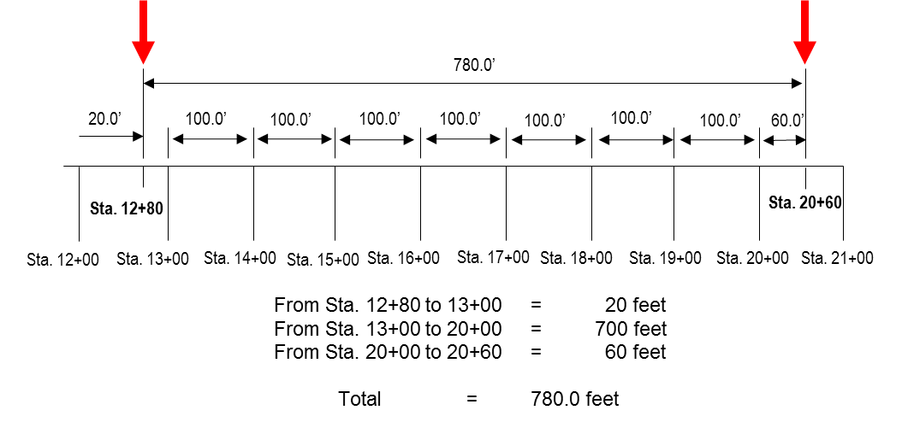
Stationing
It is 780’ from Sta. 12+80 to Sta. 20+60.
We can check this mathematically: 2,060’ – 1,280’ = 780’
Notes:
The diagram shows graphically the distance from Sta. 12=80 to Sta. 20+60.
This is also shown mathematically.
If we drop the “plus” signs from Sta. 20+60 and from Sta. 12+80, you will have 2,060 feet minus 1,280 feet which equals 780 feet.

Slide 30

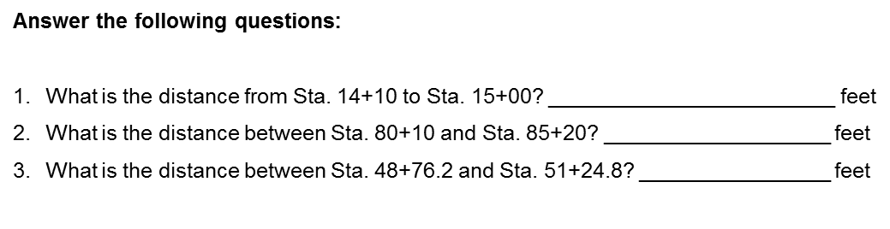
Exercise #2
Notes:
Exercise #2.
Answer the 3 questions on the Exercise 2 worksheet.
Use the diagram to answer the questions.
PAUSE the video
After completing the exercise, RESUME playing the video.

Slide 31
Exercise #2
1,500 – 1,410 = 90 feet
8,520 – 8,010 = 510 feet
5,124.8 – 4,876.2 = 248.6 feet

Slide 32
Stationing
Generally, station numbers increase from:
  WEST to EAST, or
  SOUTH to NORTH
Since roadways curve and change direction, this is not always true
Remember:
  AHEAD means toward higher stations
  BACK means toward lower stations
Notes:
Generally, projects run from WEST to EAST or SOUTH to NORTH.
In other words, station numbers are larger as you move from WEST to EAST or from SOUTH to NORTH.
Remember, AHEAD means the station numbers get higher, BACK means the station number get lower.

Slide 33
Exercise #3
If you are walking along the centerline of a project, reading the station numbers on the stakes, and these numbers are increasing as you go, there is a good chance you are walking toward the or
(East / West)
(North / South)
Notes:
Exercise #3.
Answer question number 1 on the Exercise 3 worksheet.
PAUSE the video
After completing the exercise, RESUME playing the video.

Slide 34
Exercise #3
If you are walking along the centerline of a project, reading the station numbers on the stakes, and these numbers are increasing as you go, there is a good chance you are walking toward the or
East
North
(East / West)
(North / South)
Notes:
Exercise #3.
Answer question number 1 on the Exercise 3 worksheet.
PAUSE the video
After completing the exercise, RESUME playing the video.

Slide 35
Stationing
Any point pertaining to a project may be located on the actual ground and on the plans
  By its Station, and
  The number of feet LEFT or RIGHT of the centerline
Left and Right of centerline:
  You are standing on the centerline facing AHEAD
Notes:
You can find any point on a project in the field or on the plans by using the station number or the station number and how many feet the point is right or left of the centerline.
Your RIGHT or LEFT, as you are standing on the centerline, facing AHEAD.

Slide 36
Stationing
Study Guide Page 5
Point “B”
Point “A”
Notes:
As this diagram shows,
Point “A” is at Sta. 2+00, 90 feet RIGHT of the centerline.
Point “B” is at Sta. 3+50, 123 feet, 6 inches LEFT of the centerline.

Slide 37
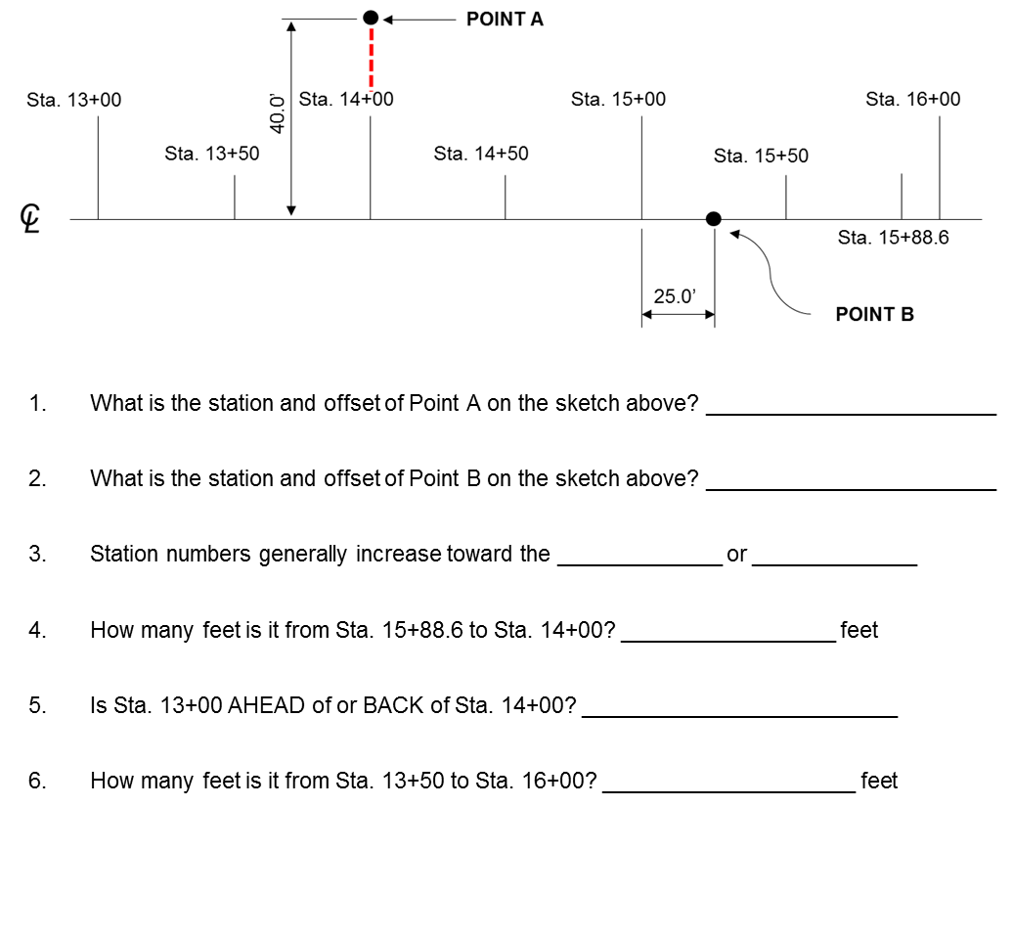
Exercise #4
Notes:
Exercise #4.
Answer the first 6 questions on the Exercise 4 worksheet.
Answer questions 1 – 6 only.
Use the diagram to answer the questions.
STOP the video.
After completing the exercise, PLAY SESSION 2 to continue.

Slide 38
Exercise #4
1. Sta. 14+00, 40 ft. left of centerline
2. Sta. 15+25 on the centerline
3. East; North
4. 1,588.6 – 1,400.0 = 188.6 feet
5. back of
1,600 – 1,350 = 250 feet

Slide 39
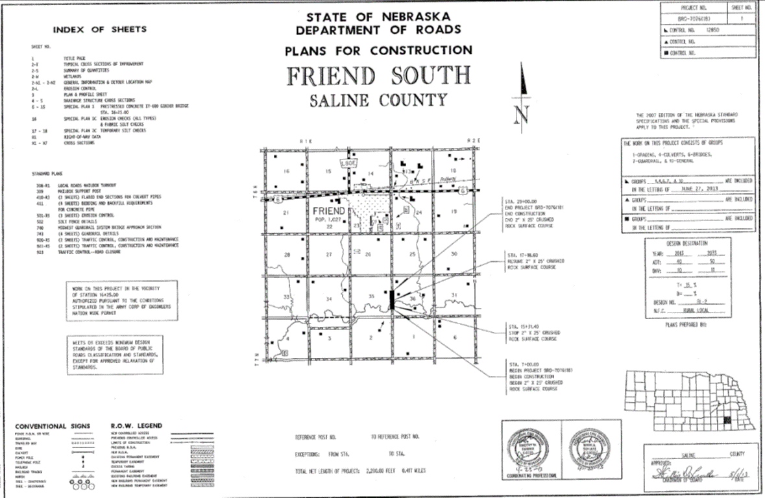
SESSION 2
Friend South Project Plans
  Title Sheet

Slide 40
Title Sheet
Notes:
The very first sheet is the TITLE SHEET.

Slide 41
Title Sheet
Study Guide Page 6
Project Name
Project Number
Project Control Number
County Project Location Map
Project Limits and Length
Project Exceptions
Traffic Design Designation
Route Number
Signature Box – Design
Signature box – Chief Engineer or Official
Date Plans Completed
Groups
Professional Engineer’s Stamp
Index of All Sheets
Legend
Notes:
This slides shows items found on the Title Sheet.
We will look at many of these individually.

Slide 42
Title Sheet – Upper Left
Notes:
In the UPPER LEFT corner you will find the INDEX OF SHEETS.
This is like the Table of Contents for the plan set.
If you are asked to find a specific item on the plans, it may be easier to refer to this to find the sheet number.

Slide 43
Title Sheet – Upper Right
Notes:
In the UPPER RIGHT you will find this table which gives you the Project Number and Control Number.

Slide 44
Title Sheet – Begin & End Points
Notes:
In the center of the Title Sheet you find the Location Map.
On the right side of the map are General Notes with Station numbers.
The project begins at Sta. 7+00 and ends at Sta. 29+00.
From that information you can get the total length of the project.

Slide 45
Title Sheet – County Location Map
Location of Project Using a Legal Description
Section, Township, Range
“Between Sections 35 & 36, Twp. 8 North, Rg. 1 East, Saline County, NE”
Notes:
Also from the location map you can give a location description for the project.
The location or LEGAL description of the project using Section, Township and Range is given.

Slide 46
Title Sheet – Bottom Center
Notes:
At the bottom center of the Title Sheet the total length of the project is given in feet and miles.

Slide 47
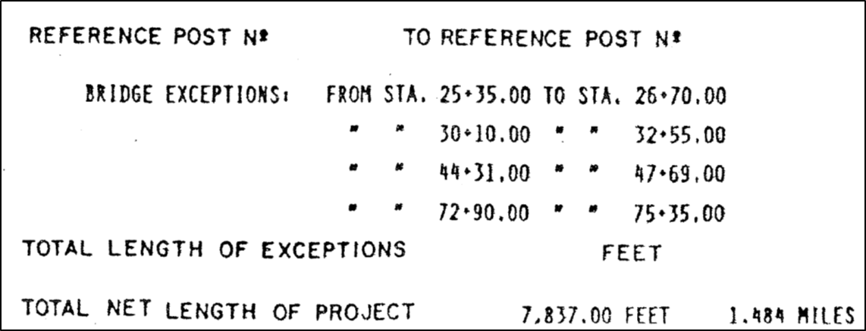
Project Length – Exceptions Example

Slide 48
Project Length – Exceptions Examples
Exceptions
2670’ – 2535’ = 135’
3255’ – 3010’ = 245’
4769’ – 4431’ = 338’
7535’ – 7290’ = 245’
Total Exceptions = 963’

Slide 49
Project Length – Exceptions Examples
9500’ – 700’ = 8800’
8800’ – 963’ = 7837’
Total Net Length of Project = 7837’ or 1.484 Miles

Slide 50
Title Sheet – Groups
Group 1 – Grading
Group 4 – Culverts
Group 6 – Bridges
Group 7 – Guardrail
Group 10 - General
Notes:
On the right hand side of the Title Sheet are the GROUPS that make up this project.
There is a number for each Group and the name of the Group for each item.
We will discuss the Groups more when we look at the Summary of Quantities Sheet.

Slide 51
Exercise #5
Turn to the TITLE SHEET, Plans for Construction, Friend South to answer the questions for Exercise #5
Notes:
Exercise #5.
Use the TITLE SHEET to answer the 10 questions on the Exercise 5 worksheets.
STOP the video.
After completing the exercise, PLAY SESSION 3 to continue.

Slide 52
Exercise #5
BRO-7076 (18)
7+00.00
29+00.00
(a.) 2,200.00 feet (b.) 0.417 miles
Crushed rock
2”, 25’
2,012.8 feet
1-Grading, 4-Culverts, 6-Bridges, 7-Guardrail, 10-General
Sta. 16+25.00
Sec. 35 & Sec. 36

Slide 53
SESSION 3
General Notes
Summary of Quantities
Construction Plan Views
Drainage Structures

Slide 54
General Notes
Study Guide Page 6
Clarifies items not completely covered elsewhere in specifications or plan details
General notes instruct the Contractor
    Incidental items of work
    Tack coat application requirements
    ROW access restrictions
    Pavement smoothness requirements
    Soil compaction requirements
Notes:
General Notes are found throughout the plan.
There may be a set of sheets within the plan titled “GENERAL INFORMATION” or “GENERAL NOTES”
General Notes gives the Contractor specific information or instructions on a number of items of work.

Slide 55
General Notes
Sheet 2-N1
  Compaction Requirements
  Earthwork Quantities
  Culvert Pipe Legend
  Mailbox Location
  NOTES!
Notes:
Sheets 2-N1 and 2-N2 are General Information Sheets, clarifying items not found elsewhere on the plans.
Remember, General Notes can be found throughout a set of construction plans.
I’ll point these out as we go through the upcoming slides.

Slide 56
General Notes
Sheet 2-N2
  Detour Map
  Access Crossing

Slide 57
Summary of Quantities (2-S)
Study Guide Page 6
Shows all the pay items of work included in the contract
Items are listed in numerical order by item code
Each section lists the item, quantity of item, & item units
Notes:
Turn to Sheet 2-S.
This is the SUMMARY OF QUANTITIES Sheet.
It shows all pay items for each of the GROUPS we discussed earlier.
For each Group or section, the item name, quantity and unit is given.

Slide 58
Summary of Quantities Sheet (2-S)
Notes:
Sheet 2-S shows the 5 Groups that were on the Title Sheet.
We’ll look at Group 4, Culverts.

Slide 59
Group 4 – Culvert Items
Study Guide Page 6
Lump Sum
Cubic Yard
Linear Feet
Notes:
Here are all the items associated with Group 4, Culverts.
The Item Name is in the LEFT column, Item Quantity in the SECOND column and the Item Units in the RIGHT column.
The Item Units can be given in LUMP SUM, CUBIC YARD, LINEAR FEET, or EACH s shown here.
Other Item Units include HOUR, POUNDS, TONS, SQUARE YARD or ACRE.
Look at the other Group Items to become familiar with NAMES, QUANTITY and UNITS.

Slide 60
Construction Plan Views
Study Guide Page 7
Plan View
  A drawing depicting a section of the road from a bird's eye view.
Profile View
  A drawing depicting the vertical plane along the longitudinal centerline of the road, expressed in elevation or gradient.
Cross-section View
  A drawing depicting a section of the road viewed vertically, as if cut across the width of the road.
Typical View
  A drawing depicting features of a particular design, installation, construction or methodology.
Notes:
A set of construction plans will show drawings from different angles.
Depending on what the designer wants to point out to the contractor, they will use a particular angle to provide a better understanding.
Here are four View Angles found on most construction plans.

Slide 61
Construction Plan Views – Plan View
Plan View (Sheet 3)
Notes:
Turn to SHEET 3
Sheet 3 has 2 views, the top view is the Plan View.
The PLAN VIEW depicts a section of the road from a bird's eye view.
You are looking down on the project, or a portion of the project, along the centerline.

Slide 62
Construction Plan Views – Plan View
NOTES!
Stationing
Notes:
Here is a larger view of a portion of the Plan View.
The information CALL-OUT boxes give instructions to the contractor.
Also notice the stationing numbers, they are telling you exactly what is to done at that point on the project.

Slide 63
Construction Plan Views – Profile View
Profile View (Sheet 3)
Notes:
The bottom half of Sheet 3 is the PROFILE VIEW.
The PROFILE VIEW depicts the vertical plane along the longitudinal centerline of the road, expressed in elevation or gradient.
You are looking through the project, sometimes referred to as a “worm’s eye” view.
Plan sheets like Sheet 3 are called PLAN & PROFILE Sheets.

Slide 64
Construction Plan Views – Profile View
Bench Mark information
Elevations
Notes
Stationing
Notes:
Here is a larger view of a portion of the PROFILE VIEW.
Along the outside edges are the Elevations.
There are also information call-out boxes giving instructions and BENCH MARK information.

Slide 65
Top & Bottom of Plan & Profile Sheet (Stationing)
Top
Bottom
Notes:
Station Numbers are found along the top and bottom of the Plan & Profile Sheet.

Slide 66
Construction Plan Views – Cross Section View
Cross-Section View (Sheet 2-T)
Notes:
Turn back to SHEET 2-T.
The Cross-section view depicts a section of the road viewed vertically, as if cut across the width of the road.
There are 2 more cross section views on Sheet 2-T, the Typical Section at Bridge Ends and the Typical Channel Section.
Remember, A CROSS SECTION View is across the WIDTH of a road, street, bridge, channel, etc.

Slide 67
Construction Plan Views – Typical View
Typical View #1
Notes:
The TYPICAL VIEW depicts features of a particular design, installation, construction or methodology.
Here is an example of a Typical View for the installation of a trench.

Slide 68
Construction Plan Views – Typical View
Typical View #2 (Sheet 8)
Notes:
Here is an example of a Typical View for a field splice weld.
As you look through the plans, see how many typical views you can find.
Remember to look for features of a particular design, installation, construction or methodology.

Slide 69
Drainage Structures
Study Guide Page 7
  Bridges
  Pipe Culverts
  Box Culverts
  Drop Inlets
  Headwalls
  Dikes
  Ditches
Notes:
A construction project may have several types of Drainage Structures.
Here is a list of Drainage Structures that may be found on a set of construction plans.

Slide 70
Drainage Structures – Sheet 4
Notes:
Sheet 4 on your set of plans shows the cross section of a culvert installation.

Slide 71
Drainage Structures – Sheet 4
Inlet Elevation
Outlet Elevation
Culvert Notes
Notes:
Information found on Sheet 4 includes:
The culvert Inlet Elevation.
The Outlet Elevation.
And Notes about the Culvert, which include the station, culvert type and size, the amount of excavation and fill.
The Notes also give hydraulic information, the Drainage Area and the Peak Discharge or Design Year Storm, which we will discuss.

Slide 72
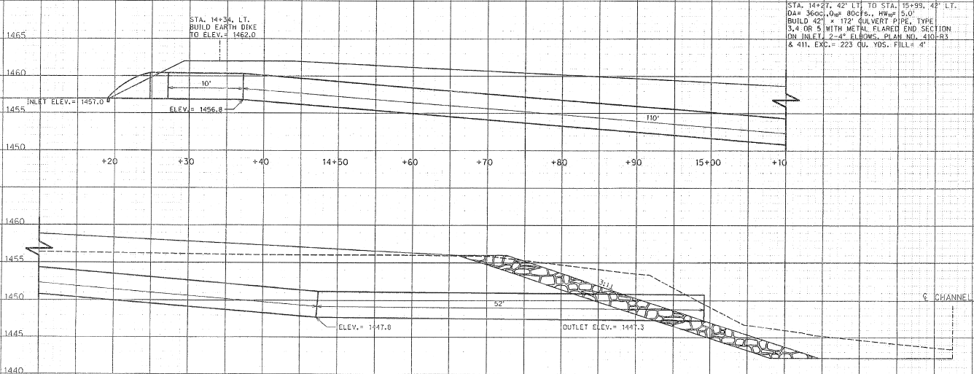
Drainage Structures – Sheet 4
Match Line
Match Line

Slide 73
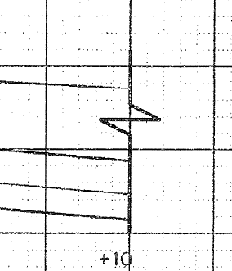
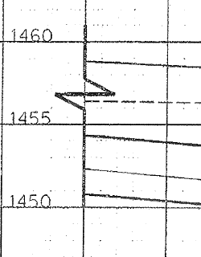
Drainage Structures – Sheet 4

Slide 74
Drainage Structures – Sheet 7
Notes:
Sheet 7 on your set of plans shows the Sectional Elevation of the new bridge for this project.
You will see the Centerline Stationing and Elevations of the Abutments and Bents.
And the Station Number of the Centerline of the Bridge and Channel.
We will discuss the Bridge Plans in more detail.

Slide 75
Drainage Structures – Q = ciA
Study Guide Page 7
Rational Method Equation
  The Rational equation is the simplest method to determine peak discharge from drainage basin runoff
Rational Equation: Q = ciA
The Rational Equation requires the following units:
  Q = Peak discharge, cubic feet per second (CFS)
  c = Rational method runoff coefficient
  i = Rainfall intensity, inches/hour
  A = Drainage area, acres
Notes:
The Formula Q = CIA is the the Rational Method Equation for determining peak discharge for a drainage structure.
You may not be required to calculate a structure’s peak discharge, but it is important that you know what it is and how it is determined.
“Q” is the peak discharge or DESIGN YEAR STORM a structure can handle.
“c” is the runoff coefficient, or the amount of rainfall that will runoff a particular type of surface.
“i” is the rainfall in inches per hour.
And “A” is the drainage are in acres for the drainage structure.

Slide 76
Drainage Structures – Q = ciA
Study Guide Page 7
Ground Cover | Runoff Coefficient, c
Lawns | 0.05 - 0.35
Forest | 0.05 - 0.25
Cultivated land | 0.08-0.41
Meadow | 0.1 - 0.5
Parks, cemeteries | 0.1 - 0.25
Unimproved areas | 0.1 - 0.3
Pasture | 0.12 - 0.62
Residential areas | 0.3 - 0.75
Business areas | 0.5 - 0.95
Industrial areas | 0.5 - 0.9
Asphalt streets | 0.7 - 0.95
Brick streets | 0.7 - 0.85
Roofs | 0.75 - 0.95
Concrete streets | 0.7 - 0.95
Notes:
This is a chart that gives values for the Runoff Coefficient “c”.
The amount of runoff is different for different types of ground cover.
As shown here, the amount of runoff for cultivated land is less then that of an asphalt street.

Slide 77
Drainage Structures – Q = ciA
Study Guide Page 8
Drainage Area = 36 acres
Q₁₀ = 80 cubic feet per second
Culvert designed for a 10-year storm
Notes:
Here are notes for a particular culvert pipe.
The Drainage Area is 36 Acres, the “Q” or Peak Discharge is 80 cubic feet per second.
The Design Year Storm is always noted by the number next to the “Q”.
In this case the number “10” means the culvert is designed for a 10-Year Storm.
A 10-year storm refers to the rainfall totals that have a 10 percent probability of occurring at that location in that year.
Encountering a 10-YEAR STORM on one day DOES NOT decrease the chance of a second 10-year storm occurring in that same year or any year to follow.
In other words, there is a 1 in 10 or 10% chance that a storm will reach this intensity in any given year.
Likewise, a 100-year rainfall event has a 1 in 100 or 1% chance of occurring in a year.
A 50-year rainfall event has a 1 in 50 or 2% chance of occurring, and so on.

Slide 78
Design Year Storm
Study Guide Page 8
A 10-yr, 25-yr, 50-yr, or even 100-yr storm frequency may be specified
What is 100 Year Storm?
  A 100-year storm refers to rainfall totals that have a one percent probability of occurring at that location in that year
  Encountering a "100-year storm" on one day does not decrease the chance of a second 100-year storm occurring in that same year or any year to follow
  In other words, there is a 1 in 100 or 1% chance that a storm will reach this intensity in any given year
  Likewise, a 50-year rainfall event has a 1 in 50 or 2% chance of occurring in a year.

Slide 79

Design Year Storm
Study Guide Page 8
Recurrence intervals and probabilities of occurrences
Recurrence interval, in years | Probability of occurrence in any given year | Percent chance of occurrence in any given year
100 | 1 in 100 | 1
50 | 1 in 50 | 2
25 | 1 in 25 | 4
10 | 1 in 10 | 10
5 | 1 in 5 | 20
2 | 1 in 2 | 50
Natural Resources Conservation Service
United States Department of Agriculture

Slide 80
Exercise #6
Use Sheet 3, Friend South Plan
  Questions 1 – 2
Use Sheet 4
  Questions 3 – 5
Notes:
Exercise #6.
Use Sheet 3, Friend South plans to answer Questions 1 & 2
Use Sheet 4 of the Plans to answer Questions 3 through 5.
STOP the video.
After completing the exercise, PLAY SESSION 4 to continue.

Slide 81
Exercise #6
1. a.) Spike in power pole
b.) BM #3
c.) 1458.27’
d.) 81’ Left
a.) Twin Span Girder & Floorbeam
b.) 120’ – 0”
c.) 20’ – 0”
d.) Remove

Slide 82
Exercise #6
8.7’
D.A. = 4 acres
Earth dike, elevation 1460.0’

Slide 83
SESSION 4
Bridge Plans

Slide 84
Bridge Plans – Sheet 6
Notes:
Turn to SHEET 6 of the Friend South Plans

Slide 85
Bridge Plans – Sheet 6
Project Name
Project Number
Notes
Quantities
Index
Title Block
Notes:
Sheet 6 is the TITLE SHEET for the new bridge.
Items found on Sheet 6 are:
The Project Name, Project Number, Notes, Quantities, an Index of Sheets and the Title Block.

Slide 86
Bridge Plans – Sheet 6
Notes:
Some of the General Notes for the Bridge Project include:
Design of the Structure
Type of Concrete
Strength of Concrete, and
Type of Reinforcing Steel

Slide 87
Bridge Plans – Sheet 6
Notes:
These are the Quantities for the New Bridge.
As with the Summary of Quantities Sheet discussed earlier, it gives the ITEMS, ITEM QUANTITIES and ITEM UNITS.

Slide 88
Bridge Plans – Sheet 6
“Special Plan” sheet numbers
Notes:
The INDEX of the sheets for the new bridge is similar to the INDEX OF SHEETS for the entire plan.
The Bridge Plans are “SPECIAL PLANS” and the sheets have their own Special Plan numbers in the LOWER RIGHT HAND CORNER..
Plan Sheet Numbers are still found in the UPPER RIGHT HAND CORNER.

Slide 89
Bridge Plans – Sheet 6
“Special Plan” sheet numbers
Location
Bridge Information
  Skew
  Clear Roadway Width
  Design Live Load
  Length
  Number of Spans
  Bridge Type
  Bridge Number
Project Number
Engineering Firm
Title Block
Notes:
The TITLE BLOCK is along the RIGHT edge of each sheet.
Here is a list of information found within the TITLE BLOCK.
As mentioned, the SPECIAL PLAN SHEET numbers are in the lower Right-hand corner, the PLAN SHEET numbers are in the upper Right-hand corner.
For referencing pages for the upcoming slides and exercise, we will use the PLAN SHEET NUMBERS in the upper right-hand corner.

Slide 90
Bridge Plans – Sheet 7
Sectional Elevation
Notes:
TURN TO SHEET 7
SHEET 7 shows the Sectional Elevation of the bridge.
We have previously discussed this sheet in the DRAINAGE STRUCTURE section.

Slide 91
Bridge Plans – Sheet 7
General Plan
Notes:
SHEET 7 also shows the GENERAL PLAN of the new bridge.
We will look closer at two areas.

Slide 92
Bridge Plans – Sheet 7
Bridge Length
  End of Floor to End of Floor Length
  Centerline Abutment to Centerline Abutment Length*
Span Lengths
Number of Spans
Notes:
Two Bridge Lengths are given, End of Floor to End of Floor, and Centerline Abutment to Centerline Abutment Length.
The length used to describe the length of the bridge is the Centerline Abutment length.
Look at the TITLE BLOCK on the right edge of the sheet to find “the length” of the bridge.
It matches the Centerline Abutment length.
The Gneral Plan view also gives the NUMBER OF SPANS AND THE SPAN LENGTHS.

Slide 93
Bridge Plans – Sheet 7
Clear Roadway Width
Notes:
At the left side of the plan view, the CLEAR ROADWAY WIDTH is given.

Slide 94
Bridge Plans – Sheet 7
Study Guide Page 8
Hydraulic Information
  Waterway (stream)
  Drainage Area (D.A.)
  Peak Discharge (Q)
  Design Year Storm (100)
Notes:
At the lower right of SHEET 7 is the BRIDGE HYDRAULIC INFORMATION.

Slide 95
Bridge Plans – Sheet 8
Study Guide Page 9
Pile Data
  Pile Location
  Pile Number
  Cut-Off Elevation
  Minimum Penetration
  Pile Length
  Design Bearing
  Type
Notes:
TURN TO SHEET 8
At the upper right is the PILE DATA TABLE.
A note about the PILE NUMBER.
Each of those is an individual pile with a specific number for a specific location.
For example – Bent Number 1 has a total of 10 piling, numbered 1B, 4, 7 & 10B, 2, 3, 5, 6, 8 & 9.

Slide 96
Bridge Plans – Sheet 8
Pile Detail
  Field Splice Detail
  Field Weld Notes
Notes:
Sheet 8 also shows the PIPE PILE DETAIL.
This is a Typical View we discussed in the VIEW ANGLES section.

Slide 97
Bridge Plans – Sheet 9
Abutment Elevation
Notes:
TURN TO SHEET 9
Sheet 9 shows the Cross Section of the Abutment.
We’ll look at the area in the upper right of this view.

Slide 98
Bridge Plans – Sheet 9
Location (point) Elevations
Notes:
Location or point elevations are labeled as Elevation A, Elevation B, Elevation C and so on.

Slide 99
Bridge Plans – Sheet 9
Abutment Location Elevations
Notes:
The table to the right gives the corresponding Abutment Location Elevations.

Slide 100
Bridge Plans – Sheet 13
Out to Out Width (30’ – 4”)
Clear Roadway Width (28’ – 0”)
Reinforcing Bar Spacing
Notes:
TURN TO SHEET 13
Sheet 13 is another Cross Section View.
Some of the information that can be found in this view:
The OUT-TO-OUT WIDTH
The CLEAR ROADWAY WIDTH, and
REINFORCING BAR SPACING

Slide 101
Exercise #7
Use Bridge Plan Sheets 6 – 13
Notes:
EXERCISE #7
Use PLAN Sheets 8 – 13 to answer the questions.
Exercise #7 has 3 pages, 15 questions
STOP the video
After completing Exercise #7, PLAY Session 5 to continue

Slide 102
Exercise #7 – Bridge Plans
47BD
4,000 PSI
ASTM A615, Grade 60
1,260 Tons
2,780 Lbs.
16+25.00
185’ – 2”
28’ – 0”
3 Spans
1’ – 2”
Turkey Creek
303.8 Square Miles
100 Years
42 Piles
20 & 45 Tons/Pile

Slide 103
SESSION 5
Right-of-Way (ROW)

Slide 104
Right of Way – Sheet R1
Study Guide Page 9
Right of Way Terms & Definitions
ACQUISITION OR TAKING
  The acquiring of a property in its entirety or a portion thereof, for highway purposes
PARCEL NUMBER
  The number designated on the plans, generally enclosed by a circle, which designates a parcel or tract of land
PERMANENT EASEMENT
  An easement in perpetuity that gives the Department the right to utilize property for an unlimited time
Notes:
TURN TO SHEET R1
The next 2 slides contain ROW Terms and Definitions.

Slide 105
Right of Way – Sheet R1
Study Guide Page 9
RIGHT OF WAY
  This is a term denoting land, interest therein, or property which is acquired for highway purposes
TEMPORARY EASEMENT
  An easement granted to the Transportation Department on a temporary basis for construction usually for a specified time and specified purpose

Slide 106
Right of Way – Sheet R1
Notes:
Sheet R1 is the ROW Data Sheet.

Slide 107
Right of Way – Sheet R1
Notes:
At the bottom right is the GENERAL LAYOUT of the project.
The Layout Map shows the Project Location, Project Number, the Beginning and Ending Stations, and the Property Owner Tract Numbers.

Slide 108
Right of Way – Sheet R1
Notes:
In the lower left is the ROW Legend.

Slide 109
Right of Way – Sheet R1
Section Corner Ties
Notes:
Along the left side are the Section Corner Ties.

Slide 110




Right of Way – Sheet R1
Study Guide Page 9
List of property owners with corresponding TRACT numbers
  Tract numbers reference individual parcels
The location (legal description) of the property owned by that person
Total Property Taken, in acres
New Taking – New ROW, in acres
Easements – Permanent or Temporary
Notes:
Near the center of the sheet is a table showing:
The Tract Numbers
The Property Owners
The Legal Description of each Tract of Land, and
What the property is being used for, such as NEW ROW and EASEMENTS.

Slide 111



Right of Way – Sheet R1
Study Guide Page 9
New ROW
  “New Taking” Column
Easement
  “Permanent” Column
  “Temporary” Column
Notes:
New ROW is in the “NEW TAKING” column.
Permanent and Temporary Easements are shown in the “EASEMENT” column.

Slide 112
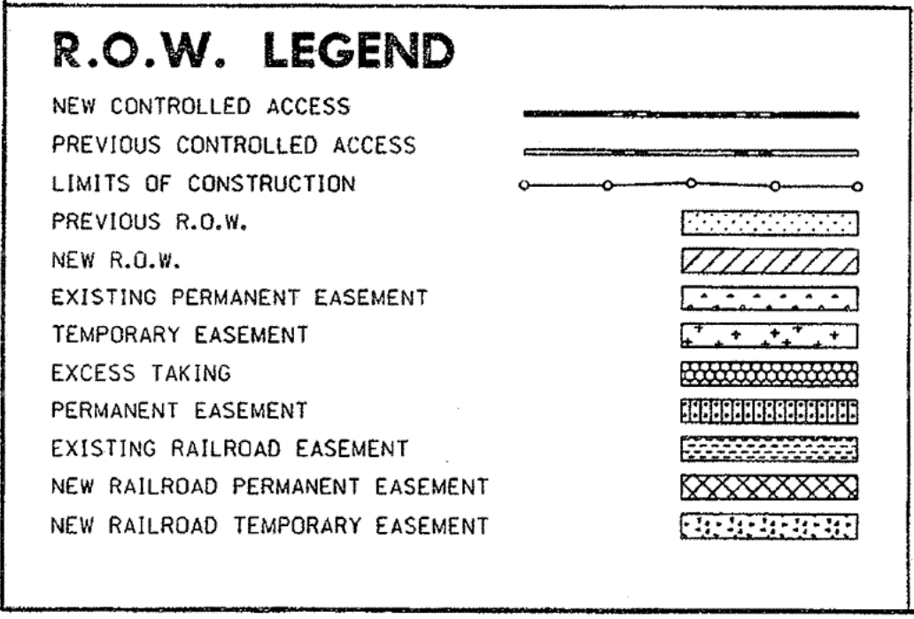
Right of Way – Sheet R1
New Taking
(ROW)
Temporary
Easement
Notes:
The PLAN VIEW shows:
The location of New ROW, Easements, Tract Numbers, Property Owners, Legal Descriptions, basically all the information from the table below.
You will see the letters “PL” in bold type with a line extending to the project centerline.
“PL” stands for PROPERTY LINE.

Slide 113
Right of Way – Easements
Notes:
Look at these 2 areas.

Slide 114
Right of Way – Easements
Notes:
The Table shows Easements 1 through 4 and what they are used for.
Find Easement 1 in Tract Number 5.
The Easement is used for DRIVEWAY CONSTRUCTION and the amount of property used for this Easement is 0.11 Acres.

Slide 115
Exercise #8
Use ROW Sheet R-1 to complete Exercise #8
Notes:
EXERCISE #8
Use Sheet R-1 to complete Exercise #8.
STOP the video
After completing Exercise #8, PLAY Session 6 to continue

Slide 116
Exercise #8 - ROW
Refer to Parcel (Tract) #1
  Stewart Revocable Trust, JL & JM
  Part of SE ¼ Sec. 35, T8N, R1E
  1.94 acres
  0.00 acres
  0.30 acres

Slide 117
Exercise #8 - ROW
3.78 acres
Permanent Easements – 0.00 acres Temporary Easements – 0.64 acres
4.
  Construction staging area
  Stewart Revocable Trust, JL & JM
  0.23 acres

Slide 118
SESSION 6
Traffic Control
Plan Reading Resources

Slide 119
Traffic Control
Study Guide Page 10
Traffic Control Plan (TCP) consists of the plans and specifications developed for each individual construction project
  Supplemented by such detailed plans as required by the contract
The TCP complements the Traffic Control Specifications and the Manual on Uniform Traffic Control Devices (MUTCD)
The TCP tells the contractor how traffic will be maintained while construction is being performed
Notes:
The TRAFFIC CONTROL PLAN for a project is based on the Standards and Guidelines set forth in the CURRENT EDITION of the Manual on Uniform Traffic Control Devices.

Slide 120
Traffic Control
Study Guide Page 10
When through traffic is detoured, the detour route is shown on either:
  The Title Sheet
  Location Map
  Schematic Plan, or
  Within the General Notes
Notes:
When traffic is Detoured, the Detour Route is usually found on one of these sheets within the Construction Plans.

Slide 121
Traffic Control
Detour Map, General Information, Sheet 2-N2
Notes:
The Detour Map for your set of Plans is on SHEET 2-2N.

Slide 122
Detour Map Example
Notes:
Here is an example of the Detour show on the TITLE SHEET

Slide 123
Traffic Control
Study Guide Page 10
When traffic is maintained during construction, the plan will normally require a number of Traffic Control notes along with several details such as:
  Sequence of operations
  Section details for maintaining traffic
  Plan insert sheets
  Crossover details
  Temporary barrier details
  Etc.
Notes:
When traffic is allowed to travel through the project while construction is taking place, TRAFFIC CONTROL requires more detailed, complex planning.

Slide 124
Traffic Control – Standard Plan 920-R7 – Sheet 1 of 3
Notes:
Most all Construction Plans will include a set of TRAFFIC CONTROL CONSTRUCTION AND MAINTENANCE STANDARD PLANS.

Slide 125
Traffic Control – Standard Plan 920-R7 – Sheet 1 of 3
Notes:
TEMPORARY TRAFFIC CONTROL DEVICES.

Slide 126
Traffic Control – Standard Plan 920-R7 – Sheet 2 of 3
Notes:
TYPICAL APPLICATION Diagrams and Notes.

Slide 127
Traffic Control – Standard Plan 920-R7 – Sheet 2 of 3
Notes:
These Standards Plans give Standards and Guidelines found in the MUTCD.
The Standards Plans include information about FLAGGING PROCEDURES

Slide 128
Traffic Control – Standard Plan 920-R7 – Sheet 3 of 3

Slide 129
Traffic Control – Standard Plan 920-R7 – Sheet 3 of 3

Slide 130
Traffic Control – Standard Plan 923-R2 – Sheet 1 of 1

Slide 131
Traffic Control – Standard Plan 923-R2 – Sheet 1 of 1
This setup similar to the Friend South project
Notes:
The contractor can use one or more of the Typical Applications that best fit the traffic control strategy required.

Slide 132
Exercise #9 – Review
Review Questions
Use the FRIEND SOUTH plans to complete Exercise #9
Notes:
EXERCISE #9
Review Questions
Use the FRIEND SOUTH plans to complete Exercise #9
PAUSE the video
After completing Exercise #9, RESUME the video

Slide 133
Exercise #9 – Basic Plan Reading Review
Title Sheet
Summary of Quantities Sheet
Plan View
Profile View
150 feet
Plan/Profile Sheet
Sheet 2-N2, General Information
South or West
36 square miles
Sheet R1, ROW Data

Slide 134
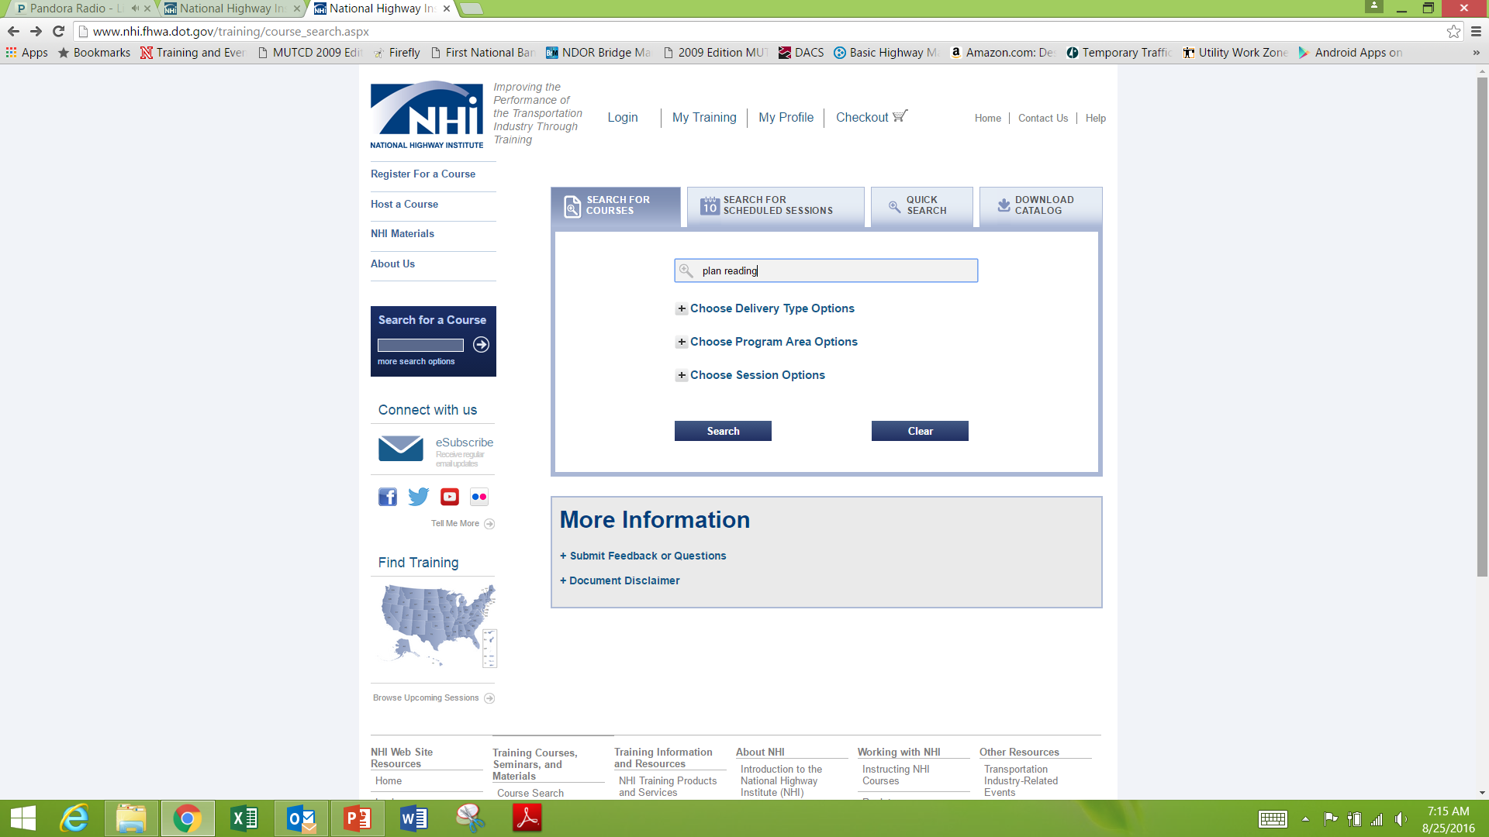
Additional Plan Reading Resources
www.nhi.fhwa.dot.gov/training/course_search.aspx
Type in “plan reading”
Notes:
Here is an online Plan Reading Training site from the National Highway Institute or NHI.
Go to the address and in the Search Box type “PLAN READING”

Slide 135
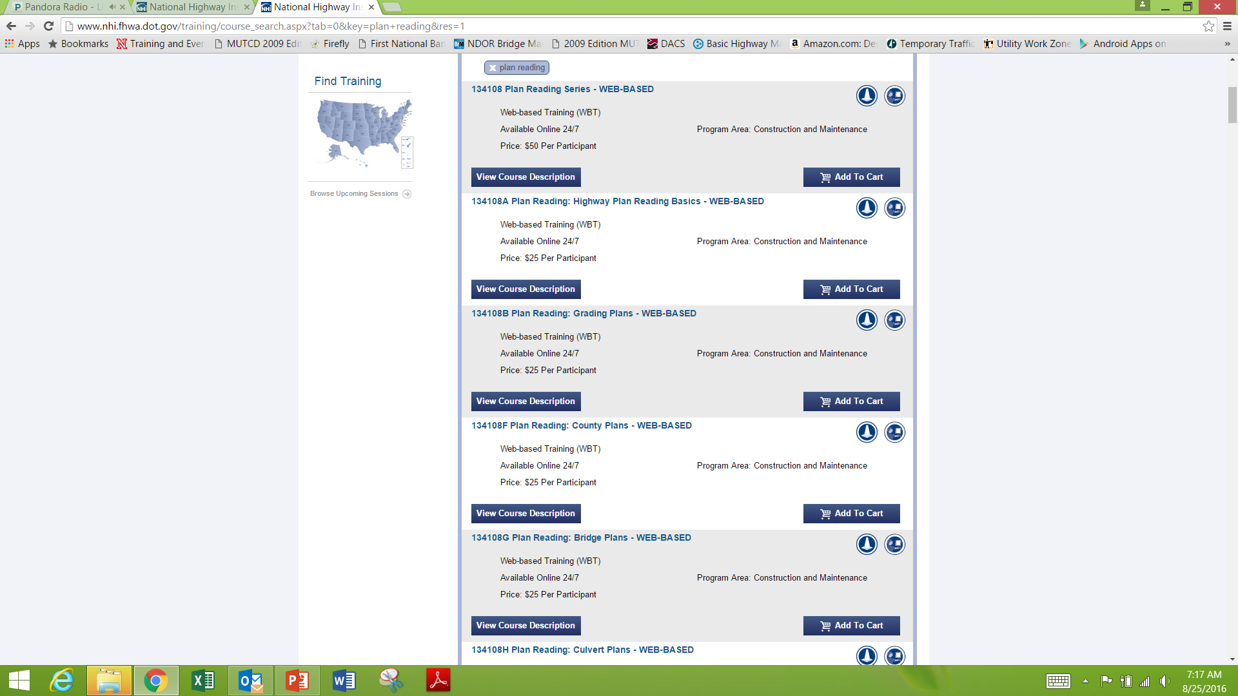
All Topics in NHI Course Where Covered Today
Notes:
Several different courses on Plan Reading will be listed.
Choose a course and create an account.
You can work on the course at any time, stop and return at any time.
These courses do charge a fee.

Slide 136
SESSION 7
Study Guide Page 10
Additional Information
  Surcharge
  Bridge Camber
  Bridge Approach Grade
  Radius Point
  Lane Cross Slope and Minimum Lane Width
  Horizontal Curves

Slide 137
Surcharge
Study Guide Page 10
Surcharge
  A pile of earth whose weight serves as a load to accelerate the compression of softer soils beneath a construction site.
This compression reduces or eliminates the settlement of any structure subsequently built at the site
  Preloading surcharge soil with other soil temporarily causes the soil to densify under the temporary weight

Slide 138
Surcharge
Study Guide Page 10
Purposes of compacting soil
  Increases soil strength
  Increased bearing capacity
  Slope stability
  Pavement system strength
  Decreases amount of settlement
  Reduces damage to structure from foundation movement (especially from differential settlement)
  Decreases permeability – e.g. dams, levees, lagoon (liner) bottoms,
  Improve site conditions for the construction process itself (working platform)
  Decrease frost susceptibility (decreased voids, less water infiltration)
Usually located on the Plan and Profile Sheet

Slide 139
Plan and Profile Sheet

Slide 140
Surcharge

Slide 141
Bridge Camber
Study Guide Page 11
The term camber actually has several different meanings
Depending on the engineering principle involved
  Bridges
  Roadways
  Airplane Wings
It is the amount of curving or arching used to counteract the effects of a load

Slide 142
Bridge Camber
Study Guide Page 11
When a number of heavy trucks cross over a bridge at the same time
  If there was no camber, the center would sag, then spring back to level when the trucks leave
By adding a slight upward curve
  Engineers can ensure that the bridge only flattens out to a level position when weight is added

Slide 143
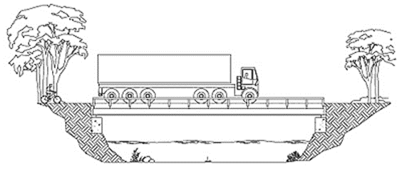
Bridge Camber
When erected and the load applied the member becomes a compression member which is considerably stronger than a bending moment

Slide 144
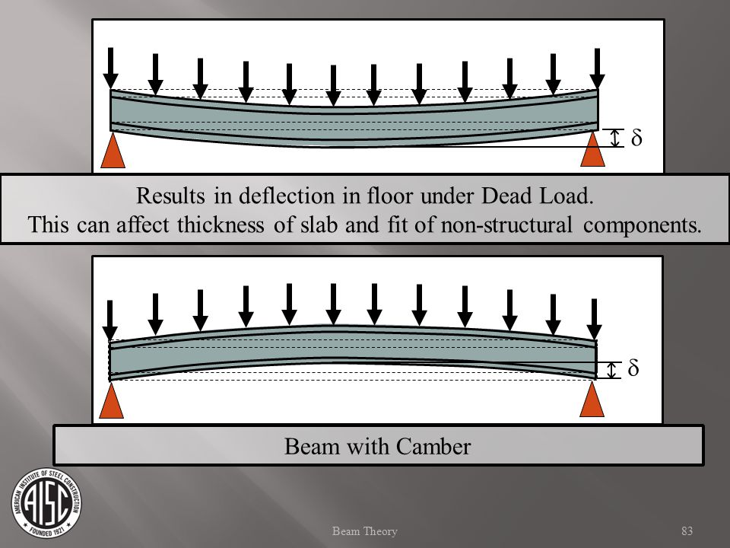
Bridge Camber

Slide 145
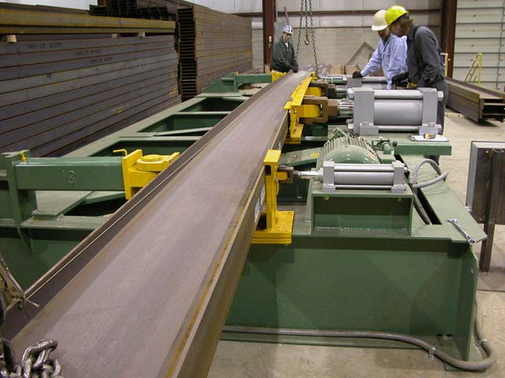
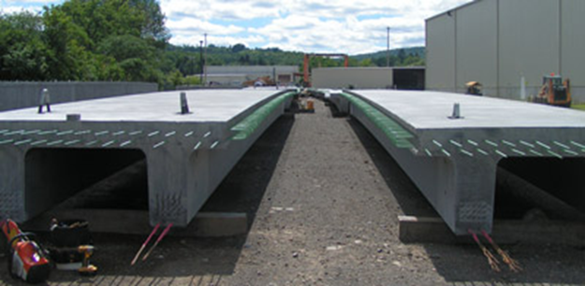
Bridge Camber
Steel
  Fabricated steel span members
Concrete
  Pre-tensioning
  Post-tensioning
See Sheet 12
  Prestressed Girder Notes

Slide 146
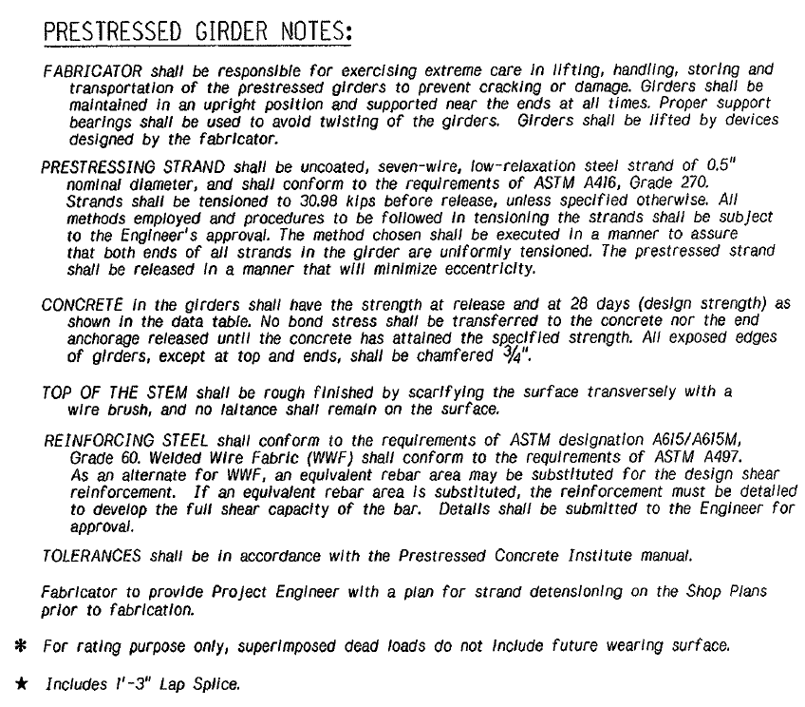
Bridge Camber – Sheet 12

Slide 147
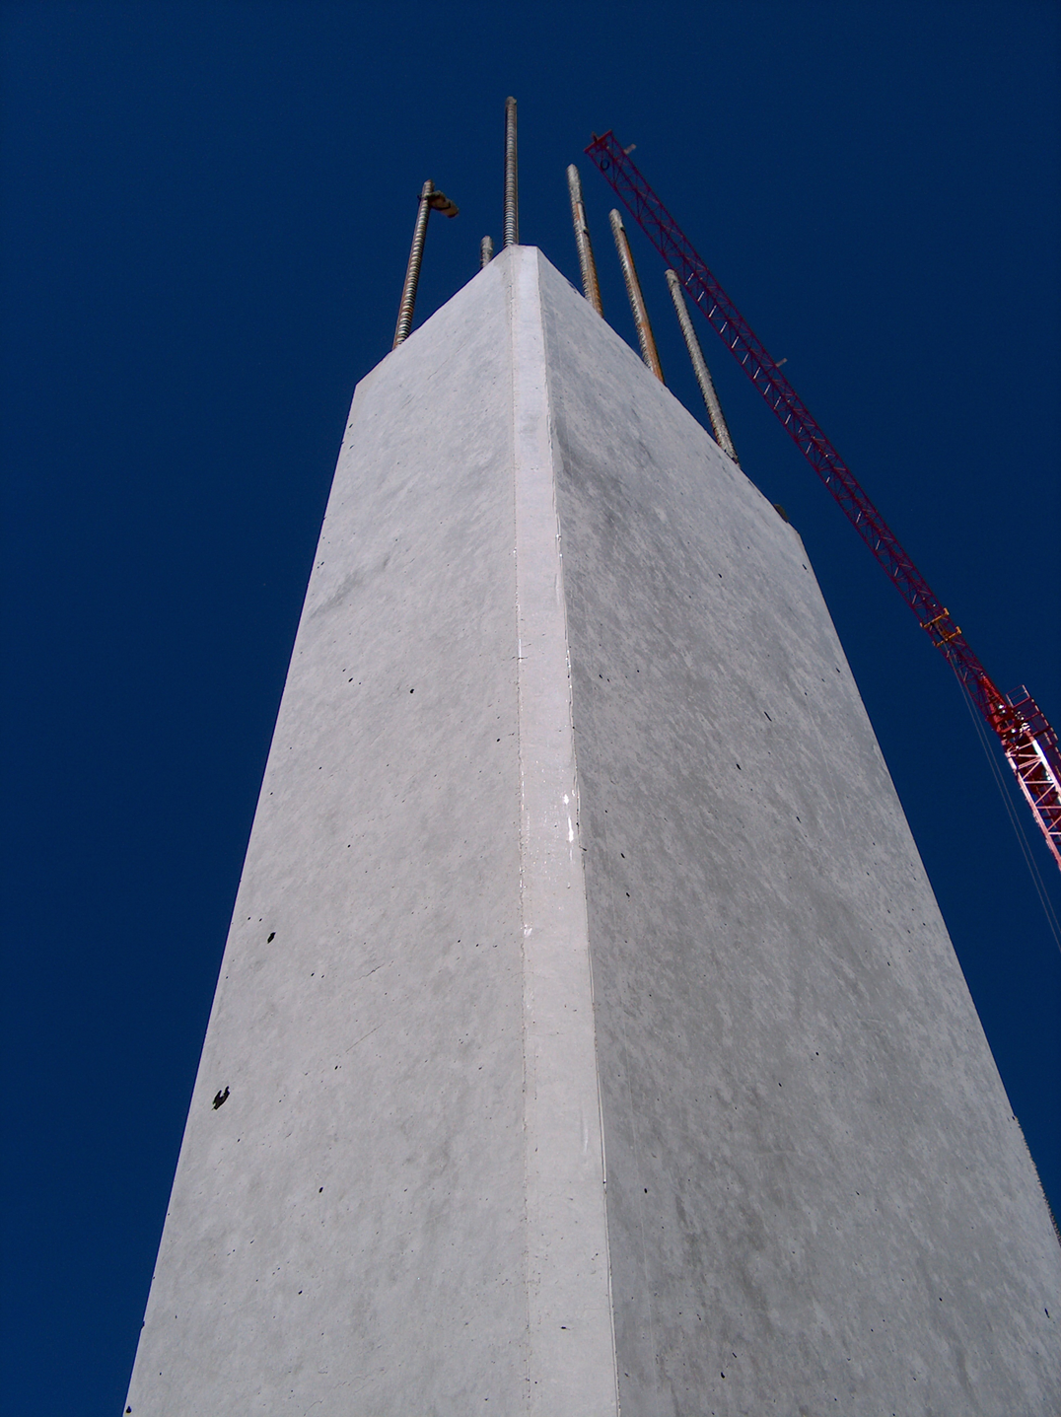
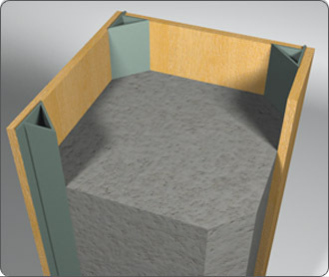

Slide 148
Bridge Approach Grade
Found on the Sectional Elevation view of the Bridge Plans

Slide 149
Bridge Approach Grade
Approach #1
Station = 15+79.28
Elevation = 1147.77
Center Line of Bridge
Station = 18+09.80
Elevation = 1150.73
Approach #2
Station = 20+40.33
Elevation = 1147.33

Slide 150
Radius Points
Plan View – “Geometrics & Grades”

Slide 151
Radius Points
Note #3
Note #6
30 ft. radius
30 ft. radius

Slide 152
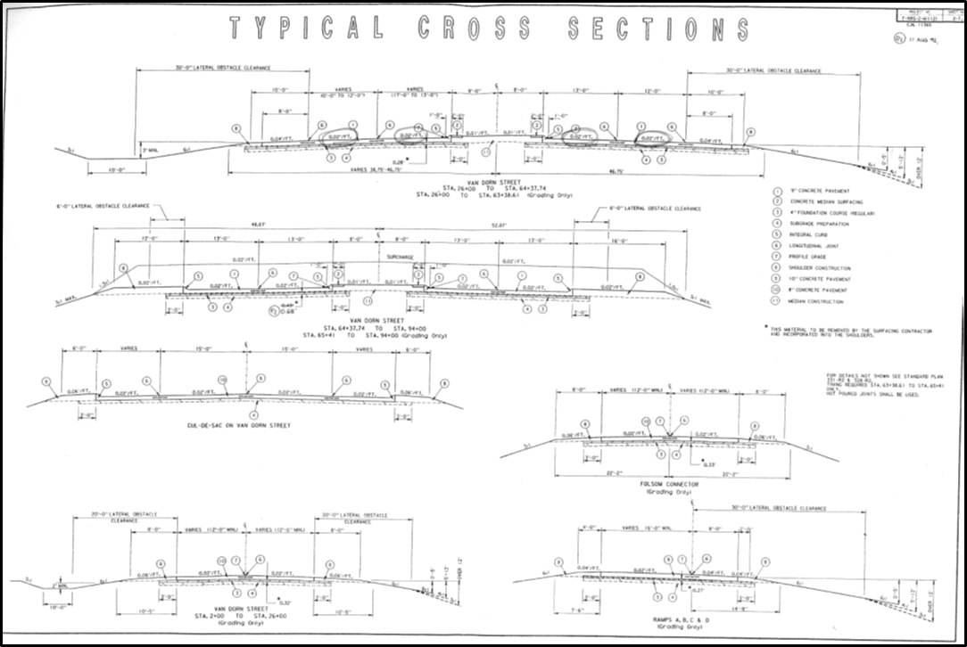
Lane Cross Slope and Minimum Lane Width

Slide 153
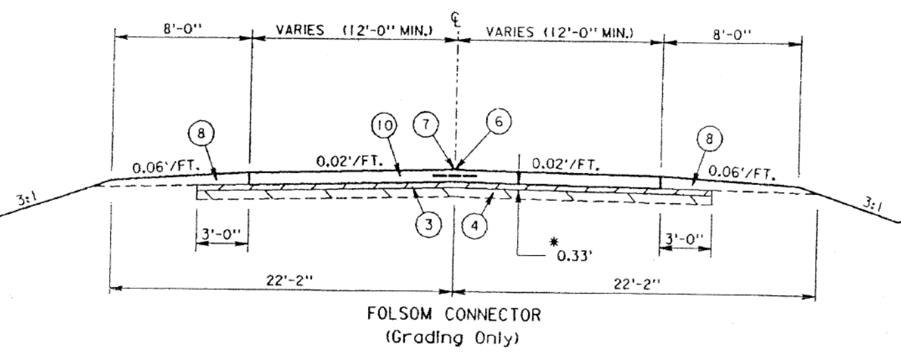
Lane Cross Slope and Minimum Lane Width
Information on Typical Cross Section sheets
  Location, Station, Construction Item

Slide 154
Lane Cross Slopes
Study Guide Page 11
Cross slope is usually expressed as a percentage:
  Cross Slope = Rise/Run X 100%
May also expressed as a decimal fraction of a foot fall (or rise) per foot of run:
  Cross Slope = 0.02’/Foot

Slide 155
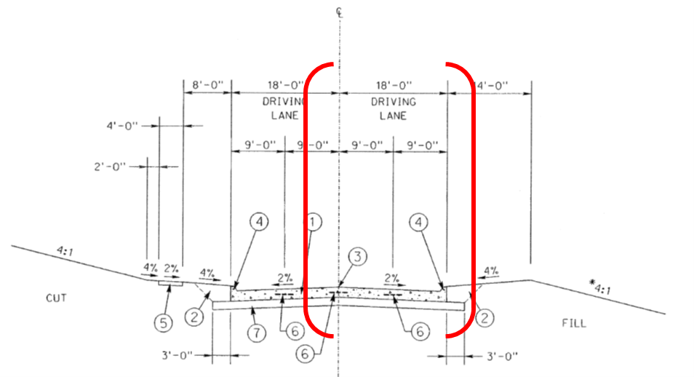
Lane Cross Slope

Slide 156
Lane Cross Slopes
Study Guide Page 11
18 Foot Lane
2% Slope
18 ft. X 2% = 18 ft. X .02
18Ft. X 0.02 = 0.36 ft. or 4.32 inches
The lane slopes 4.32 inches from the centerline to the end of the 18 foot section
The slope can be calculated for the remaining sections in the same manner

Slide 157
Lane Cross Slopes

Slide 158
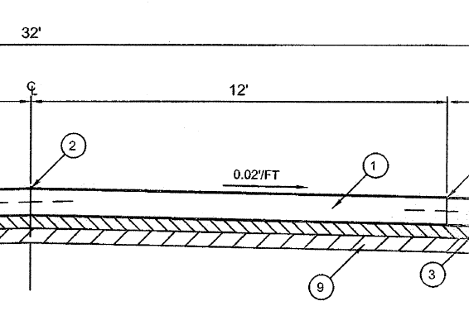
Lane Cross Slopes

Slide 159
Lane Cross Slopes
12 Foot Lane
Cross Slope = 0.02’/ft.
12Ft. X 0.02’/ft. = 0.24ft. or 2.88 inches
The lane slopes 2.88 inches from the centerline to the end of the 12 foot section
The slope can be calculated for the remaining sections in the same manner

Slide 160
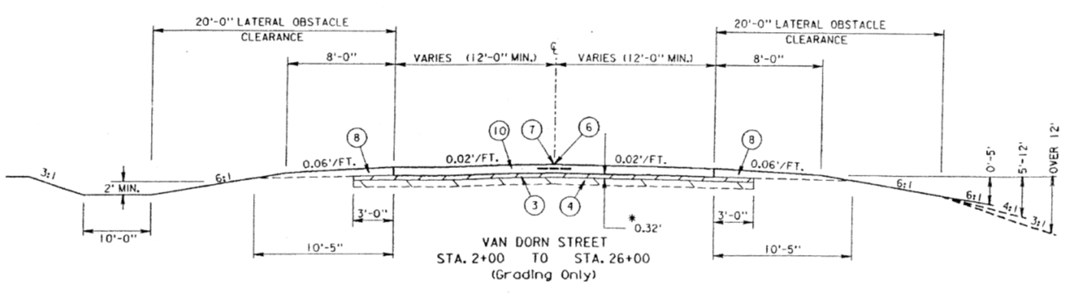


Minimum Lane Widths
Typical Cross Section Sheet

Slide 161

Minimum Lane Widths
Typical Cross Section Sheet

Slide 162
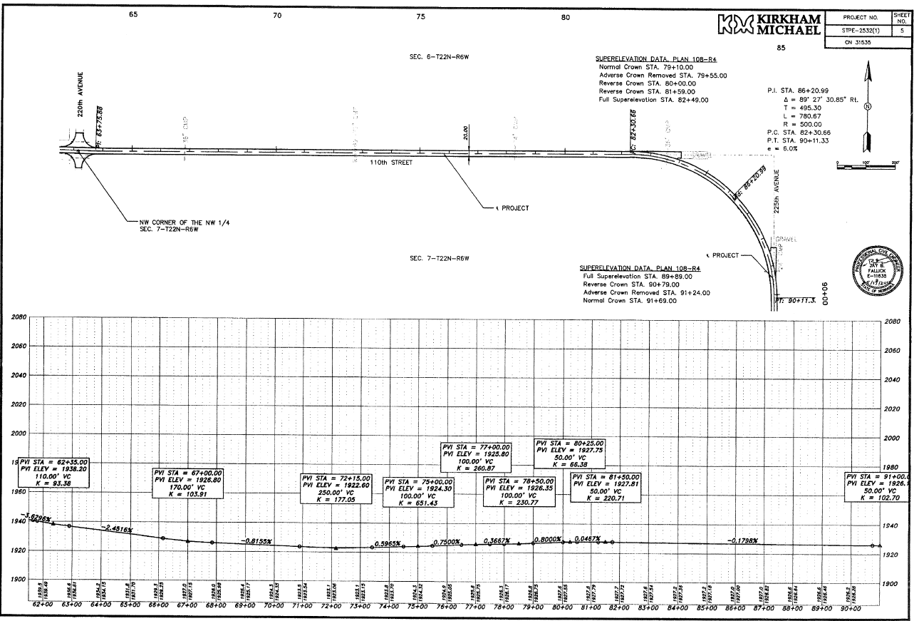
Horizontal Curves
Plan & Profile Sheet

Slide 163
Horizontal Curves

Slide 164
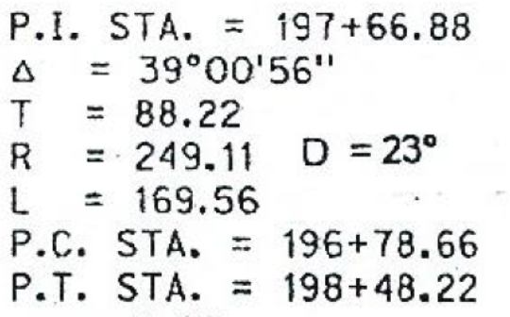

Horizontal Curves
Curve Data
  P. I. Point of Intersection
  ∆ Central Angle
  T Tangent Length
  L Length of Curve
  R Radius
  D Degree of Curve (D = 5729.578 / R)
  P. C. Point of Curvature
  P. T. Point of Tangency
Degree of Curve?
D = 5729.578 ÷ 500 = 11.5◦

Slide 165
Basic Plan Reading
Study Guide Page 11
Become familiar with project construction plans.
Be able to locate specific items on the plans related to the project.
Call in any questions, anytime.
  402-472-5748
Notes:
This ends the Basic Plan Reading Video.
I hope all the Learning Objectives have been met.
Remember to email or call about any questions or comments.
Thank you.
You may know STOP the video.

Slide 166
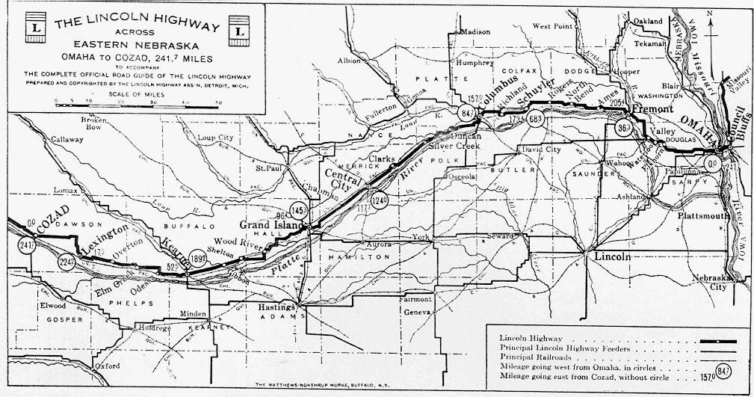
Basic Construction Plan Reading
QUESTIONS?

