Slide 1
Construction Math Review
Megan Patent-Nygren

Slide 2
Learning outcomes
At the end of this class you will be able to identify your ability to
  Understand order of operations
  Perform basic math operations
  Calculate fractions & ratios
  Convert units of measure
  Calculate unit weight
  Perform area and volume calculations

Slide 3
Basic Math CALCULATIONs

Slide 4
Order of Operations
PEMDAS
2 (4 + (2+1)²) = ?
Parentheses
Exponents (4² = 4 x 4) (4³ = 4 x 4 x 4)
Multiplication
Division
Addition
Subtraction
Notes:
Review the order in which mathematical operations must be calculated (PEMDAS is the acronym).
Inside to Outside
What is in the parentheses (innermost)
Then exponents
Then multiply/divide
Then add/subtract

Slide 5
Order of operations
PEMDAS
Work problems from the inside out
For example:
4 + (2+1)² = ?
4 + 3² = 4 + 9 = 13
2 (4 + (2+1)²) = ?
2 (4 + 3²)= 2 (4 + 9) = 2 (13) = 26
Notes:
Work through this example with the class.

Slide 6
Basic Math Operations
Wake up you brain
See
Worksheet #1
Complete problems 1 – 7

Slide 7
Solutions to Worksheet #1
30’ (feet)
24ft + 8ft = 32ft
43 bars
1.94mi
1.32ft
125.4 L
1700 tons
Notes:
Problems 8 – 11 require more experience with translating word problems. Some students will be able to complete these, but make them optionsl. Work through any problems from the worksheet that need review.

Slide 8
Ratio & Fractions

Slide 9
Ratio
… is a numerical comparison between two different things.
  Can be expressed as a fraction, decimal, or %
  Examples
    3 apples to 2 oranges – 3/2 or 1.5
    5 bags cement to 10 gals water – 5/10 or .5 or 50%

Slide 10
Ratio Example
A concrete mix has 67.5lbs of water and 150lbs of cement. What is the water to cement ratio?
67.5lbs/150lbs = .45
How much water will you need to mix with 250lbs of cement?
250lbs x .45 = 112.5lbs
Answer: you’ll need 112.5 lbs of water to mix with 250 lbs of cement.
Notes:
Point out the distinction between “water to cement” and “cement to water” ratios on this & the next slide.

Slide 11
Ratio Example (cont.)
A concrete mix has 67.5lbs of water and 150lbs of cement. What is the cement to water ratio?
150lbs / 67.5lbs = 2.222
How much cement will you need to mix with 112.5 lbs of water?
New amount of cement = 112.5 x 2.22 = 249.97
Answer: you’ll need 250 lbs of cement to mix with 112.5 lbs of water.

Slide 12
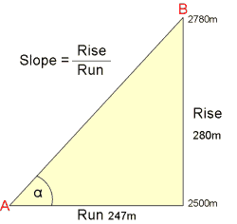
Slope
Slopes are ratios expressed as rise/run
The first or top number is the vertical distance (rise).
The second or bottom number is the horizontal distance (run).
In this example the slope is
280/247
Notes:
Provide a few common examples of slopes in their everyday work.

Slide 13
Slope
“It has been traditional in road building organizations to refer to slope (or grade) a “run over rise”. In other words the first number indicated the length of a slope and the second number indicated the height. When the Department changed to metric in 1992, the metric version of slope was adopted. The Metric version of slope uses “rise over run”. The Departments Metric to English Conversion Committee decided in 1998 to keep this feature of the metric system while returning back to English units. This was done to keep the Departments slope reference more in keeping with today’s accepted standards.”
FL DOT Construction Math
Notes:
Provide a few common examples of slopes in their everyday work.

Slide 14
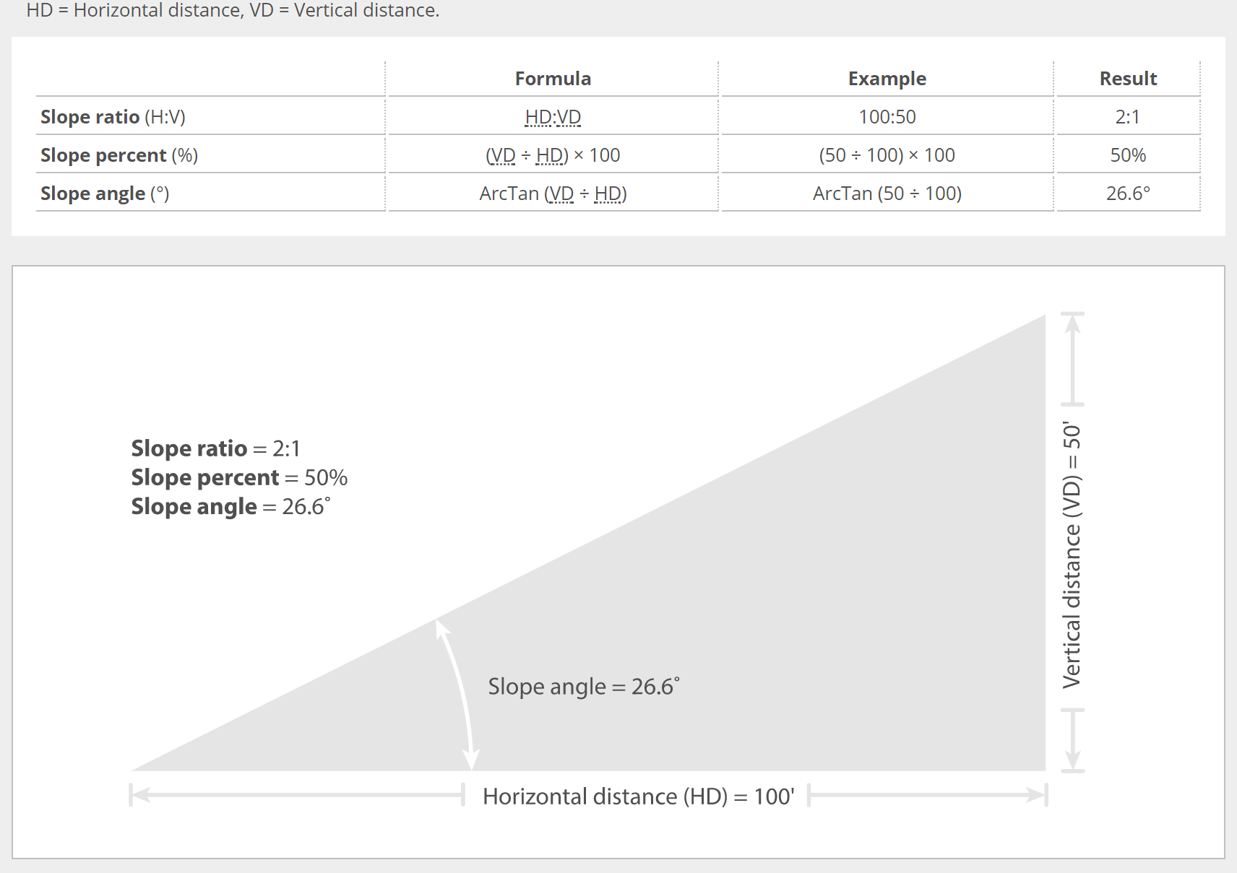
Slope
Notes:
Provide a few common examples of slopes in their everyday work.

Slide 15
Slope Examples run:rise
Run = ? Rise = 65ft slope = 3:1
Run/65ft = 3/1 R = (65ft) x 3 = 195 ft
2. Run = 42 ft Rise = 10.5 ft Slope = ? 42/10.5 = Slope = 4:1
Notes:
Explain that if you are given any 2 of the measurements from the Slope = Run/Rise formula, they can calculate the 3rd measurement or number.

Slide 16
Ratio
Calculation Exercises
See
Worksheet #2
(problems 1 & 2)

Slide 17
Solutions to Worksheet #2
(ratio problems)
1.
Step 1: 23lbs / 100gal (original amounts) = .23 (ratio)
Step 2: New salt? = 500gals x .23 = 115lbs
2.
Step 1: 30lbs (fine) to 60lbs (coarse)
Step 2: 30lbs/60lbs = .50 OR 1lb : 2lbs

Slide 18
Fractions
… represent part or parts of a whole
  Examples ½ ¼ ¾ etc.
  Top number is called the numerator
  Bottom number is the denominator
  Adding or subtracting fractions requires a common denominator (the same number on the bottom)
  Multiplication and division does not require a common denominator (number on the bottom can be different)
  1 2 3 4
  2 4 6 8

Slide 19


Finding the Common Denominator
1/6 + 1/3
Multiples of 6: 6, 12, 18, 24…
Multiples of 3: 3, 6, 9, 12, 15, 18…
What multiples do they share or have in common?
The LEAST or LOWEST Common Denominator
the for the fractions above is 6
Notes:
These images help them see how the amount we are measuring (the slice of pizza) does not change when we slice it into more slices in order to add or subtract with “common denominators”.

Slide 20
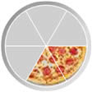

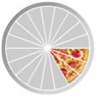
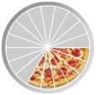
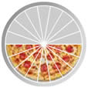
Finding the Common Denominator
1/6 + 2/6 = 3/6
3/18 + 6/18 = 9/18
Notes:
Again, point out how we have to cut each whole (pizza) into the same number of slices before we add or subtract. However, the slice of pizza (size) does not change when we do this.

Slide 21
Fraction examples
Addition example
  1/2 + 1/4
Step 1: create common denominator
2 · 1 1 2 1
2 · 2 4 4 4
Step 2: add numerators
2 1
4
3
4

Slide 22
Fraction examples
Subtraction example
  1/2 - 1/4
Step 1: create common denominator
2 · 1 1 2 1
2 · 2 4 4 4
Step 2: add numerators
2 1
4
1
4

Slide 23
Fraction examples
Multiplication example
3/16 x 1/3
Step 1: multiply numerators & denominators
3 1 3 x 1 3
16 3 16 x 3 48
Step 2: reduce fraction if possible
3
48
1
16

Slide 24
Fraction examples
Division example
1/8 ÷ 3/16
Step 1: invert or “flip” divisor (2nd fraction) & multiply
1 3 1 16
8 16 8 3
Step 2: reduce fraction if possible
16
24
2
3

Slide 25
Fraction
Calculation Exercises
See
Worksheet #2
(problems 3 - 6)

Slide 26
Solutions to Worksheet #2
(fractions)
3. 1/2 + 1/3 = 3/6 + 2/6 = (3 + 2) / 6
= 5/6 of a drum
4. 3/8lbs – 1/4lbs = 3/8lbs – 2/8 lbs = 1/8lbs, remove 1/8lbs aggregate
5. 1/3(sheet/diaphragm) x 6(diaphragms) = 1/3 x 6/1
= 6/3 = 2 sheets of plywood
7/8 ton ÷ 1/16 ton
7/8 ton x 16/1 ton = 14

Slide 27
conversions

Slide 28
Conversions
Math measurement operations have to be in same units of measurement
  (length to length)-(area to area)-(volume to volume)
Conversions differ between units
(12 inches to 1 foot)-(27 cubic feet to 1 cubic yard)-(1 inch to .08 of decimal foot)
Multiplication or division?
  If you are going to a smaller unit, multiply
    (Cubic Yards to Cubic Feet, multiply # yards by 27)
  If you are going to a bigger unit, divide
    (inches to feet, divide #inches by 12)

Slide 29

Linear Measurement
Feet to Inches
3 feet = ? Inches
48 inches = ? Feet
36
# feet x 12
4
# inches ÷ 12
Notes:
These next 3 slides help them visualize and understand unites (linear, squared, cubed) as we move into geometry calculations (area, volume).

Slide 30
Area or 2-Dimensional in² or square inches
1 foot
1 foot
1 in x 1 in

Slide 31
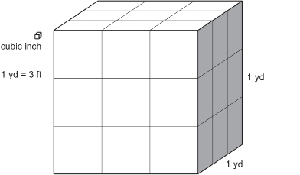
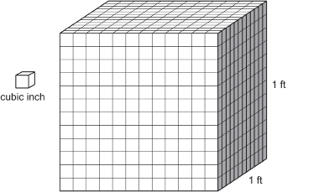
Volume or 3-Dimensional in³ or cubic inches

Slide 32
Converting Fractions to Decimals
½ same as 1 ÷ 2 same as .50
so write 1 ½ as 1.50
1/5 same as 1 ÷ 5 same as .20
write 2 1/5 as 2.20
7/16 = 7 ÷ 16 = .4375
write 5 7/16 as 5.4375
Notes:
Make sure they understand these conversions before moving on.

Slide 33
Conversion Examples
There is a bridge abutment form that is 4ft thick 4ft tall and 60ft wide. How many cubic yards will it take to fill it?
27ft³ = 1yd³ (conversion)
3 feet in each yard, 3ft x 3ft x 3ft
Step 1: 4ft x 4ft x 60ft = 960ft³
Step 2: 960ft³/27ft³ = 35.56yd³
Notes:
They first need to calculate the volume by multiplying length x width x height. Because the original units are in feet, they will need to convert to cubic yards. Show them where the 27ft³ = 1yd³ conversion comes from (3ft x 3ft x 3ft). It is important that they understand linear, squared, and cubed units of measurement.

Slide 34
Conversion
Calculation Exercises
See
Worksheet #3
(problem 1 )

Slide 35
Solutions to Worksheet #3
Conversion Problems
Step 1: 2in/12in = .167ft (converting 2 inches to feet)
Step 2: 4miles x 5280ft = 21,120ft (mile to feet)
Step 3: .167ft x 21,120ft x 24ft = 84,648.96ft³
Step 4: 84,648.96ft³/27ft³ = 3,135.15yd³

Slide 36
Unit Weight
Weight per unit of volume
  Pound per cubic foot (pcf)
  Ton per cubic yard
  Pound per gallon

Slide 37
Unit Weight Example
Water is 8.3lbs/gallon. You are batching concrete and you need 500lbs of water. How many gallons of water do you need?
500lbs ÷ 8.3lbs/gallon = 60.24 gallons

Slide 38
Unit Weight
Calculation Exercises
See
Worksheet #3
(problems 2 & 3)
*Provide answers in pounds and tons

Slide 39
Solution to Worksheet #3
Unit Weight Problems
2. 4000lbs x 2.2 yd³ = 8800lbs or 4.4 tons
3. 95lbs x 240ft³ = 22,800lbs or 11.4 tons

Slide 40
What about Word Problems?
Translating a question or request into an equation

Slide 41
Solving Word Problems
Read problem entirely & draw diagrams
List variables, the “things” or “stuff” they are talking about
Write down the unknown, what do they want to know? What unit of measure?
Estimate answer
Identify “key” words
Write equation that mirrors problem

Slide 42
Key words for
Mathematical Operations
Addition | Increased by, more than, combine, total of, sum, added to, plus
Subtraction | Difference, decreased by, less than, fewer than, take away, how many left
Multiplication | Product of, times, of, factor of, double, triple
Division | Quotient, divided by, ratio of, per, out of, percent
Equals | Is/are, was/were, will be, gives, yields, sold for, would you have
Warning: “less than” in a word problem can be confusing. Saying “she makes $2 less than Jim (or X)” does not translate mathematically into $2 – X. Think about it. If she makes $2 less than Jim, and Jim makes $10, then
She makes $10 - $2 = $8 or X - $2

Slide 43
Let’s solve one together
There are 12 students in the classroom. I need to break the students into 3 groups and then provide 5 word problems for each group to solve. How many students will I have in each group and how many word problems will I need to distribute?
Notes:
THINK ALOUD MODELING: read the problem aloud, verbalizing thoughts and questions. “Talk” through the word problem out loud.
For example (after reading the entire problem out loud): “Ok, I have 12 students, so I’m going to circle 12 in the sentence and write 12 students down below as one of the ‘things’ or variables in the problem. Then I see that I need to break the students into 3 groups. I’ll circle 3 groups and add that to my list of variables.” etc. Until you have talked all the way through the problem, carefully modelling the step on slide 41.

Slide 44
Word Problem Exercises
See
Word Problem
Worksheet
Notes:
THINK ALOUD MODELING: read the problem aloud, verbalizing thoughts and questions. “Talk” through the word problem out loud.
For example (after reading the entire problem out loud): “Ok, I have 12 students, so I’m going to circle 12 in the sentence and write 12 students down below as one of the ‘things’ or variables in the problem. Then I see that I need to break the students into 3 groups. I’ll circle 3 groups and add that to my list of variables.” etc. Until you have talked all the way through the problem, carefully modelling the step on slide 41.

Slide 45
Advanced calculations

Slide 46
Advanced Calculations
  Average
  Perimeter
  Circumference
  Area
  Volume

Slide 47
Average
The sum of all the numbers you’re averaging
Average =
The number of numbers you’re averaging
Example: What is the average foot size for a group of men who wear the following shoe sizes?
10, 11, 10, 12, 14
Average shoe size= 10 + 11 + 10 + 12 + 14 = 57 = 11.4
5 (5 shoe sizes) 5
Notes:
To make sure they understand this calculation, ask them how or if this average would change if we had one more man with a size “0” foot?

Slide 48
Average Calculation Examples
See
Worksheet #4
(complete all)

Slide 49
Solutions to Worksheet #4
  35.29 ft
  76.38ft
  11ft

Slide 50
Perimeter
… is the linear distance around an object
  One dimensional quantity
  Length unit of measure
  Side A+Side B+Side C+Side… until all of the sides are added together

Slide 51
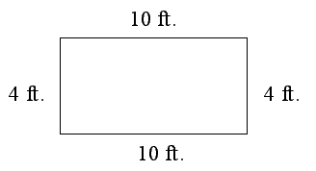
Perimeter
Example: What is the perimeter of this rectangle?
4ft + 4ft + 10ft + 10ft = 28ft
Answer: the perimeter of the rectangle is 28 feet

Slide 52
Perimeter Calculation Examples
See
Worksheet #5

Slide 53
Solutions for Worksheet #5
3ft + 4ft + 5ft + 6ft = 18ft.
3in + 4in + 5in = 12in

Slide 54
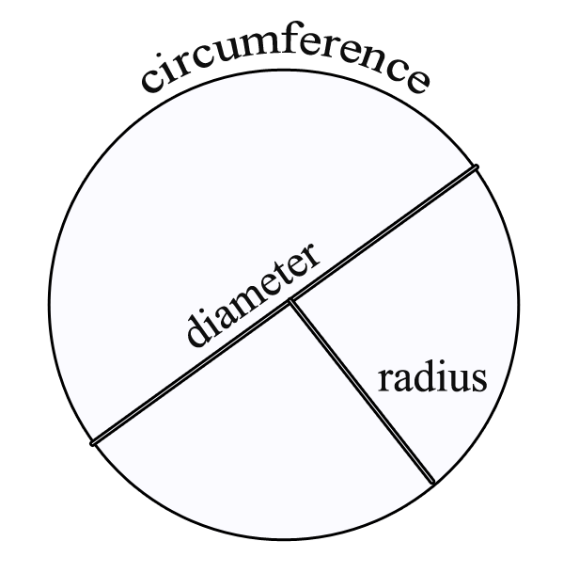
Circumference
… is the linear distance around a circle
π x diameter (πd)
or
2 x π x radius (2πr)
π = 3.14
(the symbol π is on your calculator)

Slide 55
Circumference Example
A manhole has a diameter of 48 inches. What is the circumference?
Step 1. π x 48
Step 2. 3.14 x 48in = 150.72 inches
Answer: the circumference of the circle is 150.72 inches

Slide 56
Circumference Calculation Examples
See
Worksheet #6

Slide 57
Solutions to Worksheet #6
(circumference)
1. 2 x 3.14 x 4.5in = 28.26in
2. 3.14 x 18in = 56.52in

Slide 58
Area

Slide 59
Area
… is the amount of space inside the boundary of a flat (2-dimensional) object
Examples of 2-dimensional objects:
  sheet of paper
  disk
  sheet of drywall

Slide 60
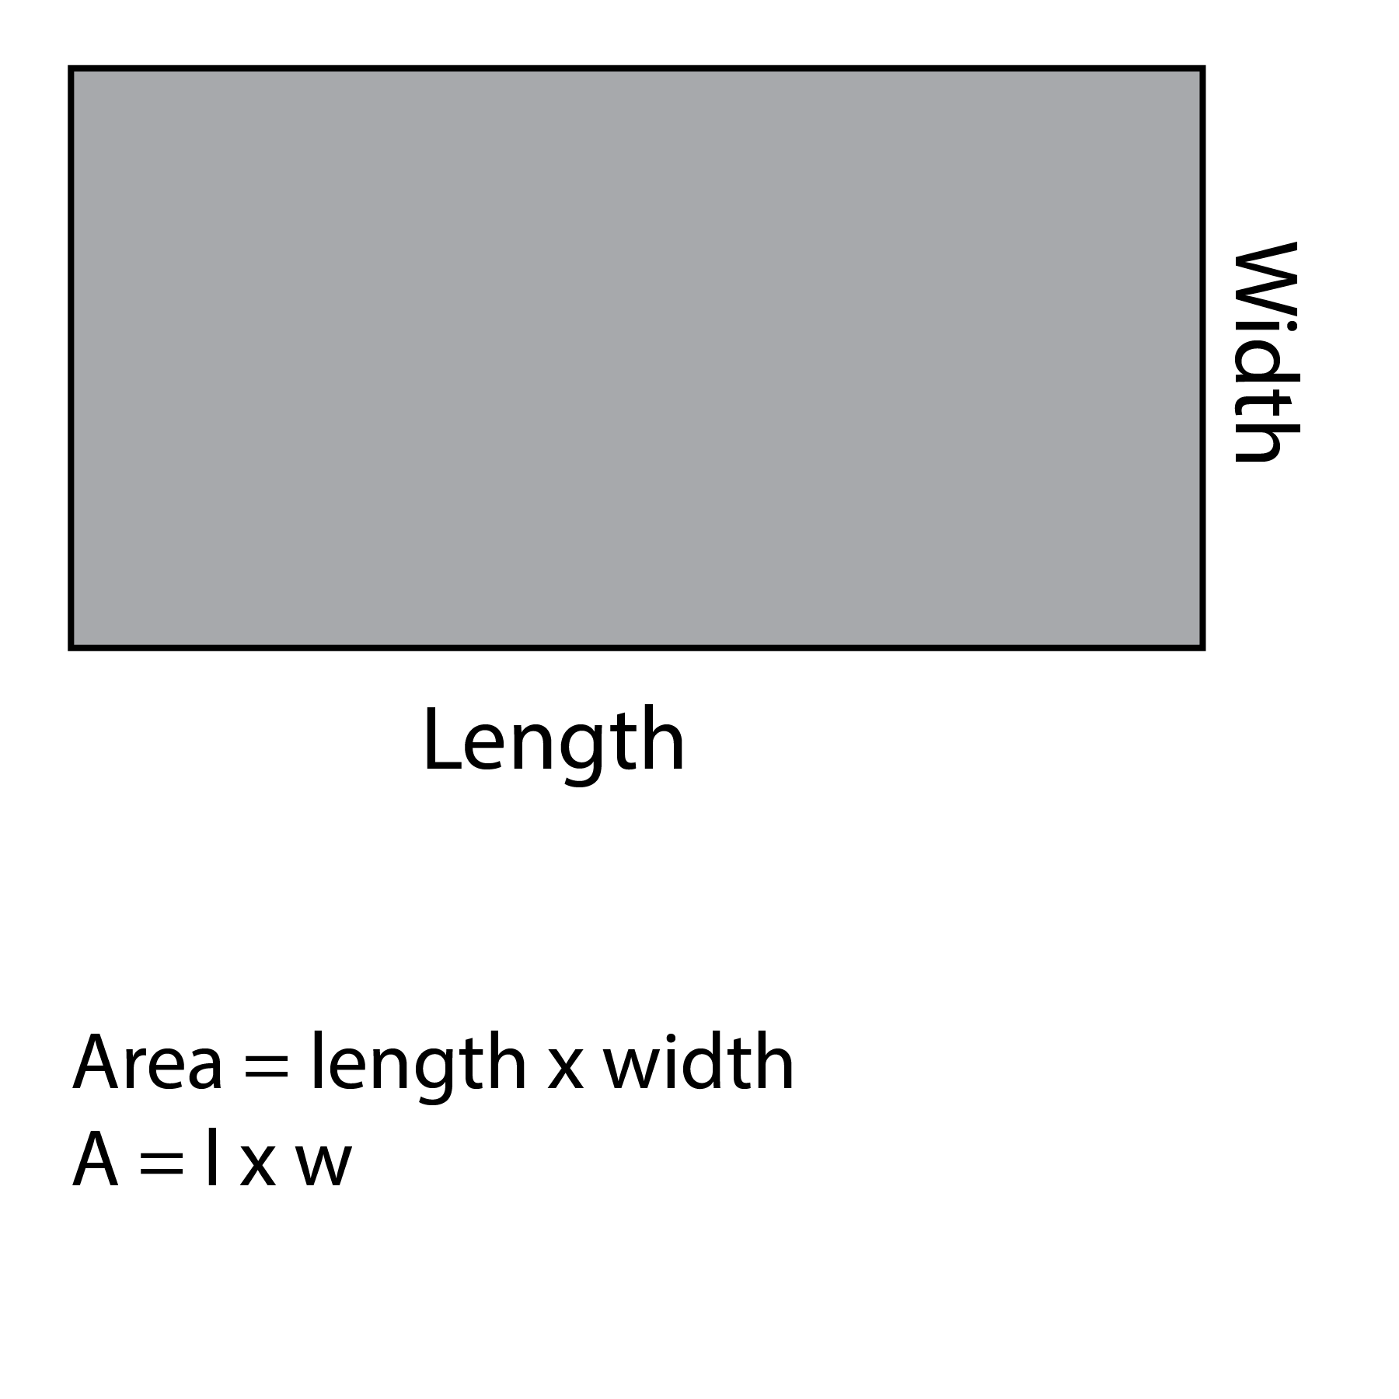
Area of Squares and Rectangles

Slide 61
Area of a Rectangle Example
Find the area of a driveway that is 18 feet wide, 32 feet long.
A = L x W
A = 32ft x 18ft = 576ft²
Area of the driveway is 576 square feet

Slide 62
Area of Rectangle
Calculation Examples
See
Worksheet #7
(Problems 1 & 2)
Notes:
You might want to give them a hint for #2 – cut that shape into 2 rectangles, then solve for each and add.

Slide 63
Solution to Worksheet #7
1. 4yd x 7yd = 28 yd²
2. This is a 3-step problem. Separate the shape into 2 rectangles, then solve.
  Step 1: (Area of 1st rectangle) 7ft x 11ft = 77ft²
  Step 2: (Area of 2nd rectangle) 3ft x 5ft = 15ft²
  Step 3: (Add the 2 Areas together)
  77ft² + 15ft² = 92ft²

Slide 64
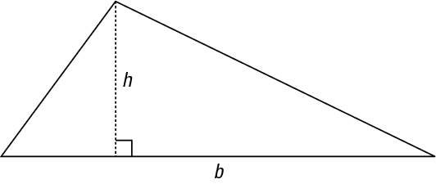
Area of a Triangle
  … is ½ Base (b) x Height (h)
  ½ bh
  (The height is perpendicular to the base)
Notes:
Spend the time to ensure that they understand how to locate the base and height of any triangle.

Slide 65
Triangle Area Example
Find the area of a triangle to the nearest tenth of a square foot whose base (b) is 4.0 feet and whose height (h) is 10 feet.
Area = ½ bh
(½ x 4.0ft) x 10ft = 20.0ft²
Answer: The area of the triangle is 20 square feet.

Slide 66
Area of Triangle
Calculation Examples
See
Worksheet #7
(Problems 3 & 4)

Slide 67
Solutions to Worksheet #7
(area of triangles)
A = ½ bh
3. ½ x 124.0ft x 93.5ft = 5797.0ft²
4. ½ x 75ft x 60ft = 2250ft²

Slide 68
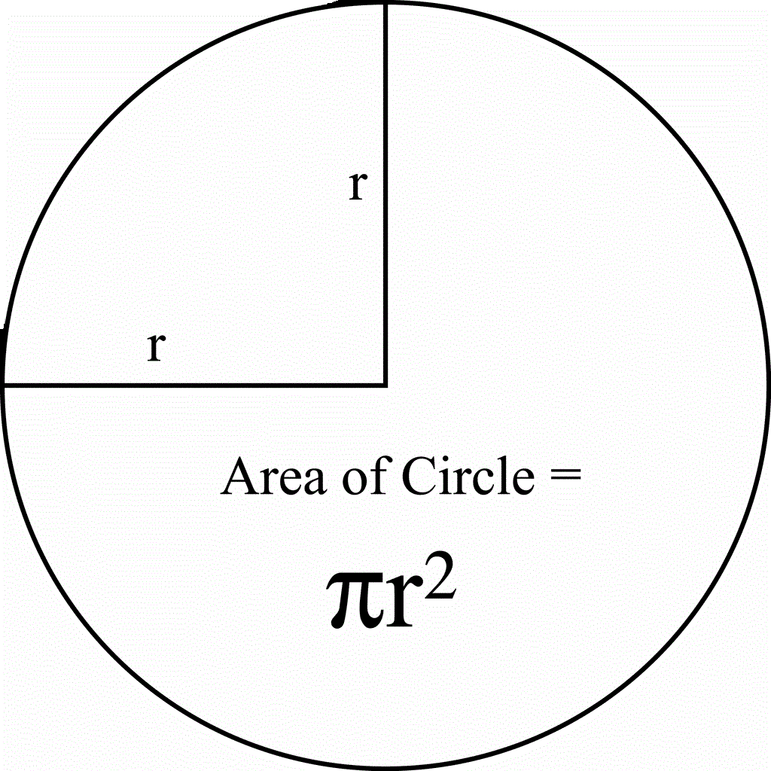
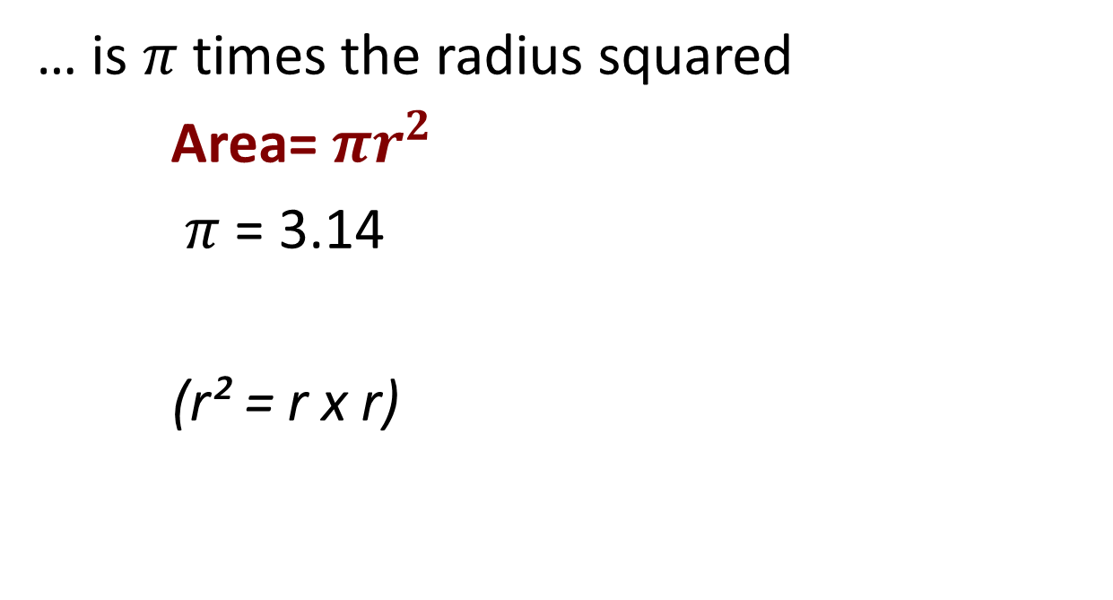
Area of a Circle
… is $π$ times the radius squared
Area=$πr^{2}$
$π$ = 3.14
(r² = r x r)
Notes:
Clearly distinguish the difference between radius and diameter. Radius: “radiates” out from the center of the circle.

Slide 69
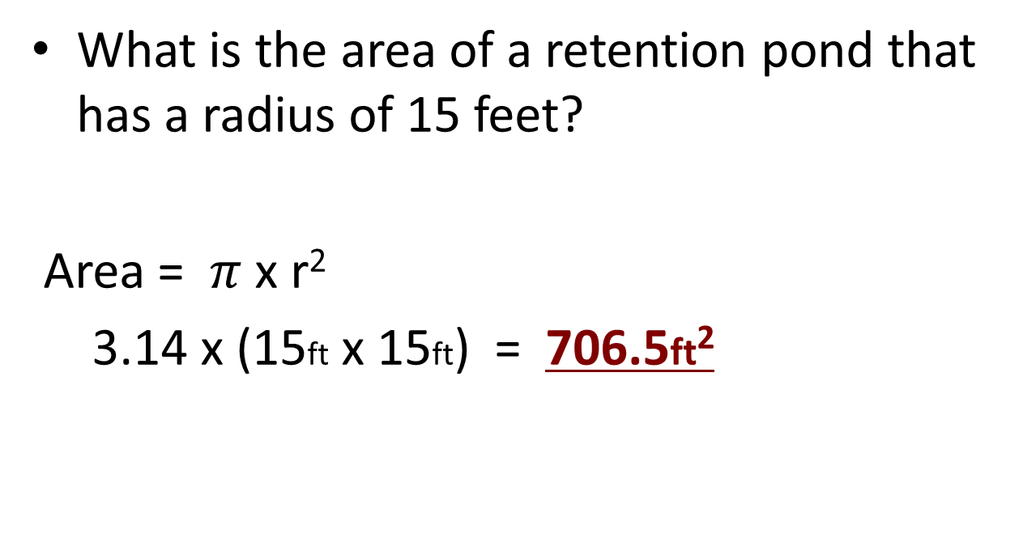
Area of a Circle Example
What is the area of a retention pond that has a radius of 15 feet?
Area = $π$x r²
3.14 x (15ft x 15ft) = 706.5ft²

Slide 70
Area of Circle
Calculation Examples
See
Worksheet #7
(problems 5 & 6)

Slide 71
Solutions to Worksheet #7
(area of a circle problems)
3.14 x (250ft x 250ft) = 196,250ft²
^{or (196,350 ft²)}
3.14 x (7ft x 7ft) = 153.86ft²
^{or (153.94 ft²)}

Slide 72
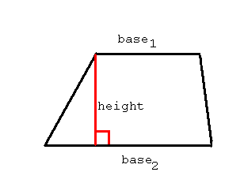
Area of a Trapezoid
…is ½ the sum of the 2 bases x height
A = ½ (b₁+b₂) x h

Slide 73
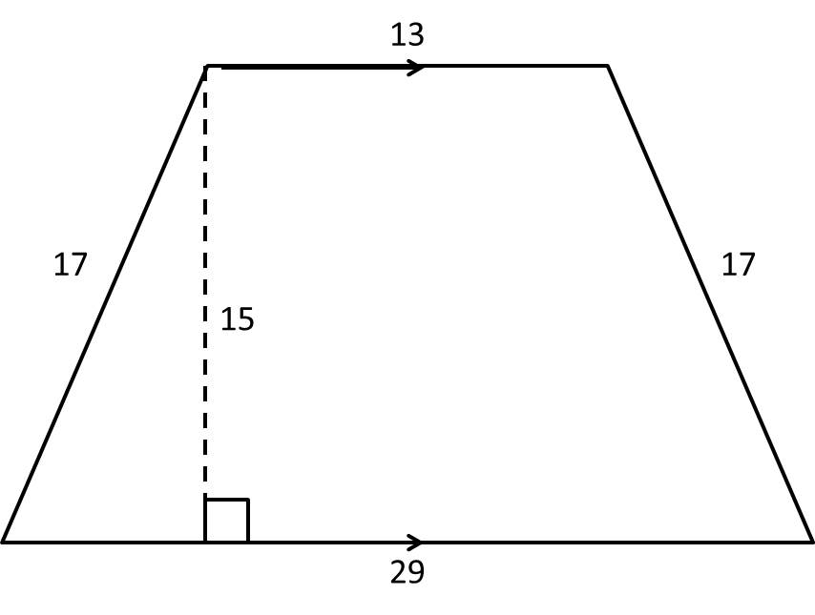
Area of a Trapezoid Example
Find the area of the trapezoid below
A = ½ (b₁+b₂) x h
A= ½ (29ft + 13ft) x 15ft = 315ft²
A = ½ (42ft) x 15ft
A = 21ft x 15ft = 315ft²

Slide 74
Area of Trapezoid
Calculation Examples
See
Worksheet #7
(problems 7 & 8)

Slide 75
Solutions to Worksheet #7
(area of a trapezoid)
A = ½ (b₁+b₂) x h
7. ½ (3ft + 6ft) x 4ft = 18ft²
8. ½ (10ft + 24ft) x 7ft = 119ft²

Slide 76
Volume
Notes:
You probably won’t have time to get to this section in a half-day class.

Slide 77
Volume
… is the amount of 3-dimensional space an object occupies
Or, in other words
…it’s the amount of space inside a 3-dimensional object like a box, a ball, a room, etc.

Slide 78
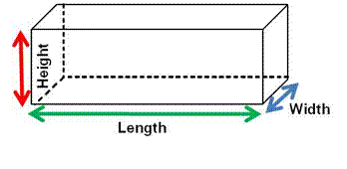
Volume of a Rectangular Prism
Volume = Length (L) x Width (W) x Height (H)

Slide 79
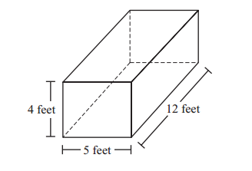
Volume of a Rectangular Prism (box) Example
V = L x W x H
12ft x 5ft x 4ft = 240ft³

Slide 80
Volume of a Rectangular Prism
Calculation Examples
See
Worksheet #8
(problems 1 & 2)

Slide 81
Solutions to Worksheet #8 volume of a rectangular prism
V = L x W x H
1. 14in x 19in x 11in = 2,926in³
2. 65ft x 6ft x 8ft = 3120ft³

Slide 82
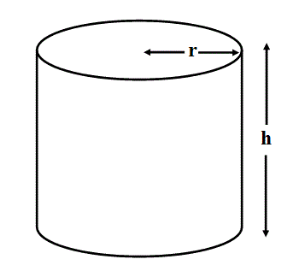
Volume of a Cylinder
Volume= πr² x Height (h)

Slide 83
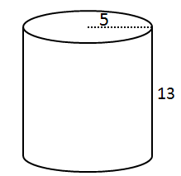
Volume of a Cylinder Example
Volume= πr² x h
Step 1: V = π5² x 13
Step 2: V = (3.14 x 25) x 13
Step 3: V = 1,020.5 ft³

Slide 84
Volume of a Cylinder
Calculation Examples
See
Worksheet #8
(problems 3 & 4)

Slide 85
Solutions to Worksheet #8
(volume of a cylinder problem)
3. (3.14 x 4.9ft²) x 7.8ft = 588.05ft³
4. (3.14 x 12in²) x 34in = 15,373.44in³

Slide 86
More Resources
NE-LTAP
https://www.khanacademy.org/math
NHI

Slide 87

Course Evaluation
Click on the link in your email, complete
the paper version, or visit: https://go.unl.edu/dd53

