Slide 1



Managing Nebraska’s Roads and Streets
One and Six Year Plans
Budgeting, Accounting, & Inventory Systems
Required Annual Certification to NBCS
Notes:
8-25-2023 MD Revised presentation to recombine one and six with budgeting accounting and inventory and added another section to stress the required annual certification. Shuffled around some slides to make the presentation flow better and to stress the annual cert.

Slide 2
Managing Nebraska’s Roads and Streets
One and Six Year Plans
for Highways, Roads and Streets
Statutes Chapter 39 Article 21
Notes:
Revised 8-24-2023, Separated OneAndSix from budget, accounting and inventory – MD
LTAP Course on One- and Six-Year Planning
Updated 7/29/2019. Deleted 12 slides. 9, 10 and 12-22.
PIVQ3 The main purpose of OneAndSix planning is: to promote the orderly development of an integrated system of public roads for the state, counties and municipalities. See 39-2101
176 minutes (2 hours, 56 minutes) THIS WILL BE SIGNIFICANTLY REDUCED BASED ON 7/29/2019 CHANGES.

Slide 3
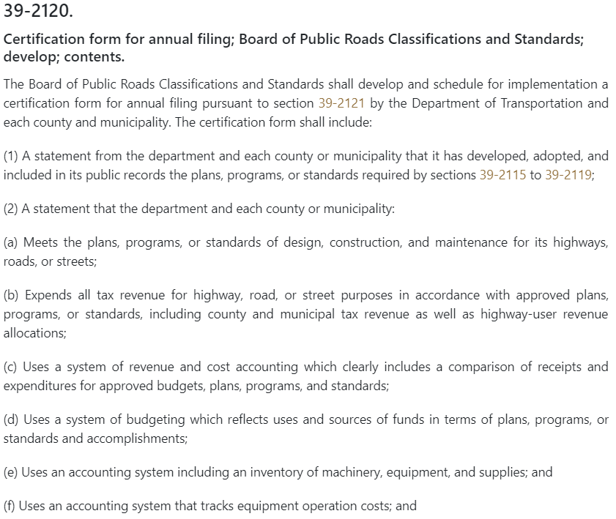

§39-2120
Certification of Program Compliance
Notes:
10/13/2021 added web link to 39-2120
8/13/2019 Updated statute per LB82
THE OLD NBCS FORM 6 WAS THE CERTIFICATION BUT THAT HAS GONE AWAY.
THIS NEW CERTIFICATION FORM IS SIMILAR BUT NOT EXACTLY THE SAME. HAND OUT THE CERTIFICATION FORM TO THE CLASS.
PIQ28 The annual certification is the ONLY annual submittal to the NBCS
The Certification provides evidence that your jurisdiction complied with the law.
The Legislature is still interested in good management of highway, road and street departments!
Need to read each line carefully to see what your jurisdiction is certifying!
(b) Includes local option sales tax, HAF and any other tax revenues dedicated to Highways, Roads and Streets
Uses vs. An Approved
Comparison of receipts to expenditures
The 2019 Legislature passed a bill called LB82 that requires an annual Certification from the Nebraska DOT, and from each county and municipality, that its highway, road or street program has complied with the conditions set forth in 39-2120.
The certification form will be mailed to County Clerks, City Clerks and Village Clerks each year, to be signed and returned to the Nebraska Board of Public Roads Classifications and Standards by October 31. It must be accompanied by a resolution authorizing the signatures on the certification.
Failing to submit this Certification form by its due date will result in the suspension of monthly Highway Allocation Fund distributions to the political jurisdiction. The money is held in escrow. If the county or municipality complies within six months, it will receive the money in the escrow account. If not, the county or municipality loses the money.
Filing a materially false certification form, or constructing any highway, road or street below NBCS minimum standards without prior approval will result in a reduction of ten percent of the county’s or municipality’s share of highway-user revenue allocated during the following calendar year. The penalty is assessed only after NBCS reviews the facts and holds a public hearing on the matter.

Slide 4
One And Six Year Planning
Overall Purpose
To Promote the Orderly Development of an Integrated System of Public Roads
Importance
§39-2101 , §39-2115
Notes:
5/22/2021 Updated slide by adding “Important.”
2 min
Part of the checks and balances set up by the Legislature
PIVQ3 The importance of OneAndSix planning is good management and transparency. It’s what the Legislature expressed in 39-2101.

Slide 5
Why Does My City or County Have To Do One and Six Year Planning?
Good Program Management Tool
Transparency: disclosure to, and getting input from, the public
It’s the law! §39-2115, §39-2119
  Penalized if not done
Why the Need to Do This?
Notes:
7/1/2021 Updated slide to clarify further why it is important to do OneAndSix Planning
5/22/2021 Updated slide by adding “Important.”
2 min
Part of the checks and balances set up by the Legislature
PIVQ3 The importance of OneAndSix planning is good management and transparency. It’s what the Legislature expressed in 39-2101.

Slide 6
Why Transparency?
Trust in Government
Compare spending to accomplishments
Good management
Certify that the law has been followed
Why?
Notes:
2 min
LB82 did not eliminate these values and principles

Slide 7
Benefits of OneAndSix Planning
Applies public funds where most needed
Provides evidence of addressing safety issues
Is a means of measuring performance
Promotes cooperation with other political jurisdictions
  Taking advantage of opportunities such as partnering with neighboring jurisdictions, economic development, nearby asphalt plant available, etc.
Benefits of OneAndSix
Notes:
7/1/2021 Updated slide to clarify that these are “Benefits” derived by doing OneAndSix Planning.
8/13/2019 Updated – added bullets “Cooperate with other jurisdictions” and “Take advantage of opportunities”
2 min
39-2101

Slide 8
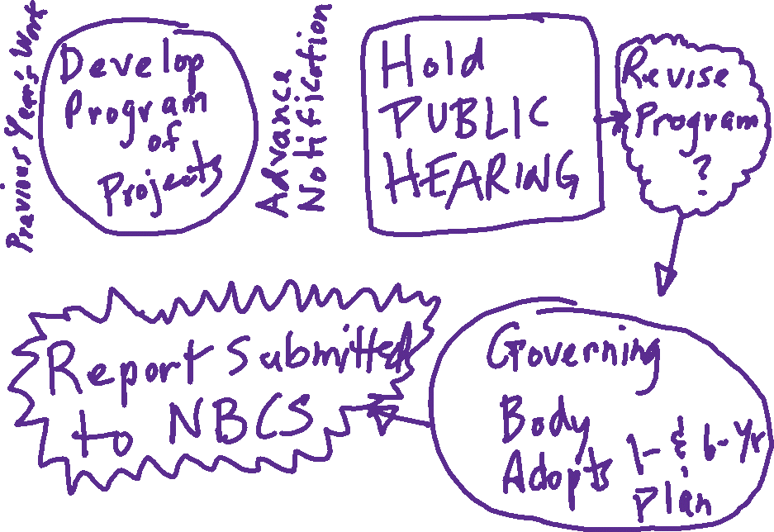


Slide 8
Notes:
PI-Q1, P1-Q8, PIVQ3
Public Hearing for One Year Plan is required by 39-2119

Slide 9
Selecting Projects - Considerations
Previous One- and Six-Year Plan
Condition of assets - preservation
Safety – crash history, trends, “hot” spots
Traffic volumes – trends, development/growth
Hierarchy – classification, school routes, bus routes
Coordination – other works and projects
Public demand – citizens, elected officials
Cost – of works/projects; material availability
Funding availability – inflation (YOE)
Slide 9
Notes:
4/19/2021 Updated – deleted the sidebar referring to 428 NAC 3 since it is no longer used.
Factors to consider which would help you as a superintendent select works/projects for your One- and Six-Year Plan

Slide 10
Public Hearings for County Plan or Program
Commissioner-Type, or Township-Type Having Adopted a County Road Unit System
Required to adopt annual plan or program no later than March 1 each year. (Doesn’t say when during the year!)
Must be within the limits of estimated funds available for next 12 months.
§39-1503
Slide 10
Notes:
10/13/2021 added web link
4/19/2021 Added slide per 4/18/2021 phone conversation with LeMoyne Schulz.
PIQ30
39-1503.
Highway superintendent or road unit system counties; county boards; duties.
It shall be the duty of the county board in commissioner-type counties having a county highway superintendent and in township-type counties having adopted a county road unit system to:
(1) Give notice to the public of the date set for public hearings upon the proposed county highway program of the county highway superintendent for the forthcoming year by publication once a week for three consecutive weeks in a legal newspaper published in the county or, if none is published in the county, in a legal newspaper of general circulation in the county. The notice shall clearly state the purpose, time, and place of such public hearings;
(2) Adopt a county highway annual program no later than March 1 of each year which shall include a schedule of construction, repair, and maintenance projects and the order of priority of such projects to be undertaken and carried out by the county and a list of equipment to be purchased and the priority of such purchases, within the limits of the estimated funds available during the next twelve months;
(3) Adopt standards to be applied in road and bridge repair, maintenance, and construction;
(4) Advertise for and take and let bids for all or any portion of the county road work when letting bids, except that when the Department of Transportation takes bids on behalf of the county, the county shall have authority to permit such bids to be taken and let at the offices of the department in Lincoln, Nebraska; and
(5) Cause investigations, studies, and inspections to be made, hold public hearings, and do all other things necessary to carry out the duties imposed upon it by law.
Source
Laws 1957, c. 155, art. II, § 3, p. 514;
Laws 1969, c. 333, § 3, p. 1190;
Laws 1986, LB 960, § 28;
Laws 2017, LB339, § 140.

Slide 11

Example – NDOT’s Program
Example One- and Six-Year Plan
Notes:
10/13/2021 Added web link
8/13/2019 Updated by adding notes.
What will your jurisdiction present to the public? May need to have a high-level discussion about that!
Maybe your jurisdiction’s attorney needs to be involved.
Old NBCS Forms
7 – Work/Project Form
8 – List of Works/Projects in One-Year Plan
9 – List of Works/Projects in Six-Year Plan
10 – Work/Project Form for Revisions to One-Year Plan
11 – List of Previous Year’s Improvements and their status
There was also the project numbering system

Slide 12
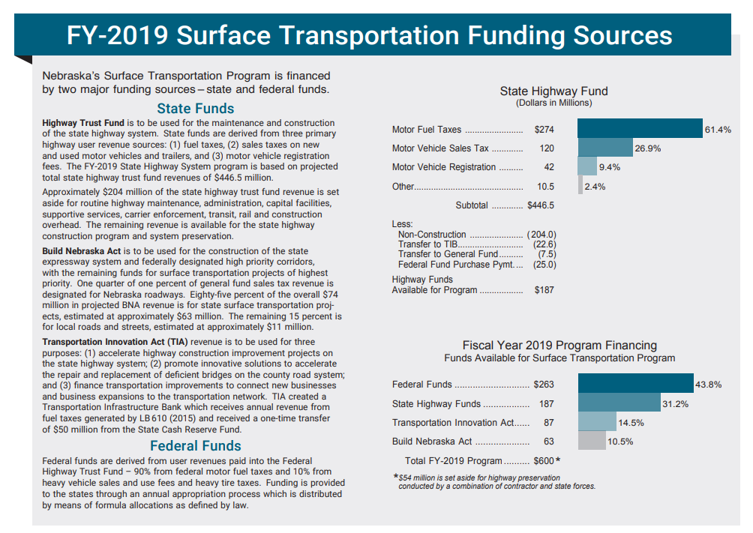
Example – NDOT’s Program
Notes:
39-2101 “Such management will provide citizens the opportunity to know how each governmental entity intends to spend its highway money, and to determine its performance when measured against its plans.”

Slide 13
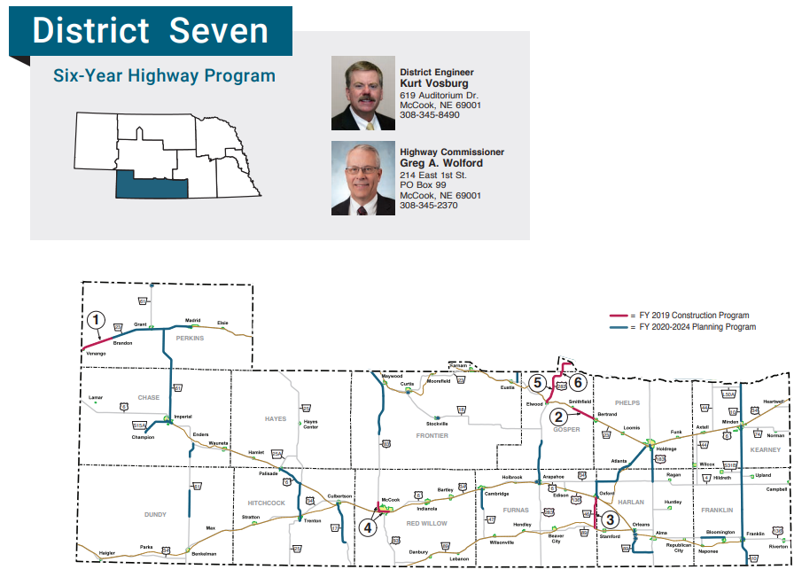
Example – NDOT’s Program
Example One- and Six-Year Plan

Slide 14
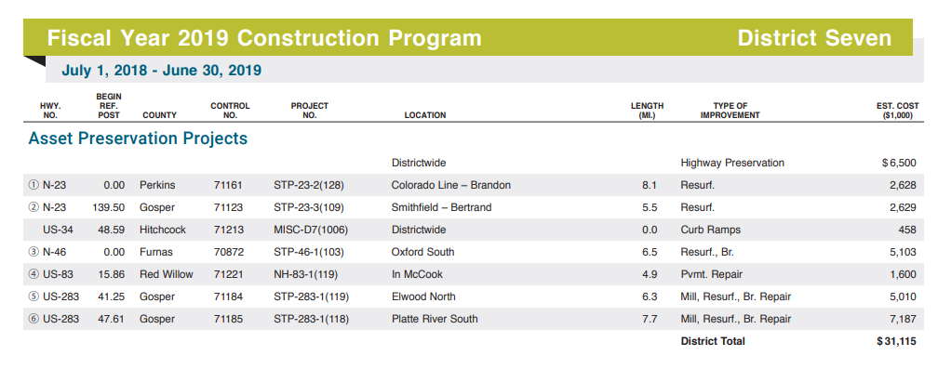
Example – NDOT’s Program
Example One- and Six-Year Plan

Slide 15
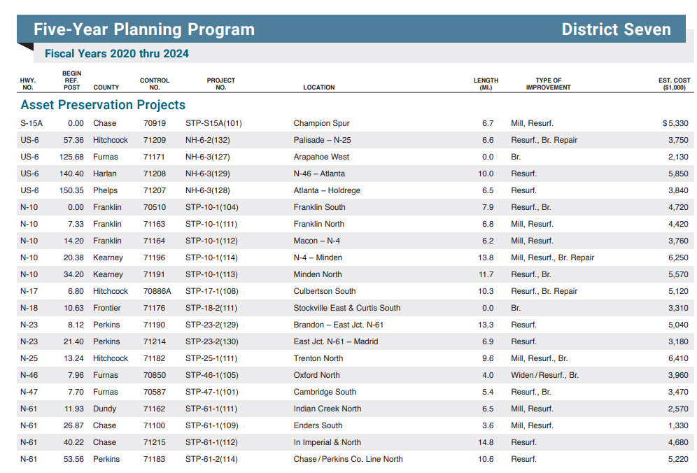
Example – NDOT’s Program
Example One- and Six-Year Plan

Slide 16
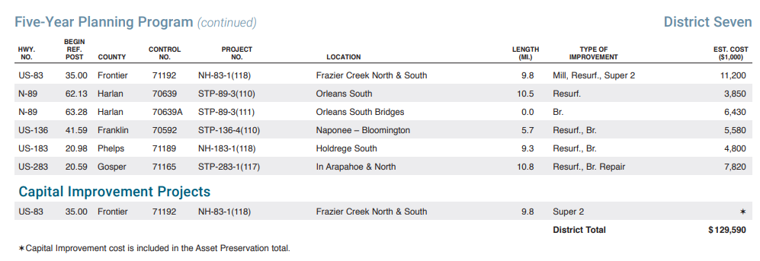
Example – NDOT’s Program
Example One- and Six-Year Plan

Slide 17
After Adoption of Plan or Program
REVISIONS TO PLAN OR PROGRAM
Political jurisdiction MUST hold a public hearing for revisions to One-Year Plan.
Public hearing not required for revisions to Six-Year Plan.
§39-2119
Slide 17
Notes:
10/13/2021 added web link
8/11/2021 Added “to One-Year Plan!”
4/19/2021 Added slide per 4/18/2021 phone conversation with LeMoyne Schulz regarding Scotts Bluff County situation (County Board member wanted to change project after plan/program had already been adopted).
PI-Q29, PIVQ3
What is a revision? Check with County Attorney.
39-2119.
Counties and municipalities; plan or program for specific improvements; hearing; duty to certify compliance; penalty; funds placed in escrow.
Each county and municipality shall annually develop, adopt, and maintain as a public record, a one-year plan or program for specific highway, road, or street improvements for the current year. No such plan or program, or revision to such plan or program, shall be adopted until after a public hearing thereon and its approval by the governing body. Each county and municipality shall schedule and hold the public hearing each year, and such hearing may be held prior to or in conjunction with that entity's annual public hearing on its proposed budget statement in any year such budget statement hearing is held pursuant to section 13-506. Each county and municipality shall annually certify compliance with the requirements of this section to the Board of Public Roads Classifications and Standards using the certification form developed by the board pursuant to section 39-2120. If any county or municipality shall fail to comply with the provisions of this section, the board shall so notify the local governing board, the Governor, and the State Treasurer, who shall suspend distribution of any highway-user revenue allocated to such county or municipality until there has been compliance. Such funds shall be held in escrow for six months until the county or municipality complies. If the county or municipality complies within the six-month period it shall receive the money in escrow, but after six months, if the county or municipality fails to comply, the money in the escrow account shall be lost to the county or municipality and shall be distributed to other counties or municipalities, as appropriate, in the manner provided by law for allocation of highway-user revenue.
Source
Laws 1969, c. 312, § 19, p. 1126;
Laws 1971, LB 100, § 8;
Laws 1973, LB 137, § 2;
Laws 1976, LB 724, § 5;
Laws 2007, LB277, § 3;
Laws 2019, LB82, § 9.

Slide 18
Revision of One-Year Plan
Purpose: Change or advance a work/project on the One-Year Plan or add a new project, at some point after governing body adopts the One-Year Plan
Public hearing is required.
Can be done at a regular meeting, a special meeting is not necessarily required.
Principle: Transparency in Government
Slide 18
Notes:
10/11/2021 Updated – changed OneAndSix to One-Year Plan.
9/8/2019 Updated – per LB82
You know the annual OneAndSix process and the forms to submit. What about if something comes up after you submit the OneAndSix? Say, there is an emergency (a flood). Or additional funding is available and you want to advance a project?
You need to submit a Notification of Revision of your One-Year Plan to the NBCS. You don’t have to wait for their approval, just submit it. The resolution of adoption, the work/project form and the two maps.
So, if flooding occurs, and you have a bridge or culvert washed out, your Board or Council can meet, declare an emergency, and adopt the One-Year Plan revision. Send the forms in and proceed. In the case of flooding, besides local funding, there are other possibilities such as FEMA and FHWA. You will also need to get the usual approvals – of course, the Board or Council action starts it, but also permits (Floodplain Administrator, Corps of Engineers, FEMA, FHWA, and if there is any request for a relaxation of standards that must come to the NBCS prior to any construction!).
Part IV Q9
During heavy April rains a bridge, on a road/street with a National Functional Classification of Local, was severely damaged by flooding and needs to be fixed or replaced as soon as possible with emergency project. (a) Referring to 428 NAC 3, indicate in your answer which forms and documents need to be completed, and when they need to be submitted to the NBCS (relative to the start of construction). (b) What are potential funding sources, other than county funds, that are available source(s) of emergency aid funding? (c) Identify approvals necessary prior to construction, approval authorities, and permits needed for a bridge replacement. (6 points)
After the annual public hearing and adoption of the OneAndSix plan by the governing body,
There is occasionally a need to change the scope of a work or project in the One-Year Plan, to advance a work or project from the last five years of the OneAndSix plan into the first year, or to add a completely new work or project to the first year. An example would be a flood that washed out a bridge or structure. Another example would be some additional funding became available allowing a work or project to advance to the first year.
428 NAC 3 allows the flexibility to address such a situation, called a One-Year Plan Revision.
A One-Year Plan Revision must be adopted by the Governing Body at a regular meeting, and submitted along with the resolution of adoption by a quorum of the Governing Body and the location maps, to the NBCS prior to construction.
There are no specific public hearing requirements for a One-Year Plan Revision in 428 NAC 3.
However, it will be considered an abuse if a work or project is willfully inserted into the One-Year Plan for the purpose of avoiding public review at the annual Public Hearing.
NOT FOR AUDIO
008.05C2 NOTIFICATION OF ONE-YEAR PLAN REVISION – This section of the form serves counties and municipalities as a record of revisions of the current One-Year Plan which occur throughout the fiscal year. These are revisions which occur after adoption of the annual One- and Six-Year Plan and before the following annual One- and Six-Year Plan public hearing. Refer to Subsection 002.02 for a definition of the One-Year Plan.
008.05C2a IDENTIFYING THE WORK/PROJECT AS A REVISION OF THE ONE‑YEAR PLAN – Check "Yes" if this is a Notification of Revision of One-Year Plan; for additional guidance, refer to 008.05C2c (Types of Revisions of the One-Year Plan). Check "No" if the information on the completed form has been disclosed to the public as part of, or as a result of, information received at the annual One- and Six-Year public hearing and included in the annual submittal to the NBCS; for this case, do not check any of the boxes or add any other information in the space to the right.
008.05C2a1 NOT A REVISION OF THE ONE-YEAR PLAN – A change of priority order for works/projects already in the One-Year Plan is not considered a revision of the One-Year Plan.
008.05C2a2 PROJECT FOR MISCELLANEOUS WORK (PMW, refer to 002.05) – It is not a requirement to file a Notification of Revision of One-Year Plan for a Project for Miscellaneous Work. However, upon construction completion of individual works/projects included in the PMW, the actual locations, including maps and other applicable details, shall be disclosed on the following year’s annual Report of Previous Year Highway or Street Improvement.
008.05C2b PROVIDING A REASON OR REASONS FOR REVISING THE ONE‑YEAR PLAN – Check the appropriate box or boxes which best describe the reason or reasons for revising the One Year Plan and, if needed, provide additional explanation; if “Other” is checked, enter the reason or reasons (Example: the condition of the road or street deteriorated unexpectedly and quickly due to heavy rains).
008.05C2c TYPES OF REVISIONS OF THE ONE-YEAR PLAN
Key Item (refer to 008.05A7) revisions to the work/project and the work/project was included in the reporting year’s One-Year Plan submitted to, and accepted by, the NBCS, or
A new work/project (including a Project of Miscellaneous Work) is added to the reporting year’s One-Year Plan (Example: unexpected damage occurs because of a disaster which causes work to be done immediately so the road or street can be opened), or
A work/project is advanced, in whole or in part(s), to the reporting year’s One-Year Plan, from the second through sixth years of the 2017 One- and Six-Year Plan (Example: additional funding becomes available, enabling the work/project to be accomplished in the first year of the One- and Six-Year Plan).
008.05C2d SUBMITTAL REQUIREMENTS FOR NOTIFICATION OF REVISION OF THE ONE-YEAR PLAN – Submittal requirements for Notification of Revision to the One-Year Plan. Submit the following to the NBCS prior to the start of construction of a One-Year Plan Revision work/project:
The completed One- and Six-Year Highway or Street Improvement Work/Project form.
Resolution of Adoption, with written signatures by the proper officials.
Maps (a National Functional Classification map and a State Functional Classification map) showing the location of the work/project. Functional classification maps are required. City plat maps are not required. NDOT functional classification maps are located online at http://www.roads.nebraska.gov/travel/map-library/ or may be requested from NDOT Boards-Liaison Services Section at DOR.BLSHelp@nebraska.gov. For map clarifications or corrections contact the NDOT Materials & Research Division.

Slide 19
Managing Nebraska’s Roads and Streets
One And Six Year Plans
for Highways, Roads and Streets
Questions?
Notes:
2 mins

Slide 20
Managing Nebraska’s Roads and Streets
Budgeting, Accounting, & Inventory Systems
Statutes Chapter 39 Article 21
Tab 10
Notes:
Revised 8-24-2023, Separated OneAndSix from budgeting, accounting and inventory – MD
9/11/2022 Updated by adding 3-ring binder Tab number.
8/16/2019 Updated – added disclaimer that the NBCS and BEX do not express policy on budgeting, accounting or inventory. Statutes require that cities and counties have a system of budgeting and accounting and inventory. The following slides are for informational purposes only.
Budgeting, Accounting and Inventory Course for Highways, Roads and Streets (no longer SSAR)
NONE OF THE FOLLOWING SLIDES ARE THE POLICY OF THE BOARD OF PUBLIC ROADS OR THE BOARD OF EXAMINERS.
Updated 7/29/2019 Deleted slides 12, 13 and 15
140 min (2 hour, 20 minutes) THIS WILL BE SIGNIFICANTLY REDUCED BASED ON 7/29/2019 CHANGES.

Slide 21
§39-2120
Financial and Accounting System
Notes:
8/13/2019 Updated statute per LB82

Slide 22
Accounting
§39-2120
System of Accounting is required (§39-2120 )
  Must meet the principles of accounting
  Records management system
Cash basis is the most common
Track work/project expenses – additional measures?
Internal controls, segregation of duties
Annual audit report to State Auditor
Independent audit for Federal-aid projects
Not NBCS or BEX Policy
Notes:
8/16/2019 Updated – added disclaimer that the NBCS and BEX do not have a policy on budgeting, accounting or inventory other than what state statute requires – to have a system or systems of budgeting, accounting and inventory.
?? mins
Quick review of topic covered during the LTAP course two days ago.
Principles of Accounting: GASB 34 for state and local governments Government Accounting Standards Board
Other than Cash Basis, there are also Accrual and Modified Accrual

Slide 23
Financial Management Systems Accounting and Retention
County Roads/City Streets Projects
Expectations for Road and Street Departments:
Systematically account and report all financial transactions
Using sound financial administration and accounting principles and
Meeting State statutes and regulations
Not NBCS or BEX Policy
Notes:
8/16/2019 Updated – added disclaimer that the NBCS and BEX do not have a policy on budgeting, accounting or inventory other than what state statute requires – to have a system or systems of budgeting, accounting and inventory.
These are expectations that were expressed by NDOT for Federal-aid projects.
Transactions help in decision-making

Slide 24
Accounting Methods
Can use any method
Accrual
Modified Accrual
Cash Basis (the most common)
Not NBCS or BEX Policy
Notes:
8/16/2019 Updated – added disclaimer that the NBCS and BEX do not have a policy on budgeting, accounting or inventory other than what state statute requires – to have a system or systems of budgeting, accounting and inventory.
Cash Basis is the most common
DO NOT NEED TO SPEND ALL OF WHAT YOU BUDGETTED.
YOUR AGENCY WILL NOT LOSE IT!!!!!
INCLUDE IT IN NEXT YEAR’S BUDGET.

Slide 25
Cash Basis Method
May need additional measures to identify and keep track of project expenses
  Allows tracking project expenses owed to outside parties and billings that have not been reimbursed

Not NBCS or BEX Policy
Notes:
8/16/2019 Updated – added disclaimer that the NBCS and BEX do not have a policy on budgeting, accounting or inventory other than what state statute requires – to have a system or systems of budgeting, accounting and inventory.

Slide 26
System of Internal Controls
Ensures that
transactions are properly reported within their accounting framework
assets are properly safeguarded and used solely for authorized purposes
expenditures comply with applicable laws, regulations, restrictions
Not NBCS or BEX Policy

Notes:
8/16/2019 Updated – added disclaimer that the NBCS and BEX do not have a policy on budgeting, accounting or inventory other than what state statute requires – to have a system or systems of budgeting, accounting and inventory.

Slide 27
Segregation of Duties
No one person should be able to complete or control all aspects of an accounting transaction or process
Road and Street Dept.’s should have a different individual review and approve transactions
These measures reduce errors, misstatements and potential abuse or fraud

Not NBCS or BEX Policy

Notes:
8/16/2019 Updated – added disclaimer that the NBCS and BEX do not have a policy on budgeting, accounting or inventory other than what state statute requires – to have a system or systems of budgeting, accounting and inventory.
It seems often that you see in the newspapers a public official or employee fraudulently taking money from the government’s coffers and is being brought up on charges.

Slide 28
If Accounting System Is Incapable of Tracking Project Costs Then:
Could utilize a ledger or spreadsheet system which
accumulates a record of costs incurred
compares budgeted vs. estimated amounts
shows total costs accumulated to date
tracks submitted reimbursement requests and payments

Not NBCS or BEX Policy
Notes:
8/16/2019 Updated – added disclaimer that the NBCS and BEX do not have a policy on budgeting, accounting or inventory other than what state statute requires – to have a system or systems of budgeting, accounting and inventory.
Keep up the ledger throughout the year. Don’t put it off!

Slide 29
Tracking Project Costs

Each month compare actual costs to budget by line item to
monitor progress
address budgetary needs
assessment if quantities are increasing or decreasing
allow modifications to budget in timely fashion
Identify errors or mis-use of funding
Not NBCS or BEX Policy

Notes:
8/16/2019 Updated – added disclaimer that the NBCS and BEX do not have a policy on budgeting, accounting or inventory other than what state statute requires – to have a system or systems of budgeting, accounting and inventory.

Slide 30

Annual Budget Report to:
Filed for Mill Levy Purposes
Not NBCS or BEX Policy
All Political Jurisdictions Required to
File Annually by September 20
ALL REPORTS AVAILABLE ONLINE!
http://auditors.nebraska.gov/Budget_Info.html
http://www.auditors.nebraska.gov/Budget_Info/Budget_FAQ.html
Notes:
8/16/2019 Updated – added disclaimer that the NBCS and BEX do not have a policy on budgeting, accounting or inventory other than what state statute requires – to have a system or systems of budgeting, accounting and inventory.
8/13/2019 Updated notes.
Villages FY ends after September 20.
Although there is no more Standardized System of Annual Reporting to the NBCS, there is still a requirement to submit an annual budget report to the State Auditor’s office. These reports are eventually made available online.
The budget referred to here is the overall budget for the political jurisdiction. Not an individual, itemized, Road or Street budget.

Slide 31
Annual Audit
Financial and Accounting System
Annual Audit Requirement
Exception: smaller political jurisdictions can apply for a waiver

Notes:
8/16/2019 Updated – added disclaimer that the NBCS and BEX do not have a policy on budgeting, accounting or inventory other than what state statute requires – to have a system or systems of budgeting, accounting and inventory.
8/13/2019 Updated notes.
Those spending less than $300,000 can apply for a waiver.
Audits are required annually, through the State Auditor's office.
This is not referring only to the Street or Roads budget. It’s the entire budget of the political jurisdiction that is subject to audit.
It is not a requirement of the NDOT, the NBCS or the BEX.

Slide 32


Independent Audits
Federal-aid Projects
Need to arrange for an independent audit for agency’s financial reports.
Audit reports for Federal-aid projects need to be sent to NDOT per the project agreement
All project documentation must be available at the county or city office for State or Federal audit inspections

Not NBCS or BEX Policy

Notes:
8/16/2019 Updated – added disclaimer that the NBCS and BEX do not have a policy on budgeting, accounting or inventory other than what state statute requires – to have a system or systems of budgeting, accounting and inventory.
8/13/2019 Updated notes
Some county clerks do this.
$500,000 requires an audit.
If your entity has a Federal-aid project through the NDOT, an independent audit may be required.
This applies to political jurisdictions that control, manage and process Federal-aid road or street project funding.
If the Nebr DOT serves as the processor and manager of payments and revenues on behalf of a county’s or municipality’s Federal-aid project, this Federal audit requirement does not apply.

Slide 33
Financial Records Retention
Retain project-related cost documentation and transactions
Until approved record retention requirements have been met
  Federal requirements may be different than State or Local requirements
Assign unique project identifiers for each project
  Project Number, Control Number, Agreement Number, Work Order Number, etc.
  Label or include unique project identifiers on all project-related documents including financial transactions (invoices, etc.). Require contractors and consultants to do the same.
  Prevents confusion or re-use on other projects

Not NBCS or BEX Policy
58-1234
Notes:
8/16/2019 Updated – added disclaimer that the NBCS and BEX do not have a policy on budgeting, accounting or inventory other than what state statute requires – to have a system or systems of budgeting, accounting and inventory.

Slide 34
Consultants, Contractors and Vendors Costs and Invoices
Need supporting documentation,
  with the unique project identifiers assigned (previous slide)
  Documentation in accordance with the terms of the project contract or agreement
    Copies of time sheets, labor rates, payroll reports, vehicle logs, weigh tickets, etc.
Invoices should be valid, necessary and within the scope of the authorized work
Invoices need to have documented approval by appropriate officials
Not NBCS or BEX Policy
Notes:
8/16/2019 Updated – added disclaimer that the NBCS and BEX do not have a policy on budgeting, accounting or inventory other than what state statute requires – to have a system or systems of budgeting, accounting and inventory.

Slide 35
Payments
Review to ensure that
invoices are for the proper project
invoice computations are verified
construction contractor progress estimates vs. the percentage of project completion are reasonable
invoiced construction units vs. bid quantities and prices are per the contract
Individuals reviewing and/or authorizing payment sign and date reviewed documents
  Check that quantities, unit prices and rates are per the contract or agreement. Check weigh tickets against invoice, contractual labor rates vs. invoiced labor rates, etc.

Not NBCS or BEX Policy
Notes:
8/16/2019 Updated – added disclaimer that the NBCS and BEX do not have a policy on budgeting, accounting or inventory other than what state statute requires – to have a system or systems of budgeting, accounting and inventory.

Slide 36
§39-2120
Financial and Accounting System
Notes:
8/13/2019 Updated statute per LB82 – old NBCS forms 1 and 2, reference to the Nebraska County Accounting Codes Manual
Old NBCS Form 1 – Expenditures (multi-page form)
Old NBCS Form 2 – Revenues (one-page form) – Local, State and Federal sources of revenue
Accumulate and Relinquish funds – what will you share with the public? Your jurisdiction needs to discuss.
Estimating works/project costs. What is your system? Do you keep up with what things cost so you can rapidly estimate costs?

Slide 37
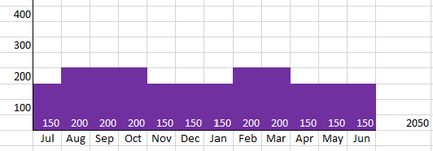
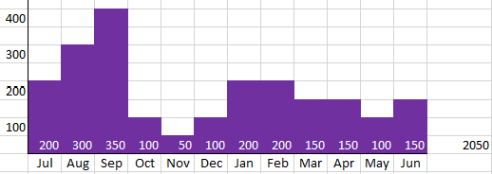
Budgeting vs. Expenditures
BUDGETED
EXPENDED
Boards - Liaison Services Section
Notes:
4/30/2021 Updated notes field with Mitch Doht’s advice on cash flow.
3/11/2020 New Slide
PIVQ2 discuss the three main categories, how they might fluctuate throughout the year.
Talk about the cyclical nature of expenditures. Much money is spent during the construction season! When is equipment purchased? So need to keep a constant eye on the expenditures vs. the budget. [reference: exam Part IV Q2 regarding personnel, capital outlay and supply budgets. Is there a typical expenditure graph that we can show?
The following are three of the major budget/expense categories, which could comprise around 75% of the budget:
Personnel Services
Supplies-Mtls
Capital Outlay
From Mitch Doht 4/29/2021 – NOT A BIG ISSUE FOR MUNICIPALITIES (SALES TAX). IS A BIG ISSUE FOR COUNTIES (PROPERTY TAX) AND ADDRESSED WITH TRANSFERS FROM OTHER FUNDS WHEN ROAD DEPT FUNDS ARE RUNNING LOW.
With most of a city’s revenue coming from sales taxes, it’s not as big of an issue for them. Cities get a more consistent stream of revenue. But this can be a big issue for a county, as their revenue is mainly from property taxes. They are generally due on an annual basis, with some people paying quarterly. So the cash flow is not consistent at all. A highway superintendent must always work within the budget approved by their governing body, while also working closely with their treasurer to verify cash on hand. Many times counties can transfer from other funds (inheritance tax fund, etc.) to allow the roads department to make expenditures when their fund is running low. The governing body must make the transfer, then when property taxes come in the transfer happens the other way. This can all get confusing for the public, as they get the idea that their road department is overspending. But all the transfers are really just due to inconsistent cash flow. Hope this helps. See ya!

Slide 38
§39-2120
Financial and Accounting System
Notes:
8/13/2019 Updated statute per LB82 and Notes – old NBCS forms 3 and 4
The old NBCS Form 3 (Material & Supply Inventory Report) by Commodity Group had four columns and was a log of
Item Description
Quantity on Hand
Unit Price
Dollar Value
The old NBCS Form 4 (Machinery & Equipment Inventory Report) had thirteen columns and was a log of
Equipment No.
Date Purchased
License No.
Make
Type
Size
Life Expectancy
Year
Model Engine or Serial No.
Cost
Rental Rate
Remarks

Slide 39
§39-2120
Financial and Accounting System
Notes:
8/13/2019 Updated statute per LB82 and Notes – old NBCS Form 5
What will your jurisdiction track?
The old NBCS Form 5 had 25 columns and was a log of
Description
Equipment No
Year Mfg
Miles or Hours Operated (over the past year)
Fuel and Oil used (over the past year) – gallons and cost
Greasing, Tires/Tubes and Special Services costs
Operation Cost per mile or per hour
Repair Costs (labor, parts)
Other Costs (indirect expenses, depreciation)
Total of all Costs (Operation Cost + Repair Cost + Other Costs)
Average Cost per Mile or per Hour
Rental Earned
Gain or Loss (+/-)

Slide 40
Managing Nebraska’s Roads and Streets
TTC-18048-B
Budgeting, Accounting, & Inventory Systems
Questions?
Notes:
2 mins

Slide 41
Managing Nebraska’s Roads and Streets
Required Annual Certification to NBCS
Statutes Chapter 39 Article 21
Notes:
Revised 8-24-2023, Separated OneAndSix from budget, accounting and inventory – MD
LTAP Course on One- and Six-Year Planning
Updated 7/29/2019. Deleted 12 slides. 9, 10 and 12-22.
PIVQ3 The main purpose of OneAndSix planning is: to promote the orderly development of an integrated system of public roads for the state, counties and municipalities. See 39-2101
176 minutes (2 hours, 56 minutes) THIS WILL BE SIGNIFICANTLY REDUCED BASED ON 7/29/2019 CHANGES.

Slide 42


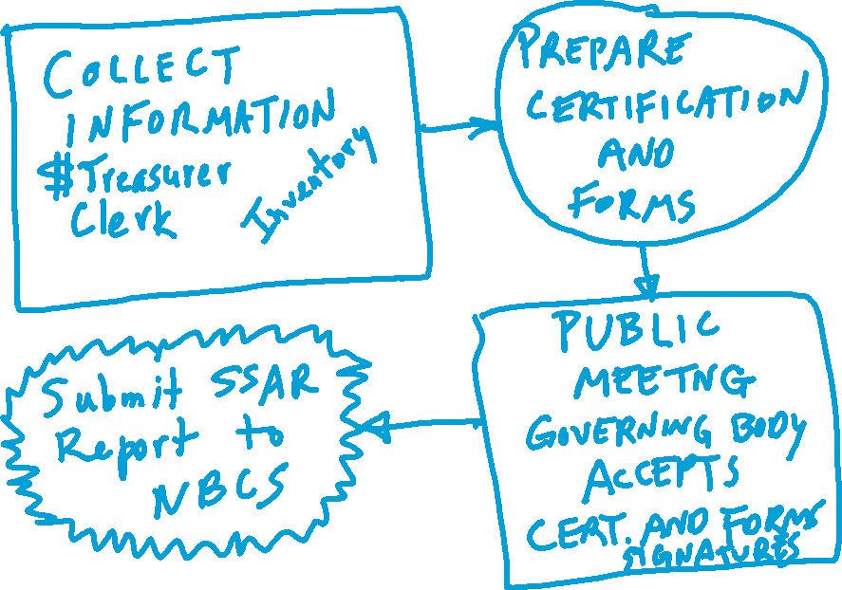
LB82(2019)
Notes:
9/11/2022 added LB82(2019)
8/13/2019 Updated notes.
Handout: Certification of Program Compliance.
The certification form has signatures required by the Superintendent and the Chair/Mayor, and also needs an attestation.
Budget reports are due to State Auditor by September 20 each year.

Slide 43
Notice to file the Annual Certification of Program Compliance and Signing Resolution with the Nebraska Board of Public Roads Classifications and Standards (NBCS) by October 31, 2021.
To avoid the suspension of Highway-user Revenue to your county please complete the enclosed COUNTY ANNUAL CERTIFICATION OF PROGRAM COMPLIANCE and SIGNING RESOLUTION and return them to the NBCS by October 31, 2021. Reference Neb. Rev. Stat. §§39-2120 and 39-2121(1).
Penalties for failure to comply can be found in the following State Statutes:
• Failure to comply with the provisions of Neb. Rev. Stat. §39-2115.
• Failure to comply with the provisions of Neb. Rev. Stat. §39-2119.
• Failure to file the County Annual Certification of Program Compliance with the NBCS, Neb. Rev. Stat. §39-2121(2).
• Filing of a materially false County Annual Certification of Program Compliance, Neb. Rev. Stat. §39-2121(3).
• Construction below minimum standards without the prior approval of the NBCS, Neb. Rev. Stat. §39-2121(3).
Note: While the signature of the County Highway Superintendent is optional on the certification, the NBCS strongly recommends that the superintendent sign this certification if said county has a superintendent.
Notes:
9/11/2022 added LB82(2019)
8/13/2019 Updated notes.
Handout: Certification of Program Compliance.
The certification form has signatures required by the Superintendent and the Chair/Mayor, and also needs an attestation.
Budget reports are due to State Auditor by September 20 each year.

Slide 44
Do not recreate or revise the pages of this document, as revisions and recreations will not be accepted.
Failure to return both pages of the original document by the filing deadline (October 31) may result in the suspension of Highway Allocation funds until the documents are filed.
RESOLUTION
SIGNING OF THE
COUNTY ANNUAL CERTIFICATION OF PROGRAM COMPLIANCE
2021
Resolution No. ___________
Whereas: State of Nebraska Statutes, sections 39-2115, 39-2119, 39-2120, 39-2121, and 39-2510(2),
requires an annual certification of program compliance to the Nebraska Board of Public Roads
Classifications and Standards; and
Whereas: State of Nebraska Statute, section 39-2120 also requires that the annual certification of program
compliance by each county shall be signed by the County Board Chairperson and shall include the resolution of
the governing body of the county authorizing the signing of the certification.
Be it resolved that the County Board Chairperson of _______________________________ County is hereby
authorized to sign the County Annual Certification of Program Compliance.
Adopted this _______ day of ______________, 20 at Nebraska.
County Board Members
___________________________________________ _____________________________________________
___________________________________________ _____________________________________________
    County Board Member______________________
    Moved the adoption of said resolution
    Member ____________________________ Seconded the Motion
    Roll Call: _____ Yes _____ No _____ Abstained _____ Absent
    Resolution adopted, signed and billed as adopted.
Attest:
_____________________________________________
(Signature of Clerk)
Notes:
9/11/2022 added LB82(2019)
8/13/2019 Updated notes.
Handout: Certification of Program Compliance.
The certification form has signatures required by the Superintendent and the Chair/Mayor, and also needs an attestation.
Budget reports are due to State Auditor by September 20 each year.

Slide 45
COUNTY
ANNUAL CERTIFICATION OF PROGRAM COMPLIANCE
TO
NEBRASKA BOARD OF PUBLIC ROADS CLASSIFICATIONS
AND STANDARDS
2021
In compliance with the provisions of the State of Nebraska Statutes, sections 39-2115, 39-2119, 39-2120,
39-2121, and 39-2510(2), requiring annual certification of program compliance to the Board of Public Roads
Classifications and Standards, the County of ___________________________________ hereby certifies that it:
✓ has developed, adopted, and included in its public records the plans, programs, or standards required by sections 39-2115 and 39-2119;
✓ meets the plans, programs, or standards of design, construction, and maintenance for its highways, roads, or streets;
✓ expends all tax revenue for highway, road, or street purposes in accordance with approved plans, programs, or standards, including county and municipal tax revenue as well as highway-user revenue allocations;
✓ uses a system of revenue and costs accounting which clearly includes a comparison of receipts and expenditures for approved budgets, plans, programs, and standards;
✓ uses a system of budgeting which reflects uses and sources of funds in terms of plans, programs, or standards and accomplishments;
✓ uses an accounting system including an inventory of machinery, equipment, and supplies;
uses an accounting system that tracks equipment operation costs;
✓ has included in its public records the information required under subsection (2) of section 39-2510; and
✓ has included in its public records a copy of this certification and the resolution of the governing body authorizing the signing of this certification by the County Board Chairperson.
_____________________________________________________ __________________
Signature of County Board Chairperson (Required) (Date)
_____________________________________________________ __________________
Signature of County Highway Superintendent (Optional) (Date)
Notes:
9/11/2022 added LB82(2019)
8/13/2019 Updated notes.
Handout: Certification of Program Compliance.
The certification form has signatures required by the Superintendent and the Chair/Mayor, and also needs an attestation.
Budget reports are due to State Auditor by September 20 each year.

Slide 46
Managing Nebraska’s Roads and Streets
TTC-18048-B
Required Annual Certification to NBCS
Questions?
Notes:
2 mins

