Slide 1



Bridge Inspection
NBIS*
23 CFR 650-C
* National Bridge Inspection Standards
Tab 14
Boards - Liaison Services Section
Notes:
7/28/2023 slide 16 added program manager duties, slide 18 eliminated “NICET Level III or IV Bridge Safety Inspector” qualification, slide 25 changed the topmost line by eliminating the”+/-” and adding a note that some cases are 48 months based on a risk-based approach
From: Patras, Wayne <wayne.patras@nebraska.gov>
Sent: Friday, July 28, 2023 8:08 AM
To: Schulz, LeMoyne <Lemoyne.Schulz@nebraska.gov>
Subject: RE: Pre-exam Training for Superintendents - Day 3 - Bridge Inspections segment
LeMoyne,
I reviewed your slides and made a couple of comments.
Slide 18, there have been some updates to the qualifications and I made corrections.
Slide 25, I made some corrections. Inspections are every 24 months. No +/-. I also added a comment that in some cases, 48 months.
Other than that, it looks like it’s good to go.
There will be more changes in the future with the changes in the SNBI that will be coming the next few years.
Thanks and have a great day.
Wayne Patras
10/13/2021 added web link to slide 1 and same to last slide, added the 428 NAC 2 citation on slide 5, and eliminated slide 7 animation.
8/13/2021 added slide 23 to summarize deadlines
5/21/2021 and 5/22/2021 Updated several slides with references to exam questions.
4/28/2021 Based on Zoom call with Babrak Niazi, the series of slides, Slides 3 thru 11, “What Bridges and Structures Does My Agency Need to Inspect?” is revised by re-arranging existing slides and adding some slides for the purpose of clarifying that NBIS only covers bridges and structures more than 20 ft. Updated slide 7, now slide (state statute 60-6,383) per discussion with Babrak Niazi.
4/23/2021 Updated per feedback from Bridge Division. Slide 15 changed because (per Mark Traynowicz 4/19/2021 email) “NDOT no longer coordinates fracture critical inspections, so the local bridge owner needs to do the inspections or hire a consultant.” Slide 23 revised by Kent Miller per his email to LeMoyne Schulz dated 4/20/2021 at 10:34 a.m.
1/31/2020 Updated. Previous version 8/11/2019. Slide 1 added “National Bridge Inspection Standards.” Slide 6 minor wording change. Previous version 8/11/2019.
8/11/2019 Updated – deleted two slides (qualifications for Team Leader by consolidating the five paths onto one slide, made minor changes to a few other slides (Slide 10 added graphics, Slide 15 updated reference to Bridge Inspection Manual).
Handouts – describe to audience

Slide 2
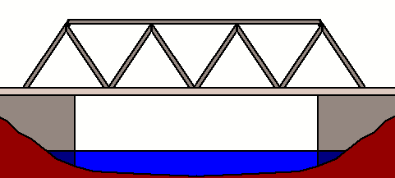
Bridges and Structures Inspections
What bridges and structures does my agency need to inspect?
Why do these inspections need to be done?
Who does the inspections, and when?
2
Slide 2

Slide 3
Bridges and Structures Inspections
What bridges and structures does my agency need to inspect?
Why do these inspections need to be done?
Who does the inspections, and when?
NBIS requires all BRIDGES to be inspected
What is a Bridge?
3
Slide 3
Notes:
4/28/2021 Updated slide to emphasize toward the beginning of the presentation that the NBIS requires all BRIDGES to be inspected and documented on a regular basis.
NDOT manages the NBIS system in Nebraska. More about that later.

Slide 4
NBCS Definition of a Bridge
US Law – Title 23, Part 650 Bridges, Structures, and Hydraulics Subpart C National Bridge Inspection Standards (NBIS)
Nebraska Rule and Regulation 428 NAC 2-001.03A5a (page 44)
A structure over water, roadway, railway or other depression or obstruction with a track over it to move traffic
An opening measured along the center of the roadway of MORE THAN 20 feet between abutments
Includes multiple chambers (pipes) where the distance between openings is less than ½ of the smaller contiguous opening
4

Slide 5
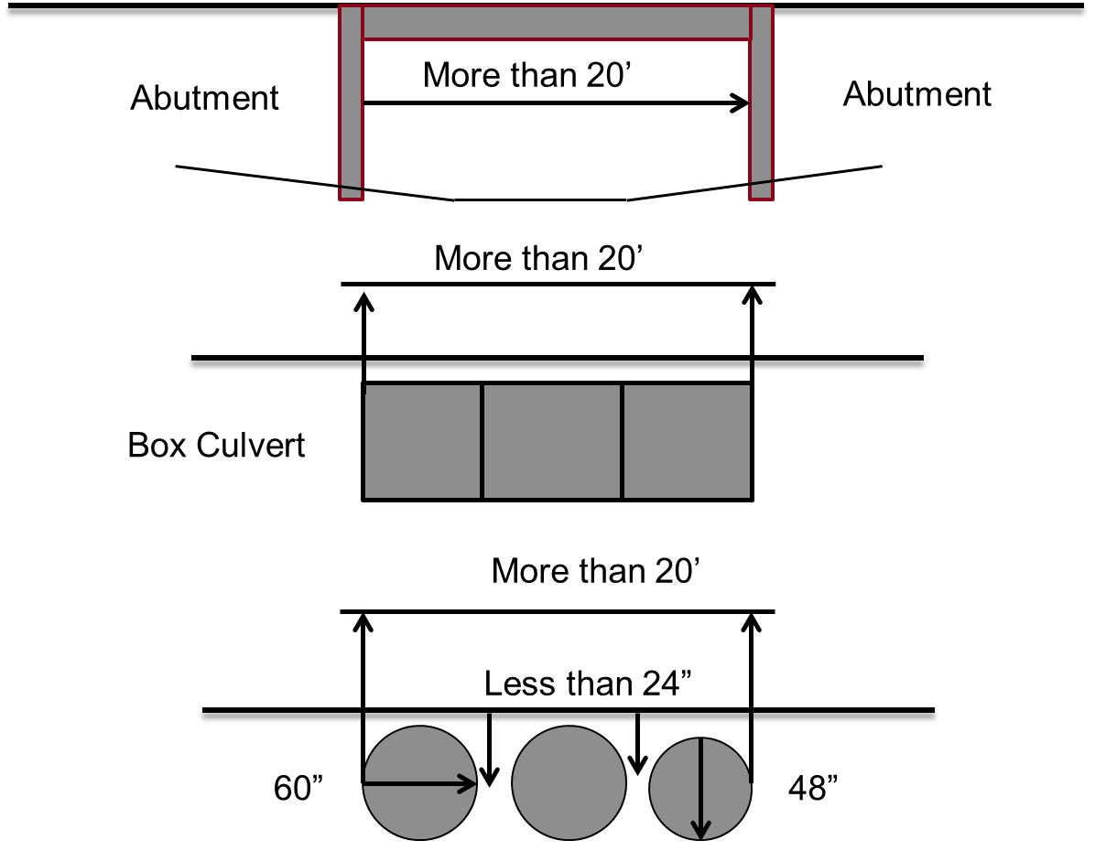
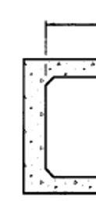
Edge of Opening
National and State Definition of Bridge – by sketches
84”
5
428 NAC 2-001.03A4k on page 44
Slide 5
Notes:
9/11/2022 added 428 NAC 2 citation
4/28/2021 Updated. Added “National and State Definition of Bridge – by Sketches” on the slide to emphasize that State law agrees with National law on the definition of BRIDGE.
According to the definition of a BRIDGE, it can be a
bridge
culvert (buried or non-buried)
a series of pipes
if it has an opening of more than 20 feet along the center of the roadway.
See 428 NAC 2 page 44 for definitions of the above. Those definitions also include low water stream crossing (which could be a series of pipes) and ford.

Slide 6
Inspecting Bridges and Structures
Vehicles Weight Limit Statutes:
§60-6,294
.
.
.
§60-6,301
6
Slide 6
Notes:
Implies that structures and culverts will be able to handle these loads
60-6,294.
Vehicles; weight limit; further restrictions by Department of Transportation, when authorized; axle load; load limit on bridges; overloading; liability.
(1) Every vehicle, whether operated singly or in a combination of vehicles, and every combination of vehicles shall comply with subsections (2) and (3) of this section except as provided in sections 60-6,294.01, 60-6,297, and 60-6,383. The limitations imposed by this section shall be supplemental to all other provisions imposing limitations upon the size and weight of vehicles.
(2) No wheel of a vehicle or trailer equipped with pneumatic or solid rubber tires shall carry a gross load in excess of ten thousand pounds on any highway nor shall any axle carry a gross load in excess of twenty thousand pounds on any highway. An axle load shall be defined as the total load transmitted to the highway by all wheels the centers of which may be included between two parallel transverse vertical planes forty inches apart extending across the full width of the vehicle.
(3) No group of two or more consecutive axles shall carry a load in pounds in excess of the value given in the following table corresponding to the distance in feet between the extreme axles of the group, measured longitudinally to the nearest foot, except that the maximum load carried on any group of two or more axles shall not exceed eighty thousand pounds on the National System of Interstate and Defense Highways unless the Director-State Engineer pursuant to section 60-6,295 authorizes a greater weight.
Etc.

Slide 7
Inspecting Bridges and Structures
§60-6,383 passed in 2018: Culverts with spans of more than 5 ft (60 inches) must be load posted
This is not managed within the NBIS, or by NDOT
7
Slide 7
Notes:
9/11/2022 eliminated animation associated with the main message
4/28/2021 Updated per Zoom call with Babrak Niazi. Added disclaimer that the requirements of this statute are not managed or regulated by the NBIS or the NDOT. It is up to each county to do its own load posting!
60-6,383.
Implement of husbandry; weight and load limitations; operation restrictions.
(1) An implement of husbandry being operated on any highway of this state, except the National System of Interstate and Defense Highways, shall be exempt from the weight and load limitations of subsections (2), (3), and (4) of section 60-6,294 but shall be subject to any ordinances or resolutions enacted by local authorities pursuant to section 60-681.
(2) An implement of husbandry being operated on any highway of this state shall not cross any culvert with a span of more than sixty inches or any bridge if the vehicle axle, axle groupings, or gross weight exceeds the limits established in subsections (2), (3), and (4) of section 60-6,294 or weight limits established by bridge postings.
(3) For purposes of this section, an implement of husbandry includes (a) a farm tractor with or without a towed farm implement, (b) a self-propelled farm implement, (c) self-propelled equipment designed and used exclusively to carry and apply fertilizer, chemicals, or related products to agricultural soil or crops, (d) an agricultural floater-spreader implement as defined in section 60-303, (e) a fertilizer spreader, nurse tank, or truck permanently mounted with a spreader used for spreading or injecting water, dust, or liquid fertilizers or agricultural chemicals, (f) a truck mounted with a spreader used or manufactured to spread or inject animal manure, and (g) a mixer-feed truck owned and used by a livestock-raising operation designed for and used for the feeding of livestock.
Source
Laws 2016, LB977, § 22;
Laws 2018, LB310, § 3.
Effective Date: July 19, 2018

Slide 8
Inspecting Bridges and Structures
Statutes Specific to Counties:
§39-1411
§39-1412
8
Slide 8
Notes:
4/28/2021 added state statutes in notes field.
39-1411.
Road and bridge records, who must keep; carrying capacity posted on bridges.
The county highway superintendent or some other qualified person designated by the county board shall keep in his or her office a road record which shall include a record of the proceedings in regard to the laying out, establishing, changing, or discontinuing of all roads in the county hereafter established, changed, or discontinued, and a record of the cost and maintenance of all such roads. Such person shall record in the bridge record a record of all county bridges and culverts showing number, location, and description of each, and a record of the cost of construction and maintenance of all such bridges and culverts. If the carrying capacity or weight limit of any bridge is less than the limits set forth in subsections (2), (3), and (4) of section 60-6,294, the county shall cause to be firmly posted or attached upon such bridge in a conspicuous place at each end thereof a board or metal sign showing the carrying capacity or weight which the bridge will safely carry or bear.
Source
Laws 1957, c. 155, art. I, § 11, p. 511;
Laws 2018, LB310, § 1.
39-1412.
County bridges; loads exceeding limits or posted capacity; no damage recovery; violation; penalty.
(1) No person shall drive across or go upon any county bridge with a greater weight than the limits set forth in subsections (2), (3), and (4) of section 60-6,294 or the carrying capacity or weight posted or attached pursuant to section 39-1411.
(2) A person who violates this section shall recover no damages from the county for any accident or injury which may happen to him or her upon such bridge because of damage to or the failure of such bridge caused by such violation.
(3) A person who violates this section shall be guilty of a Class III misdemeanor.
Source
Laws 1957, c. 155, art. I, § 12, p. 512;
Laws 1977, LB 40, § 214;
Laws 2018, LB310, § 2.

Slide 9
Inspecting Bridges and Structures
NBIS requires all bridges and structures that meet the definition of BRIDGE to be inspected
YOUR AGENCY MAY CHOOSE TO ALSO INVENTORY AND INSPECT SMALLER BRIDGES, CULVERTS, AND PIPES
Some May Even Recommend:
inventory and inspect ALL agency structures
9
Slide 9
Notes:
4/28/2021 Update slide extensively to emphasize that NBIS is the minimum requirement, but that it might be good asset management practice for counties and municipalities to inventory and regularly inspect smaller structures as well, especially if they are critical for mobility and operations, and anticipating and managing road closures.
1/31/2020 Update change “on” to “to” as in “reportable to the NBIS.”
Privately owned bridges (canal companies is an example) or bridges on private property (like Fallbrook) are NOT the responsibility of the NDOT and that information does not go in to the NBIS.
There are some bridges – big bridges – that are not required to be in the NBIS but the NDOT works with the bridge owner to make sure the bridge gets inspected and maintained. Example: a private toll bridge. Another example: the Bob Kerry Pedestrian Bridge from Omaha to Council Bluffs.

Slide 10
NBCS Minimum Design Standards Do NOT Require Bridge Inspections
428 NAC 2 Minimum Design Standards for County Roads and Municipal Streets – Page 53, Note 18 - apply to the DESIGN of . . .
  All structures (bridges, non-buried structures and culverts) on public roadways with a 4-ft (48 inches) opening or greater along the center of the roadway
10
Slide 10
Notes:
4/28/2021 updated slide by changing the title, and added “ . . . the DESIGN of . . . “ in the text. The old title “Inspecting Bridges and Structures” may create confusion that counties and municipalities must inspect structures between 4 ft and 20 ft openings.

Slide 11
Bridges and Structures Inspections
What bridges and structures does my agency need to inspect?
Why do these inspections need to be done?
Who does the inspections, and when?
11
Slide 11

Slide 12
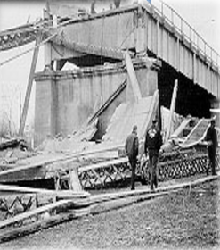
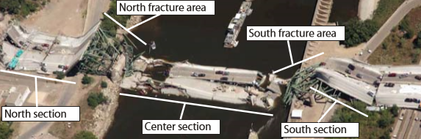
12
Notes:
1967 Silver Bridge Collapse image (FHWA pptx for Tribal): https://search.usa.gov/search?utf8=%E2%9C%93&affiliate=dot-fhwa&query=silver+bridge+collapse
2007 Minneapolis bridge collapse image: http://www.dot.state.mn.us/i35wbridge/pdf/ntsb-report.pdf

Slide 13
Bridges and Structures Inspections
What bridges and structures does my agency need to inspect?
Why do these inspections need to be done?
Who does the inspections, and when?
13
Slide 13

Slide 14
Inspection Organization
Each State Transportation Department (NDOT)
  Must inspect, or
  Cause to be inspected,
All highway bridges located on public roads that are fully or partially located within the State's boundaries
  Except for bridges that are owned by Federal agencies
14
Slide 14

Slide 15
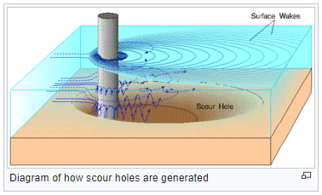
Who does Inspections for County- and Municipality-Owned Bridges?
The Bridge Owner, i.e. Your Agency
  Or a qualified consulting engineer
  Includes fracture critical bridges
Exception: underwater inspections. These are currently done by NDOT.
Bridge Owners also responsible for:
  Bridge Load Rating
  Bridge Hydraulic Assessment
  Monitoring the Scour Plan of Action, if any
  Addressing critical and non-critical findings
  Maintaining bridge files and records at their facility
  Cooperating with NDOT
Reference: Bridge Inspection Program Manual (Rev 6, March 2018), Page 12
15
Slide 15
Notes:
4/23/2021 Updated because (per Mark Traynowicz 4/19/2021 email) “NDOT no longer coordinates fracture critical inspections, so the local bridge owner needs to do the inspections or hire a consultant.”

Slide 16
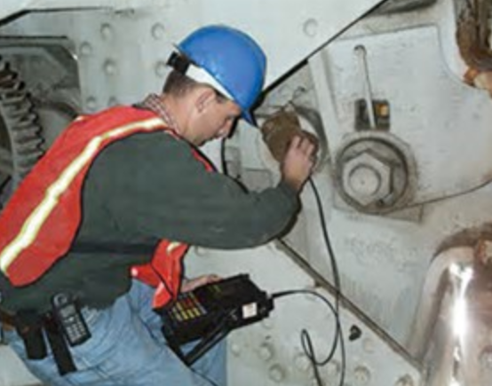
650.309 Personnel Qualifications
Program Manager
  In charge of a unit that performs bridge inspections, reporting, bridge load rating and inventory; Certifies inspector qualifications, maintains inventory data, follows up on critical findings, ensures inspection interval requirements are met, facilitates quality assurance inspections for local bridge owners
Team Leader
  In charge of the bridge inspection team
National Bridge Inspection Standards
16
Notes:
7/28/2023 added duties to the program manager description
The Bridge Inspection Program Manager is in charge of a unit that performs bridge inspections, reporting, bridge load rating and inventory.
The Bridge Inspection Team leader is in charge of the bridge inspection team.
NOT FOR AUDIO
From Babrak Niazi 3/14/2017:
Add Bridge Load Rating on Slide 11 under Program Manager responsibilities

Slide 17
650.309 Personnel Qualifications
Program Manager Qualifications
  Registered professional engineer
  10 years bridge inspection experience
AND
  Successfully completed FHWA approved comprehensive training course (2-week course)
National Bridge Inspection Standards
17
Notes:
Minimum qualifications for a Program Manager are
Registration as a professional engineer
10 years bridge inspection experience
And successful completion of a Federal Highway Administration approved bridge inspection training course

Slide 18


650.309 Personnel Qualifications
Team Leader Qualifications – 5 paths
  Same as Program Manager
  Five years bridge inspection experience (BIE)*
  Bachelors degree from ABET accredited school + pass the FE exam + Two years BIE*
  Associates degree from ABET accredited school + Four years BIE*
* AND successfully completed FHWA approved comprehensive training course
18
Notes:
7/28/2023 Eliminated “NICET Level III or IV Bridge Safety Inspector”, was item (c)
There are four ways to qualify as a Bridge Inspection Team Leader
One way is to have the same qualifications as a Program Manager, as previously described
A second way is to have 5 years of Active participation in bridge inspections in accordance with the NBIS, in a field inspection, supervisory, or management role and successful completion of a Federal Highway Administration approved bridge inspection training course
A third way to qualify is to graduate with a bachelor's degree from an ABET (Accreditation Board for Engineering and Technology)
accredited school, pass the FE (Fundamentals of Engineering) exam, and have two years Bridge Inspection experience.
and successful completion of a Federal Highway Administration approved bridge inspection training course

Slide 19
Inspection Frequency and Procedures
Regular intervals not to exceed 24 months
Inspect certain bridges more often than every 24 months
Establish interval based on bridge deficiencies and characteristics
Fracture Critical Bridges may have members that require more frequent inspection
19
Slide 19
Notes:
PIQ37
FRACTURE CRITICAL INSPECTIONS ARE NOW BEING DONE BY BRIDGE OWNERS, NOT COORDINATED BY NDOT ANY LONGER (per Mark Traynowicz 4/19/21 email)

Slide 20
Inspection Frequency and Procedures
NDOT requires that participants generating data and supporting reports submit them to NDOT as soon as QC has been completed, but within 90 days of the inspection date
20
Slide 20
Notes:
AASHTOWare
Exam Part I Q40
Placing load restriction signs (i.e. load posting) must be reported to and entered into the State’s inspection reports no later than 180 days after the change in status of the bridge.

Slide 21
Load Posting or Closure
Bridges* must be load posted if Load Carrying Capacity is less than Nebraska Legal Load thresholds (§60-6,294) – within 30 days after load rating
Bridges* must be closed if the Load Carrying Capacity is less than 3 ton
  Bridge* Owner must install permanent closure barricades immediately upon notification of the need to close
  Bridge* Owner must provide documentation of closure to NDOT Within 3 days of barricade installation
Culverts with a span of more than 60 inches or “any bridge” must be load posted if Load Carrying Capacity is less than Nebraska Legal Load thresholds (§60-6,383, §60-6,294,§39-1411 and §39-1412)
* The Federal definition of bridge
21
Slide 21
Notes:
8/11/2019 – load posting within 30 days (NOT 60 days) after load posting, per Babrak Niaizi 8/9/2019 email.
PIQ40
§60-6,383 via LB310, 2018 – Steve Riehle was involved in this. The point: structure owners must be diligent in load posting, or could be held liable for damages in the event of a failure.
From: Steve Riehle <stever@hallcountyne.gov>
Sent: Monday, August 27, 2018 2:42 PM
To: Schulz, LeMoyne <Lemoyne.Schulz@nebraska.gov>
Subject: RE: load rating of 60-inch culverts
LeMoyne,
My thoughts:
1. What is an Ag Implement of Husbandry: We’re pretty nervous about what falls into the category. We’re also pretty nervous that grain carts, for example, are designed with very large tires so they can run through the field, but I don’t think there is any consideration to the grain carts impact on roads.
2. NHS: I am not sure, but I think only the Interstates are considered part of the “Interstate and Defense” highways per 60-6,383. I am also pretty sure that Ag Implements of Husbandry are prohibited on freeways. The law change exempts Ag Implements of Husbandry from some of the statutory weight restrictions on the NHS, state highways off the NHS, county roads, etc.
3. The old statutes used to prohibit Ag Implements of Husbandry from crossing any culvert. The ag and cattle industry wanted this changed. I can support this on smaller diameter culverts, especially if there is some fill to spread the tire and axle weight. A CMP with a few feet of cover can be very strong.
4. Can’t Exceed Posted Weight: No Ag Implement of Husbandry can exceed the weight limit on a posted sign for a road, bridge or culvert.
5. Why 60”? The industry was pushing for a number. It’s our thought that culverts with a span 60” and under would be okay.
6. Load Rating culverts: The county can still load rate culverts and post them if the weight the culvert will safely carry is less than a legal load for the road.
7. The county can still weight restrict county roads using statute 60-681. Any road or bridge that is weight restricted by the county under this statute supersedes any exceptions allowed in statute on ag implements of husbandry.
8. What is a Bridge: We only addressed culverts since the old statute would not allow any ag implement of husbandry to be exempt from weights in statute if they crossed a culvert.
9. The county has to be diligent in posting bridges. That is why an improperly posted bridge or bridge missing posting signs is a significant finding per NBIS.
10. NDOT Permit:
a. Trucks: I believe farmers still have to get an overweight permit for trucks to carry 115% of a legal load when transporting crops from field to market. Some might haul crops from bins to market, but I believe the exemption is only allowed field to market.
b. Ag Implements of Husbandry don’t have to get a permit.
11. Liability and Responsibility: The old statute required the County Highway Superintendent to post a sign on each and every bridge with the weight it would safely carry. Then if a sign was not posted, such as on a bridge that can carry a legal load (same as road), the county would still be liable. It’s messy in statute, but I believe the county’s liability was reduced with the statute changes.
Bottom line, County’s will have to watch how the change impacts roads and bridges, because exempting Ag Implements of Husbandry could have a pretty large and negative impact on county roads and bridges.
Steve Riehle
Hall County Engineer/Highway Superintendent
60-6,383. Implement of husbandry; weight and load limitations; operation restrictions.
(1) An implement of husbandry being operated on any highway of this state, except the National System of Interstate and Defense Highways, shall be exempt from the weight and load limitations of subsections (2), (3), and (4) of section 60-6,294 but shall be subject to any ordinances or resolutions enacted by local authorities pursuant to section 60-681.
(2) An implement of husbandry being operated on any highway of this state shall not cross any culvert with a span of more than sixty inches or any bridge if the vehicle axle, axle groupings, or gross weight exceeds the limits established in subsections (2), (3), and (4) of section 60-6,294 or weight limits established by bridge postings.
(3) For purposes of this section, an implement of husbandry includes (a) a farm tractor with or without a towed farm implement, (b) a self-propelled farm implement, (c) self-propelled equipment designed and used exclusively to carry and apply fertilizer, chemicals, or related products to agricultural soil or crops, (d) an agricultural floater-spreader implement as defined in section 60-303, (e) a fertilizer spreader, nurse tank, or truck permanently mounted with a spreader used for spreading or injecting water, dust, or liquid fertilizers or agricultural chemicals, (f) a truck mounted with a spreader used or manufactured to spread or inject animal manure, and (g) a mixer-feed truck owned and used by a livestock-raising operation designed for and used for the feeding of livestock.
Source: Laws 2016, LB977, § 22; Laws 2018, LB310, § 3.
Effective Date: July 19, 2018
39-1411.
Road and bridge records, who must keep; carrying capacity posted on bridges.
The county highway superintendent or some other qualified person designated by the county board shall keep in his or her office a road record which shall include a record of the proceedings in regard to the laying out, establishing, changing, or discontinuing of all roads in the county hereafter established, changed, or discontinued, and a record of the cost and maintenance of all such roads. Such person shall record in the bridge record a record of all county bridges and culverts showing number, location, and description of each, and a record of the cost of construction and maintenance of all such bridges and culverts. If the carrying capacity or weight limit of any bridge is less than the limits set forth in subsections (2), (3), and (4) of section 60-6,294, the county shall cause to be firmly posted or attached upon such bridge in a conspicuous place at each end thereof a board or metal sign showing the carrying capacity or weight which the bridge will safely carry or bear.
Source
Laws 1957, c. 155, art. I, § 11, p. 511;
Laws 2018, LB310, § 1.
Effective Date: July 19, 2018
39-1412.
County bridges; loads exceeding limits or posted capacity; no damage recovery; violation; penalty.
(1) No person shall drive across or go upon any county bridge with a greater weight than the limits set forth in subsections (2), (3), and (4) of section 60-6,294 or the carrying capacity or weight posted or attached pursuant to section 39-1411.
(2) A person who violates this section shall recover no damages from the county for any accident or injury which may happen to him or her upon such bridge because of damage to or the failure of such bridge caused by such violation.
(3) A person who violates this section shall be guilty of a Class III misdemeanor.
Source
Laws 1957, c. 155, art. I, § 12, p. 512;
Laws 1977, LB 40, § 214;
Laws 2018, LB310, § 2.
Effective Date: July 19, 2018
60-681.
Highways, travel on; regulation by local authorities; when authorized; signs.
Local authorities may by ordinance or resolution prohibit the operation of vehicles upon any highway or impose restrictions as to the weight of vehicles, for a total period not to exceed one hundred eighty days in any one calendar year, when operated upon any highway under the jurisdiction of and for the maintenance of which such local authorities are responsible whenever any such highway by reason of deterioration, rain, snow, or other climatic condition will be seriously damaged or destroyed unless the use of vehicles thereon is prohibited or the permissible weight thereof reduced. Such local authorities enacting any such ordinance or resolution shall erect or cause to be erected and maintained signs designating the provisions of the ordinance or resolution at each end of that portion of any highway affected thereby, and the ordinance or resolution shall not be effective until such signs are erected and maintained.
Local authorities may also, by ordinance or resolution, prohibit the operation of trucks or other commercial vehicles or impose limitations as to the weight thereof on designated highways, which prohibitions and limitations shall be designated by appropriate signs placed on such highways.

Slide 22
Prohibiting Vehicles or Restricting Weight
Highways, Roads and Streets may be Load Restricted, or Certain Vehicles Prohibited
  If local authorities believe the vehicles will seriously damage or destroy its road/street (including bridges)
  Caused by deterioration, rain, snow or other climatic conditions
  County or Municipality must pass a resolution or an ordinance
  County or Municipality must erect and maintain signs for this purpose, i.e. “WEIGHT LIMIT SIGNS”
  Cannot exceed 180 days in any one calendar year
  Reference: §60-681
22
Slide 22
Notes:
60-681.
Highways, travel on; regulation by local authorities; when authorized; signs.
Local authorities may by ordinance or resolution prohibit the operation of vehicles upon any highway or impose restrictions as to the weight of vehicles, for a total period not to exceed one hundred eighty days in any one calendar year, when operated upon any highway under the jurisdiction of and for the maintenance of which such local authorities are responsible whenever any such highway by reason of deterioration, rain, snow, or other climatic condition will be seriously damaged or destroyed unless the use of vehicles thereon is prohibited or the permissible weight thereof reduced. Such local authorities enacting any such ordinance or resolution shall erect or cause to be erected and maintained signs designating the provisions of the ordinance or resolution at each end of that portion of any highway affected thereby, and the ordinance or resolution shall not be effective until such signs are erected and maintained.
Local authorities may also, by ordinance or resolution, prohibit the operation of trucks or other commercial vehicles or impose limitations as to the weight thereof on designated highways, which prohibitions and limitations shall be designated by appropriate signs placed on such highways.

Slide 23
Bridges and Structures Inspections
Why do these inspections need to be done?
  Safety, compliance, asset management
Which bridges and structures does my agency need to inspect?
  Upcoming Bridge Inspection Map hosted by NDOT
    https://dot.nebraska.gov/business-center/bridge/inspection/
  NDOT also hosts an online bridge inspection reporting platform (BrM) that can be used to view bridge inspection reports. For more information contact kent.miller@nebraska.gov
Who does the inspections, and when?
  Owner is responsible and NBIS Certified Inspectors perform Routine and Fracture Critical Inspections in the scheduled month and reported in BrM within 90 days of inspection
  Underwater inspections are managed by NDOT
Slide 23
Notes:
4/23/2021 Updated – as recommended by Kent Miller per his email to LeMoyne Schulz dated 4/20/2021 at 10:34 a.m.

Slide 24
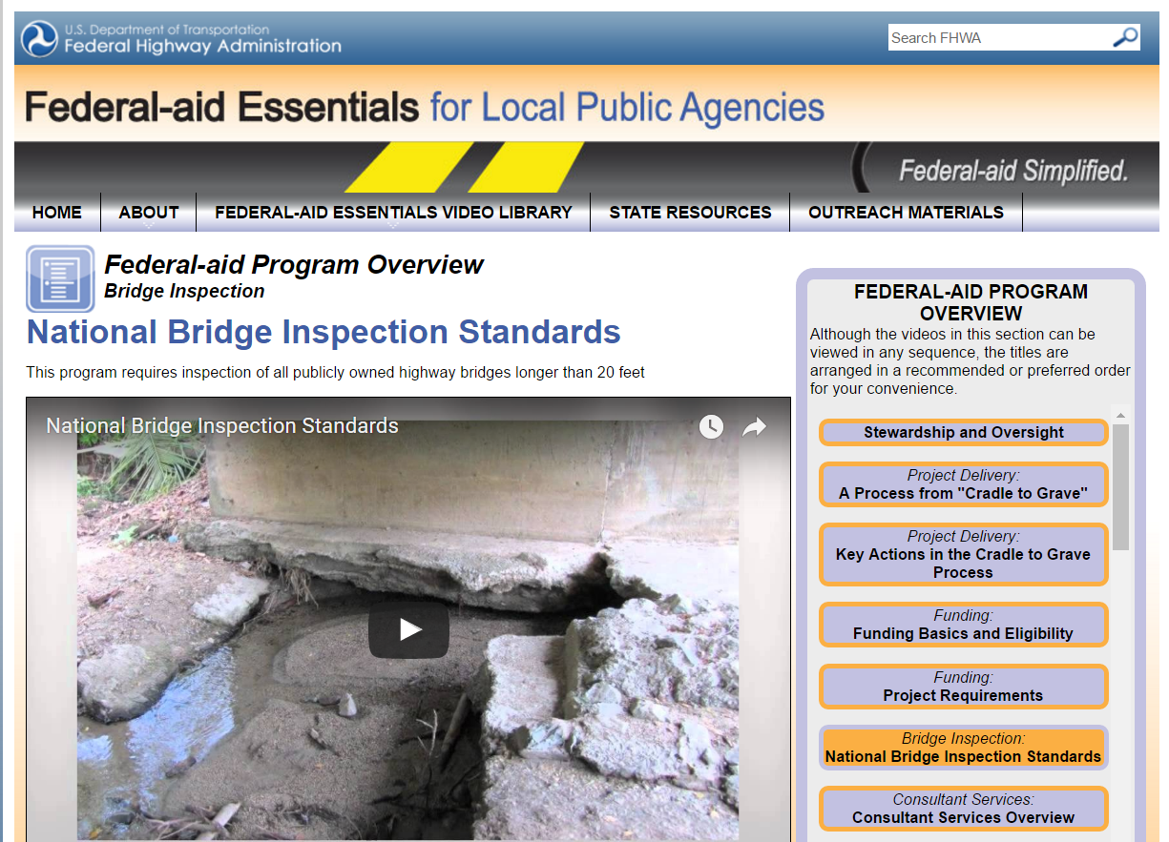
National Bridge Inspection Standards
24
Slide 24

Slide 25
Summary of Timelines
Bridge Inspections – 24 months (some cases 48 months if certain risk-based criteria is met)
Inspection Reports – right after QC but no later than 90 days after bridge inspection
Load Posting – 30 days after bridge load rating
Bridge Closing – immediately, and send documentation to NDOT within 3 days
25
Slide 25
Notes:
7/28/2023 Deleted the “+/-” in the topmost point and added the note some cases may be allowed up to 48 months
8/13/2021 Added slide to help remember deadlines

Slide 26
Bridge Inspection
NBIS
23 CFR 650-C
Questions?
Boards - Liaison Services Section
Notes:
Handouts – describe to audience

