Slide 1
Utility program
District 6 Breakout Session

Slide 2
This Meeting is Being Recorded
Notes:
HDR

Slide 3
Welcome
Before we begin, let’s have a brief safety moment.
In-Person Attendees
Emergency Exits
Tornado Shelter
911 Caller
AED Location
Restrooms
Virtual Attendees
Unmute yourself or use your chat box if you are in an emergency situation.
Notes:
HDR

Slide 4
Agenda
Introductions
High Impact Project Review (by construction year)
Communication and Coordination
Questions and Wrap Up
Notes:
HDR

Slide 5
Introductions
Notes:
All speakers introduce themselves briefly (Dave, section head, HDR facilitators); Attendees can introduce themselves if it’s a small group. If not – skip it!

Slide 6
2024 Utility policy
NDOT rolled out a new utility accommodation policy in 2024.
You can find more information, as well as a webinar about the changes, on the NDOT utility website at https://dot.nebraska.gov/business-center/utilities/.

Slide 7
Outstanding Cy 2025
The following projects will likely not be completed in 2025

Slide 8
Cozad Viaduct (MS)
Project Number: STP-21-2(116) Control No: 61635
Project Length: 13.83
Scope of Work:
  Bridge Repair

Slide 9
Cozad Viaduct (MS)
Project Number: STP-21-2(116) Control No: 61635
Status: Construction
Right-of-way: In Progress
Construction Timing: 4/7/2025 - 12/13/2025

Slide 10
Cozad Viaduct (MS)
Project Number: STP-21-2(116) Control No: 61635
Anticipated Utilities Impact:
  Bridge Repair/Replace
Anticipated Request from Utilities:
  Provide Existing Locations
Additional Information:
  No K-Sheets Required
  Special Provisions Required
Utilities Involved:
  Black Hills Energy
  Charter Communication
  City of Cozad
  Cozad Telephone Company
  Lumen
  Tallgrass Energy
  Cogent Communications
  Verizon

Slide 11
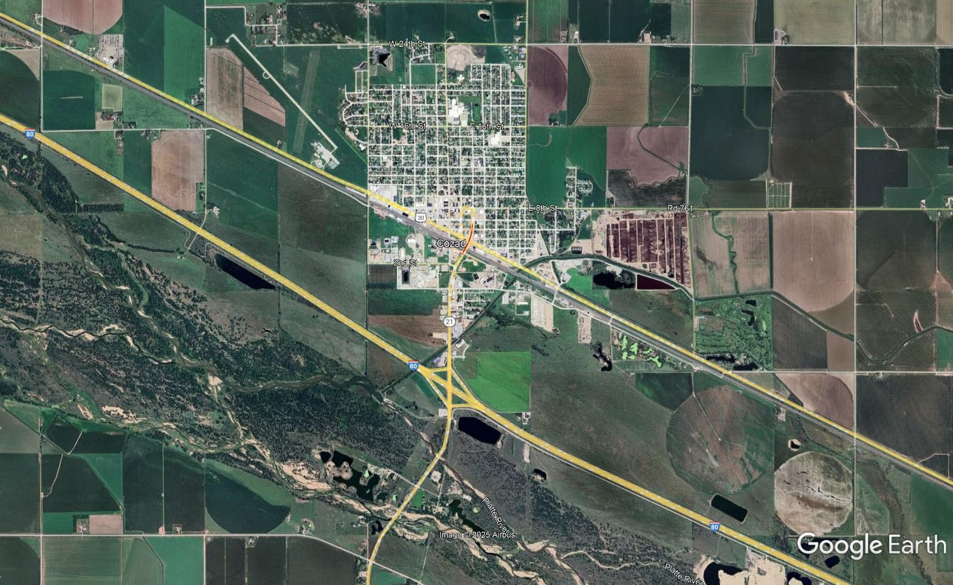

Slide 12
Cy 2026
The following projects are anticipated to be let during 2026

Slide 13
Halsey Spur Bridge
Project Number: STP-FL-S86B(102) Control No: 61472
Project Length: 0.00
Scope of Work:
  Guardrail
  Bridge Replacement

Slide 14
Halsey Spur Bridge
Project Number: STP-FL-S86B(102) Control No: 61472
Status: Award Pending
Right-of-way: In Progress
Construction Timing: 3/23/2026- 10/24/2026

Slide 15
Halsey Spur Bridge
Project Number: STP-FL-S86B(102) Control No: 61472
Anticipated Utilities Impact:
  Bridge Repair/Replace
  Guardrail
Anticipated Request from Utilities:
  Provide Existing Locations
  Locates
Additional Information:
  No K-Sheets Required
  No Special Provisions Required
Utilities Involved:
  Consolidated Telephone Company
  Custer Public Power District

Slide 16
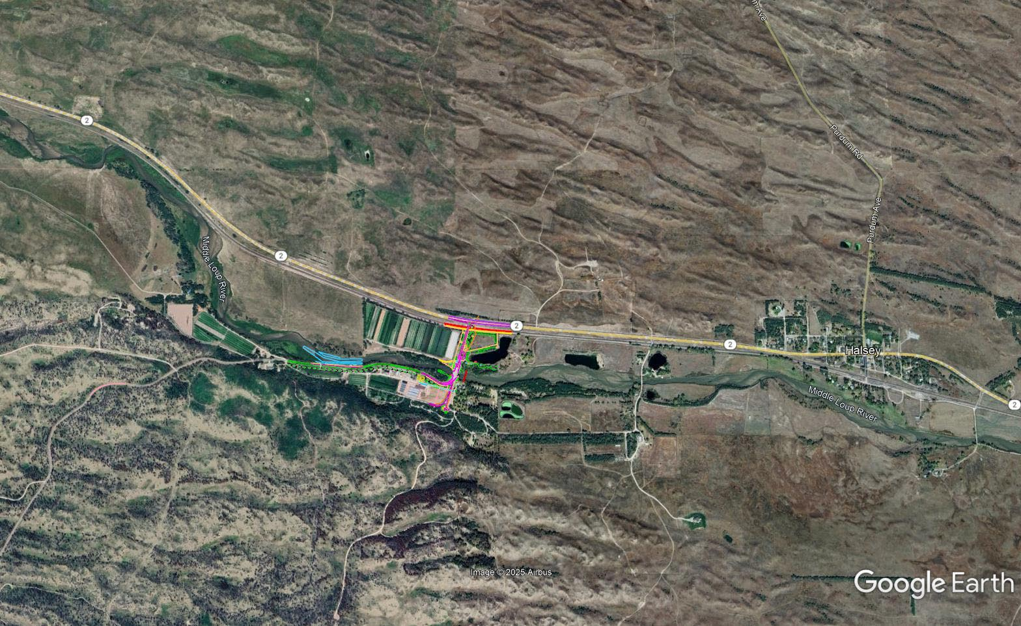

Slide 17
Tryon South
Project Number: STP-97-3(107) Control No: 61633
Project Length: 10.86
Scope of Work:
  Culvert Extension/Replacement
  Grading

Slide 18
Tryon South
Project Number: STP-97-3(107) Control No: 61633
Status: Design
Right-of-way: In Progress
Construction Timing: 6/22/2026 - 11/21/2026

Slide 19
Tryon South
Project Number: STP-97-3(107) Control No: 61633
Anticipated Utilities Impact:
  Culvert Extension/Replace
  Grading
Anticipated Request from Utilities:
  Provide Existing Locations
  Locates
  Potholing TBD
Additional Information:
  No K-Sheets Required
  Special Provisions Required
Utilities Involved:
  Custer Public Power District
  Great Plains Communications

Slide 20
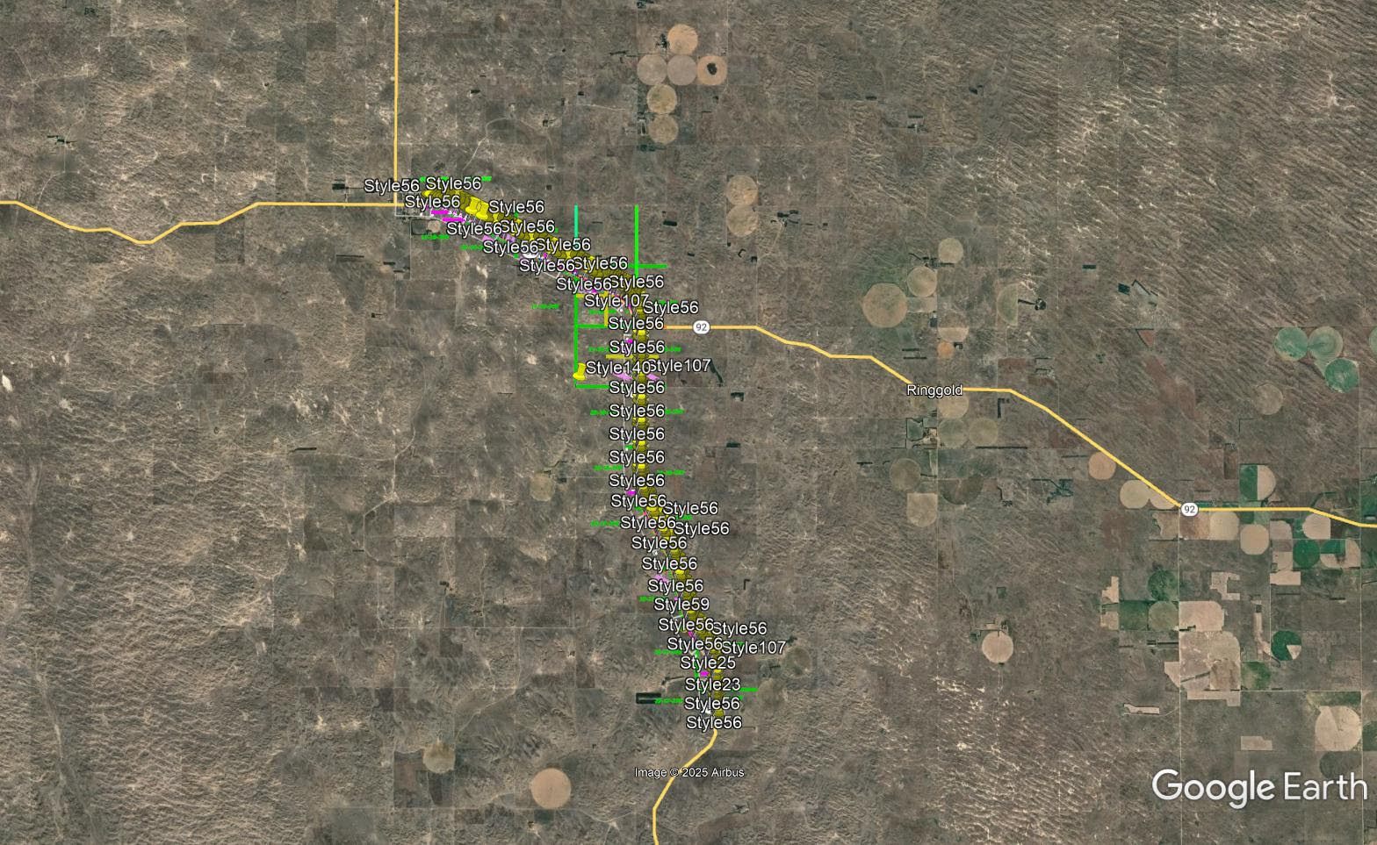

Slide 21
NORTH PLATTE I-80 WIM SCALE
Project Number: ITS-MISC-80-4(1042) Control No: 61764
Status: Preparing for Bid
Right-of-way:
Construction Timing: 4/1/2026 - 7/30/2026

Slide 22
NORTH PLATTE I-80 WIM SCALE
Project Number: ITS-MISC-80-4(1042) Control No: 61764
Project Length: 1.73
Scope of Work:
  Replace Scale
  Interstate ITS

Slide 23
NORTH PLATTE I-80 WIM SCALE
Project Number: ITS-MISC-80-4(1042) Control No: 61764
Anticipated Utilities Impact:
  Interstate ITS
  Replace Scale
Anticipated Request from Utilities:
  Provide Existing Locations
Additional Information:
  Special Provisions Required
Utilities Involved:
  AT&T Communications
  Central Nebraska Public Power District
  Charter Communications
  City of North Platte
  Dawson Public Power District
  Lumen

Slide 24
Cy 2027
The following projects are anticipated to be let during 2027

Slide 25
In Lexington South
Project Number: STP-283-2(108) Control No: 61733
Project Length: 2.23
Scope of Work:
  Culvert Extension/Replacement

Slide 26
In Lexington South
Project Number: STP-283-2(108) Control No: 61733
Status: Design
Right-of-way: In Progress
Construction Timing: 4/1/2027 - 10/31/2027

Slide 27
In Lexington South
Project Number: STP-283-2(108) Control No: 61733
Anticipated Utilities Impact:
Anticipated Request from Utilities:
Additional Information:
Utilities Involved:
  Black Hills Energy
  Charter Communications
  City of Lexington – Public Works & Electric
  Dawson County Public Power District
  Great Plains Communications
  Lumen
  Nebraska Public Power District
  OPTK Networks
  Tyson Foods
  Viaero Fiber Networks

Slide 28
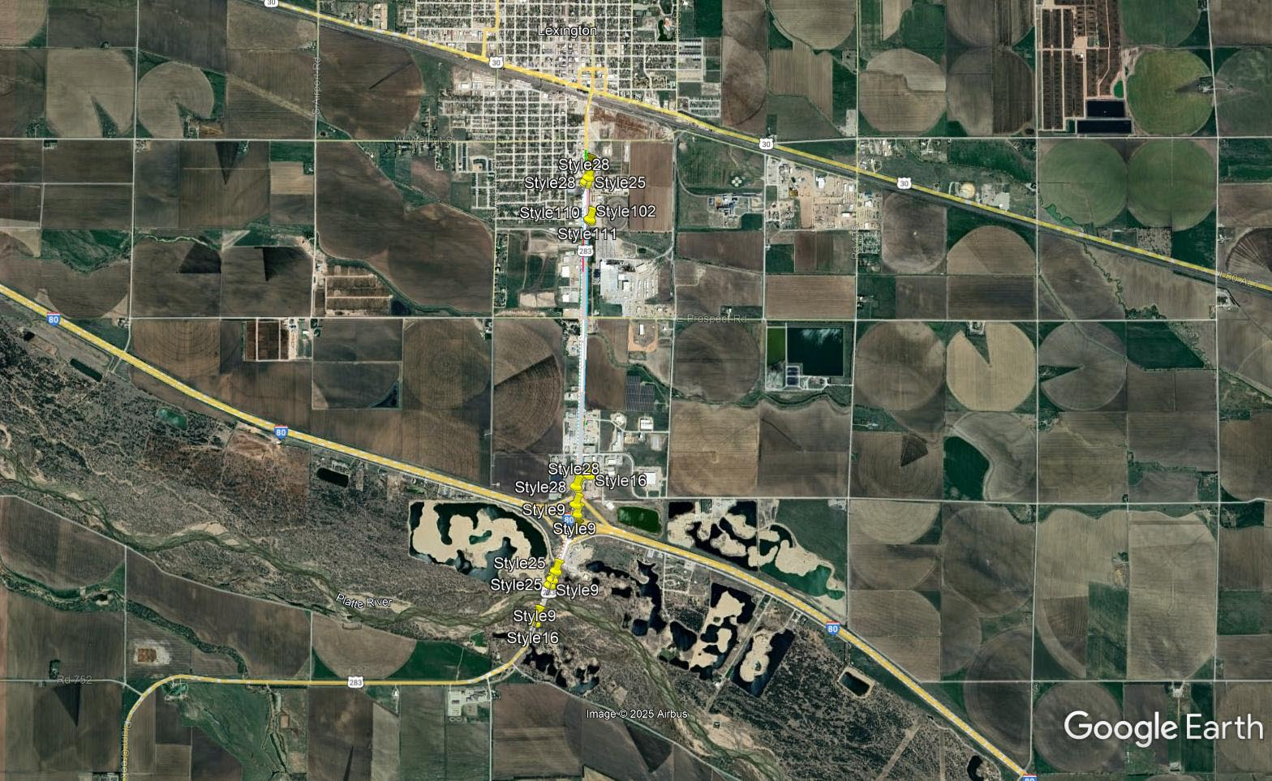

Slide 29
Leota – 1st St (NB), North Platte
Project Number: NH-83-2(129) Control No: 61360
Project Length: 1.07
Scope of Work:
  Urban Reconstruction

Slide 30
Leota – 1st St (NB), North Platte
Project Number: NH-83-2(129) Control No: 61360
Status: Design
Right-of-way: In Progress
Construction Timing: 4/5/2027 - 11/18/2028

Slide 31
Leota – 1st St (NB), North Platte
Project Number: NH-83-2(129) Control No: 61360
Anticipated Utilities Impact:
  Urban Reconstruction
  Storm Sewer
  Electrical
  Traffic Signals
Anticipated Request from Utilities:
Additional Information:
Utilities Involved:
  Allo Communications
  Charter Communications
  City of North Platte
  Great Plains Regional Medical
  Lumen
  North Platte Public School
  Northwestern Energy
  OPTK Networks

Slide 32
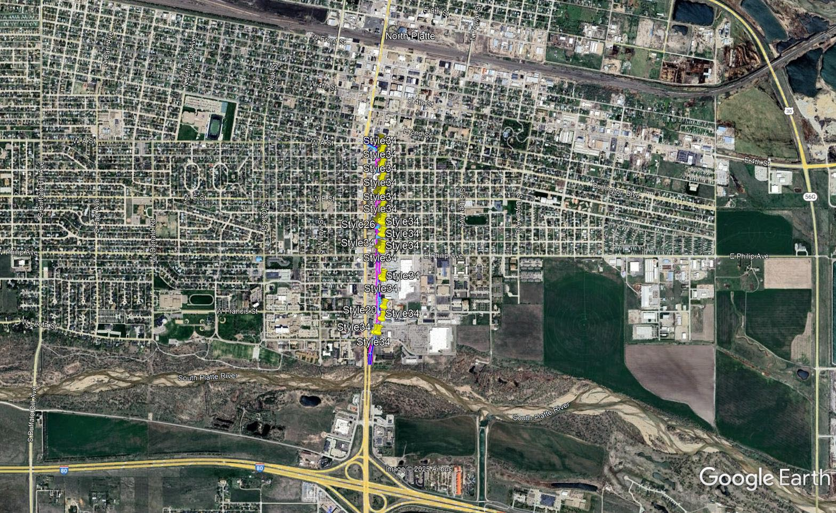

Slide 33
Maxwell South
Project Number: STP-S56A(107) Control No: 61648
Project Length: 2.10
Scope of Work:
  Bridge Replacement

Slide 34
Maxwell South
Project Number: STP-S56A(107) Control No: 61648
Status: Design
Right-of-way: In Progress
Construction Timing: 4/1/2027 - 11/4/2028

Slide 35
Maxwell South
Project Number: STP-S56A(107) Control No: 61648
Anticipated Utilities Impact:
Anticipated Request from Utilities:
Additional Information:
Utilities Involved:
  AT&T
  Black Hills Energy
  Charter Communications
  City of Maxwell
  Consolidated Telecommunications
  Dawson Public Power District
  Great Plains Communications
  Nebraska Department of Water, Energy, and Environment
  OPTK Networks
  Pinpoint Communications
  Tallgrass Energy
  T-Mobile/Sprint
  Verizon
  Viaero Fiber

Slide 36
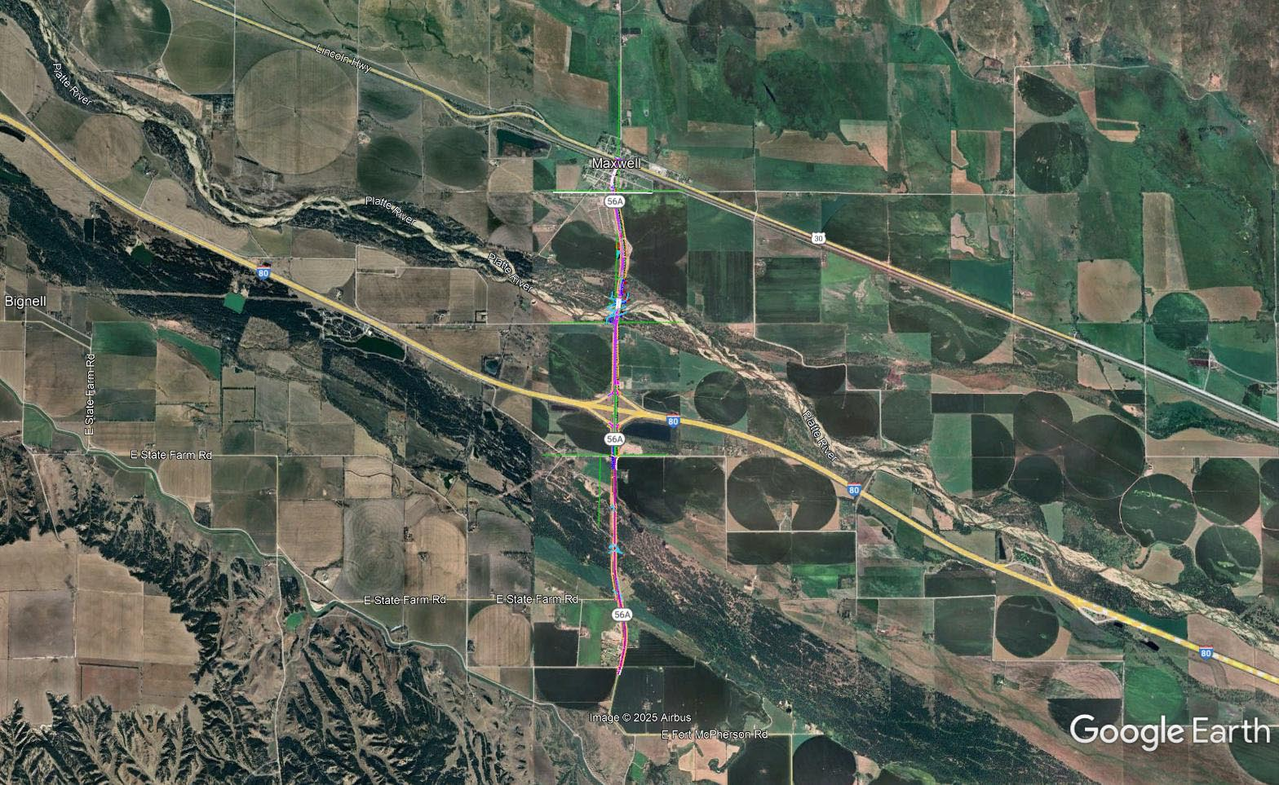

Slide 37
D6 Fiber Connectivity
Project Number: ITS-NH-83-2(145) Control No: 61767
Project Length: 3.05
Scope of Work:

Slide 38
D6 Fiber Connectivity
Project Number: ITS-NH-83-2(145) Control No: 61767
Status: Design
Right-of-way: Not Required
Construction Timing: 4/1/2027 - 10/31/2027

Slide 39
D6 Fiber Connectivity
Project Number: ITS-NH-83-2(145) Control No: 61767
Anticipated Utilities Impact:
  Fiber and Conduit Installation
Anticipated Request from Utilities:
Additional Information:
Utilities Involved:
  Allo Communications
  Charter Communications
  City of North Platte
  Great Plains Regional Medical Center
  Lumen
  North Platte Public School
  Northwestern Energy
  OPTK Networks
  Panhandle Geotech & Environmental
  Pinpoint Communications
  Village of Big Springs

Slide 40
Berwyn - Ansley
Project Number: NH-STP-2-3(130) Control No: 61703
Project Length: 8.51
Scope of Work:
  Pavement Repairs
  Bridge Repair

Slide 41
Berwyn - Ansley
Project Number: NH-STP-2-3(130) Control No: 61703
Status: Design
Right-of-way: In Progress
Construction Timing: 3/1/2027 - 10/31/2027

Slide 42
Berwyn - Ansley
Project Number: NH-STP-2-3(130) Control No: 61703
Anticipated Utilities Impact:
  Bridge Repair/Replace
Anticipated Request from Utilities:
  Provide Existing Locations
  Utilities Workshop
Additional Information:
  No K-Sheets Required
  Special Provisions Required
Utilities Involved:
  Black Hills Energy
  Custer Public Power District
  Hamilton Telecommunications
  Lumen
  Tallgrass Energy
  Viaero Fiber Network
  Village of Ansley

Slide 43
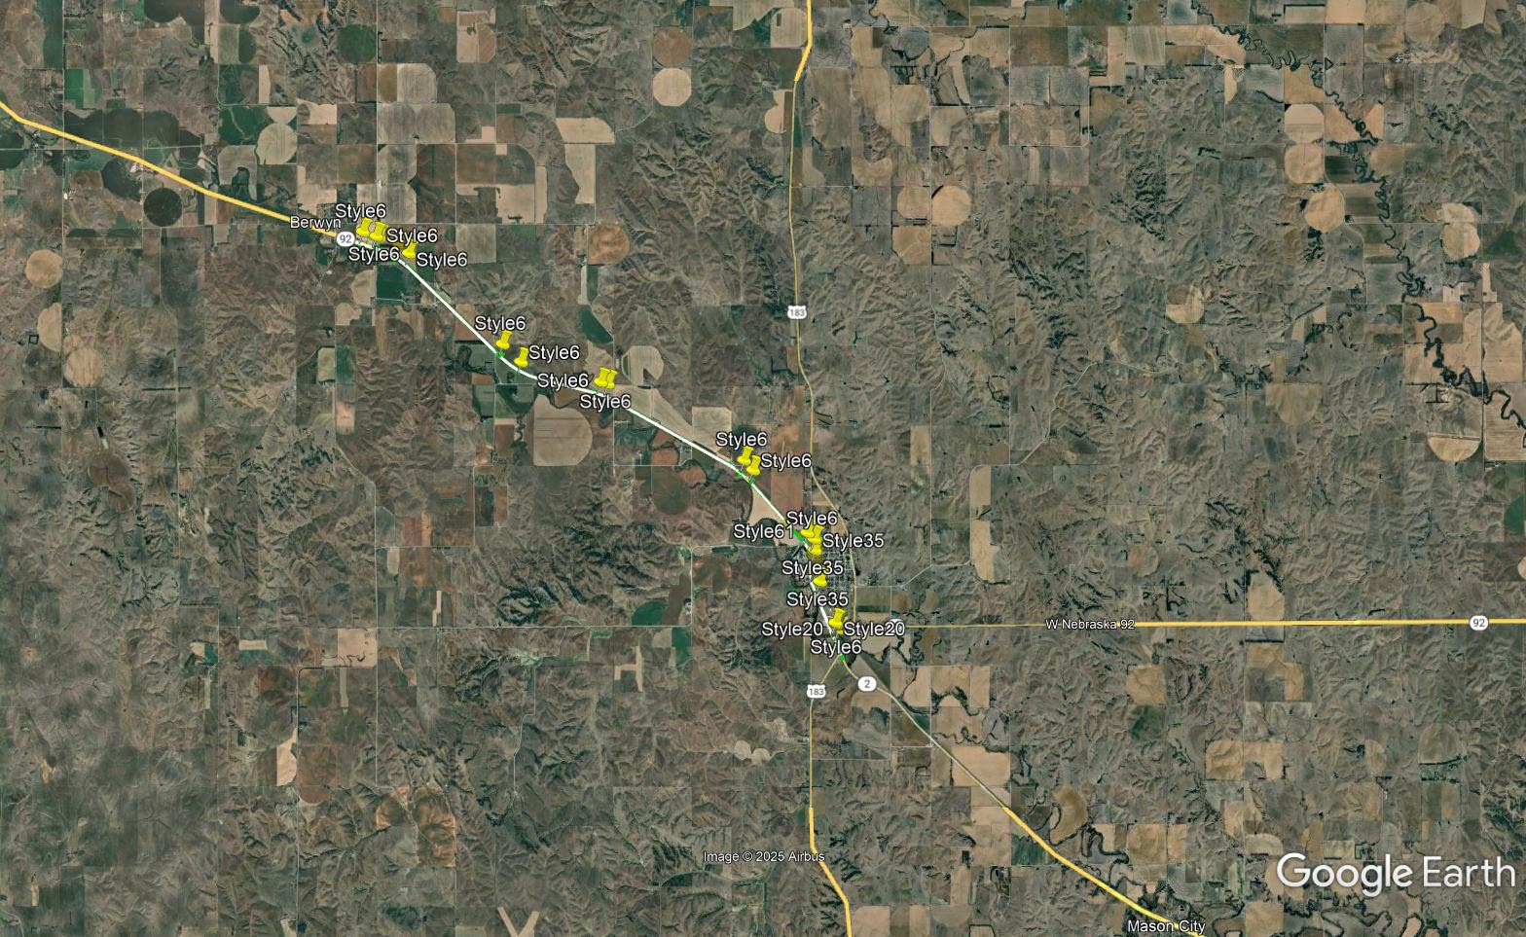

Slide 44
TRYON WEST
Project Number: STP-92-2(111) Control No: 61613
Project Length: 13.2
Scope of Work:
  Asphalt
  Shouldering
  Grading

Slide 45
TRYON WEST
Project Number: STP-92-2(111) Control No: 61613
Status:
Right-of-way: In Progress
Construction Timing: 4/10/2027 - 9/25/2027

Slide 46
TRYON WEST
Project Number: STP-92-2(111) Control No: 61613
Anticipated Utilities Impact:
  Asphalt
  Shouldering
  Grading
Anticipated Request from Utilities:
  Provide Existing Locations
Additional Information:
  Special Provisions Required
Utilities Involved:
  Great Plains Communications
  Custer Public Power District

Slide 47
Questions & Wrap Up
Notes:
HDR

Slide 48
Any final Questions?
Ask them now!
If you have questions after this meeting, or would like to view more detailed project maps, please reach out to your utility coordinator.
Notes:
HDR

Slide 49
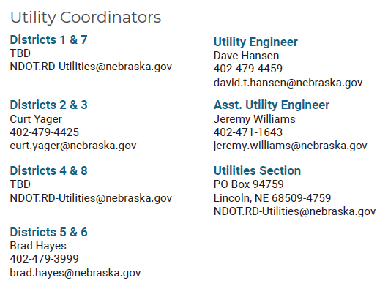
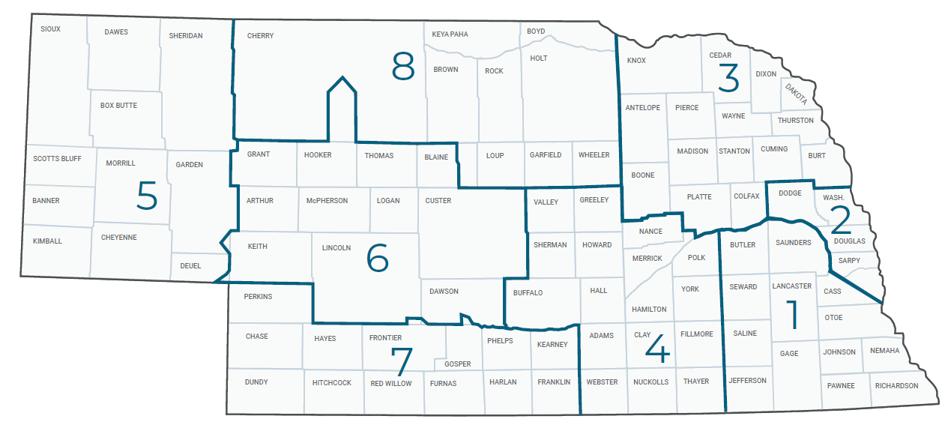
Have a Question about a project your Utility is involved in?
Contact your district’s utility coordinator!
Notes:
HDR

Slide 50
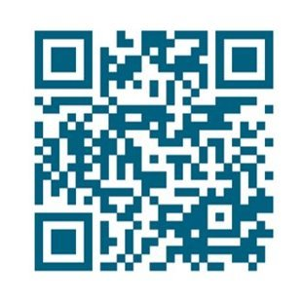
We need your feedback
Your valuable feedback helps these meetings – and NDOT’s utility coordination program – be better.
Use your phone’s camera to scan this QR code or use our paper survey.
Notes:
HDR

Slide 51
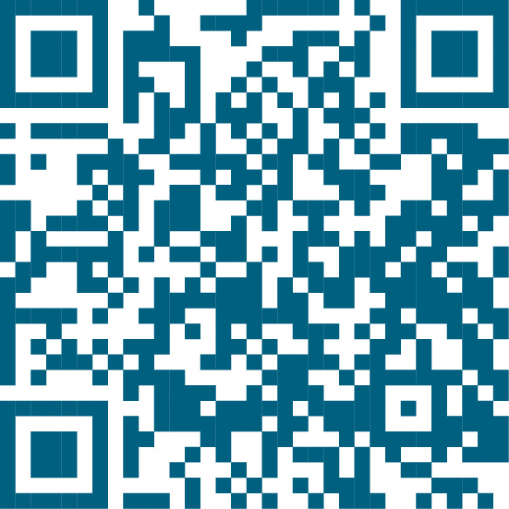
Visit our Website
Visit NDOT.info/utility for more information on:
Utility accommodation
Permitting
Coordination
Project information
Reimbursements
Additional information
Scan the QR Code to view the 2026 Program Book!
Notes:
HDR

Slide 52
Thank You
Notes:
HDR

