Slide 1
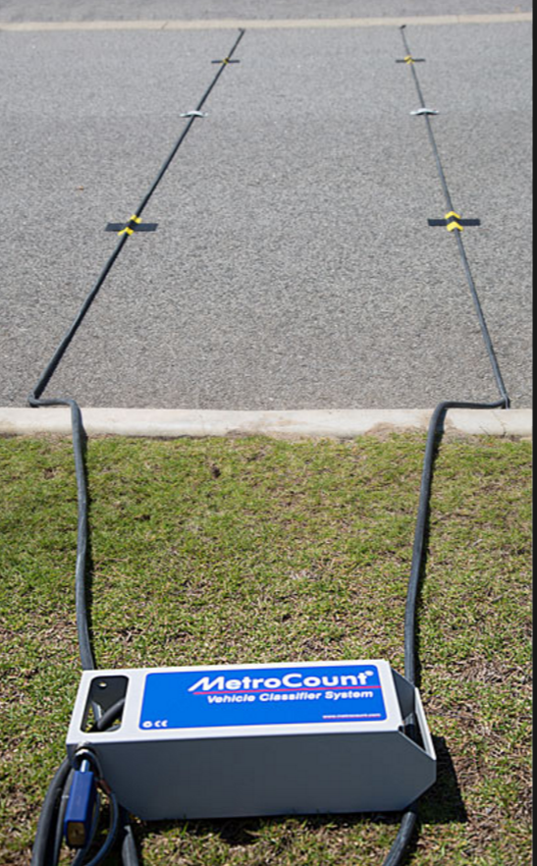
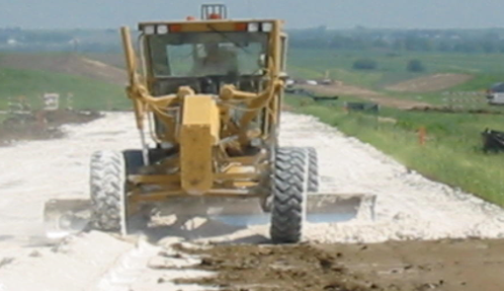
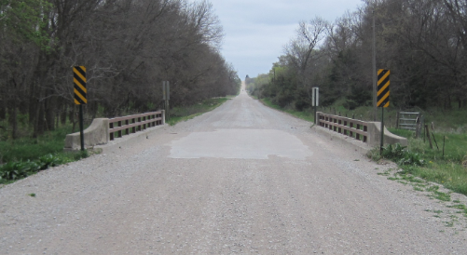
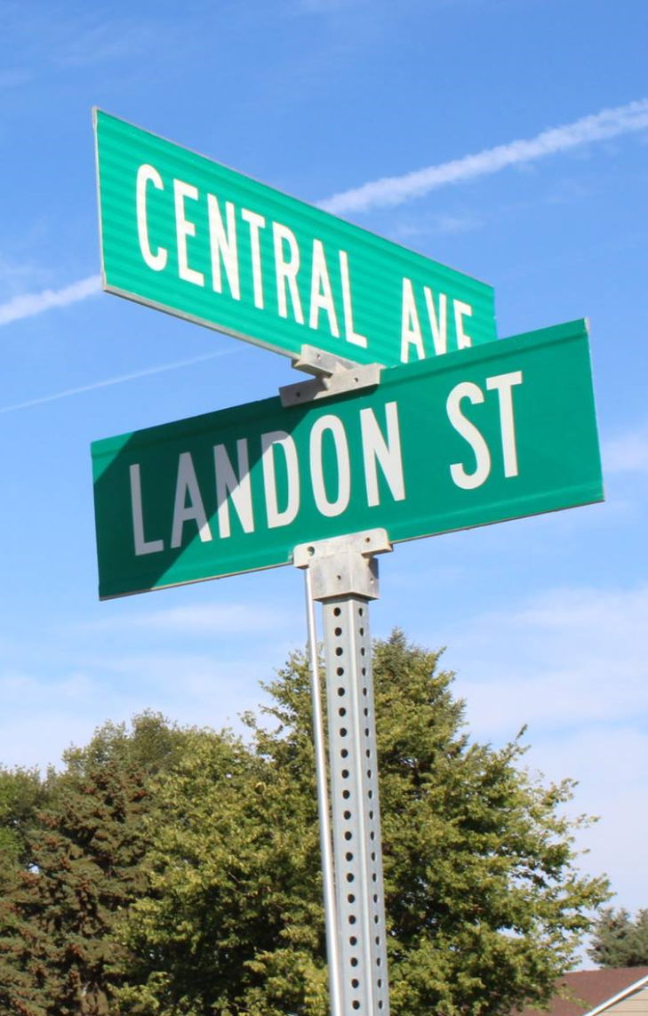
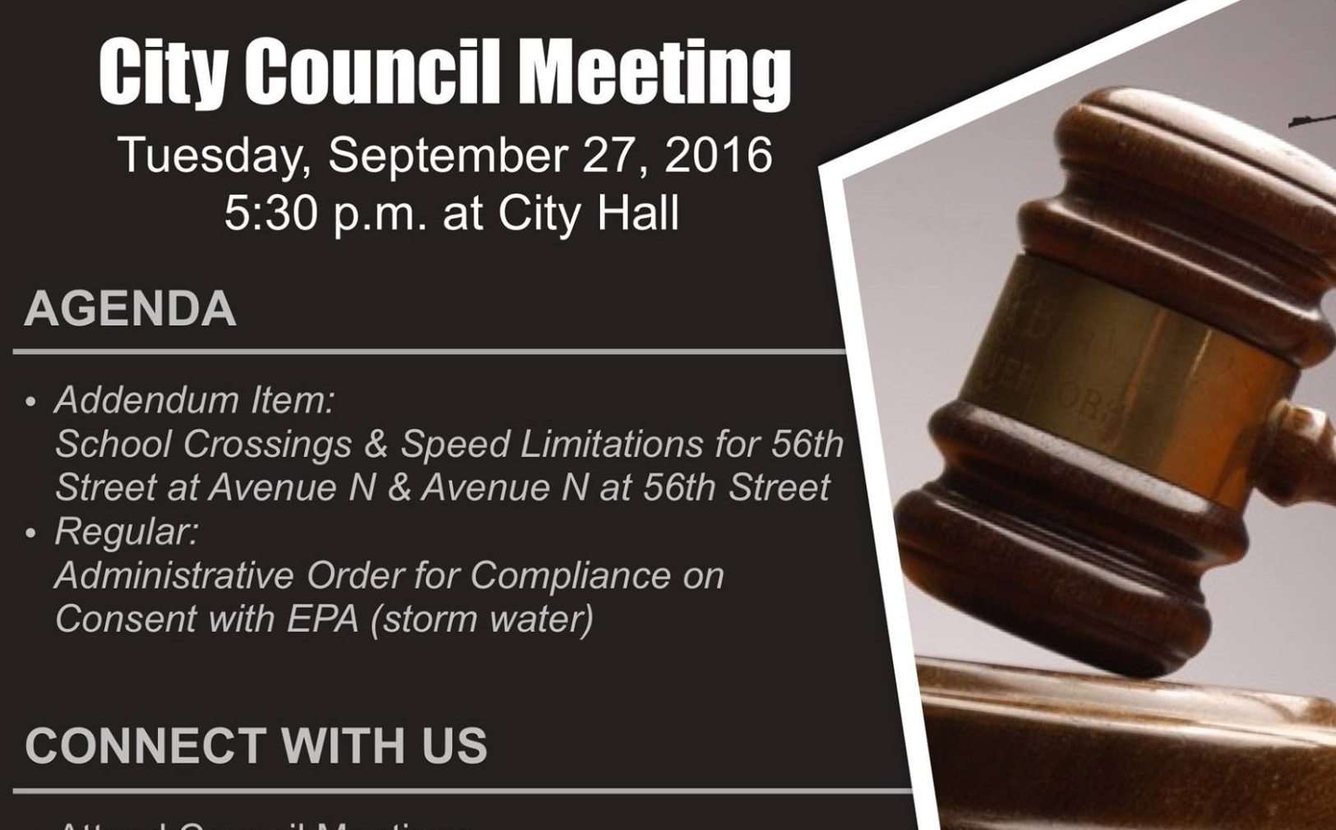
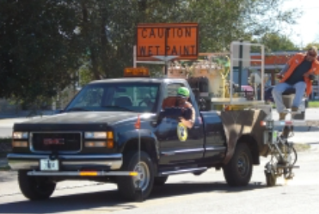

Managing Nebraska’s
Public Roads and Streets
Introduction – The “Big Picture”
Boards - Liaison Services Section
https://dot.nebraska.gov/business-center/lpa/boards-liaison/training/
8/5/2019
Video A
Notes:
8/5/2019 Updated Slide 8 (removed reference 39-2117), Slide 18 to point out potential penalties for not filing the annual certification form, etc. and slides 22-24 to explain more about annual budget reports to the Auditor, the State Auditor’s annual audits, and when the Federal audit process may be required or not required.
8/4/2019 Updated to reflect changes per LB82 (2019). The following slide numbers refer to the previous version (12/21/2017). Deleted Slide 2 (or the previous version) – it’s already in the Prelude video. Updated slides 3, 8, 10, 11 and 45 (12/21/2017 version slide numbers 4, 9, 11, 12, and 17). Updated the “Not for Audio” section of Slide 4 (12/27/2017 version Slide 5).
The following refers to slides from other presentations that are integrated into this one. A total of 25 slides added.
8/1/2019 Five slides (11 thru 13, 14, and 16) from the 12/21/2017 version of Video C, the OneAndSix Overview video (slides 1, 5, 6, 7 and 11), are incorporated into this Introduction video with changes per LB82 (2019).
8/1/2019 One slide (Slide 15) added new, showing a page from NDOT’s 2019-2024 Program Book as an example of a OneAndSix.
7/31/2019 Four slides (17, 19 thru 21) from the 12/21/2017 version of Video D, the SSAR Overview video (1, 7, 8, and 10), incorporated into this Introduction video with changes per LB82 (2019).
8/1/2019 Five slides (Slide 18, 22 thru 25) from the 2/21/2018 version of Day 3 session 309b LTAP Course Day 3 Fin-Acctng System presentation (Slides 3, 12, 13, 14 and 15), incorporated into this Introduction video with changes per LB82 (2019).
8/1/2019 Three slides (Slides 34 thru 36) from the 2/21/2018 version of 303_LTAP Course Day 3_Incentive Payments presentation (slides 2, 5, and 15).
8/1/2019 Seven slides (Slides 37 thru 43) from the 2/4/2019 version of 309a_LTAP Course Day 3_Funding presentation (slides 6, 7, 17, 18, 19, 22, and 26).
Welcome to “Managing Nebraska’s Public Roads and Streets Introduction – The Big Picture.”
This is the first in a series of videos the purpose of which is to summarize Nebraska’s management of public roads and streets as directed by state law and also by rule and regulation. Best practices and other related information are also included.
The target audience is county highway and city street superintendents, and those aspiring to attain those positions. Elected officials and anyone interested in the management of the state’s public roads and streets are also encouraged to view these videos to learn about Nebraska’s system of roads and streets.

Slide 2


Nebraska Highway Law
Slide 2
Notes:
8/1/2019 Updated to reflect changes per LB82 (2019).
This video summarizes Nebraska Highway Law, in particular key statutes pertaining to county roads and municipal streets, to provide the big picture view of the structure of Nebraska’s management of its road and street systems.
This video gives a Big Picture view of the structure of Nebraska’s management of its highway, road and street systems, according to Nebraska Highway Law.
It briefly discusses key statutes and requirements pertaining to county roads and municipal streets, emphasizing the importance of good management by the governing body and having a licensed county highway or city street superintendent.
State statutes control everything a county or municipality does.

Slide 3
Chapter 39
State Law
Key articles in Chapter 39:
21 – Functional Classification
23 – County Highway and City Street Superintendents Act
25 – Funding Distribution to Political Subdivisions
Slide 3
Notes:
7/31/2019 Updated to reflect changes per LB82 (2019).
Articles 21, 23 and 25 of Chapter 39, passed by the Legislature in 1969, created Nebraska’s current system of classification, management and funding for its highways, roads and streets.
The focus of this video is on Articles 21 and 23.
Funding Distribution will be addressed in the video on SSAR, Funding and Accounting.
This video gives a broad overview of the management and regulation of Nebraska’s public road and street system, including the two regulatory boards created by the Legislature, emphasizing the importance of good management by the governing body and a licensed county highway or city street superintendent,

Slide 4
Chapter 39
State Law
Key articles in Chapter 39:
21 – Functional Classification
23 – County Highway and City Street Superintendents Act
25 – Funding Distribution to Political Subdivisions
Slide 4
Notes:
7/31/2019 Updated to reflect changes per LB82 (2019).
The next few screens address some of the more important parts of Article 21.
NOT FOR AUDIO
Article 21 is important to this series of videos. Among other things,
It requires classification according to the function of a highway, road or street; this is called functional classification [39-2102 thru 39-2104],
assigns jurisdictional responsibility for the various functional classifications to the State, counties and incorporated municipalities [39-2105],
created the Nebraska Board of Public Roads Classifications and Standards (NBCS) [39-2106],
requires the NBCS to develop specific criteria for each functional classification [39-2109],
requires the NDOT to assign a functional classification to each segment of highway, road or street [39-2110],
requires the NBCS to develop minimum standards of design, construction and maintenance for each functional classification [39-2113]
encourages counties and municipalities to cooperate to gain efficiencies and lower costs [39-2114],
requires the NDOT, counties and municipalities to develop, each year, a One- and Six-Year plan or program of highway, road and street improvements [39-2115 thru 39-2119.01],
requires NDOT, counties and municipalities to annually report expenditures, revenues, inventory of supplies and equipment, and costs of operating equipment, to the NBCS [39-2120],
and allows the NBCS the right to make random checks of construction projects (39-2122].
In 39-2125, statute 13-914 is referenced along with 39-2101 thru 39-2105.
13-914.
Defective bridge or highway; compliance with standards; effect.
For purposes of sections 13-912 and 13-913, no minimum maintenance road or highway shall be deemed to be in want of repair or insufficient if it complies with the standards and level of minimum maintenance developed pursuant to section 39-2113.
Source
Laws 1983, LB 10, § 7;
R.S.1943, (1983), § 23-2411.01.

Slide 5
Chapter 39 Article 21
§39-2101 Provides
“The Big Picture”
State Law
In 1969, Nebraska Legislature declared the importance of:
Safe and efficient transportation over public roads is a priority
  An integrated system of public roads is needed
  Adequate Public Roads have many benefits
Slide 5
Notes:
State Statute 39-2101 is a declaration that provides a broad overview, or the Big Picture view of 1969 legislation, which at that time was a significant change in Nebraska’s approach to its system of highways, roads and streets. The Nebraska Legislature recognized, determined and declared that
Safe and efficient transportation over public roads is a matter of major importance to all Nebraskans
An integrated system of public roads is essential to the general welfare of the State. Providing an integrated system of facilities and the efficient management, operation, and control thereof are recognized as urgent problems and proper objectives of legislation pertaining to all public roads.
Adequate Public Roads
- Provide for the free flow of traffic
Protect the health and safety of the citizens of the state,
result in lower cost of motor vehicle operation
- Increase property values and
- Generally promote the economic and social progress of the state

Slide 6
§39-2101
“The Big Picture”
(continued)
State Law
Establishes a system of functional classification (§39-2103 and §39-2104)
Requires identification of each segment of public road or street according to the function it serves (§39-2109 thru §39-2112)
Enables uniform, reasonable, standards for each functional classification (§39-21139)
  - Design
  - Construction
  - Operation (Local Decision)
  Maintenance
Slide 6
Notes:
Fundamental to the development of an integrated system of public roads is a determination of the function that each road segment serves.
Through adoption by law of a functional classification system, it is the intent of the Legislature that each segment of public road be identified according to the function it serves
Identifying functional classifications permits the establishment of uniform standards for:
- Design
- Construction
- Maintenance
Standards must be adequate to meet the needs of an increasingly mobile society
For more information on these topics, see the Classification and Standards videos.

Slide 7
§39-2101
The Big Picture
(continued)
State Law
  Assigns responsibility for each segment of highway, road and street generally based on functional classification (§39-2105)
  Intends that each highway, road and street on the system be brought up to adequate standards over time
  Intends to provide reasonable financing and equitable distribution of revenue
Slide 7
Notes:
39-2101 assigns responsibility for public roads to the NDOT, counties and municipalities based on functional classification.
The intent is that each segment of road or street eventually be brought up to New & Reconstructed standards
And to provide reasonable and equitably distributed revenues.

Slide 8
§39-2101
The Big Picture
(continued)
State Law
  Encourages efficient management, operation, and control of public roads, and requires transparency
Requires continuous planning and development
  Long-range planning via a 6-Year Plan (§39-2115)
  Annual Programming via a 1-Year Plan (§39-2119)
  Systems of Budgeting, Accounting and Inventory (§39-2120)
Encourages the state, its counties, and its municipalities to work in cooperation and as equal partners (§39-2114)
Slide 8
Notes:
8/5/2019 removed the reference to 39-2117 in the first bullet under (h)
8/1/2019 Updated to reflect changes per LB82 (2019).
39-2101 encourages Improved Management Methods of:
- Planning
- Programming
- Budgeting
- Reporting
Accounting
Inventory
Such management will provide citizens the opportunity to know how each governmental entity intends to spend its road and street money, and to determine its performance when measured against its plans
It requires Continuous Planning and Development:
- Long Range Planning (6-year plans) and Annual Programing (1-year plans) updated annually
- Each entity programs its needs on a Priority Basis
It Allows some Flexibility, as Annual Programs cannot always be met due to unforeseen problems and opportunities (one-year plan revisions)
And it requires annual financial and inventory reporting
Cooperation among governmental entities is essential in bringing to fruition the development of a truly integrated system of public roads
The Legislature provides by law the structure upon which the state, its counties, and its municipalities can work as equal partners in the development, operation, and management of such a system

Slide 9
State Oversight & Support
Two Regulatory Boards
State Law
Board of Public Roads Classifications and Standards (NBCS)
§39-2106 thru §39-2108
428 NAC
Board of Examiners for County Highway and City Street Superintendents (BEX)
§39-2304 & §39-2305
425 NAC
https://dot.nebraska.gov/business-center/lpa/boards-liaison/
https://dot.nebraska.gov/business-center/lpa/boards-liaison/nbcs/downloads/
https://dot.nebraska.gov/business-center/lpa/boards-liaison/bex/downloads/
Slide 9
Notes:
There are two boards created by state statutes for regulating Nebraska’s public highways, roads and streets:
NBCS has 11 members
BEX has 7 members
Both Boards have a wide range of representation required by statute
They are Appointed by the Governor
And all have Four-year terms
Rule and regulations for highways, roads and streets are part of the Nebraska Administrative Code, or NAC.
Rules and regulations are interpretations of state statutes and have the force of law.
428 NAC and 425 NAC are the rules and regulations adopted by these Boards, respectively
You can find them on the SOS website, or NDOT’s website
Shown at the bottom of the screen

Slide 10
NBCS
RESPONSIBILITIES
State Law
Develop specific criteria for each Functional Classification (§39-2109)
Render Decisions on Functional Classification Appeals (§39-2111)
Develop Minimum Standards (§39-2113)
Develop programs and project strategies that provide additional design and maintenance flexibility. (§39-2113)
Render Decisions on Relaxation of Standards Requests (§39-2113)
Render Decisions on Penalties (§39-2121 et al)
Make Random Inspections of Construction Projects (§39-2122)
Slide 10
Notes:
8/2/2019 Updated to reflect changes per LB82 (2019).
Responsibilities of the Board or Public Roads, or NBCS, are to
Prioritize State-aid Bridge Fund spending
Develop specific criteria for Each functional classification
Hear appeals on Functional Classification issues
Develop minimum standards for each functional classification
In cooperation with NDOT, counties and municipalities, develop, support, approve and implement programs and project strategies that provide additional flexibility in the design and maintenance standards. [from LB82 (2019)]
Hear and decide on Relaxation of Standards requests
Receive interlocal agreements
Apply penalties
And Make random inspections of construction projects as needed
SHOULD WE ADD PRACTICAL PROGRAMS REQUESTS?

Slide 11
Managing Nebraska’s
Public Roads and Streets
Continuous Planning and Programming
One- and Six-Year
Plans and Programs
Boards - Liaison Services Section
https://dot.nebraska.gov/business-center/lpa/boards-liaison/training/
Notes:
7/31/2019 Updated to reflect changes per LB82 (2019). This is Slide 1 from the 12/21/2017 version of Video C, the OneAndSix Overview video, incorporated into this Introduction video with changes per LB82 (2019).
State statute section 39-2101 requires continuous planning and development. Part of that requirement is satisfied with an annual OneAndSix Year Plan or Program. A public hearing is required for the One-Year Plan or Program. Other statutes, 39-2115 thru 39-2119, address this in more detail.
Welcome to “Managing Nebraska’s Public Roads and Streets Planning and Reporting, One- and Six-Year Plans, Rule and Regulation Title 428 NAC Chapter 3.
The focus of this video will be reporting required for counties and municipalities.
This is the third topic in a series of videos the purpose of which is to summarize Nebraska’s management of public roads and streets as directed by state law and also by rule and regulation.
The target audience is county highway and city street superintendents, and those aspiring to attain those positions. Elected officials and anyone interested in the management of the state’s public roads and streets are also encouraged to view this.

Slide 12
Purpose of OneAndSix
Planning and Programming
Promote the orderly development of an integrated system of Nebraska’s public roads
Slide 12
Notes:
7/31/2019 Updated to reflect changes per LB82 (2019). This is Slide 5 from the 12/21/2017 version of Video C, the OneAndSix Overview video, incorporated into this Introduction video. No changes made to the slide.
The purpose of OneAndSix Planning is to [read slide]
OneAndSix provides the public with information and expectations,
yet allows for flexibility
such as changes in funding or for emergency projects
The law, in effect, discourages inefficient, haphazard and inconsistent planning and construction of works and projects.

Slide 13
Benefits of OneAndSix
Planning and Programming
A good management tool
Promotes planning and prioritizing work
Cooperation and coordination
Public involvement and input
Transparency in Government
Slide 13
Notes:
7/31/2019 Updated to reflect changes per LB82 (2019). This is Slide 6 from the 12/21/2017 version of Video C, the OneAndSix Overview video, incorporated into this Introduction video with changes per LB82 (2019).
The benefits of OneAndSix Planning are
It serves as a good management tool,
Allows the state, counties and municipalities to work as equal partners in the orderly development, operation and management of an integrated system of public roads
Provides a structure for cooperation and coordination among government entities for works/projects, timetables and funding
Allows public input at a hearing at least annually
Maximizes use of public funds and informs the public where and how funds are being applied
Uses a standardized system of reporting, i.e. Municipalities and counties are under the same laws and report on the same forms

Slide 14
OneAndSix Plan/Program
Six-Year Plan or Program: works/projects that can be accomplished over the next six years
One-Year Plan or Program: those Six-Year Plan works/projects intended to be accomplished in the first year of the plan or program
Slide 14
Notes:
7/31/2019 Updated to reflect changes per LB82 (2019). This is Slide 7 from the 12/21/2017 version of Video C, the OneAndSix Overview video, incorporated into this Introduction video with changes per LB82 (2019).
The Name “OneAndSix” denotes planning a program of works and projects for a six-year period, and requires designation of those works and projects intended to be accomplished in the first year of the plan.
More precisely . . ..
002.01 DEFINITION AND SCOPE OF WORKS/PROJECTS, AND FUNDING SOURCES – The One- and Six-Year Plan consists of planned works and projects, for which the reporting entity has responsibility (or shared responsibility – see 002.03), that can be accomplished over the next six years and within the estimated available funding for those six years. Funding may be from any source dedicated to highways, roads and streets.
002.02 DEFINITION OF ONE-YEAR PLAN – Works and projects included in the One- and Six-Year Plan that are intended to be accomplished in the first year and typically within the estimated available funding for the first year of the plan, are referred to in this regulation collectively as the One-Year Plan. These works and projects must be designated on the NBCS Summary of One- and Six-Year Plan form.

Slide 15
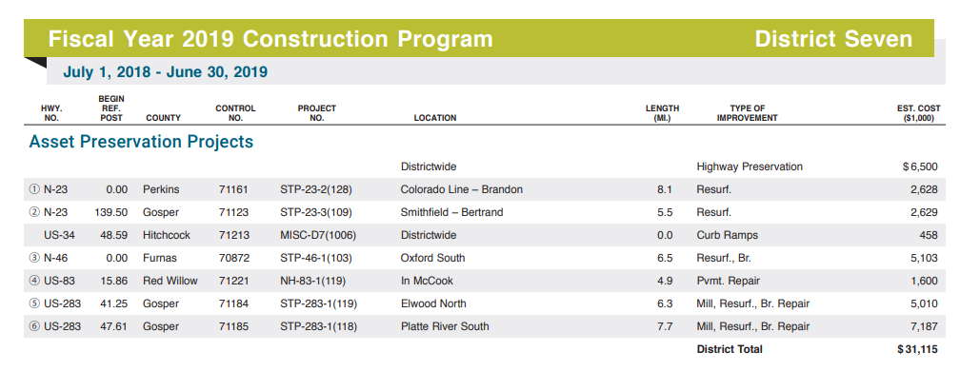
Example – NDOT’s Program
Example OneAndSix Plan/Program
https://dot.nebraska.gov/projects/publications/program-book/
Notes:
7/31/2019 Updated to reflect changes per LB82 (2019). This slide is added as an example only.
There are many ways a OneAndSix Plan or Program can be presented to the public.
This shows one example.
It is a page from the Nebraska DOT’s annual program, presenting projects in a list format.
It is up to each entity to determine its own format and what to present to the public.

Slide 16
OneAndSix Plan/Program Process
Develop works/projects annually
Advance Notification Requirements: per your governing body
Public Hearing – seek public input – 39-2119 requires a public hearing for the One-Year Plan or Program
Governing body adopts the Plan after considering Public Hearing input
Implementation
Do not submit the OneAndSix Plan/Program to the NBCS
Slide 16
Notes:
7/31/2019 Updated to reflect changes per LB82 (2019). This is Slide 11 from the 12/21/2017 version of Video C, the OneAndSix Overview video, incorporated into this Introduction video with changes per LB82 (2019).
The submittal OneAndSix process is to
Plan and develop the needed works and projects annually.
Seek public input via a public hearing.
Adopt the Plan after considering public input.
Finally, Submit the OneAndSix Report to the NBCS.
And then implement the plan or program.
Note that in 2019, the Legislature passed a bill that no longer requires the NDOT, counties and municipalities to submit OneAndSix Year Plan or Program reports to the Nebraska Board of Public Roads Classifications and Standards.

Slide 17
Managing Nebraska’s
Public Roads and Streets
Budgeting, Accounting, and Inventory
Requirements of §39-2120
Boards - Liaison Services Section
https://dot.nebraska.gov/business-center/lpa/boards-liaison/training/
Notes:
7/31/2019 Updated to reflect changes per LB82 (2019). This is Slide 1 from the 12/21/2017 version of Video D, the SSAR video, incorporated into this Introduction video with changes per LB82 (2019).
The next several slides present State Law relating to the budgeting, accounting and inventory for highway, road and street programs in Nebraska.

Slide 18
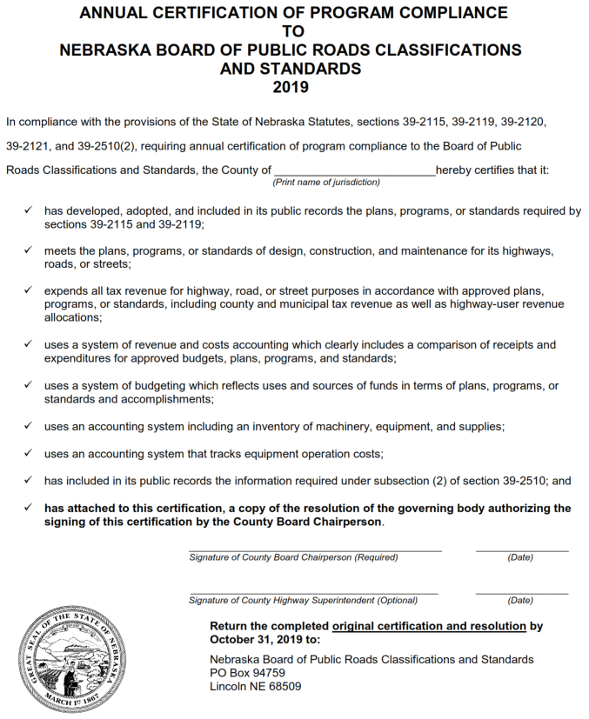
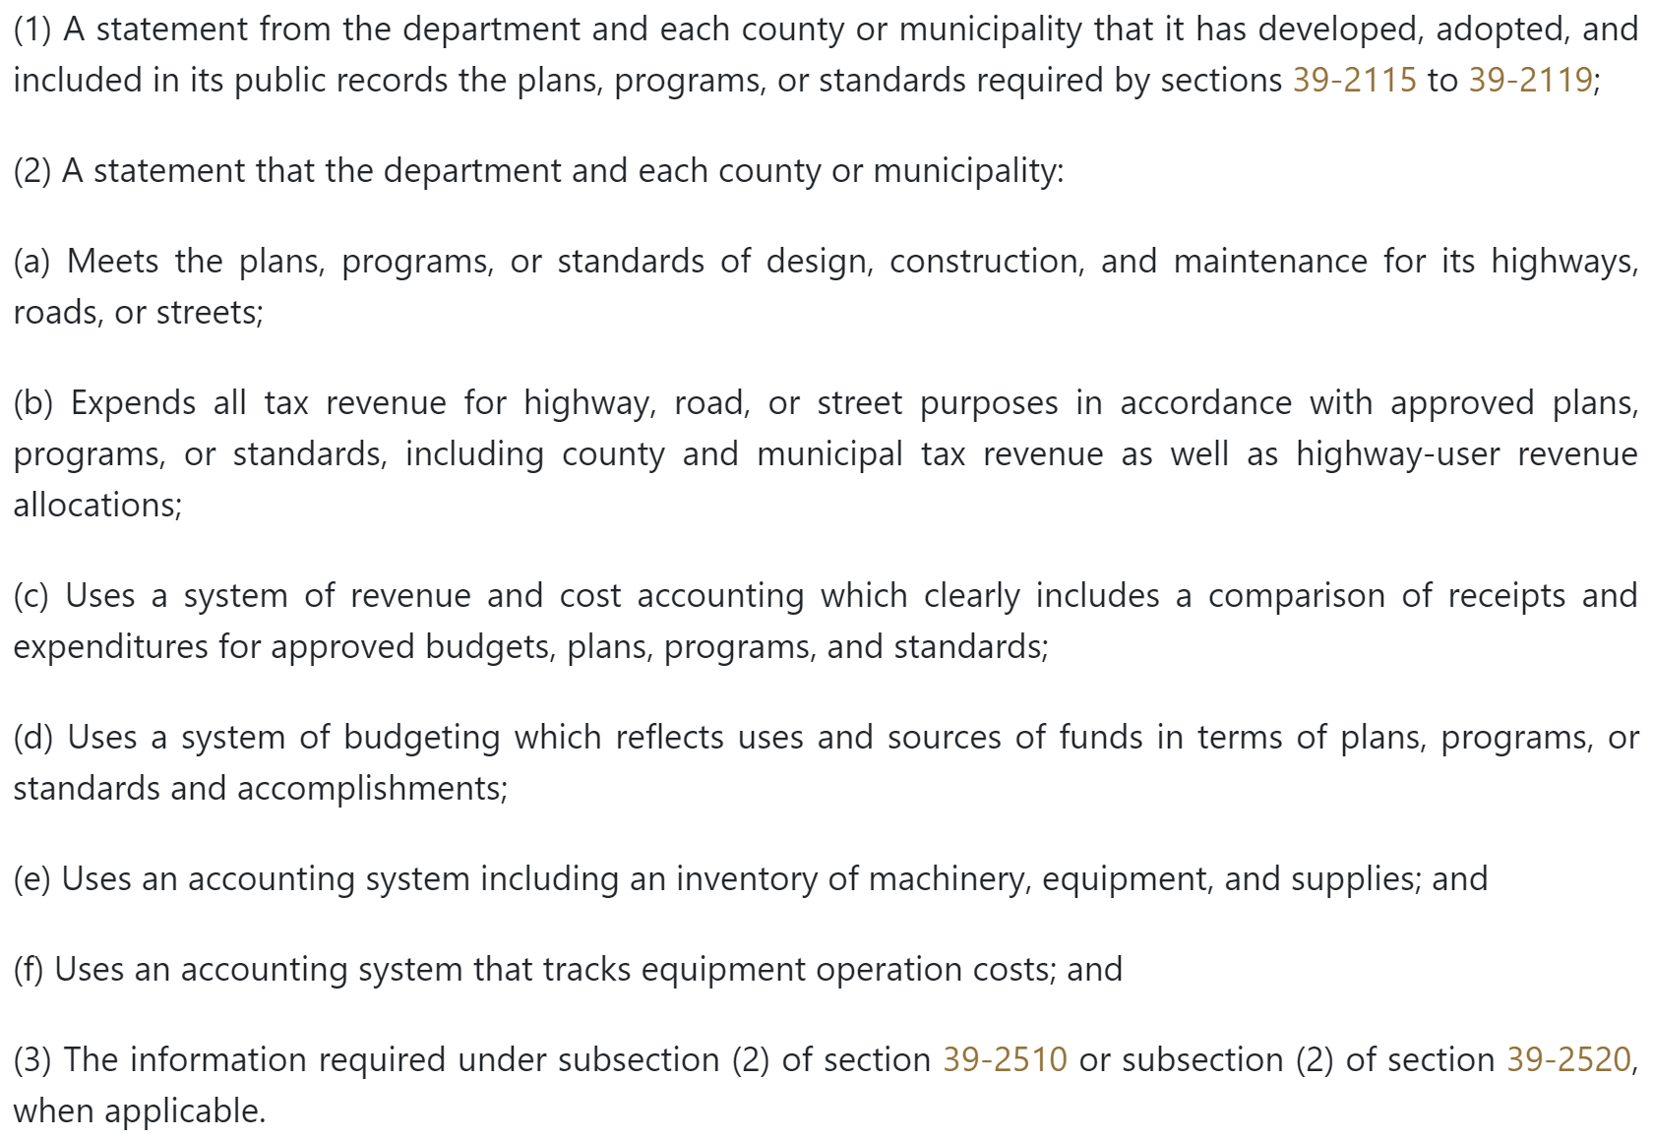
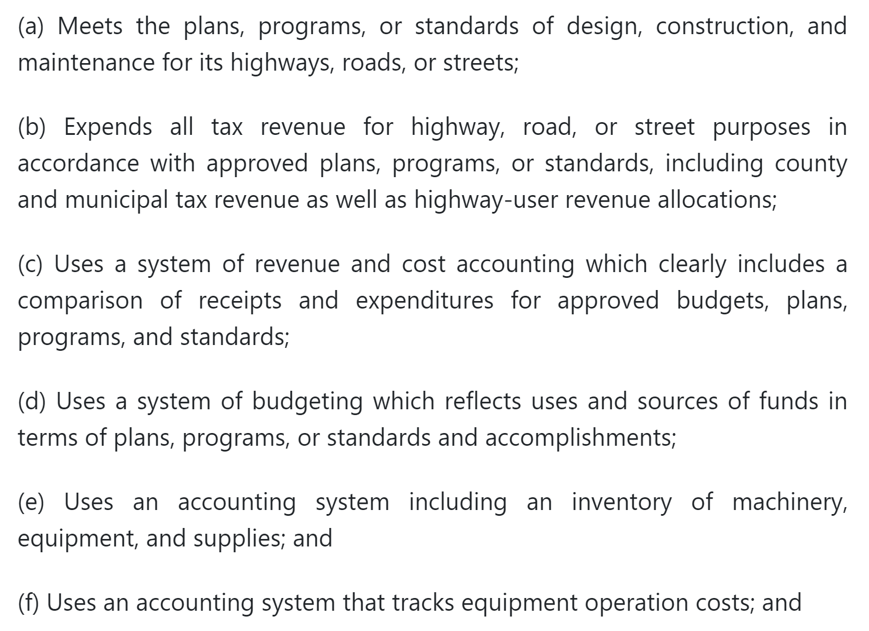
Certification of Program Compliance
Required by §39-2120
Filing a False Certification or Constructing Below NBCS Standards
Lose 10% of Next Calendar Year’s Highway-user Revenue.
Financial and Accounting System
Return by October 31, with Resolution
Failure to File Highway-user Revenue Held in Escrow
Slide 18
Notes:
8/15/2019 Updated audio media added mentioning the penalty for failing to file the annual certification of program compliance.
7/31/2019 Updated to reflect changes per LB82 (2019). This is Slide 3 (modified by adding an image of the new annual certification form) from the 2/21/2018 version of Day 3 session 309b LTAP Course Day 3 Fin-Acctng System presentation, incorporated into this Introduction video with changes per LB82 (2019).
---------------------------------------------------------------------------------------------------------------------------
The 2019 Legislature passed a bill called LB82 that requires an annual Certification from the Nebraska DOT, and from each county and municipality, that its highway, road or street program has complied with the conditions set forth in 39-2120.
The certification form will be mailed to County Clerks, City Clerks and Village Clerks each year, to be signed and returned to the Nebraska Board of Public Roads Classifications and Standards by October 31. It must be accompanied by a resolution authorizing the signatures on the certification.
Failing to submit this Certification form by its due date will result in the suspension of monthly Highway Allocation Fund distributions to the political jurisdiction. The money is held in escrow. If the county or municipality complies within six months, it will receive the money in the escrow account. If not, the county or municipality loses the money.
Filing a materially false certification form, or constructing any highway, road or street below NBCS minimum standards without prior approval will result in a reduction of ten percent of the county’s or municipality’s share of highway-user revenue allocated during the following calendar year. The penalty is assessed only after NBCS reviews the facts and holds a public hearing on the matter.
LB82 also eliminated the requirement to submit OneAndSix Plans and Programs, and the Standardized System of Annual Reporting to the Nebraska Board of Public Roads Classifications and Standards.
The next several slides address the conditions of state statute 39-2120 in more detail, specifically the financial aspects.

Slide 19
State Law
§39-2120
Certification of Program Compliance
Requirements
(1) Meets NBCS standards of design, construction, and maintenance
(2) All tax revenues for road or street purposes have been expended properly, for roads and streets
(3) Use a system of revenue and accounting which clearly indicates a comparison of receipts and expenditures to approved budgets, plans, programs and standards
Slide 19
Notes:
7/31/2019 Updated to reflect changes per LB82 (2019). This is Slide 7 from the 12/21/2017 version of Video D, the SSAR video, incorporated into this Introduction video with changes per LB82 (2019).
State law requires that the highway, road or street program - of NDOT, and each county and municipality - must
(1) A procedure for documenting and certifying that standards of design, construction, and maintenance of roads and streets have been met; Meet the plans, programs, or standards of design, construction, and maintenance for its highways, roads, and streets
A procedure for documenting and certifying that all tax revenues for road or street purposes have been expended in accordance with approved plans and standards, to include county and municipal tax revenue, as well as highway- user revenue allocations made by the state; Expend all tax revenue for highway, road, or street purposes in accordance with approved plans, programs, or standards, including county and municipal tax revenue as well as highway-user revenue allocations
(3) A uniform system of accounting which clearly indicates, through a system of reports, a comparison of receipts and expenditures to approved budgets and programs; Use a system of revenue and cost accounting which clearly includes a comparison of receipts and expenditures for approved budgets, plans, programs, and standards

Slide 20
State Law
§39-2120
Certification of Program Compliance
Requirements
(continued)
(4) Uses a system of budgeting
Uses a system of accounting for
inventory of machinery, equipment, and
supplies
Uses a system of accounting that tracks
equipment operation costs
Do not submit annual financial, budgeting or accounting information to the NBCS
Slide 20
Notes:
7/31/2019 Updated to reflect changes per LB82 (2019). This is Slide 8 from the 12/21/2017 version of Video D, the SSAR video, incorporated into this Introduction video with changes per LB82 (2019).
The law also requires that the NDOT, and each county and municipality
(4) A system of budgeting which reflects uses and sources of funds in terms of programs and accomplishments; Uses a system of budgeting which reflects uses and sources of funds in terms of plans, programs, or standards and accomplishments
(5) An approved system of reporting an inventory of machinery, equipment, and supplies; Uses an accounting system including an inventory of machinery, equipment, and supplies
An approved system of cost accounting of the operation of equipment Uses an accounting system that tracks equipment operation costs
Do not submit annual financial, budgeting or accounting information to the NBCS.

Slide 21
428 NAC Chapter 4 (SSAR)
Benefits of State Law Requirements for Highway, Road and Street Programs
Promotes good management of roads and streets
Provides status of the highway, road or street program – comparing expenditures, revenues and accomplishments
Provides evidence of compliance with the law
Slide 21
Notes:
7/31/2019 Updated to reflect changes per LB82 (2019). This is Slide 10 from the 12/21/2017 version of Video D, the SSAR video, incorporated into this Introduction video with changes per LB82 (2019).
39-2120
State Law
Promotes good management of roads and streets by requiring budgeting and accounting systems.
With the required tools in place, it Allows the public to get a complete picture a comparison of roads and streets budgets and to accomplishments for each county and municipality
And provides evidence of compliance with the law. Agencies are required to certify that public funds dedicated to roads and streets were spent properly, and that standards were met. Reports to the NBCS, as well as information on file at each county and municipality, provide evidence that public funds were spent according to the law.
NOT FOR AUDIO
Since all municipalities and counties report the same way on the same forms, agencies can be compared and statewide figures can be compiled.

Slide 22

Annual Budget Report to:
State Auditor
Filed for Mill Levy Purposes
All Political Jurisdictions Required to
File Annually by September 20
ALL REPORTS AVAILABLE ONLINE!
http://auditors.nebraska.gov/Budget_Info.html
http://www.auditors.nebraska.gov/Budget_Info/Budget_FAQ.html
Slide 22
Notes:
8/5/2019 added audio media explaining that the submitted budgets are the overall County or Municipality budget
7/31/2019 Updated to reflect changes per LB82 (2019). This is Slide 12 from the 2/21/2018 version of session 309b LTAP Course Day 3 presentation Fin-Acctng System, incorporated into this Introduction video with changes per LB82 (2019).
Although there is no more Standardized System of Annual Reporting to the NBCS, there is still a requirement to submit an annual budget report to the State Auditor’s office. These reports are eventually made available online.
The budget referred to here is the overall budget for the political jurisdiction. Not an individual, itemized, Road or Street budget.
Villages FY ends after September 20.
SSAR reports require actual funds.

Slide 23
Annual Audit
State Auditor
Annual Audit Requirement
Exception: smaller political jurisdictions can apply for a waiver

Slide 23
Notes:
8/5/2019 added audio media explaining that the submitted budgets are the overall County or Municipality budget
7/31/2019 Updated to reflect changes per LB82 (2019). This is Slide 13 from the 2/21/2018 version of session 309b LTAP Course Day 3 presentation Fin-Acctng System, incorporated into this Introduction video with changes per LB82 (2019).
Audits are required annually, through the State Auditor's office.
This is not referring only to the Street or Roads budget. It’s the entire budget of the political jurisdiction that is subject to audit.
It is not a requirement of the NDOT, the NBCS or the BEX.
NOT FOR AUDIO
Those spending less than $300,000 can apply for a waiver.

Slide 24


Independent Audits
Federal-aid Projects

Need to arrange for an independent audit of agency’s financial reports.
Audit reports for Federal-aid projects need to be sent to NDOT per the project agreement
All project documentation must be available at the county or city office for State or Federal audit inspections

Slide 24
Notes:
8/5/2019 added audio media explaining that this slide applies only to entities that manage all the funding.
7/31/2019 Updated to reflect changes per LB82 (2019). This is Slide 14 from the 2/21/2018 version of session 309b LTAP Course Day 3 presentation Fin-Acctng System, incorporated into this Introduction video with changes per LB82 (2019).
If your entity has a Federal-aid project through the NDOT, an independent audit may be required.
This applies to political jurisdictions that control, manage and process Federal-aid road or street project funding.
If the Nebr DOT serves as the processor and manager of payments and revenues on behalf of a county’s or municipality’s Federal-aid project, this Federal audit requirement does not apply.
NOT FOR AUDIO
Some county clerks do this.
$500,000 requires an audit.

Slide 25
Financial Records Retention
Retain project-related cost documentation and transactions
Until approved record retention requirements have been met
  Federal requirements may be different than State or Local requirements
Assign unique project identifiers for each project
  Project Number, Control Number, Agreement Number, Work Order Number, etc.
  Label or include unique project identifiers on all project-related documents including financial transactions (invoices, etc.). Require contractors and consultants to do the same.
  Prevents confusion or re-use on other projects

58-1234
Slide 25
Notes:
7/31/2019 Updated to reflect changes per LB82 (2019). This is Slide 15 from the 2/21/2018 version of session 309b LTAP Course Day 3 presentation Fin-Acctng System, incorporated into this Introduction video with changes per LB82 (2019).
Record-keeping is very important. Appropriate records must be available for auditors.
Federal record keeping requirements may be different than state requirements, so be sure to understand the differences if you take on a Federal-aid project.
Individual projects should be tracked separately, with unique project identifiers on the documentation.

Slide 26
Chapter 39
State Law
Key articles in Chapter 39:
21 – Functional Classification
23 – County Highway and City Street Superintendents Act
25 – Funding Distribution to Political Subdivisions
Slide 26
Notes:
The next few screens address some of the more important parts of Article 23
NOT FOR AUDIO
Article 23, the County Highway and City Street Superintendents Act,
defines superintending [39-2301.01],
requires superintendents to be licensed [39-2302],
creates the Board of Examiners for County Highway and City Street Superintendents [39-2304],
requires the Board of Examiners to conduct an examination twice annually for applicants for Class B licenses [39-2307],
And requires professional development hours for superintendents [39-2308.02]

Slide 27
County Highway and City Street Superintendent Act
§39-2301 to §39-2311
State Law
Purposes:
  To Safeguard life, health, property
  To further Professional Management of road & street programs
  Create the Board of Examiners (BEX)
  Provide for Licenses
Slide 27
Notes:
The County Highway and City Street Superintendent Act is covered by Article 23 of Section 39 of the State Statutes. The purposes of this Article are:
Read the bullets
For county highway and city street superintendents
For a licensing system for those superintendents
NOT FOR AUDIO
§39-2301
The Legislature finds that in order to safeguard life, health, and property, and in order to
further professional management of county road and municipal street programs, persons
practicing or offering to practice street or highway superintending in this state are encouraged to
become licensed as provided in the act.

Slide 28
BEX
RESPONSIBILITIES
State Law
Receive Superintendent license applications (§39-2306)
Conduct examinations of applicants (§39-2307)
Renew licenses annually (§39-2308)
Approve activities for professional development hours (§39-2308.02)
Suspend or revoke licenses (§39-2309)
Adopt rules and regulations for administering the County Highway and City Street Superintendents Act (§39-2311)
Slide 28
Notes:
The responsibilities of the Board of Examiners for County Highway and City Street Superintendents are:
Receive applications for the Superintendent’s license
Conduct examinations of applicants
Renew licenses annually
Approve PDH’s
Suspend or revoke licenses
And administer, through rules and regulations, the County Highway and City Street Superintendents Act.
Exam tests qualifications of applicants and covers ability to:
Develop and annually update long-range plans based on needs and coordinated with adjacent local governmental units;
Develop annual programs for design, construction, and maintenance;
Develop annual budgets based on programmed projects and activities;
Implement the capital improvements and maintenance activities provided in the approved plans, programs, and budgets; and
Understand principles pertaining to highway, road, and street operations and to management of personnel, contractors, and equipment
BEX Administers Class B License Exam twice a year
Suspension or Revocation of License - BEX can only take action after notice and hearing and only for:
Fraud or deceit in obtaining license
Neglect of duty
Incompetence in the performance of duty
The appoints Superintendent must be licensed in order to receive incentive payments (§39-2302). See Article 25 for incentive payments.

Slide 29
Superintending
§39-2301.01
State Law
Developing and annually updating long-range plans
Developing annual programs
Developing annual budgets
Implementing the capital improvements and maintenance activities
Managing personnel, consultants, contractors, and equipment
Notes:
From a state law perspective, Superintending duties must include:
Developing and annually updating long-range plans based on needs and coordinated with adjacent local governmental units
Developing annual programs for design, construction, and maintenance
Developing annual budgets based on programmed projects and activities
Implementing the capital improvements and maintenance activities provided in the approved plans, programs, and budgets
Managing personnel, contractors, and equipment in support of such planning, programming, budgeting, and implementation of operations
Counties - also reference Chapter 39, Section 15.

Slide 30
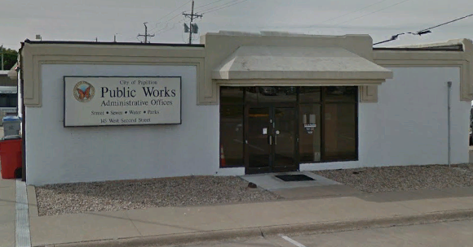
The Superintendent
Actual job titles vary
Employed or consulting
May require a bond – counties (§39-1507)
Notes:
County Engineer, County Surveyor, County Highway Superintendent, Director of Public Works, City Engineer, Chief of Street Maintenance (§16-321), etc.
Cities of the First Class: §16-324 Street Commissioner The street commissioner shall be subject to the orders of the mayor and city council by resolution, have general charge, direction, and control of all work in the streets, sidewalks, culverts, and bridges of the city, except matters in charge of the board of public works, and shall perform such other duties as the city council may require
Cities of the Second Class and Villages: §17-119 Overseer of the Streets The overseer of the streets shall, subject to the orders of mayor and council, have general charge, direction, and control of all work on the streets, sidewalks, culverts, and bridges of the city, and shall perform such other duties as the council may require.
Employed or consulting: for counties, the superintendent cannot be a member of the County Board
Not Mandatory: §39-2301 encourages anyone attempting to practice or offer to practice street or highway superintending to become licensed, to safeguard life, health, and property, and to further professional management of the county road or municipal street program.
Incentive funds: as a way of encouraging licensing, the Legislature set up a system of providing additional funding CALLED INCENTIVE PAYMENTS for entities that appoint a licensed superintendent.
The Nebraska Board of Public Roads Classification and Standards expects the appointed licensed superintendent to complete, or cause to be completed under his/her supervision, all reports to the Board.
For counties, if there is no appointed superintendent, the County Board must assume the role of the Superintendent (§39-1504), with all of is responsibilities. Superintending requires certain knowledge and skills (as described in statutes as a “competent, experienced, practical road builder” per §39-1506), involves a lot of time and effort to do it right, and is likely asking too much of board members to take on that role. Not to mention the loss of incentive payments.
NOT FOR AUDIO
§39-2301
The Legislature finds that in order to safeguard life, health, and property, and in order to
further professional management of county road and municipal street programs, persons
practicing or offering to practice street or highway superintending in this state are encouraged to
become licensed as provided in the act.
If a commissioner-type county or a township-type of county having adopted a county road unit system [or municipality?] chooses not to use the services of a licensed superintendent, the [City Council or?] County Board must assume the role of the Superintendent (§39-1504), with all of is responsibilities. Superintending requires certain knowledge and skills (“competent, experienced, practical road builder” per §39-1506), involves a lot of time and effort to do it right, and is likely asking too much of [council or?] board members to take on that role. Not to mention the loss of incentive payments

Slide 31
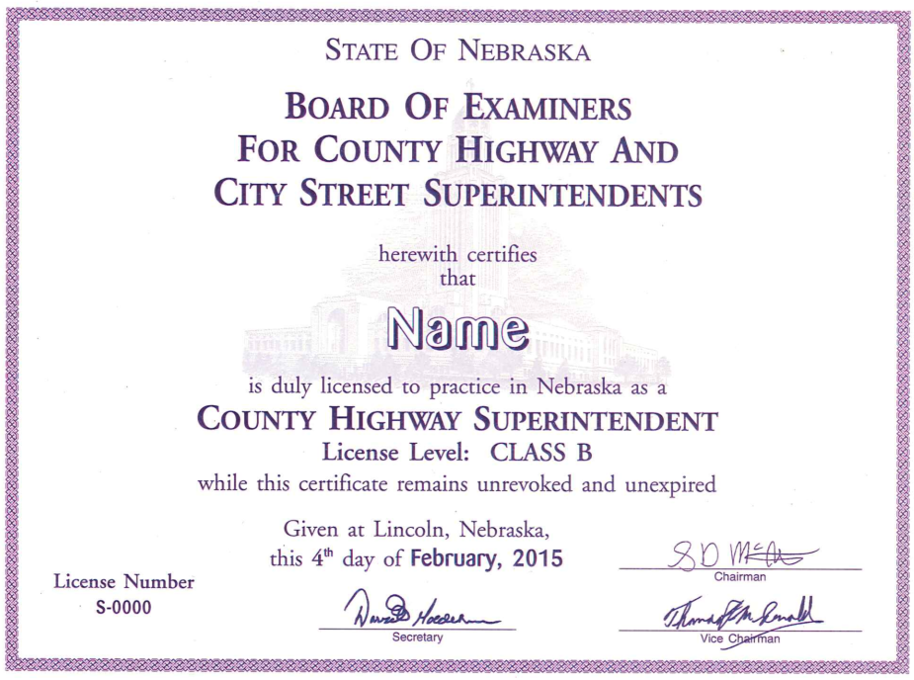
Notes:
8/2/2019 Updated with image of a license certificate. No changes to the audio.
The Superintendent is a key to Nebraska’s successful road and street programs.
Road and street crews and supporting personnel are critically important,
So it follows that the Superintendent’s professional management and leadership is essential for success.
NOT FOR AUDIO
Empowers the workforce

Slide 32

Managing Opportunities and Risks
State & Federal funding programs
  Provide significant resources - use them wisely and effectively
  Come with complex requirements - follow them carefully
  Don’t miss out on economic development opportunities
“Flying under the radar” won’t work
  Protect your county / municipality against: deteriorating facilities; set-backs and delays on projects; penalties; increased liability
$
Notes:
8/2/2019 Update
There are funding opportunities available. You need to know what they are and how and when to take advantage of them. They likely come with requirements, some of them complex. Superintendents need to know these requirements or know how to find out.
Managing risk, avoiding penalties and delays, and minimizing liability are also important aspects of program management.
NOT FOR AUDIO
Do it right!!!

Slide 33
Chapter 39
State Law
Key articles in Chapter 39:
21 – Functional Classification
23 – County Highway and City Street Superintendents Act
25 – Funding Distribution to Political Subdivisions
Slide 33
Notes:
7/31/2019 Updated to reflect changes per LB82 (2019).
The next several slides discuss some aspects of Chapter 39, Article 25 – Funding Distribution to Political Subdivisions

Slide 34
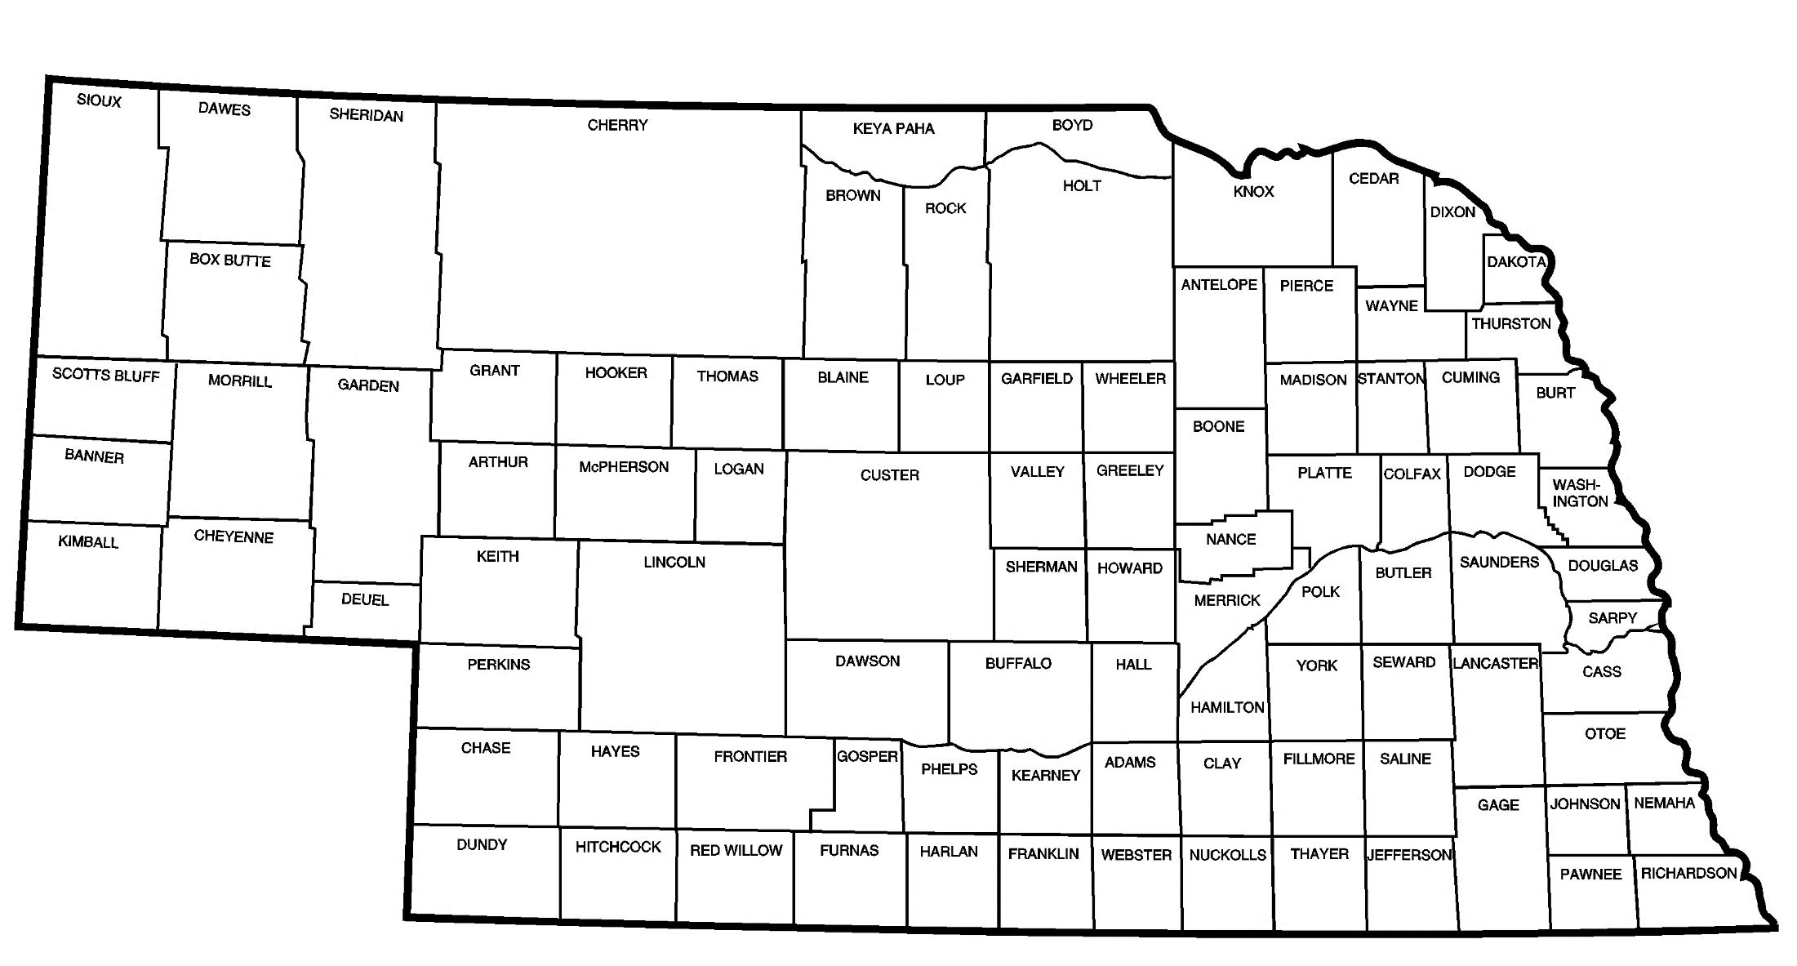

Purpose of Incentive Payments
Provide encouragement to appoint licensed superintendents to manage the road or street program
Slide 34
Notes:
8/1/2019 Updated to reflect changes per LB82 (2019). This slide added from the 2/21/2018 version of 303_LTAP Course Day 3_Incentive Payments, Slide 2.
State law encourages professional management of highways, roads and streets. One tangible way it does this is to provide incentive payments to each entity that appoints a superintendent, licensed by the Board of Examiners, and who performs certain minimum duties for the entity including active management of the road or street system.

Slide 35
§39-2502
State Law
Incentive Payments
Conditional Duties of Appointed Licensed Superintendent
Incentive Payment is made to each county having an Appointed Employed Licensed Superintendent for the prior calendar year, who performs the following duties:
Developing annually a long-range plan (OneAndSix)
Developing an annual program for design, construction, and maintenance
Developing an annual budget for that program
Submitting 1-3 above to the local governing body for approval
Implementing 1-3 above
Project No.
C-46(1)A
C-46(2)
Slide 35
Notes:
8/1/2019 Updated to reflect changes per LB82 (2019). This slide added from the 2/21/2018 version of 303_LTAP Course Day 3_Incentive Payments, Slide 5.
In Nebraska law,
Municipalities are not required to have a licensed city street superintendent
Not all counties are required to have a licensed county highway superintendent
However if the political subdivision appoints a licensed superintendent – and duties are performed as required by state statute – it can receive
Incentive Payments annual amounts to
Counties vary from $4,500 to $12,750
Cities and Municipalities vary from $300 to $8,500
depending on several factors including population and the type of license (Class A or Class B)
The minimum duties are listed here. They include developing a OneAndSix plan or program, annually developing a program for design, construction and maintenance, developing an annual budget for that program, submitting plans and programs to the governing body for approval, and implementing the approved plans and programs.
NOT FOR AUDIO
Section 39-2502. County highway superintendent, defined; duties; incentive payment. An incentive payment shall be made to each county having in its employ a county highway superintendent licensed under the County Highway and City Street Superintendents Act, during the calendar year preceding the year in which payment is made. … [C]ounty highway superintendent means a person who actually performs the following duties:
(1) Developing and annually updating a long-range plan based on needs and coordinated with adjacent local governmental units;
(2) Developing an annual program for design, construction, and maintenance;
(3) Developing an annual budget based on programmed projects and activities;
Section 39-2502. County highway superintendent, defined; duties; incentive payment. An incentive payment shall be made to each county having in its employ a county highway superintendent licensed under the County Highway and City Street Superintendents Act, during the calendar year preceding the year in which payment is made. For purposes of sections 39-2501 to 39-2510, county highway superintendent means a person who actually performs the following duties:
(1) Developing and annually updating a long-range plan based on needs and coordinated with adjacent local governmental units;
(2) Developing an annual program for design, construction, and maintenance;
(3) Developing an annual budget based on programmed projects and activities;
(4) Submitting such plans, programs, and budgets to the local governing body for approval;
(5) Implementing the capital improvements and maintenance activities provided in the approved plans, programs, and budgets; and
(6) Preparing and submitting annually to the Board of Public Roads Classifications and Standards the county's one-year plans, six-year plans, or annual metropolitan transportation improvement programs for highway, road, and street improvements under sections 39-2115 to 39-2117, 39-2119, and 39-2119.01 and a report showing the actual receipts, expenditures, and accomplishments compared with those budgeted and programmed in the county's annual plans as set forth in section 39-2120. (Emphasis added)
Source
Laws 1969, c. 315, § 2, p. 1133; Laws 1976, LB 724, § 7; Laws 2003, LB 500, § 15; Laws 2007, LB 277, § 7.September 1, 2007
Cross References: County Highway and City Street Superintendents Act, see section 39-2301.

Slide 36
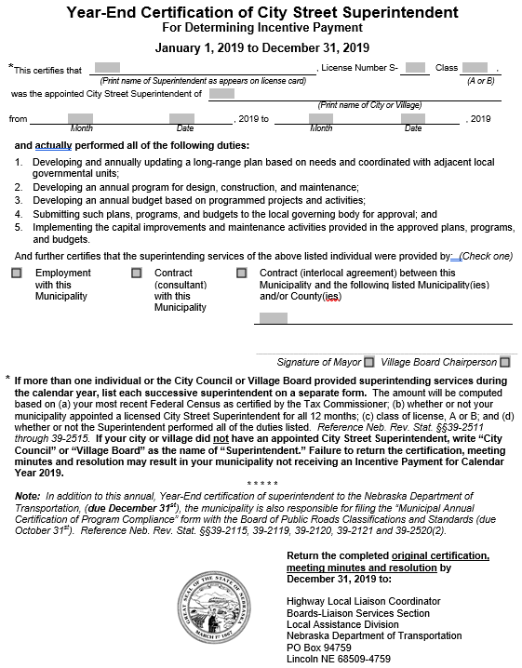
Incentive Funds Certification
Annual certification, to NDOT, of your appointed licensed superintendent for previous calendar year
For your town or county to receive Incentive Funds, your superintendent must be licensed and actually performing duties (is responsible for them)
One-page form, due Dec. 31. Form is mailed to clerks from NDOT – Liaison Services. Funds disbursed by February 15
The appointed superintendent must be involved in the total road / street program
Slide 36
Notes:
8/1/2019 Updated to reflect changes per LB82 (2019). This slide added from the 2/21/2018 version of 303_LTAP Course Day 3_Incentive Payments, Slide 15; it is modified by adding an image of the new (2019) Year-End Certification form.
To receive incentive payments, your entity must submit a completed and signed year-end certification form. It will be mailed to your Clerk and the completed form is due back to the NDOT by December 31, via regular mail.
To reiterate, In order to receive incentive payments, the appointed licensed superintendent must be actively involved in the total road or street program!
The Clerk goes into OnBase and certifies the identity of the appointed licensed superintendent
NOT FOR AUDIO
8/2/2019 email from LeMoyne Schulz to Jim Wilkinson
The ‘Annual Certification of Program Compliance’ and the ‘Year-End Certification of Superintendent’ will be sent out by snail mail and returned to us by snail mail therefor Liaison Services will no longer use Onbase. Additionally, County Clerks, County Highway and City Street Superintendents will no longer register in OnBase, only Municipal Clerks will register as the NDOT Lane Mile update request will be sent to the Clerks by email address they have in OnBase, not to the Street Superintendent, and the City and Village Clerks will send in their ‘Lane Mile’ update to NDOT using the OnBase Nebraska Enterprise Content Management Portal.

Slide 37
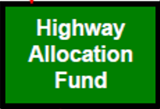


$
Funding
Main Sources
Counties and Municipalities
Highway Allocation Fund (HAF) Distributions
Local (Motor Vehicle Fee, Property Tax, Wheel Tax, Bonds, etc.)
State (Federal Funds Buyout, State-aid Bridge, etc.)
Federal, mainly FHWA)
Slide 37
Notes:
8/1/2019 Updated to reflect changes per LB82 (2019). This slide added from 2/4/2019 version of 309a_LTAP Course Day 3_Funding, Slide 6.
The Highway Allocation Fund is the main mechanism for distributing funds to Nebraska’s counties and municipalities for developing and maintaining roads and streets.
Of course, a county or municipality provides its own local funding, and it may also obtain funds from other State and Federal sources.
The focus of the next several slides is to give an overview of Nebraska’s Highway Allocation Fund.

Slide 38
§39-2510 (1), §39-2520 (1)
Use of Funds
HAF and Local Match may only be spent on highways, streets and roads and related items/activities!
Can’t borrow from the Road/Street fund to pay for non-Roads items!
Examples: water tower, jail, county fair building, a library, swimming pool, wastewater treatment plant
COUNTY
MUNICIPALITY
Other State and Federal funds have similar restrictions
Slide 38
Notes:
8/1/2019 Updated to reflect changes per LB82 (2019). This slide added from 2/4/2019 version of 309a_LTAP Course Day 3_Funding, Slide 7.
First, however, note that the proper use of funds is addressed in several state statutes. The screen shows two of them at the top.
Highway allocation funds and its local matching funds may be spent ONLY on highway, streets and roads and related items/activities. Borrowing from the fund to pay for other items is against state law.
NOT FOR AUDIO
(2) The requirements of subsection (1) of this section also apply to sales and use taxes imposed on motor vehicles, trailers, and semitrailers pursuant to sections 13-319 and 77-27,142, except that such provisions shall not apply in a county or municipal county that has issued bonds
(a) the proceeds of which were used for purposes listed in subsection (1) of this section and for which revenue other than sales and use taxes on motor vehicles, trailers, and semitrailers is pledged for payment or
(b) approved by a vote that required the use of sales and use taxes imposed on motor vehicles, trailers, and semitrailers for a specific purpose other than those listed in subsection (1) of this section, until all such bonds issued prior to January 1, 2006, have been paid or retired. The county or municipal county shall include a certification with the report … (Emphasis added)

Slide 39
Distributing the HAF
HAF (MUNI) FUNDING
HAF (COUNTY) FUNDING
Counties and Municipalities
Slide 39
Notes:
8/1/2019 Updated to reflect changes per LB82 (2019). This slide added from 2/4/2019 version of 309a_LTAP Course Day 3_Funding, Slide 17.
Money from the Highway Allocation Fund, which is funded largely through the State Highway Trust Fund, is distributed to Counties and Municipalities.

Slide 40
§66-4,148
Each County
Each Municipality
Distribution of Highway Allocation Funds
  Monthly ½ to counties ($154 Million in FY19)
  Monthly ½ to municipalities ($154 Million in FY19)
Distribution of funds based on the provisions of Chapter 39, Article 25
HAF (MUNI) DISTRIBUTION
HAF (COUNTY) DISTRIBUTION
Slide 40
Notes:
8/1/2019 Updated to reflect changes per LB82 (2019). This slide added from 2/4/2019 version of 309a_LTAP Course Day 3_Funding, Slide 18.
½ goes to counties and ½ goes to municipalities.
The NDOT calculates the amounts that go to each political jurisdiction, and the State Treasurer distributes the money monthly.
NOT FOR AUDIO
Section 66-4,148. Highway Allocation Fund; distribution of funds. (1) The State Treasurer shall monthly distribute the receipts accruing to the Highway Allocation Fund pursuant to section 66-4,147. One-half of such receipts shall be distributed to the various counties and municipal counties for road purposes and one-half of such receipts shall be distributed to the various municipalities and municipal counties for street purposes.
(2) The distribution of funds to the respective cities, counties, and municipal counties under subsection (1) of this section shall be based on the provisions of Chapter 39, article 25. (Emphasis added)
-- Turn to p. 32, bottom of page --
Ch. 77, Art 27, Sec. 132
Sales & Income Tax Distribution (Sales Tax on Motor Vehicles)
Section 66-4,148. Highway Allocation Fund; distribution of funds. (1) The State Treasurer shall monthly distribute the receipts accruing to the Highway Allocation Fund pursuant to section 66-4,147. One-half of such receipts shall be distributed to the various counties and municipal counties for road purposes and one-half of such receipts shall be distributed to the various municipalities and municipal counties for street purposes.
(2) The distribution of funds to the respective cities, counties, and municipal counties under subsection (1) of this section shall be based on the provisions of Chapter 39, article 25. (Emphasis added)
Source: Laws 1980, LB 722, § 18; Laws 1986, LB 599, § 20; R.S.1943, (1990), § 66-480; Laws 2001, LB 142, § 53

Slide 41
§39-2507
  Distribution of Highway Allocation Funds (HAF) to Counties – 7 Factors
  Rural population of each county as determined by the most recent federal census 20%
  Total population of each county as determined by the most recent federal census 10%
  Lineal feet of bridges twenty feet or more in length and all overpasses in each county as determined by the most recent NDOT inventory 10%
  Total Motor vehicle registrations, other than prorated commercial vehicles, in the rural areas of each county as determined from the most recent information available from the DMV 20%
  Total Motor vehicle registrations, other than prorated commercial vehicles, in each county as determined from the most recent information available from the DMV 10%
  Miles of county and township roads within each county as determined by the most recent inventory available within the NDOT 20%
  Value of farm products sold from each county as determined from the most recent federal Census of Agriculture 10%
HAF (COUNTY) DISTRIBUTION
Slide 41
Notes:
8/1/2019 Updated to reflect changes per LB82 (2019). This slide added from 2/4/2019 version of 309a_LTAP Course Day 3_Funding, Slide 19.
The NDOT computes County Highway Allocation amounts monthly, using the seven (7) factors shown here: rural and total populations, length of bridges, rural and total motor vehicle registrations, miles of roads (county and township) and the value of farm products sold. Each of these factors is weighted 10% or 20% as shown.
State Treasurer direct deposits amount with County Treasurer monthly
NOT FOR AUDIO
Section 39-2507. Allocation of funds for road purposes; factors used. The following factors and weights shall be used in determining the amount to be allocated to each of the counties or municipal counties for road purposes each year:
(1) Rural population of each county or municipal county, as determined by the most recent federal census, twenty percent;
(2) Total population of each county or municipal county, as determined by the most recent federal census, ten percent;
(3) Lineal feet of bridges twenty feet or more in length and all overpasses in each county or municipal county, as determined by the most recent inventory available within the Department of Transportation, ten percent, and for purposes of this subdivision a bridge or overpass located partly in one county or municipal county and partly in another shall be considered as being located one-half in each county or municipal county;
(4) Total motor vehicle registrations, other than prorated commercial vehicles, in the rural areas of each county or municipal county, as determined from the most recent information available from the Department of Motor Vehicles, twenty percent;
(5) Total motor vehicle registrations, other than prorated commercial vehicles, in each county or municipal county as determined from the most recent information available from the Department of Motor Vehicles, ten percent;
(6) Total miles of county or municipal county and township roads within each county or municipal county, as determined by the most recent inventory available within the Department of Transportation, twenty percent; and
(7) Value of farm products sold from each county or municipal county, as determined from the most recent federal Census of Agriculture, ten percent. (Emphasis added)
Source: Laws 1969, c. 315, § 7, p. 1135; Laws 2001, LB 142, § 42

Slide 42
§39-2517
  Distribution of Highway Allocation Funds (HAF) to Municipalities – 3 Factors
  Total Population as determined by the most recent federal census figures annually certified by the Tax Commissioner as provided in §77-3,119 50%
  Total motor vehicle registrations as determined from the most recent information available from the DMV 30%
  Total Miles of traffic lanes of streets as determined by the most recent inventory available within NDOT 20%
HAF (MUNI) DISTRIBUTION
Note: municipalities use lane-miles, counties use roadway miles
Slide 42
Notes:
8/1/2019 Updated to reflect changes per LB82 (2019). This slide added from 2/4/2019 version of 309a_LTAP Course Day 3_Funding, Slide 26.
The NDOT computes Municipality Highway Allocation amounts monthly, using the three (3) factors shown here:
total population of the municipality, total motor vehicle registrations within the municipality, and the total number of lane-miles of streets within the jurisdiction.
Each of these factors is weighted as shown, with the total population weighing the most at 50%.
Regarding the number of lane-miles, the NDOT will annually email Municipal Clerks a request to submit updated information. Municipal clerks must register on the Nebraska Enterprise Content Management Portal and submit updated lane-mile information annually to NDOT using that portal.
NOT FOR AUDIO
8/2/2019 email from LeMoyne Schulz:
The ‘Annual Certification of Program Compliance’ and the ‘Year-End Certification of Superintendent’ will be sent out by snail mail and returned to us by snail mail therefor Liaison Services will no longer use Onbase. Additionally, County Clerks, County Highway and City Street Superintendents will no longer register in OnBase, only Municipal Clerks will register as the NDOT Lane Mile update request will be sent to the Clerks by email address they have in OnBase, not to the Street Superintendent, and the City and Village Clerks will send in their ‘Lane Mile’ update to NDOT using the OnBase Nebraska Enterprise Content Management Portal.
Section 39-2517. Allocation of funds for street purposes; factors used. The following factors and weights shall be used in determining the amount to be allocated to each of the municipalities … for street purposes each year:
(1) Total population of each incorporated municipality …, as determined by the most recent federal census figures certified by the Tax Commissioner as provided in section 77-3,119, fifty percent;
(2) Total motor vehicle registrations, other than prorate commercial vehicles, in each incorporated municipality …, as determined from the most recent information available from the Department of Motor Vehicles, thirty percent; and
(3) Total number of miles of traffic lanes of streets in each incorporated municipality …, as determined by the most recent inventory available within the Department of Transportation, twenty percent. (Emphasis added)

Slide 43
§39-2509 (Counties)
§39-2519 (Municipalities)
Matching Funds Requirement for Monthly HAF Allocations
Counties, Cities of the First and Second Class, and Villages
  First ½ - no matching requirement
  Second ½ - $1 for each $2 received
Match with ANY funds (Local, State or Federal) other than those from HAF – can’t match HAF $ with HAF $
Omaha and Lincoln have higher matching requirements
Slide 43
Notes:
8/1/2019 Updated to reflect changes per LB82 (2019). This slide added from 2/4/2019 version of 309a_LTAP Course Day 3_Funding, Slide 22.
Previously, the local matching requirement was mentioned, as related to the Highway Allocation Funds distributions.
For counties, cities of the first class, cities of the second class, and villages, the first half of the Highway Allocation Funds distributions have no matching requirement. The second half is required to be matched one dollar for every two dollars received.
Local funds can be used to match Highway Allocation Funds , or it could be from other sources: Federal or State including “buy-back” funds.
You cannot use Highway Allocation Funds to match Highway Allocation Funds; an example would be State-Aid bridge funds, which come from the Highway Allocation Fund.
Incentive Payments are taken off the top of the Highway Allocation Fund and no local match is required for those funds.
NOT FOR AUDIO
8/2/2019 email from LeMoyne Schulz from Jim Wilkinson
Is it your understanding that Federal Buy Back funds can be used to meet the HAF distributions matching requirement (39-2509 and 39-2519)? Yes
Section 39-2509. Matching funds; requirement; exceptions; effect. (1) Each county or municipal county shall be entitled to one-half of the amount allocated to it each year under sections 39-2507 and 39-2508 with no requirement for providing funds locally, but shall be required to match the second one-half on the basis of one dollar for each two dollars it receives with any available funds.
(2) Each county or municipal county which, during the preceding fiscal year, failed to provide locally the minimum required by subsection (1) of this section shall forfeit one dollar for each dollar which it fails to so provide locally. Any amounts forfeited under the provisions of this subsection first shall be made available to the incorporated municipalities, as determined by the county board or the council of the municipal county, within the county …. Such distribution shall be made as provided in sections 39-2507 and 39-2508…

Slide 44

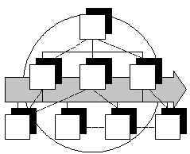
What Does It Take to be Successful?
Good roads and streets require:
Funding - state, local & federal
People - professionals
Organization - effective, efficient, accountable
$
Notes:
To build and maintain a good road or street system requires
Adequate funding
A solid workforce
And an effective, efficient and accountable organization
NOT FOR AUDIO
You - the elected or appointed officials in charge - make it happen!!

Slide 45
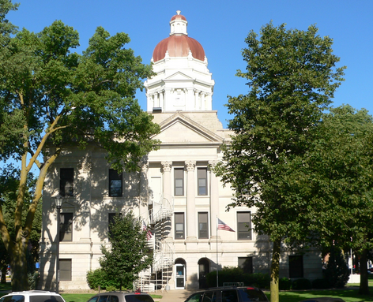
Organization and Duties
Program Policy & Oversight
  County Board’s / City Mayor’s & Council’s / Village Board’s responsibility
Program Management
  Superintendent’s role
Interlocal Agreements - important (State Statutes §39-2114 & §13-513)
Townships - responsible for maintenance
Notes:
7/31/2019 Updated to reflect changes per LB82 (2019).
Each entity has its own organization and sets of duties.
This screen provides an overall view, from a statutory frame of reference, roles and responsibilities with respect to roads and streets.
The Governing body is responsible for oversight and setting policy. Oversight includes employees as well as extended staff such as consultants and contractors.
The appointed, licensed Superintendent responsibilities are for managing actively manages the road or street program including planning and reporting. The Superintendent manages, on a day-to-day basis, Road or Street Department staff, and extended staff such as consultants and contractors.
Cooperation with other entities, through Interlocal agreements can and should be an important way of doing business.
Over one fourth of Nebraska counties have a township form of government, in which the Townships are usually responsible for road maintenance.
NOT FOR AUDIO
26 (?) township counties?

Slide 46
Nebraska’s Public Roads
Nebraska's large public roads system
Different standards for different functions
Public funds spent wisely
Professional management
Notes:
Nebraska's public roads system
is one of the largest in the nation, serves sparsely populated areas as well as large urban centers, all of which have transportation needs
Modern standards must address roads of various functions, classifications and areas
There is Not enough money to build every road as if it is an arterial, which is why we have an integrated system of public roads with a variety of classifications and standards
Good program management leads to more efficient use of public roads funds

Slide 47
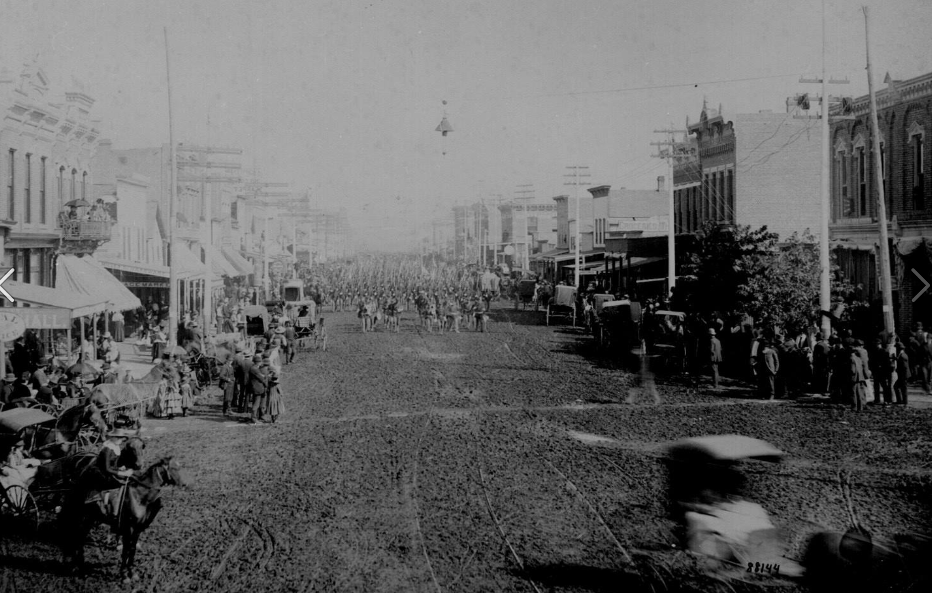
Online Resources
State Statutes: http://nebraskalegislature.gov/laws/browse-statutes.php
Rules and Regulations: http://www.sos.ne.gov/rules-and-regs/regsearch/Rules/index.cgi?l=Roads_Dept_of
NDOT Boards - Liaison Services Section: https://dot.nebraska.gov/business-center/lpa/boards-liaison/
NE LTAP website: https://ltap.unl.edu/
Slide 47
Notes:
This screen shows a few online web sites that provide additional information on Nebraska’s road and street program.
Press the pause button if you wish to write down any of these web links.

Slide 48
Managing Nebraska’s
Public Roads and Streets
Introduction – The “Big Picture”
Boards - Liaison Services Section
https://dot.nebraska.gov/business-center/lpa/boards-liaison/training/
8/5/2019
Video A
Notes:
This has been an introduction, big picture review of Managing Nebraska’s Public Roads and Streets
Sections 21, 23 and 25 of Chapter 39 of state statutes set forth the Legislature’s requirements for the needs of all public roads in terms of
Design, Construction and Maintenance
Financial
Management
This is a starting point. More information and details are provided in this series of videos, and in face-to-face courses provided by the Nebraska Department of Transportation and the Nebraska Local Technical Assistance Program known as NE-LTAP.

