Slide 1




Nebraska Highway Law
See Notebook for Compilation of Nebraska Statutes
Boards - Liaison Services Section
Tab 3
Slide 1
Notes:
9/12/2022 Slide 1 updated with 3-ring-binder Tab number, minor changes to slides 28, 30, 31, 56, 57
10/11/2021 updated Slide 2, five slides (22-25) moved up and are now slides 10-14. Duplicate slide (“Selected Statutes of Highway Law”) deleted – there is only one of those slides now, Slide 25. Added some clarification to slides 21 and 22 (county classes, municipality classes, and equal representation on the two Boards), Delete Slide 43 (Gollum) – no one gets this reference. Deleted slides 45-46 (finding money on the street) to save some time. Updated Slide 55.
9/9/2021 Hid Slides 44 (Gollum), 47 and 48, need to update slide 57
8/10/2021 Updated – minor. Slide 31 added “Jurisdictional Responsibility” in 2nd bullet to make sure they see that term.
6/21/2021 Updated slides 3 and 28, and added slide 57 (the house analogy)
6/19/2021 Update – added slides 56-64 from the first PowerPoint file from old one-day Exam Review class.
4/23/2021 Update – added another slide to the Conflict-of-Interest part (making 15 slides in that part) regarding the Valparaiso librarian using the library’s Amazon account for personal use.
4/21/2021 Update – added Slide 17 showing classes of counties since it matters when determining
4/18/2021 Update – modified added slide 18 (classes of cities) for under 100 populations.
4/17/2021 Update – added slide 51 (Douglas Co landfill scam).
4/16/2021 Update – added two more slides showing a listing of Township Counties and explaining County Road Unit System, and 13 slides on Conflict of Interest/Ethics
3/31/2021 Updated – added three slides (13-15) how counties and municipalities are organized. 4/21/2021 note: Ultimately this expanded to six slides, 13 thru 18 with changes occurring 4/16/2021 thru 4/21/2021.
1/30/2020 Updated slide 2 (notes field) and slide 7. Previous version was 8/13/2019.
8/13/2019 Updates made to this presentation some based on LB82 (2019). Previous version dated 7/29/2018. Eleven (11) slides updated. Slides 3, 7, 9, 11 thru 14, 16, 18, 27, 28 and 34 were updated.
Handouts – describe to audience
Note that Nebraska State Statutes are available online, free.

Slide 2
Laws - General Information
Road and street programs in Nebraska are governed by State and Federal law and regulations and local ordinances and policies
Your challenge
be able to explain the legal and regulatory basis for roads/street programs to elected officials, constituents, the media, and others
Slide 2
Notes:
1/30/2020 Updated notes field to have a possible answer to the challenge question on the slide.
Challenge answer (possible):
The legal basis for our road/street program is in Nebraska law. Chapter 39 Section 21 sets up the general framework. It creates our system of classifying roads and standards. It also creates the Nebraska Board of Public Roads Classifications and Standards (NBCS). The main objectives of Nebraska’s public highway, road and street system are in 39-2101.
Other key parts of the law pertaining to roads and streets are the Superintendent’s Act (Chapter 39, Article 23) and the means for distributing incentive payments and highway allocation fund distributions (Chapter 39, Article 25). Article 23 defines the duties of a Superintendent and creates a licensing system, that is overseen by a Board of Examiners for County Highway and City Street Superintendents (which is created by this article.
Chapter 60 addresses motor vehicles and has statutes that we need to be aware of such as speed limits (60-6,190) and legal weight limits (60-6,294).
There are many other laws in those two chapters, and other chapters that affect our road/street system and how we do business!

Slide 3
Laws-General Information
The law controls everything a superintendent does
  Establishes the Superintendent position
  Provides Roads & Streets Funding allocations
  Requires Planning and Public Participation
    Financial
    Program of projects
    Minimum design standards
Slide 3
Notes:
10/11/2021 added “Roads/Streets” to bullet two
6/21/2021 added “and participation” in third bullet
8/13/2019 Updated, deleted reference to Reporting to the NBCS, BEX and NDOT (second bullet in 7/29/2018 version)

Slide 4
State Law
Laws
General Information
Identifying and referring to laws
- Individual Nebraska statutes are referred to as “Section (hyphenated number)”
- Example: Section 39-2307,
Chapter 39
Article 23
Section 7
Slide 4

Slide 5
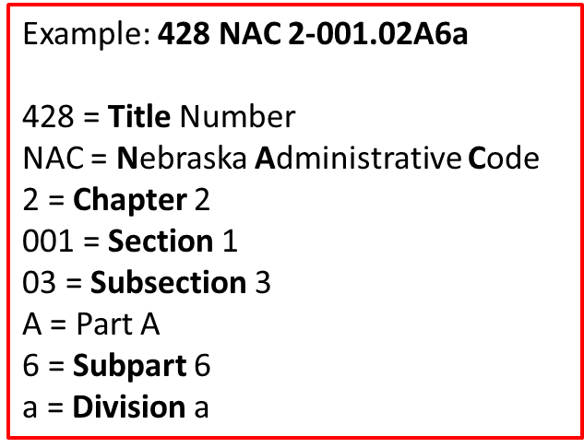

Law-General Information
- Regulations are cited as “Title ____” or “Title ___, Chapter ____”, followed by “Nebraska Administrative Code” (“NAC”), or “Code of Federal Regulations” (“CFR”).
- Regulations also may be cited by the name of the Agency charged with administering them (“Nebraska Department of Transportation”, “Federal Highway Administration”, etc.).
Slide 5

Slide 6
End of Article 21
State Law
39-2124 Legislative intent is not to prohibit or inhibit NDOT, Counties and Municipalities
39-2125 Section, how Construed (next slide)
End of Article 21
Slide 6
Notes:
39-2123 is outdated and no longer needed, therefore it was repealed by the legislature
39-2124 legislative intent – not to tell LPAs how to do their planning, etc. Not to tell locals how to do plats, subdivisions, etc.
39-2125 was covered at the beginning of this session
REPEALEDSection 39-2123. County board; develop numbering system for its principal roads; arterial and collector roads; time. The county board of each county shall develop a numbering system for its principal roads classified as other arterial and collector roads within two years after the Board of Public Roads Classifications and Standards has prescribed rules and regulations to achieve the maximum practicable uniformity of such numbering systems throughout the state and coordination between adjacent counties. Provisions shall be made for the placing of suitable signs along roads covered by such system, in such numbers and at such locations as the rules and regulations shall provide, and to give adequate notice of such numbering system.
[IGNORE THIS SECTION – IT NEVER WAS IMPLEMENTED]
Source: Laws 1969, c. 312, § 23, p. 1128; Laws 1971, LB 100, § 12
Section 39-2124. Legislative intent. It is the intent of the Legislature to recognize the responsibilities of the Department of Transportation, of the counties, and of the municipalities in their planning programs as authorized by state law and by home rule charter and to encourage the acceptance and implementation of comprehensive, continuing, cooperative, and coordinated planning by the state, the counties, and the municipalities. Sections 13-914 and 39-2101 to 39-2125 are not intended to prohibit or inhibit the actions of the counties and of the municipalities in their planning programs and their subdivision regulations, nor are sections 13-914 and 39-2101 to 39-2125 intended to restrict the actions of the municipalities in their creation of street improvement districts and in their assessment of property for special benefits as authorized by state law or by home rule charter. (Emphasis added)
Source
Laws 1969, c. 312, § 24, p. 1128; Laws 1971, LB 100, § 13; Laws 1983, LB 10, § 8; Laws 2007, LB 277, § 5.September 1, 2007
Section 39-2125. Sections, how construed. Sections 13-914 and 39-2101 to 39-2125 shall be construed as an independent act, complete in itself, and in the event of conflict between any provisions of sections 13-914 and 39-2101 to 39-2125 and any other statutes, the provisions of sections 13-914 and 39-2101 to 39-2125 shall control.
Source
Laws 1969, c. 312, § 25, p. 1128; Laws 1983, LB 10, § 9; Laws 2007, LB 277, § 6.September 1, 2007
13-914.
Defective bridge or highway; compliance with standards; effect.
For purposes of sections 13-912 and 13-913, no minimum maintenance road or highway shall be deemed to be in want of repair or insufficient if it complies with the standards and level of minimum maintenance developed pursuant to section 39-2113.
Source
Laws 1983, LB 10, § 7;
R.S.1943, (1983), § 23-2411.01.

Slide 7
Nebraska Statutes on
Highway and Street Programs
State Law
CAUTION!!! Be careful with independent Acts, as other statutes may or may not prevail.
Section 39-2125. Sections, how construed. Sections 13-914 and 39-2101 to 39-2125 shall be construed as an independent act, complete in itself, and in the event of conflict between any provisions of sections 13-914 and 39-2101 to 39-2125 and any other statutes, the provisions of sections 13-914 and 39-2101 to 39-2125 shall control.
Source Laws 1969, c. 312, § 25, p. 1128; Laws 1983, LB 10, § 9, Laws 2007, LB 277, § 6. September 1, 2007.
Slide 7
Notes:
1/30/2020 Updated. Added “”or may not” in the CAUTION sentence
8/13/2019 Updated. Added 13-914 in script below.
Some older laws may be superseded by new laws. (next slide)
13-914.
Defective bridge or highway; compliance with standards; effect.
For purposes of sections 13-912 and 13-913, no minimum maintenance road or highway shall be deemed to be in want of repair or insufficient if it complies with the standards and level of minimum maintenance developed pursuant to section 39-2113.
Source
Laws 1983, LB 10, § 7;
R.S.1943, (1983), § 23-2411.01.

Slide 8
Nebraska Statutes on
Highway and Street Programs
Independent Acts - Example
State Law
§39-1309(2) [1955] identifies factors (ADT, cost, economic impact, etc.) to take into consideration when changing or adding to the State Highway system.
§39-2103 - §39-2109 [1969] requires classification of roads by function. The State is required to be responsible for certain functional classifications (i.e. the State Highway System).
428 NAC 1 [1970] identifies criteria for each functional classification using different factors than listed in §39-1309(2).
The 1969/1970 laws prevail over the 1955 law
Slide 8
Notes:
Look at other statutes – do word searches
§39-1309(2) [1955] identifies factors to take into consideration when changing the State Highway system.
§39-2103 and §39-2104 [1969] provides functional classification names and general descriptions not all the same as factors identified in §39-1309(2).
§39-2105(1) [1969] requires the State to be responsible for Interstate, Expressway and Major Arterials functional classifications, and municipal extensions.
§39-2109(1) [1969] requires the NBCS to establish criteria for functional classifications.
428 NAC 1 [1970] identifies criteria for functional classifications different than factors in §39-1309(2).

Slide 9

Laws - General Information
Your County Attorney or City / Village Attorney is your Legal Counsel
Slide 9
Notes:
8/13/2019 Updated. Added to the script in light of LB82 (2019) changes.
See your agency’s attorney for any questions.
This has become more important now that reporting to the NBCS has been eliminated. For example, what do you present to the public at the annual public hearing for project in the one-year plan or program?

Slide 10
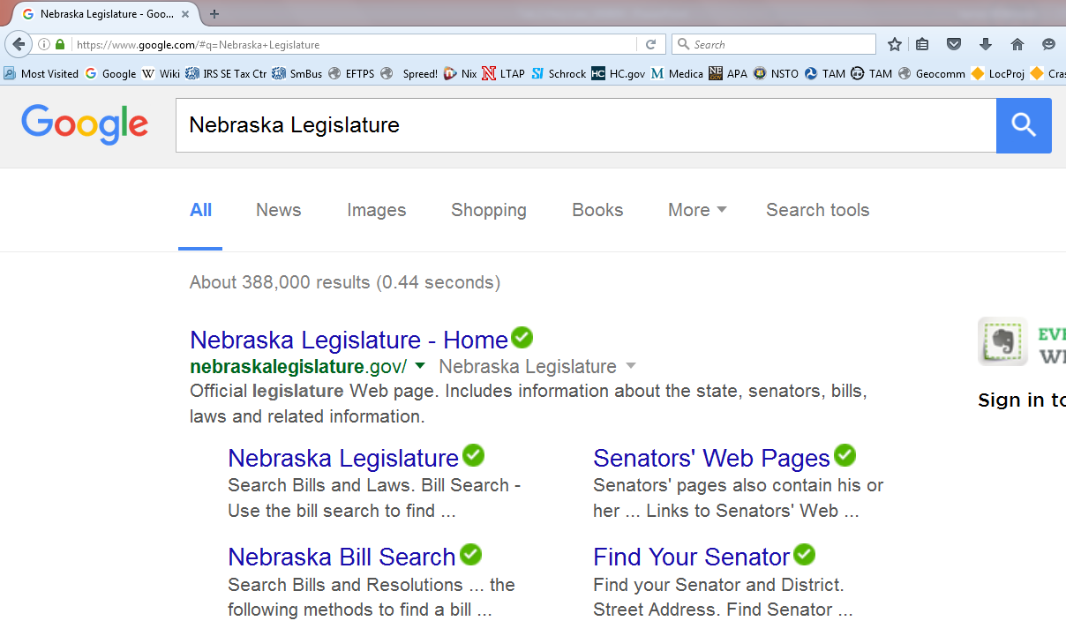
Highway Law
Slide 10

Slide 11
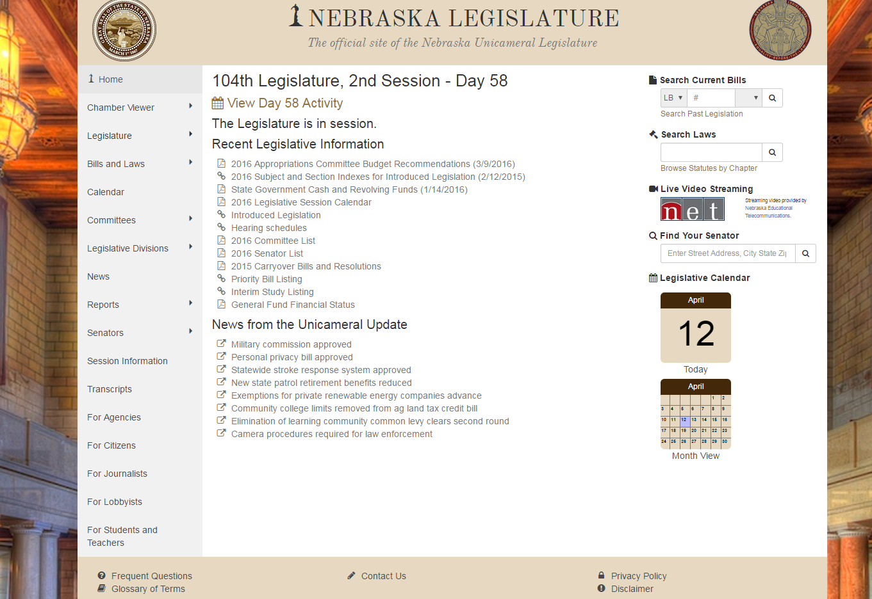
Highway Law
https://nebraskalegislature.gov
Know the Difference?
All Nebraska State Laws are available online, free!
Slide 11
Notes:
8/13/2019 Updated web link.

Slide 12
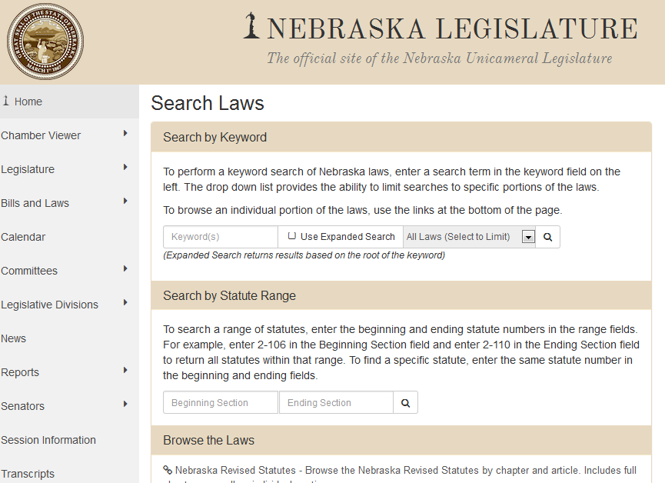
Highway Law
Searching
Search by Keyword
Search by Statute Range
Browse the Laws
Slide 12

Slide 13
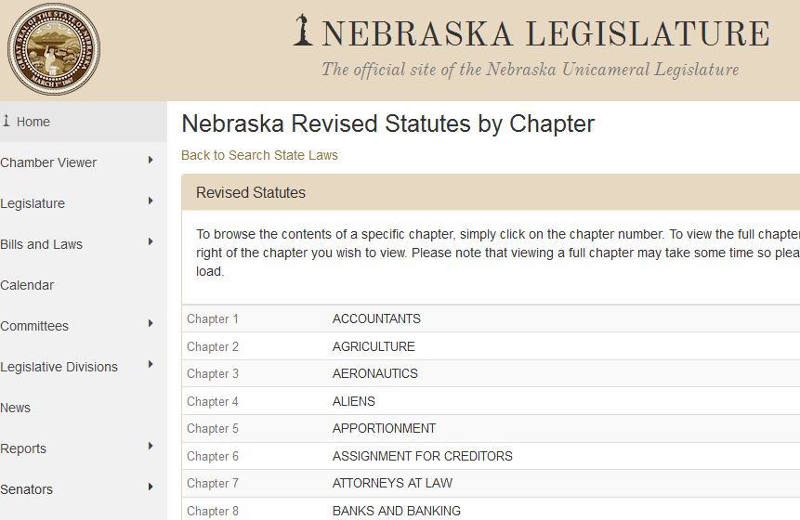
Browse By Chapter
Highway Law
https://nebraskalegislature.gov/laws/browse-statutes.php
Slide 13
Notes:
8/13/2019 Updated web link.

Slide 14
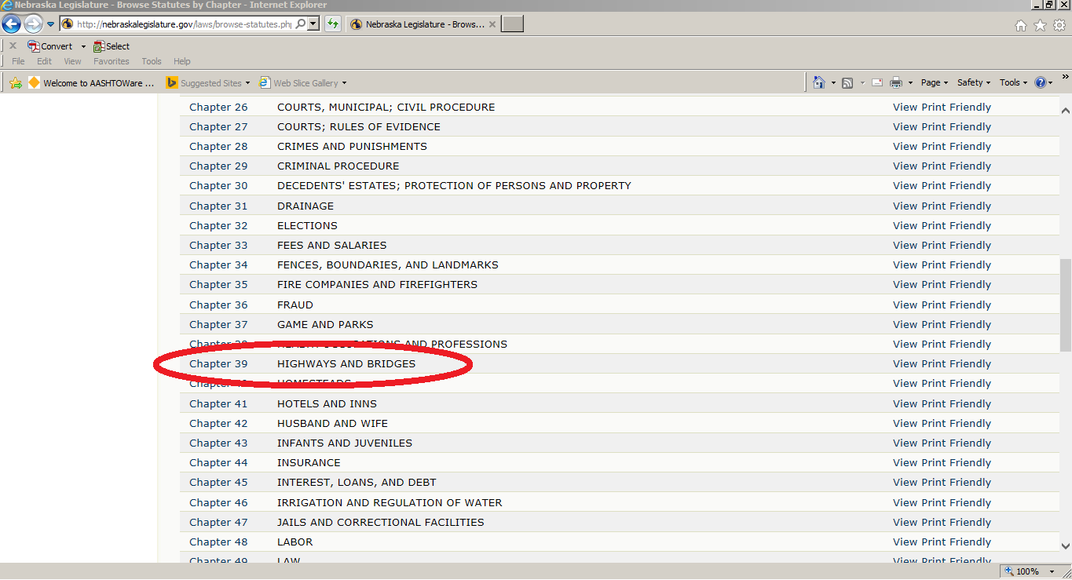
Chapter 39
Highways and Bridges
Highway Law
Slide 14

Slide 15
State Law
Nebraska Statutes Pertaining to
Highway and Street Programs
https://nebraskalegislature.gov/laws/browse-statutes.php
Chapter | Subject (Selected Articles in parenthesis)
13 | Cities, Counties, and Other Political Subdivisions (Article 8 - Interlocal Cooperation Act; Article 9 - Political Subdivisions Tort Claims Act)
14 | Cities of the Metropolitan Class [Omaha]
15 | Cities of the Primary Class [Lincoln]
16 | Cities of the First Class
17 | Cities of the Second Class and Villages
18 | Cities and Villages; Laws Applicable to All
19 | Cities and Villages; Particular Classes
Slide 15
Notes:
8/13/2019 Updated web link.

Slide 16
State Law
Nebraska Statutes Pertaining to
Highway and Street Programs
https://nebraskalegislature.gov/laws/browse-statutes.php
Chapter | Subject (Selected Articles in parenthesis)
22 | Counties
23 | County Government and Officers
31 | Drainage (Article 7 - Sanitary & Improvement Districts)
39 | Highways and Bridges
48 | Labor (Article 4 - Health & Safety Regulations)
60 | Motor Vehicles (Article 6 - Nebraska Rules of the Road)
Slide 16
Notes:
8/13/2019 Updated web link.

Slide 17
State Law
Counties
How Organized
Commissioner and Township Forms
By Function
COMMISSIONER
All functions of county government
TOWNSHIP (Supervisor)
Roads (apply gravel, remove snow, etc.)
Cemeteries
Libraries
Construct wells
Prairie fire protection
Other
COUNTY
Slide 17
Notes:
3/31/2021 New slide
The purpose of a township is “to carry into effect with ease and facility certain powers and functions . . . Which may be more readily and conveniently carried on by subdivision of the territory of the state into smaller areas.” i.e. local control. vs. efficiencies of scale via the Commissioner form.
Township employees are NOT considered county employees.
Most townships limit their activities to roads.
Some townships contract with the county to perform road functions, so they have no employees and are considered inactive.
Counties collect the taxes and distribution money to Townships. Townships are limited to a levy of 28 cents /$100,000 but Counties are only allowed to allocate up to 15 cents. (1996 statutes - levy limits). Townships can override the county’s levy allocation by vote.
Recently, several counties dissolved their Township form a government:
Phelps (2008), Buffalo (2015), Antelope (2017), Hall (2021). Two more will do so: Adams and Kearney.
Recently, three counties tried to dissolve but was voted down: Dixon, Fillmore, Harlan.
This slide is taken from a NACO document, circa 2020, titled “Township Government”
References cited by that document:
Nebraska Constitution, Article IX, section 4 and 5
Gordon, Harold F., Nebraska Township Government: A Handbook for Officials, Department of Public Administration, University of Nebraska at Omaha, April, 1975
§23-224 (includes authority to spend), §32-101 et seq., §32-530, §23-260, §77-3443 and -3444, §23-252, §84-304, §84-1408 et seq., §23-293 thru - 297

Slide 18
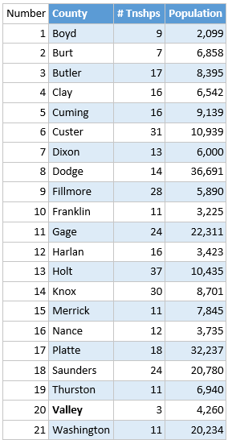
State Law
Township Counties as of 2023
COUNTY
Kearney Co will transition in 2023
Slide 18
Notes:
4/16/2021 New slide

Slide 19
State Law
Counties
How Organized
Township County with a
County Road Unit System
§39-1513 - §39-1518
Township counties may adopt County Road Unit System
COUNTY
What does that mean?
The county maintains township roads
Slide 19
Notes:
4/16/2021 New slide
In this case, the County maintains all roads except municipal streets and State highways.
Valley is the only county that has a county road unit system.
Some townships contract with the county to perform road functions, so they have no employees and are considered inactive.
39-1514 says that the county can abandon the county road unit system at any GENERAL ELECTION after two years from the date of such adoption, and return to the county and township system, as long as every contract has been satisfied and complied with.
39-1513.
County road unit system; optional for township counties; procedure for adoption.
In the event of the filing with the county clerk of a petition signed by ten percent of the qualified electors in the county, the board of county supervisors shall adopt the provisions of the county road unit system by resolution at the next regular meeting of the board. The resolution shall be published once a week for three consecutive weeks in a legal newspaper published in the county or, if none is published in the county, in a legal newspaper of general circulation in the county. The adoption of the county unit plan shall take effect ninety days after the date of the first publication of the resolution providing for such adoption or any later date designated by the resolution, but not later than one year after the date of the first publication of the resolution unless before the effective date of adoption there is filed with the county clerk a petition signed by ten percent of the qualified electors in the county protesting such adoption. In that event, the board of county supervisors shall submit the question of a county road unit system to the electors of the respective counties.
Source
Laws 1957, c. 155, art. II, § 13, p. 517;
Laws 1959, c. 167, § 4, p. 610;
Laws 1986, LB 960, § 29.

Slide 20
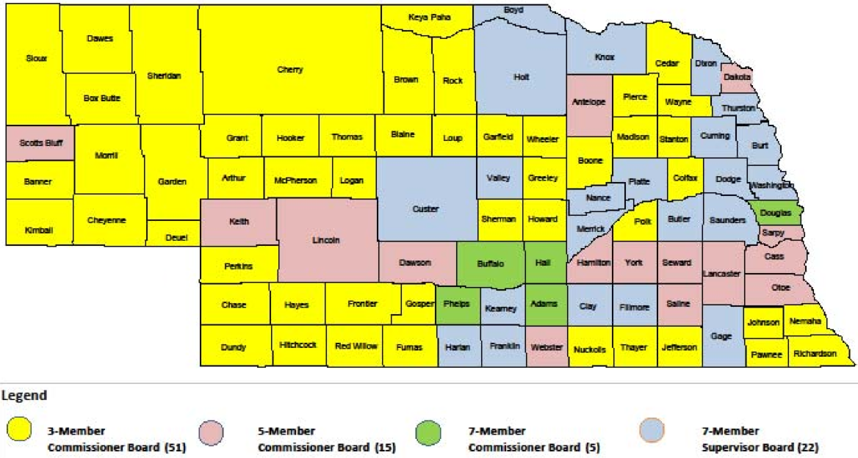
Counties
How Organized
Commissioner and Township Forms
State Law
Map dated 2020
Slide 20
Notes:
3/31/2021 New slide
Starting in 2023, there will be 21 of the 93 counties having a Township form of government. Valley is a Township form of government, but it voted for the County Unit Road System (§39-1501, §39-1503, §39-1513 thru §39-1519, §39-1520.01.
Number County # Townships Population 1 Boyd 9 2,099 2 Burt 7 6,858 3 Butler 17 8,395 4 Clay 16 6,542 5 Cuming 16 9,139 6 Custer 31 10,939 7 Dixon 13 6,000 8 Dodge 14 36,691 9 Fillmore 28 5,890 10 Franklin 11 3,225 11 Gage 24 22,311 12 Harlan 16 3,423 13 Holt 37 10,435 14 Knox 30 8,701 15 Merrick 11 7,845 16 Nance 12 3,735 17 Platte 18 32,237 18 Saunders 24 20,780 19 Thurston 11 6,940 20 Valley 3 4,260 21 Washington 11 20,234
236,679 total populations out of Nebraska’s total populations.

Slide 21
State Law
Classes of Counties
7 Classes - By Population §23-1114.01
Class 1 – less than 3,000
Class 2 – 3,000 – 8,999
Class 3 – 9,000 – 13,999
Class 4 – 14,000 – 19,999
Class 5 – 20,000 – 59,999
Class 6 – 60,000 – 199,999
Class 7 – 200,000 and more
COUNTY
Equal representation on the two Boards that govern highways, roads and streets: NBCS and BEX.
Slide 21
Notes:
10/11/2021 added text box at bottom to relate classes to equal representation on the two Boards, NBCS and BE.
4/21/2021 New slide – counties of classes.
23-1114.01 – states that the purpose of creating classes of counties is to fix the salaries of certain officers and their deputies.
23-1114.02 to 23-1114.07 set salaries by county class for clerk, treasure, sheriff, attorney and appointive full-time veterans service officer
Four our purposes - Classes are used to determine the composition of
NBCS Board members – per 39-2106 of the 3 county representatives, one shall be a representative from either a Class 1 or Class 2 county, one from either a Class 3 or Class 4 county, and one from either a Class 5, Class 6 or Class 7 county.
NBEX Board members – per 39-2304(2)(b) of the 4 county representatives, no more than one member shall be appointed from each class of county as defined in 23-1114.01.
FOR COUNTIES, INCENTIVE PAYMENTS DO NOT GO BY COUNTY CLASS, INSTEAD THEY GO BY THE POPULATION GROUPS IN 39-2503
Note that 39-2503 incentive payments to counties are a function of population but does not use the same populations as the 7 classes
39-2503 goes by rural populations and there are six categories: <3,000, 3,001-5,000, 5,001-10,000, 10,001-20,000, 20,001-30,000, >30,000.
County Class is NOT used to determine Highway Allocation Fund distributions.
2019 statistics from US Census Bureau Note that 69% (64 of 93) are in Class 1 and Class 2
Class 1 – 27 (Franklin, Brown, Perkins, Hitchcock, Frontier, Pawnee, Greeley, Gosper, Garfield, Boyd . . . Grant, McPherson, Blaine, Arthur)
Class 2 – 37 (Cheyenne, Cuming, Dawes, Cedar, Knox, Keith, Butler, Richardson . . . . Nance, Webster, Harlan, Sherman)
Class 3 - 9 (York, Box Butte, Custer, Red Willow, Colfax, Holt, Wayne,. Hamilton, Phelps)
Class 4 – 3 (Seward, Otoe, Saline)
Class 5 – 13 (Buffalo, Dodge, Scotts Bluff, Madison, Lincoln, Platte, Adams, Cass, Dawson, Saunders, Gage, Washington, Dakota)
Class 6 – 2 (Sarpy and Hall)
Class 7 – 2 (Douglas and Lancaster)

Slide 22
State Law
Cities/Municipalities
How Organized
Classes
5 Classes - By Population
Metropolitan – more than 300,000 (§14-101)
Primary – 100,001 – 299,999 (§15-101)
First Class – 5,001 – 100,000 (§16-101)
Second Class – 801 – 5,000 (§17-101)
Village – 100 – 800 (§17-201)
Under 100 – part of the county unless previously incorporated as a village
MUNICIPALITY
Equal representation on one of the two Boards that govern highways, roads and streets: BEX.
Slide 22
Notes:
10/11/2021 added text box at bottom to relate classes to equal representation on the BEX Board.
4/18/2021 added explanation for under 100 populations
3/31/2021 New slide
Population counts use the most recent federal decennial census or the most recent revised certified count by the United States Bureau of the Census.
This comes into play with INCENTIVE PAYMENTS to municipalities.
Classes are also used to determine the composition of
NBEX Board municipality members – per 39-2304(2)(b) of the 3 municipality representatives, one shall be a representative of a city of the metropolitan class, primary class OR first class (changed by LB174-2021), one shall be a representative of a city of the second class, and one shall be a representative of a village. And no more than one shall be appointed from each Congressional District.
NBCS Board municipality members are NOT a function of class – per 39-2106 one shall be a representative from a municipality of less than 2,500, one from a municipality from 2,500 to 50,000, and one from a municipality over 50,000 inhabitants. This does NOT follow the classes of cities.
City Class is NOT used to determine Highway Allocation Fund distributions.

Slide 23
State Law
Nebraska Statutes Pertaining to
Highway and Street Programs
https://nebraskalegislature.gov/laws/browse-statutes.php
Chapter | Subject (Selected Articles in parenthesis)
66 | Oils, Fuels, and Energy (Article 4 - Motor Fuel Tax; Article 6 - Diesel, Alternative, and Compressed Fuel Taxes)
73 | Public Lettings and Contracts
74 | Railroads (Article 13 - Railroad Safety [Crossings])
76 | Real Property (Article 7 - Eminent Domain; Article 12 - Relocation Assistance; Article 23 - One Call Notification System)
77 | Revenue and Taxation
Slide 23
Notes:
8/13/2019 Updated web link.

Slide 24
State Law
Nebraska Statutes Pertaining to
Highway and Street Programs
https://nebraskalegislature.gov/laws/browse-statutes.php
Chapter | Subject (Selected Articles in parenthesis)
81 | State Administrative Departments (Article 7 - NDOT; Article 8 – Independent Boards & Commissions [incl. State Tort Claims Act]; Article 34 - Engineers & Architects Regulation Act)
84 | State Officers (Article 7 – General Provisions [including Public Records]; Article 9 – Administrative Procedure Act [incl. Rules & Regulations]; Article 14 – Public Meetings [Open Meetings Act])
86 | Telecommunications and Technology
Slide 24
Notes:
8/13/2019 Updated web link.

Slide 25
Selected Statutes of Highway Laws
Many Nebraska statues govern the operations of local road and street system.
Mostly in Chapters 39 and 60, but other chapters also have laws that affect roads and streets.
Slide 25

Slide 26
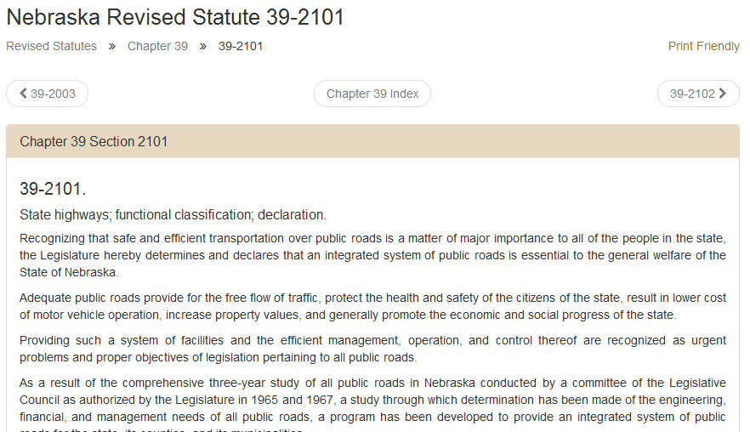
Example Statute
Highway Law
Slide 26

Slide 27
§39-2101
The Big Picture
State Law
1 of 9
In 1969, Nebraska Legislature declared the importance of:
Safe and efficient transportation over public roads
  An integrated system of public roads is needed
  Adequate Public Roads benefits
  Free flow of traffic
  Protect the health and safety of our citizens
  Lower cost of motor vehicle operation
  Increased property values
  Economic and social progress of the state
Slide 27
Notes:
6/21/2021 Simplified – cut the number of words down.

Slide 28
§39-2101
The Big Picture
(continued)
State Law
2 of 9
  Providing such a system of facilities and the efficient management, operation, and control thereof are recognized as urgent problems and proper objectives of legislation pertaining to all public roads
  Cooperation among governmental entities is essential in bringing to fruition the development of a truly integrated system of public roads
  The Legislature provides the legal structure upon which the state, its counties, and its municipalities can work as equal partners in the development, operation, and management of such a system
Slide 28
Notes:
9/12/2022 – in third bullet, added an “s” to spell “provides”, removes the word “law” and inserts the word “legal”
Cooperation on projects, their timing and funding

Slide 29
§39-2101
The Big Picture
(continued)
State Law
3 of 9
Fundamental to the development of an integrated system of public roads is a determination of the function each road segment serves
Through adoption by law of a functional classification system, it is the intent of the Legislature that each segment of public road shall be identified according to the function it serves
Identification by function will permit the establishment of uniform standards for each classification:
  - Design
  - Construction
  - Operation (Local Decision)
  Maintenance
Slide 29

Slide 30
§39-2101
The Big Picture
(continued)
State Law
4 of 9
Standards:
- promote the general safety of the traveling public
- enhance the free flow of traffic,
- provide improved utilization of highway financing
  Each FC is assigned by State Law to NDOT, County or Municipality, as appropriate, such assignments reflecting the general responsibilities of each entity. JURISDICTIONAL RESPONSIBILITY
Slide 30
Notes:
9/12/2022 in the second bullet eliminate “Responsibility for” and change “be” to “is”
8/10/2021 added JURISDICTIONAL RESPONSIBILITY term to 2nd bullet

Slide 31
§39-2101
The Big Picture
(continued)
State Law
5 of 9
Establishment of Board of Public Roads Classifications and Standards, with NDOT, County, Municipal & General Public Representation will provide that:
Each governmental entity & the public will have equal voice in developing reasonable standards for each classification of road
Standards shall be adequate to meet the needs of an increasingly mobile society
Slide 31
Notes:
9/12/2022 in second bullet made “equal voice” bold font to emphasize

Slide 32
§39-2101
The Big Picture
(continued)
State Law
6 of 9
Orderly development of an Integrated system of roads requires:
- Long Range Planning (Six-year plan) and Annual Programing (One-year plan)
- That each entity prioritize its needs, orderly (works/projects, equipment, etc.)
- That each entity work in cooperation with other entities to attain desired objectives (Interlocal Agreements)
- Flexibility, as Annual Programs cannot always be met as unforeseen problems may arise
Slide 32
Notes:
8/13/2019 Updated. Deleted reference to one-year plan revisions (last bullet “Flexibility”).
Prioritizing Needs (2nd bullet) additional reference §39-1503(2). The bullet applies to the entire program.

Slide 33
§39-2101
The Big Picture
(continued)
State Law
7 of 9
Maximum Benefits will result from Improved Management Methods of:
- Planning
- Programming
- Budgeting
Accounting
Inventory
Such management will provide citizens the opportunity to know how each governmental entity intends to spend its highway money, and to determine its performance when measured against its plans
Slide 33
Notes:
8/13/2019 Updated. Deleted reference to Reporting.
Transparency! LB82 (2019 did not change that!

Slide 34
§39-2101
The Big Picture
(continued)
State Law
8 of 9
Legislature intended to provide reasonable financing and more equitable distribution of revenue
Objectives of Nebraska’s program are to bring the state highway system, county roads and municipal streets up to adequate standards in a 20-year period.
Encourages continuous highway planning and improvements; every highway and bridge is subject to reevaluation and change.
Slide 34

Slide 35
§39-2101 Summary
State Law
9 of 9
Desire to meet the needs of all public roads
  Design, Construction and Maintenance
  Financial
  Management
Slide 35

Slide 36
The Big Picture
Law, Rules and Regulations, Boards, Licensing, Reporting, Transparency, Public Involvement
How it all fits together

Slide 37

Nebraska’s Landmark Legislation
1969
NBCS
Nebraska Board of Public Road Classifications and Standards
BEX
Nebraska Board of Examiners for County Highway and City Street Superintendents
Slide 37
Notes:
1969 Legislation established two regulatory boards:
The Nebraska Board of Public Roads, Classifications and Standards, referred to as the NBCS.
The Nebraska Board of Examiners for County Highway and City Street Superintendents, referred to as the BEX.
The first video in the series provides basic information on these boards.

Slide 38
Key Regulations
NAC = Nebraska Administrative Code
NBCS
428 NAC
BEX
425 NAC
Slide 38
Notes:
State regulations related to highways, roads and streets were developed as a result of the 1969 legislation.
A regulation is a rule made by an authority and has the force of law. Essentially, a regulation is an extension of state statutes, only with more details as to how to carry out the law.
These two regulations are discussed in this video and throughout the video series. Most of the attention is on Title 428 Nebraska Administrative Code (aka 428 NAC).

Slide 39
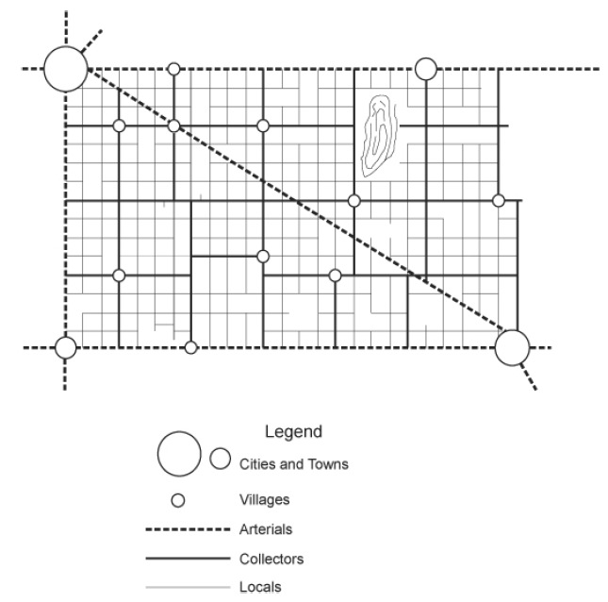

Nebraska’s System - Overview
Functional Classification
428 NAC 1
Basis for
Standards
428 NAC 2
Each Highway, Road and Street is assigned a Classification, by its Function
Uniform Standards for Each Functional Classification
Projects Meet Standards
ONE-AND SIX-YEAR PLANNING
HIGHWAY, ROAD & STREET IMPROVEMENTS
Annual Certification of Program Compliance
to NBCS
BUDGETING, ACCOUNTING, INVENTORY SYSTEMS
Slide 39
Notes:
7/29/2019 Updated slide – to remove reporting requirement to NBCS. By LB82 (2019).
A functional classification system is a system of classifying our highways, roads and streets according to the function each one serves, such as local access, collector, arterial, expressway and interstate. This is fundamental to the development of an integrated system of roads. 428 NAC 1 covers functional classification.
A functional classification system permits the establishment of uniform standards of design, construction, and maintenance for each classification of road. Such standards promote the general safety of the traveling public, enhance the free flow of traffic, and also provide improved utilization of highway financing. 428 NAC 2 covers standards.
Maintaining and improving the system is important, and statutes emphasize transparency by requiring annual disclosure of upcoming projects. These are called One- and Six-Year Plans; as the name indicates, these cover the next six years of planned works and projects. They are disclosed to the public, via a public hearing, and reported to the NBCS. Works and Projects must meet Board standards. 428 NAC 3 covers One- and Six-Year Plans and reporting.
How public funds are spent is also very important. Again, statutes emphasize transparency by requiring annual disclosure of expenditures and revenues along with certification that state statutes were followed. They are disclosed to the NBCS and are available to the public. 428 NAC 4 covers the Standardized System of Annual Reporting. Aka SSAR. In this report to the NBCS, the local public agency certifies that all of its works and projects met NBCS standards.
NOT FOR AUDIO
Nebraska's public roads system is one of the largest in the nation; yet its population is relatively
small and ranges from high concentrations of people in urban centers to vast rural areas in which
the population is sparsely located. The citizens in these diverse areas have the same need,
however, for a transportation system which will meet their respective needs. It is not economically feasible to develop all public roads throughout the state to the same high standards, and thus it
became incumbent upon the Legislature to devise a program under which the roads most
important to these diverse areas are developed to modern standards. Adoption of a functional
classification system and implementation of modern management methods will combine to bring
such a program into being and result in improved utilization of highway financing.

Slide 40
Conflict of Interest and Ethics
1 of 15
What is a Conflict of Interest?
A conflict between a person’s private interests and public obligations
Responsibility to one party interferes with responsibility to another party.
A person in a position of trust has competing professional or personal interests
A situation in which a public official’s decisions are influenced by the official’s personal interests.
Slide 40
Notes:
4/16/2021 New Slide Conflict of Interest
EXAMPLE: Use of government property or assets for personal use is fraud.
Self-dealing, outside employment (one job competes with another), family interests (nepotism, overlapping business with public)

Slide 41
2 of 15
Notes:
4/16/2021 New Slide showing pie chart of overlapping interests
The real world: Competing Duties. I think we all know, intuitively, what is a conflict of interest. For example you know that a legal firm representing both the plaintiff and the defendant is just not right!
A conflict of interest (COI) we can say it in several different ways:
any situation in which an individual or organization is in a position to exploit a professional or official capacity for their personal or organization’s benefit.
Profit on both sides of a transaction
occurs when an individual or organization is involved in multiple interests, one of which could possibly corrupt the motivation for an act in the other. (Wikipedia)
LPA officials/employees: potentially using a government position for personal gain for self or someone close (relative or personal relation).
For LPA’s: a situation in which a public official's [or employee’s] decisions are influenced by the official's [or employee’s] personal interests

Slide 42

Conflict of Interest
3 of 15
Any situation in which an individual or corporation (either private or governmental) is in a position to exploit a professional or official capacity (role) in some way for their personal or corporate benefit (role).
Therefore, conflict of interest = conflict of roles
Notes:
4/16/2021 New Slide wearing more than one hat

Slide 43
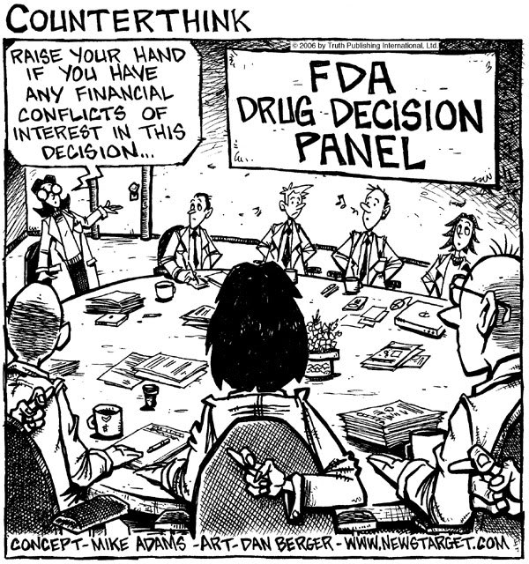
5 of 15
Notes:
4/16/2021 New Slide (humor)
We cannot avoid confronting ethical or moral problems.
No more than we can avoid making choices as to what to eat – healthy or unhealthy (that would be me)
EXPLAIN THE CARTOON. FACILITATOR ASKED IF ANYONE HAS ANY FINANCIAL CONFLICTS OF INTEREST IN A DECISION. THE PEOPLE AROUND THE TABLE ARE CROSSING THEIR FINGERS AND WHISTLING TUNES.
Our actions affect others.
That includes the general public – a unique aspect of ethics which I will be addressing with respect to government contracts.

Slide 44
Conflict of Interest and Ethics
6 of 15
What are Ethics?
Rules of conduct
System of moral principles and values which affect personal or professional actions
Knowing how to apply the rules AND having the character to behave in an ethical manner
The difference between “right” and “wrong”
Slide 44
Notes:
4/16/2021 New Slide Ethics
Character, the six pillars: trustworthiness (honest, reliable, reputable), respect (tolerant, considerate), responsibility (self-control, self-discipline), fairness, caring, citizenship

Slide 45
Values in Public Service
9 of 15
The Public’s Welfare
Public Trust
Public Safety
Transparency
Accountability
Notes:
4/16/2021 New Slide Values
This slide shows some of the values that government agencies aspire to. Contemporary terminology: Accountability for public expenditures, Transparency to the public
Public Projects=Public Funds=Public Responsibility. Oversight controls are basic governmental functions to provide assurance and transparency to the public. Controls are in place to ensure that all of the applicable laws regulations are complied with and to ensure that that compliance is documented as part of the public record.
Every day, in myriad ways, public servants make decisions and take actions that affect the lives and interests of the public: they handle private and confidential information, manage and account for public funds, etc. Because of such a significant public trust, ethical values must be important for public servants. It is necessary to preserve the integrity, reputation and legitimacy of public service as an important institution. Consultants, when hired temporarily to shore up the government agency’s staff, become part of the government team and therefore play a significant role in upholding these values.

Slide 46
Conflict of Interest and Ethics
State Law
10 of 15
There are state statutes that address conflict of interest
One example:
§39-1509
Highway superintendent; interest in public contracts prohibited; reports to county board; neglect of duty; removal from office.
The county highway superintendent shall not be interested directly or indirectly in any contract with the county, and shall render at any time an accounting of his acts and doings to the county board when requested by it so to do; and he may be removed from office by such board at any time upon failure to perform the duties of his office.
Slide 46
Notes:
4/16/2021 New Slide Conflict of Interest

Slide 47
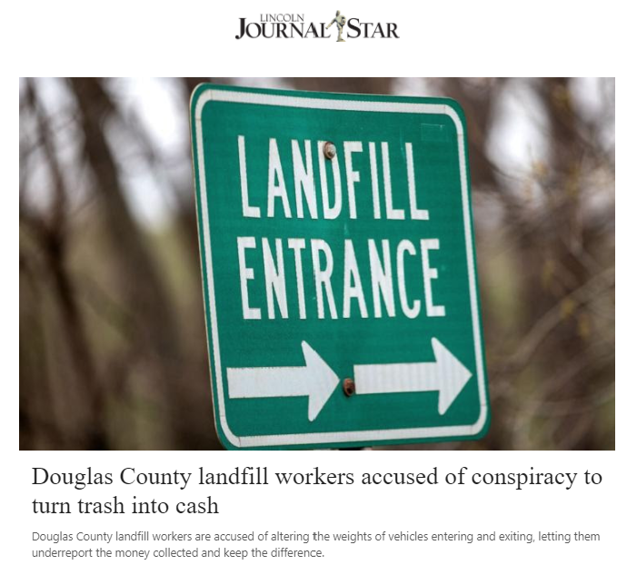
Conflict of Interest and Ethics
11 of 15
Slide 47
Notes:
4/17/2021 New Slide Conflict of Interest – Recent (April 2021) Example

Slide 48
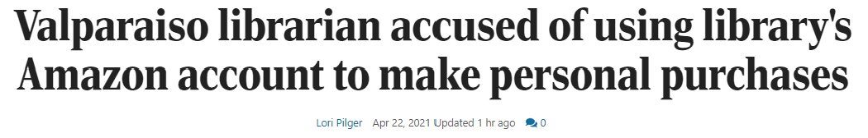
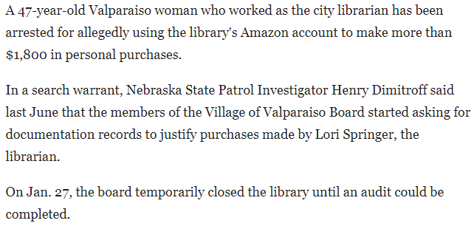
Conflict of Interest and Ethics
12 of 15
Slide 48
Notes:
4/23/2021 New Slide Conflict of Interest – Recent (April 2021) Example

Slide 49
Conflict of Interest
13 of 15
Conflicts happen!
Needs to be handled
Notes:
4/16/2021 New Slide Conflict of Interest
COI is not uncommon. In private business as well as government projects.
There is nothing inherently wrong with having a COI. No one needs to feel bad if there is a COI.
It is all in how you handle it
What we do not want:
public officials and employees to not invest in private sector
private sector employees not seeking public office
anyone to lose their job!
people to feel that they can’t fraternize with one another any more
And we certainly cannot stop people from being a part of families!!
Public sector projects are in a different category than private business, however, and the law must be followed.

Slide 50
Conflict of Interest and Ethics
State Law
14 of 15
§49-14,105 thru §49-14,142
Nebraska Political Accountability and Disclosure Act
https://www.nadc.nebraska.gov/
Public “watchdog” for campaign finance, lobbying, and
Conflicts of Interest
Public officials and public employees of the State of Nebraska are subject to laws requiring the disclosure of personal financial interests, interests in contracts with government and potential conflicts of interests. Forms and instructional materials are available through this site. To access this information, click on the tab above marked CONFLICTS OF INTEREST.
Slide 50
Notes:
4/16/2021 New Slide Conflict of Interest
This is the State’s administrative Commission that addresses, among other things, conflicts of interest. You can disclose potential conflicts to them, and see what they say.
49-14,114 – Commission members themselves cannot have any conflict of interest!!
49-14,123 – list of Commission duties
Commission; duties.
In addition to any other duties prescribed by law, the commission shall:
(1) Adopt and promulgate rules and regulations to carry out the Nebraska Political Accountability and Disclosure Act pursuant to the Administrative Procedure Act;
(2) Prescribe forms for statements and reports required to be filed pursuant to the Nebraska Political Accountability and Disclosure Act and furnish such forms to persons required to file such statements and reports;
(3) Prepare and publish one or more manuals explaining the duties of all persons and other entities required to file statements and reports by the act and setting forth recommended uniform methods of accounting and reporting for such filings;
(4) Accept and file any reasonable amount of information voluntarily supplied that exceeds the requirements of the act;
(5) Make statements and reports filed with the commission available for public inspection and copying during regular office hours and make copying facilities available at a cost of not more than fifty cents per page;
(6) Compile and maintain an index of all reports and statements filed with the commission to facilitate public access to such reports and statements;
(7) Prepare and publish summaries of statements and reports filed with the commission and special reports and technical studies to further the purposes of the act;
(8) Review all statements and reports filed with the commission in order to ascertain whether any person has failed to file a required statement or has filed a deficient statement;
(9) Preserve statements and reports filed with the commission for a period of not less than five years from the date of receipt;
(10) Issue and publish advisory opinions on the requirements of the act upon the request of a person or government body directly covered or affected by the act. Any such opinion rendered by the commission, until amended or revoked, shall be binding on the commission in any subsequent charges concerning the person or government body who requested the opinion and who acted in reliance on it in good faith unless material facts were omitted or misstated by the person or government body in the request for the opinion;
(11) Act as the primary civil enforcement agency for violations of the Nebraska Political Accountability and Disclosure Act and the rules or regulations adopted and promulgated thereunder;
(12) Receive all late filing fees, civil penalties, and interest imposed pursuant to the Nebraska Political Accountability and Disclosure Act and remit all such funds to the State Treasurer for credit to the Nebraska Accountability and Disclosure Commission Cash Fund;
(13) Provide current information or a list of persons owing civil penalties and interest to filing officers to determine compliance with subsection (4) of section 32-602. The commission shall provide the current information or list to each filing officer on December 1 prior to a statewide primary election, shall continuously update the information or list through March 1 prior to the statewide primary election, and shall update such information or list at other times upon request of a filing officer; and
(14) Prepare and distribute to the appropriate local officials statements of financial interest, campaign committee organization forms, filing instructions and forms, and such other forms as the commission may deem appropriate.

Slide 51
Decision Framework
15 of 15
Ask yourself:
  Would the resulting action be legal?
  Would stakeholders/citizens/taxpayers see the action as responsible stewardship?
  Would I feel good about the resulting action?
  Would I mind having information regarding the decision publicized?
  Have I consulted with peers/others regarding the perceived action and possible ramifications?
  Would the public view the perceived act as a responsible professional action?
Notes:
4/16/2021 New Slide - public perception is important, even if the action is legal or “ethical”

Slide 52
Nebraska’s System of Public Roads
Review and Summary
State Law
Slide 52
Notes:
Your challenge
be able to explain the legal and regulatory basis for roads/street programs to elected officials, constituents, the media, and others
The law controls everything political jurisdictions can do, and everything a superintendent an do
You need to know – at least broadly – what is in the law and how it affects you and your job
You definitely need to know where to find statutes and regulations – where to look
The law establishes the superintendent position, provides funding, requires planning to occur, and requires reporting to the NBCS

Slide 53


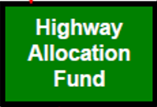
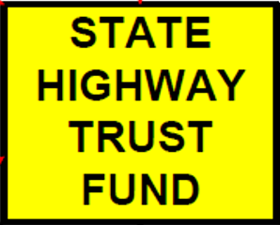

TAXPAYERS
(Licensed) City Street and County Highway Superintendents
Munici-palities
Counties
NDOT
Two Boards
NBCS
BEX
§39-21, -23, -25
§39-2101
Notes:
3/10/2020 New Slide
7/24/2020 and 7/25/2020 Updated, changed “renters” to “occupants” and a few other changes
THE FOLLOWING IS AN ANALOGY – SUGGESTING THAT STUDENTS USE THIS OR MAKE UP THEIR OWN MENTAL IMAGE TO USE WHEN MODELLING NEBRASKA’S SYSTEM FOR ITS HIGHWAYS, ROADS AND STREETS – TO HELP STUDENTS UNDERSTAND THE SYSTEM AND HELP THEM PLANT IT INTO THEIR MINDS
The HOUSE represents the LEGAL STRUCTURE of Nebraska’s highways, roads and streets system and the facilities themselves. Chapter 39-2101 is the foundational state statute (the “footings”) for our current system; Chapter 39 articles 21, 23 and 25 are the foundation walls. BIG HINT: KNOW THESE STATUTES FOR THE EXAM!!
The GOVERNMENTAL ORGANIZATIONS (represented by their respective governing bodies) labeled on the windows and living in the house are really just OCCUPANTS and caretakers; the TAXPAYERS of the State of Nebraska are the OWNERS of our public roads system.
*************************SORRY, IT’S PUBLIC PROPERTY SO NO PARTYING IN THIS HOUSE!!! *******************************
WHO PAID/PAYS for our highways, roads and streets? Represented by the State Seal and the two State funds, on the left side of the slide, THE PUBLIC PAID for construction of the house (public highways, roads and streets) - see the left side of the slide – and THE PUBLIC PAYS also for the ongoing maintenance and improvements, via various state and local taxes, and sometimes federal and other monies as well. The public is the local “banker” so to speak.
It is the job of the OCCUPANTS, with City Street and County Highway SUPERINTENDENTS in key roles, to maintain and improve the house, with each renter taking (JURISDICTIONAL) RESPONSIBILITY for its part of the house. Jurisdictional responsibility is covered in 39-21.
The TWO BOARDS are akin to the BUILDING CODES AND INSPECTIONS DEPARTMENT in the jurisdiction where the house resides, and OWNER REPRESENTATIVES combined – renters need to keep the facility up to CODE, like NBCS STANDARDS. If it’s a hardship to meet code, renters must seek permission from the NBCS. The BEX is the approver of LICENSED Superintendents. (7/24/2020)
Each room has a FUNCTION. So let’s classify them; FUNCTIONAL CLASSIFICATION. Say the kitchen is the interstate, the bathroom is the expressway, the dining room is an arterial, the living room is a collector, bedrooms are local, etc. The owner provides money to clean and maintain these rooms.
To upkeep the house, as there is always something wearing out or breaking down, superintendents need to PLAN AND PROGRAM various works and projects; call it a ONE- AND SIX-YEAR PLAN/PROGRAM. Renters are required to get input from the owners (the people) – at a PUBLIC HEARING. Transparency is an important part of the 1969 legislation. The renter approves and adopts the final plan or program, then, superintendents IMPLEMENT the plan or program, including building to code, or in our case, Board standards and industry standards. YOU MAKE IT HAPPEN. YOU ARE A KEY TO KEEPING THE HOUSE IN ORDER THE RIGHT WAY. They need to be sure to build to code (i.e. standards).
Renters should INVENTORY everything in the house; you can’t manage what you don’t know you own! (ASSET MANAGEMENT)
The property must be maintained! That includes activities such as snow removal.
Renters must have (or get or hire) an ACCOUNTING and BUDGETING and INVENTORY system in place to track all expenditures, receipts, supplies and equipment. After all, the owners want to know how their investments are doing. Occupants also CERTIFY annually to the OWNER REPRESENTATIVES (the NBCS in this analogy) that they have those systems in place and that their projects met code (standards) and all laws. They do NOT send any reports to the owner representatives, just certify that they are fulfilling their end of the bargain.
Occupants must inspect or have inspected the structure (i.e. bridges) typically every two years. (ASSET MANAGEMENT)
Occupants must maintain documents relating to the house - a file cabinet in each respective area. (RECORDS MANAGEMENT)
If occupants want to put an addition on the house and need to purchase additional property to do so, they must follow strict laws to protect neighbors and to treat them fairly. If that doesn’t happen, there could be serious consequences. (RIGHT-OF-WAY ACQUISITION AND THE UNIFORM ACT)
SO, THE MESSAGE IS NOT TO PUT ON THE TEST THAT NEBRASKA’S SYSTEM IS LIKE A HOUSE, OR THAT GOVERNING BODIES ARE OCCUPANTS!! THIS IS ONLY A TOOL TO SIMPLIFY THE BLIZZARD OF INFORMATION THAT CANDIDATES FOR LICENSURE GET IN FOUR DAYS OF CLASS AND HELP GET THE BASIC STRUCTURE OF NEBRASKA’S SYSTEM INTO THE MINDS OF THOSE WANTING TO BECOME SUPERINTENDENTS.

Slide 54
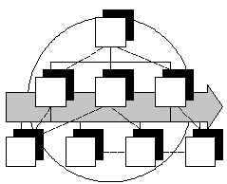
What Does It Take to be Successful?
Good roads and streets require:
Funding - state, local & federal
People - professionals
Organization - effective, efficient, accountable
You - the elected or appointed officials in charge - make it happen!!
Slide 54

Slide 55
Local Organization and Duties
County roads and Municipal streets are part of an Integrated Highway, Road & Street System -
State Policy, legislated in 1969
Components: Standards; planning; budgeting; accounting; Highway Trust Fund (shared); licensed superintendent (incentive payments to entities); public participation and input
Slide 55
Notes:
10/11/2021 Updated by adding “payments to entities” and added “public participation and input”
7/24/2020 Updated by adding “incentive” last bullet
3/10/2020 Updated to remove “reporting” and add important components of Nebraska’s system

Slide 56
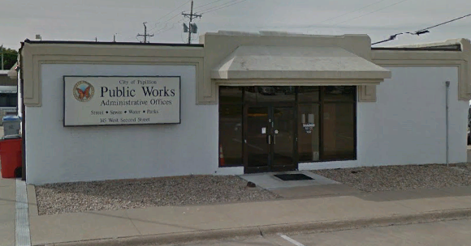
Local Organization and Duties (continued)
Highway / Street Superintendent -
Actual job titles vary
Employed or consulting
Not mandatory for lower populated counties
Licensing is required for Incentive Funds (Funds go to the county or municipality)
-Class B = entry level, requires exam or P.E.
-Class A = experienced; professional development required for renewal
18,000
§39-1501(2)
Slide 56
Notes:
9/12/2022 added statute reference in 3rd bullet

Slide 57
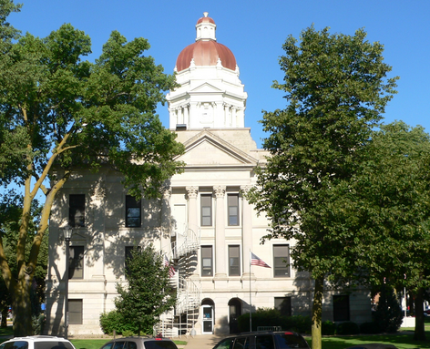
Local Organization and Duties (continued)
Program Planning & Management
  Superintendent must (at least) assist in process
Program Policy & Oversight
  County Board’s / City Mayor’s & Council’s / Village Board’s responsibility
Interlocal Agreements - important (State Laws §39-2114 & §13-513)
Townships - responsible for maintenance
Slide 57
Notes:
9/12/2022 in 3rd bullet added “s” to make “Laws”
4/27/2021 Updated per LB174(2021) sub-bullet to first bullet “to at least assist in process”
9/8/2019 Updated – removed reference to “Reporting” first bullet

Slide 58
Superintending
§39-2301.01
Means assisting in:
State Law
Developing and annually updating long-range plans or programs
Developing annual programs
Developing annual budgets
Implementing the capital improvements and maintenance activities
Managing personnel, contractors, and equipment
Notes:
4/27/2021 Updated per LB174(2021) assisting
From a state law perspective, Superintending duties must include assisting an incorporated municipality or a county in the following:
Developing and annually updating long-range plans or programs based on needs and coordinated with adjacent local governmental units
Developing annual programs for design, construction, and maintenance
Developing annual budgets based on programmed projects and activities
Implementing the capital improvements and maintenance activities provided in the approved plans, programs, and budgets
Managing personnel, contractors (includes consultants!), and equipment in support of such planning, programming, budgeting, and implementation of operations
Counties - also reference Chapter 39, Section 15.

Slide 59
Conclusions
Your community has made a large investment -
Your roads, streets and structures have great value - maintain and improve them
People (your customers) depend on the program you provide -
Give them the best return on investment and the best quality service (consistent with best practices, policies, procedures & the law)
Quality
ROI
Slide 59

Slide 60
Conclusions (continued)
State & Federal funding programs -
Provide significant resources - use them wisely and effectively
Come with complex requirements - follow them carefully
“Flying under the radar” won’t work -
Protect your county / municipality against: deteriorating facilities; set-backs and delays on projects; penalties; increased liability; missed economic development opportunities
Do it right !!!
Slide 60
Notes:
Things that a savvy superintendent will be aware of and account for

Slide 61
Conclusions (continued)
Empower your workforce -
Your road / street crews and personnel are critically important
Make sure you provide leadership and rely on professional management
The Superintendent is key
Slide 61

Slide 62
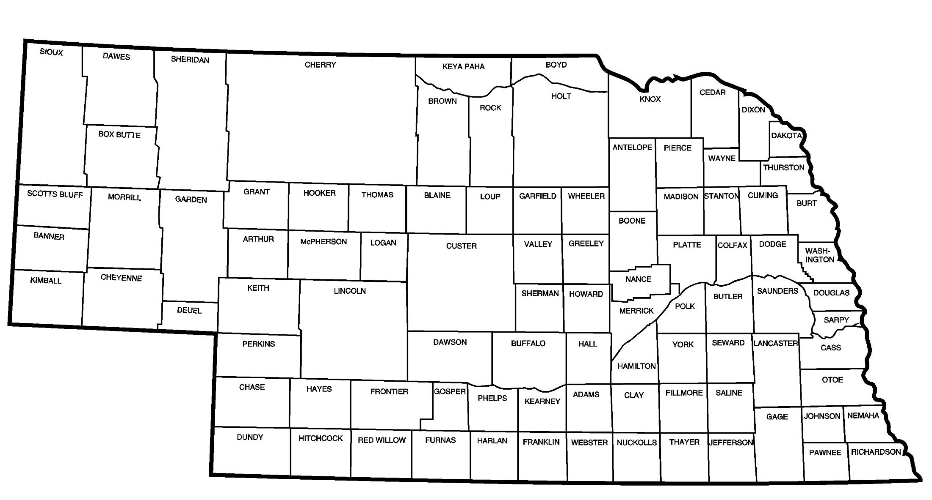

Conclusion
Nebraska's public roads system
  is one of the largest in the nation, serves sparsely populated areas as well as large urban centers, all which have transportation needs
Modern standards must address roads of various functions, classifications and areas
Not enough money to build every road as if it is an arterial
Good program management leads to more efficient use of public roads funds
Slide 62
Notes:
4/16/2021 – minor grammatical correction in the sub-bullet under the first bullet

Slide 63

Nebraska Highway Law
Questions?
Boards - Liaison Services Section
Slide 63

