Slide 1
Utility program
District 1 Breakout Session
Notes:
HDR

Slide 2
This Meeting is Being Recorded
Notes:
HDR

Slide 3
Welcome
Before we begin, let’s have a brief safety moment.
In-Person Attendees
Emergency Exits
Tornado Shelter
911 Caller
AED Location
Restrooms
Virtual Attendees
Unmute yourself or use your chat box if you are in an emergency situation.
Notes:
HDR

Slide 4
Agenda
Introductions
High Impact Project Review (by construction year)
Communication and Coordination
Questions and Wrap Up
Notes:
HDR

Slide 5
Introductions
Notes:
All speakers introduce themselves briefly (Dave, section head, HDR facilitators); Attendees can introduce themselves if it’s a small group. If not – skip it!

Slide 6
2024 Utility policy
NDOT rolled out a new utility accommodation policy in 2024.
You can find more information, as well as a webinar about the changes, on the NDOT utility website at https://dot.nebraska.gov/business-center/utilities/.
Notes:
Dave

Slide 7
Recently Completed projects
The following projects were recently completed in District 1.

Slide 8
Recently completed projects
Cheese Creek Bridge (MS)
Elk Creek East Bridge (MS)
District 1-B High Mast Tower Replacement
District 1-A High Mast Tower Replacement
Table Rock & Humboldt
Church Road Lighting
Peru Spur – S Jct US-75 (MS)
Bee Spur Bridge
W Junction N-92 – David City
Seward West
Burr Spur (MS)
Greenwood East
Murdock Spur – N-50
Cordova Spur

Slide 9
Outstanding Cy 2025
The following projects will likely not be completed in 2025

Slide 10
US-77/Warlick Boulevard Interchange
Project Number: S-77-2(1077) Control No: 12552C
Project Length: 5.03
Scope of Work:
  Urban Reconstruction
  Culvert Extension/Replacement
  Bridge Replacement

Slide 11
US-77/Warlick Boulevard Interchange
Project Number: S-77-2(1077) Control No: 12552C
Status: Construction
Right-of-way: In Progress
Construction Timing: 9/2/2025 – 7/31/2027

Slide 12
US-77/Warlick Boulevard Interchange
Project Number: S-77-2(1077) Control No: 12552C
Anticipated Utilities Impact:
  Urban Recon
  Bridge Repair/Replace
Anticipated Request from Utilities:
  Provide Existing Locations
  Potholing Required
Additional Information:
  Special Provisions Required
Utilities Involved:
  Black Hills Energy
  Charter Communications
  City Of Lincoln - Water, Wastewater, Traffic, Parks
  Lincoln Electric Systems
  Segra
  Windstream Communications

Slide 13
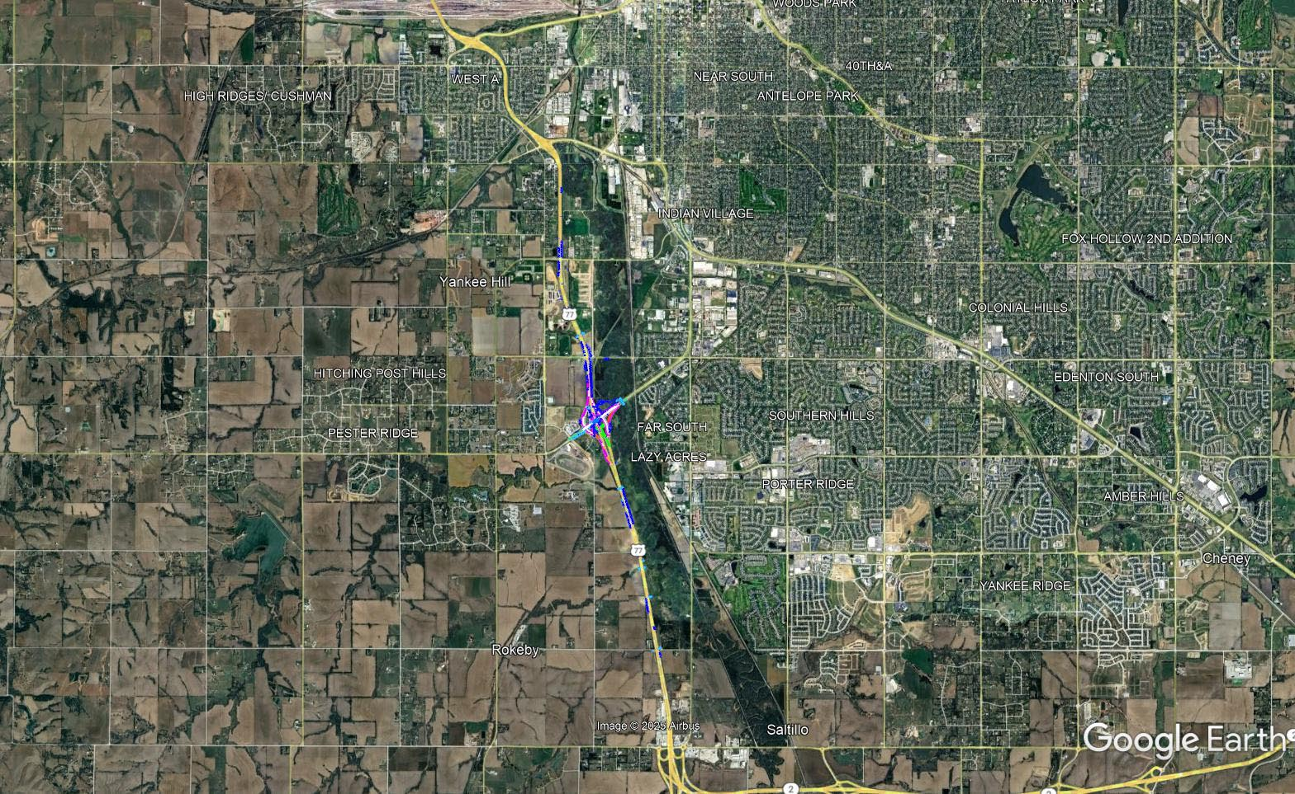

Slide 14
Fairbury West Bridge (MS)
Project Number: NH-136-6(121) Control No: 13183
Project Length: 0.00
Scope of Work:
  Bridge Repair
  Full Depth Pavement
  Access X-ings & Shoo-Fly
Anticipated Completion:
  Late Spring 2026

Slide 15
Fairbury West Bridge (MS)
Project Number: NH-136-6(121) Control No: 13183
Anticipated Utilities Impact:
  Bridge Repair/Replace
  Access X-ing
Anticipated Request from Utilities:
  Provide Existing Locations
  Potholing Required
Additional Information:
  Special Provisions Required
Utilities Involved:
  Altice USA
  Black Hills Energy
  Charter Communications
  City of Fairbury
  Great Plains Communications
  Little Blue Natural Resources
  Viaero
  Windstream Communications

Slide 16
CY 2026
The following projects are anticipated to be let during 2026

Slide 17
Hwy 6 & Adams Street Bridges over I-180 (MS)
Project Number: NH-180-9(733) Control No: 12046
Project Length: 0.00
Scope of Work:
  Full Depth Pavement
  Guardrail
  Bridge Replacement

Slide 18
Hwy 6 & Adams Street Bridges over I-180 (MS)
Project Number: NH-180-9(733) Control No: 12046
Status: Design
Right-of-way: Not Required
Construction Timing: 11/30/2026

Slide 19
Hwy 6 & Adams Street Bridges over I-180 (MS)
Project Number: NH-180-9(733) Control No: 12046
Anticipated Utilities Impact:
  Bridge Repair/Replace
  Full Depth Pavement
  Guardrail
Anticipated Request from Utilities:
  Provide Existing Locations
Additional Information:
  Special Provisions Required
Utilities Involved:
  Allo Communications
  Black Hills Energy
  Charter Communications
  City of Lincoln
  Lincoln Electric Systems
  Lumen
  Segra
  Windstream Communications

Slide 20
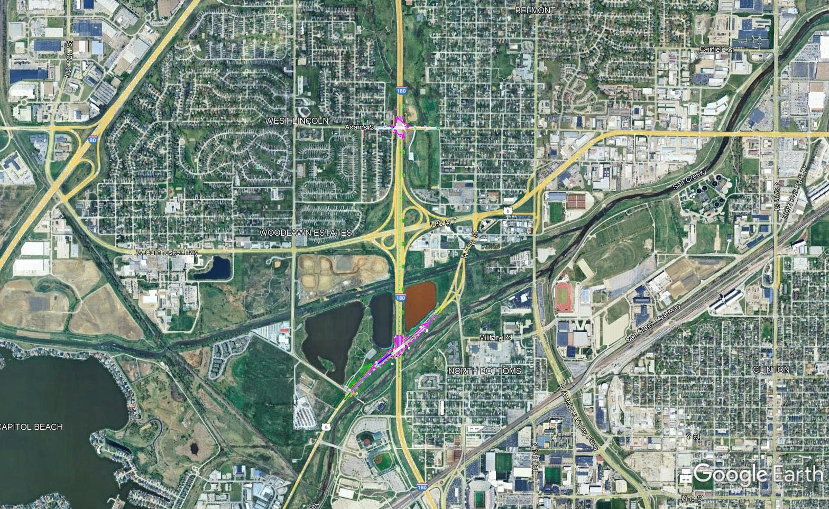

Slide 21
Wilber North
Project Number: STP-103-1(112) Control No: 13265
Project Length: 9.44
Scope of Work:
  Full Depth Pavement

Slide 22
Wilber North
Project Number: STP-103-1(112) Control No: 13265
Status: Design
Right-of-way: Not Required
Construction Timing: 10/24/2026

Slide 23
Wilber North
Project Number: STP-103-1(112) Control No: 13265
Anticipated Utilities Impact:
  Full Depth Pavement either side of I Road
  Mill & Fill majority of project
Anticipated Request from Utilities:
  Coordination with NDOT
  Potholing Required
  Locates
Additional Information:
  Special Provisions Required
Utilities Involved:
  Black Hills Energy
  Allo Communications
  Charter Communications
  City of Crete
  City of Wilber
  Nebraska Public Power District
  Norris Public Power District
  Omaha Public Power District
  Segra
  Windstream Communications

Slide 24
Beatrice West Bridges
Project Number: STP-TAP-4-6(117) Control No: 13373
Project Length: 0.00
Scope of Work:
  Bridge Replacement
  Access X-ings & Shoo-Fly

Slide 25
Beatrice West Bridges
Project Number: STP-TAP-4-6(117) Control No: 13373
Status: Design
Right-of-way: In Progress
Construction Timing: 10/9/2027

Slide 26
Beatrice West Bridges
Project Number: STP-TAP-4-6(117) Control No: 13373
Anticipated Utilities Impact:
  Bridge Repair/Replace
  Access X-ing
  Full Depth Pavement
  Guardrail
Anticipated Request from Utilities:
  Provide Existing Locations
Additional Information:
  Special Provisions Required
Utilities Involved:
  City of Beatrice
  Charter Communications
  Diller Telephone Co
  Great Plains Communications
  Kinder Morgan
  Lower Big Blue Natural Resources District
  Nebraska Public Power District
  Norris Public Power District
  Northern Natural Gas
  Omaha Public Power District
  Pawnee County Rural Water District #1
  Segra
  Village of Lewiston
  Windstream Communications

Slide 27
Beatrice Southwest
Project Number: NH-136-6(128) Control No: 13413
Project Length: 9.11
Scope of Work:
  Full Depth Pavement
  Grading

Slide 28
Beatrice Southwest
Project Number: NH-136-6(128) Control No: 13413
Status: Design
Right-of-way: In Progress
Construction Timing: 9/19/2026

Slide 29
Beatrice Southwest
Project Number: NH-136-6(128) Control No: 13413
Anticipated Utilities Impact:
  Full Depth Pavement
  Grading
  Mill & Fill
  Reconstruction of Locust St.
Anticipated Request from Utilities:
  Provide Existing Locations
  Potholing Required
Additional Information:
  Special Provisions Required
Utilities Involved:
  Black Hills Energy
  Charter Communications
  City of Beatrice
  City of Fairbury
  Diller Telephone Co
  Great Plains Communications
  Norris Public Power District
  Northern Natural Gas
  Pinpoint Communications
  Segra
  Windstream Communications

Slide 30
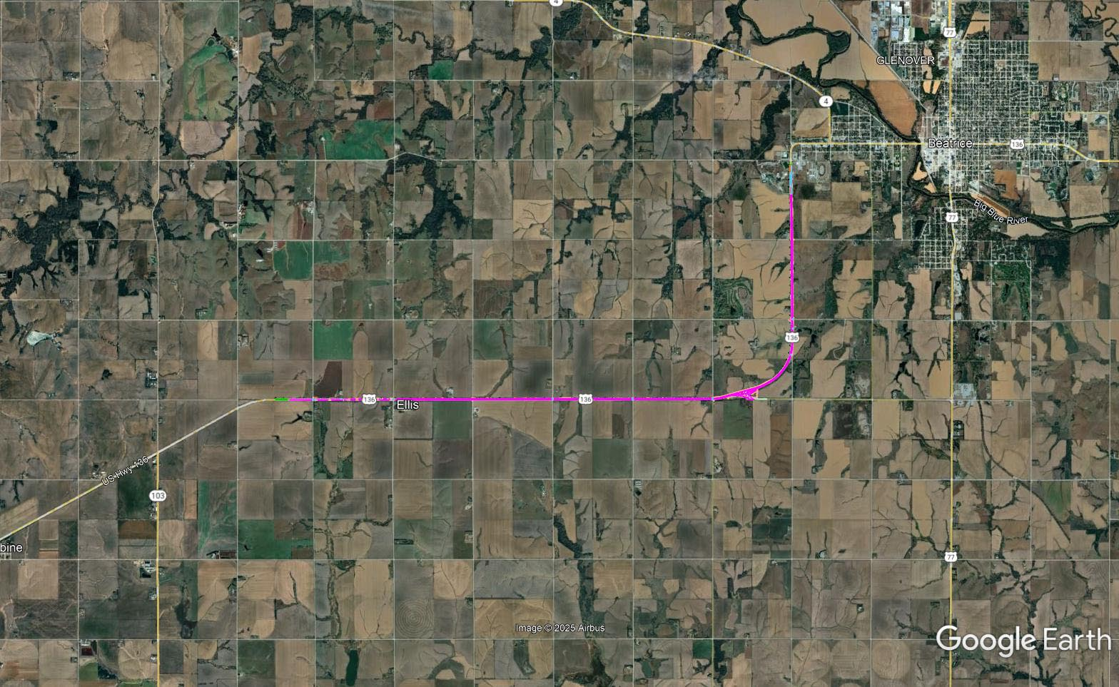

Slide 31
N-99 - W Jct N-50 (MS)
Project Number: STP-4-7(110) Control No: 13460
Project Length: 9.03
Scope of Work:
  Grading
  Access X-ings
  Guardrail
  Bridge Repair/Replace

Slide 32
N-99 - W Jct N-50 (MS)
Project Number: STP-4-7(110) Control No: 13460
Status: Design
Right-of-way: In Progress
Construction Timing: 8/10/2026

Slide 33
N-99 - W Jct N-50 (MS)
Project Number: STP-4-7(110) Control No: 13460
Anticipated Utilities Impact:
  Grading
  Access X-ing
  Guardrail
  Bridge Repair/Replace
Anticipated Request from Utilities:
  Provide Existing Locations
  Potholing Required
Additional Information:
  Special Provisions Required
Utilities Involved:
  Great Plains Communications
  Lumen
  Omaha Public Power District
  Pawnee County Rural Water District #1
  Segra
  Windstream Communications

Slide 34
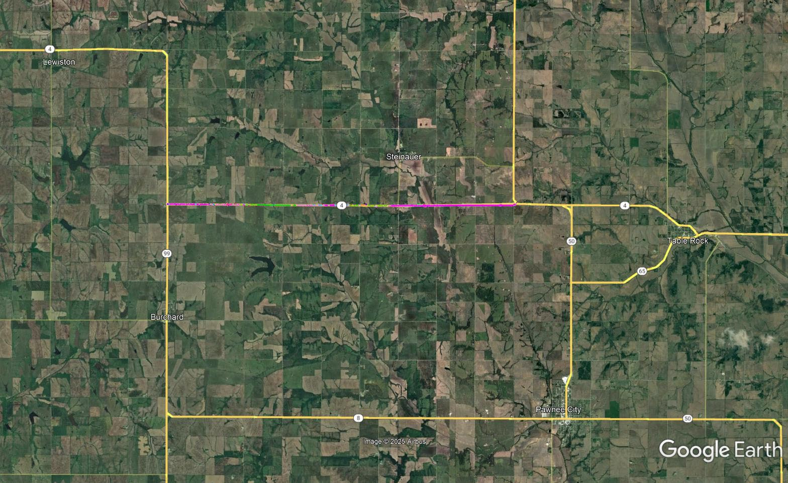

Slide 35
I-180 Bridges over I-80 (MS)
Project Number: NH-180-9(8) Control No: 13472
Project Length: 0.35
Scope of Work:
  ITS/Lighting
  Bridge Replacement

Slide 36
I-180 Bridges over I-80 (MS)
Project Number: NH-180-9(8) Control No: 13472
Status: Design
Right-of-way: Not Required
Construction Timing: 3/30/2026

Slide 37
I-180 Bridges over I-80 (MS)
Project Number: NH-180-9(8) Control No: 13472
Anticipated Utilities Impact:
  Lighting
Anticipated Request from Utilities:
  Coordination with NDOT
Additional Information:
  Special Provisions Required
Utilities Involved:
  Black Hills Energy
  City of Lincoln
  Lincoln Electric Systems
  Lower Platte South Natural Resource District
  OPTK Networks
  Segra
  Windstream Communications

Slide 38
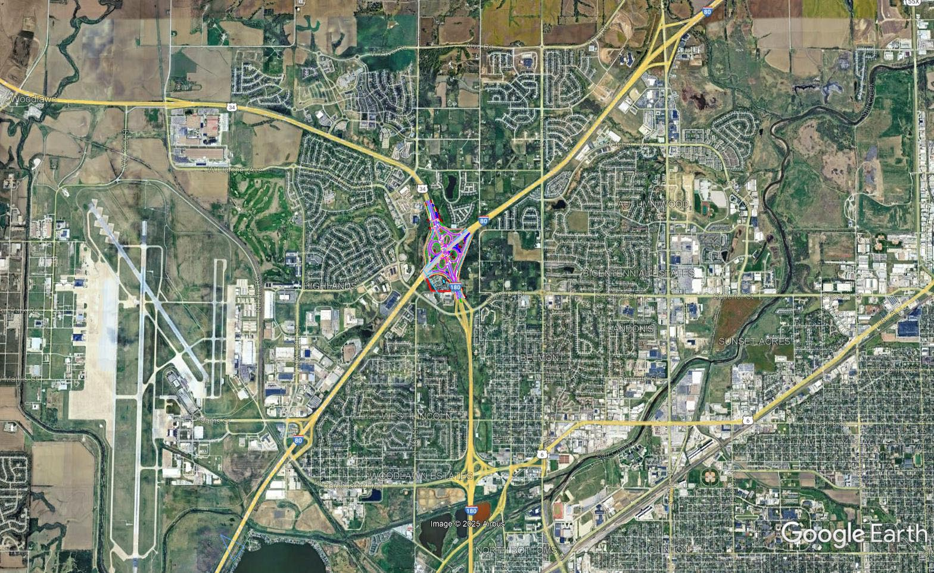

Slide 39
US-75 Kansas State Line-Dawson (MS)
Project Number: NH-75-1(110) Control No: 13487
Project Length: 9.92
Scope of Work:
  Bridge Replacement
  Culvert Extension/Replacement

Slide 40
US-75 Kansas State Line-Dawson (MS)
Project Number: NH-75-1(110) Control No: 13487
Status: Design
Right-of-way: In Progress
Construction Timing: 5/4/2026

Slide 41
US-75 Kansas State Line-Dawson (MS)
Project Number: NH-75-1(110) Control No: 13487
Anticipated Utilities Impact:
  Culvert Extensions/Replacement
  Bridge Repair/Replace
  Grading
  Guardrail
Anticipated Request from Utilities:
  Coordination with NDOT
  Provide Existing Locations
  Potholing Required
Additional Information:
  Special Provisions Required
Utilities Involved:
  AT&T
  Lumen
  Nebraska Public Power District
  Omaha Public Power District
  Richardson County Rural Water District #1
  Southeast Nebraska Communications
  Segra
  Village of Dawson
  Windstream Communications
  Zayo Group

Slide 42
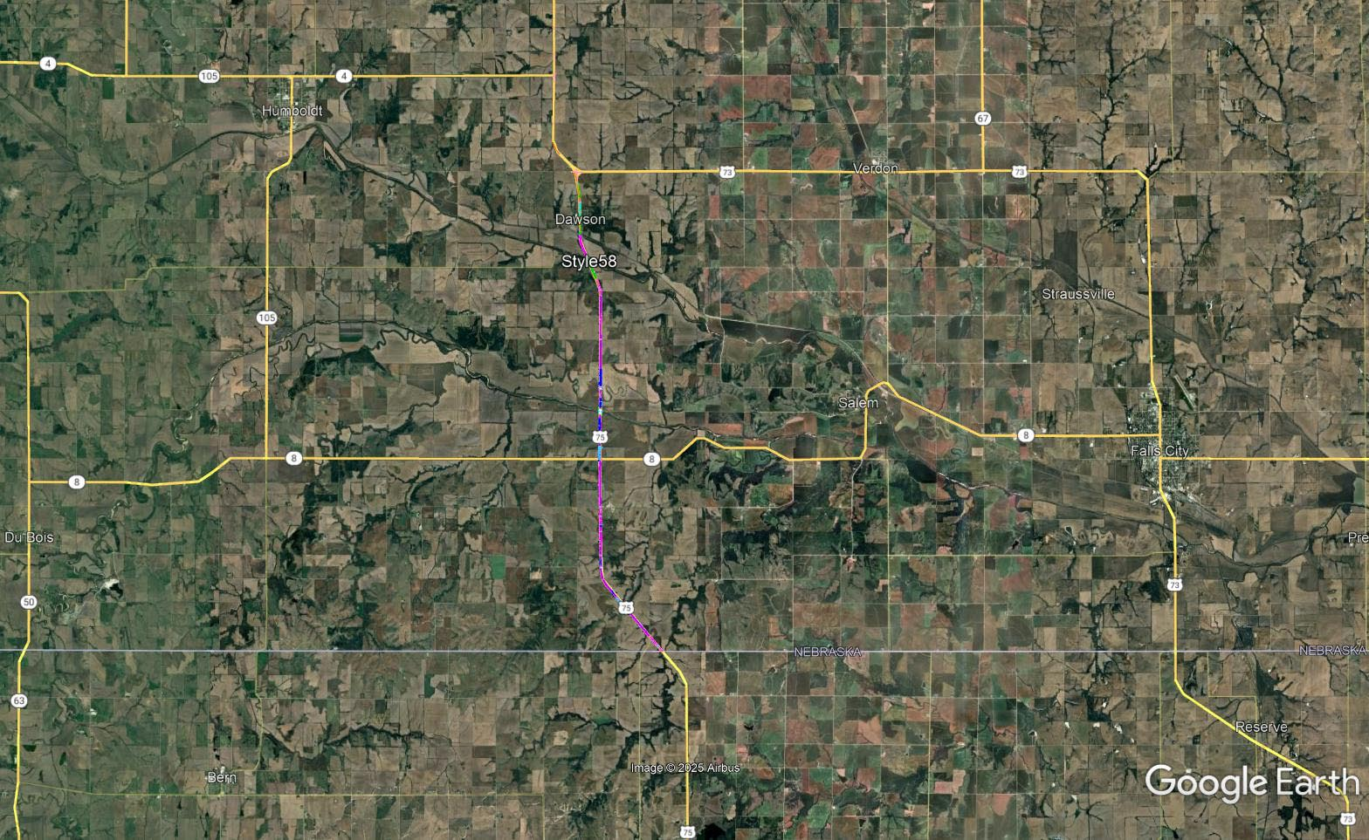

Slide 43
Wahoo West (MS)
Project Number: NH-92-6(123) Control No: 13414
Project Length: 14.30
Scope of Work:
  Grading
  Culvert Extension/Replacement
  Bridge Repair
  Guardrail

Slide 44
Wahoo West (MS)
Project Number: NH-92-6(123) Control No: 13414
Status: Design
Right-of-way: In Progress
Construction Timing: 4/1/2026 to 10/31/2026

Slide 45
Wahoo West (MS)
Project Number: NH-92-6(123) Control No: 13414
Anticipated Utilities Impact:
  Grading
  Culvert Extension/Replace
Anticipated Request from Utilities:
  Provide Existing Locations
  Potholing Required
Additional Information:
  Special Provisions Required
Utilities Involved:
  Butler Public Power District
  City of Wahoo
  Northeast Nebraska Telephone Company
  Omaha Public Power District
  Segra
  Village of Malmo
  Village of Weston
  Windstream Communications

Slide 46
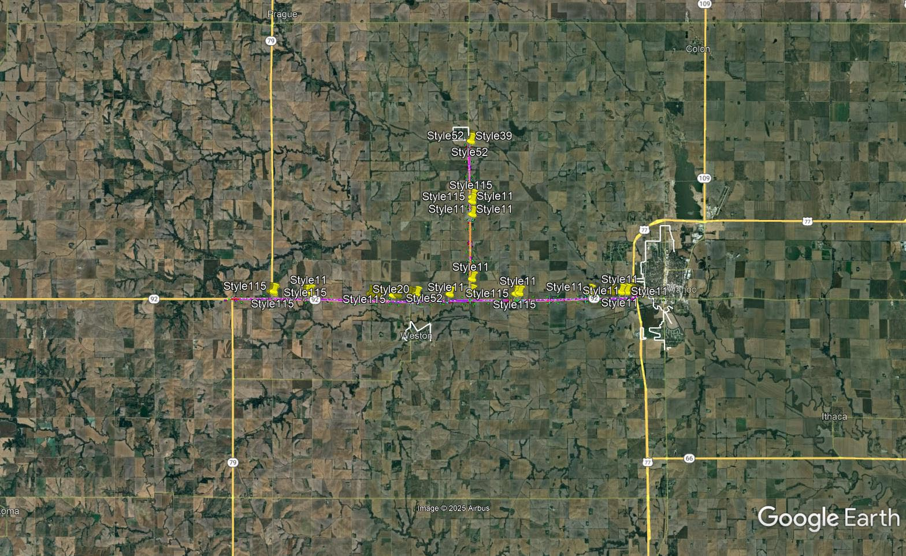

Slide 47
Palmyra East & West
Project Number: HSIP-2-7(125) Control No: 13573
Project Length: 1.50
Scope of Work:
  Full Depth Pavement
  ITS/Lighting

Slide 48
Palmyra East & West
Project Number: HSIP-2-7(125) Control No: 13573
Status: Design
Right-of-way: Complete
Construction Timing: 4/1/2026

Slide 49
Palmyra East & West
Project Number: HSIP-2-7(125) Control No: 13573
Anticipated Utilities Impact:
  Full Depth Pavement
  Lighting
Anticipated Request from Utilities:
  Provide Existing Locations
  Potholing Required
Additional Information:
  Special Provisions Required
Utilities Involved:
  Black Hills Energy
  Cass County Rural Water District #2
  Charter Communications
  Lancaster County Rural Water District #1
  Nebraska City Utilities
  Northern Natural Gas
  Omaha Public Power District
  OneOK
  Otoe County Rural Water District #3
  Segra
  Village of Palmyra
  Windstream Communications

Slide 50
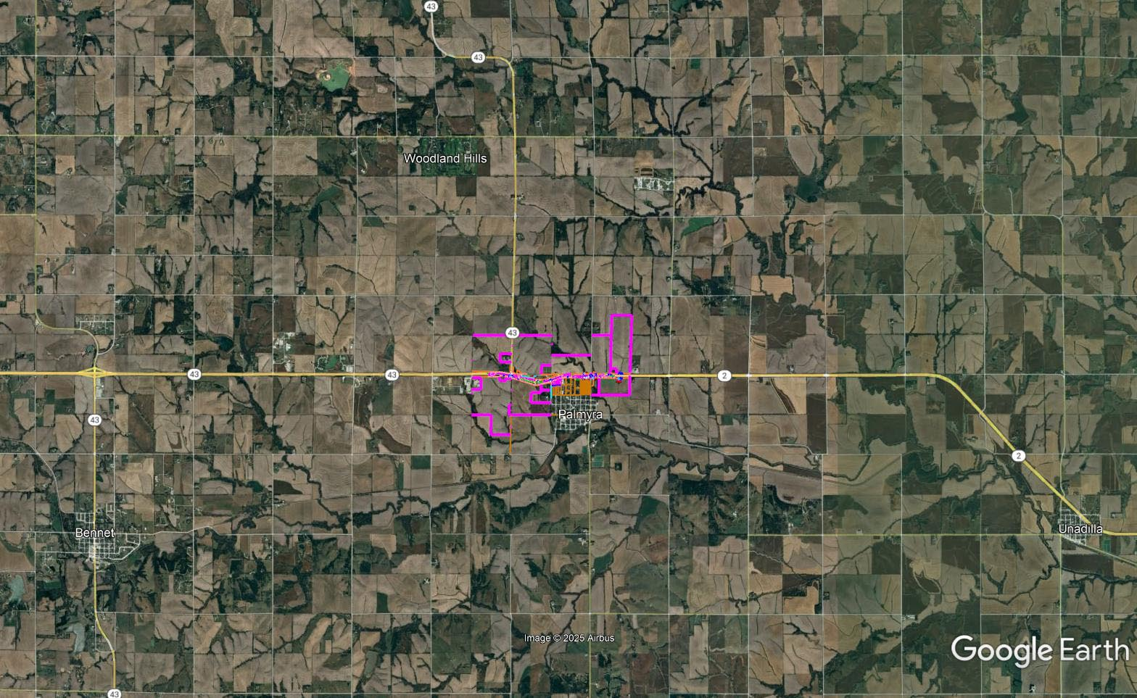
Palmyra East & West
Project Number: HSIP-2-7(125) Control No: 13573

Slide 51
US-6 & N. 141st Street, Waverly
Project Number: ELEC-6-6(1060) Control No: 13582
Project Length: 0.00
Scope of Work:
  ITS/Lighting

Slide 52
US-6 & N. 141st Street, Waverly
Project Number: ELEC-6-6(1060) Control No: 13582
Status: Design
Right-of-way: Not Required
Construction Timing: 11/9/2026

Slide 53
US-6 & N. 141st Street, Waverly
Project Number: ELEC-6-6(1060) Control No: 13582
Anticipated Utilities Impact:
  Lighting
Anticipated Request from Utilities:
  Coordination with NDOT
Additional Information:
  Special Provisions Required
Utilities Involved:
  Black Hills Energy
  City of Waverly
  Great Plains Communications
  Lincoln Electric Systems
  Lumen
  Windstream Communications

Slide 54
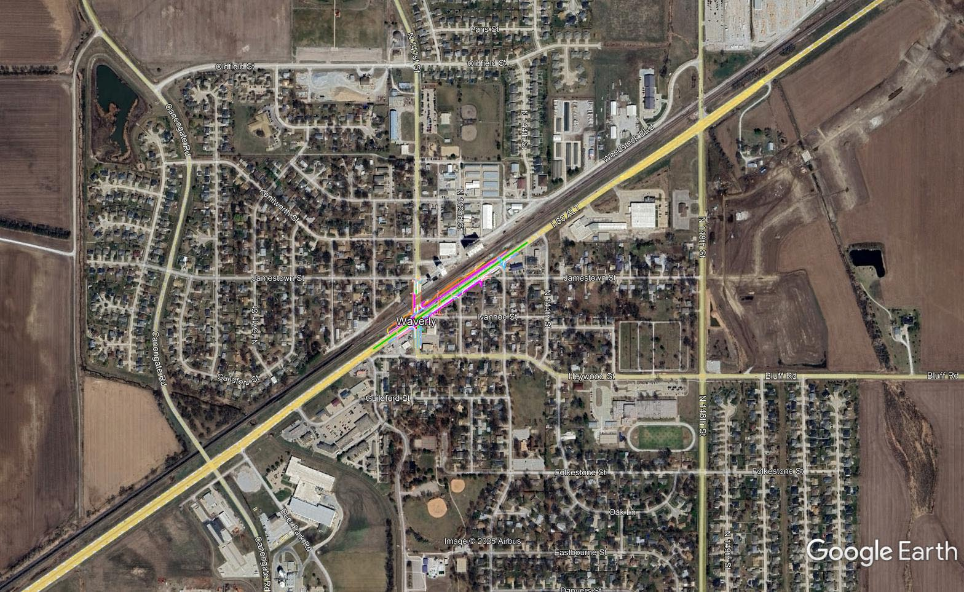

Slide 55
CY 2027
The following projects are anticipated to be let during 2027

Slide 56
Lorton West
Project Number: STp-128-7(110) Control No: 13397
Project Length: 7.90
Scope of Work:
  Resurfacing
  Bridge Repair
  Culvert Extension/Replacement

Slide 57
Lorton West
Project Number: STp-128-7(110) Control No: 13397
Status: Design
Right-of-way: Not Required
Construction Timing: 8/11/2027

Slide 58
Lorton West
Project Number: STp-128-7(110) Control No: 13397
Anticipated Utilities Impact:
Anticipated Request from Utilities:
  Lorton West
Additional Information:
  No K-Sheets Required
  Special Provisions Required
Utilities Involved:
  Aliant Communications
  Charter Communications
  City of Syracuse E-W-S
  Nebraska City Utilities – Rural Electric
  Omaha Public Power District
  Otoe County Rural Water District #1, #2, #3
  Pinpoint Communications
  Viaero
  Windstream Communications

Slide 59
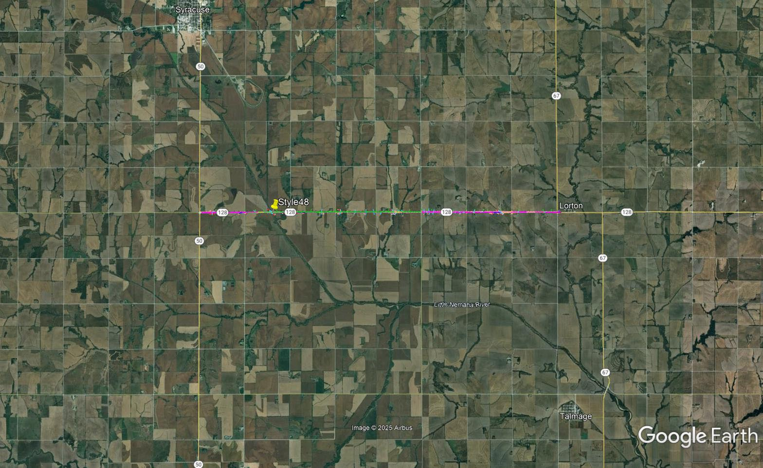

Slide 60
In Syracuse (MS)
Project Number: STP-50-2(143) Control No: 13478
Project Length: 2.11
Scope of Work:

Slide 61
In Syracuse (MS)
Project Number: STP-50-2(143) Control No: 13478
Status: Design
Right-of-way:
Construction Timing: 8/9/2027

Slide 62
In Syracuse (MS)
Project Number: STP-50-2(143) Control No: 13478
Anticipated Utilities Impact:
Anticipated Request from Utilities:
Additional Information:
Utilities Involved:
  Charter Communications
  City of Syracuse E-S-W
  Great Plains Communications
  Nebraska City Utilities – Syracuse Electric & Gas
  Nebraska City Utilities – Rural Electric
  Nebraska City Utilities – Rural Gas
  Omaha Public Power District
  OneOK
  OPTK Networks
  Otoe Couty Rural Water District #3
  Pinpoint Communications
  Segra
  Windstream Communications
  Zito Midwest

Slide 63
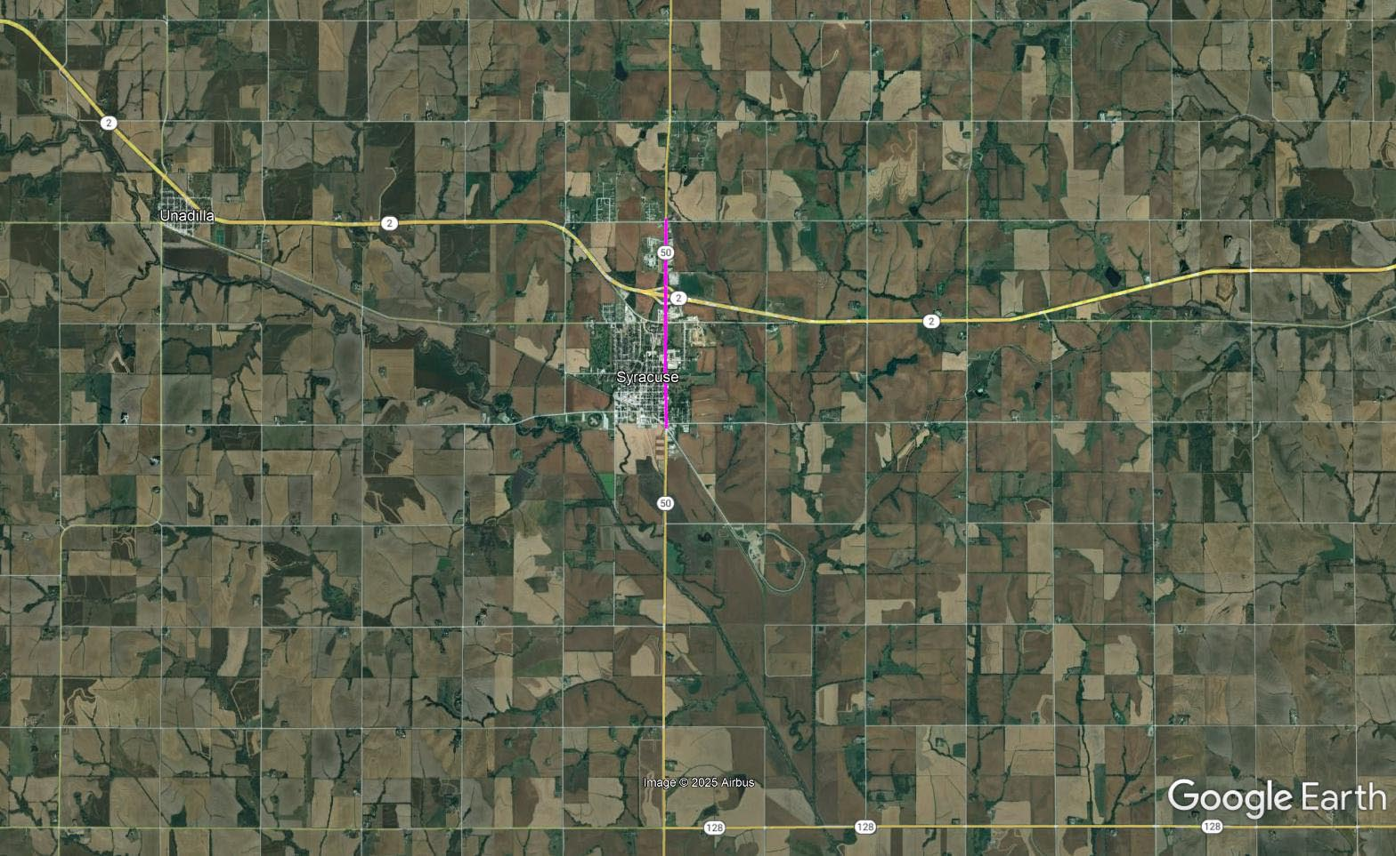

Slide 64
US-34 - Murdock
Project Number: STP-HSIP-1-7(110) Control No: 13469
Project Length: 8.37
Scope of Work:
  Full Depth Pavement
  Bridge Replacement
  Resurfacing
  Grading
  Bridge Repair

Slide 65
US-34 - Murdock
Project Number: STP-HSIP-1-7(110) Control No: 13469
Status: Design
Right-of-way: In Progress
Construction Timing: 4/1/2027

Slide 66
US-34 - Murdock
Project Number: STP-HSIP-1-7(110) Control No: 13469
Anticipated Utilities Impact:
Anticipated Request from Utilities:
  US-34 - Murdock
Additional Information:
Utilities Involved:
  Black Hills Energy
  Cass County Rural Water District #2
  Cogent Communications
  Great Plains Communications
  Kinder Morgan
  OPTK Networks
  Northern Natural Gas
  Omaha Public Power District
  Otoe County Rural Water District #3
  Segra
  Viaero
  Village of Avoca W-S
  Village of Elmwood W-S
  Village of Murdock W-S
  Windstream Communications
  Galaxy Telecom
  Natural Gas Pipeline Co.
  AT&T

Slide 67
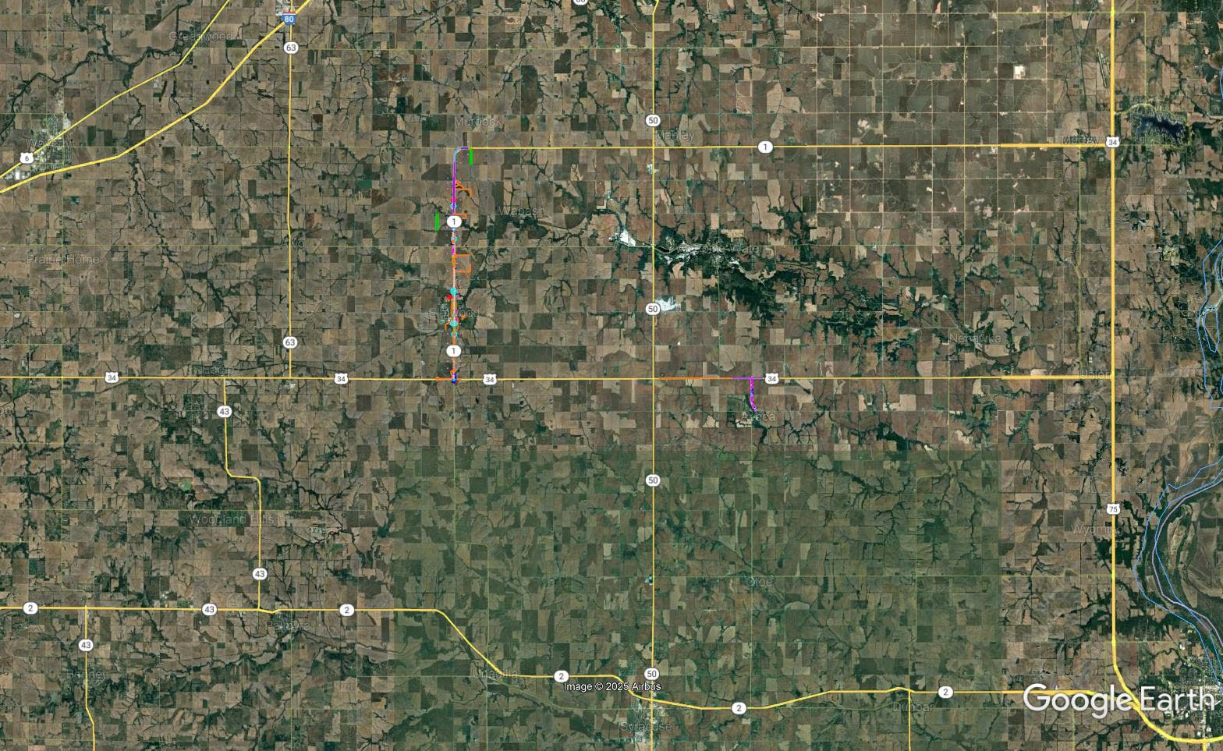

Slide 68
Lorton North & East
Project Number: STP-67-2(110) Control No: 12974
Project Length: 6.32
Scope of Work:
  Resurfacing
  Culvert Extension/Replacement
  Guardrail

Slide 69
Lorton North & East
Project Number: STP-67-2(110) Control No: 12974
Status: Design
Right-of-way: In Progress
Construction Timing: 4/13/2027

Slide 70
Lorton North & East
Project Number: STP-67-2(110) Control No: 12974
Anticipated Utilities Impact:
Anticipated Request from Utilities:
  Lorton North & East
Additional Information:
Utilities Involved:
  Great Plains Communications
  NE City Utilities - Dunbar Elec
  NE City Utilities - Dunbar Gas
  NE City Utilities - Rural Elec
  NE City Utilities - Rural Gas
  Omaha Public Power District
  Otoe County Rural Water District #1, #2, #3
  Pinpoint Communications
  Segra
  Viaero
  Village of Dunbar
  Windstream Communications

Slide 71
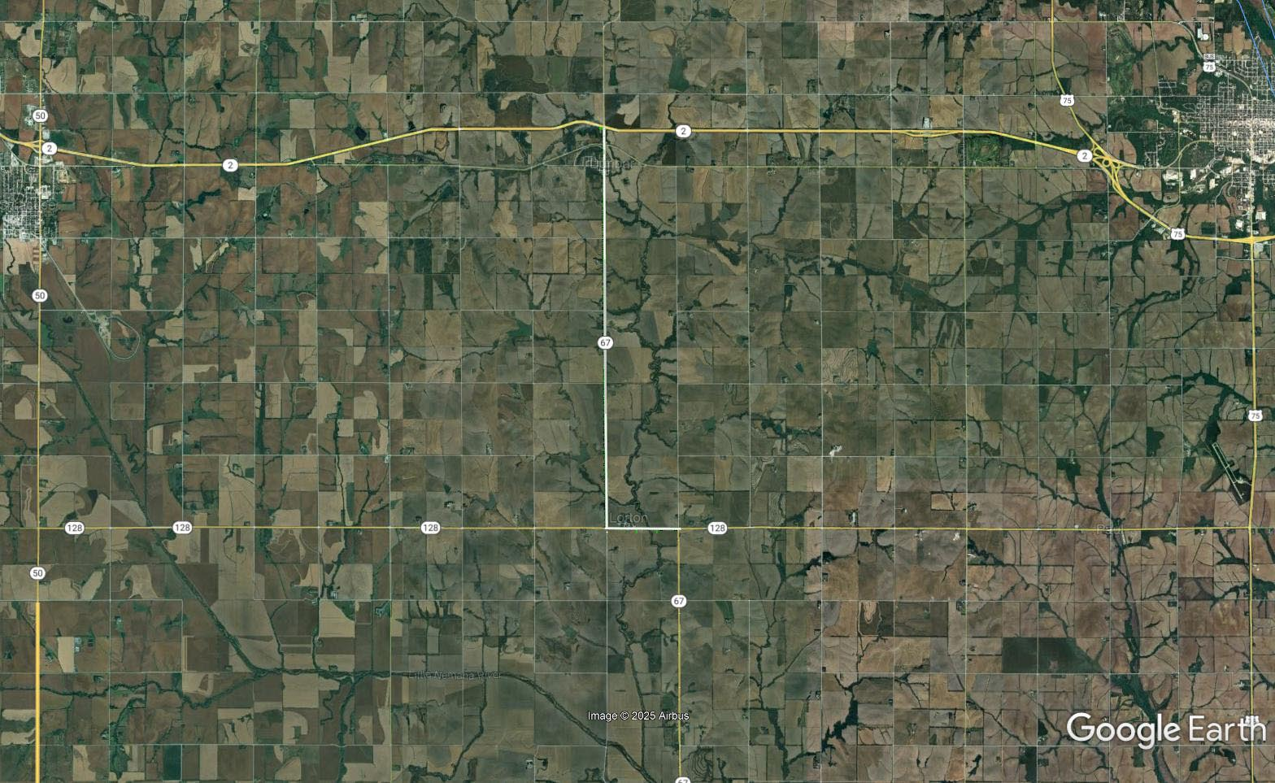

Slide 72
Jct US-34/N-50
Project Number: HSIP-34-7(135) Control No: 13515
Project Length: 1.00
Scope of Work:
  Full Depth Pavement
  ITS/Lighting
  Culvert Extension/Replacement

Slide 73
Jct US-34/N-50
Project Number: HSIP-34-7(135) Control No: 13515
Status: Design
Right-of-way: In Progress
Construction Timing: 9/7/2027

Slide 74
Jct US-34/N-50
Project Number: HSIP-34-7(135) Control No: 13515
Anticipated Utilities Impact:
Anticipated Request from Utilities:
  Jct US-34/N-50
Additional Information:
Utilities Involved:
  Omaha Public Power District
  Otoe County Rural Water District #3
  Segra
  Viaero
  Windstream Communications

Slide 75
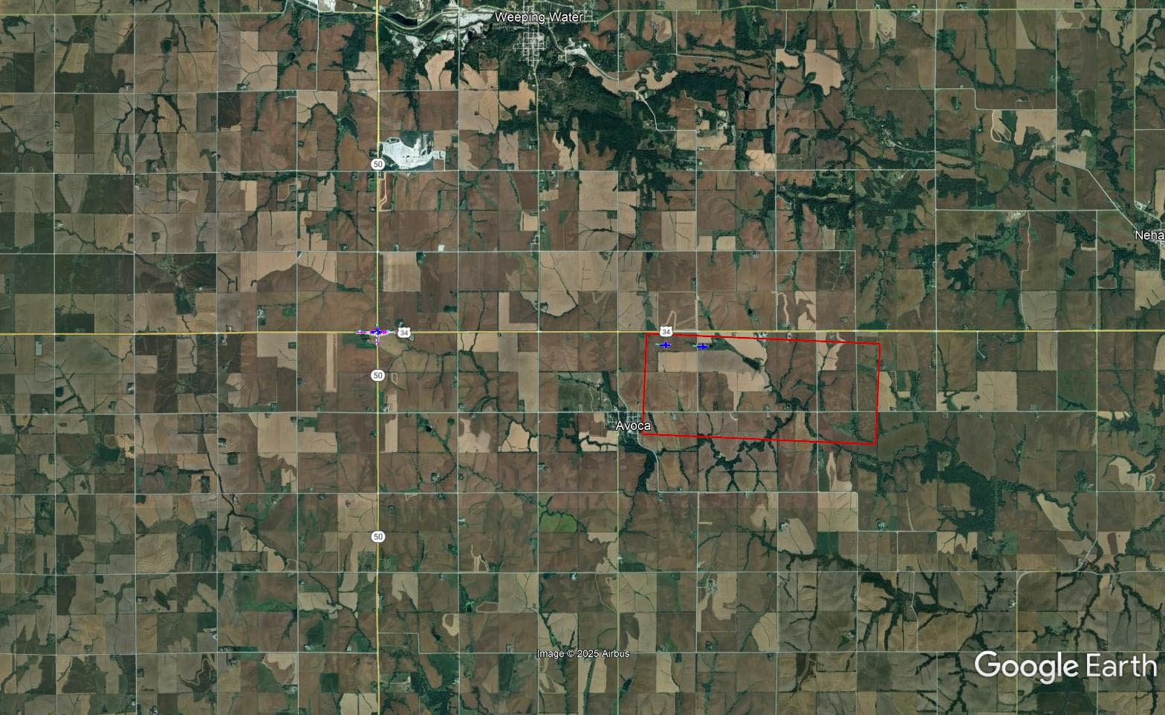
Jct US-34/N-50
Project Number: HSIP-34-7(135) Control No: 13515

Slide 76
Questions & Wrap Up
Notes:
HDR

Slide 77
Any final Questions?
Ask them now!
If you have questions after this meeting, or would like to view more detailed project maps, please reach out to your utility coordinator.
Notes:
HDR

Slide 78
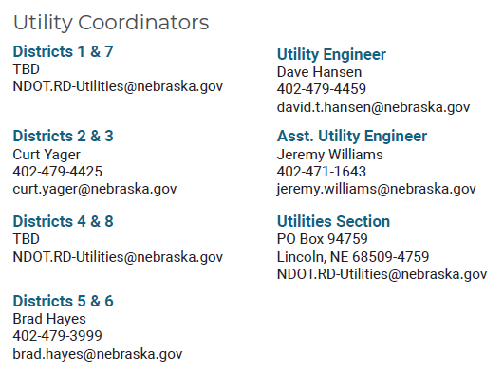
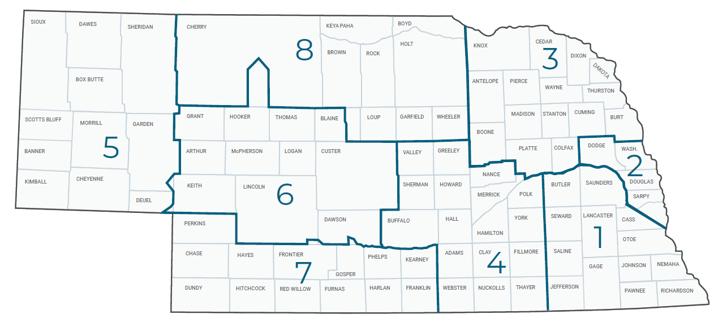
Have a Question about a project your Utility is involved in?
Contact your district’s utility coordinator!
Notes:
HDR

Slide 79
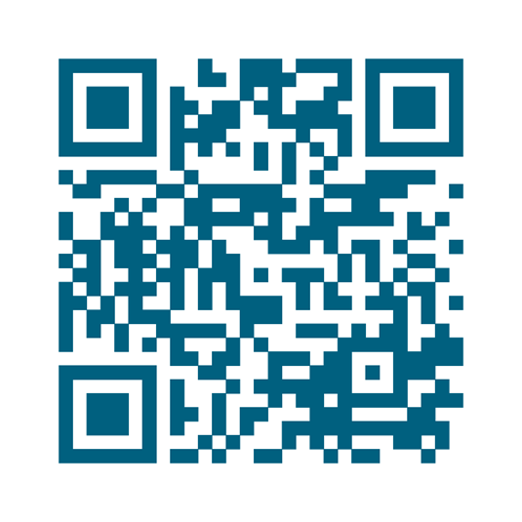
We need your feedback
Your valuable feedback helps these meetings – and NDOT’s utility coordination program – be better.
Use your phone’s camera to scan this QR code or use our paper survey.
Notes:
HDR

Slide 80
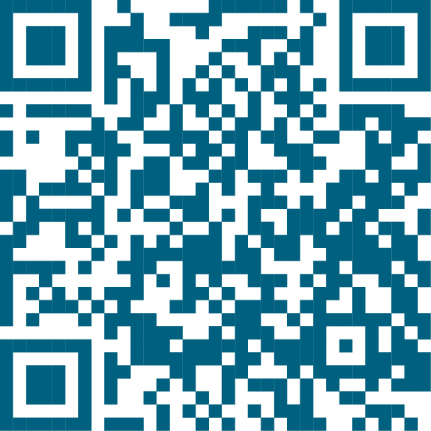
Visit our Website
Visit NDOT.info/utility for more information on:
Utility accommodation
Permitting
Coordination
Project information
Reimbursements
Additional information
Scan the QR Code to view the 2026 Program Book!
Notes:
HDR

Slide 81
Thank You
Notes:
HDR

