Slide 1
Superintendents Exam Preparation
Nebraska County Highway and City Street Superintendents
Please sign the Sign-in sheet
Boards - Liaison Services Section
Tab 1
August 24, 2023
Notes:
8/24/2023 updated slide 5 to reflect a single exam for a class B license, revised exam date on slide 6, and added current exam letter to slide 10.
1/23/2022 updated Slide 6 with April exam date, and Slide 10 with the April, 2023 explanation of written exam
9/12/2022 Slide 1 updated with 3-ring-binder Tab number, minor change to Slide 12
8/16/2022 Updated Slide 10
2/24/2022 Updated Slide 10
10/11/2021 Delete slides 2-6 (intro, done on Day 1 of the 4-day format) and slide 22 (organization of 3-ring notebook). Minor changes to Slide 20.
9/9/2021 update slide 4, hide slide 22 (organization of 3-ring binder), switched 30 and 31 around

Slide 2
This Afternoon’s Agenda
Exam Overview and Tips
State Law – Highways, Roads, Streets
BEX and Superintendent Licensing
Incentive Payments
Slide 2
Notes:
8/10/2021 Updated agenda.

Slide 3

State Statute §39-2307
Exam Requirements
The board of examiners shall, twice each year, conduct examinations of candidates for Class B licenses under section 39-2308. Such examinations shall be designed to test the qualifications of candidates for the position of county highway superintendent or city street superintendent and shall cover the ability to assist in:
(1) Developing and annually updating long-range plans or programs based on needs and coordinated with adjacent local governmental units;
(2) Developing annual programs for design, construction, and maintenance;
(3) Developing annual budgets based on programmed projects and activities; and
(4) Implementing the capital improvements and maintenance activities provided in the approved plans, programs, and budgets.
Slide 3

Slide 4
State Statute §39-1506
Qualifications of a County Highway Superintendent
Any person, whether or not a resident of the county, who is a duly licensed engineer in this state, any firm of consulting engineers duly licensed in this state, or any other person who is a competent, experienced, practical road builder shall be qualified to serve as county highway superintendent, except that no member of the county board shall be eligible for appointment. In counties having a population of sixty thousand but less than one hundred fifty thousand inhabitants according to the most recent official United States census, the county surveyor shall perform all the duties and possess all the powers and functions of the county highway superintendent. In counties having a population of one hundred fifty thousand or more inhabitants, the county engineer shall serve as county highway superintendent.
Slide 4
Notes:
39-1506.
County highway superintendent; qualifications.
Any person, whether or not a resident of the county, who is a duly licensed engineer in this state, any firm of consulting engineers duly licensed in this state, or any other person who is a competent, experienced, practical road builder shall be qualified to serve as county highway superintendent, except that no member of the county board shall be eligible for appointment. In counties having a population of sixty thousand but less than one hundred fifty thousand inhabitants according to the most recent official United States census, the county surveyor shall perform all the duties and possess all the powers and functions of the county highway superintendent. In counties having a population of one hundred fifty thousand or more inhabitants, the county engineer shall serve as county highway superintendent.
Source
Laws 1957, c. 155, art. II, § 6, p. 515;
Laws 1982, LB 127, § 9;
Laws 1986, LB 512, § 3;
Laws 2017, LB200, § 4.

Slide 5
Single exam for Class B License:
County Highway and City Street Superintendent License
  $25 application fee
  May take the exam twice in a two-year period; must reapply after that
§39-2306, §39-2307, §39-2308
Slide 5

Slide 6
Exam Location, Date and Time
Exam is at the Nebraska Department of Transportation Auditorium, 1500 Nebraska Parkway, in Lincoln.
Friday, October 6, 2023
Starts promptly at 9 a.m. (Lunch break at noon)
Ends promptly at 4 p.m.
Building has controlled access - Check in with receptionist (main door on South Side of Building) and get a temporary I.D. badge
Slide 6

Slide 7
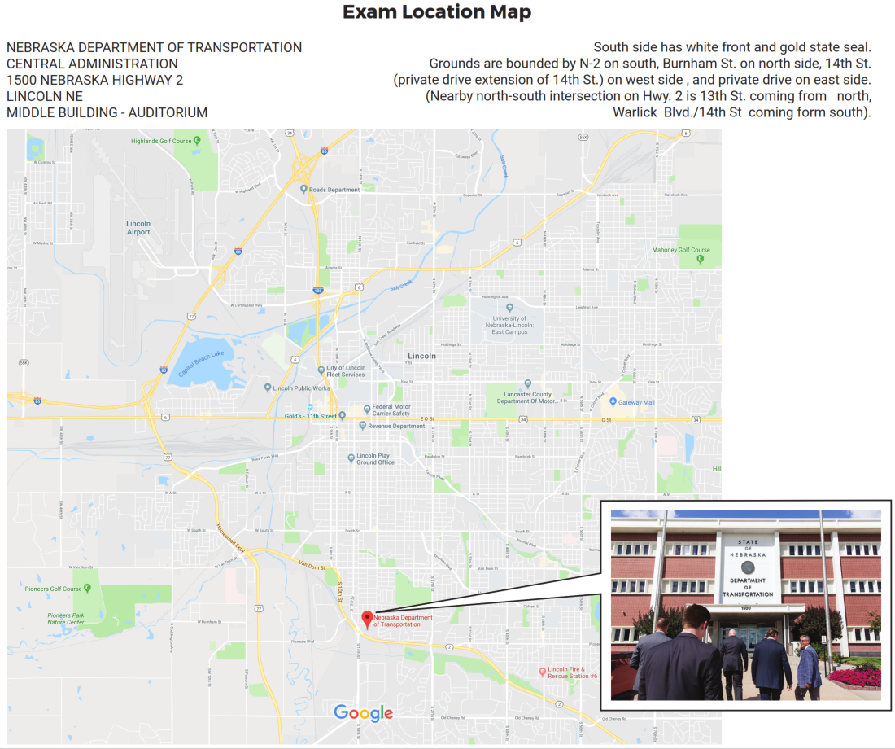
14th & Nebraska Parkway, Lincoln
Slide 7

Slide 8
Coronavirus (COVID-19)
Countermeasures: Social Distancing
Tables 6 ft apart; one person per table
Avoid gatherings
Wash hands as appropriate
Feeling sick? Don’t come! RESPECT OTHERS.
Slide 8

Slide 9
Slide 9
Notes:
1/23/2023 Updated with latest Written Exam Preparation letter
2/24/2022 Updated with latest Written Exam Preparation letter
Number of questions you need to get correct, per part:
Part 70% 65%
I 35 33
V 56 52
The others depend on points (weighted), so you can’t say how many correct answers it takes

Slide 10
During Exam
First-time candidates will receive a brief oral interview (un-graded)
  Permitted to use at the exam
    Board-furnished materials
    Your notes from exam prep classes
    Simple Calculator
    Earplugs
    Magnifying glass
    Small battery-power light are permitted
  Not permitted
    electronic devices (except calculator, as noted above)
    listening to audio
    earbuds
    going out to your vehicle
    talking/communicating with other exam candidates
Slide 10
Notes:
Turn off your phones and devices and put them away and out-of-sight during the exam

Slide 11
Exam – Two Sessions, and Passing Thresholds
Two sessions – a.m. and p.m. – each 3 hours (180 minutes)
  Once the a.m. session is done, you cannot go back to it later (in the p.m.)
Morning Session – starts at 9:00 a.m., turn in answer sheets by 12:00 p.m.
  Three parts, 105 points (50 + 25 + 30)
Afternoon Session – starts at 1:00 p.m., turn in answer sheets by 4:00 p.m.
  Two parts, 145 points (65 + 80)
Passing Thresholds
  Each Part: 70%, except only ONE part can be as low as 65%.
  Overall: 70%
Notes:
9/12/2022 resmove the first sub-bullet under the first bullet (can skip around) because that is covered later.
Number of points you need, per part (only one part can be below 70%, as low as 65%):
Part 70% 65%
I 35 33
II 18 17
III 21 20
IV 46 43
V 56 52

Slide 12
Exam (continued)
The exam is point-weighted
50
True-false questions
=
50 pts.
13
Plan reading questions
=
25 pts.
17
Written answer / performance questions
=
95 pts.
(30 + 65)
13
Multiple choice questions
=
80 pts.
Total Points Available
=
250 pts.
175 pts.
minimum overall passing grade
=
Slide 12
Notes:
Updated 3/10/2020
Number of points you need, per part (only one part can be below 70%, as low as 65%):
Part 70% 65%
I 35 33
II 18 17
III 21 20
IV 46 43
V 56 52

Slide 13
Written Examination Policy
After grading, the exam will NOT be returned to you.
“The secretary may furnish grades to the candidate upon receipt of a written request. The secretary may also furnish a written summary of areas of difficulty, upon receipt of a written request.”
SO: If you don’t pass, you may write for your score and areas of difficulty
Slide 13

Slide 14
Exam Format: Open-Book
Allowed materials
Furnished via NDOT websites:
  Boards-Liaison Services (B-LS)
  B-LS Training
  B-LS Resources for Training Classes
  Nebraska Board of Public Roads (NBCS) Downloads
Nebraska State Legislature website (state statutes)
Your notes taken during this exam preparation class.
Slide 14

Slide 15
Before the Exam
Get Information Organized
  Organize your references and notes – create an index
  Have key State Statutes handy – correlate them to 428 NAC
  Tab, highlight, notate, draw
Documents likely to be of use during the exam
Exam Prep Course
428 NAC 1 and 2 (copy provided)
Power Point presentations (videos and courses)
Key Statutes
Records Retention Schedules (17, 22, 24)
Anything printed from NDOT's website Resources for Training Classes
Anything printed from NDOT's website NBCS Downloads
Roads and Streets Funding (“LeMoyne’s chart”)
Terminology
Exam Study Guide
Study Guide for the Minimum Standards
Superintendent Booklet
Slide 15

Slide 16
Suggested Study Approach
Know/understand the big picture – goals, legislature’s expectations, how everything fits together, the framework for our public roads and streets system
Use study time wisely. Watch the videos (AGAIN). Review LTAP course material. Self-testing can be very effective in preparing for the exam.

Slide 17
Before the Exam
Know the “Why” Be able to explain in simple terms
    Why classify highways, roads and streets?
    Why have standards?
    Why do OneAndSix planning?
    Why document revenues and expenditures?
    Why does State law make incentive payments available?
    Why do the NBCS and the BEX exist?
Slide 17
Notes:
It is best if you can answer these questions in your own words, without looking at notes or statutes or slides. You don’t need to state answer verbatim (i.e. the “official” answer via statute or a slide), you will get credit on the exam.

Slide 18
Exam Strategies *
Linear/Series – Do Parts in the Order they Appear on the Exam
  Leave enough time for the last Part of the session
Passing-Score Oriented
  Answer some percentage (your choice - 70%, 75%, etc.) with confidence, move on to another Part(s), return later to answer skipped questions
Skip Difficult / Do Easy / Return to Difficult
ANSWER ALL QUESTIONS
* BEX is neutral as to how you approach answering exam questions
Slide 18
Notes:
Think about these strategies, before taking the exam
YOU DON’T HAVE TO ANSWER QUESTIONS IN THE ORDER THEY APPEAR ON THE EXAM

Slide 19
During the Exam
Read instructions carefully before starting.
Read each question carefully. Understand what it is asking for!
  Note words such as “all”, “never” and “always” and respond accordingly.
Before answering, especially free-style questions, organize your thoughts (a brief outline or bullet points). Then answer (EACH PART) completely.
  The grader makes no assumptions as to what is in your head.
  The answer must use same labels as the question (a, b, c, etc.).
  Put the answers in the same order as stated in the question.
Your writing must be legible and clear. If not, you won’t get points.
Math: show your work/computations. It may help your grade.
Stuck on a question? Move on. Don’t forget to come back to it!!!
Use Extra Sheets? Indicate on exam “see attached sheet”, on extra sheet put your name, exam part number, and question number. Note: there is enough room for answers on the exam itself!
Answer as if YOU ARE THE SUPERINTENDENT
Slide 19
Notes:
10/11/2021 In #3 change “essay” to ‘free-style” and delete some repetitive wording and in #9 add verbiage.
3/10/2020 Updated 3(b) minor edits
T/F Q’s: don’t circle the Q#!!
Filling out form(s) – fill them out completely.
The answer must be pertinent to the question. Steve Harvey – Family Feud – his look when the answer has nothing to do with the question.
YOU ARE THE SUPERINTENDENT – you are asked a question and must explain how the system works, what the legislature and the NBCS intends for the system to work, what you and your Board or Council can do and cannot do within the law and regulations, and you as the decision maker being decisive and clear as to how you would solve a problem (posed by the question). Explain the significance of an issue; provide some logical, coherent solutions to the problem posed by the question. IN A SENSE, THIS EXAM IS ONE WAY OF DETERMINING IF YOU ARE READY TO BE CONSIDERED FOR A ROLE AS SUPERINTENDENT. The exam is only going to determine if you get licensed or not. You still need to be a competent road builder, manage people, manage consultants, be a good communicator verbally and in writing, be able to deal with the public and with your Board or Council, etc.

Slide 20
Estimated Average Pace of Exam*
True/False (50) – 1 minute each, 50 minutes total
Plan Reading (13) – 2.5 minutes per point, 63 minutes total
Free Style (5 & 12) – 1.5 minutes per point, 45 mins. a.m., 98 mins. p.m.
Multiple Choice (13) – 0.75 minute per point, 60 minutes total
a.m. 50 + 63 + 45 = 158 minutes
p.m. 98 + 60 = 158 minutes
That leaves over 20 minutes available each session for review, bathroom breaks and (if required) an oral interview with Board
* Unofficial, unverified
Slide 20
Notes:
7/30/2020 Updated – clarified “extra” available time
3/10/2020 Updated times based on adjusting after last Fall’s exam: plan reading (from 2 to 2.5) and MC (from 1 to 0.75)
DON’T BE OBSESSED WITH THE TIME – IT CAN AFFECT YOUR PERFORMANCE IN A NEGATIVE WAY

Slide 21
Exam Format: Open-Book
Time Limits – too much looking up information increases your average time per question and may hurt your results.
  Think about a strategy for information look-up, in advance
When looking up information, know exactly where to find it, QUICKLY
Finding the right balance. “Off the top of you head” vs. referring to allowed materials. Better preparation = better performance. Good preparation will help you understand the question, recall information and, if needed, where to quickly locate the appropriate allowed material. Staying calm is key.
Slide 21
Notes:
Taking a long time to look up an answer for a one-point question may not make sense.
Getting information into your memory will help. You don’t have to memorize word-for-word; if you have the idea, you will get at least some credit.

Slide 22
Before Handing in the Exam
Review your answers
  Did you answer each question?
  Did you answer each question completely?
  Name, Part #, Question # on extra sheets?
Slide 22

Slide 23
Class Disclaimer for
Examination Preparation Training Courses
Some examination questions may not be explicitly covered
Some information presented is not addressed in the examination – but good to know on the job
Slide 23

Slide 24




After the Exam
Smile!
Slide 24

Slide 25
Superintendents Exam Preparation
Nebraska County Highway and City Street Superintendents
Questions?
Boards - Liaison Services Section
January 23, 2023
Notes:
1/23/2023 updated date

