Slide 1
Utility program
District 4 Breakout Session

Slide 2
This Meeting is Being Recorded
Notes:
HDR

Slide 3
Welcome
Before we begin, let’s have a brief safety moment.
In-Person Attendees
Emergency Exits
Tornado Shelter
911 Caller
AED Location
Restrooms
Virtual Attendees
Unmute yourself or use your chat box if you are in an emergency situation.
Notes:
HDR

Slide 4
Agenda
Introductions
High Impact Project Review (by construction year)
Communication and Coordination
Questions and Wrap Up
Notes:
HDR

Slide 5
Introductions
Notes:
All speakers introduce themselves briefly (Dave, section head, HDR facilitators); Attendees can introduce themselves if it’s a small group. If not – skip it!

Slide 6
2024 Utility policy
NDOT rolled out a new utility accommodation policy in 2024.
You can find more information, as well as a webinar about the changes, on the NDOT utility website at https://dot.nebraska.gov/business-center/utilities/.

Slide 7
Outstanding cy 2025
The following projects will likely not be completed in 2025

Slide 8
Kearney East
Project Number: STP-30-4(167) Control No: 42969
Project Length: 1.88
Scope of Work:
  ITS/Lighting

Slide 9
Kearney East
Project Number: STP-30-4(167) Control No: 42969
Status: Design
Right-of-way: In Progress
Construction Timing: 9/29/2025 - 3/31/2026

Slide 10
Kearney East
Project Number: STP-30-4(167) Control No: 42969
Utilities Involved:
  Allo Communications
  Black Hills Energy
  Charter Communications
  City of Kearney
  Cogent Communications
  Frontier Communications
  Great Plains Communications
  Nebraska Public Power District
  Northwestern Energy
  Segra
  Verizon
  Windstream Communications
Anticipated Utilities Impact:
  Lighting
Anticipated Request from Utilities:
  Provide Existing Locations
  Coordination with NDOT
Additional Information:
  TBD

Slide 11
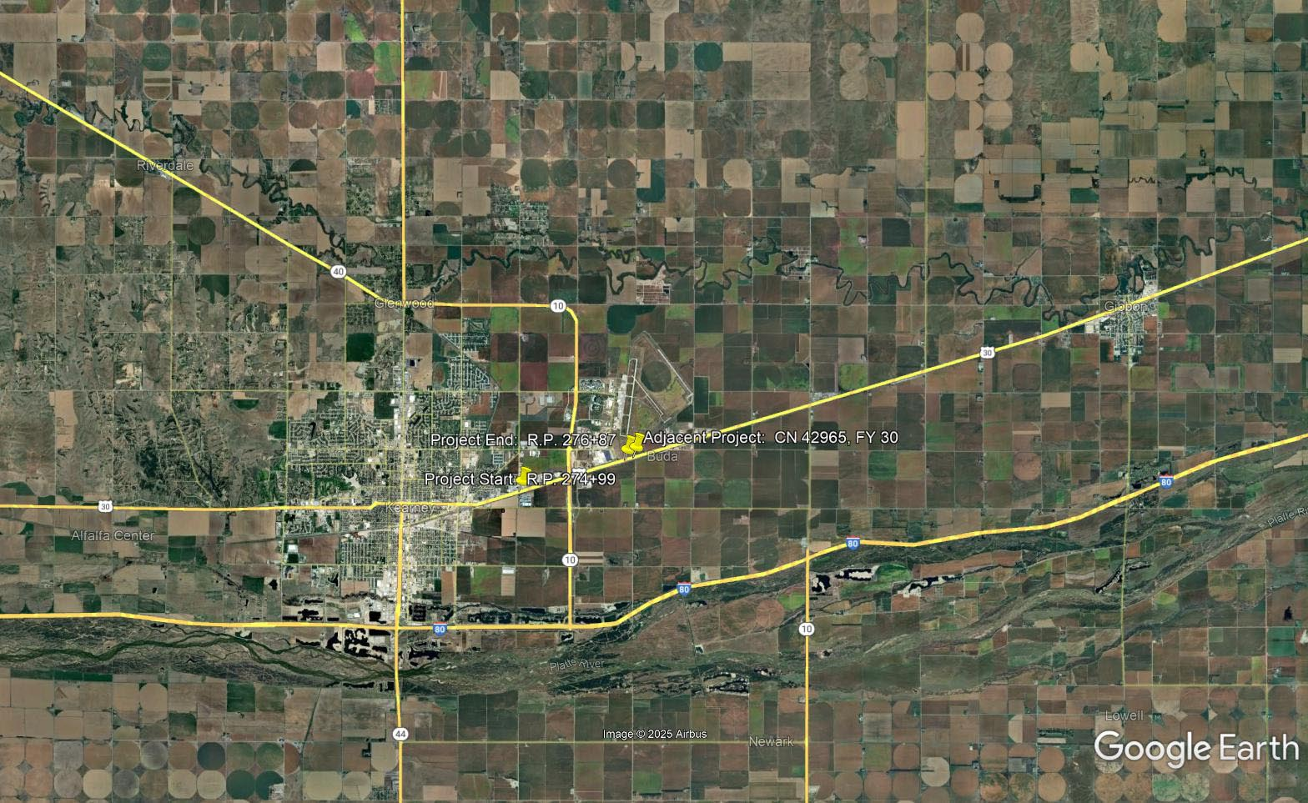

Slide 12
Cy 2026
The following projects are anticipated to be let during 2026

Slide 13
Hastings Southeast
Project Number: S-6-4(1022) Control No: 41086
Project Length: 2.34
Scope of Work:
  Urban Reconstruction
  Culvert Extension/Replacement
  Grading

Slide 14
Hastings Southeast
Project Number: S-6-4(1022) Control No: 41086
Status: Design
Right-of-way: In Progress
Construction Timing: 4/1/2026 - 11/1/2027

Slide 15
Hastings Southeast
Project Number: S-6-4(1022) Control No: 41086
Anticipated Utilities Impact:
  Urban Recon
  Culvert Extension/Replace
  Grading
Anticipated Request from Utilities:
  Provide Existing Locations
  Utilities Workshop
Additional Information:
  K-Sheets Required
  TBD
Utilities Involved:
  Allo Communications
  Black Hills Energy
  Charter Communications
  Cogent Communications
  Great Plains Communications
  City of Hastings
  Kinder Morgan
  Lumen
  Nebraska Public Power District
  OPTK Networks
  Southern Public Power District
  Verizon
  Windstream Communications
  Zayo Group

Slide 16
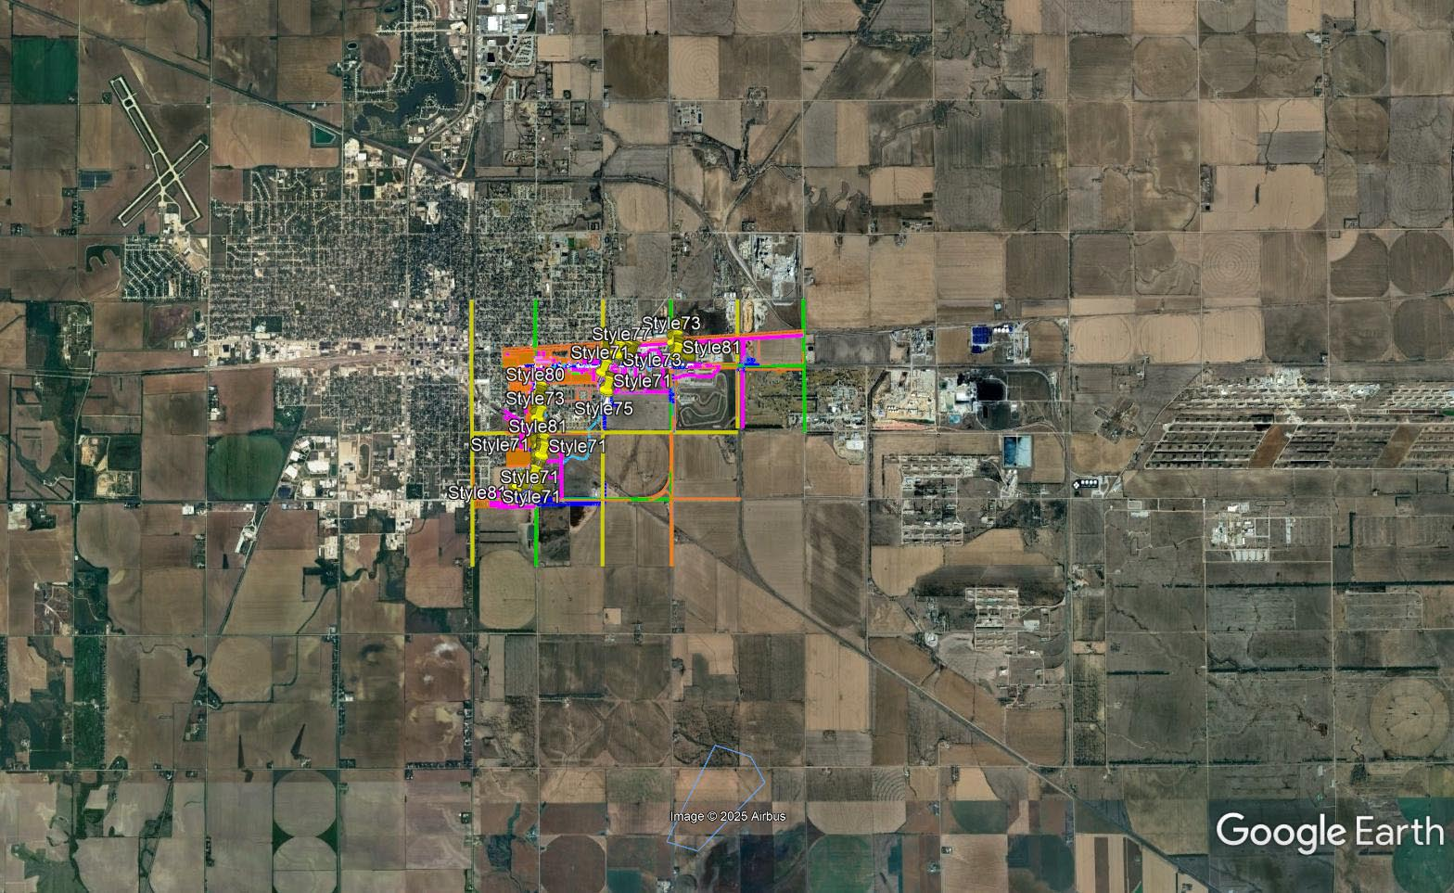

Slide 17
McCool Junction - York
Project Number: NH-81-2(144) Control No: 42574
Project Length: 8.07
Scope of Work:
  Grading
  Guardrail
  Pavement Repairs

Slide 18
McCool Junction - York
Project Number: NH-81-2(144) Control No: 42574
Status: Design
Right-of-way: In Progress
Construction Timing: 4/1/2026 - 11/30/2026

Slide 19
McCool Junction - York
Project Number: NH-81-2(144) Control No: 42574
Anticipated Utilities Impact:
  Turn Lane Add/Adjust
  Lighting
  Grading
Anticipated Request from Utilities:
  Coordination with NDOT
  Provide Existing Locations
  Locates
Additional Information:
  TBD
Utilities Involved:
  Allo Communications
  Black Hills Energy
  Charter Communications
  City of York
  Hamilton Telecommunications
  Nebraska Public Power District
  NuStar Energy
  OneOK
  OPTK Networks
  Perennial Public Power District
  Segra
  Windstream Communications
  Village of McCool Junction
  Zito Midwest

Slide 20
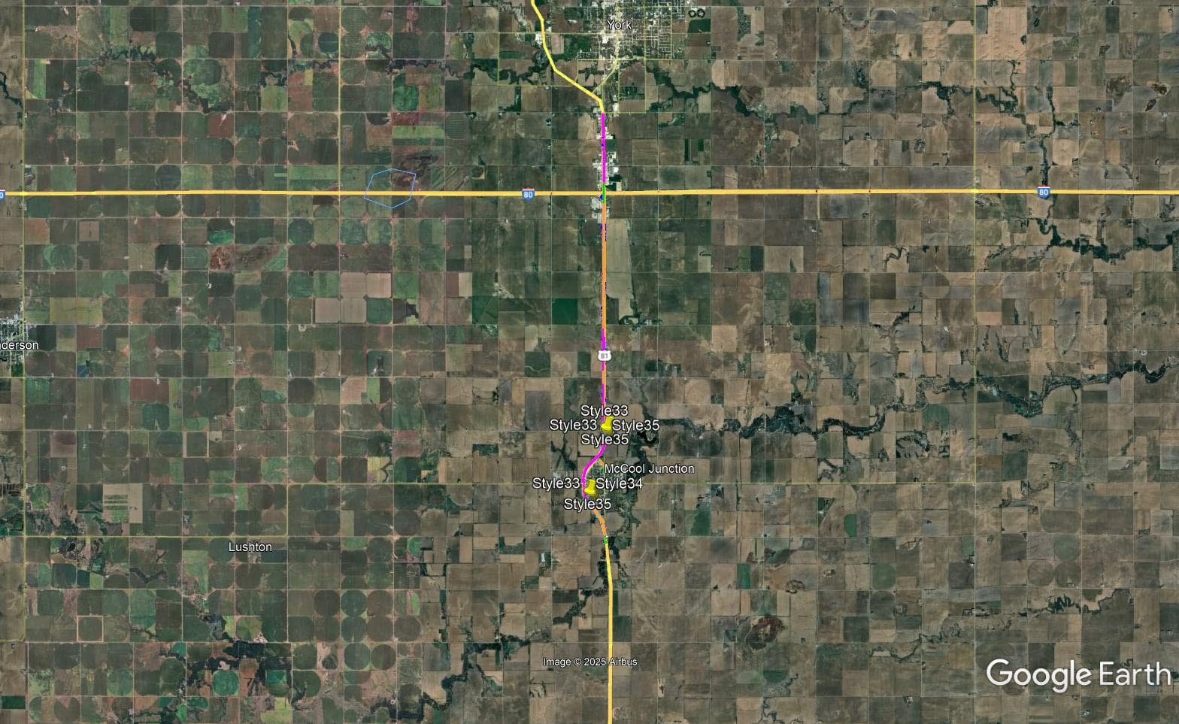

Slide 21
In Red Cloud
Project Number: STP-281-1(117) Control No: 42619
Project Length: 1.38
Scope of Work:
  Urban Reconstruction
  ITS/Lighting
  Culvert Extension/Replacement

Slide 22
In Red Cloud
Project Number: STP-281-1(117) Control No: 42619
Status: Design
Right-of-way: In Progress
Construction Timing: 4/1/2026 - 11/25/2026

Slide 23
In Red Cloud
Project Number: STP-281-1(117) Control No: 42619
Anticipated Utilities Impact:
  Urban Recon
  Lighting
  Culvert Extension/Replace
Anticipated Request from Utilities:
  Coordination with NDOT
  Provide Existing Locations
  Utilities Workshop
Additional Information:
  K-Sheets Required
  TBD
Utilities Involved:
  Black Hills Energy
  City of Red Cloud
  Great Plains Communications
  Viaero Fiber Network
  VyVe Broadband

Slide 24
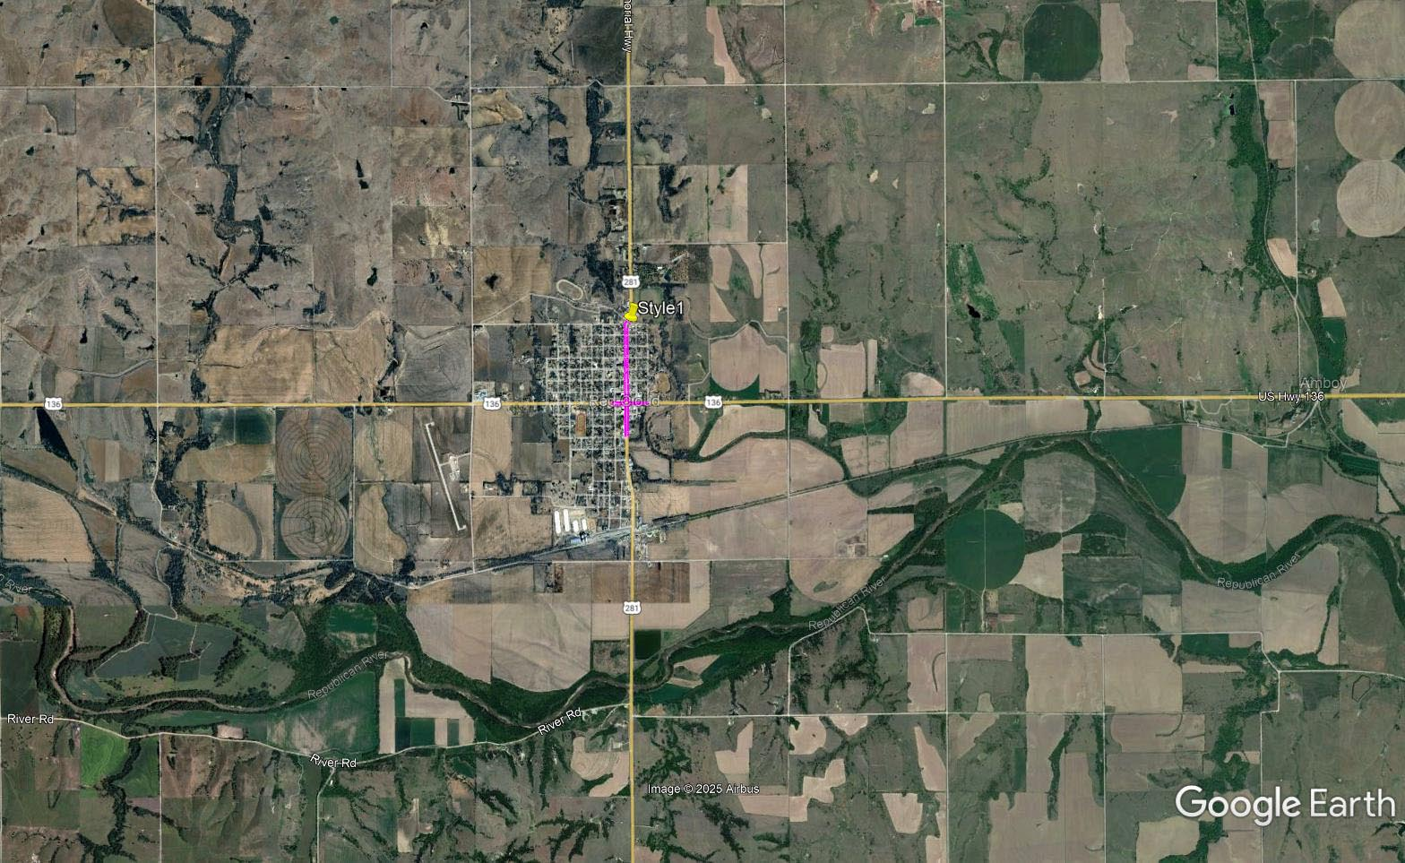

Slide 25
Odessa - Kearney (EB) (MS)
Project Number: NH-80-5(83) Control No: 42852
Project Length: 9.29
Scope of Work:
  Full Depth Pavement
  Culvert Extension/Replacement
  ITS/Lighting

Slide 26
Odessa - Kearney (EB) (MS)
Project Number: NH-80-5(83) Control No: 42852
Status: Design
Right-of-way: Not Required
Construction Timing: 4/1/2026 - 5/31/2027

Slide 27
Odessa - Kearney (EB) (MS)
Project Number: NH-80-5(83) Control No: 42852
Anticipated Utilities Impact:
  Full Depth Pavement
  Culvert Extension/Replace
  Grading
Anticipated Request from Utilities:
  Coordination with NDOT
  Provide Existing Locations
  Locates
Additional Information:
  TBD
Utilities Involved:
  Allo Communications
  Black Hills Energy
  Charter Communications
  City of Kearney
  Dawson Public Power District
  Frontier Communications
  Glenwood Telecommunications
  Great Plains Communications
  Nebraska Public Power District
  Northwestern Energy
  Viaero Fiber Network
  Windstream Communications

Slide 28
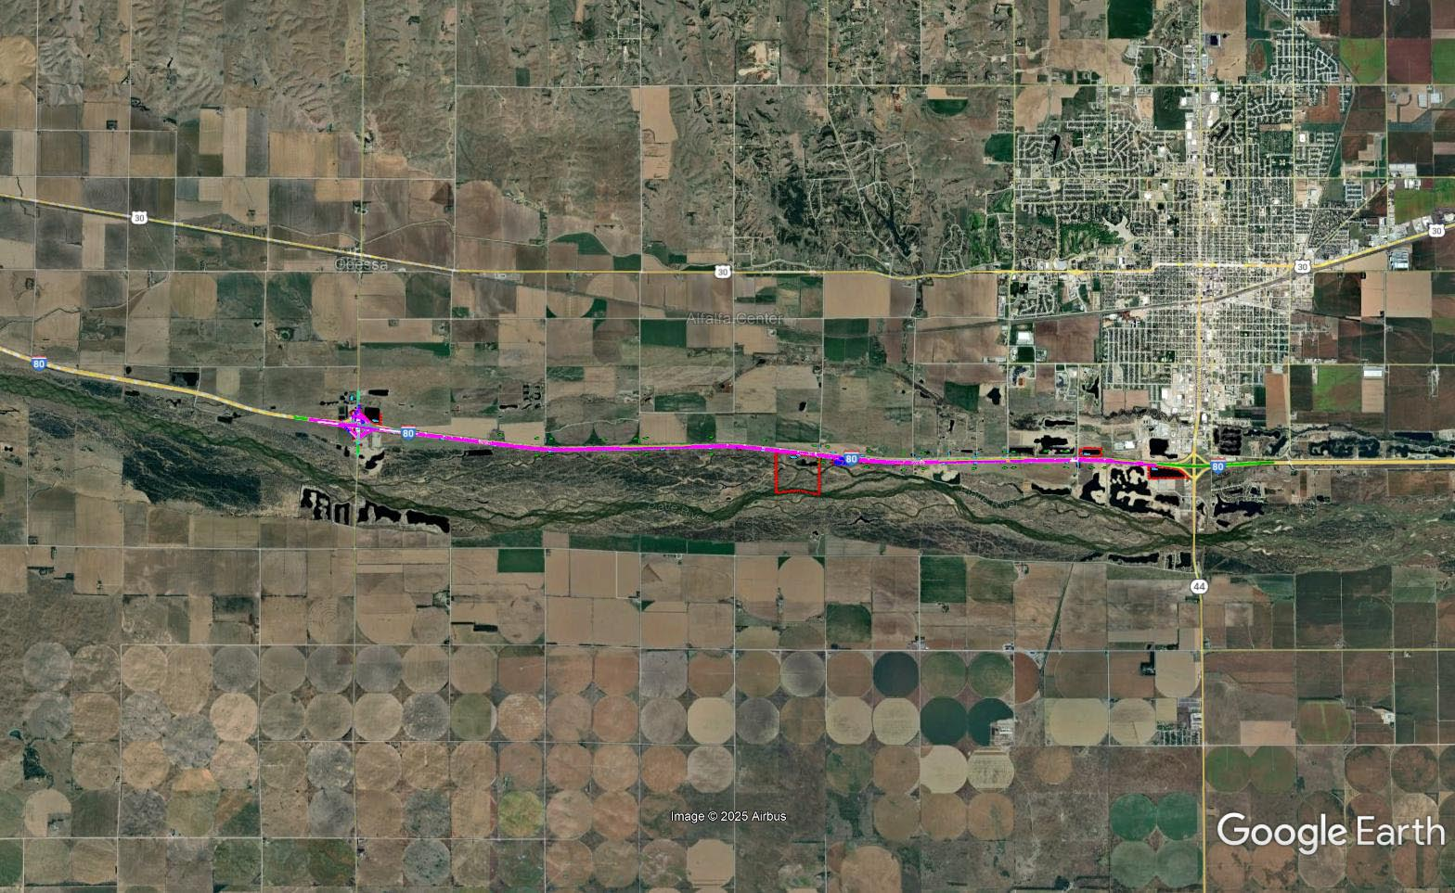

Slide 29
District 4- CCTV Cameras
Project Number: ITS-STP-D4(108) Control No: 43008
Project Length: 0.00
Scope of Work:
  ITS/Lighting
  Grading

Slide 30
District 4- CCTV Cameras
Project Number: ITS-STP-D4(108) Control No: 43008
Status: Design
Right-of-way: Not Required
Construction Timing: 3/23/2026 - 11/25/2026

Slide 31
District 4- CCTV Cameras
Project Number: ITS-STP-D4(108) Control No: 43008
Anticipated Utilities Impact:
  Grading
Anticipated Request from Utilities:
  Coordination with NDOT
  Provide Existing Locations
Additional Information:
  TBD
Utilities Involved:
  Black Hills Energy
  Butler Public Power District
  Charter Communications
  Cogent Communications
  City of Chapman
  City of Stromsburg
  City of Wood River
  Frontier Communications
  Glenwood Telecommuncations
  Great Plains Communications
  Hamilton Telecommunications
  Loup River Public Power District
  Lumen
  Mainstay Communications
  Northeast Nebraska Telephone Company
  OPTK Networks
  Perennial Public Power District
  Polk County Rural Public Power District
  Southern Public Power District

Slide 32
District 4- CCTV Cameras
Project Number: ITS-STP-D4(108) Control No: 43008

Slide 33
Davenport East (MS)
Project Number: STP-4-5(107) Control No: 42875
Project Length: 12.95
Scope of Work:
  Culvert Extension/Replacement
  Guardrail
  Bridge Repair

Slide 34
Davenport East (MS)
Project Number: STP-4-5(107) Control No: 42875
Status: Design
Right-of-way: In Progress
Construction Timing: 4/27/2026 - 11/25/2026

Slide 35
Davenport East (MS)
Project Number: STP-4-5(107) Control No: 42875
Anticipated Utilities Impact:
  Culvert Extension/Replace
  Guardrail
  Bridge Repair/Replace
Anticipated Request from Utilities:
  Coordination with NDOT
  Provide Existing Locations
  Locates
Additional Information:
  TBD
  TBD
Utilities Involved:
  Black Hills Energy
  Great Plains Communications
  Nebraska Public Power District
  Norris Public Power District
  NuStar Energy
  Tallgrass Energy
  Segra
  Viaero Fiber Network
  Windstream Communications

Slide 36
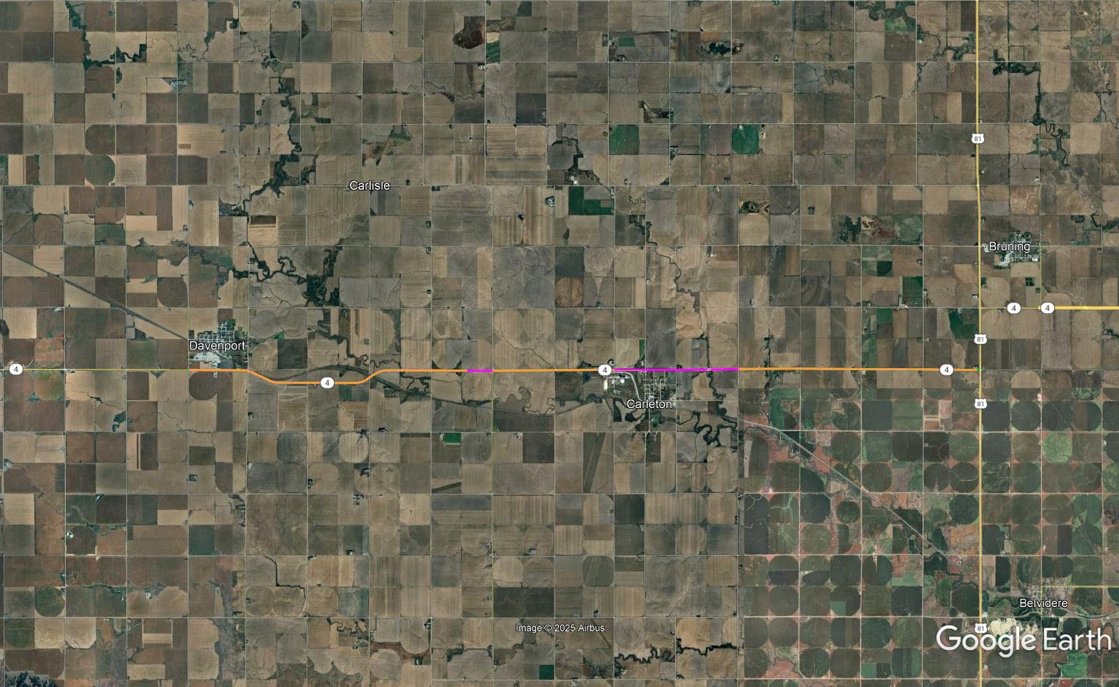

Slide 37
Giltner - Hampton
Project Number: HSIP-80-7(173) Control No: 42989
Project Length: 13.96
Scope of Work:
  Guardrail
  Culvert Extension/Replacement
  Grading

Slide 38
Giltner - Hampton
Project Number: HSIP-80-7(173) Control No: 42989
Status: Design
Right-of-way: Not Required
Construction Timing: 6/1/2026 - 11/25/2026

Slide 39
Giltner - Hampton
Project Number: HSIP-80-7(173) Control No: 42989
Anticipated Utilities Impact:
  Guardrail
  Grading
  Culvert Extension/Replace
Anticipated Request from Utilities:
  Coordination with NDOT
  Provide Existing Locations
  Locates
Additional Information:
  No K-Sheets Required
  Special Provisions Required
Utilities Involved:
  Black Hills Energy
  City of Aurora
  Hamilton Telecommunications
  Mainstay Communications
  Southern Public Power District
  Tallgrass Energy

Slide 40
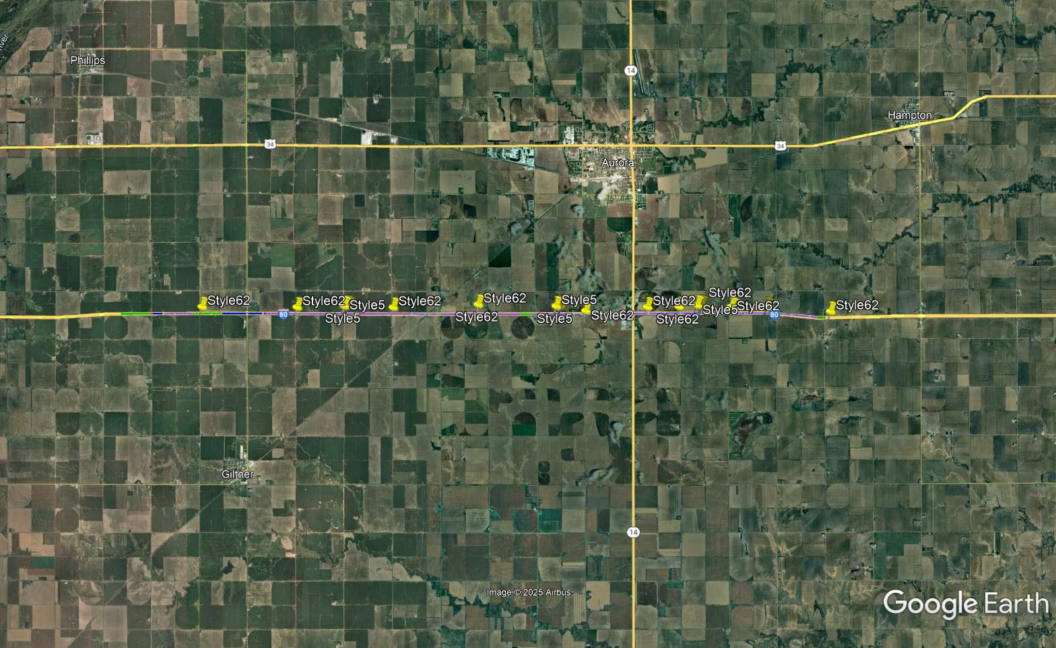

Slide 41
Chapman West (MS)
Project Number: NH-30-5(139) Control No: 42929
Project Length: 8.03
Scope of Work:
  Culvert Extension/Replacement
  Grading
  ITS/Lighting

Slide 42
Chapman West (MS)
Project Number: NH-30-5(139) Control No: 42929
Status: Design
Right-of-way: In Progress
Construction Timing: 6/15/2026 - 11/25/2026

Slide 43
Chapman West (MS)
Project Number: NH-30-5(139) Control No: 42929
Anticipated Utilities Impact:
  Turn Lane Add/Adjust
  Culvert Extension/Replace
  Lighting
Anticipated Request from Utilities:
  Coordination with NDOT
  Provide Existing Locations
  Locates
Additional Information:
  No K-Sheets Required
  TBD
Utilities Involved:
  City of Grand Island
  Village of Chapman
  Southern Public Power District
  City of Grand Island
  Black Hills Energy
  Tallgrass Energy
  AT&T
  Charter Communications
  Cogent Communications
  Great Plains Communications
  Hamilton Telecommunications
  Lumen
  VyVe Broadband

Slide 44
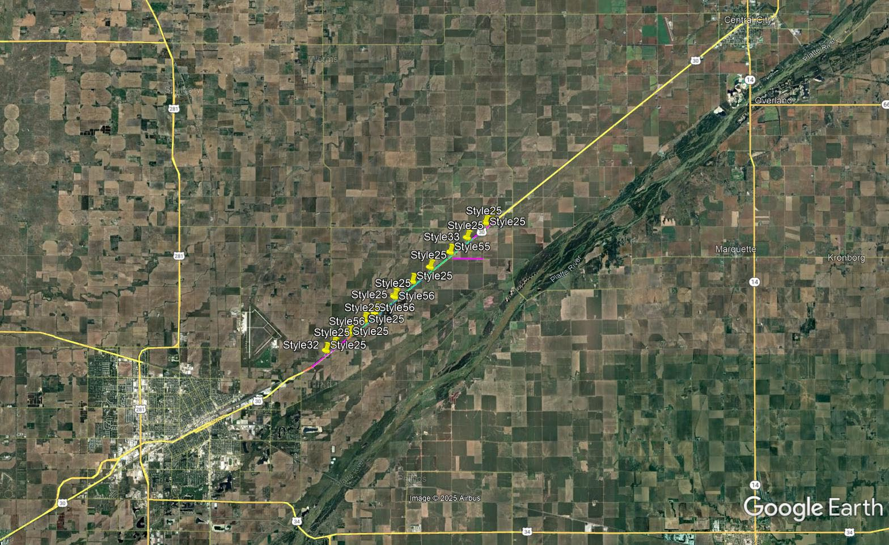

Slide 45
Central City East (MS)
Project Number: NH-30-5(136) Control No: 42818
Project Length: 8.23
Scope of Work:
  Culvert Extension/Replacement
  Full Depth Pavement
  Grading

Slide 46
Central City East (MS)
Project Number: NH-30-5(136) Control No: 42818
Status: Design
Right-of-way: In Progress
Construction Timing: 6/1/2026 - 11/7/2026

Slide 47
Central City East (MS)
Project Number: NH-30-5(136) Control No: 42818
Anticipated Utilities Impact:
  Turn Lane Add/Adjust
  Culvert Extension/Replace
  Grading
Anticipated Request from Utilities:
  Coordination with NDOT
  Provide Existing Locations
  Locates
Additional Information:
  No K-Sheets Required
  TBD
Utilities Involved:
  City of Central City
  Cogent Communications
  Great Plains Communications
  Hamilton Telecommunications
  Lumen
  Northeast Nebraska Telephone Company
  Southern Public Power District

Slide 48
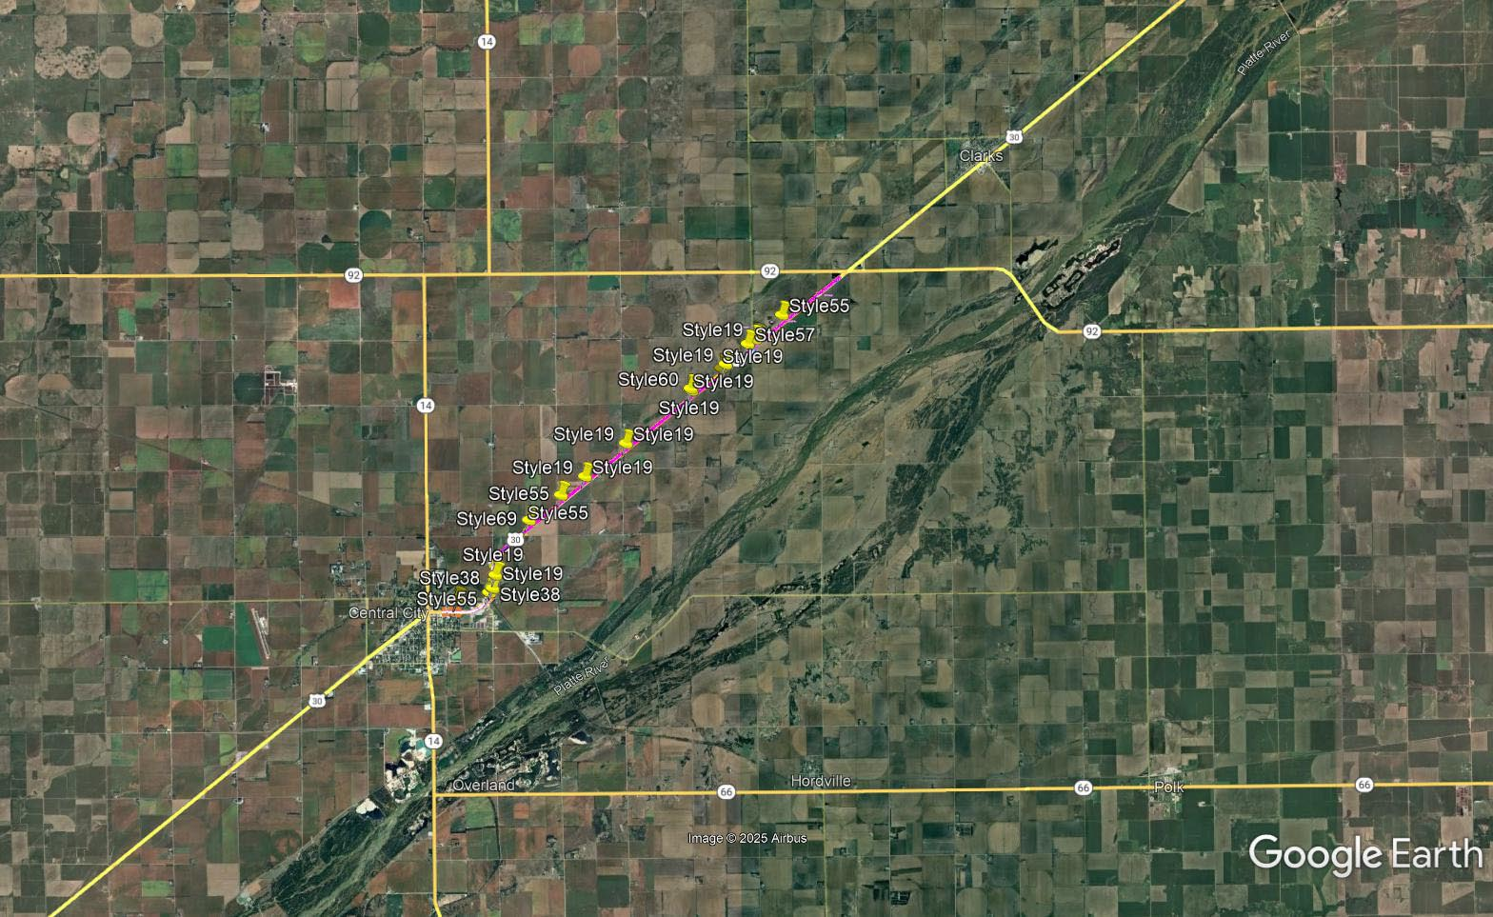

Slide 49
Elm Creek - Miller (MS)
Project Number: STP-183-2(111) Control No: 42898
Project Length: 14.42
Scope of Work:
  Culvert Extension/Replacement
  Guardrail
  Bridge Replacement

Slide 50
Elm Creek - Miller (MS)
Project Number: STP-183-2(111) Control No: 42898
Status: Design
Right-of-way: In Progress
Construction Timing: 8/3/2026 - 10/23/2027

Slide 51
Elm Creek - Miller (MS)
Project Number: STP-183-2(111) Control No: 42898
Anticipated Utilities Impact:
  Culvert Extension/Replace
  Guardrail
  Bridge Repair/Replace
Anticipated Request from Utilities:
  Coordination with NDOT
  Provide Existing Locations
  Locates
Additional Information:
  No K-Sheets Required
  TBD
Utilities Involved:
  Black Hills Energy
  Charter Communications
  Cogent Communications
  Dawson Public Power District
  Frontier Communications
  Great Plains Communications
  Lumen
  Nebraska Public Power District
  OPTK Networks
  Tallgrass Energy
  Verizon
  Village of Elm Creek
  Village of Miller

Slide 52
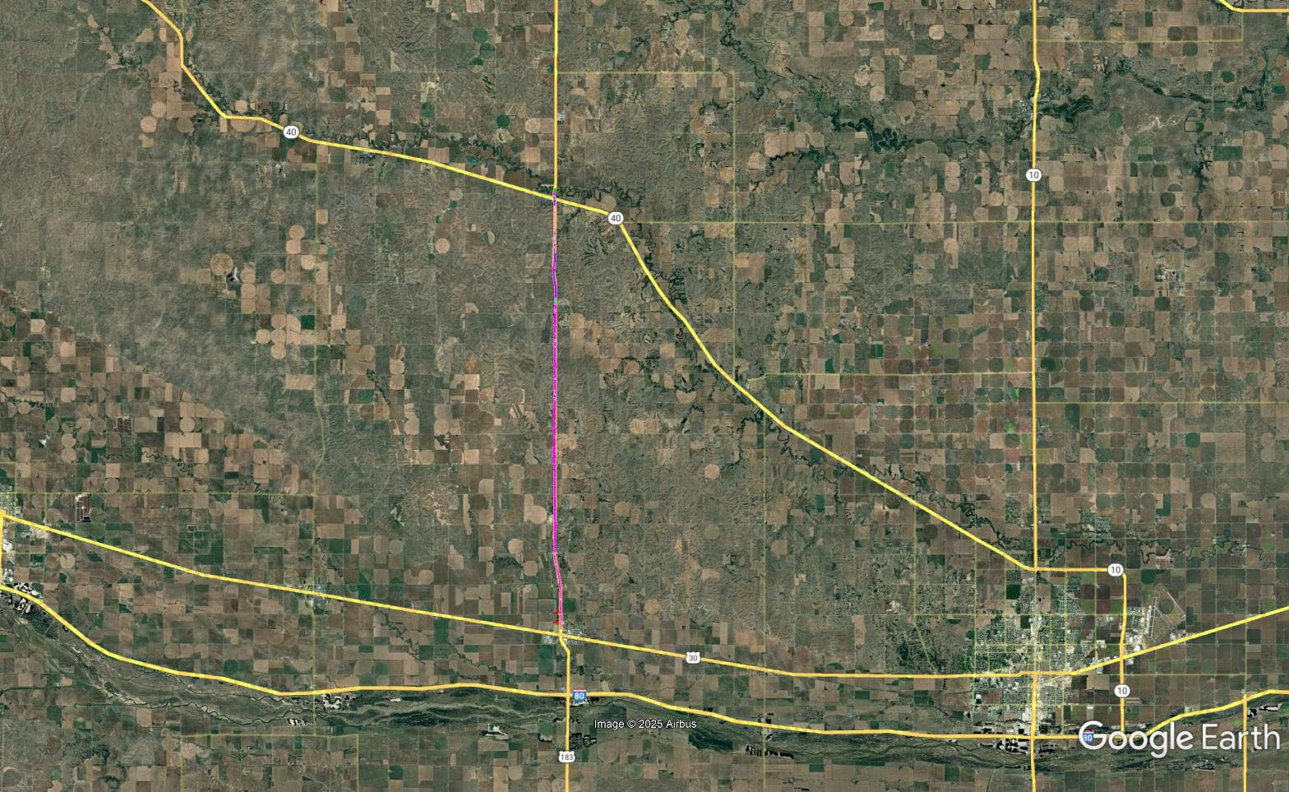

Slide 53
Waco to Utica
Project Number: NH-STP-80-8(168) Control No: 42949
Project Length: 5.74
Scope of Work:
  Bridge Repair

Slide 54
Waco to Utica
Project Number: NH-STP-80-8(168) Control No: 42949
Status: Design
Right-of-way: Not Required
Construction Timing: 11/1/2026 - 3/31/2027

Slide 55
Waco to Utica
Project Number: NH-STP-80-8(168) Control No: 42949
Anticipated Utilities Impact:
  Bridge Repair/Replace
Anticipated Request from Utilities:
  Coordination with NDOT
  Provide Existing Locations
Additional Information:
  No K-Sheets Required
  TBD
Utilities Involved:
  Black Hills Energy
  Norris Public Power District
  Perennial Public Power District
  Windstream Communications

Slide 56
Waco to Utica
Project Number: NH-STP-80-8(168) Control No: 42949

Slide 57
Cy 2027
The following projects are anticipated to be let during 2027

Slide 58
Davenport West
Project Number: STP-4-5(106) Control No: 42778
Project Length: 12.90
Scope of Work:
  Bridge Repair
  Culvert Extension/Replacement
  Guardrail

Slide 59
Davenport West
Project Number: STP-4-5(106) Control No: 42778
Status: Design
Right-of-way: In Progress
Construction Timing: 4/5/2027 - 11/24/2027

Slide 60
Davenport West
Project Number: STP-4-5(106) Control No: 42778
Anticipated Utilities Impact:
Anticipated Request from Utilities:
Additional Information:
Utilities Involved:
  Black Hills Energy
  Nebraska Public Power District
  South Central Public Power District
  Tallgrass Energy
  Viaero
  Windstream Communications

Slide 61
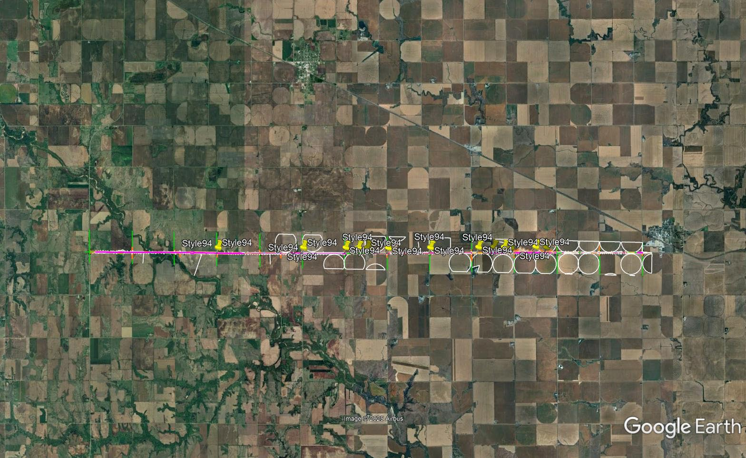

Slide 62
Miller - Buffalo/Custer Co Line
Project Number: STP-183-2(112) Control No: 42899
Project Length: 8.06
Scope of Work:
  Culvert Extension/Replacement
  Bridge Repair
  Guardrail

Slide 63
Miller - Buffalo/Custer Co Line
Project Number: STP-183-2(112) Control No: 42899
Status: Design
Right-of-way: In Progress
Construction Timing: 3/30/2027 - 11/25/2027

Slide 64
Miller - Buffalo/Custer Co Line
Project Number: STP-183-2(112) Control No: 42899
Anticipated Utilities Impact:
Anticipated Request from Utilities:
Additional Information:
Utilities Involved:
  AT&T
  Charter Communications
  Dawson Public Power District
  Frontier Communications
  Lumen
  Nebraska Department of Water, Energy, and Environment
  Village of Miller
  Windstream Communications

Slide 65
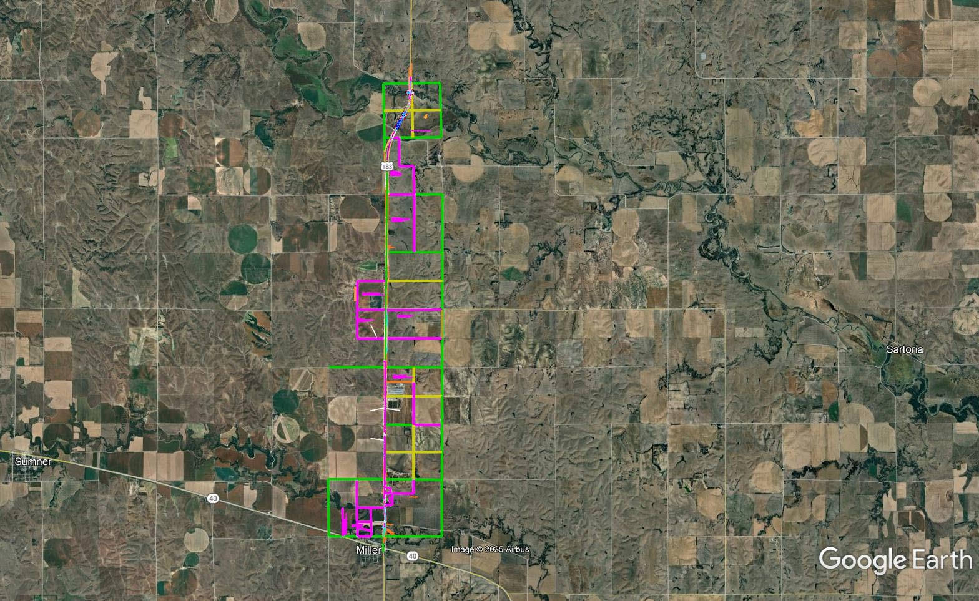

Slide 66
Doniphan - I-80
Project Number: NH-34-4(136) Control No: 42944
Project Length: 3.36
Scope of Work:
  Bridge Repair

Slide 67
Doniphan - I-80
Project Number: NH-34-4(136) Control No: 42944
Status: Design
Right-of-way: Not Required
Construction Timing: 4/19/2027 - 11/24/2027

Slide 68
Doniphan - I-80
Project Number: NH-34-4(136) Control No: 42944
Anticipated Utilities Impact:
Anticipated Request from Utilities:
Additional Information:
Utilities Involved:
  Black Hills Energy
  Charter Communications
  Great Plains Communications
  Hamilton Telecommunications
  Lumen
  Nebraska Public Power District
  Southern Public Power District
  Village of Doniphan Sewer-Water
  Windstream Communications

Slide 69
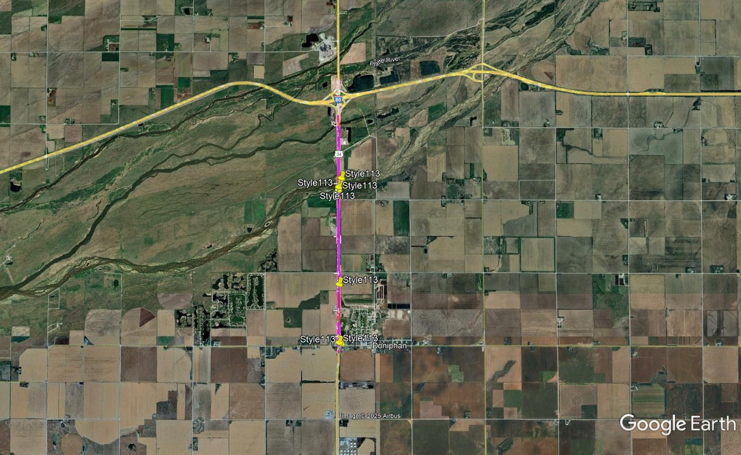

Slide 70
Platte River - Phillips
Project Number: NH-80-7(178) Control No: 43023
Project Length: 7.70
Scope of Work:
  Culvert Extension/Replacement
  Bridge Repair
  Resurfacing

Slide 71
Platte River - Phillips
Project Number: NH-80-7(178) Control No: 43023
Status: Design
Right-of-way: Not Required
Construction Timing: 4/1/2027 - 10/31/2027

Slide 72
Platte River - Phillips
Project Number: NH-80-7(178) Control No: 43023
Anticipated Utilities Impact:
Anticipated Request from Utilities:
Additional Information:
Utilities Involved:
  Black Hills Energy
  Charter Communications
  City of Grand Island – Electric, Streets, Wastewater, Water
  Great Plains Communications
  Hamilton Telecommunications
  Lumen
  Nebraska Public Power District
  Northwestern Energy
  Southern Public Power District
  Windstream Communications

Slide 73
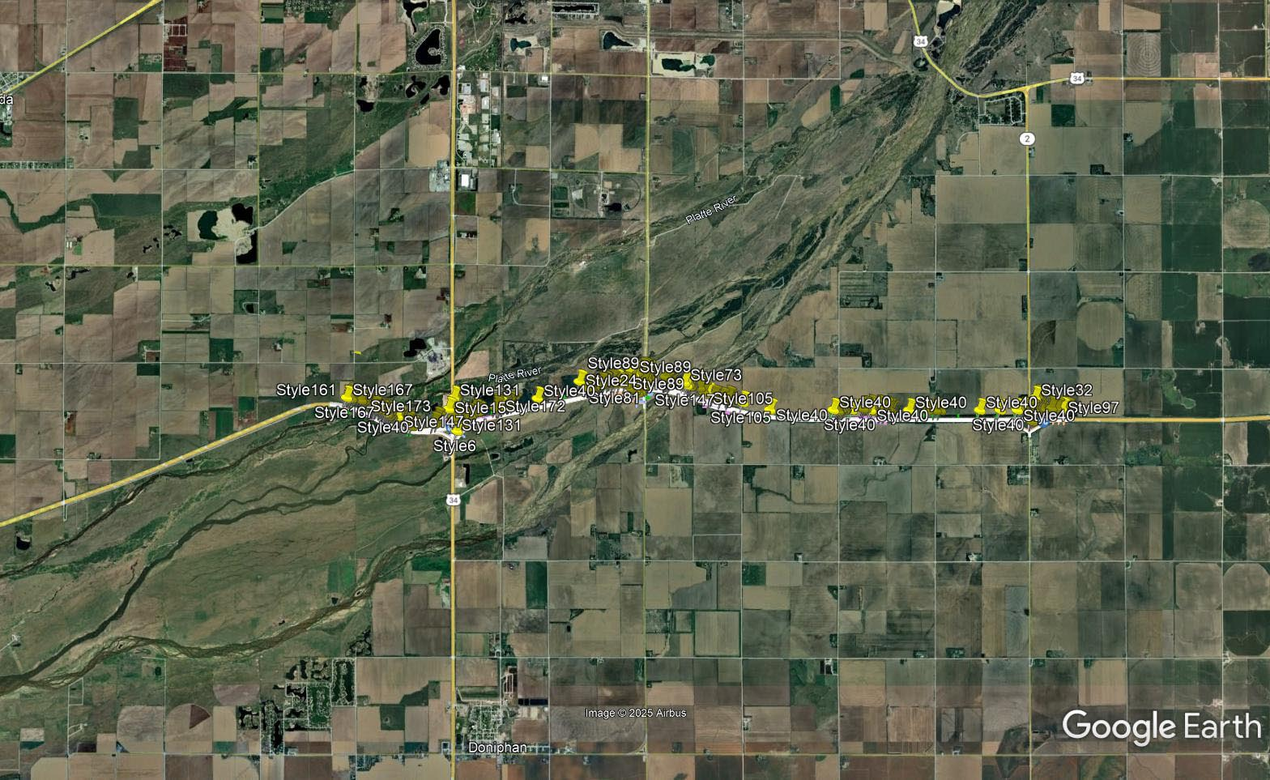

Slide 74
Miller - Amherst
Project Number: STP-40-4(104) Control No: 42924
Project Length: 10.95
Scope of Work:
  Bridge Replacement
  Culvert Extension/Replacement
  Bridge Repair

Slide 75
Miller - Amherst
Project Number: STP-40-4(104) Control No: 42924
Status: Design
Right-of-way: In Progress
Construction Timing: 4/1/2027 - 10/31/2027

Slide 76
Miller - Amherst
Project Number: STP-40-4(104) Control No: 42924
Anticipated Utilities Impact:
Anticipated Request from Utilities:
Additional Information:
Utilities Involved:
  Black Hills Energy
  Charter Communications
  Dawson Public Power District
  Frontier Communications
  Lumen
  Village of Amherst
  Village of Miller

Slide 77
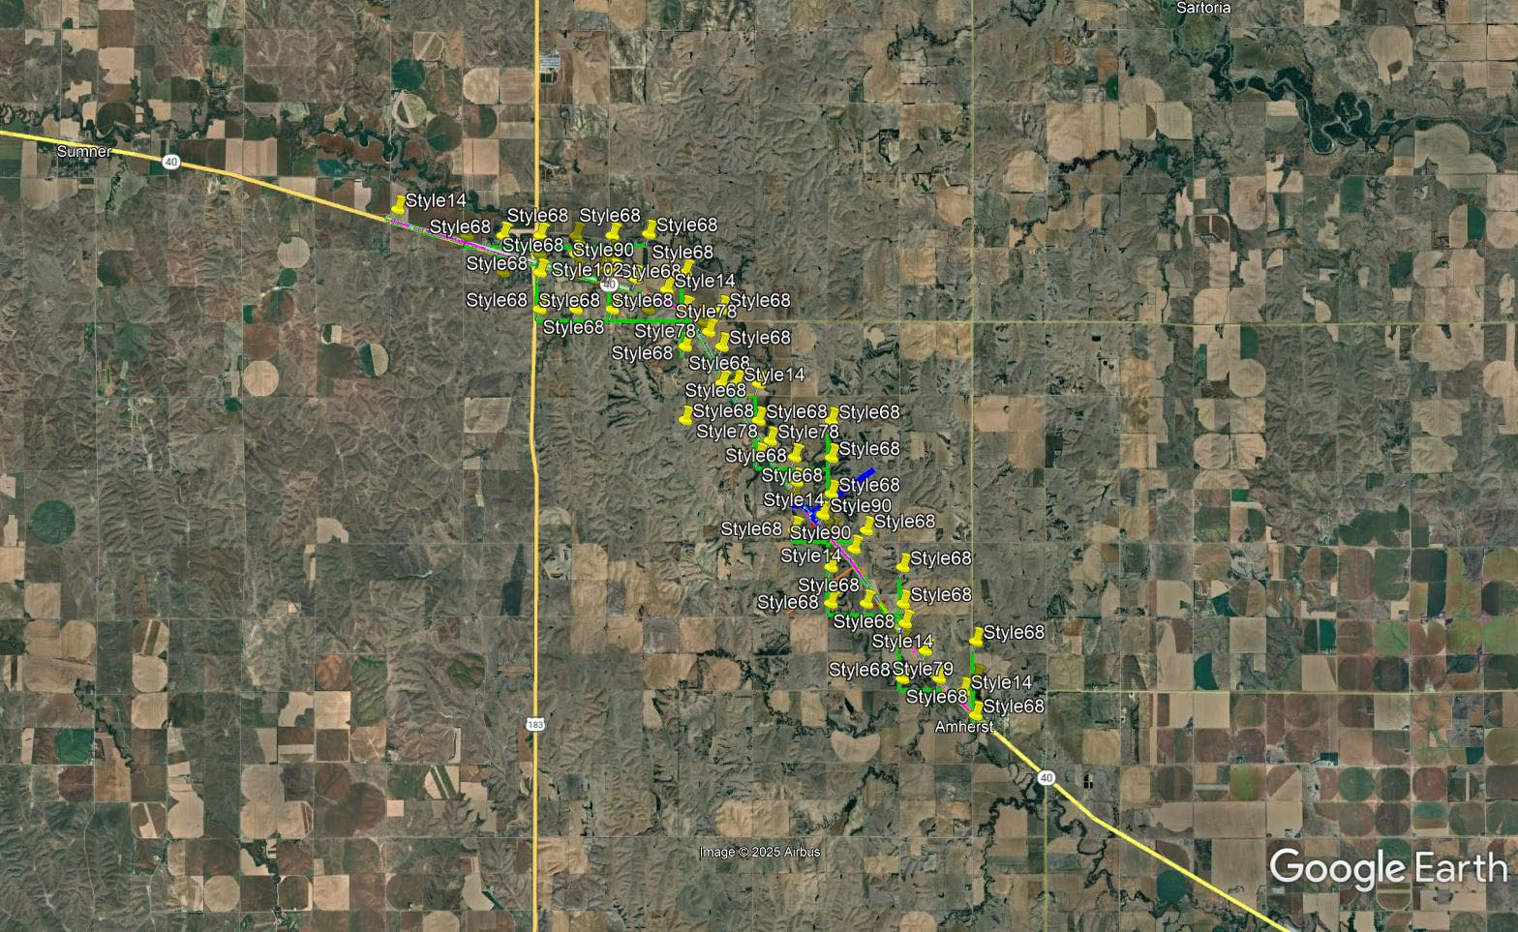

Slide 78
Central City Viaduct
Project Number: RRZ-TMT-14-2(123) Control No: 42013
Project Length: 1.09
Scope of Work:
  Urban Reconstruction
  Bridge Replacement

Slide 79
Central City Viaduct
Project Number: RRZ-TMT-14-2(123) Control No: 42013
Status: Design
Right-of-way: In Progress
Construction Timing: 4/1/2027 - 10/31/2028

Slide 80
Central City Viaduct
Project Number: RRZ-TMT-14-2(123) Control No: 42013
Anticipated Utilities Impact:
Anticipated Request from Utilities:
Additional Information:
Utilities Involved:
  City of Central City-City Administrator
  City of Central City – Electric, Gas, Sewer, Water
  Building and zoning administrator
  Street Superintendent
  Cogent Communications
  Great Plains Communications
  Hamilton Telecommunications
  Lumen
  Northeast Nebraska Telephone Company
  Southern Public Power District
  Vyve Broadband

Slide 81
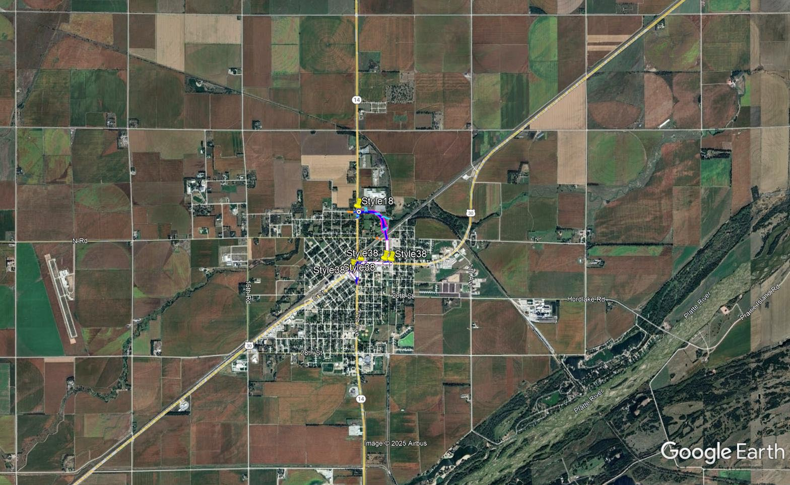

Slide 82
Nelson North
Project Number: STP-14-1(125) Control No: 42945
Project Length: 11.40
Scope of Work:
  Culvert Extension/Replacement
  Bridge Replacement

Slide 83
Nelson North
Project Number: STP-14-1(125) Control No: 42945
Status: Design
Right-of-way: In Progress
Construction Timing: 3/29/2027 - 9/30/2028

Slide 84
Nelson North
Project Number: STP-14-1(125) Control No: 42945
Anticipated Utilities Impact:
Anticipated Request from Utilities:
Additional Information:
Utilities Involved:
  Black Hills Energy
  City of Nelson
  Glenwood Telephone
  Nustar Pipeline
  Platte Pipeline Company
  Tallgrass Energy
  Segra
  USGS
  Windstream Communications
  Zayo Group

Slide 85
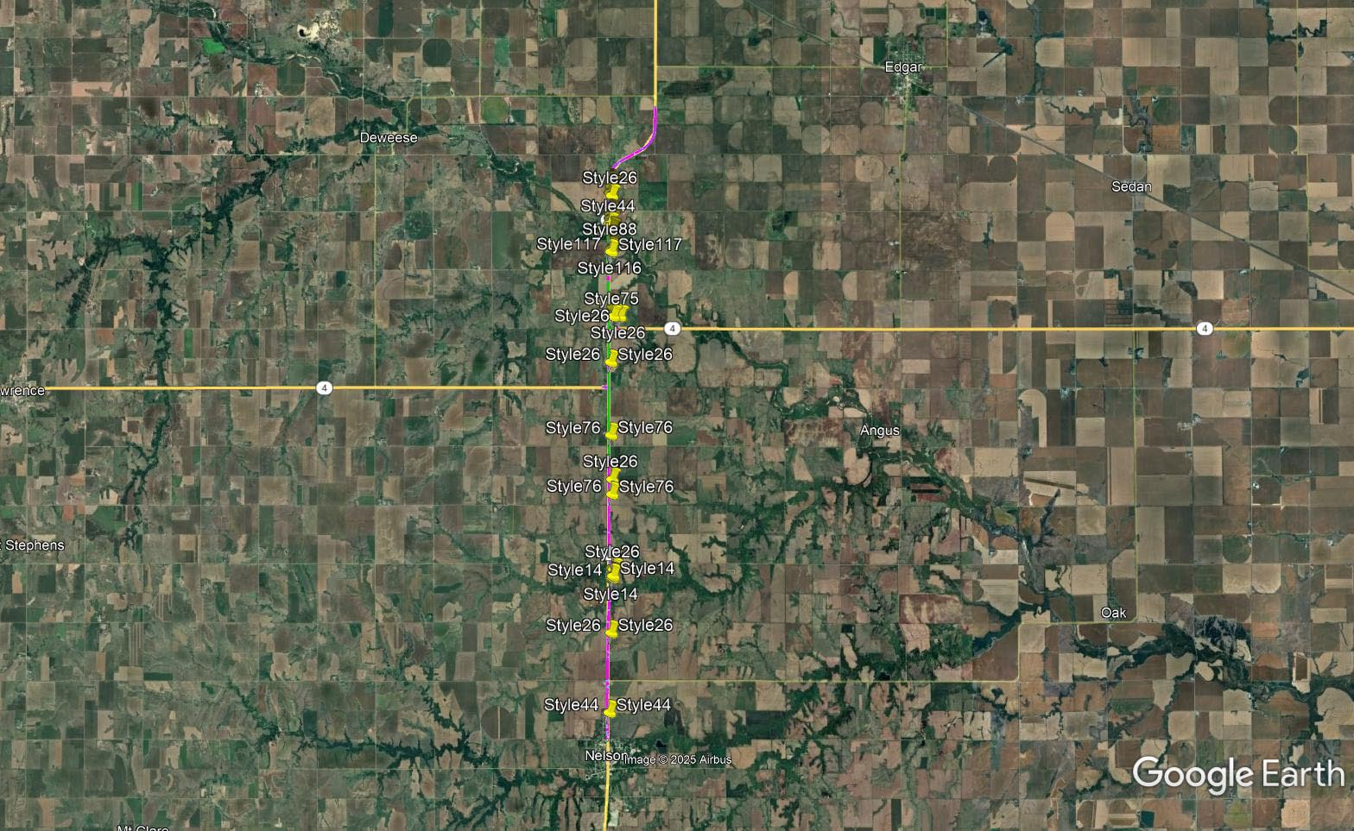

Slide 86
Bruning North and South
Project Number: NH-81-1(126) Control No: 42947
Project Length: 10.04
Scope of Work:
  Culvert Extension/Replacement
  Bridge Repair

Slide 87
Bruning North and South
Project Number: NH-81-1(126) Control No: 42947
Status: Design
Right-of-way: Not Required
Construction Timing: 3/29/2027 - 10/30/2027

Slide 88
Bruning North and South
Project Number: NH-81-1(126) Control No: 42947
Anticipated Utilities Impact:
Anticipated Request from Utilities:
Additional Information:
Utilities Involved:
  Black Hills Energy
  Glenwood Telephone
  Great Plains Communications
  Norris Public Power District
  Tallgrass Energy
  Segra
  Village of Bruning – Sewer & Water
  Windstream Communications

Slide 89
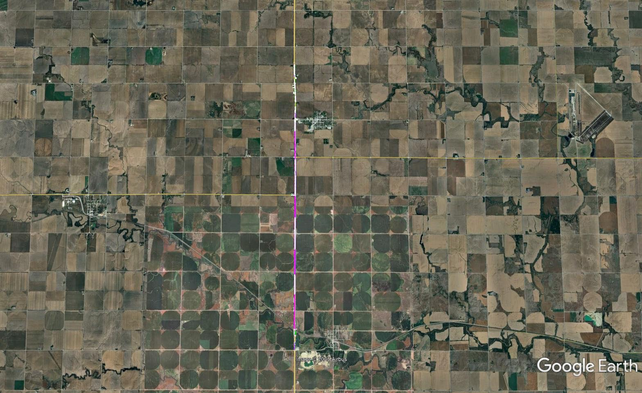

Slide 90
In Kearney West of UNK
Project Number: STP-30-4(165) Control No: 42955
Project Length: 1.58
Scope of Work:
  Urban Reconstruction
  Full Depth Pavement

Slide 91
In Kearney West of UNK
Project Number: STP-30-4(165) Control No: 42955
Status: Design
Right-of-way: In Progress
Construction Timing: 4/1/2027 - 10/31/2027

Slide 92
In Kearney West of UNK
Project Number: STP-30-4(165) Control No: 42955
Anticipated Utilities Impact:
Anticipated Request from Utilities:
Additional Information:
Utilities Involved:
  Allo Communications
  Buckle Inc.
  Charter Communications
  City of Kearney
  Dawson Public Power District
  Frontier Communications
  Great Plains Communications
  Nebraska Public Power District
  Northwestern Energy
  OPTK Networks
  Segra
  University of Nebraska – Kearney

Slide 93
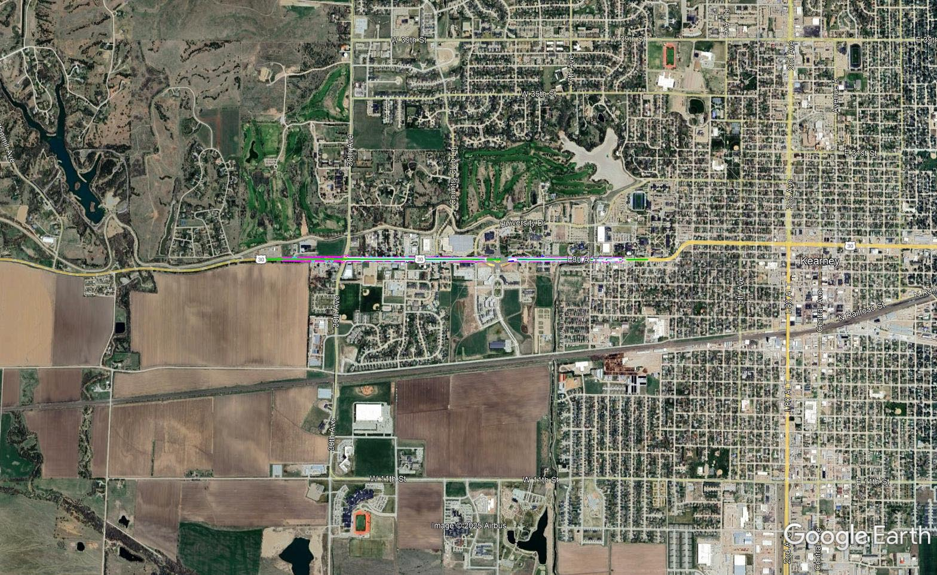
In Kearney West of UNK
Project Number: STP-30-4(165) Control No: 42955

Slide 94
Questions & Wrap Up
Notes:
HDR

Slide 95
Any final Questions?
Ask them now!
If you have questions after this meeting, or would like to view more detailed project maps, please reach out to your utility coordinator.
Notes:
HDR

Slide 96
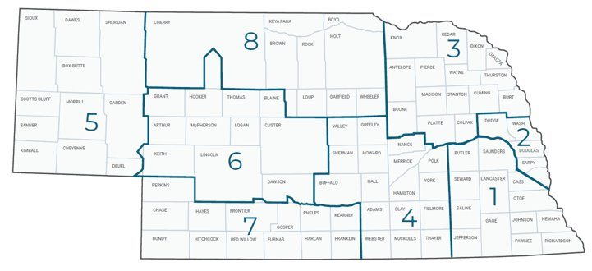
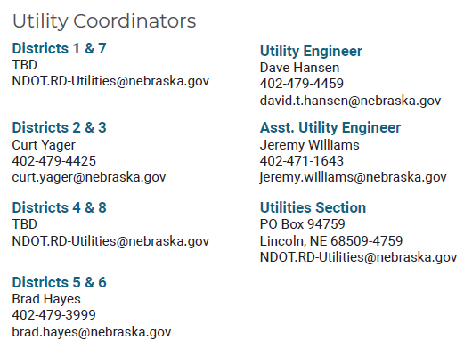
Have a Question about a project your Utility is involved in?
Contact your district’s utility coordinator!
Notes:
HDR

Slide 97
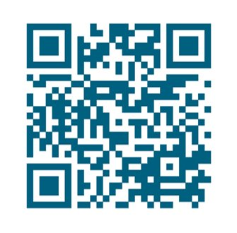
We need your feedback
Your valuable feedback helps these meetings – and NDOT’s utility coordination program – be better.
Use your phone’s camera to scan this QR code or use our paper survey.
Notes:
HDR

Slide 98
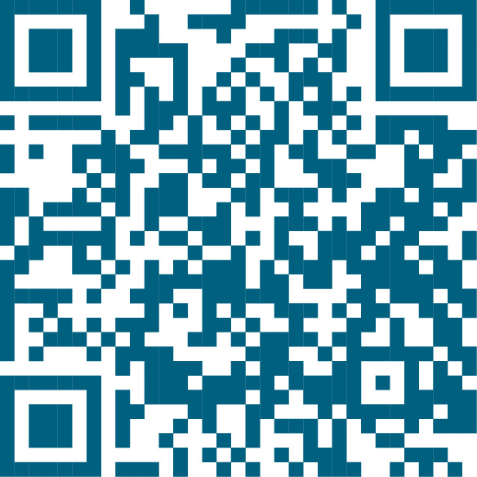
Visit our Website
Visit NDOT.info/utility for more information on:
Utility accommodation
Permitting
Coordination
Project information
Reimbursements
Additional information
Scan the QR Code to view the 2026 Program Book!
Notes:
HDR

Slide 99
Thank You
Notes:
HDR

