Slide 1
NEBRASKA
AIRPORT INSPECTIONS and
LICENSING STANDARDS
Nebraska Aviation Symposium, Kearney, NE 2025

Slide 2
3 Inspections Every Three Years
Pavement: PCI (Pavement Condition Index)
5010 (Part 77 Approach Obstructions)
Nebraska Airport License

Slide 3
Exceptions to 3-Year Intervals
License Issue: may return following year to confirm mitigation
FAA Request: Pavement or Part 77 Approach
Aeronautics: (to synchronize 3-year rotation)

Slide 4
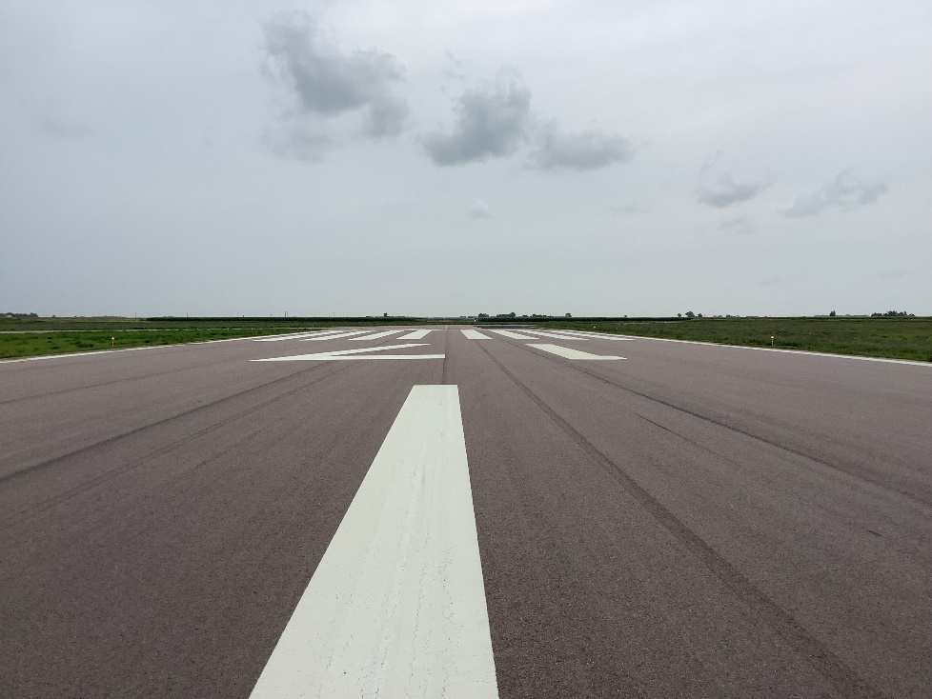
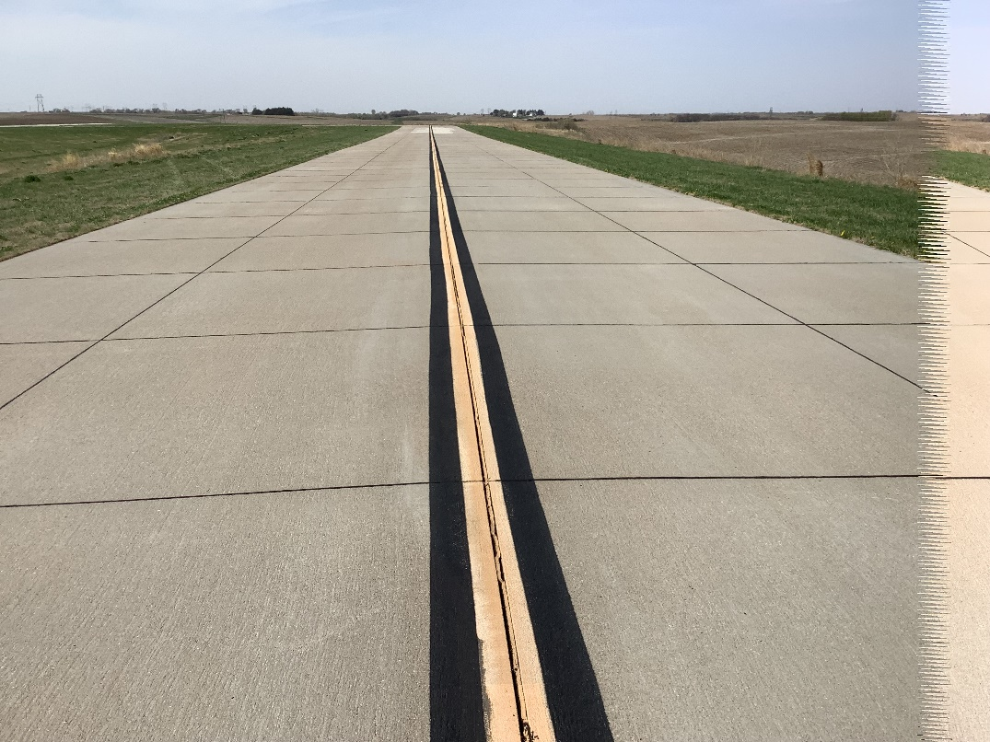
PAVEMENT

Slide 5
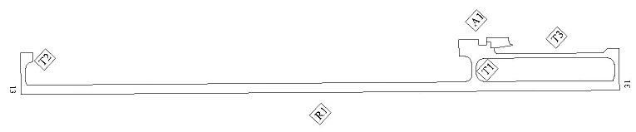
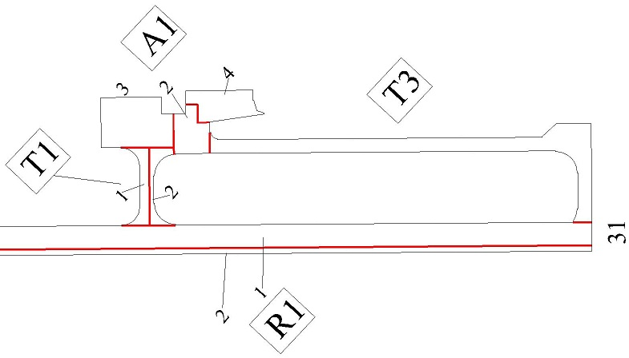
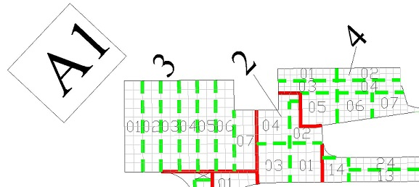
Pavement Organization
Branch
Section
Sample Unit

Slide 6
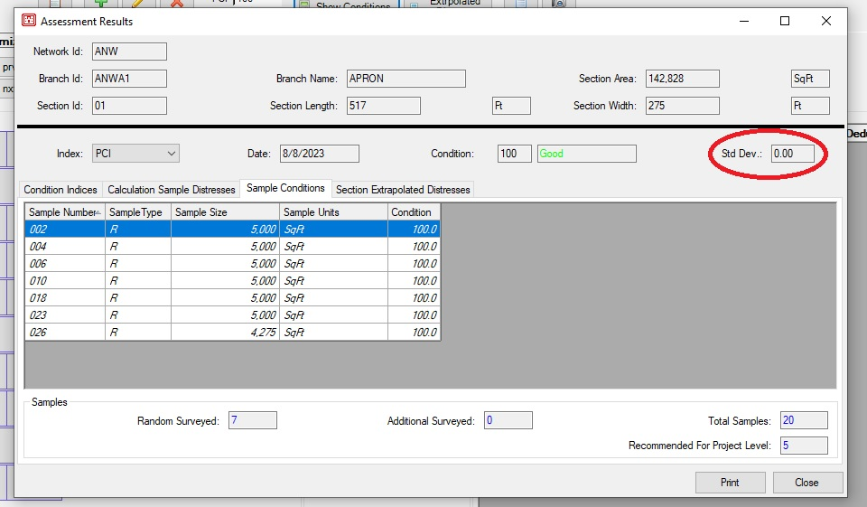
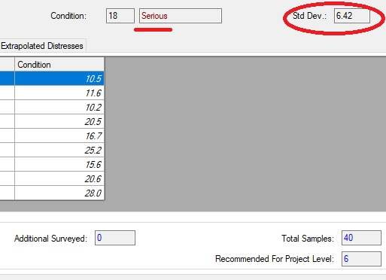
The Standard Deviation
“Measures the variation of Sample Units’ scores”
A low Standard Deviation does not mean “good condition.” It means the pavement’s condition is consistent throughout the Section, and you can be confident that your results are accurate.

Slide 7
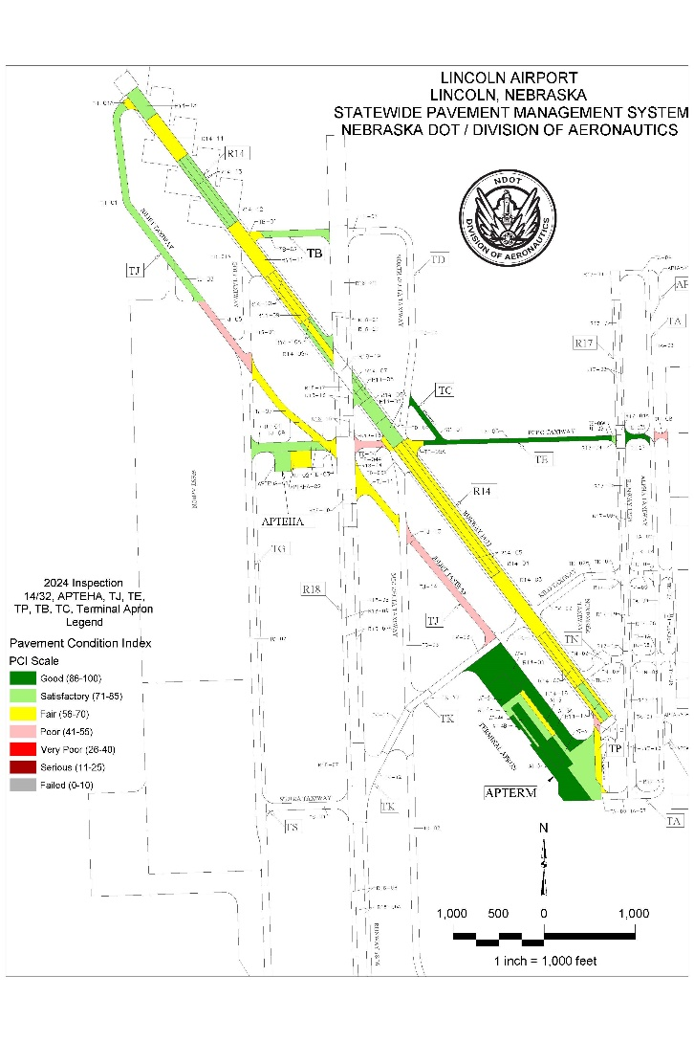
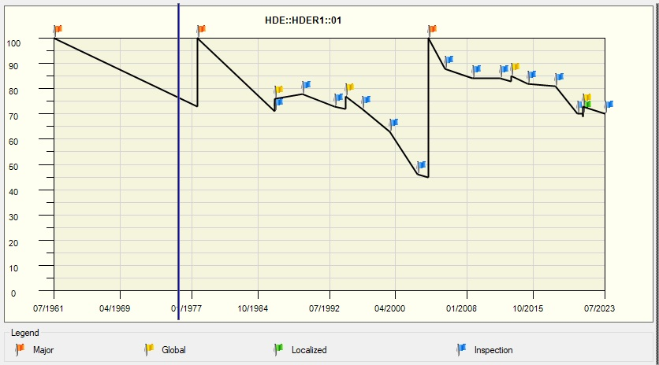
In Your PCI Report
Graph showing PCI score over time
Color-coded Map
(You also get a cover letter, a recommended budget for maintenance &/or projects, a Section Condition report, and a breakdown of distresses in each inspected Sample Unit)

Slide 8
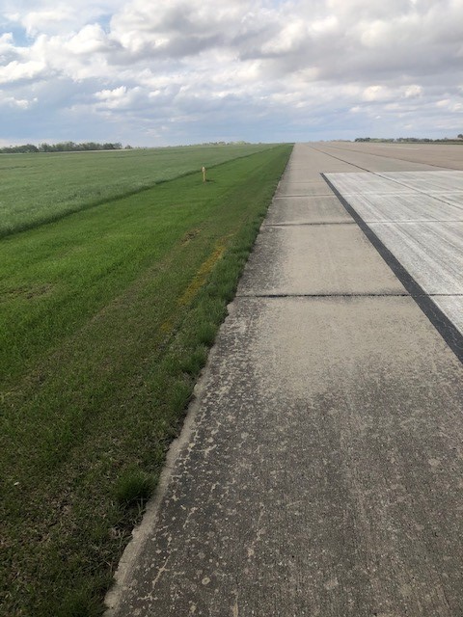
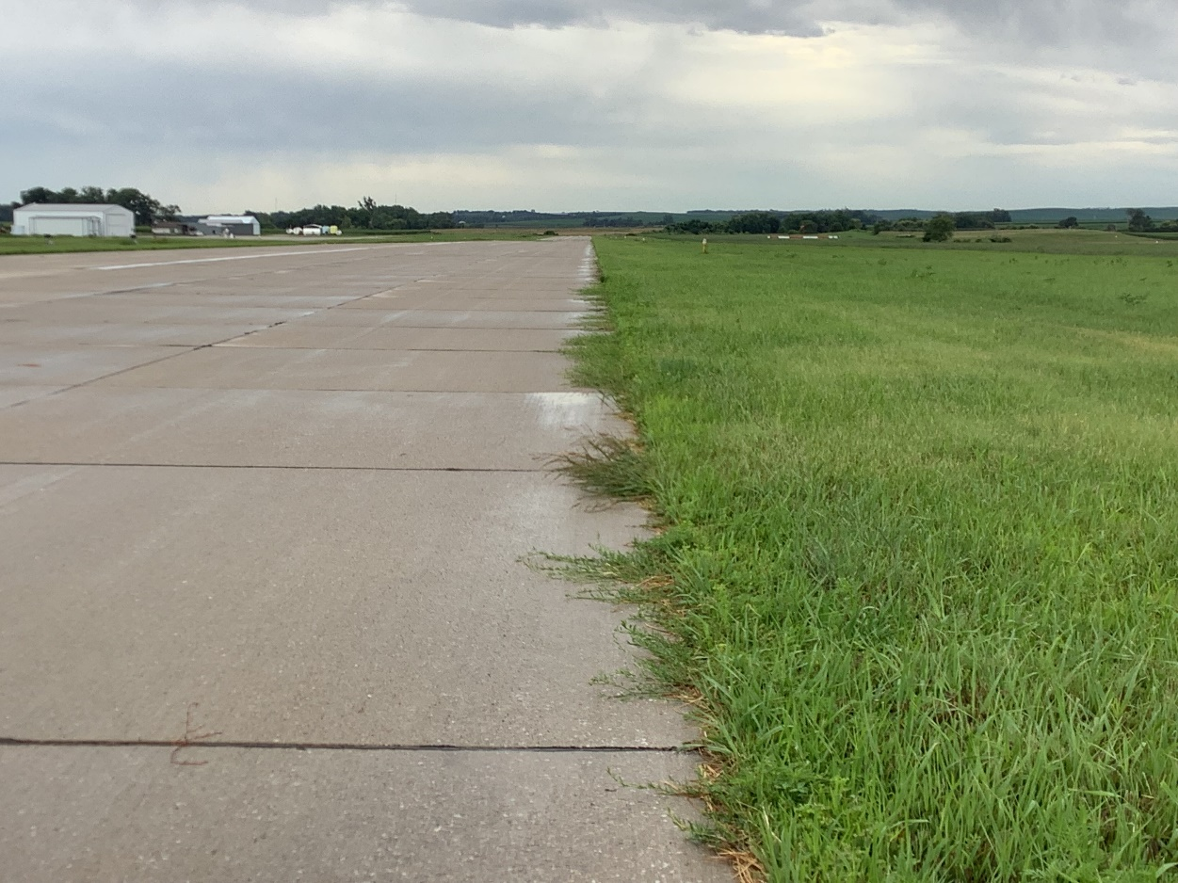
Want to preserve your pavement?
Keep the water off of it . . .
N
(No edge dams!)
N

Slide 9
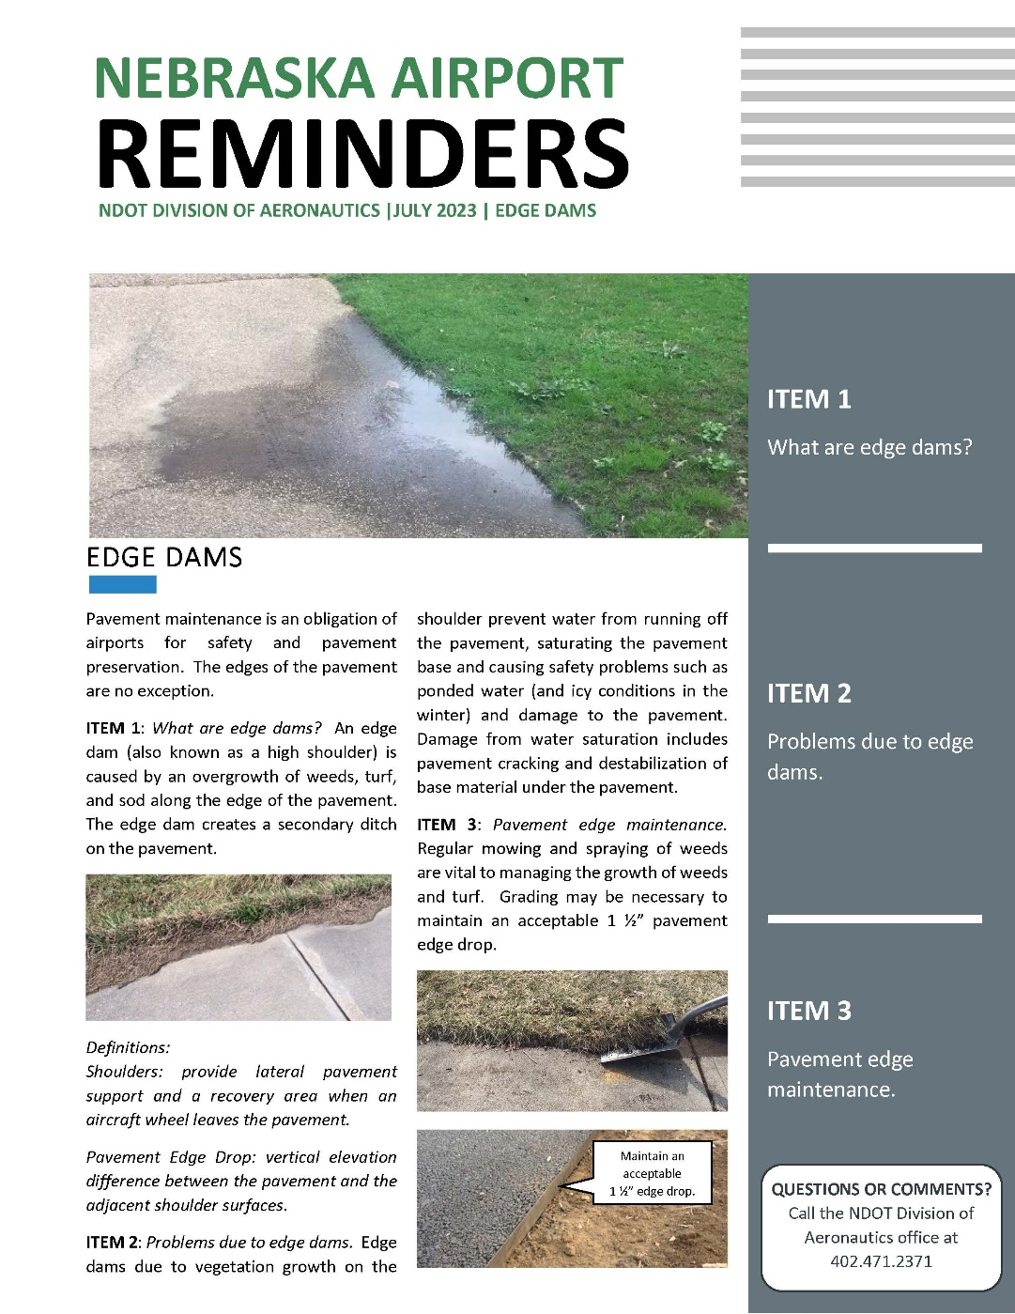

Slide 10
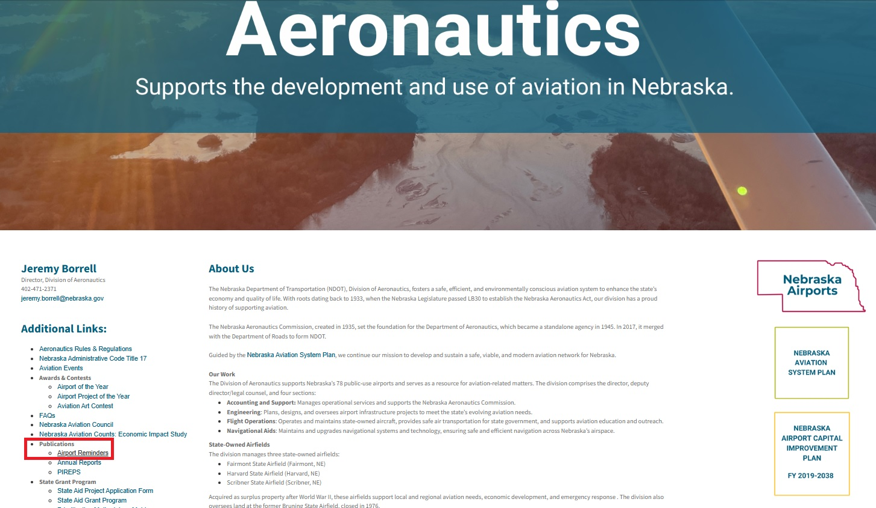
Where To Find Those Informative, Useful, Beautiful Airport Reminders

Slide 11
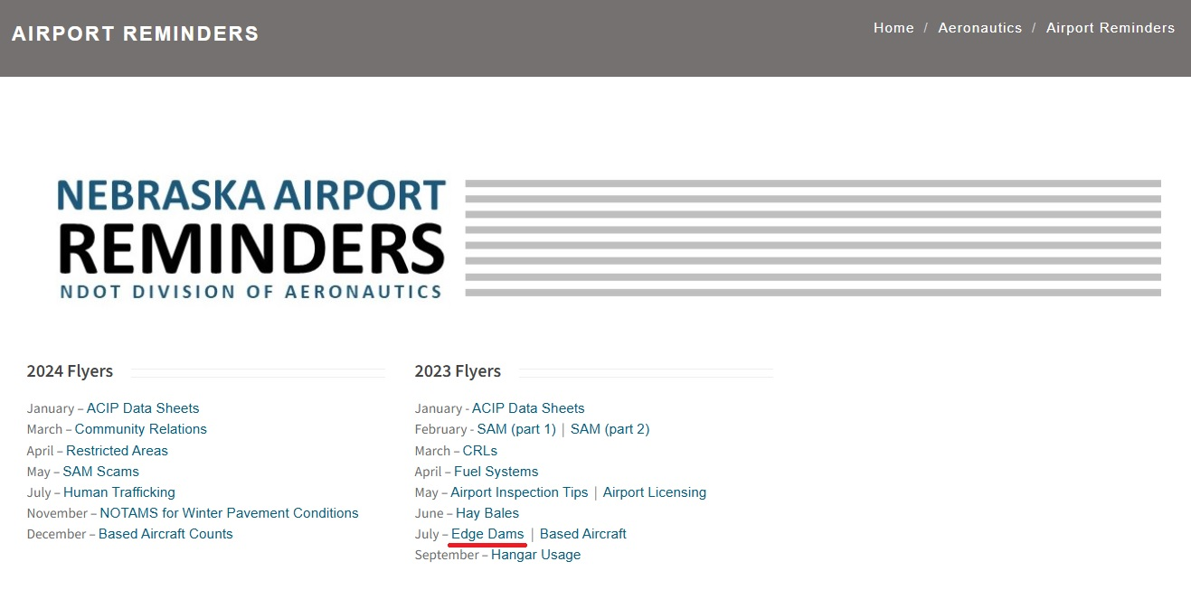
And Here’s A List Of Those Informative, Useful, Beautiful Airport Reminders

Slide 12
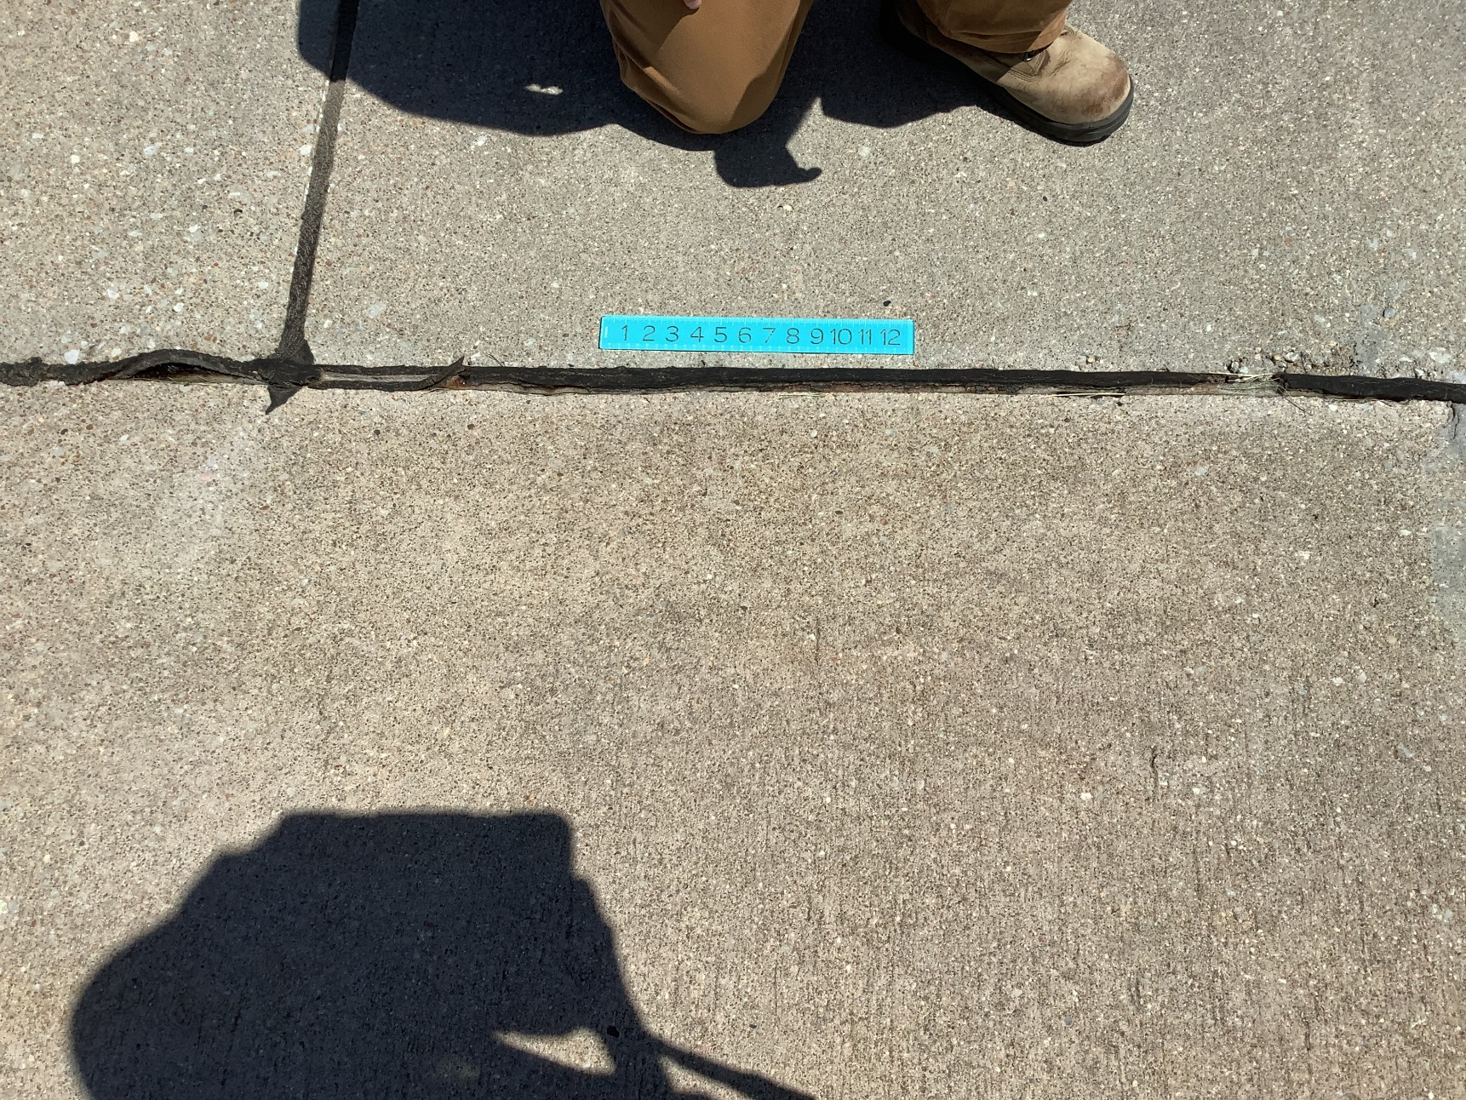
. . . and out of it

Slide 13
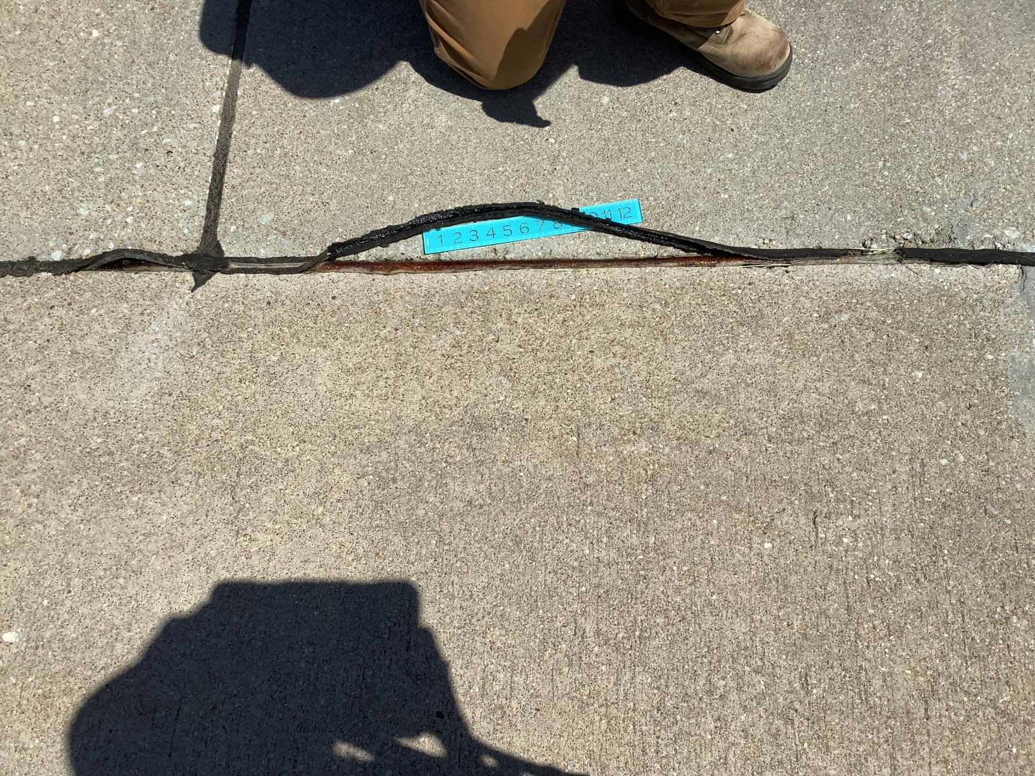

Slide 14
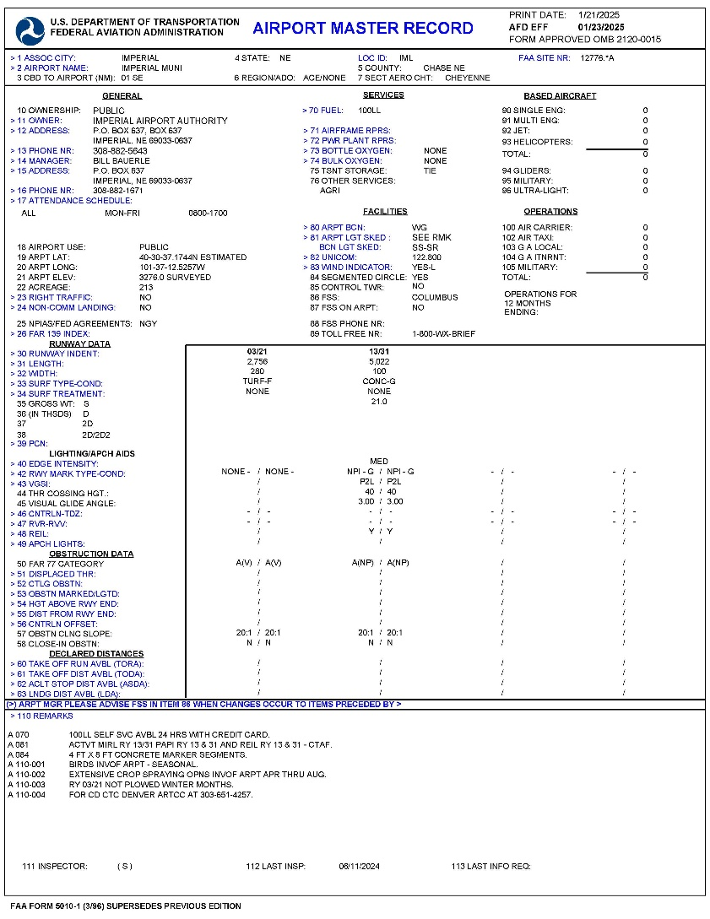
5010 (Airport Master Record) & Part 77

Slide 15
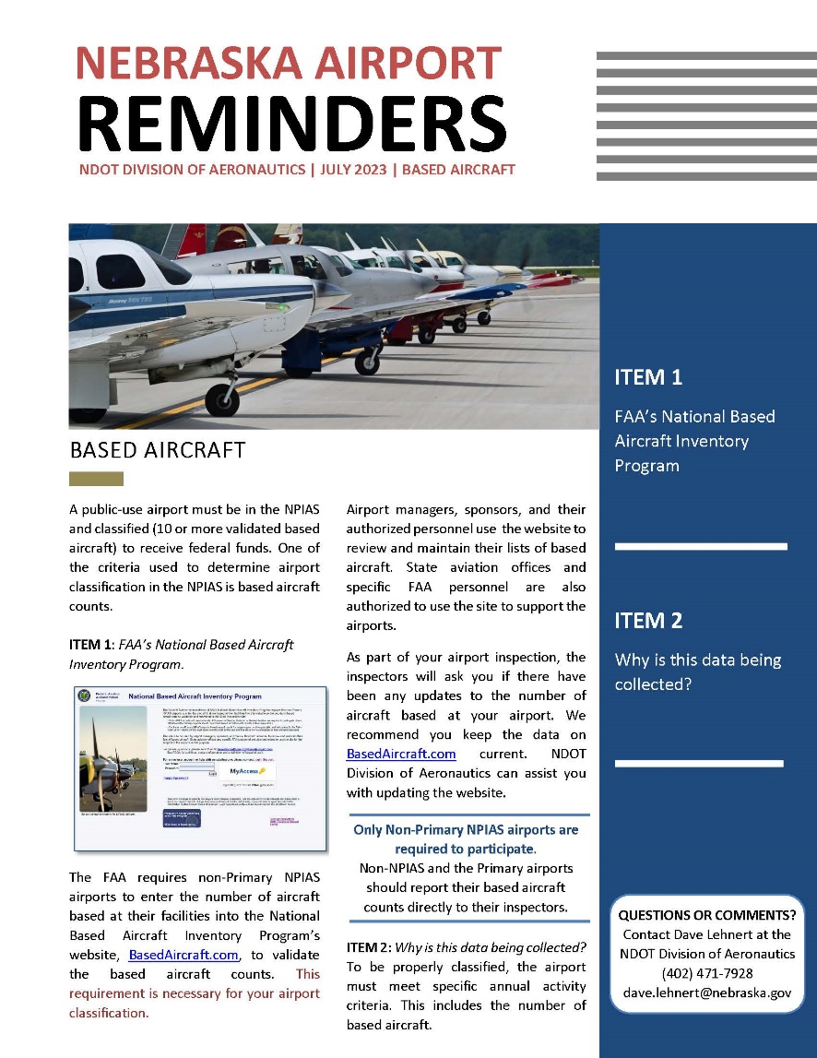
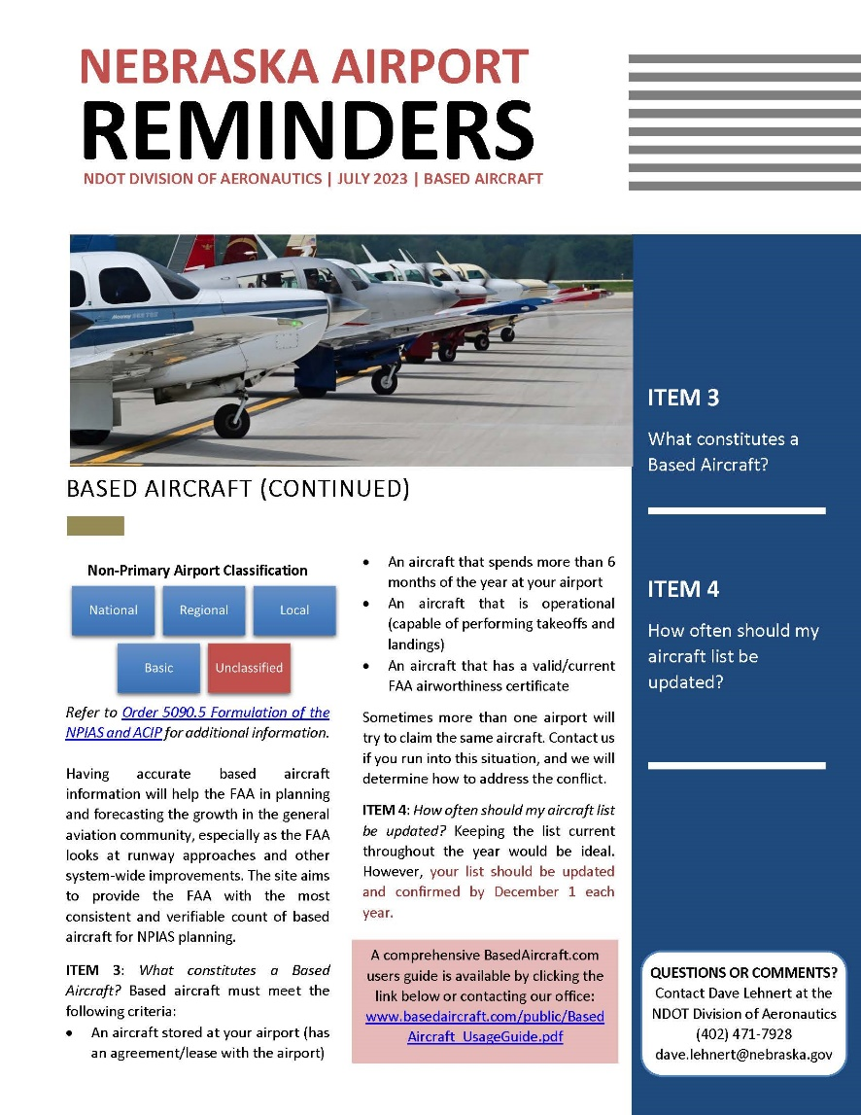
Based Aircraft

Slide 16
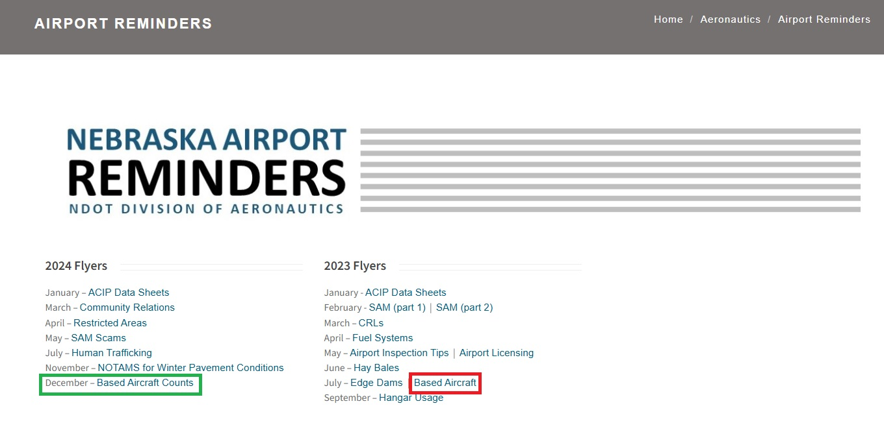

Slide 17
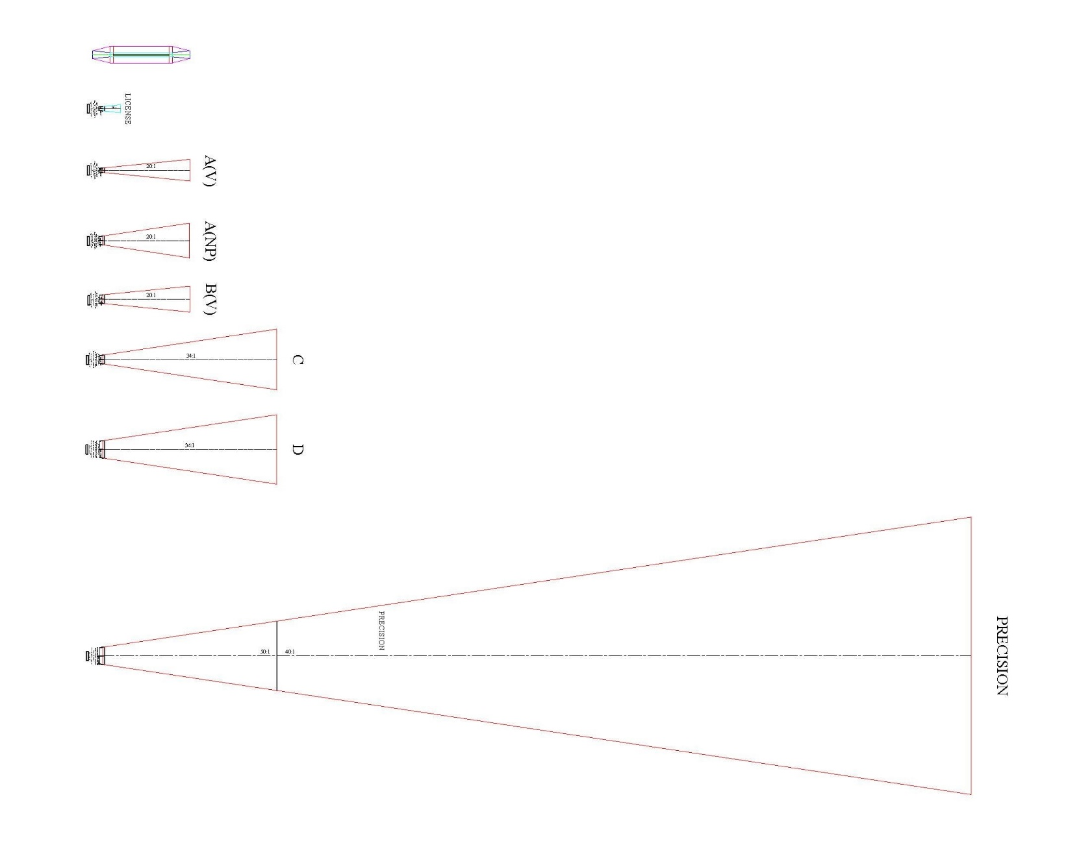
Part 77 Approach Trapezoids

Slide 18

Title 17
Nebraska Administrative Code, Chapter 1
Just google
rules.nebraska.gov
or

Slide 19
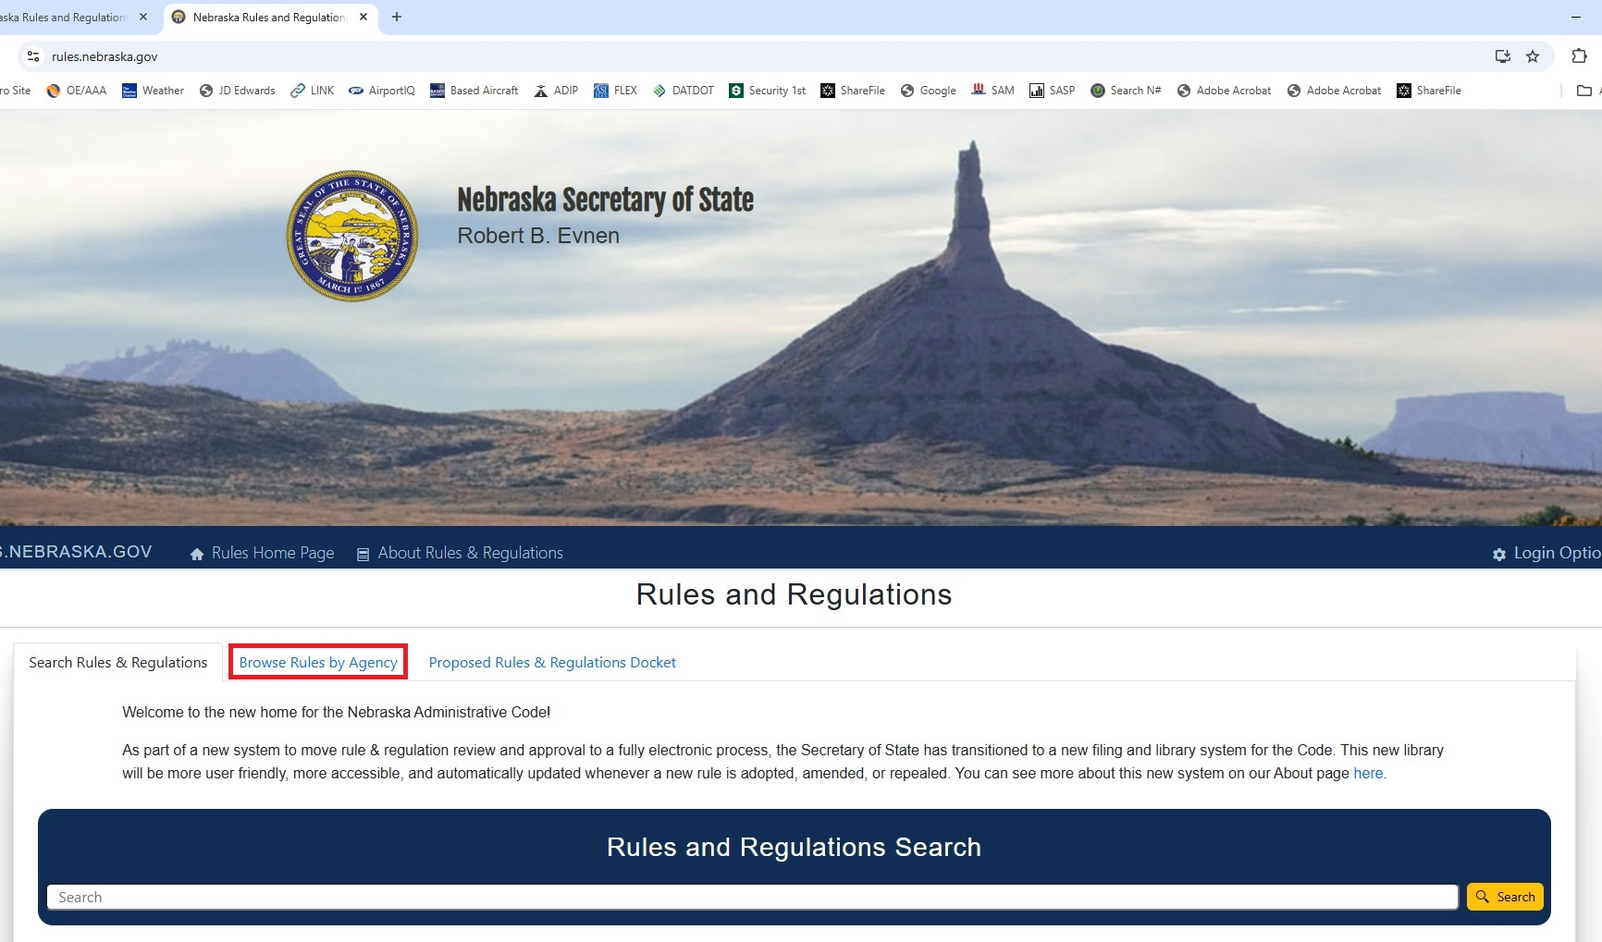
Nebraska Rules & Regulations Homepage

Slide 20
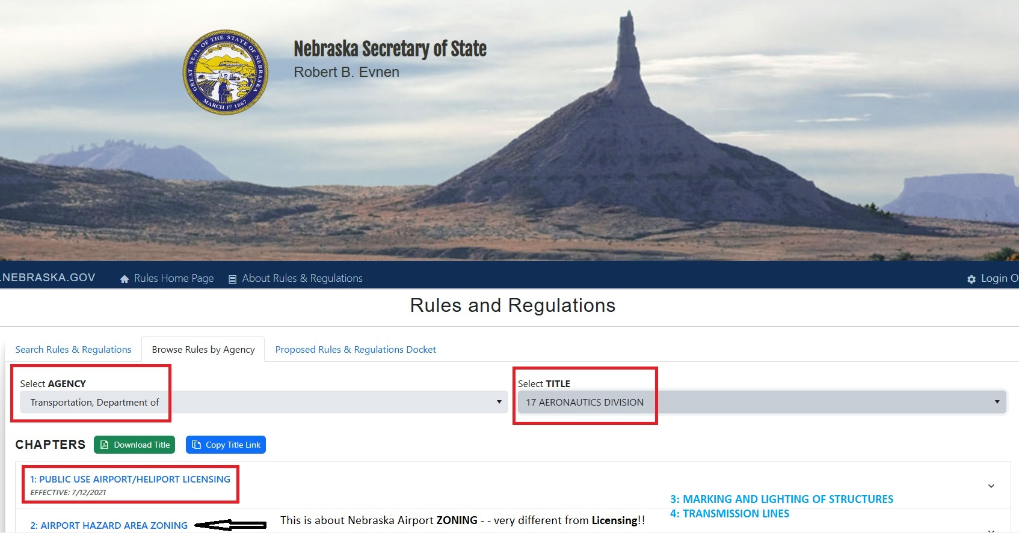
(Navigating the Page)

Slide 21
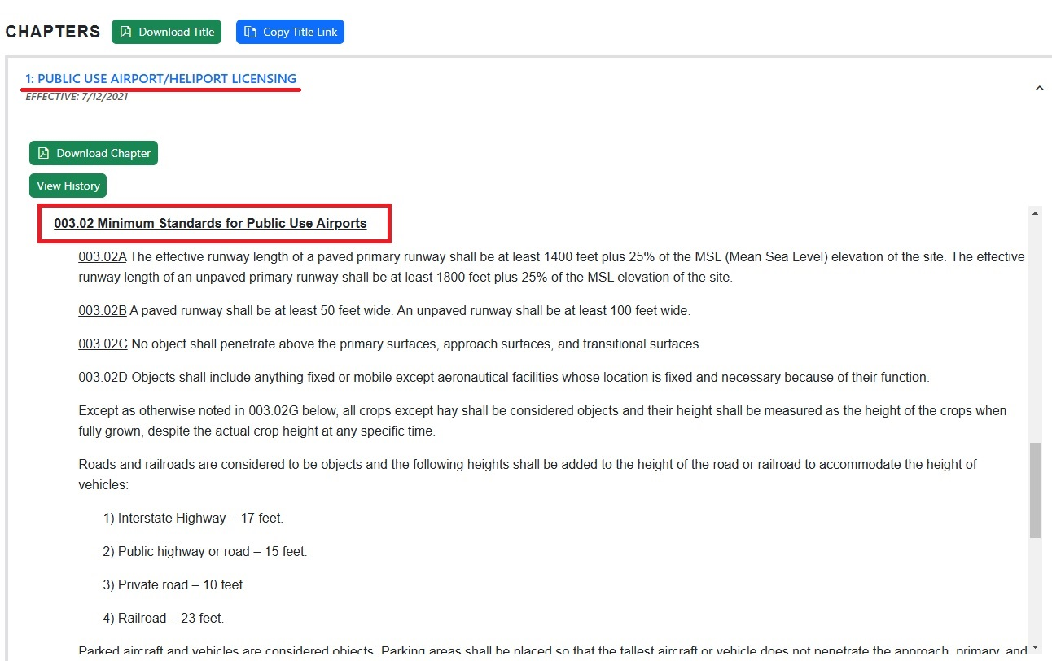
003.02 Minimum Standards

Slide 22
THREE SURFACES:
PRIMARY SURFACE
APPROACH
TRANSITION ZONE

Slide 23
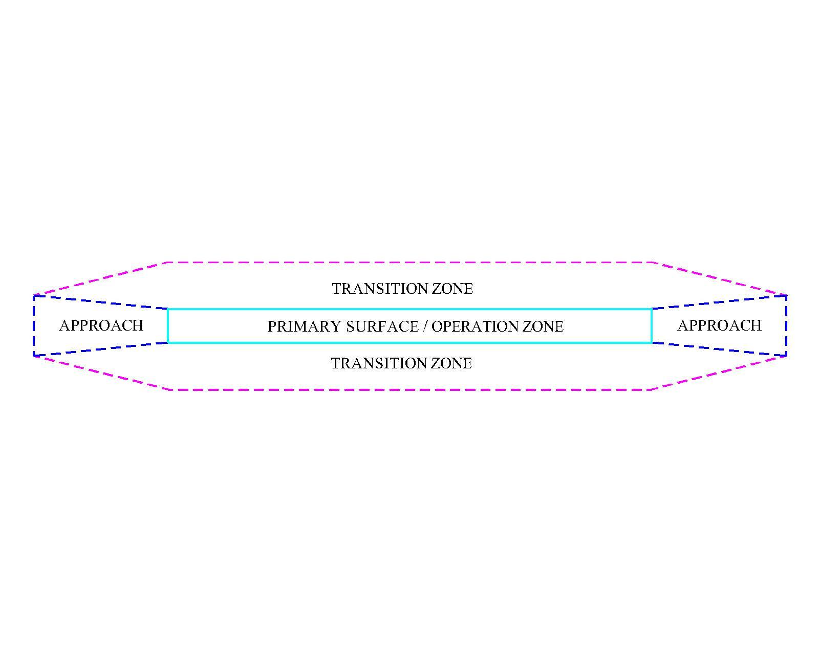

Slide 24
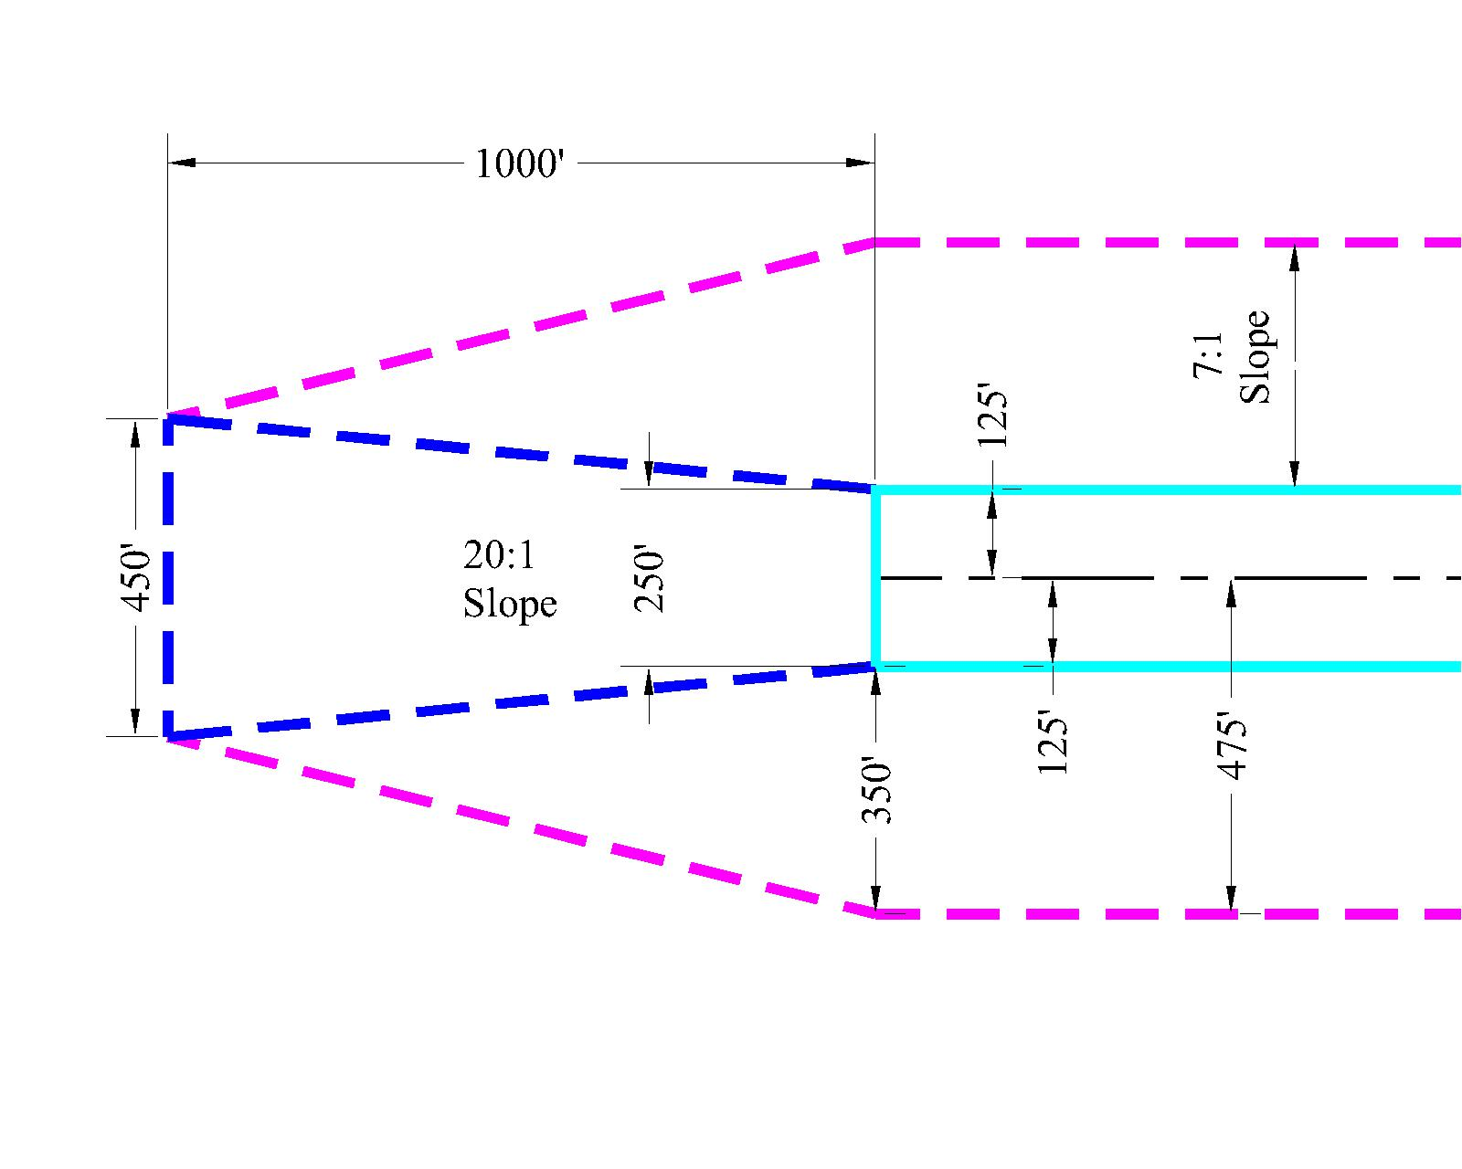
License Surface Dimensions and Slopes

Slide 25
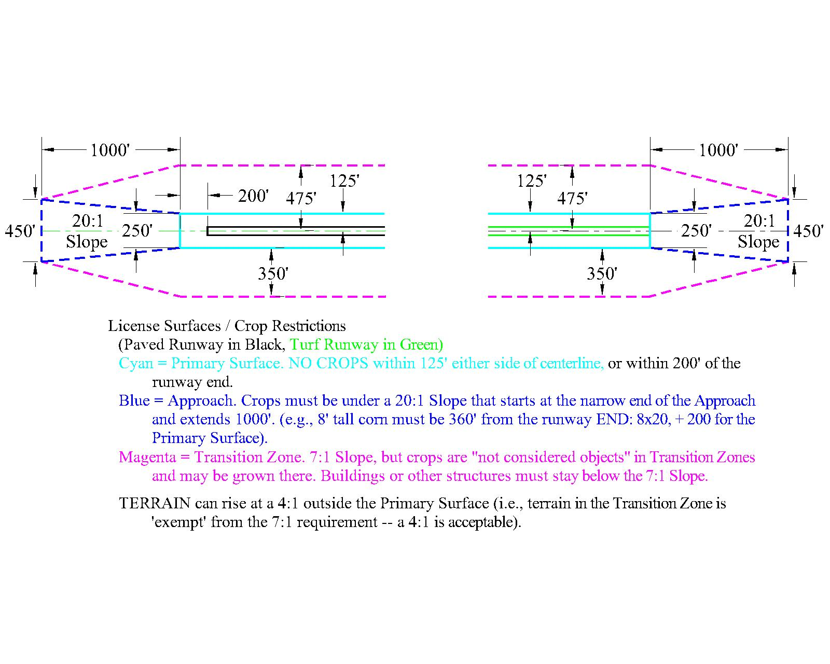
License Surfaces Plan View
Paved Runway
Turf Runway

Slide 26
License Surfaces in 3 Dimensions!
Approach
Approach
Approach Dimensions
250’ x 1000’ x 450’
20:1 slope
Transition Zone
Approach Dimensions
250’ x 1000’ x 450’
20:1 slope
200’
Paved Runway
Turf Runway
Primary Surface
7:1 slope
7:1 slope
350’
350’
250’
250’

Slide 27
CROPS
Hay bales need to be moved below the Transition Zone Surface.
450’
7:1 Slope
7:1 Slope
APPROACH
Crops OK
No Crops
Crops OK
ALL
CROPS
ALLOWED
350’
Transition
Zone
250’
Primary
Surface
350’
Transition
Zone
282’
1,000’
BEANS ALLOWED
(No Corn)
Turf
Runway End
Approach 20:1 Slope
Approach 20:1 Slope
Paved
Runway End
266’
All
Crops
Ok
All
Crops
Ok
NO CROPS
(Hay/Alfalfa Ok)
160’
No Crops
Beans
Ok
No Crops
Beans
Ok
80’
80’
160’
280’
360’
250’
Beans
(4’ tall)
Corn
(8’ tall)
Beans
(4’ tall)
Corn
(8’ tall)
200’
Paved Runways Only
Turf Runway
Paved
Runway
(Beans are treated as 4’ tall; corn, 8’ tall)
Crops are NOT considered ‘objects’ in the Transition Zone!
(Keep them 125’ off the runway centerline)

Slide 28
450’
APPROACH
Surface
1,000’
Trees above the approach slope.
Trim or remove tree.
Trees below the transition zone. OK
Crops taller than transition zone. OK
Trees above the transition zone.
Trim or remove tree.
Crops cannot be above the approach slope.
7:1 Slope
Paved Runway End
7:1 Slope
Turf Runway End
Approach 20:1 Slope
Turf Runway
Runway
350’
Transition
Zone
200’
Paved
Runways
Only
Primary Surface
350’
Transition
Zone
250’
Primary
Surface
Paved
Runway
200’
Trees below the approach slope. OK
OBJECTS IN LICENSING SURFACES

Slide 29

But what if I can’t fix it in time??

Slide 30
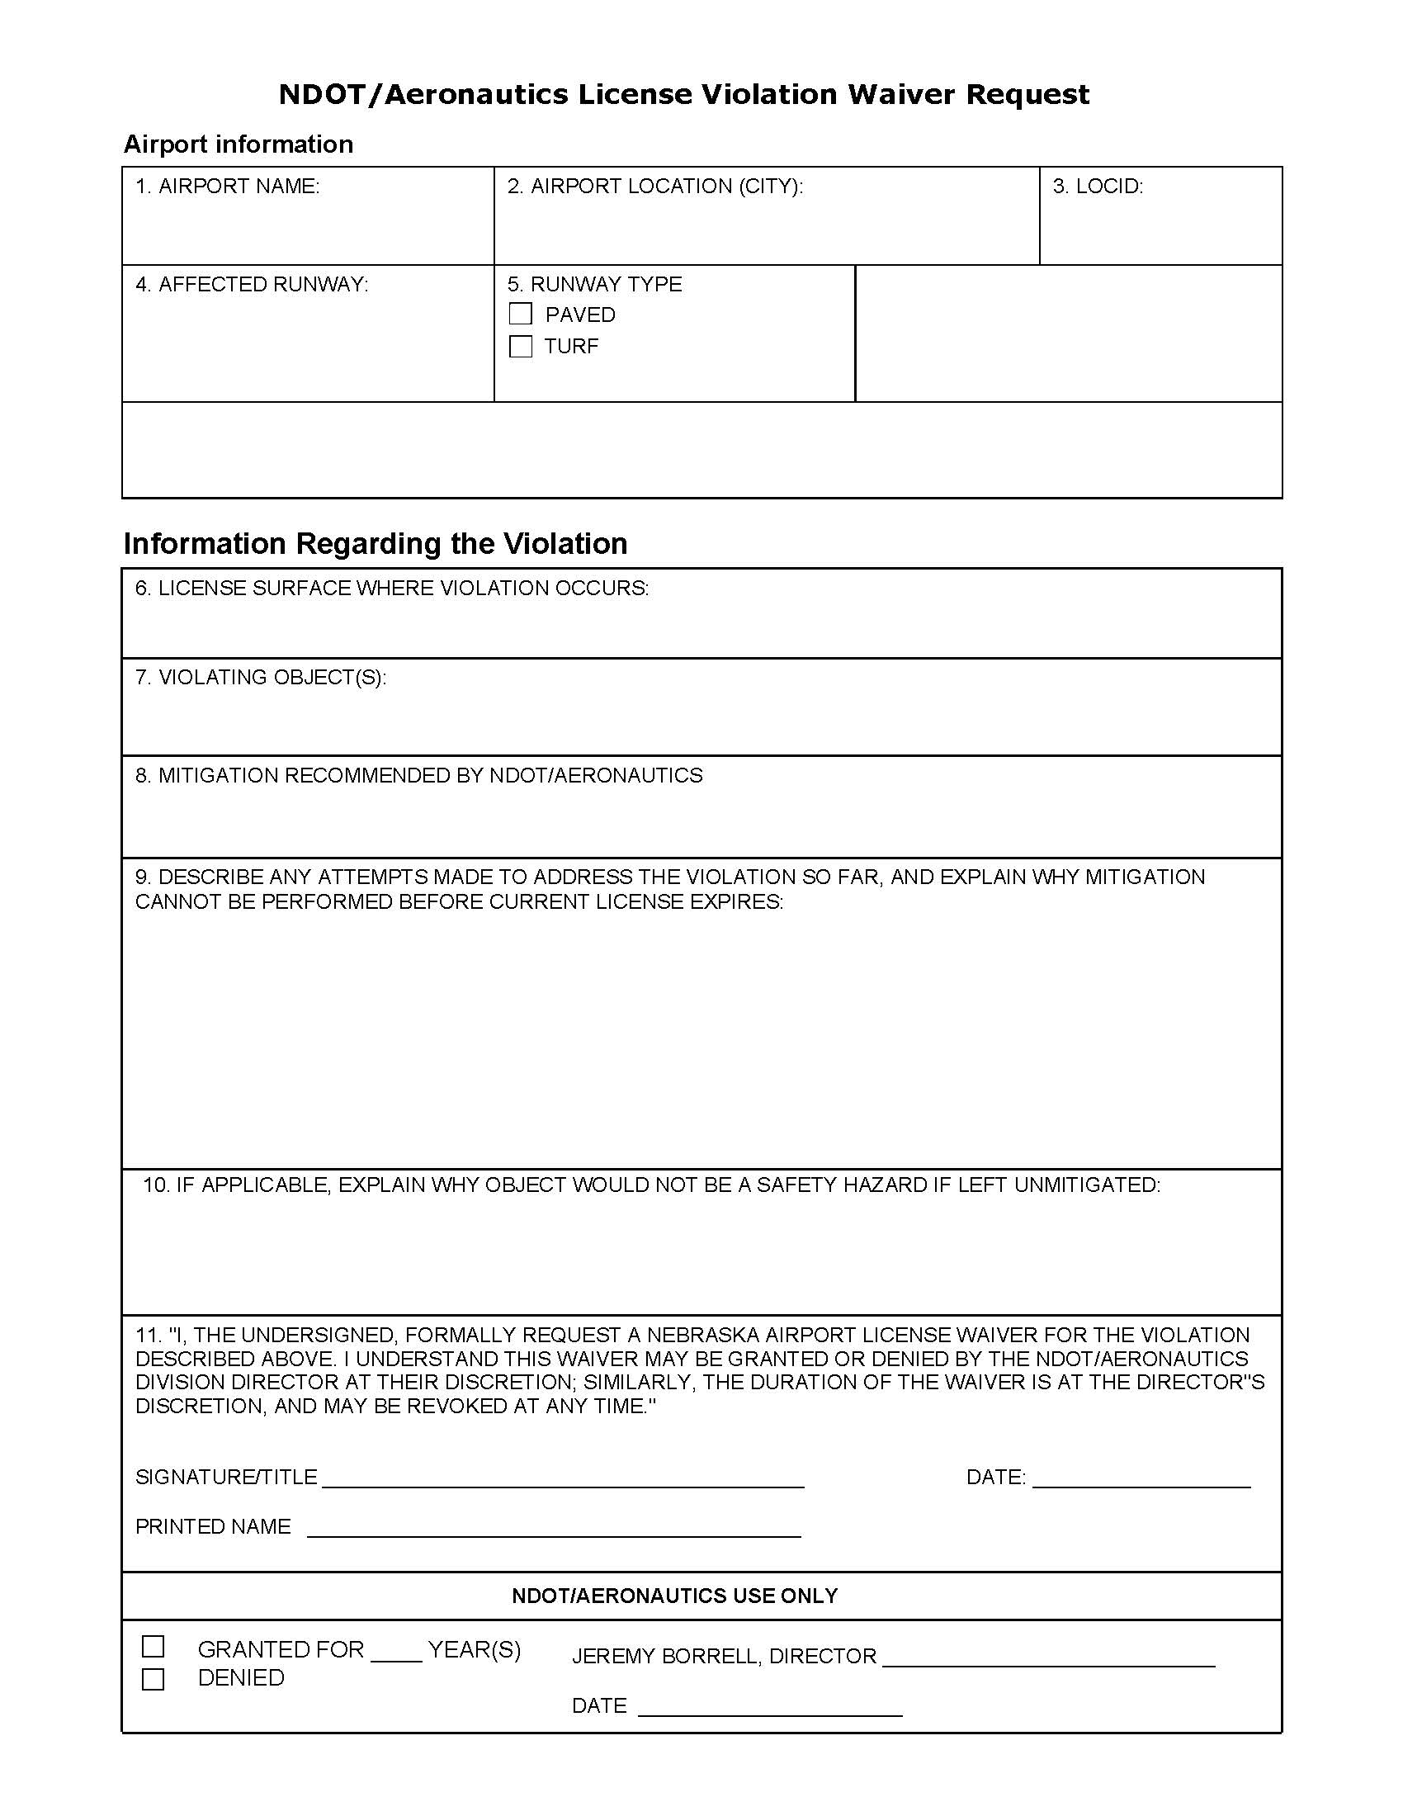
Waivers will no longer be granted ‘automatically.’ If you cannot correct a violation within the allotted time (by end-of-year), you MUST REQUEST A WAIVER using this Request Form.
The form will be available to download from our website (including an instruction sheet), or you can request a paper or electronic copy from Aeronautics.

Slide 31
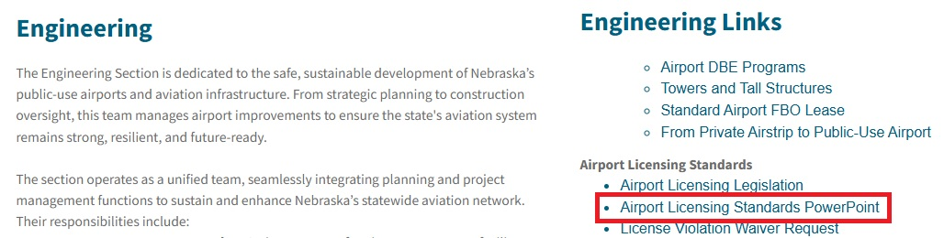
Thank You
For protecting your airspace and keeping your airports safe!
QUESTIONS??
Dave Lehnert 402-471-7928 dave.lehnert@nebraska.gov
Ahmed El-Ashwah 402-471-5738 Ahmed.ElAshwah@nebraska.gov
Jeremy Borrell 402-471-7922 jeremy.borrell@nebraska.gov
AND
This PowerPoint is linked on our website!

