Slide 1
Utility program
District 2 Breakout Session

Slide 2
This Meeting is Being Recorded
Notes:
HDR

Slide 3
Welcome
Before we begin, let’s have a brief safety moment.
In-Person Attendees
Emergency Exits
Tornado Shelter
911 Caller
AED Location
Restrooms
Virtual Attendees
Unmute yourself or use your chat box if you are in an emergency situation.
Notes:
HDR

Slide 4
Agenda
Introductions
High Impact Project Review (by construction year)
Communication and Coordination
Questions and Wrap Up
Notes:
HDR

Slide 5
Introductions
Notes:
All speakers introduce themselves briefly (Dave, section head, HDR facilitators); Attendees can introduce themselves if it’s a small group. If not – skip it!

Slide 6
2024 Utility policy
NDOT rolled out a new utility accommodation policy in 2024.
You can find more information, as well as a webinar about the changes, on the NDOT utility website at https://dot.nebraska.gov/business-center/utilities/.

Slide 7
Cy 2026
The following projects are anticipated to be let during 2026

Slide 8
US-275/72nd St. Interchange
Project Number: NH-275-7(194) Control No: 22469
Project Length: 0.62
Scope of Work:
  Urban Reconstruction
  Full Depth Pavement
  Grading

Slide 9
US-275/72nd St. Interchange
Project Number: NH-275-7(194) Control No: 22469
Status: Design
Right-of-way: In Progress
Construction Timing: 9/15/2025 - 11/25/2026

Slide 10
US-275/72nd St. Interchange
Project Number: NH-275-7(194) Control No: 22469
Anticipated Utilities Impact:
  Urban Recon
  Full Depth Pavement
  Grading
Anticipated Request from Utilities:
  Coordination with NDOT
  Potholing TBD
  Provide Existing Locations
Additional Information:
Utilities Involved:
  AT&T Communications
  City of Omaha
  City of Ralston
  Cox Communications
  Great Plains Communications
  Lumen
  Verizon
  Metropolitan Utilities District
  Northern Natural Gas
  Omaha Public Power District
  Papio-Missouri Natural Resources District
  Pinpoint Communications

Slide 11
Millard highlands along i-80
Project Number: NH-80-9(215) Control No: 22975
Project Length: 1.27 miles
Scope of Work:
  Grading
  Culverts

Slide 12
Millard highlands along i-80
Project Number: NH-80-9(215) Control No: 22975
Status: Design
Right-of-way: In Progress
Construction Timing: 7/13/2026 - 10/31/2026

Slide 13
Millard highlands along i-80
Project Number: NH-80-9(215) Control No: 22975
Anticipated Utilities Impact:
  Grading
  Culvert
Anticipated Request from Utilities:
  Coordination with NDOT
  Potholing TBD
  Provide Existing Locations
Additional Information:
Utilities Involved:
  Allo Communications
  AT&T Communications
  Black Hills Energy
  City of La Vista
  City of Omaha
  Cox Communications
  Great Plains Communications
  Lumen
  Verizon
  Metropolitan Utilities District
  Omaha Public Power District
  Segra

Slide 14
Rawhide creek culvert
Project Number: nh-30-6(140) Control No: 22720a
Project Length: 0.4
Scope of Work:
  Culvert Extension/Replacement
  Grading
  Full Depth Pavement

Slide 15
Rawhide creek culvert
Project Number: nh-30-6(140) Control No: 22720a
Status: Design
Right-of-way: Not Required
Construction Timing: 5/29/2026 - 11/28/2026

Slide 16
Rawhide creek culvert
Project Number: nh-30-6(140) Control No: 22720a
Anticipated Utilities Impact:
  Culvert Extension/Replacement
  Full Depth Pavement
  Grading
Anticipated Request from Utilities:
  Coordination with NDOT
  Potholing TBD
  Provide Existing Locations
Additional Information:
Utilities Involved:
  Charter Communications
  City of Fremont
  Cox Communications
  Fastwyre
  Great Plains Communications
  Lumen
  Omaha Public Power District

Slide 17
Louisville - springfield
Project Number: stp-50-2(141) Control No: 22833
Project Length: 4.88
Scope of Work:
  Culvert Extension/Replacement
  Grading

Slide 18
Louisville - springfield
Project Number: stp-50-2(141) Control No: 22833
Status: Design
Right-of-way: Not Required
Construction Timing: 8/31/2026 - 11/28/2026

Slide 19
Louisville - springfield
Project Number: stp-50-2(141) Control No: 22833
Anticipated Utilities Impact:
  Culvert Extension/Replacement
  Grading
Anticipated Request from Utilities:
  Potholing TBD
  Provide Existing Locations
Additional Information:
Utilities Involved:
  Charter Communications
  City of Louisville
  City of Springfield
  Cogent Communications
  Cox Communications
  Great Plains Communications
  Lumen
  Metropolitan Utilities District
  OPTK Networks
  Northern Natural Gas
  Omaha Public Power District
  Segra
  Verizon
  Windstream Communications
  Zayo Group

Slide 20
132ND STREET– N-133
Project Number: STP-36-7(116) Control No: 22597
Project Length: 2.19
Scope of Work:
  Full Depth Pavement
  Resurfacing
  Bridge Repair

Slide 21
132ND STREET– N-133
Project Number: STP-36-7(116) Control No: 22597
Status: Design
Right-of-way: Not Required
Construction Timing: 7/27/2026 - 11/25/2026

Slide 22
132ND STREET– N-133
Project Number: STP-36-7(116) Control No: 22597
Anticipated Utilities Impact:
  Full Depth Pavement
  Bridge Repair/Replace
Anticipated Request from Utilities:
  Coordination with NDOT
  Potholing TBD
  Provide Existing Locations
Additional Information:
Utilities Involved:
  AT&T
  City of Bennington
  Cox Communications
  Fastwyre
  Lumen
  OneOK
  Metropolitan Utilities District
  OPTK Networks
  Omaha Public Power District
  Papio-Missouri River Natural Resources District
  Segra
  VYVE Broadband

Slide 23
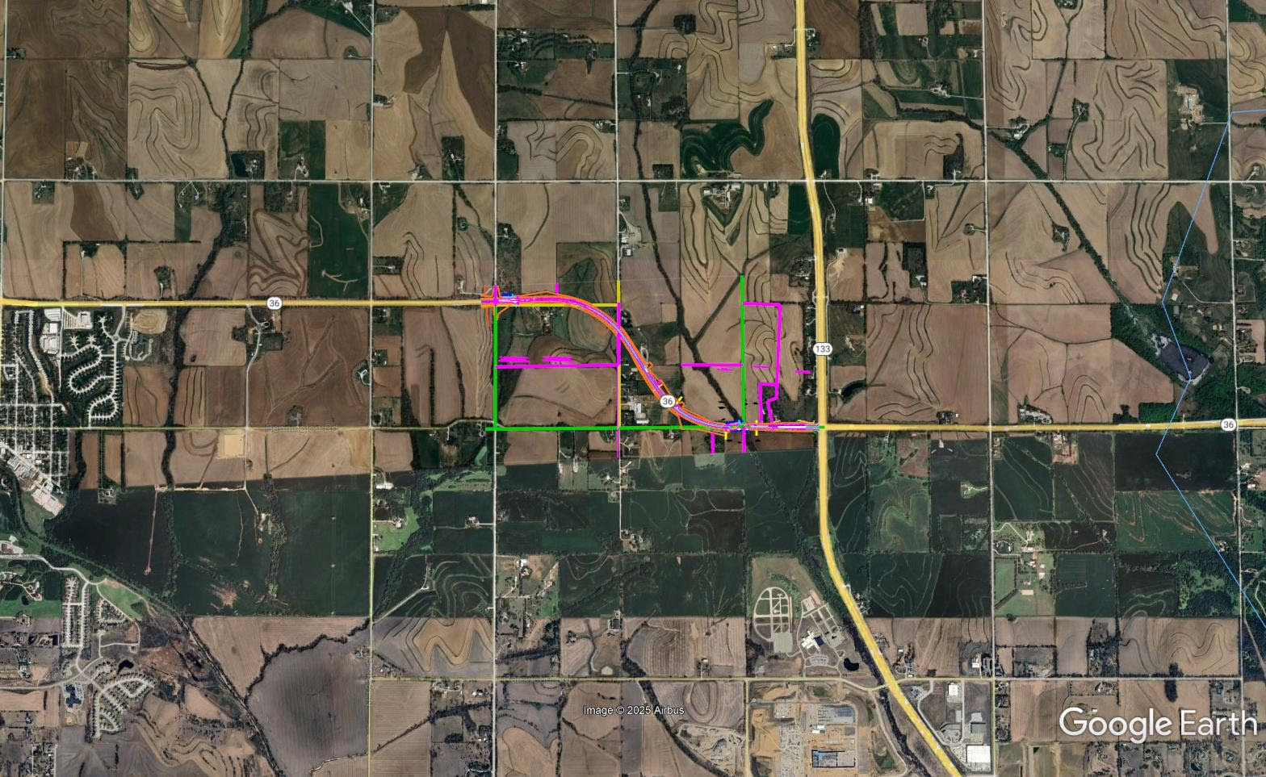
Elkhorn River – N-133
Project Number: STP-36-7(116) Control No: 22597

Slide 24
D2-A High Mast Tower Repl.
Project Number: STP-275-7(210) Control No: 22898
Project Length: 0.00 (4 interchanges)
Scope of Work:
  ITS/Lighting
  Grading

Slide 25
D2-A High Mast Tower Repl.
Project Number: STP-275-7(210) Control No: 22898
Status: Awarded
Right-of-way: Not Required
Construction Timing: 6/1/2026 - 11/25/2026

Slide 26
D2-A High Mast Tower Repl.
Project Number: STP-275-7(210) Control No: 22898
Anticipated Utilities Impact:
  Grading
Anticipated Request from Utilities:
  Provide Existing Locations
  Potholing TBD
Additional Information:
Utilities Involved:
  Black Hills Energy
  Omaha Public Power District
  City of Valley
  Great Plains Communications
  WelTel Systems
  Lumen

Slide 27
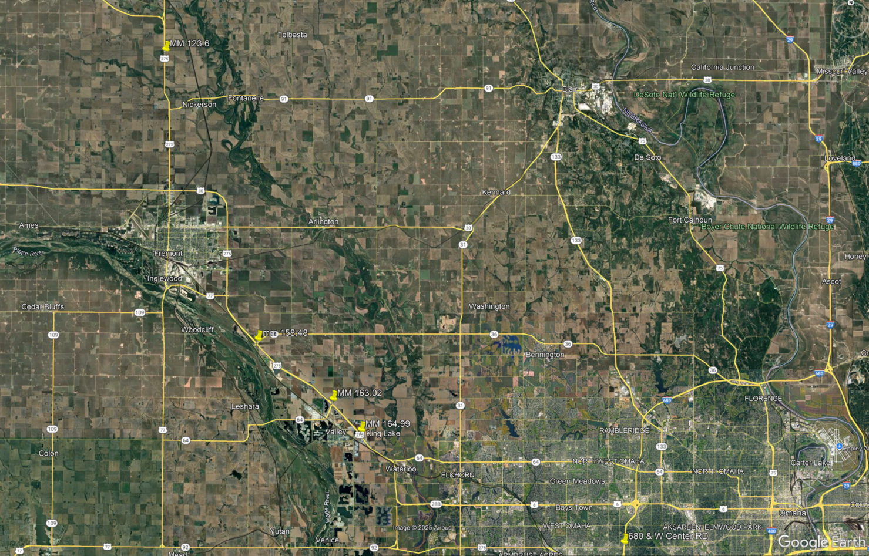
D2-A High Mast Tower Repl.
Project Number: STP-275-7(210) Control No: 22898

Slide 28
Pacific - Dodge, Omaha
Project Number: NH-MTIS-680-9(13) Control No: 22852
Project Length: 1.50
Scope of Work:
  Full Depth Pavement
  Grading
  Bridge Repair

Slide 29
Pacific - Dodge, Omaha
Project Number: NH-MTIS-680-9(13) Control No: 22852
Status: Design
Right-of-way: In Progress
Construction Timing: 4/1/2026 - 10/30/2026

Slide 30
Pacific - Dodge, Omaha
Project Number: NH-MTIS-680-9(13) Control No: 22852
Anticipated Utilities Impact:
  Full Depth Pavement
  Grading
  Bridge Repair/Replace
Anticipated Request from Utilities:
  Coordination with NDOT
  Potholing TBD
  Provide Existing Locations
Additional Information:
Utilities Involved:
  AT&T Communications
  City of Omaha
  Cox Communications
  Great Plains Communications
  Lumen
  Metropolitan Utilities District
  Omaha Public Power District
  Segra
  Verizon

Slide 31
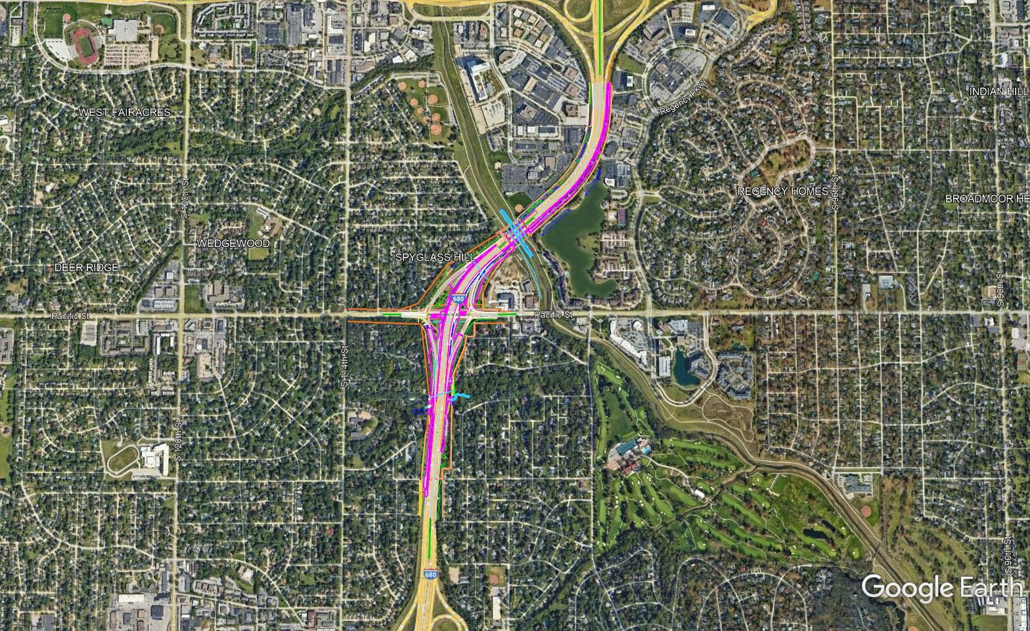
Pacific - Dodge, Omaha
Project Number: NH-MTIS-680-9(13) Control No: 22852

Slide 32
US-275 & W. Dodge Road
Project Number: HSIP-275-7(209) Control No: 22888
Project Length: 0.00
Scope of Work:
  Urban Reconstruction
  Grading
  Culvert Extension/Replacement

Slide 33
US-275 & W. Dodge Road
Project Number: HSIP-275-7(209) Control No: 22888
Status: Design
Right-of-way: In Progress
Construction Timing: 7/13/2026 - 11/25/2026

Slide 34
US-275 & W. Dodge Road
Project Number: HSIP-275-7(209) Control No: 22888
Anticipated Utilities Impact:
  Urban Recon
  Grading
  Culvert Extension/Replace
Anticipated Request from Utilities:
  Coordination with NDOT
  Potholing TBD
  Provide Existing Locations
Additional Information:
Utilities Involved:
  Black Hills Energy
  Lumen
  Omaha Public Power District

Slide 35
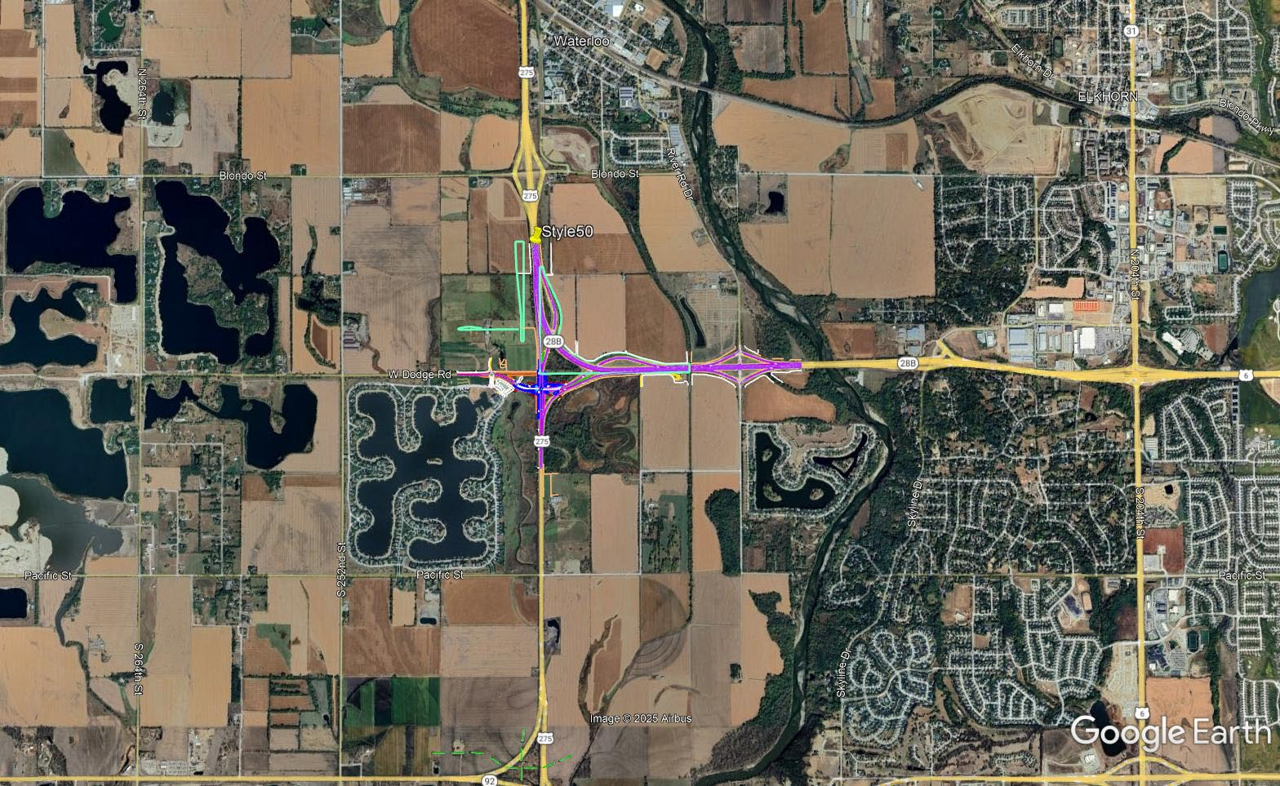
US-275 & W. Dodge Road
Project Number: HSIP-275-7(209) Control No: 22888

Slide 36
US-75 – NASHVILLE
Project Number: MISC-75-3(1031) Control No: 22994
Project Length: 0.00
Scope of Work:
  Culvert Replacement
  Full-depth pavement

Slide 37
US-75 – Nashville
Project Number: MISC-75-3(1031) Control No: 22994
Status: Design
Right-of-way: In Progress
Construction Timing: TBD

Slide 38
US-75 – NASHVILLE
Project Number: MISC-75-3(1031) Control No: 22994
Anticipated Utilities Impact:
  Culvert Extension/Replace
Anticipated Request from Utilities:
  Coordination with NDOT
  Potholing TBD
  Provide Existing Locations
Additional Information:
Utilities Involved:
  Cox Communications
  Lumen
  Metropolitan Utilities District
  Omaha Public Power District
  Washington County Rural Water District #1

Slide 39
I-80 Drainage at 96th Street
Project Number: MISC-80-9(1223) Control No: 22950
Project Length: 0.15
Scope of Work:
  Grading
  Culvert Extension/Replacement

Slide 40
I-80 Drainage at 96th Street
Project Number: MISC-80-9(1223) Control No: 22950
Status: Design
Right-of-way: In Progress
Construction Timing: 9/28/2026 - 10/10/2026

Slide 41
I-80 Drainage at 96th Street
Project Number: MISC-80-9(1223) Control No: 22950
Anticipated Utilities Impact:
  Grading
  Culvert Extension/Replace
Anticipated Request from Utilities:
  Coordination with NDOT
  Potholing TBD
  Provide Existing Locations
Additional Information:
  Declared emergency project
Utilities Involved:
  AT&T Communications
  City of Omaha
  Metropolitan Utilities District
  Omaha Public Power District
  OneOK
  Verizon

Slide 42
Cy 2027
The following projects are anticipated to be let during 2027

Slide 43
District 2 & District 1 Fiber Cleanup
Project Number: ITS-NH-D2(120) Control No: 22967
Project Length: 4.36
Scope of Work:
  Miscellaneous

Slide 44
District 2 & District 1 Fiber Cleanup
Project Number: ITS-NH-D2(120) Control No: 22967
Status: Design
Right-of-way: Not Required
Construction Timing: 4/1/2027- 10/31/2027

Slide 45
District 2 & District 1 Fiber Cleanup
Project Number: ITS-NH-D2(120) Control No: 22967
Anticipated Utilities Impact:
Anticipated Request from Utilities:
Additional Information:
Utilities Involved:
  Allo Communications
  AT&T Communications
  Black Hills Energy
  City of Gretna
  City of Omaha
  Cox Communications
  Great Plains Communications
  Lumen
  Metropolitan Utilities District
  Northern Natural Gas
  Omaha Public Power District
  Sarpy County
  Segra
  Verizon
  Windstream Communications
  Zayo Group

Slide 46
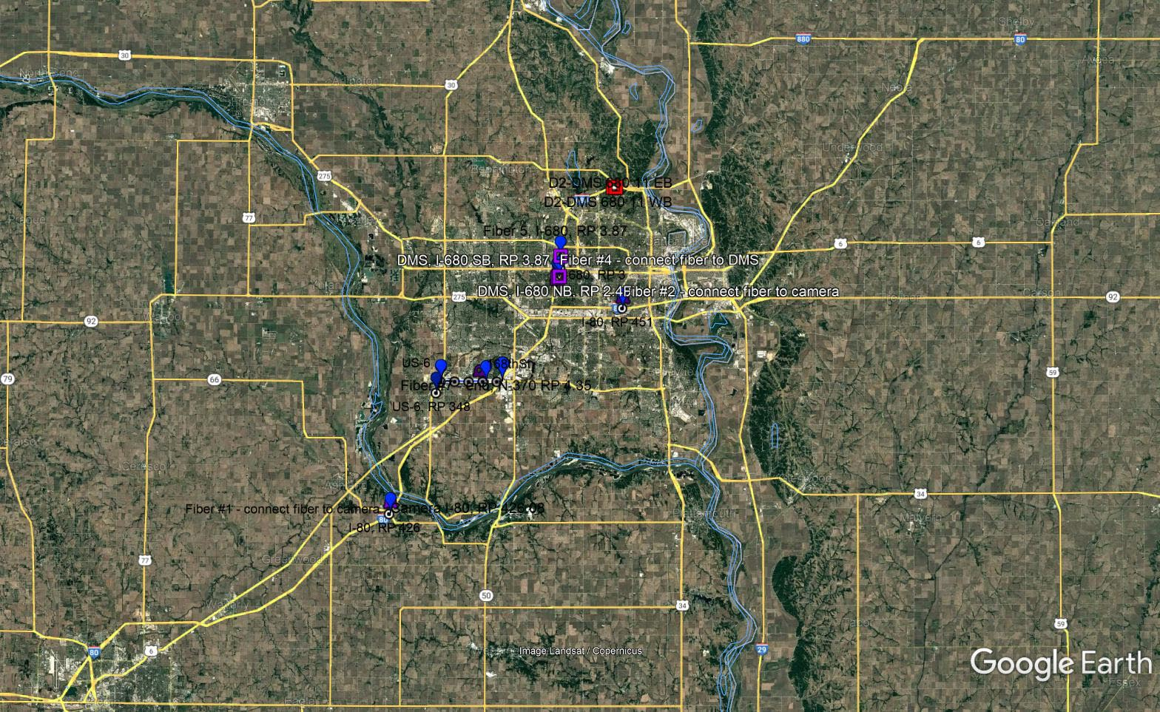
District 2 & District 1 Fiber Cleanup
Project Number: ITS-NH-D2(120) Control No: 22967

Slide 47
50th St- I-480, Omaha
Project Number: NH-MTIS-80-9(203) Control No: 22855
Project Length: 2.06
Scope of Work:
  Bridge Repair/Redecking
  Culvert Extension/Replacement
  Full Depth Pavement
  Potential Noise Wall (to be determined)

Slide 48
50th St- I-480, Omaha
Project Number: NH-MTIS-80-9(203) Control No: 22855
Status: Design
Right-of-way: In Progress
Construction Timing: 4/1/2027 - 10/31/2028

Slide 49
50th St- I-480, Omaha
Project Number: NH-MTIS-80-9(203) Control No: 22855
Anticipated Utilities Impact:
Anticipated Request from Utilities:
Additional Information:
Utilities Involved:
  AT&T Communications
  City of Omaha
  Cogent Communications
  Cox Communications
  Lumen
  Metropolitan Utilities District
  Omaha Public Power District
  Verizon

Slide 50
WB I-80 Bridge at I-680
Project Number: NH-80-9(216) Control No: 22980
Project Length: 0.00
Scope of Work:
  Bridge Repair
  Guardrail

Slide 51
WB I-80 Bridge at I-680
Project Number: NH-80-9(216) Control No: 22980
Status: Design
Right-of-way: Not Required
Construction Timing: 4/1/2027- 10/31/2027

Slide 52
WB I-80 Bridge at I-680
Project Number: NH-80-9(216) Control No: 22980
Anticipated Utilities Impact:
Anticipated Request from Utilities:
Additional Information:
Utilities Involved:
  City of Omaha
  Metropolitan Utilities District
  Omaha Public Power District

Slide 53
N-66 Connection in Louisville
Project Number: STP-66-7(119) Control No: 22795
Project Length: 0.54
Scope of Work:
  Full Depth Pavement
  Urban Reconstruction
  Miscellaneous

Slide 54
N-66 Connection in Louisville
Project Number: STP-66-7(119) Control No: 22795
Status: Design
Right-of-way: In Progress
Construction Timing: 3/29/2027 - 11/24/2027

Slide 55
N-66 Connection in Louisville
Project Number: STP-66-7(119) Control No: 22795
Anticipated Utilities Impact:
  Full Depth Pavement
  Urban Recon
Anticipated Request from Utilities:
  Coordination with NDOT
  Provide Existing Locations
  Potholing TBD
Additional Information:
Utilities Involved:
  Black Hills Energy
  Charter Communications
  City of Louisville
  Omaha Public Power District
  OPTK Networks
  Segra
  Windstream Communications

Slide 56
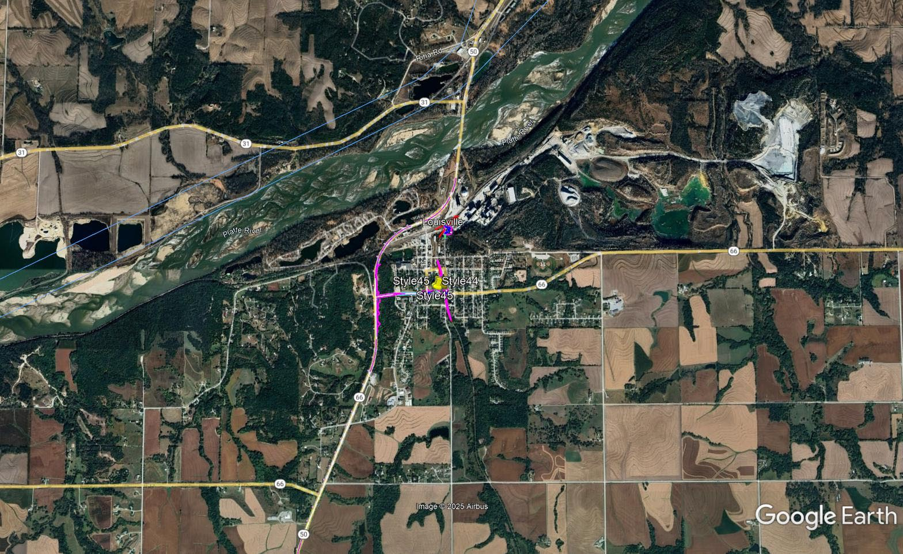
N-66 Connection in Louisville
Project Number: STP-66-7(119) Control No: 22795

Slide 57
I-80, Sarpy County Interchange
Project Number: NH-MTIS-80-9(131) Control No: 22917
Project Length: 0.0
Scope of Work:
  Full Depth Pavement
  Urban Reconstruction

Slide 58
I-80, Sarpy County Interchange
Project Number: NH-MTIS-80-9(131) Control No: 22917
Status: Design
Right-of-way: In Progress
Construction Timing: 4/1/2027-10/31/2028

Slide 59
I-80, Sarpy County Interchange
Project Number: NH-MTIS-80-9(131) Control No: 22917
Anticipated Utilities Impact:
  Full Depth Pavement
  Urban Recon
Anticipated Request from Utilities:
  Coordination with NDOT
  Provide Existing Locations
  Potholing TBD
Additional Information:
Utilities Involved:
  City of Omaha
  Cox Communications
  Fastwyre Broadband
  Great Plains Communications
  Lumen
  Metropolitan Utilities District
  Omaha Public Power District
  OneOK
  OPTK Networks
  Segra
  Verizon
  Windstream
  Zayo Group

Slide 60
Cy 2028
The following projects are anticipated to be let during 2028

Slide 61
Elkhorn Viaduct
Project Number: NH-31-2(114) Control No: 22636
Project Length: 0.28
Scope of Work:
  Bridge Replacement
  Full Depth Pavement
  Grading

Slide 62
Elkhorn Viaduct
Project Number: NH-31-2(114) Control No: 22636
Status: Design
Right-of-way: In Progress
Construction Timing: TBD 2028

Slide 63
Elkhorn Viaduct
Project Number: NH-31-2(114) Control No: 22636
Anticipated Utilities Impact:
  Bridge Repair/Replace
  Full Depth Pavement
  Grading
Anticipated Request from Utilities:
  Coordination with NDOT
  Provide Existing Locations
  Potholing TBD
Additional Information:
Utilities Involved:
  Black Hills Energy
  Charter Communications
  City of Louisville
  Great Plains Communications
  OneOK
  Northern Natural Gas
  Omaha Public Power District
  OPTK Networks
  Otoe County Rural Water District 3
  Segra
  Verizon
  Village of Manley
  Windstream Communications
  Zayo Group

Slide 64
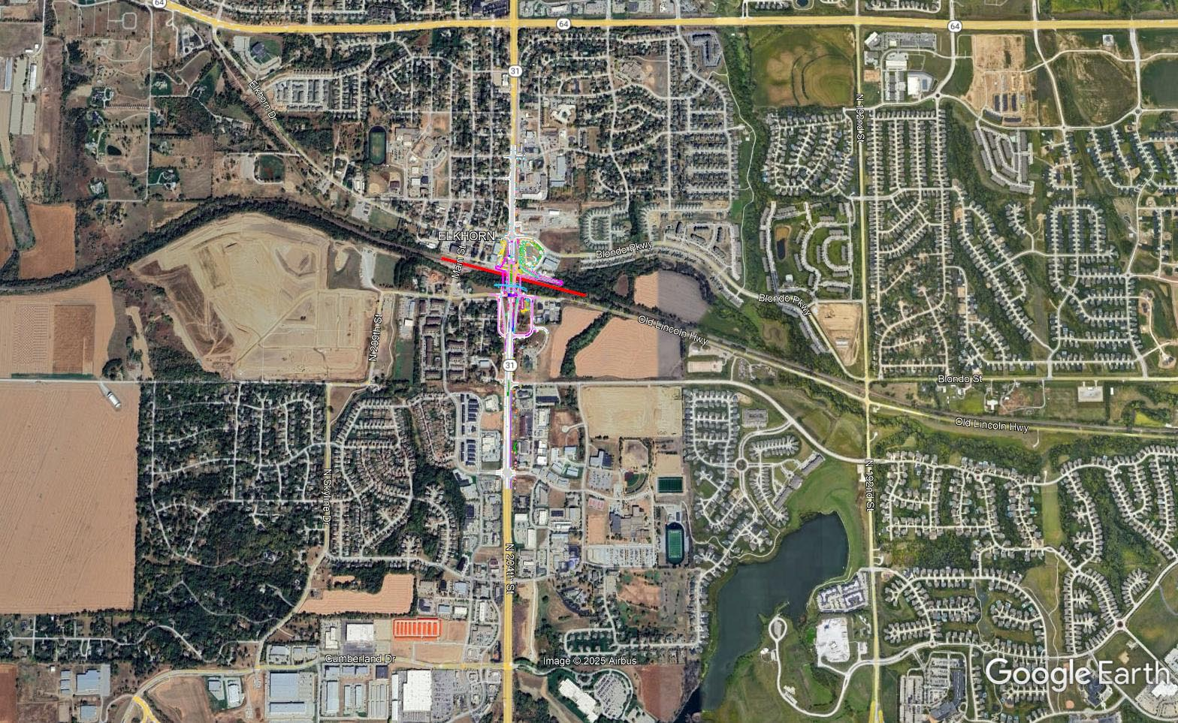
Elkhorn Viaduct
Project Number: NH-31-2(114) Control No: 22636

Slide 65
Questions & Wrap Up
Notes:
HDR

Slide 66
Any final Questions?
Ask them now!
If you have questions after this meeting, or would like to view more detailed project maps, please reach out to your utility coordinator.
Notes:
HDR

Slide 67
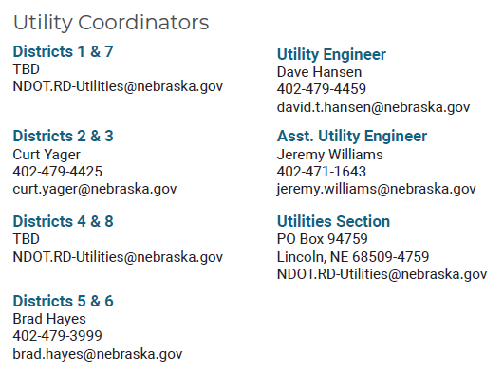
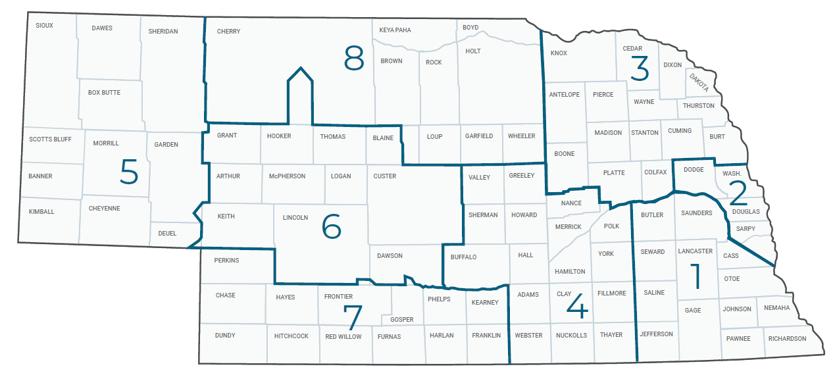
Have a Question about a project your Utility is involved in?
Contact your district’s utility coordinator!
Notes:
HDR

Slide 68
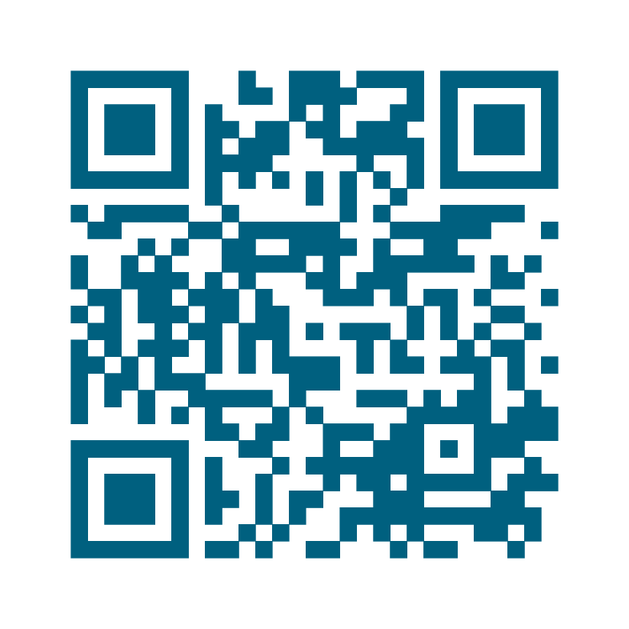
We need your feedback
Your valuable feedback helps these meetings – and NDOT’s utility coordination program – be better.
Use your phone’s camera to scan this QR code or use our paper survey.
Notes:
HDR

Slide 69
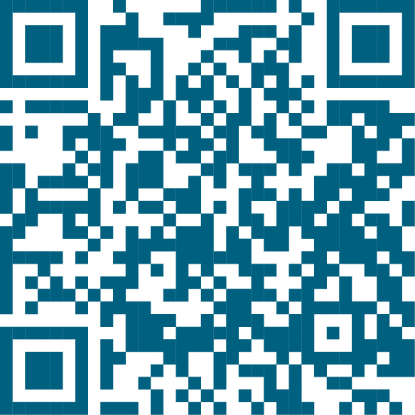
Visit our Website
Visit NDOT.info/utility for more information on:
Utility accommodation
Permitting
Coordination
Project information
Reimbursements
Additional information
Scan the QR Code to view the 2026 Program Book!
Notes:
HDR

Slide 70
Thank You
Notes:
HDR

Slide 71
Outstanding Cy 2025
The following projects will likely not be completed in 2025

Slide 72
I-480 Missouri River Bridge
Project Number: NH-480-9(11) Control No: 22807
Project Length: 0.00
Scope of Work:
  Bridge Repair
  Pavement Repairs
  Miscellaneous

Slide 73
I-480 Missouri River Bridge
Project Number: NH-480-9(11) Control No: 22807
Status: Construction
Right-of-way: Not Required
Construction Timing: 9/23/2024 - 10/31/2026

Slide 74
I-480 Missouri River Bridge
Project Number: NH-480-9(11) Control No: 22807
Anticipated Utilities Impact:
  Bridge Repair/Replace
Anticipated Request from Utilities:
  Coordination with NDOT
Additional Information:
Utilities Involved:

Slide 75
I-480 Missouri River Bridge
Project Number: NH-480-9(11) Control No: 22807

Slide 76
D2-B High Mast Tower Repl.
Project Number: STP-680-9(44) Control No: 22899
Project Length: 5.00
Scope of Work:
  ITS/Lighting
  Grading

Slide 77
D2-B High Mast Tower Repl.
Project Number: STP-680-9(44) Control No: 22899
Status: Award Pending
Right-of-way: Not Required
Construction Timing: 2/3/2025 - 11/26/2025

Slide 78
D2-B High Mast Tower Repl.
Project Number: STP-680-9(44) Control No: 22899
Anticipated Utilities Impact:
  Urban Recon
Anticipated Request from Utilities:
  Provide Existing Locations
  Potholing Required
Additional Information:
Utilities Involved:
  AT&T Communications
  City of Omaha
  Cox Communications
  Great Plains Communications
  Lumen
  Metropolitan Utilities District
  Omaha Public Power District
  OneOK
  Segra
  Verizon
  Windstream Communications

Slide 79
D2-B High Mast Tower Repl.
Project Number: STP-680-9(44) Control No: 22899

Slide 80
D2-C High Mast Tower Repl.
Project Number: STP-680-9(43) Control No: 22900
Project Length: 3.00
Scope of Work:
  ITS/Lighting
  Grading

Slide 81
D2-C High Mast Tower Repl.
Project Number: STP-680-9(43) Control No: 22900
Status: Award Pending
Right-of-way: Not Required
Construction Timing: 4/7/2025 - 6/6/2026

Slide 82
D2-C High Mast Tower Repl.
Project Number: STP-680-9(43) Control No: 22900
Anticipated Utilities Impact:
  Urban Recon
Anticipated Request from Utilities:
  Provide Existing Locations
  Potholing Required
Additional Information:
Utilities Involved:
  City of Omaha
  Cox Communications
  Fastwyre Broadband
  Great Plains Communications
  Lumen
  Metropolitan Utilities District
  Omaha Public Power District
  OneOK
  Segra
  Verizon

Slide 83
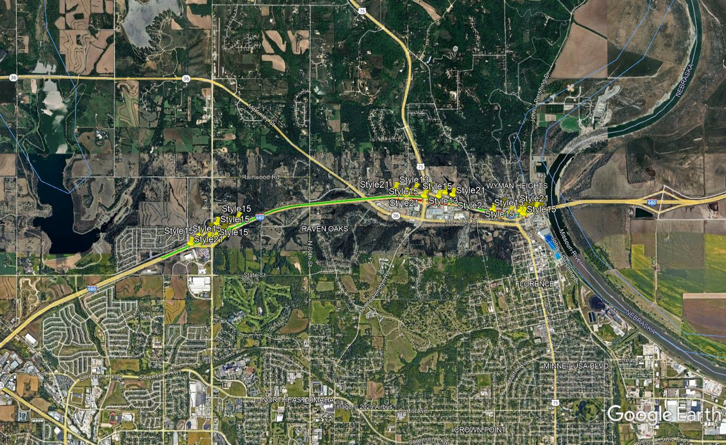
D2-C High Mast Tower Repl.
Project Number: STP-680-9(43) Control No: 22900

Slide 84
N-50 / N-31 Intersection
Project Number: STP-50-2(140) Control No: 22805
Project Length: 0.00
Scope of Work:
  Full Depth Pavement

Slide 85
N-50 / N-31 Intersection
Project Number: STP-50-2(140) Control No: 22805
Status: Award Pending
Right-of-way:
Construction Timing: 4/1/2025 - 10/31/2025

Slide 86
N-50 / N-31 Intersection
Project Number: STP-50-2(140) Control No: 22805
Anticipated Utilities Impact:
  Full Depth Pavement
Anticipated Request from Utilities:
  Provide Existing Locations
  Potholing Required
Additional Information:
Utilities Involved:
  Charter Communications
  City of Louisville
  Lumen
  Omaha Public Power District
  OPTK Networks
  Segra
  Verizon
  Windstream Communications
  Zayo Group

Slide 87
N-50 / N-31 Intersection
Project Number: STP-50-2(140) Control No: 22805

Slide 88
US-275 / N-92 Culvert
Project Number: NH-HSIP-275-7(1047) Control No: 22892
Project Length: 0.00
Scope of Work:
  Culvert Extension/Replacement
  Grading

Slide 89
US-275 / N-92 Culvert
Project Number: NH-HSIP-275-7(1047) Control No: 22892
Status: Design
Right-of-way:
Construction Timing: 6/10/2025 - 7/24/2025

Slide 90
US-275 / N-92 Culvert
Project Number: NH-HSIP-275-7(1047) Control No: 22892
Anticipated Utilities Impact:
  Culvert Extension/Replace
  Grading
Anticipated Request from Utilities:
  Provide Existing Locations
  Potholing Required
  Coordination with NDOT
Additional Information:
Utilities Involved:
  Cox Communications
  Great Plains Communications
  Lumen
  Metropolitan Utilities District
  Omaha Public Power District

Slide 91
US-275 / N-92 Culvert
Project Number: NH-HSIP-275-7(1047) Control No: 22892

Slide 92
Union – Murray
Project Number: NH-34-7(129) Control No: 22543
Project Length: 7.24
Scope of Work:
  Resurfacing
  Bridge Repair

Slide 93
Union – Murray
Project Number: NH-34-7(129) Control No: 22543
Status: Design
Right-of-way:
Construction Timing: 06/02/2025 - 10/31/2025

Slide 94
Union – Murray
Project Number: NH-34-7(129) Control No: 22543
Anticipated Utilities Impact:
  Bridge Repair/Replace
Anticipated Request from Utilities:
  Provide Existing Locations
  Coordination with NDOT
Additional Information:
Utilities Involved:
  Cass County Rural Water District #1
  Lumen
  Nebraska Public Power District
  Nustar Pipeline
  Omaha Public Power District
  OneOK
  Village of Murray
  Village of Union
  Windstream Communications
  Zayo Group

Slide 95
Union – Murray
Project Number: NH-34-7(129) Control No: 22543

Slide 96
US-75 & North 48th Street
Project Number: NH-75-2(191) Control No: 22874
Project Length: 0.13
Scope of Work:
  Culvert Extension/Replacement
  Grading
  Access X-ings & Shoo-Fly

Slide 97
US-75 & North 48th Street
Project Number: NH-75-2(191) Control No: 22874
Status: Design
Right-of-way:
Construction Timing: 9/1/2025 - 11/7/2025

Slide 98
US-75 & North 48th Street
Project Number: NH-75-2(191) Control No: 22874
Anticipated Utilities Impact:
  Culvert Extension/Replace
  Grading
  Access X-ing
Anticipated Request from Utilities:
  Provide Existing Locations
  Potholing Required
Additional Information:
Utilities Involved:
  Cox Communications
  Lumen
  Metropolitan Utilities District
  Omaha Public Power District
  Washington Co. Rural Water District #1

Slide 99
US-75 & North 48th Street
Project Number: NH-75-2(191) Control No: 22874

Slide 100
156th St. – 132nd St., Omaha
Project Number: NH-6-7(189) Control No: 22812
Project Length: 2.62
Scope of Work:
  Full Depth Pavement
  Grading
  Culvert Extension/Replacement

Slide 101
156th St. – 132nd St., Omaha
Project Number: NH-6-7(189) Control No: 22812
Status: Design
Right-of-way:
Construction Timing: 4/28/2025 - 11/8/2025

Slide 102
156th St. – 132nd St., Omaha
Project Number: NH-6-7(189) Control No: 22812
Anticipated Utilities Impact:
  Full Depth Pavement
  Urban Recon
  Grading
Anticipated Request from Utilities:
  Provide Existing Locations
  Potholing Required
  Coordination with NDOT
Additional Information:
Utilities Involved:
  AT&T Communications
  City of Omaha
  Cox Communications
  Lumen
  Metropolitan Utilities District
  Omaha Public Power District
  Pinpoint Communications
  Segra
  Verizon
  Windstream Communications

Slide 103
156th St. – 132nd St., Omaha
Project Number: NH-6-7(189) Control No: 22812

Slide 104
US-275/72nd St. Interchange
Project Number: NH-275-7(194) Control No: 22469
Project Length: 0.62
Scope of Work:
  Urban Reconstruction
  Full Depth Pavement
  Grading

Slide 105
US-275/72nd St. Interchange
Project Number: NH-275-7(194) Control No: 22469
Status: Design
Right-of-way:
Construction Timing: 9/15/2025 - 11/25/2026

Slide 106
US-275/72nd St. Interchange
Project Number: NH-275-7(194) Control No: 22469
Anticipated Utilities Impact:
  Full Depth Pavement
  Urban Recon
  Grading
Anticipated Request from Utilities:
Additional Information:
Utilities Involved:
  AT&T Communications
  City of Omaha
  City of Ralston
  Cox Communications
  Great Plains Communications
  Lumen
  Verizon
  Metropolitan Utilities District
  Northern Natural Gas
  Omaha Public Power District
  Papio-Missouri Natural Resources District
  Pinpoint Communications
  Segra

Slide 107
US-275/72nd St. Interchange
Project Number: NH-275-7(194) Control No: 22469

