Slide 1
Utility program
District 3 Breakout Session

Slide 2
This Meeting is Being Recorded
Notes:
HDR

Slide 3
Welcome
Before we begin, let’s have a brief safety moment.
In-Person Attendees
Emergency Exits
Tornado Shelter
911 Caller
AED Location
Restrooms
Virtual Attendees
Unmute yourself or use your chat box if you are in an emergency situation.
Notes:
HDR

Slide 4
Agenda
Introductions
High Impact Project Review (by construction year)
Communication and Coordination
Questions and Wrap Up
Notes:
HDR

Slide 5
Introductions
Notes:
All speakers introduce themselves briefly (Dave, section head, HDR facilitators); Attendees can introduce themselves if it’s a small group. If not – skip it!

Slide 6
2024 Utility policy
NDOT rolled out a new utility accommodation policy in 2024.
You can find more information, as well as a webinar about the changes, on the NDOT utility website at https://dot.nebraska.gov/business-center/utilities/.

Slide 7
Outstanding Cy 2025
The following projects will likely not be completed in 2025

Slide 8
Columbus South Bridges
Project Number: NH-30-5(131) Control No: 31983
Project Length: 0.00
Scope of Work:
  Bridge Replacement
  Bridge Repair
  Guardrail

Slide 9
Columbus South Bridges
Project Number: NH-30-5(131) Control No: 31983
Status: Construction
Right-of-way: Completed
Construction Timing: 4/1/2025 - 11/30/2027

Slide 10
Columbus South Bridges
Project Number: NH-30-5(131) Control No: 31983
Anticipated Utilities Impact:
  Bridge Repair/Replace
Anticipated Request from Utilities:
Additional Information:
  No K-Sheets Required
  Special Provisions Required
Utilities Involved:
  Allo Communications
  Black Hills Energy
  City of Columbus
  Frontier Communications
  Great Plains Communications
  Loup River Public Power District
  Lumen

Slide 11
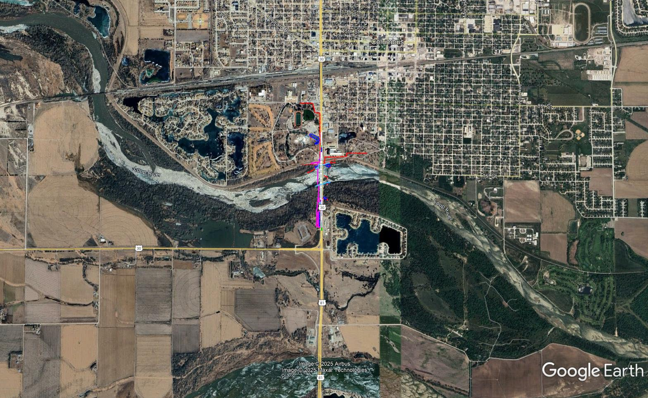

Slide 12
Monroe East & West (MS)
Project Number: STP-22-5(119) Control No: 32292
Project Length: 13.20
Scope of Work:
  Bridge Replacement
  Grading
  Bridge Repair

Slide 13
Monroe East & West (MS)
Project Number: STP-22-5(119) Control No: 32292
Status: Construction
Right-of-way: Completed
Construction Timing: 3/24/2025 - 10/17/2026

Slide 14
Monroe East & West (MS)
Project Number: STP-22-5(119) Control No: 32292
Anticipated Utilities Impact:
  Bridge Repair/Replace
  Grading
  New ROW
Anticipated Request from Utilities:
Additional Information:
  K-Sheets Required
  Special Provisions Required
Utilities Involved:
  Cornhusker Public Power District
  Frontier Communications
  OneOK
  Loup River Public Power District
  Northeast Nebraska Telephone Company
  Village of Monroe

Slide 15
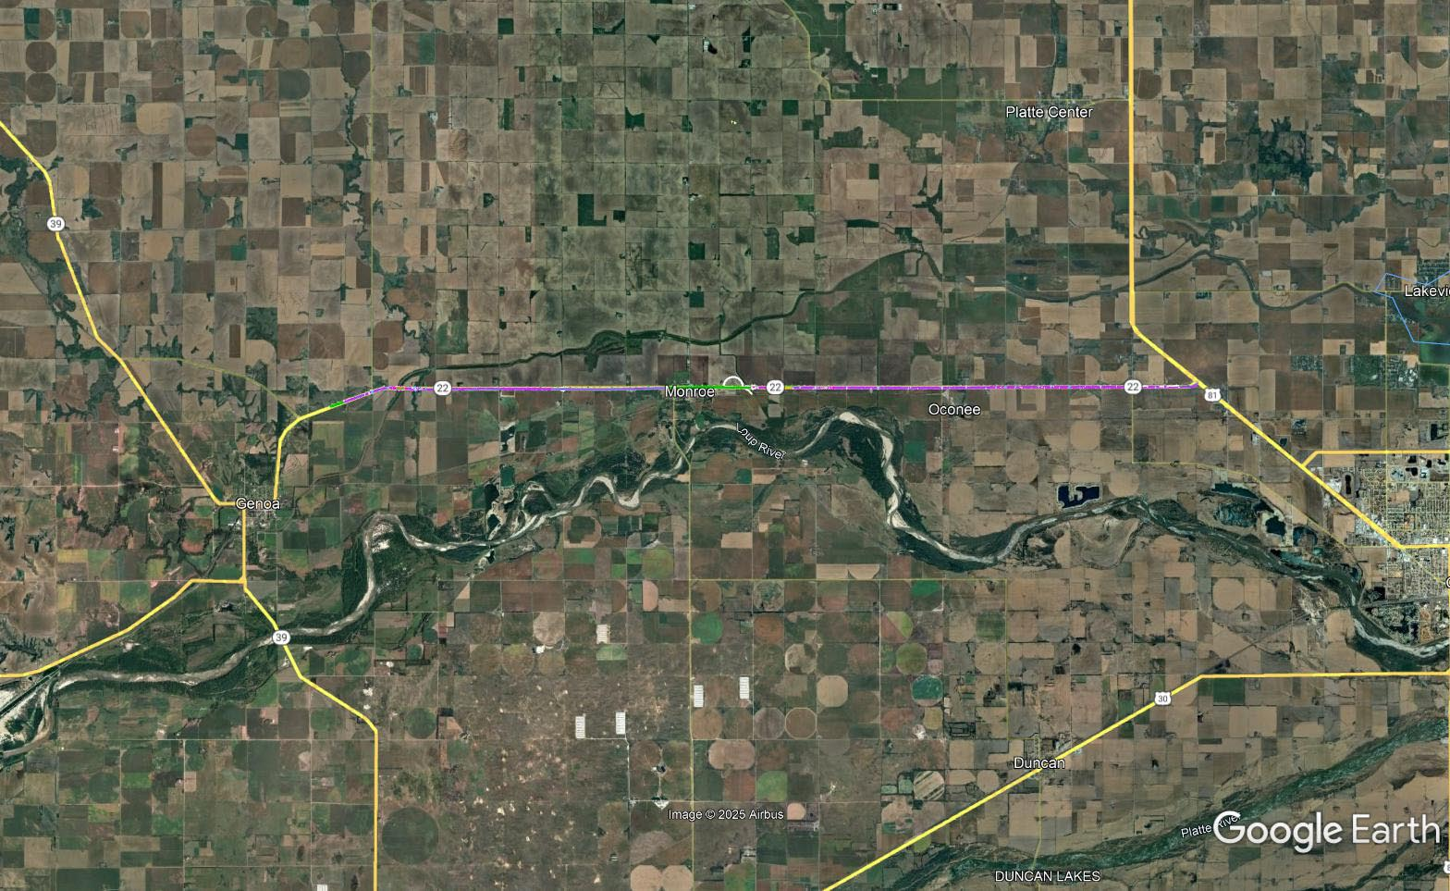

Slide 16
N-57 - East Jct N-15
Project Number: TIB-275-6(149) Control No: 32319A
Project Length: 11.78
Scope of Work:
  Grading
  Full Depth Pavement

Slide 17
N-57 - East Jct N-15
Project Number: TIB-275-6(149) Control No: 32319A
Status: Construction
Right-of-way: In Progress
Construction Timing: 4/1/2025 - 11/30/2027

Slide 18
N-57 - East Jct N-15
Project Number: TIB-275-6(149) Control No: 32319A
Anticipated Utilities Impact:
  New Alignment
  Grading
  New ROW
Anticipated Request from Utilities:
Additional Information:
  K-Sheets Required
  Special Provisions Required
Utilities Involved:
  Black Hills Energy
  Cuming County Public Power District
  Great Plains Communications
  Lumen
  Stanton County Public Power District
  Stanton Telecommunications

Slide 19
Niobrara East & West
Project Number: S-12-5(1011) Control No: 31674
Project Length: 10.64
Scope of Work:
  Grading
  Full Depth Pavement
  Guardrail
Notes:
+ separate streambank project

Slide 20
Niobrara East & West
Project Number: S-12-5(1011) Control No: 31674
Status: Construction
Right-of-way: In Progress
Construction Timing: 9/1/2025 - 7/31/2029

Slide 21
Niobrara East & West
Project Number: S-12-5(1011) Control No: 31674
Anticipated Utilities Impact:
  New Alignment
  Grading
  New ROW
Anticipated Request from Utilities:
Additional Information:
  K-Sheets Required
  Special Provisions Required
  Related Wetland Bank project
Utilities Involved:
  Great Plains Communications
  North Central Public Power District
  Santee Tribe
  U.S. Army Corps of Engineers
  Village of Niobrara

Slide 22
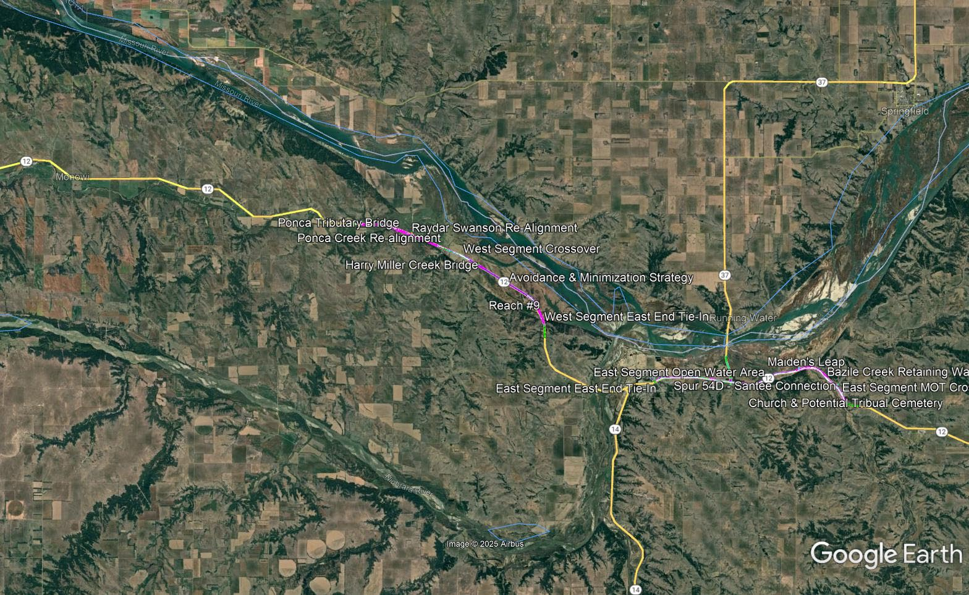

Slide 23
Macy Intersection
Project Number: DPS-75-4(118) Control No: 32415
Project Length: 0.00
Scope of Work:
  Grading
  Full Depth Pavement
  Access X-ings & Shoo-Fly

Slide 24
Macy Intersection
Project Number: DPS-75-4(118) Control No: 32415
Status: Design
Right-of-way: In Progress
Construction Timing: 5/1/2025

Slide 25
Macy Intersection
Project Number: DPS-75-4(118) Control No: 32415
Anticipated Utilities Impact:
  New Alignment
  Grading
  New ROW
Anticipated Request from Utilities:
Additional Information:
  K-Sheets Required
  Special Provisions Required
Utilities Involved:

Slide 26
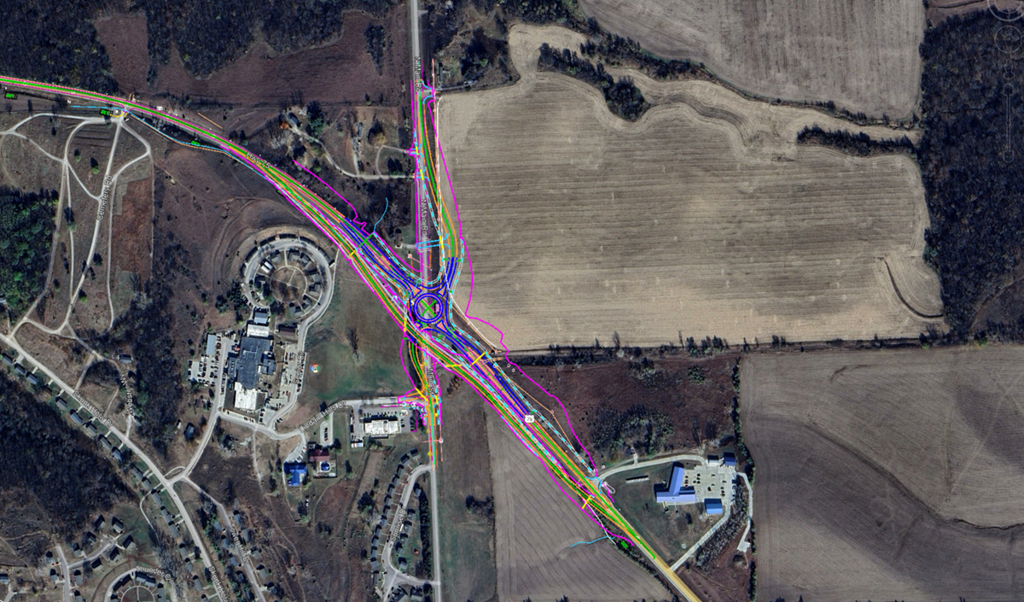

Slide 27
Cy 2026
The following projects are anticipated to be let during 2026

Slide 28
East Jct N-15 - Wisner
Project Number: TIB-275-6(150) Control No: 32319B
Project Length: 4.21
Scope of Work:
  Grading
  Full Depth Pavement

Slide 29
East Jct N-15 - Wisner
Project Number: TIB-275-6(150) Control No: 32319B
Status: Design
Right-of-way: In Progress
Construction Timing: 10/27/2025 - 11/30/2028

Slide 30
East Jct N-15 - Wisner
Project Number: TIB-275-6(150) Control No: 32319B
Anticipated Utilities Impact:
  Grading
  Temp. Roads/Drives
  New ROW
Anticipated Request from Utilities:
  Provide Existing Locations
  Utilities Workshop
  Provide Existing Locations
Additional Information:
  K-Sheets Required
  Special Provisions Required
Utilities Involved:
  City of Wisner Water
  Cuming County Public Power District
  Cuming County Rural Water District 1
  Great Plains Communications
  Lumen
  Tallgrass Energy

Slide 31
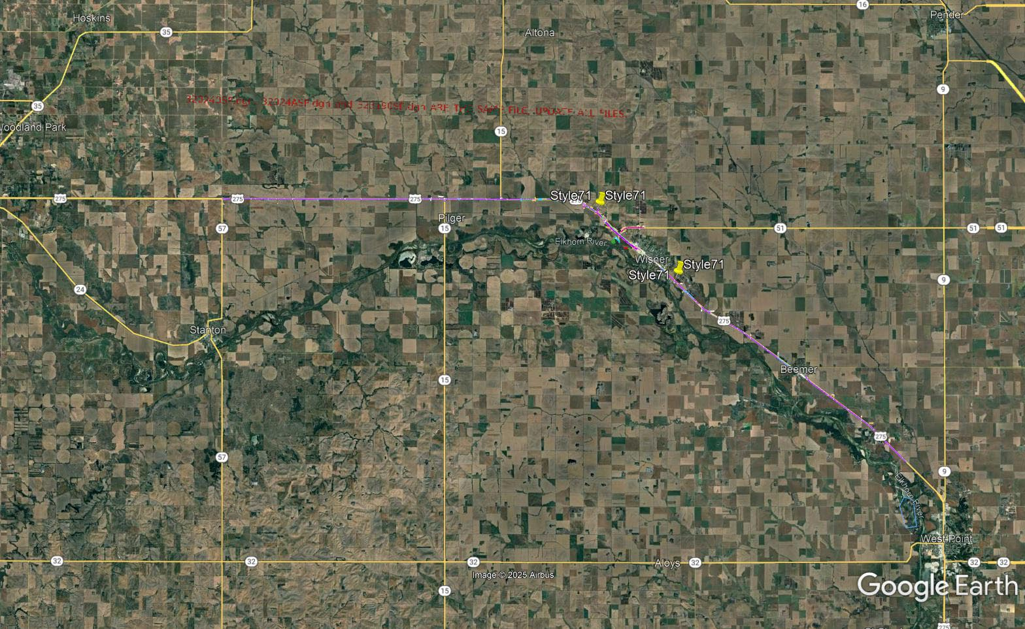

Slide 32
District 3 High Mast Tower Replacement
Project Number: STP-129-1(32) Control No: 32417
Project Length:
Scope of Work:

Slide 33
District 3 High Mast Tower Replacement
Project Number: STP-129-1(32) Control No: 32417
Status: Design
Right-of-way: Not Required
Construction Timing: 5/18/2026 - 10/31/2026

Slide 34
District 3 High Mast Tower Replacement
Project Number: STP-129-1(32) Control No: 32417
Anticipated Utilities Impact:
Anticipated Request from Utilities:
Additional Information:
Utilities Involved:
  Dakota County Rural Water District
  Fiber Communications
  Great Plains Communications
  Long Lines Broadband
  Mid American Energy
  Nebraska Public Power District
  South Sioux City
  Sparklight Internet
  Verizon

Slide 35
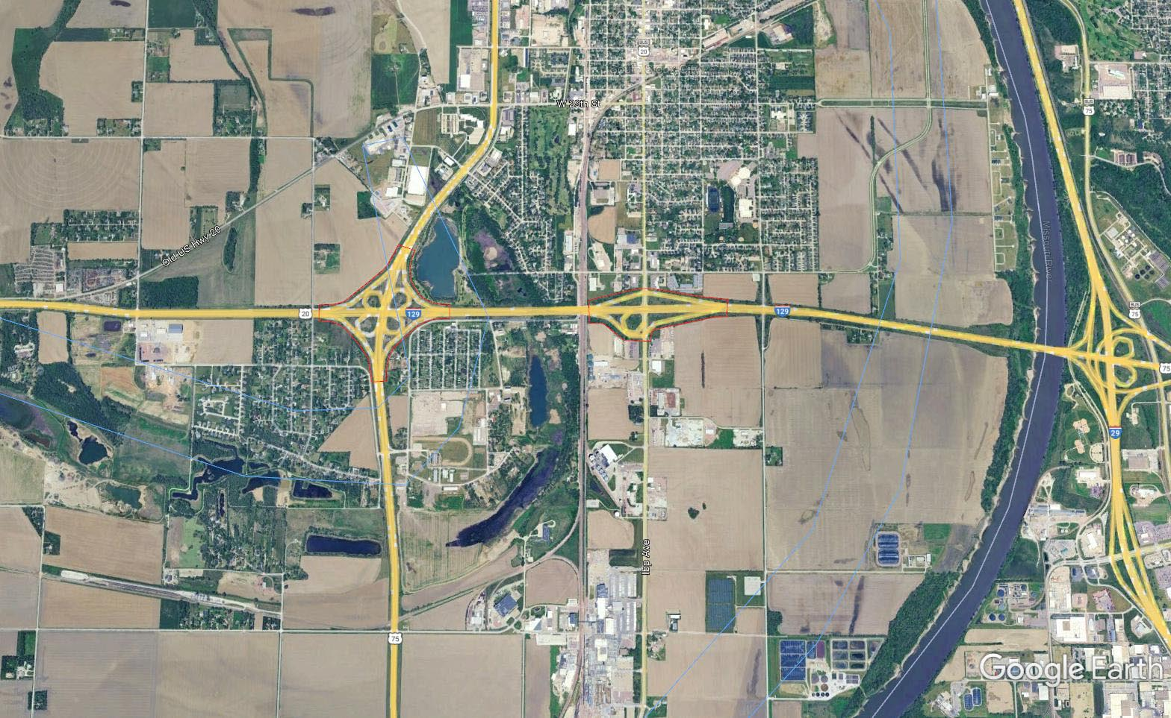

Slide 36
Wisner- West Point North
Project Number: S-275-6(1062) Control No: 32024A
Project Length: 12.21
Scope of Work:
  Grading
  Full Depth Pavement

Slide 37
Wisner- West Point North
Project Number: S-275-6(1062) Control No: 32024A
Status: Design
Right-of-way: In Progress
Construction Timing: 4/1/2026 - 10/31/2027

Slide 38
Wisner- West Point North
Project Number: S-275-6(1062) Control No: 32024A
Anticipated Utilities Impact:
  Grading
  New Alignment
  New ROW
Anticipated Request from Utilities:
  Provide Existing Locations
  Potholing Required
  Coordination with NDOT
Additional Information:
  K-Sheets Required
  Special Provisions Required
Utilities Involved:
  Black Hills Energy
  City of Wisner
  Cuming County Public Power District
  Great Plains Communications
  Lumen
  Skywave Wireless
  Sparklight
  Tallgrass Energy
  Village of Beemer
  Cuming County Rural Water District

Slide 39
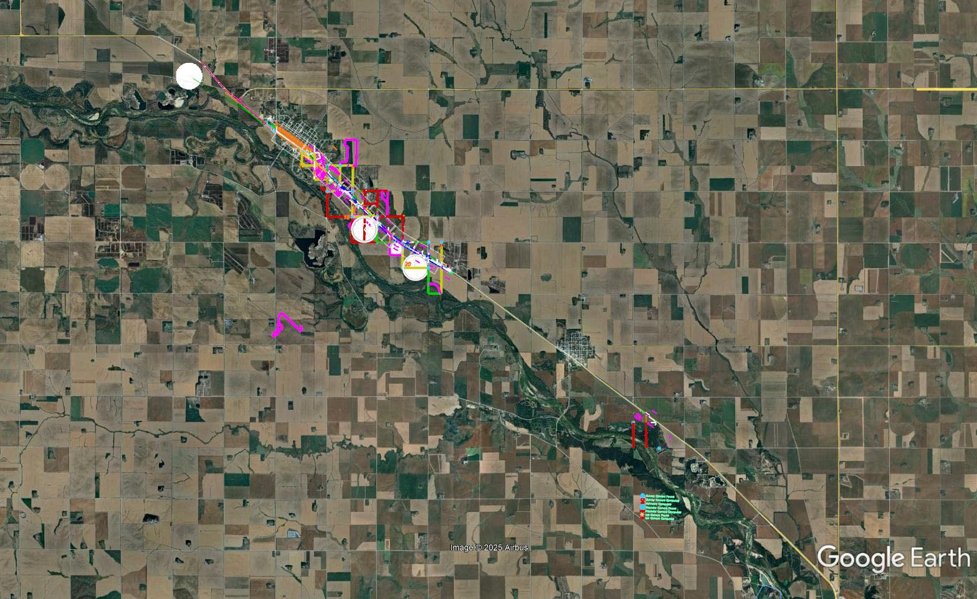

Slide 40
cy 2027
The following projects are anticipated to be let during 2027

Slide 41
Elgin - Neligh
Project Number: STP-14-4(119) Control No: 32383
Project Length: 10.80
Scope of Work:
  Culvert Extension/Replacement
  Bridge Repair

Slide 42
Elgin - Neligh
Project Number: STP-14-4(119) Control No: 32383
Status: Design
Right-of-way: In Progress
Construction Timing: 4/12/2027 - 11/24/2027

Slide 43
Elgin - Neligh
Project Number: STP-14-4(119) Control No: 32383
Anticipated Utilities Impact:
  Temp. Roads/Drives
  New ROW
Anticipated Request from Utilities:
  Provide Existing Locations
  Utilities Workshop
  Provide Existing Locations
Additional Information:
  K-Sheets Required
  Special Provisions Required
Utilities Involved:
  Black Hills Energy
  City of Elgin
  City of Neligh
  Elkhorn Rural Public Power District
  Frontier Communications
  Great Plains Communications
  Lumen
  Midstates Data Transport
  OPTK Networks
  Northeast Nebraska Telephone Company
  Tallgrass Energy

Slide 44
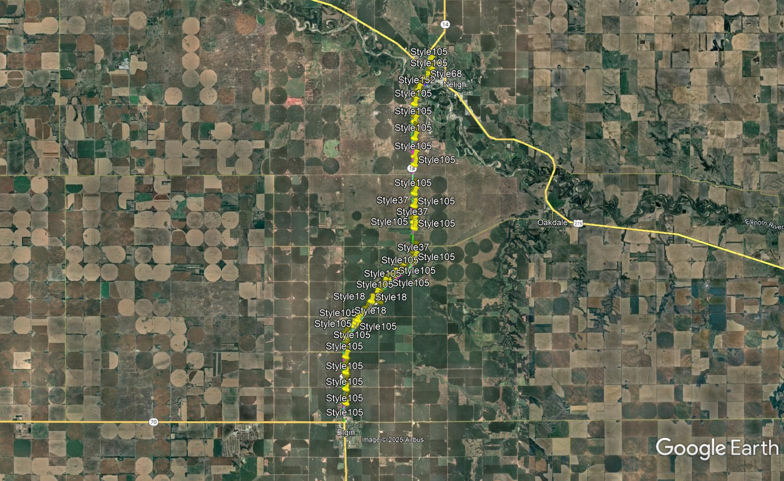

Slide 45
Fordyce East & West
Project Number: STP-HSIP-12-6(120) Control No: 32382
Project Length: 9.20
Scope of Work:
  Culvert Extension/Replacement
  Bridge Repair
  Grading

Slide 46
Fordyce East & West
Project Number: STP-HSIP-12-6(120) Control No: 32382
Status: Design
Right-of-way: In Progress
Construction Timing: 4/1/2027-10/31/2027

Slide 47
Fordyce East & West
Project Number: STP-HSIP-12-6(120) Control No: 32382
Anticipated Utilities Impact:
Anticipated Request from Utilities:
Additional Information:
  K-Sheets Required
  Special Provisions Required
Utilities Involved:
  Cedar Knox Rural Water District
  Cedar Knox Public Power District
  Great Plains Communications
  Hartington Telecommunications
  Lumen
  Nustar Pipeline
  TransCanada Keystone Pipeline
  Village of Fordyce

Slide 48
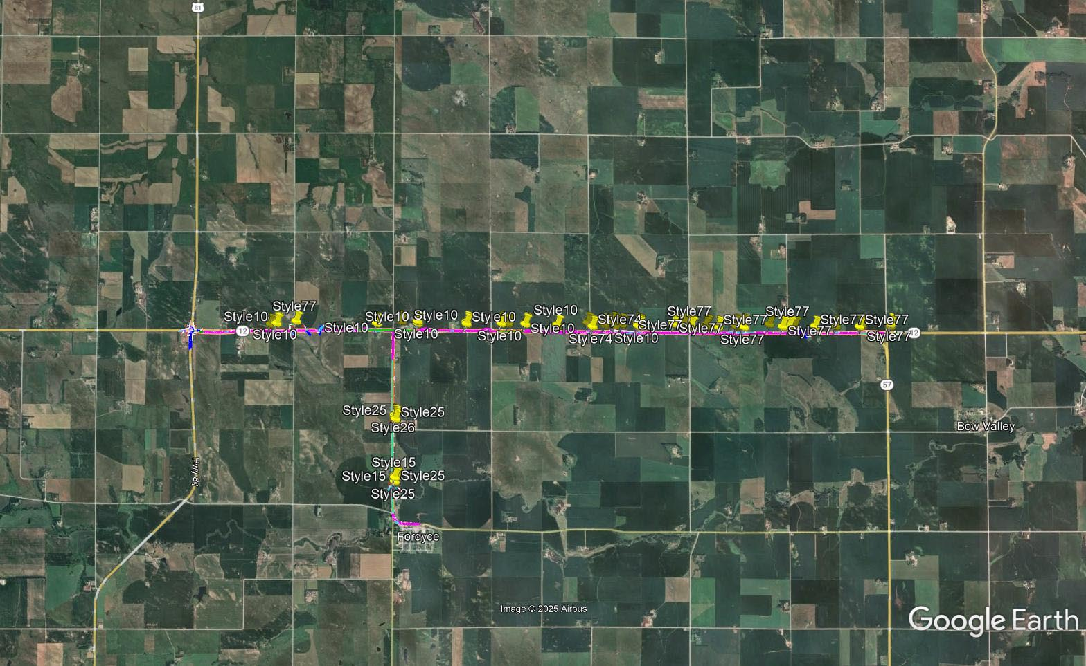

Slide 49
Clearwater West
Project Number: NH-275-5(147) Control No: 32387
Project Length: 6.49
Scope of Work:
  Culvert Extension/Replacement
  Resurfacing

Slide 50
Clearwater West
Project Number: NH-275-5(147) Control No: 32387
Status: Design
Right-of-way: In Progress
Construction Timing: 8/9/2027 - 11/24/2027

Slide 51
Clearwater West
Project Number: NH-275-5(147) Control No: 32387
Anticipated Utilities Impact:
Anticipated Request from Utilities:
Additional Information:
Utilities Involved:
  Black Hills Energy
  Elkhorn Rural Public Power District
  Great Plains Communications
  Lumen
  Northeast Nebraska Telephone Company
  Tallgrass Energy

Slide 52
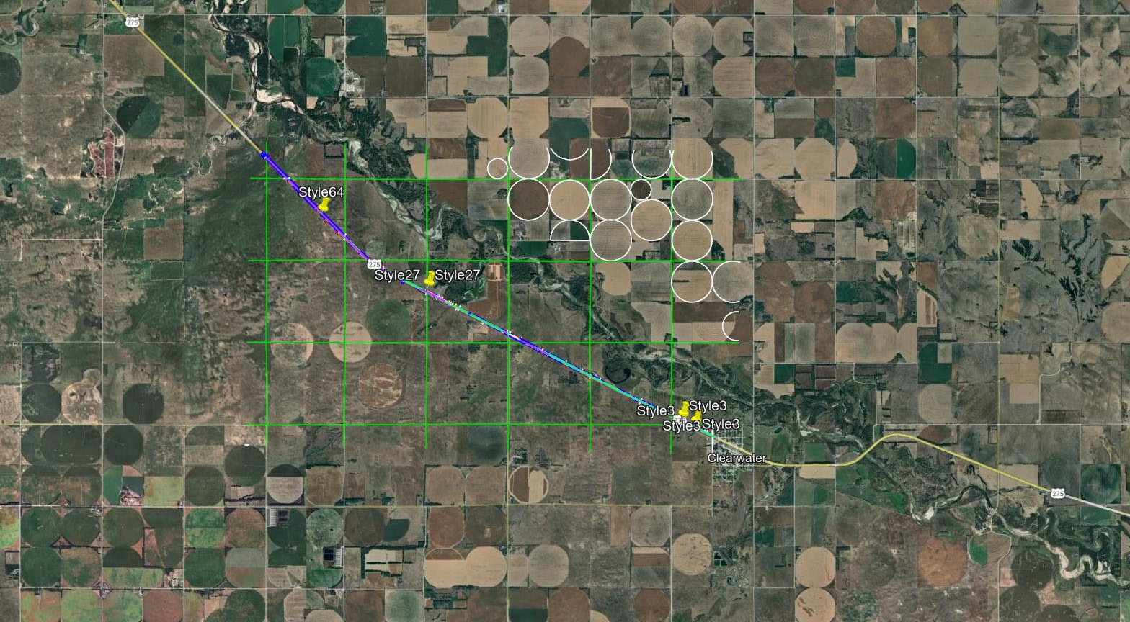
Clearwater West
Project Number: NH-275-5(147) Control No: 32387

Slide 53
Jct. US-81/ N-12 Intersection
Project Number: HSIP-81-4(130) Control No: 32409
Project Length: 0.00
Scope of Work:
  Full Depth Pavement
  Culvert Extension/Replacement
  ITS/Lighting

Slide 54
Jct. US-81/ N-12 Intersection
Project Number: HSIP-81-4(130) Control No: 32409
Status: Design
Right-of-way: In Progress
Construction Timing: 7/12/2027 - 11/6/2027

Slide 55
Jct. US-81/ N-12 Intersection
Project Number: HSIP-81-4(130) Control No: 32409
Anticipated Utilities Impact:
Anticipated Request from Utilities:
Additional Information:
Utilities Involved:
  Cedar Knox Rural Water District
  Great Plains Communications
  Lumen

Slide 56
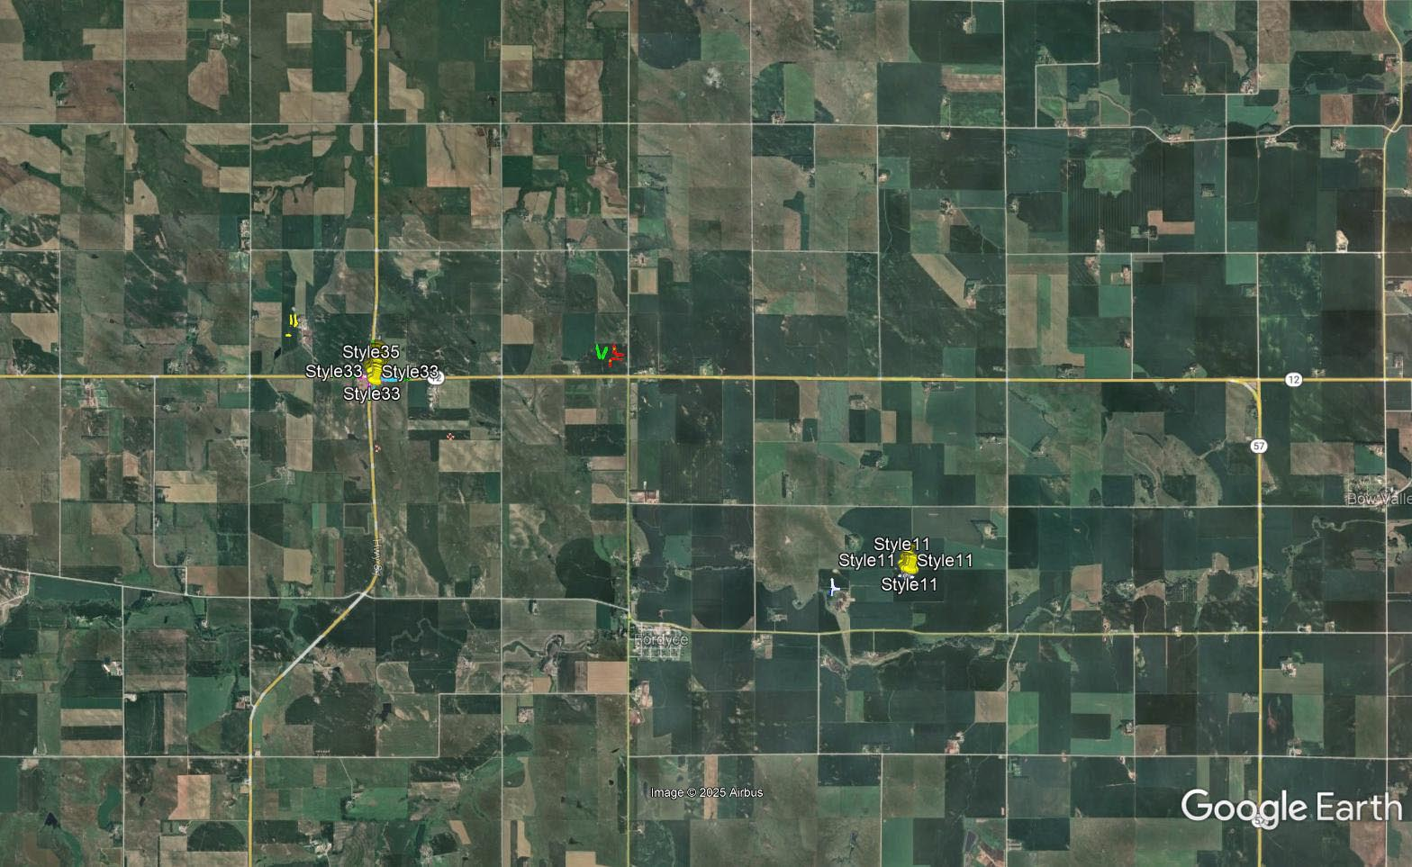

Slide 57
Neligh to Tilden
Project Number: NH-275-5(146) Control No: 32381
Project Length: 12.35
Scope of Work:
  Full Depth Pavement
  Bridge Replacement
  Bridge Repair

Slide 58
Neligh to Tilden
Project Number: NH-275-5(146) Control No: 32381
Status: Design
Right-of-way: In Progress
Construction Timing: 3/29/2027 - 11/22/2028

Slide 59
Neligh to Tilden
Project Number: NH-275-5(146) Control No: 32381
Anticipated Utilities Impact:
Anticipated Request from Utilities:
Additional Information:
Utilities Involved:
  Black Hills Energy
  City of Neligh
  City of Tilden
  Elkhorn Rural Public Power District
  Frontier Communications
  Great Plains Communications
  Lumen
  Midstates Data Transport
  Nebraska Public Power District
  Tallgrass Energy
  Village of Oakdale

Slide 60
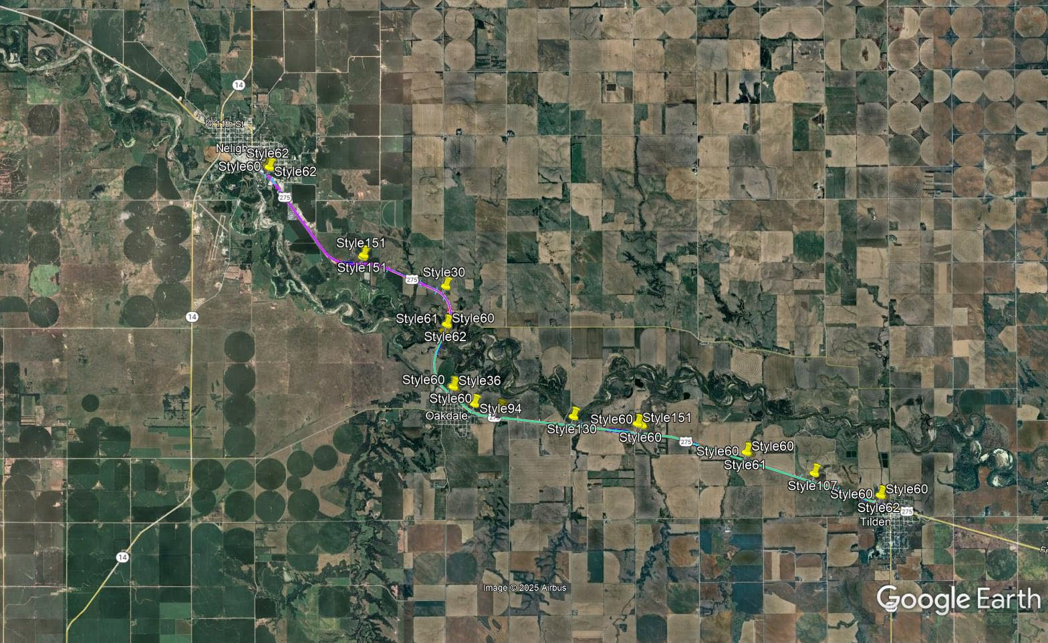
Neligh to Tilden
Project Number: NH-275-5(146) Control No: 32381

Slide 61
Madison East
Project Number: STP-32-5(110) Control No: 32405
Project Length: 11.97
Scope of Work:
  Mill and Fill
  Box Culvert Repairs
  Bridge Repairs with Guardrail Replacement

Slide 62
Madison East
Project Number: STP-32-5(110) Control No: 32405
Status: Design
Right-of-way: N/A
Construction Timing: 7/19/2027 - 11/24/2027

Slide 63
Madison East
Project Number: STP-32-5(110) Control No: 32405
Anticipated Utilities Impact:
Anticipated Request from Utilities:
Additional Information:
Utilities Involved:
  Black Hills Energy
  City of Madison
  Elkhorn Rural Public Power District
  Frontier Communications
  Midstates Data Transport
  Nebraska Public Power District
  Sparklight
  Stanton Telecommunications

Slide 64
Questions & Wrap Up
Notes:
HDR

Slide 65
Any final Questions?
Ask them now!
If you have questions after this meeting, or would like to view more detailed project maps, please reach out to your utility coordinator.
Notes:
HDR

Slide 66
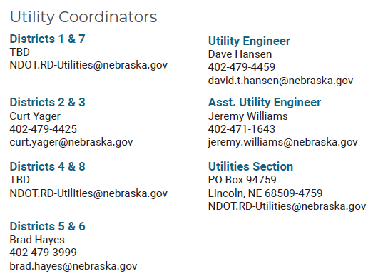
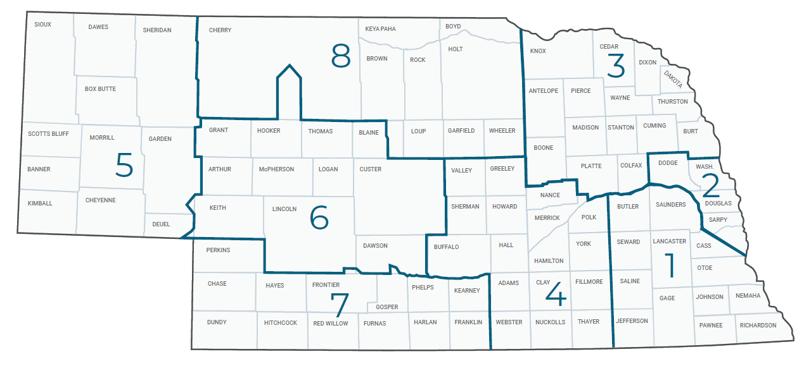
Have a Question about a project your Utility is involved in?
Contact your district’s utility coordinator!
Notes:
HDR

Slide 67
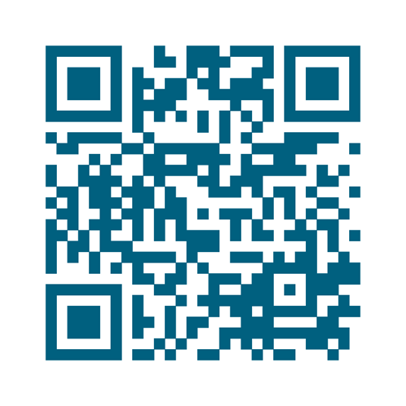
We need your feedback
Your valuable feedback helps these meetings – and NDOT’s utility coordination program – be better.
Use your phone’s camera to scan this QR code or use our paper survey.
Notes:
HDR

Slide 68
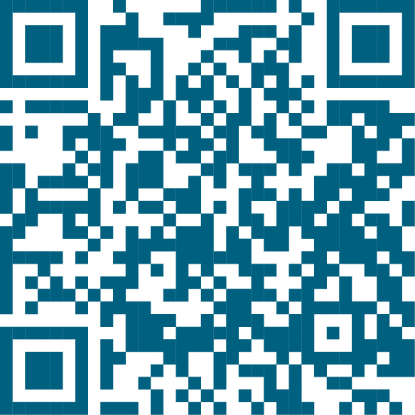
Visit our Website
Visit NDOT.info/utility for more information on:
Utility accommodation
Permitting
Coordination
Project information
Reimbursements
Additional information
Scan the QR Code to view the 2026 Program Book!
Notes:
HDR

Slide 69
Thank You
Notes:
HDR

Slide 70
In Stanton & North
Project Number: STP-57-3(111) Control No: 32359
Project Length: 5.03
Scope of Work:
  Resurfacing
  Shoulder Work
  Grading

Slide 71
In Stanton & North
Project Number: STP-57-3(111) Control No: 32359
Status: Preparing for Bid
Right-of-way: Completed
Construction Timing: 3/24/2025 - 11/26/2025

Slide 72
In Stanton & North
Project Number: STP-57-3(111) Control No: 32359
Anticipated Utilities Impact:
  Grading
  Culvert Extension/Replace
Anticipated Request from Utilities:
Additional Information:
  K-Sheets Required
  Special Provisions Required
Utilities Involved:
  Black Hills Energy
  City of Stanton
  Great Plains Communications
  Lumen
  Sparklight Internet
  Stanton County Public Power District
  Stanton Telecommunications
  Tallgrass Energy

Slide 73
In Norfolk Traffic Signals (LET)
Project Number: HSIP-81-3(150) Control No: 32363
Project Length: 5.32
Scope of Work:
  Miscellaneous

Slide 74
In Norfolk Traffic Signals (LET)
Project Number: HSIP-81-3(150) Control No: 32363
Status: Design
Right-of-way: Not Required
Construction Timing: 7/7/2025 - 11/1/2025

Slide 75
In Norfolk Traffic Signals (LET)
Project Number: HSIP-81-3(150) Control No: 32363
Anticipated Utilities Impact:
Anticipated Request from Utilities:
Additional Information:
  No K-Sheets Required
  Special Provisions Required
Utilities Involved:
  Allo Communications
  Black Hills Energy
  City of Norfolk
  Lumen
  Midstates Data Transport
  Nebraska Department of Water, Energy, and Environment
  Nebraska Public Power District
  NuStar Pipeline
  Pierce Telephone Company
  Sparklight Internet
  Segra
  USCOC N-K

Slide 76
In Norfolk Traffic Signals (LET)
Project Number: HSIP-81-3(150) Control No: 32363

