Slide 1
Utility program
District 5 Breakout Session

Slide 2
This Meeting is Being Recorded
Notes:
HDR

Slide 3
Welcome
Before we begin, let’s have a brief safety moment.
In-Person Attendees
Emergency Exits
Tornado Shelter
911 Caller
AED Location
Restrooms
Virtual Attendees
Unmute yourself or use your chat box if you are in an emergency situation.
Notes:
HDR

Slide 4
Agenda
Introductions
High Impact Project Review (by construction year)
Communication and Coordination
Questions and Wrap Up
Notes:
HDR

Slide 5
Introductions
Notes:
All speakers introduce themselves briefly (Dave, section head, HDR facilitators); Attendees can introduce themselves if it’s a small group. If not – skip it!

Slide 6
2024 Utility policy
NDOT rolled out a new utility accommodation policy in 2024.
You can find more information, as well as a webinar about the changes, on the NDOT utility website at https://dot.nebraska.gov/business-center/utilities/.

Slide 7
cy 2026
The following projects are anticipated to be let during 2026

Slide 8
D5 - CCTV Cameras
Project Number: D5(106) Control No: 51666
Project Length: 0.00
Scope of Work:
  ITS/Lighting
  Grading

Slide 9
D5 - CCTV Cameras
Project Number: D5(106) Control No: 51666
Status: Awarded
Right-of-way: Not Required
Construction Timing: 10/19/2026 - 10/31/2026

Slide 10
D5 - CCTV Cameras
Project Number: D5(106) Control No: 51666
Anticipated Utilities Impact:
Anticipated Request from Utilities:
Additional Information:
Utilities Involved:
  OPTK Networks
  Panhandle Rural Electric
  Hemingford COOP Telephone Company

Slide 11
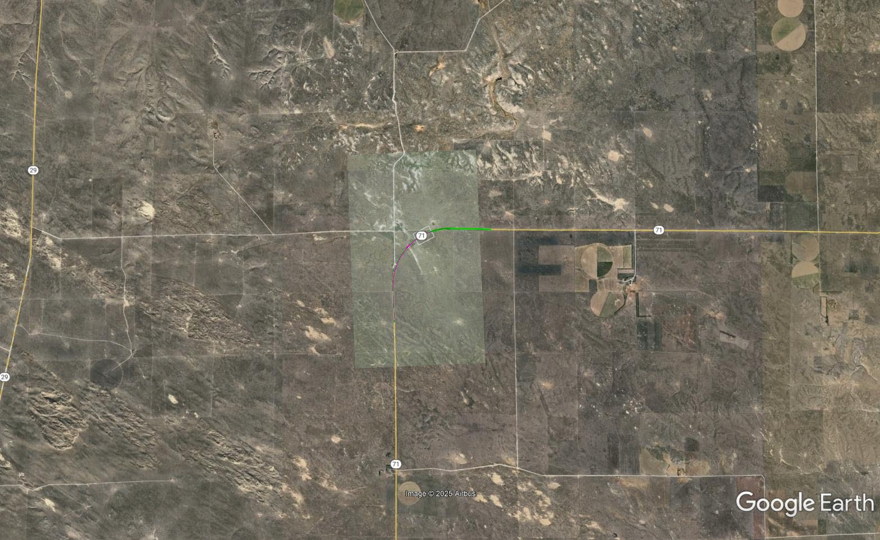

Slide 12
D5 Sidemount DMS Boards
Project Number: D5(107) Control No: 51667
Project Length: 0.0 (7 locations)
Scope of Work:
  ITS/Lighting
  Grading

Slide 13
D5 Sidemount DMS Boards
Project Number: D5(107) Control No: 51667
Status: Award Pending
Right-of-way: Not Required
Construction Timing: 4/1/2026 - 10/31/2026

Slide 14
D5 Sidemount DMS Boards
Project Number: D5(107) Control No: 51667
Anticipated Utilities Impact:
Anticipated Request from Utilities:
Additional Information:
Utilities Involved:
  Charter Communications
  Chimney Rock Public Power District
  City of Alliance
  Lumen
  Rural Nebraska Health
  Viaero Fiber Network

Slide 15
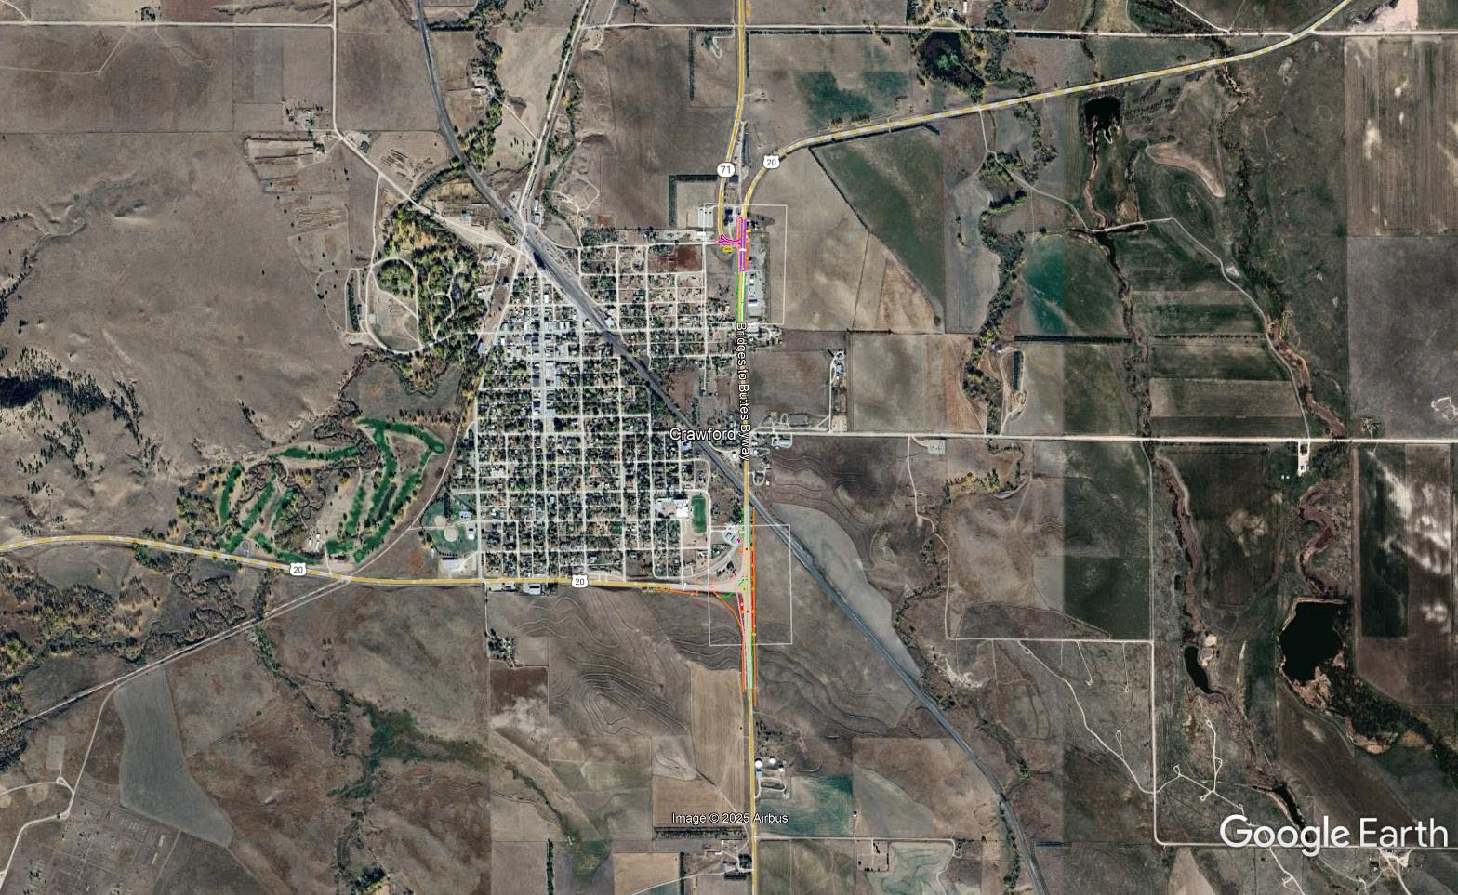

Slide 16
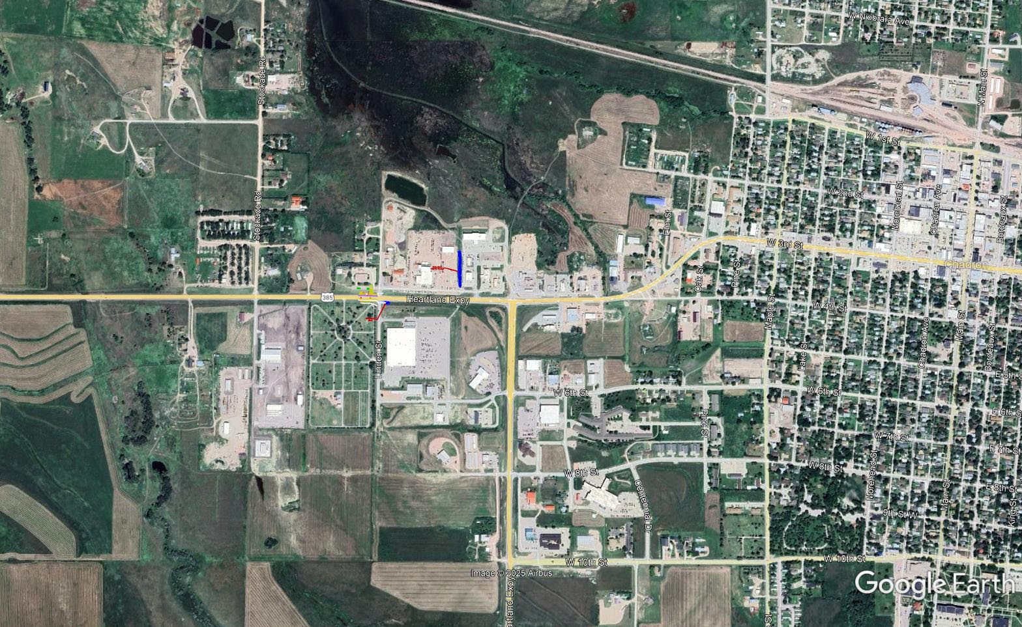

Slide 17
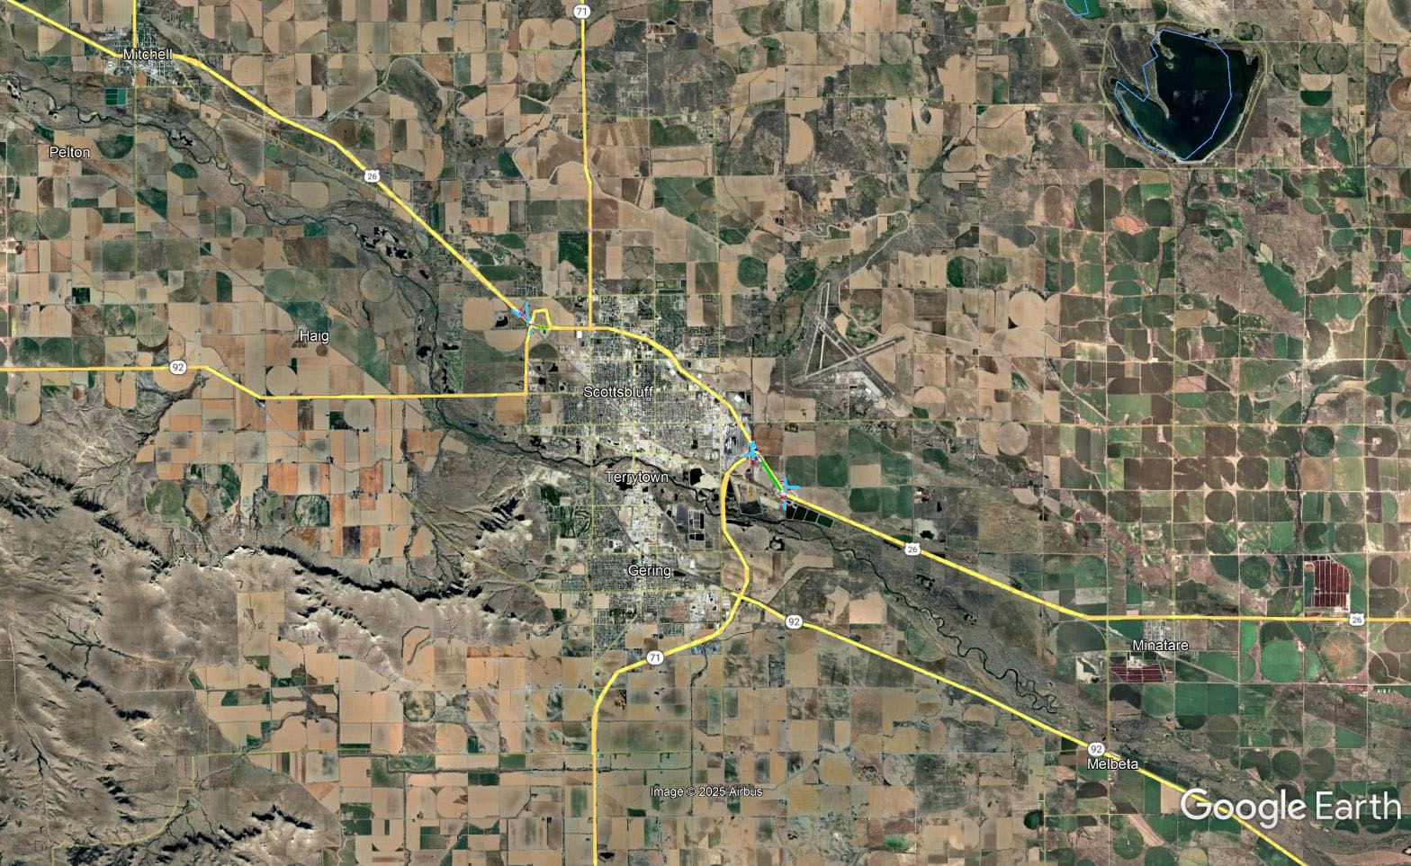

Slide 18
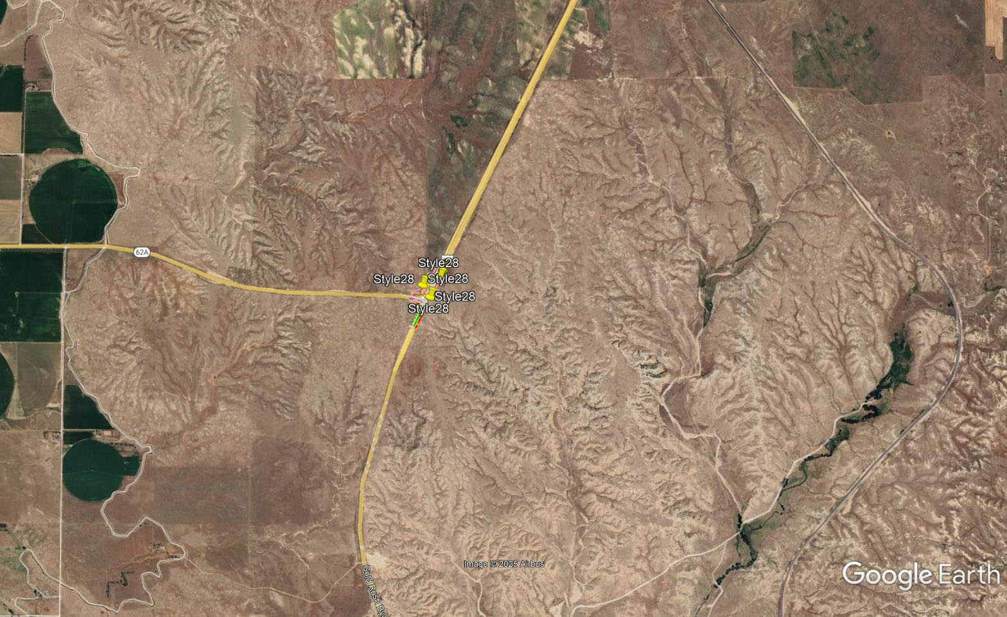

Slide 19
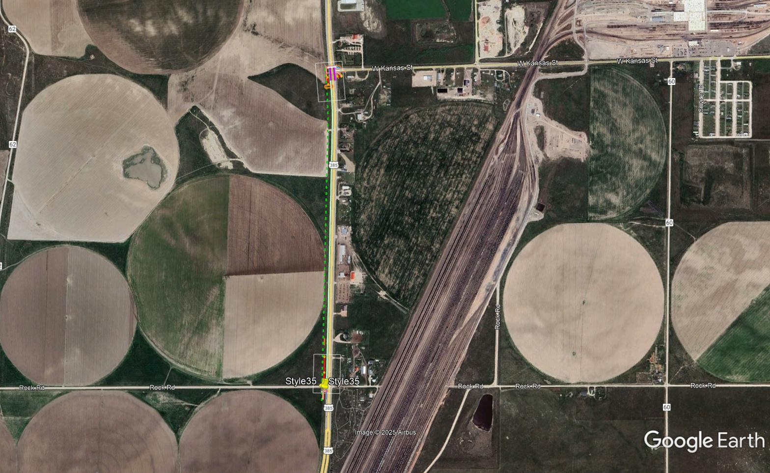

Slide 20
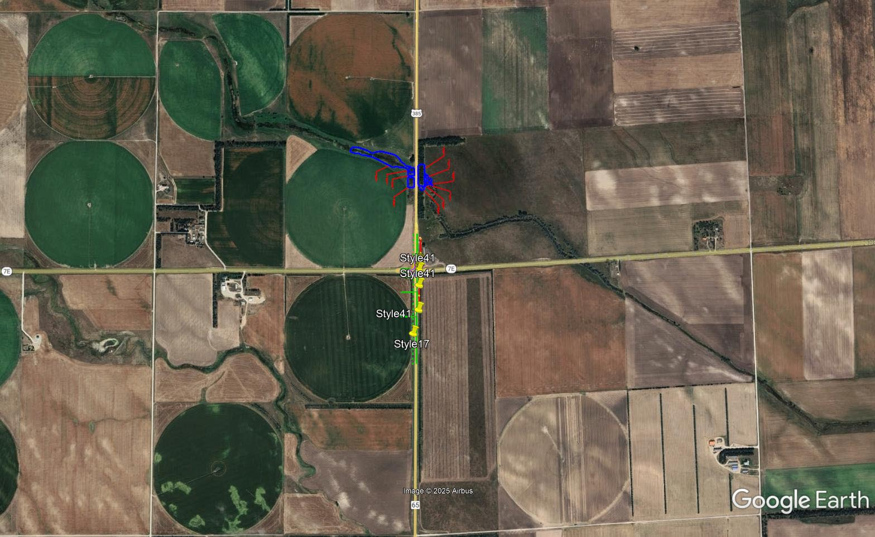

Slide 21
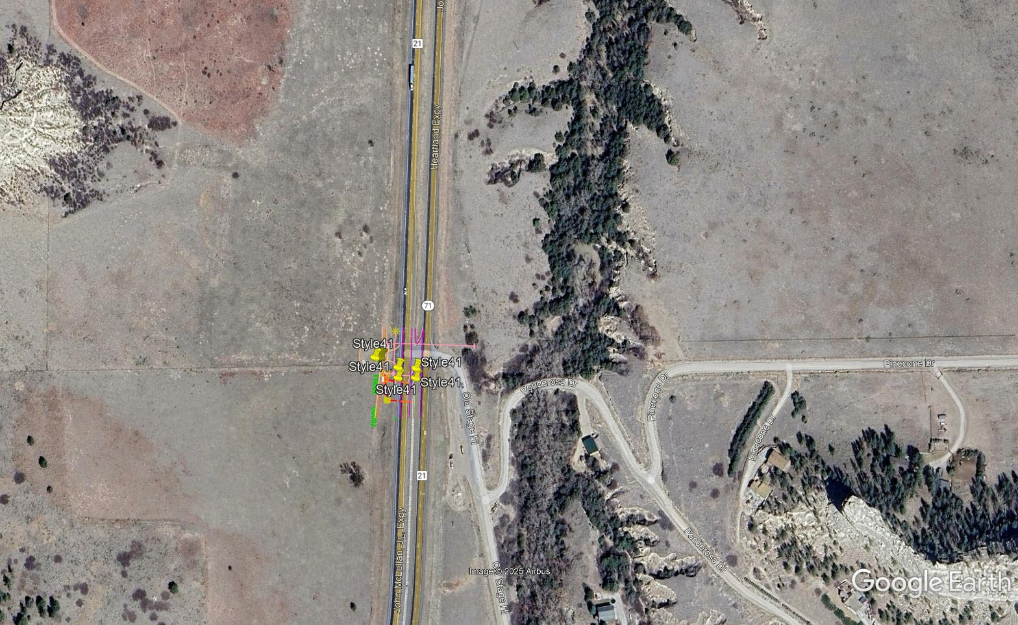

Slide 22
D5 High Mast Tower Replacement
Project Number: 80-1(207) Control No: 51669
Project Length: 0.0 (3 locations)
Scope of Work:
  ITS/Lighting
  Grading

Slide 23
D5 High Mast Tower Replacement
Project Number: 80-1(207) Control No: 51669
Status: Award Pending
Right-of-way: Not Required
Construction Timing: 5/1/2026 - 10/31/2026

Slide 24
D5 High Mast Tower Replacement
Project Number: 80-1(207) Control No: 51669
Anticipated Utilities Impact:
Anticipated Request from Utilities:
Additional Information:
Utilities Involved:
  Black Hills Energy
  Dalton Telephone Company
  High West Energy
  Lumen
  Warren Air Force Base

Slide 25
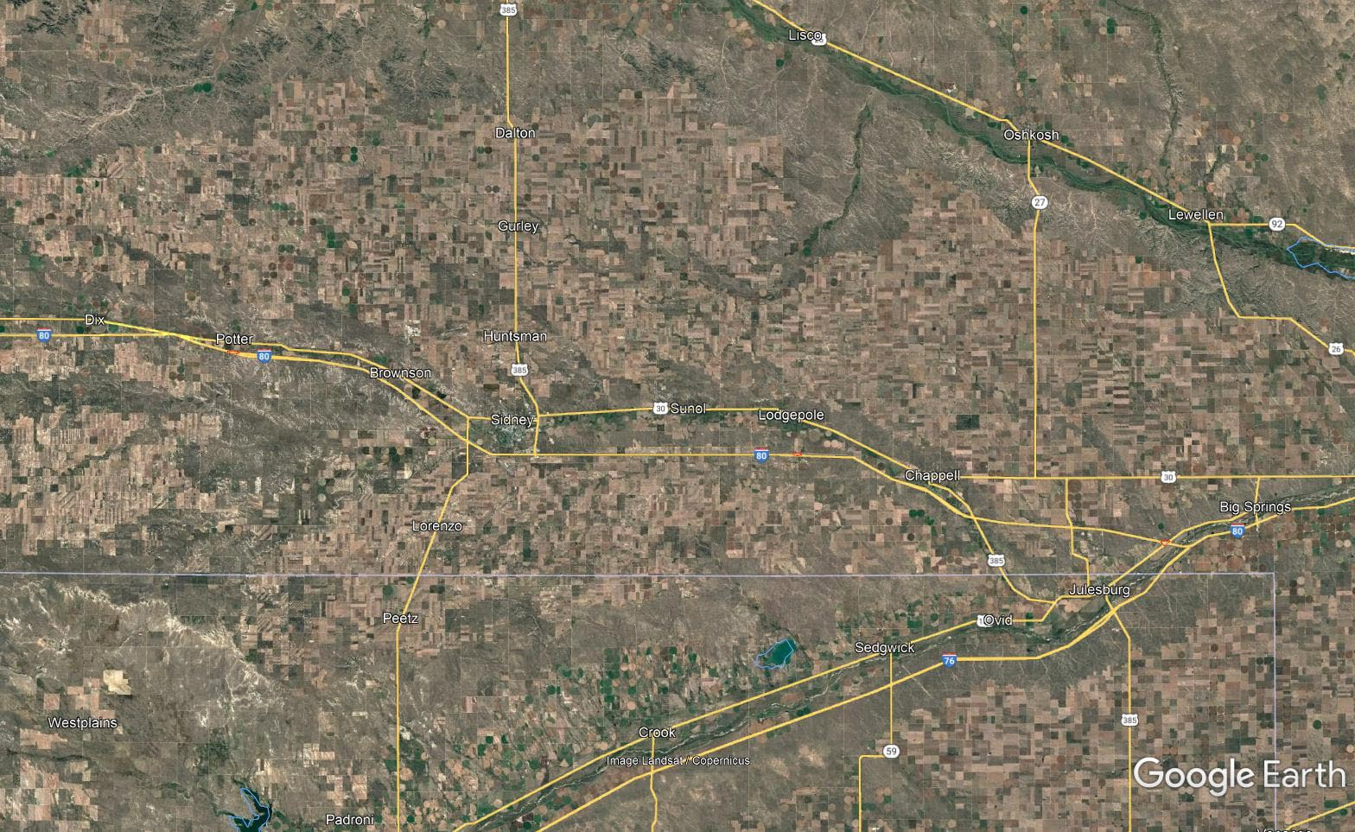

Slide 26
In Bridgeport
Project Number: 26-1(177) Control No: 51642
Project Length: 3.74
Scope of Work:
  Resurfacing
  Bridge Repair
  Misc.

Slide 27
In Bridgeport
Project Number: 26-1(177) Control No: 51642
Status: Design
Right-of-way: In Progress
Construction Timing: 6/1/2026 - 11/21/2026

Slide 28
In Bridgeport
Project Number: 26-1(177) Control No: 51642
  OPTK Networks
  Viaero Fiber
  Network
  Wheatbelt Public Power District
Utilities Involved:
  Allo Communications
  Black Hills Energy
  Charter Communications
  Chimney Rock Public
  Power District
  City of Bridgeport
  Lumen
  Nebraksa Public Power District
Anticipated Utilities Impact:
Anticipated Request from Utilities:
Additional Information:

Slide 29
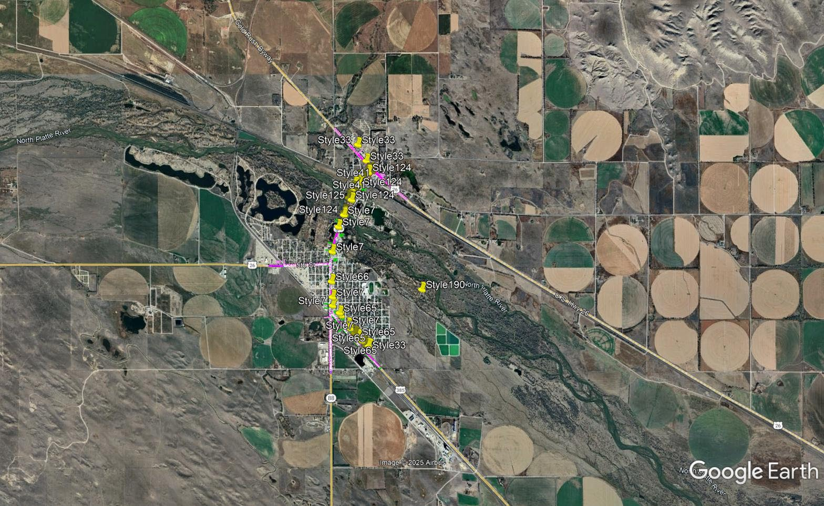

Slide 30
Minatare - US-385, Phase 1
Project Number: 26-1(172) Control No: 51521a
Project Length: 18.47
Scope of Work:
  Full Depth Pavement
  Resurfacing
  Grading

Slide 31
Minatare - US-385, Phase 1
Project Number: 26-1(172) Control No: 51521a
Status: Design
Right-of-way: In Progress
Construction Timing: 6/8/2026 - 11/7/2026

Slide 32
Minatare - US-385, Phase 1
Project Number: 26-1(172) Control No: 51521a
Anticipated Utilities Impact:
Anticipated Request from Utilities:
Additional Information:
Utilities Involved:
  Black Hills Energy
  Charter Communications
  Chimney Rock Public Power District
  City of Minatare
  Cogent Communications
  Farmers Irrigation District
  Lumen
  Nebraska Public Power District
  OPTK Networks
  Tallgrass Energy
  Viaero Fiber Network

Slide 33
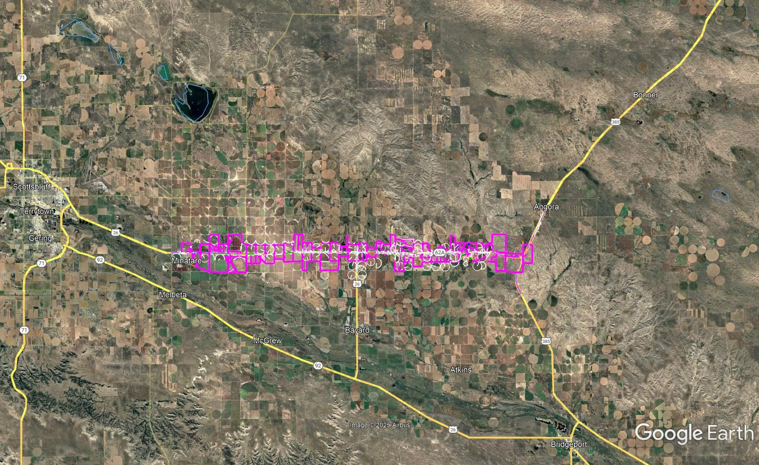

Slide 34
Cy 2027
The following projects are anticipated to be let during 2027

Slide 35
Minatare - US-385, Phase 2
Project Number: NH-26-1(182) Control No: 51521B
Project Length: 18.11
Scope of Work:
  Full Depth Pavement
  Misc.

Slide 36
Minatare - US-385, Phase 2
Project Number: NH-26-1(182) Control No: 51521B
Status: Design
Right-of-way: In Progress
Construction Timing: 6/1/2027 - 10/31/2028

Slide 37
Minatare - US-385, Phase 2
Project Number: NH-26-1(182) Control No: 51521B
Anticipated Utilities Impact:
Anticipated Request from Utilities:
Additional Information:
Utilities Involved:
  Black Hills Energy
  Bureau of Reclamation
  Charter Communications
  Chimney Rock Public Power District
  City of Minatare – Water – Sewer
  Farmers Irrigation District
  Kinder Morgan
  Lumen
  Nebraska Public Power District
  OPTK Networks
  Pathfinders Irrigation
  Tallgrass Energy
  T-Mobile
  Viaero Fiber Network

Slide 38
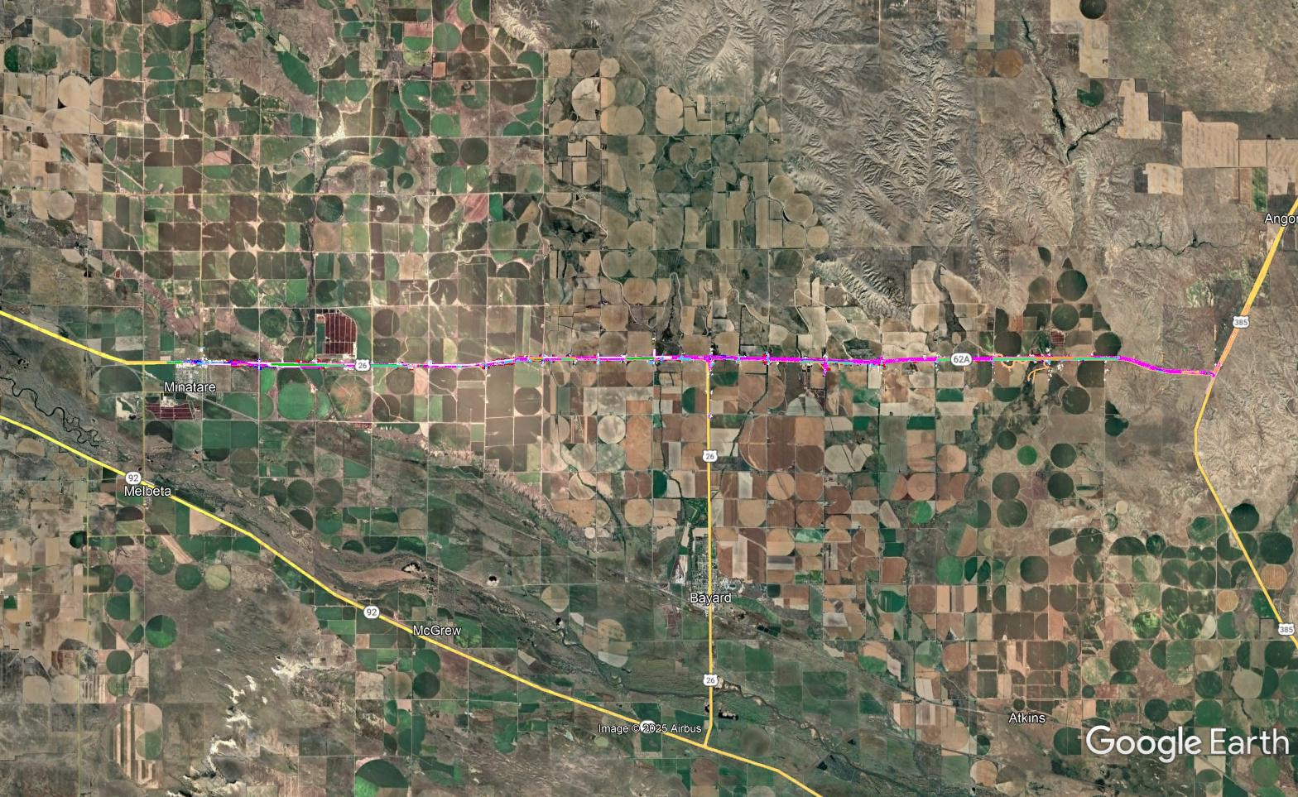

Slide 39
Chadron North
Project Number: NH-385-4(141) Control No: 51657
Project Length: 16.82
Scope of Work:
  Full Depth Pavement
  Bridge Repair

Slide 40
Chadron North
Project Number: NH-385-4(141) Control No: 51657
Status: Design
Right-of-way: In Progress
Construction Timing: 4/1/2027 - 10/31/2027

Slide 41
Chadron North
Project Number: NH-385-4(141) Control No: 51657
Anticipated Utilities Impact:
Anticipated Request from Utilities:
Additional Information:
Utilities Involved:
  Lumen
  Mobius
  Nebraska Public Power District
  OPTK Networks

Slide 42
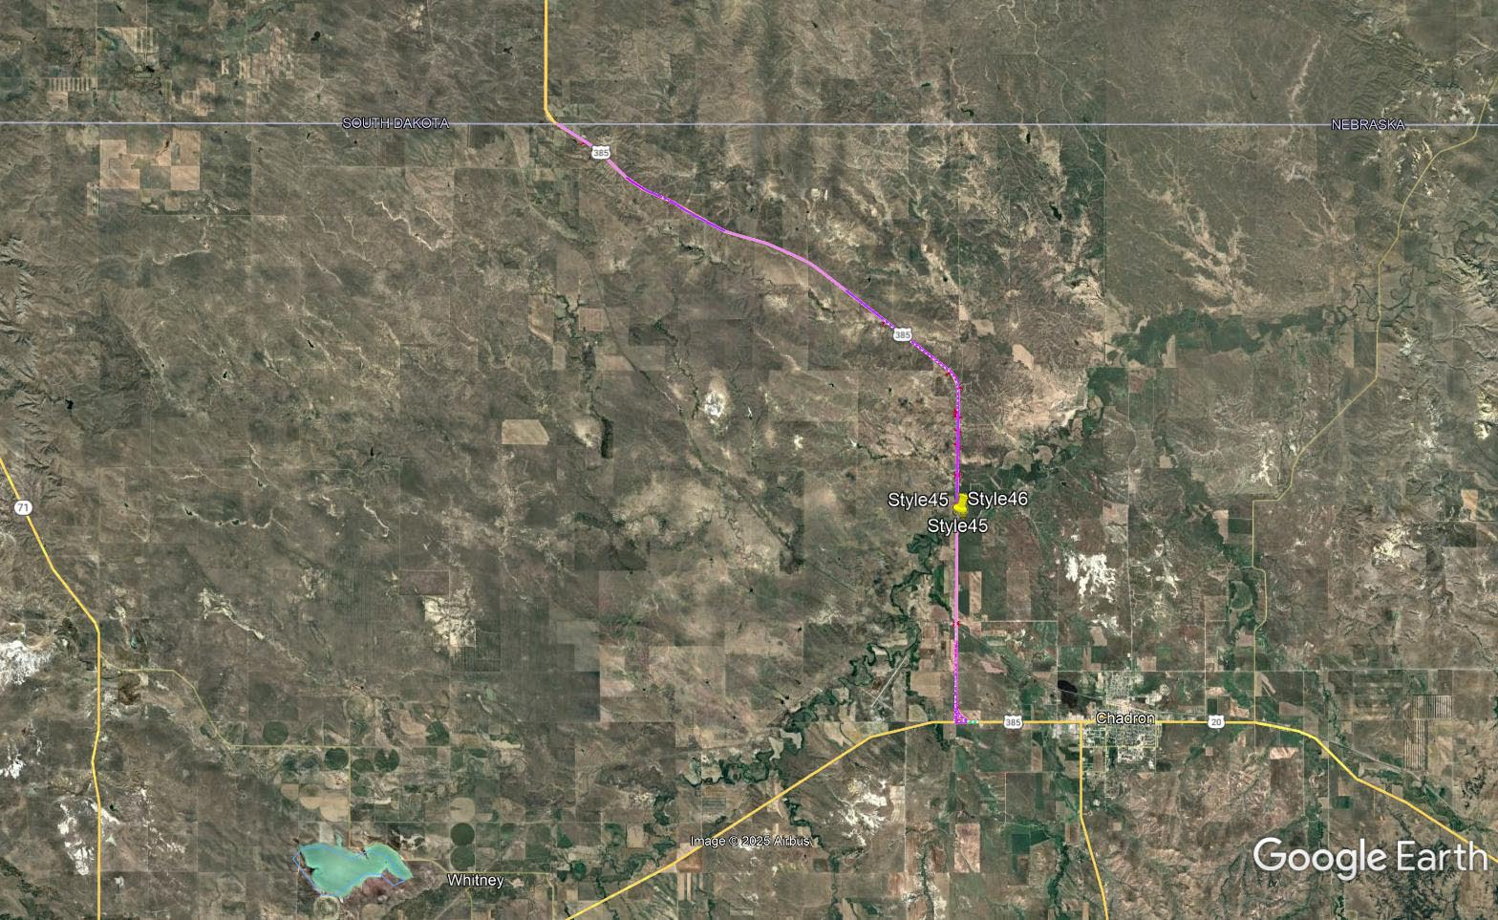

Slide 43
Smith Lake North
Project Number: STP-250-4(104) Control No: 51193
Project Length: 11.1
Scope of Work:
  Grading
  Culvert Extension/Replacement
  Resurfacing

Slide 44
Smith Lake North
Project Number: STP-250-4(104) Control No: 51193
Status: Design
Right-of-way: In Progress
Construction Timing: 4/1/2027 - 11/25/2027

Slide 45
Smith Lake North
Project Number: STP-250-4(104) Control No: 51193
Anticipated Utilities Impact:
Anticipated Request from Utilities:
Additional Information:
Utilities Involved:
  Great Plains Communications
  Northwest Rural Public Power District

Slide 46
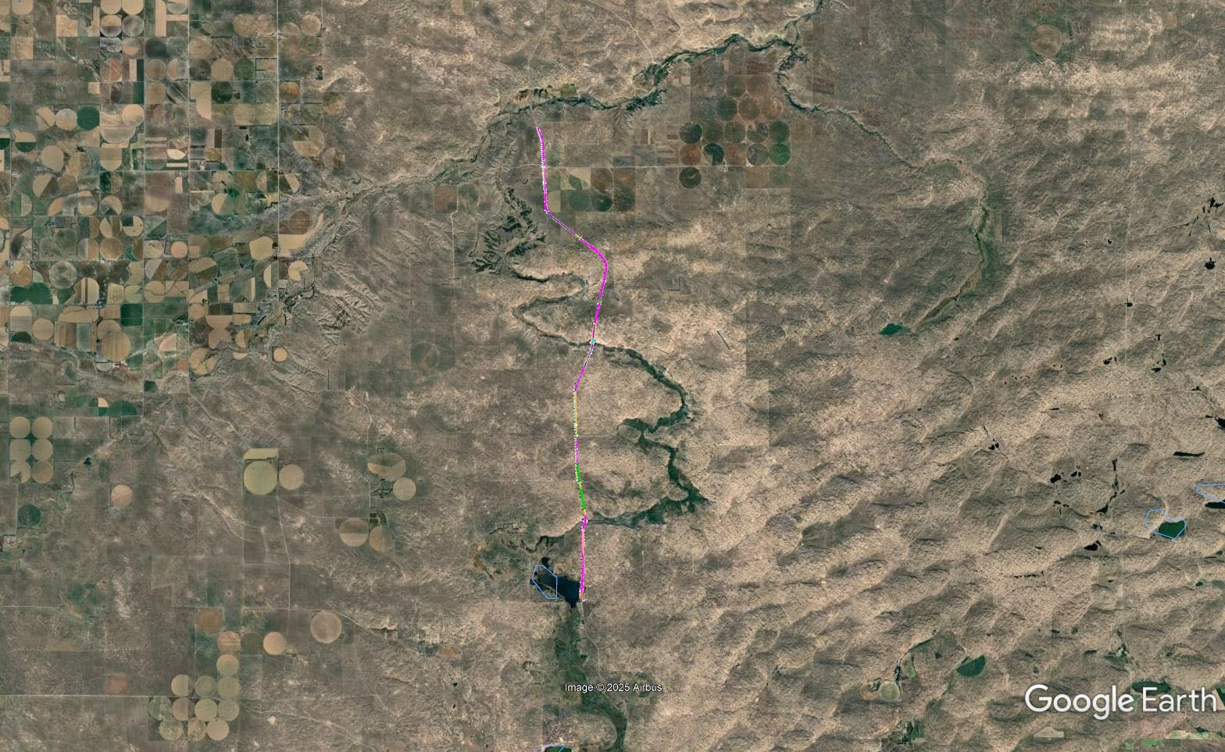

Slide 47
Sidney - Gurley
Project Number: NH-385-2(115) Control No: 51651
Project Length: 12.49
Scope of Work:
  Grading
  ITS/Lighting

Slide 48
Sidney - Gurley
Project Number: NH-385-2(115) Control No: 51651
Status: Design
Right-of-way: In Progress
Construction Timing: 6/15/2027 - 11/25/2027

Slide 49
Sidney - Gurley
Project Number: NH-385-2(115) Control No: 51651
Anticipated Utilities Impact:
Anticipated Request from Utilities:
Additional Information:
Utilities Involved:
  Black Hills Energy
  Charter Communications
  City of Sidney
  Dalton Telephone Company
  Lumen
  OPTK Networks
  Tallgrass Energy
  Viaero Fiber
  Village of Gurley
  Warren Air Force Base
  Wheatbelt Public Power District

Slide 50
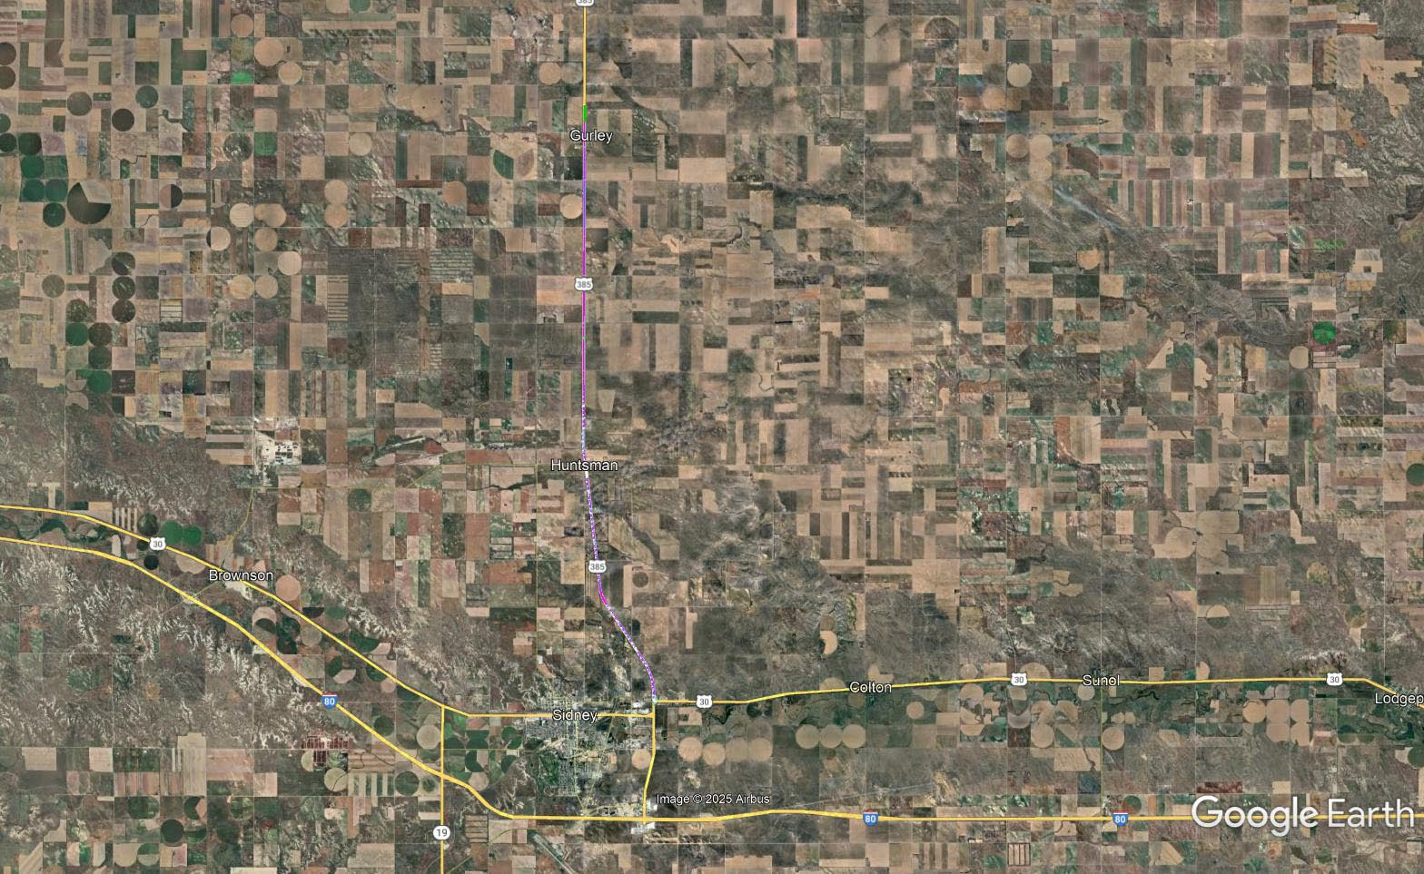

Slide 51
Sidney - Lodgepole
Project Number: STP-30-1(141) Control No: 51671
Scope of Work:
  Major bridge and culvert work
  Sidewalk and ADA improvements in Lodgepole

Slide 52
Sidney - Lodgepole
Project Number: STP-30-1(141) Control No: 51671
Status: Design
Construction Timing: TBD 2027-2028

Slide 53
Sidney - Lodgepole
Project Number: STP-30-1(141) Control No: 51671
Anticipated Utilities Impact:
  Bridge Repair
  Culvert Extension/Replacement
  Pavement Improvements
Utilities Involved:
  TBD

Slide 54
Questions & Wrap Up
Notes:
HDR

Slide 55
Any final Questions?
Ask them now!
If you have questions after this meeting, or would like to view more detailed project maps, please reach out to your utility coordinator.
Notes:
HDR

Slide 56
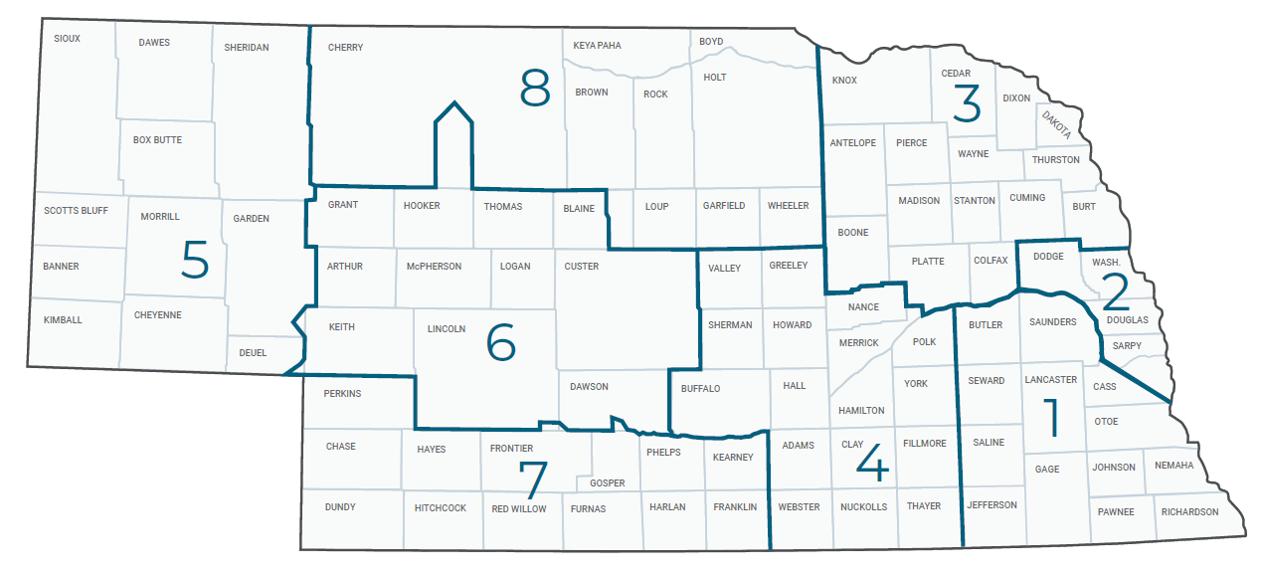
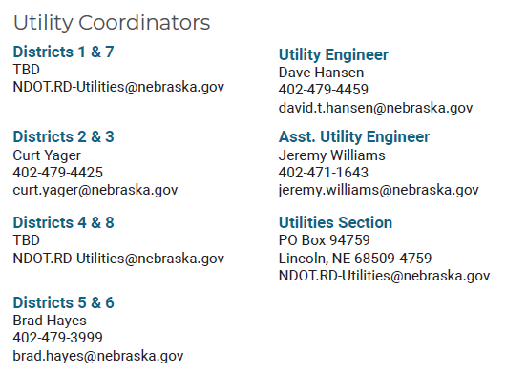
Have a Question about a project your Utility is involved in?
Contact your district’s utility coordinator!
Notes:
HDR

Slide 57
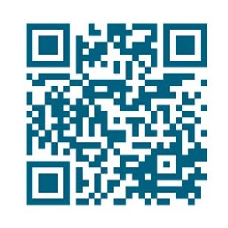
We need your feedback
Your valuable feedback helps these meetings – and NDOT’s utility coordination program – be better.
Use your phone’s camera to scan this QR code or use our paper survey.
Notes:
HDR

Slide 58
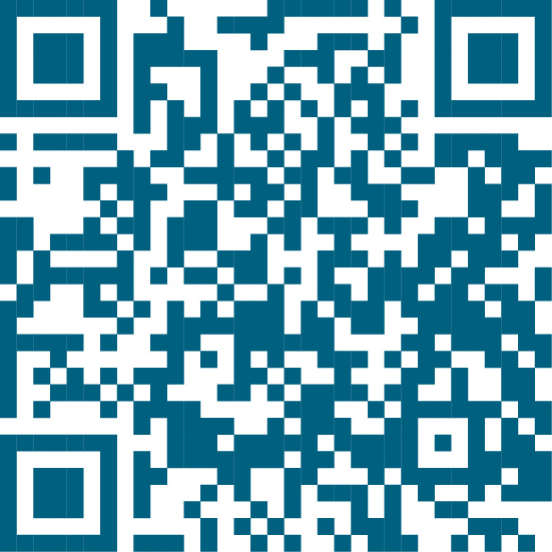
Visit our Website
Visit NDOT.info/utility for more information on:
Utility accommodation
Permitting
Coordination
Project information
Reimbursements
Additional information
Scan the QR Code to view the 2026 Program Book!
Notes:
HDR

Slide 59
Thank You
Notes:
HDR

