Slide 1

Key Topics
Quick Review
Nebraska County Highway and City Street
Superintendents Exam Preparation
Ask Your Questions Now!
9/27/2022
Boards - Liaison Services Section
Notes:
9/27/2022 Updated notes fields in slides 4 and 26
9/12/2022 Updated Slide 26 with statute number
9/10/2022 Updated slide 25 by adding photo of SWPPP permit posted on board at a jobsite
9/9/2022 Updated slides 3, 7, 15, 16, 19, and 26 by adding the 3-ring binder tab number. Updated Slide 5. Updated slides 8 and 14 to emphasize the 1970 Federal Uniform Act.
10/13/2021 Updated Slide 15 (added an example snow removal plan), and added web link to Slide 16
10/11/2021 Updated slide 11 (encroachments), added list of considerations to slide 15 (Snow Plan),
9/12/2021 Updated slide 14
9/10/2021 Updated slides 21 and 25. Slide 26 need more info on $30k municipal threshold LeMoyne mentioned? SEND LIST OF PERMITS AND AGENCIES TO MITCH AND LEMOYNE!
8/23/2021 updated slide 17 with latest (2019) Nebraska MUTCD Supplement
8/15/2021 deleted slide 7 under plan reading, updated slide 17
6/23/2021 deleted many slides in transitioning to the 2-day training format
6/9/2021 added notes to Slide 12 and added note to slide 22 regarding when cost effective analyses are required.
5/21/2021 and 5/22/2021 Updated several slides with references to exam questions.
5/7/2021 Hid Slide 79 Safety Plan – this topic won’t be discussed in training any longer. Neither will Human Resources.
5/5/2021 Updated slide 2 (removed Employee Safety Plan and Human Resources).
4/30/2021 Updated slide 16 notes field by adding Mitch Doht’s discussion of cash flow for cities and counties.
4/28/2021 Updated slides (notes field only) 13, 14, 15, 17, 45
4/27/2021 Updated date. Slide 80 (Human Resources) is now hidden – because of LB174(2021) Supt will rely on HR.
7/24/2020 and 7/24/2020 Updated slides 12, 25, 52, 66, 70, 71, 72, and 82.
3/12/2020 Updated – added slides 12 and 16.
9/9/2019 Updated: revised five slides, deleted six slides, and added 20 slides. Previous version 3/27/2019. Revised slides 7, 8, 17 (previously 20), 34 (previously 37), and 36 (previously 41). From the previous version (slide numbers from 3/27/2019 version) deleted slides 9 thru 11 (they are in the first Power Point presentation), and 38-39 and 47 (no more OneAndSix reporting to the NBCS). Added ROW slides (Slides 49-55), Funding sources slides (Slides 57-61), MUTCD slides (Slides 64 and 65) and Erosion Control slides (Slides 67 thru 72).

Slide 2
Nebraska County Highway and City Street
Superintendents Exam Preparation
Plan Reading
ROW
Snow Removal/Plan
MUTCD
Erosion Control
Consultants
Boards - Liaison Services Section
Notes:
5/5/0221 Updated – removed Safety Plan and Human Resources
21 topics listed here

Slide 3
Plan Reading
Nebraska County Highway and City Street Superintendents Workshop
Plans are a means of communication
Tab 20.5
9/9/2022
Boards - Liaison Services Section
Notes:
9/9/2022 updated with Tab number and revision date

Slide 4
Plan Reading Questions – Rural or Municipal
All answers are found on the plan set provided, unless noted.
  It’s mostly a matter of finding the information and then writing it on the exam.
  Most are on the cover sheet, typical sections sheet, quantities sheet, and plan/profile sheets.
  Some may require a little math.
  To find some answers you may need to refer to other documents (e.g. MDS).
It’s very helpful to know terminology, or where to find it.
  ADT. 428 NAC 2-001.03A3a (page 42)
  Grade, units are percent. 428 NAC 2-001.03A6e2 (page 46)
  Horizontal Clear Zone. 428 NAC 2-001.03A6k (page 46).
  Design Year. 428 NAC 2-001.03B Note 7 (pg 48). Initial Year of Construction.
  Lane width –only one lane, i.e. not the whole traveled way.
  Approach (to a bridge). The road/street just prior. Grade - %.
  Frontage Road. NDOT Terms Dictionary 1998.
  Net Length. Exception(s).
  Fill. Height of Fill. Unit is length (feet).
  Camber. LTAP plan reading course. Unit is length (inches or feet).
  Surcharge. LTAP plan reading course. Unit is length (feet).
  Curve information. PI, Dc, Lc, etc. (next slide)
Horizontal Clear Zone for curbed sections is always 2 ft. from back-of-curb or 6 ft. from edge-of-traveled-way, whichever is greater.
The township system. Township-Range-Section.
Slide 4
Notes:
9/27/2022 update comments – 1st sentence – need 18 points to pass plan reading (70%)
Definitely answer them all. This Part is only 25 points. You need at least 18 points to pass. Every point counts!
Some questions are worth more than others. Make sure you don’t make a silly error or misunderstand a question that is worth more than one point.
You can find all of the answers right on the set of plans you are provided, unless the question specifically directs you elsewhere (such as “what is the MDS value for _____” then you would have to go into 428 NAC 2, or you may have to do some math such as adding up some quantities.
Need to be able to read plans for a county road and a municipal street. It doesn’t matter. Because any of you could get licensed in one area (e.g. county highway superintendent) and later get a license in the other (e.g. city street superintendent).
Answer must fit the question! What is the approach grade? Answer must be % grade. What is cross slope? Answer must be % cross slope, not a height over length. What is the camber? Answer must be in inches or feet. Amount of excavation is typically in CY.
Township system. Everyone get it?

Slide 5
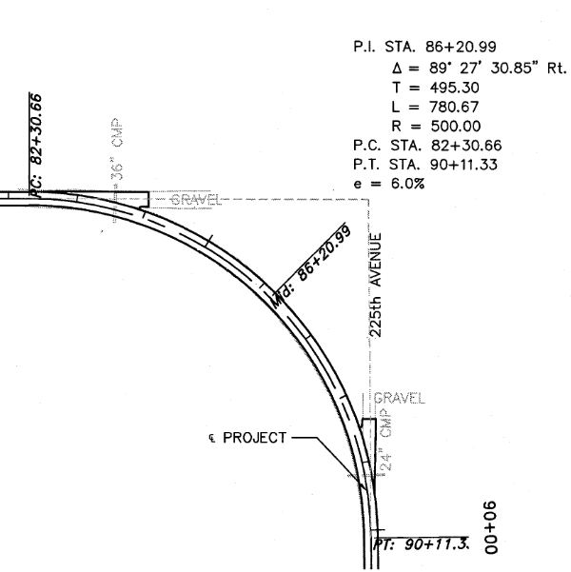
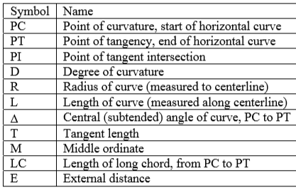
Curve Information
Deg/100 ft centerline
ft
ft
deg
ft
ft
ft
ft
R = 5730
D
L = 100 ∆
D
https://engineering.purdue.edu/~ce361/JFRICKER/HW/HC_02fHW6.pdf
https://www.easycalculation.com/engineering/civil/highways-horizontal-curve.php
Slide 5
Notes:
9/9/2022 added actual horizontal curve (from Petersburg NE plans) and reconfigured legend table.

Slide 6
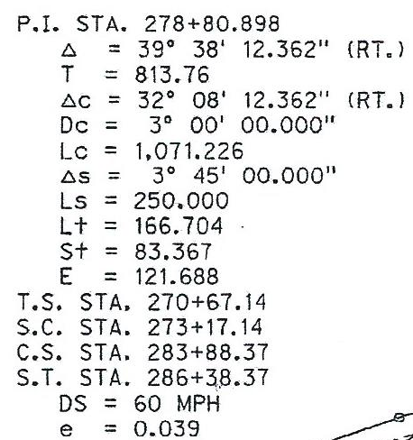
Curve Information
Point of Intersection
Total Curve Deflection Angle
Semi-tangent Length (total curve)
Main Curve Delta
Main Curve Degree of Curve
Length of Main Curve
Spiral Deflection Angle
Length of Spiral
Long Tangent (of Spiral)
Short Tangent (of Spiral)
External Distance (PI to midpoint of curve)
Tangent to Spiral
Spiral to Curve
Curve to Spiral
Spiral to Tangent
1
2
3
Design Speed
Superelevation Rate
Slide 6
Notes:
Might be asked to find the radius of a curve at ____ station. The plan sheet may have several curves. The curve information may be shown individually on the plan sheet, like on this slide, or there may be a table listing the station and then the curve information (radius is typically one of the first values listed in the table after the station).

Slide 7
ROW
Nebraska County Highway and City Street Superintendents Workshop
Right-of-Way Acquisition for Roads and Streets Projects
Tab 15
9/9/2022
Boards - Liaison Services Section
Notes:
9/9/2022 Updated with 3-ring binder tab number.
Constitutional protections – serious business – rights (nothing coercive), just compensation, appraisals
Both constitutions: United States and Nebraska
Uniform Act – it’s a process – it takes time – must afford property owners and tenants time throughout the process
Keep public ROW free from encroachments
Contact your county/city attorney for guidance
Uniform Relocation Assistance and Real Estate Acquisition Policies Act = the “Uniform Act” https://www.fhwa.dot.gov/real_estate/uniform_act/acquisition/real_property.cfm#appr
ROW acquisitions for roadway construction and maintenance should be officially filed - with the County Registrar of Deeds/County Clerk.
Exam Part I Q11
Permanent easements for roadway construction and maintenance should be filed with the County Register of Deeds/County Clerk.
Exam Part I Q32
Appraisals usually establish fair market value, which is key to just compensation. An appraisal is usually needed, except for low-value (under $10,000), non-complex acquisitions when the appraisal can be waived. A compensation estimate can be used for an uncomplicated acquisition (only part taken, and less than $10k without fencing). There are different types of appraisals (Compensation Estimate, Short Form, and Before and After. Reference NDOT’s LPA ROW Manual.
Exam Part II Q2
What are real property interests? Easements (temporary and permanent), fee simple, tenant, access rights.

Slide 8
What is Right-of-Way (ROW)?
ROW is real property acquired for highway, road and street construction, operation and maintenance.
Includes ALL interests:
  Fee Simple
  Permanent Easements
  Temporary Easements
  Access Rights
  Tenant Interests
All are considered ROW acquisitions
Must be acquired per 1970 Uniform Act (Federal). Uniform Relocation Assistance and Real Properties Acquisition Act.
Only what is needed for construction, operation and maintenance of highways, roads and streets
Slide 8
Notes:
9/9/2022 Split 3rd bullet into two bullets to emphasize that the 1970 Federal Uniform Act is the overarching law when it comes to ROW relocations and acquisitions,
9/9/2019 added slide
PVQ2
Applies to easements!
Fee simple - a permanent and absolute tenure of an estate in land with freedom to dispose of it at will, especially in full fee simple absolute a freehold tenure, which is the main type of land ownership.

Slide 9

U.S. Constitution 5th Amendment
“No person shall…be deprived of life, liberty, or property, without due process of law; nor shall private property be taken for public use without just compensation.”
Slide 9
Notes:
5/21/2021 added a note relating to an exam question.
9/9/2019 added slide
ALSO PROTECTIONS IN THE STATE OF NEBRASKA CONSTITUTION
PIQ32 It can be a complicated process, and time-consuming. Just follow the process and don’t shortcut. Fortunately, there are some simple takings. For example, for some uncomplicated acquisitions, with no fencing involved, and only a part of a parcel is acquired, the government may not need three appraisals in order to negotiate with the property owner.
Image Source:
http://www.fedupusa.org/wp-content/uploads/2012/12/United+States+Constitution+Sept+2012.jpg

Slide 10
No Coercive Actions
No “or else” statement to get donation
Don’t publicize individual project opposition
No threat of withholding services or causing loss
Publicly requesting individual property owners to donate
No threat of condemnation
Slide 10
Notes:
9/9/2019 added slide
Negotiations must be conducted free of any attempt to coerce the property owner into
donating their property.
For example, the negotiator shall not imply that the owner must
donate their property, “or else”.
These detrimental factors could be things like the LPA
withholding the building of certain construction features beneficial to the owner or the
project itself.
Other threats prohibited are those that imply that the LPA may “do”
harmful things such as remove trees or other property features when it is not necessary.
Similarly, the use of condemnation as a threat must be avoided.
Publicly requesting individual property owners to donate is considered coercive.

Slide 11
Encroachments
Definition
An encroachment includes:
  Any non-local agency (municipality or county) use or occupancy of the existing ROW
    Above, below or on the surface
    That has not been permitted, in writing, by the local agency
  Any object or structure including, but not limited to:
    Real property
    Fixtures, or
    Personal property
Slide 11
Notes:
10/11/2021 updated wording to make this not so much about Federal-aid projects
9/9/2019 added slide

Slide 12
Encroachments
Examples
Fences
Signs
Wells
Retaining Walls
Awnings / Canopies
Non-Break Away Mailboxes
Decorative Items
Slide 12
Notes:
9/9/2019 added slide

Slide 13
Clearing Encroachments
When To Start
Continual
Check when planning a work or project
Slide 13
Notes:
9/9/2019 added slide

Slide 14


State Statutes and Regulations for ROW
http://www.nebraskalegislature.gov/laws/browse-chapters.php?chapter=76
Nebraska: State Statutes Chapter 76
  Uniform Property Act §§76-101 to 76-123
  Relocation Assistance Act §§76-1214 to 76-1242
  Others in Chapter 76, and §39-1701 and §39-1702 (counties), §13-403, §23-325, and more
Title 410: Right of Way Rules (Permits, Relocation Assistance)
But . . . follow the (Federal) 1970 Uniform Act
Check with your county or city attorney when acquiring ROW
Slide 14
Notes:
9/9/2022 state statutes cited here but if 1970 Uniform Act is followed all will be OK
9/12/2021 added (permits and relocation assistance) after Title 410. This is an NDOT regulation.
9/9/2019 added slide

Slide 15
Snow Removal Plan
Nebraska County Highway and City Street Superintendents Workshop
Engaging you staff, community leaders, neighboring governments, and the public
Snow Plan – a written document – updated annually
Prioritization (order of plowing) of Roads/Streets
Considerations for a good snow removal plan
Example Snow Removal Plan: Fillmore County
No Tab
9/9/2022
Boards - Liaison Services Section
Notes:
10/13/2021 Added web link to Fillmore County snow plan
10/11/2021 Updated notes (considerations)
Safety
Staff training
Who does what, and when?
Minimizing liability
Having supplies and equipment ready for the winter season
Clearing roads and streets in an orderly (prioritization is important), timely fashion, what triggers a response, when does response begin
Considerations: public awareness/engagement, personnel training, safety of employees and the public, readiness, drift prevention, threshold (minimum snow thickness), time-of-day, peak traffic, off-peak traffic, overnight, get out right away to avoid snowpack, weather conditions (wind, wet/dry snow, snowfall intensity, icyh), getting contracts in place before winter, equipment availability (age, need to replace), supplies (abrasives, deicers, etc), environmental impact, interlocal agreements.

Slide 16
Traffic Control Devices and the MUTCD including the Nebraska Supplement
Nebraska County Highway and City Street Superintendents Workshop
Signing, Marking, Signals
Process, documentation
§60-6,118
https://dot.nebraska.gov/business-center/contractor/mutcd/
Tab 16
9/9/2022
Boards - Liaison Services Section
Notes:
9/9/2022 added Tab number and revision date
10/13/2021 added web link to statute
PIQ2
The MUTCD is kind of buried in the Contractor’s part of NDOT’s website structure.
60-6,118.
Manual on Uniform Traffic Control Devices; adoption by Department of Transportation.
Consistent with the provisions of the Nebraska Rules of the Road, the Department of Transportation may adopt and promulgate rules and regulations adopting and implementing a manual providing a uniform system of traffic control devices on all highways within this state which, together with any supplements adopted by the department, shall be known as the Manual on Uniform Traffic Control Devices.
Source
Laws 1973, LB 45, § 98;
Laws 1984, LB 677, § 1;
R.S.1943, (1988), § 39-698;
Laws 1993, LB 370, § 214;
Laws 2017, LB339, § 193.

Slide 17
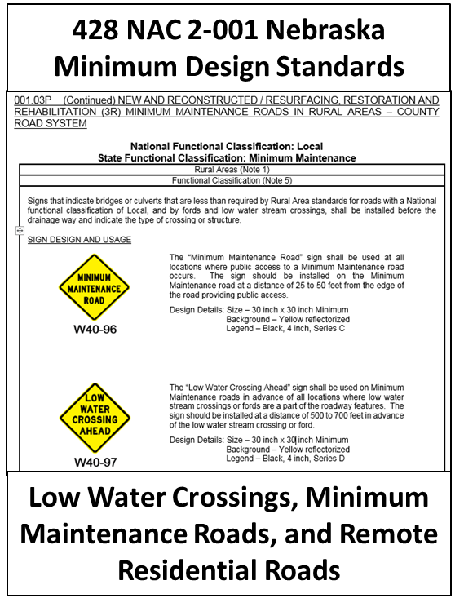
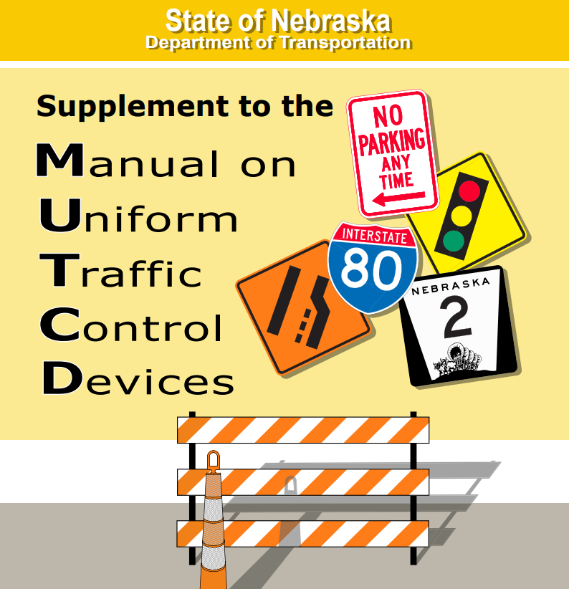

Order of Precedence - Summary
1 2 3
§60-6,118 adoption of MUTCD
17
Slide 17
Notes:
8/23/2021 replaced Nebraska Supplement with 2019 version
8/15/2021 added statutory reference to 60-6,118 which adopts the MUTCD and its Nebraska supplement
7/30/2020 added numbers to clearly show order of precedence
9/9/2019 added slide
PIQ2

Slide 18
Superintendent – Must Learn/Know:
Why and where signing and paint striping is used
Requirements for Engineering Studies
Approvals needed:
  County Board, City Council, Village Board
Importance of Record Keeping and Documentation of decisions and actions
The need to keep an inventory of:
  Signs
  When paint striping was done
  Construction project plans
  Signals, etc.
Note: NBCS standards (428 NAC 2 001.03B Note 9) states that Paint Striping is not used to measure lane widths
Slide 18
Notes:
5/21/2021 added a note that the MUTCD refers to more than just signs
7/24/2020 updated slide adding “Know” in title
9/9/2019 added slide
PIQ2, PIQ22
Note that the MUTCD refers not only to signs, but also to signals and paint striping

Slide 19
Erosion Control and Sediment Control Design Basics
Nebraska County Highway and City Street Superintendents Workshop
1 acre threshold
SWPPP – a written plan
Waters of the US – 1/10 acre threshold
Tab 17
9/9/2022
Boards - Liaison Services Section
Notes:
9/9/2022 added Tab number and revision date
7/25/2020 Updated slide – notes
SWPPP = Stormwater Pollution Prevention Plan

Slide 20
Construction Storm Water Permit
Project size
  1 acre or more
  Including staging area, borrow pits, etc.
SWPPP must be developed
Requires routine site inspections
Slide 20
Notes:
9/9/2019 added slide
SWPPP - stormwater pollution prevention plan

Slide 21
CWA Section 404 Permit
A permit is required for the discharge of dredged or fill material into waters of the U.S., including wetlands via the Corps of Engineers.
Many waterbodies and wetlands are waters of the U.S. and are subject to the Corps’ regulatory authority.
CWA Section 401 coordination with NDEE is required for any impacts to waters of the State.
Slide 21
Slide 21
Notes:
9/10/2021 changed NDEQ to NDEE
9/9/2019 added slide
Section 404 of the Clean Water Act (CWA) establishes a program to regulate the discharge of dredged or fill material into waters of the United States, including wetlands. Activities in waters of the United States regulated under this program include fill for development, water resource projects (such as dams and levees), infrastructure development (such as highways and airports) and mining projects. Section 404 requires a permit before dredged or fill material may be discharged into waters of the United States, unless the activity is exempt from Section 404 regulation (e.g., certain farming and forestry activities).
The basic premise of the program is that no discharge of dredged or fill material may be permitted if: (1) a practicable alternative exists that is less damaging to the aquatic environment or (2) the nation’s waters would be significantly degraded. In other words, when you apply for a permit, you must first show that steps have been taken to avoid impacts to wetlands, streams and other aquatic resources; that potential impacts have been minimized; and that compensation will be provided for all remaining unavoidable impacts.

Slide 22
Waters of the U.S.
Examples of possible waters of the U.S. include:
  Streams, lakes and ponds
  Impounding reservoirs
  Marshes and Wetlands
  Watercourses, waterways
  Irrigation and drainage systems
  Roadside ditch wetlands
Impacts greater than 1/10 acre will also require mitigation.
Usually > a 1:1 ratio.
Slide 22
Notes:
9/9/2019 added slide

Slide 23
Storm Water Pollution Prevention Plan
A narrative describing the timing for installation of BMP’s (Best Management Practices)
  A. Erosion Control
  B. Sediment Control
Plan sheets detailing the placement of BMP’s
Standard details describing BMP’s
Permits / Environmental Commitments
  Wetlands
Endangered species protection
Temporary and Permanent Plans
Good Housekeeping Practices
Slide 23
Notes:
9/9/2019 added slide
Includes site specific information – identify streams or bodies of water that could be impacted. NDEQ listed impaired streams, Particular erosive soil types…

Slide 24
Purpose of a SWPPP
Minimize accelerated soil erosion on disturbed areas
Minimize the discharge of sediment and other pollutants in storm water runoff
Maintain compliance with the local Ordinance (track-out) and state NPDES Permit
Slide 24
Notes:
9/9/2019 added slide
Trackout is defined as any material that adheres to and agglomerates on vehicle tires or exterior surfaces and is deposited on a public paved road. This source of fugitive dust is typically caused by soil being dragged out of a disturbed or unpaved surface onto a public paved street where vehicle traffic pulverizes and disperses soil particles into the atmosphere. Mud, dirt, and other debris carried from a work site on the wheels or undercarriage of trucks and other equipment onto public roads is not only a health concern but can cause visibility issues and safety hazards.

Slide 25
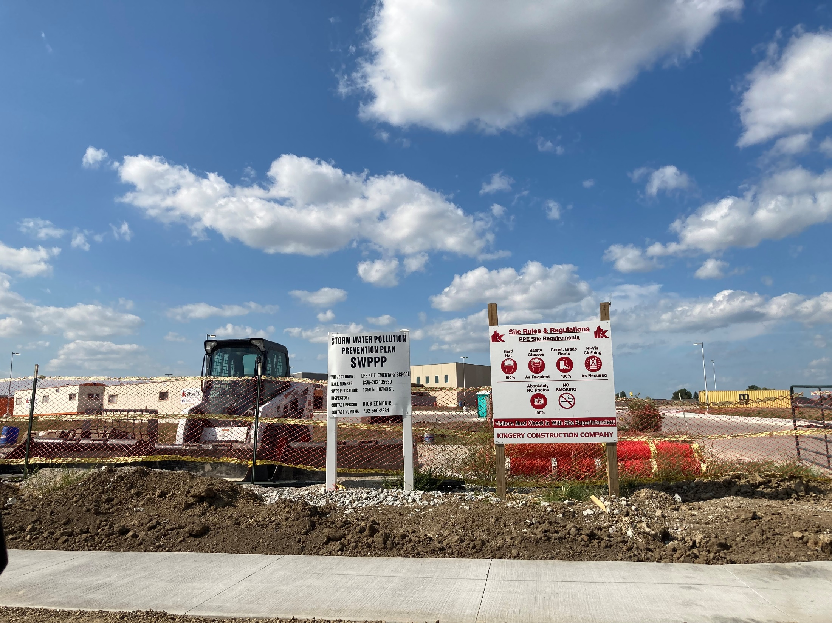
Training and Certification
Erosion and Sediment Control Basics for Designers
Erosion and Sediment Control Basics for Inspectors
  NDEE approved
  Five-year certification
Slide 25
Notes:
9/10/2022 added photo of SWPPP posted at actual jobsite (new school in northeast Lincoln)
9/10/2021 changed NDEQ to NDEE
9/9/2019 added slide

Slide 26
Consultants
Nebraska County Highway and City Street Superintendents Workshop
$118,000 threshold
§81-3445
Records Management
(GOVERNING BODY)
Design and Construction Services
Consultant: extended staff, providing professional services that meets laws, regulations, standards, ethics, and good practice
Superintendent: manages consultant – refer to duties of a Superintendent (“manage personnel”)
§39-2301.01
(slide 10)
Governing Body: overall responsible, cannot cede its statutory responsibility to a consultant
§39-1402
(counties)
Tab 18
Boards - Liaison Services Section
Notes:
9/12/2022 added statute for counties governing bodies
9/9/2022 added Tab number and revision date
9/10/2021 need to add info on $30,000 municipal threshold (what is the statute?)
9/27/2022 added verbiage to notes field ($30,000 threshold municipalities)
5/21/2021 added verbiage to notes field
7/25/2020 Updated – public works exemption adjustment
PIVQ12
DAS set $118,000 effective July 1, 2019 thru June 30, 2024. Per LeMoyne Schulz email 3/6/2020. Refer to the Engineers website under “Latest News” June 26, 2019 – Public Works Exemption Adjustment.
$118,000 threshold (per LeMoyne Schulz, municipal laws have a $30,000 threshold)
Consultant: extended staff, professional work, meets laws, regulations, standards, ethics, good practice DELIVERS A PLROFESSIONAL PRODUCT
Superintendent: manages consultant – manages consultant refer to duties of a Superintendent (“manage personnel”) 39-2301.01(4)(3) and 39-2502(5)
Governing body: overall responsible! Cannot cede its responsibility to consultant ULTIMATELY RESPONSIBLE FOR THE WORK
MAKE SURE YOU AS THE PROJECT OWNER HAVE/TAKE POSSESSION OF PROJECT DOCUMENTS. Don’t rely on the consultant to store documentation. That is a big no-no.

Slide 27
Key Topics
Quick Review
Nebraska County Highway and City Street
Superintendents Exam Preparation
Ask Your Questions Now!
9/27/2022
Boards - Liaison Services Section
Notes:
9/27/2022 updated date
9/9/2022 updated date
9/12/2021 Updated date

