Slide 1
Federal Performance Update
MPO Coordination Meeting
May 10, 2016
Notes:
Most of us work in processes and work toward improving processes. I’m going to be describing the process improvement methods and techniques I’ve been exposed to and why they are unique when compared with other process improvement efforts

Slide 2

Background
Performance Management: a strategic approach that uses system information to make investment and policy decisions to achieve national performance goals.
Established by Congress in MAP-21 in 2012, perpetuated by the FAST Act
FHWA must create performance measures and every State DOT/MPO must report performance

Slide 3
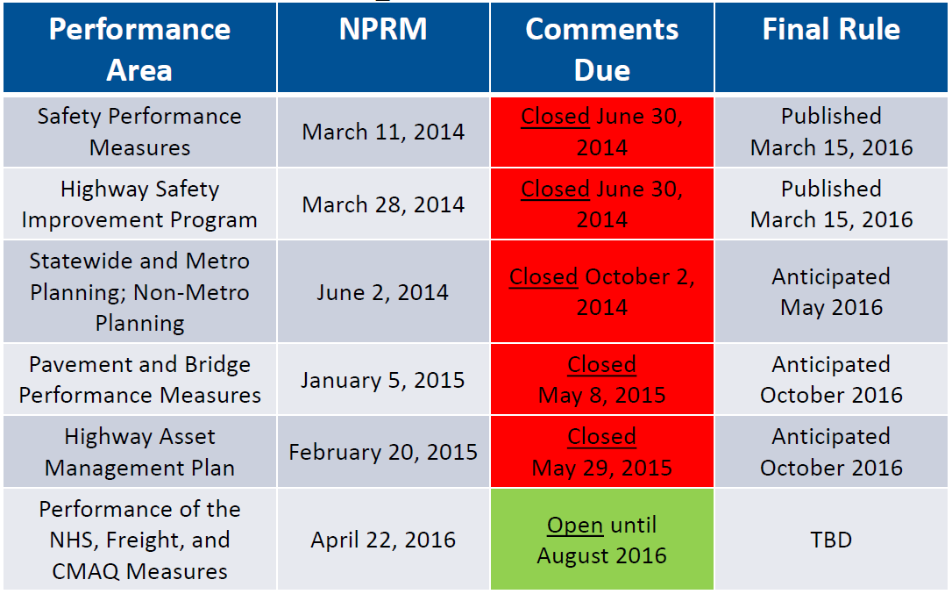
Rulemaking Schedule

Slide 4
Final HSIP Rule
HSIP : Federal-aid program whose purpose is to achieve a significant reduction in fatalities and serious injuries on all public roads
Final rule was effective as of 4/14/16
HSIP must be submitted at the end of August, Annually
Removes 10% flex funding and reporting requirements for HRRR

Slide 5
Final HSIP Rule
Updates requirements for the Strategic Highway Safety Plan
Submit a plan and implement a program to collect MIRE data on all public roads
  Plan for implementation due in 2017
  Implemented fully by 2026

Slide 6
Final Safety Rule
Measures
  Number and Rate of Fatalities
  Number and Rate of Serious Injuries
  Number of Non-Motorized Fatalities and Serious Injuries
Data: 5 year rolling average

Slide 7
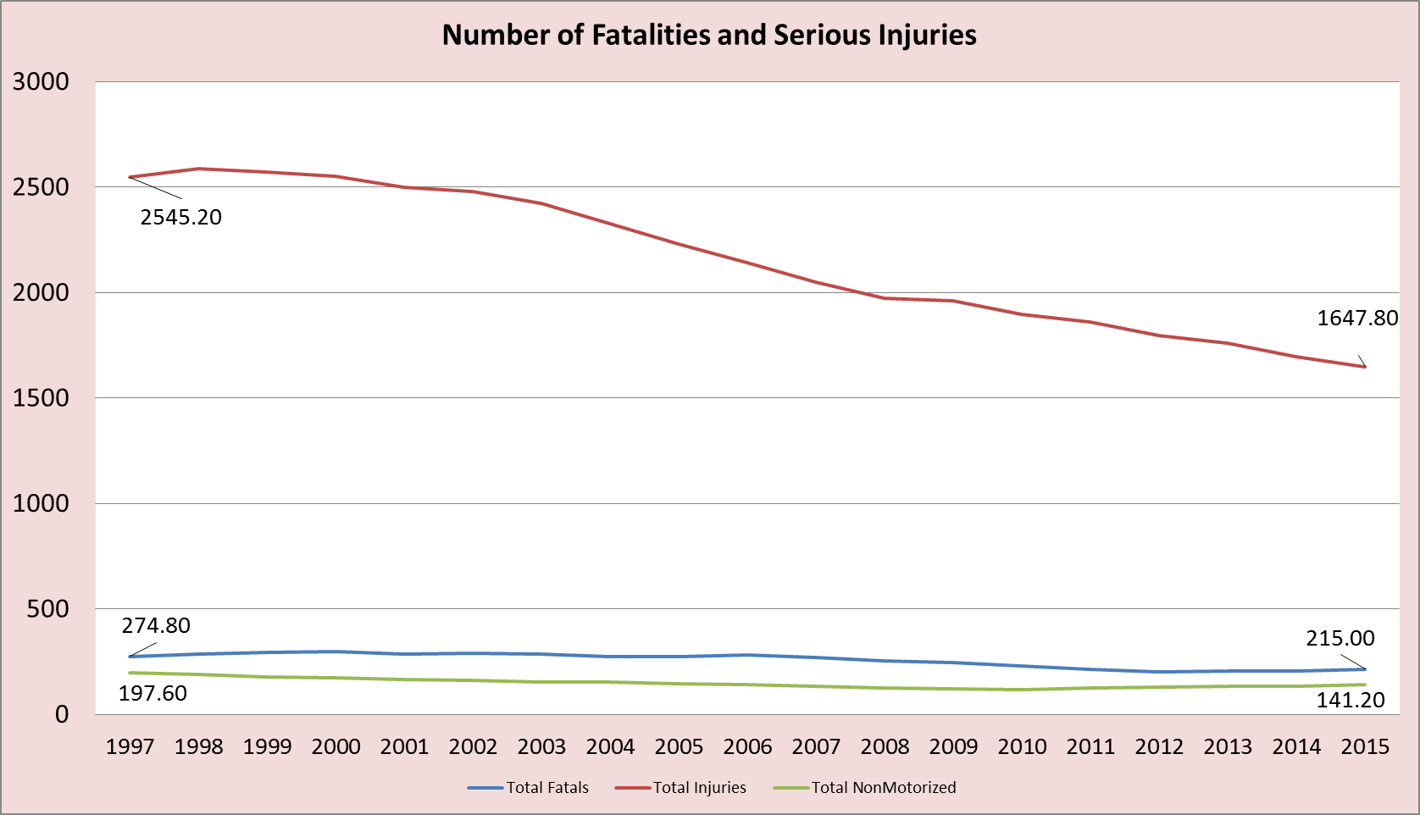
Final Safety Rule

Slide 8
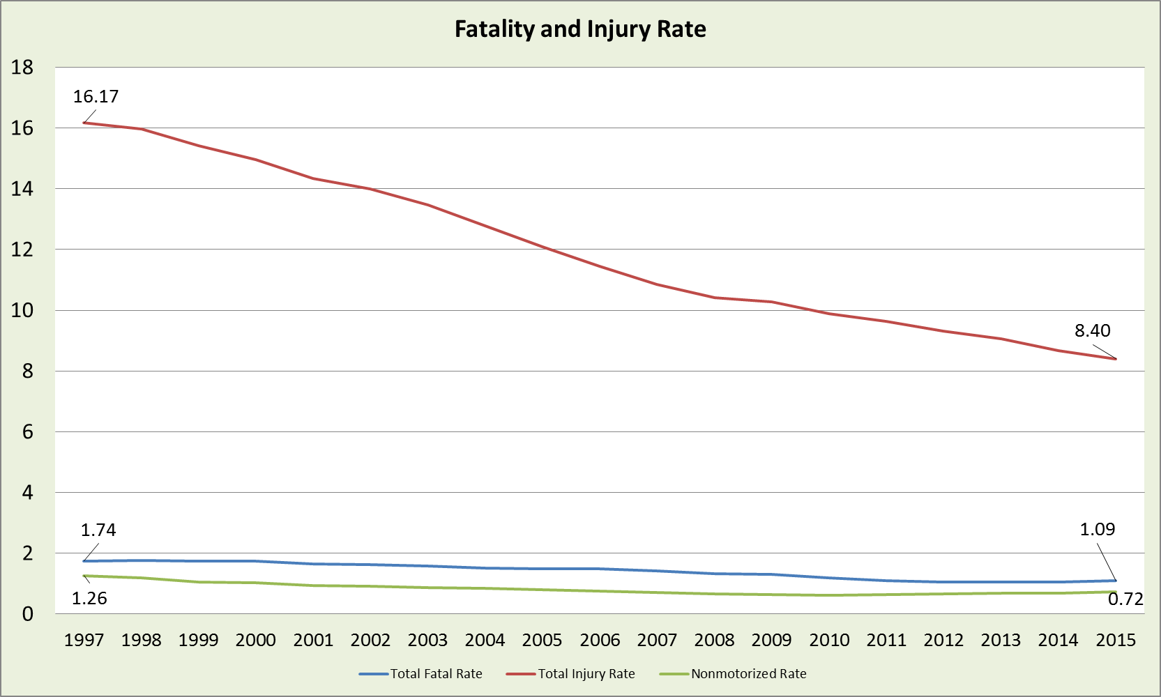
Final Safety Rule

Slide 9
Final Safety Rule
Reporting
  State DOT: HSIP Annual report
  MPO: To the State DOT
Significant progress
  A State meets or makes significant progress towards meeting its targets when
    4 of 5 targets are either met or;
    The outcome is better than the State's baseline safety performance for that measure (the number or rate is less than the 5-year rolling average).

Slide 10
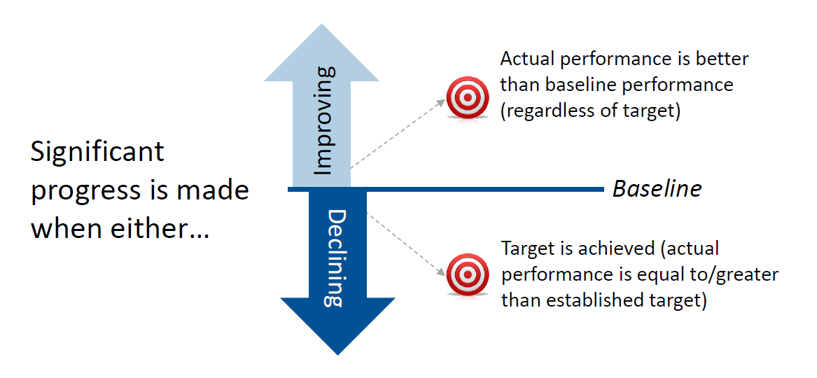
Final Safety Rule
Significant progress

Slide 11
Final Safety Rule
DOT Targets
  Due Date: Targets will be established annually, beginning in August 2017 for calendar year 2018.
  Performance year: representing the calendar year following each HSIP annual report.
  Must also coordinate with the MPOs to the maximum extent practicable

Slide 12
Final Safety Rule
MPO Targets
  Targets will be established annually, up to 180 days after the State DOT establishes their targets
  Set for all public roads within the MPO Planning area
  May agree with State DOT target or set MPO specific targets
  Must coordinate with State DOT to the maximum extent practicable
  MPOs that cross state lines must prepare a set of targets for each state in their region - §490.209(d)(2)

Slide 13
Final Safety Rule
Penalties
  DOT:
    If States don't meet their targets, they must:
    (a) Use a portion of their obligation authority, equal to the HSIP apportionment only, for the fiscal year prior to the year when the target was not met, for HSIP projects only.
    (b) Submit an annual implementation plan that describes the actions they will take to meet their targets in the future.
  MPO: None

Slide 14
Time Line for Safety and HSIP Rule
Now – 8/31/17: Begin coordinating target setting activities
8/31/17: State DOT Targets are Due with HSIP Submission
2/28/18: MPO Targets Due
5/1/18: State DOT must prepare an implementation plan if targets aren’t met

Slide 15
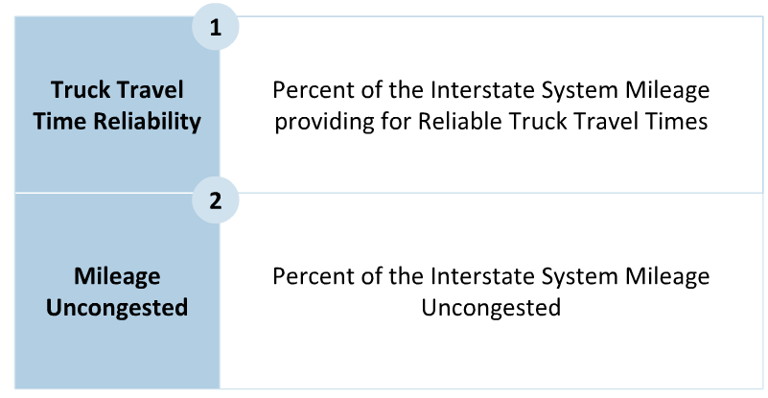
NPRM - Freight
Measures

Slide 16
NPRM - Freight
National Performance Management Research Data Set (NPMRDS) will be used to calculate – unless an equivalent data set is available and approved by FHWA

Slide 17
NPRM - Freight
Geographic Area Used for establishing targets
  Statewide (only within state boundaries)
  MPO - within their planning area, including all states (goes beyond state boundaries)
Multi state MPOs
  MPO must coordinate with all states
  State only adopts targets for its area; i.e. NDOR must only adopt targets for the area within the MPO that is within the state.

Slide 18
NPRM - Freight
Geographic Area Used for establishing targets
  Statewide (only within state boundaries)
  MPO - within their planning area, including all states (goes beyond state boundaries)
Multi state MPOs
  MPO must coordinate with all states
  State only adopts targets for its area; i.e. NDOR must only adopt targets for the area within the MPO that is within the state.

Slide 19
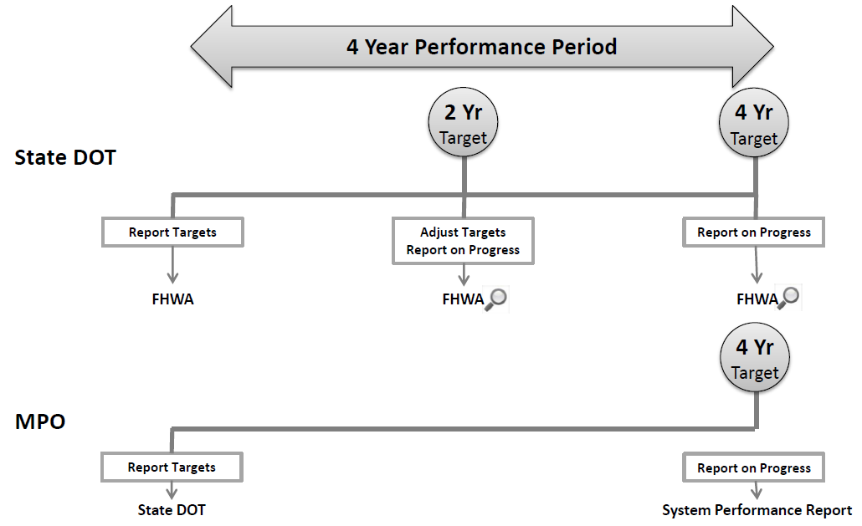
NPRM - Freight
Start Date: 1/1/18

Slide 20
NPRM - Freight
Consequence: State DOTs are required to achieve or make significant progress toward their targets every biennial reporting period (every 2 years), and are to take additional reporting actions for the measure group if FHWA determines significant progress is not made.
  No MPO Consequence

Slide 21
Next Steps
Begin scheduling target setting coordination meetings with the MPOs for the Safety Rule
Provide comments to the Docket regarding System Performance NPRM

Slide 22
Q & A
Helpful Information:
FHWA Overview Webinars for System Performance: http://www.fhwa.dot.gov/tpm/rule/pm3_nprm.cfm
Fact Sheets available for Safety Final Rule and System Performance NPRM
Thanks to the FHWA for all the updates and graphics!
Ryan Huff
Rail And Public Transportation Engineer - NDOR
Ryan.huff@Nebraska.gov
402-479-3797

