Slide 1
Superintendents Exam Preparation
Nebraska County Highway and City Street Superintendents
Please sign the Sign-in sheet
Boards - Liaison Services Section
Tab 11
July 27, 2023
Notes:
7/27/2023 Updated slide 5 screenshot, updated slide 6 screenshot (Treasure’s website), updated slides 11 and 12 with current screenshots and information, changed slide 16, removing reference to the Build Nebraska Act because it pertains only to state highways, changed slide 17 extensively with latest statute changes per LB727, 2023 deemphasized the Build Nebraska Act, modified slide 18 By noting that the county bridge match program sunsets in 2029 per a recent statute change, changed slide 40 per LB683, 2023, and LB818, 2023, also added web links, and updated slide 42 screenshot (new financial flow chart)
1/23/2023 updated Slide 12 with latest fuel tax rates
9/17/2022 changed animations Slide 10
9/9/2022 added Tab number to Slide 1
8/16/2022 updated slides 11 and 12 with latest motor fuels tax info, slide 20 distribution amounts, and slide 42 with latest transportation financing flow chart.
10/13/2021 added web link to slides 44 and 45
9/3/2021 Updated slides 15, 16, 18, 20
8/10/2021 Updated – major changes – eliminated many State and Federal funding slides which shortened this part considerably.

Slide 2
Day 4 Agenda
Funding Sources
Other Topics
Free Style Exercises
Practice Exam (one hour)
Slide 2

Slide 3



Funding Sources and Highway Law
$
TTC-18049-B
Boards - Liaison Services Section
Slide 3
Notes:
Point to handouts

Slide 4
Funding Sources and Highway Law
Why Learn about Funding and Financing?
Be able to communicate accurate information to elected officials and constituents
Take advantage of funding opportunities
Slide 4
Notes:
6/23/2021 switched the order of the two bullets
1/31/2020 Updated. Changed “correct” to “accurate” in second bullet.
8/14/2019 Updated reworded first bullet point and eliminated second bullet (SSAR report to NBCS) per LB82.
Reasons for reviewing this material

Slide 5
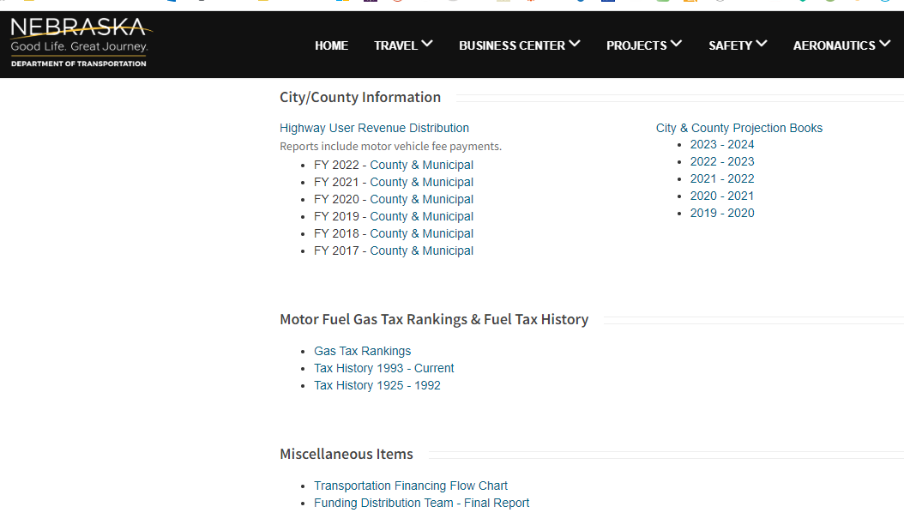
Where to Find Financials
https://dot.nebraska.gov/business-center/financial-reports/
Slide 5
Notes:
8/14/2019 Updated web link.

Slide 6
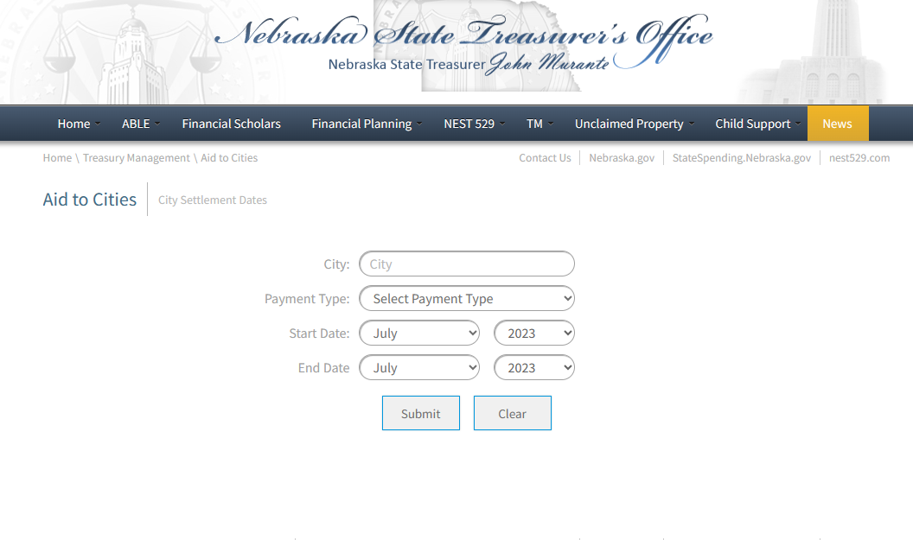
Where to Find Financials
https://treasurer.nebraska.gov/tm/aid-to-cities.aspx
https://treasurer.nebraska.gov/tm/aid-to-counties.aspx
Slide 6
Notes:
7/27/2023 Updated screen shot (The reference to the Build Nebraska Act has been deleted).
8/14/2019 Updated screen shot (Stenberg no longer in office).

Slide 7

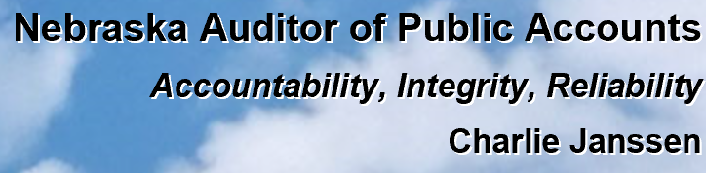
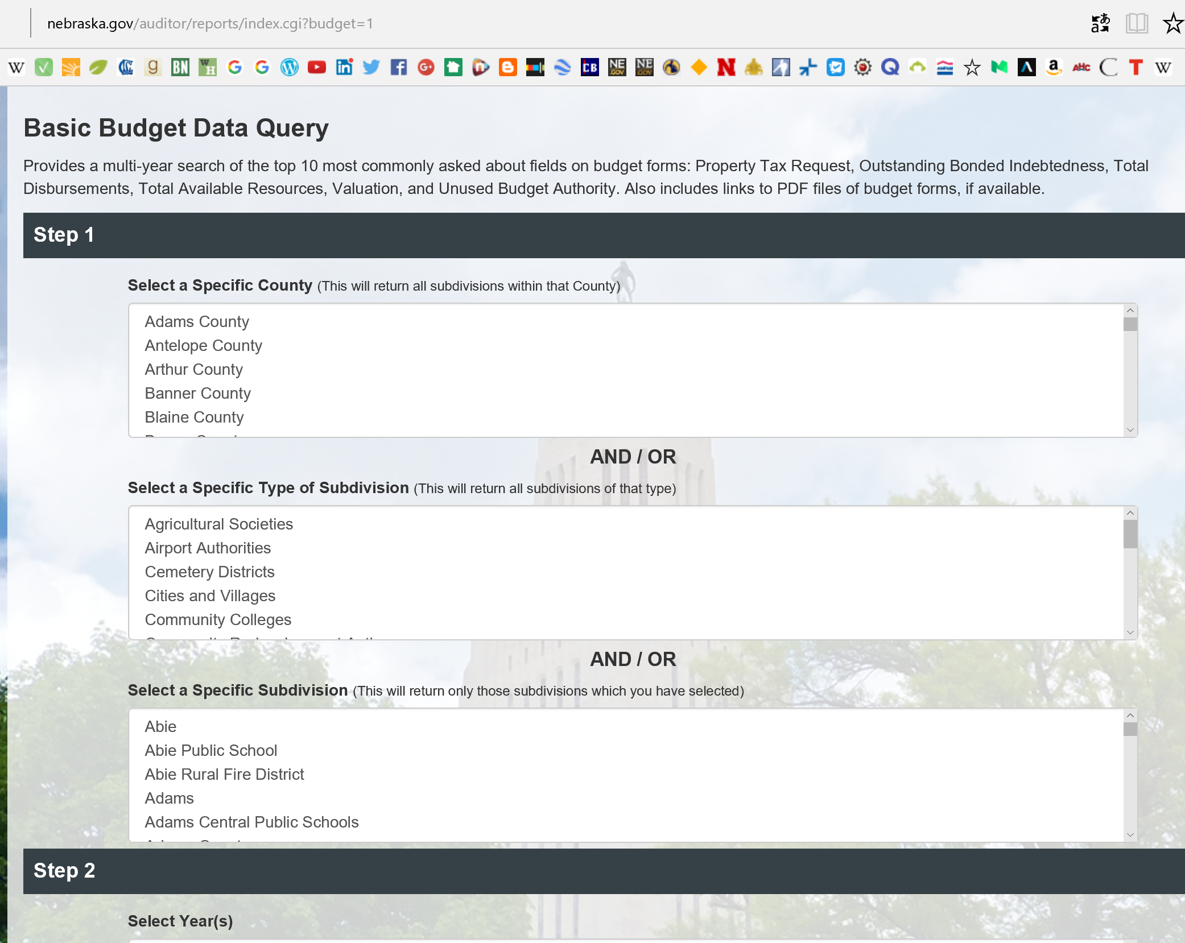
Where to Find Financials
http://www.nebraska.gov/auditor/reports/index.cgi?budget=1
Slide 7

Slide 8
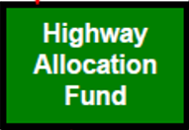

$
Funding
Main Sources
Counties and Municipalities
Highway Allocation Fund (HAF) Distributions
Local (Motor Vehicle Fee, Property Tax, Wheel Tax, Bonds, etc.)
State (Federal Funds Buyout, State-aid Bridge, etc.)
Federal, mainly FHWA)
Slide 8

Slide 9


§39-2510 (1), §39-2520 (1)
Use of Funds
HAF and Local Match may only be spent on highways, streets and roads and related items/activities!
Use Restriction: Can’t borrow from the Road/Street fund to pay for non-Roads items!
Examples: water tower, jail, county fair building, a library, swimming pool, wastewater treatment plant
COUNTY
MUNICIPALITY
Other State and Federal funds have similar restrictions
Slide 9
Notes:
(2) The requirements of subsection (1) of this section also apply to sales and use taxes imposed on motor vehicles, trailers, and semitrailers pursuant to sections 13-319 and 77-27,142, except that such provisions shall not apply in a county or municipal county that has issued bonds
(a) the proceeds of which were used for purposes listed in subsection (1) of this section and for which revenue other than sales and use taxes on motor vehicles, trailers, and semitrailers is pledged for payment or
(b) approved by a vote that required the use of sales and use taxes imposed on motor vehicles, trailers, and semitrailers for a specific purpose other than those listed in subsection (1) of this section, until all such bonds issued prior to January 1, 2006, have been paid or retired. The county or municipal county shall include a certification with the report … (Emphasis added)

Slide 10
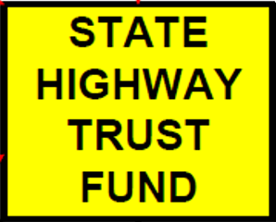
§39-2215
Three main funding sources for the HTF:
Certain Motor Vehicle Fuel Taxes & related penalties and interest
5 cents of State Sales Tax from motor vehicles, trailers, and semitrailers (§77-27,132)
Certain Motor Vehicle registration fees
Also:
  International Truck Registration Fees
  Interest Earnings on Investments
  Any other Highway-user taxes imposed by state law
STATE HIGHWAY TRUST FUND
Slide 10
Notes:
9/17/2022 changed animations.
That is actually 5.5 cents of State Sales Tax, but ½ cent of the 5.5 cents goes directly into the Highway Allocation Fund
Art. 22, Nebraska Highway Bonds (Partial Listing)
Section 39-2215. Highway Trust Fund; created; allocation; investment; State Treasurer; transfer; disbursements. (1) There is hereby created in the state treasury a special fund to be known as the Highway Trust Fund.
(2) All funds credited to the Highway Trust Fund pursuant to [certain Motor Fuel Taxes] sections 66-489.02, 66-499, 66-4,140, 66-4,147, 66-6,108, and 66-6,109.02, and related penalties and interest, shall be allocated as provided in such sections.
(3) All other motor vehicle fuel taxes, … related to highway use retained by the state, all motor vehicle registration fees retained by the state other than those fees credited to the State Recreation Road Fund … and other highway-user taxes imposed by state law and allocated to the Highway Trust Fund, except for the proceeds of the sales and use taxes derived from motor vehicles, trailers, and semitrailers … are hereby irrevocably pledged for the terms of the bonds issued prior to January 1, 1988 … [Not applicable – no bonds have been issued for years]
ARTICLE 22
NEBRASKA HIGHWAY BONDS
(Partial Listing)
Section.
39-2215. Highway Trust Fund; created; allocation; investment; State Treasurer; transfer; disbursements.
Section 39-2215. Highway Trust Fund; created; allocation; investment; State Treasurer; transfer; disbursements. (1) There is hereby created in the state treasury a special fund to be known as the Highway Trust Fund.
(2) All funds credited to the Highway Trust Fund pursuant to sections 66-489.02, 66-499, 66-4,140, 66-4,147, 66-6,108, and 66-6,109.02, and related penalties and interest, shall be allocated as provided in such sections.
(3) All other motor vehicle fuel taxes, diesel fuel taxes, compressed fuel taxes, and alternative fuel taxes related to highway use retained by the state, all motor vehicle registration fees retained by the state other than those fees credited to the State Recreation Road Fund pursuant to subdivision (3) of section 60-3,156, and other highway-user taxes imposed by state law and allocated to the Highway Trust Fund, except for the proceeds of the sales and use taxes derived from motor vehicles, trailers, and semitrailers credited to the fund pursuant to section 77-27,132, are hereby irrevocably pledged for the terms of the bonds issued prior to January 1, 1988, to the payment of the principal, interest, and redemption premium, if any, of such bonds as they mature and become due at maturity or prior redemption and for any reserves therefor and shall, as received by the State Treasurer, be deposited in the fund for such purpose.
(4) Of the money in the fund specified in subsection (3) of this section which is not required for the use specified in such subsection, (a) an amount equal to three dollars times the number of motorcycles registered during the previous month shall be placed in the Motorcycle Safety Education Fund, (b) an amount to be determined annually by the Legislature through the appropriations process may be transferred to the Motor Fuel Tax Enforcement and Collection Cash Fund for use as provided in section 66-738 on a monthly or other less frequent basis as determined by the appropriation language, (c) an amount to be determined annually by the Legislature through the appropriations process shall be transferred to the License Plate Cash Fund as certified by the Director of Motor Vehicles, and (d) the remaining money may be used for the purchase for retirement of the bonds issued prior to January 1, 1988, in the open market.
(5) The State Treasurer shall monthly transfer, from the proceeds of the sales and use taxes credited to the Highway Trust Fund and any money remaining in the fund after the requirements of subsections (2) through (4) of this section are satisfied, thirty thousand dollars to the Grade Crossing Protection Fund.
(6) Except as provided in subsection (7) of this section, the balance of the Highway Trust Fund shall be allocated fifty-three and one-third percent, less the amount provided for in section 39-847.01, to the Department of Transportation, twenty-three and one-third percent, less the amount provided for in section 39-847.01, to the various counties for road purposes, and twenty-three and one-third percent to the various municipalities for street purposes. If bonds are issued pursuant to subsection (2) of section 39-2223, the portion allocated to the Department of Transportation shall be credited monthly to the Highway Restoration and Improvement Bond Fund, and if no bonds are issued pursuant to such subsection, the portion allocated to the department shall be credited monthly to the Highway Cash Fund. The portions allocated to the counties and municipalities shall be credited monthly to the Highway Allocation Fund and distributed monthly as provided by law. Vehicles accorded prorated registration pursuant to section 60-3,198 shall not be included in any formula involving motor vehicle registrations used to determine the allocation and distribution of state funds for highway purposes to political subdivisions.
(7) If it is determined by December 20 of any year that a county will receive from its allocation of state-collected highway revenue and from any funds relinquished to it by municipalities within its boundaries an amount in such year which is less than such county received in state-collected highway revenue in calendar year 1969, based upon the 1976 tax rates for highway-user fuels and registration fees, the Department of Transportation shall notify the State Treasurer that an amount equal to the sum necessary to provide such county with funds equal to such county's 1969 highway allocation for such year shall be transferred to such county from the Highway Trust Fund. Such makeup funds shall be matched by the county as provided in sections 39-2501 to 39-2510. The balance remaining in the fund after such transfer shall then be reallocated as provided in subsection (6) of this section.
(8) The State Treasurer shall disburse the money in the Highway Trust Fund as directed by resolution of the commission. All disbursements from the fund shall be made upon warrants drawn by the Director of Administrative Services. Any money in the fund available for investment shall be invested by the state investment officer pursuant to the Nebraska Capital Expansion Act and the Nebraska State Funds Investment Act and the earnings, if any, credited to the fund. (Emphasis added)
Source
Laws 1969, c. 309, § 15, p. 1111; Laws 1971, LB 53, § 3; Laws 1979, LB 571, § 2; Laws 1981, LB 22, § 8; Laws 1983, LB 118, § 2; Laws 1984, LB 1089, § 1; Laws 1986, LB 599, § 11; Laws 1988, LB 632, § 9; Laws 1989, LB 258, § 3; Laws 1990, LB 602, § 1; Laws 1991, LB 627, § 4; Laws 1992, LB 319, § 1; Laws 1994, LB 1066, § 25; Laws 1994, LB 1160, § 49; Laws 1995, LB 182, § 22; Laws 2002, LB 989, § 7; Laws 2002, Second Spec. Sess., LB 1, § 2; Laws 2003, LB 563, § 17; Laws 2004, LB 983, § 1; Laws 2004, LB 1144, § 3; Laws 2005, LB 274, § 228; Laws 2008, LB 846, § 1.Operative date July 18, 2008
Cross References: Nebraska Capital Expansion Act, see section 72-1269.
Nebraska State Funds Investment Act, see section 72-1260.

Slide 11
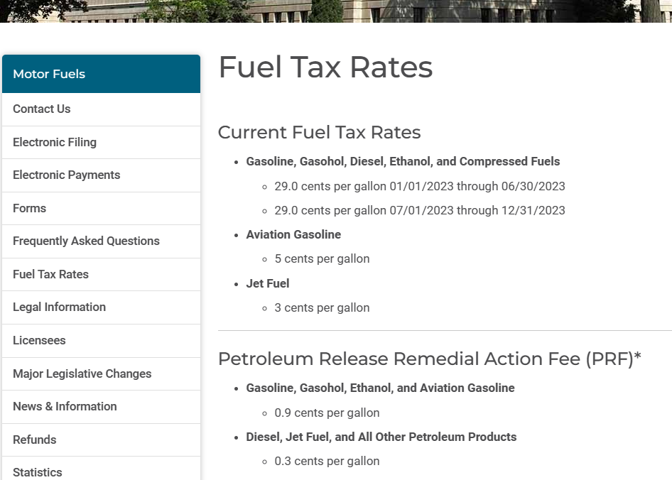
Motor Fuels Tax https://revenue.nebraska.gov/motor-fuels/fuel-tax-rates
Slide 11
Notes:
7/27/2023 Updated with latest fuel tax info
8/16/2022 Updated with latest fuel tax info
6/23/2021 Updated with latest fuel tax info

Slide 12

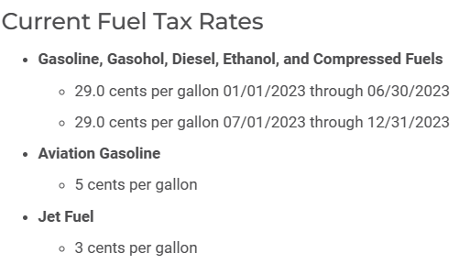
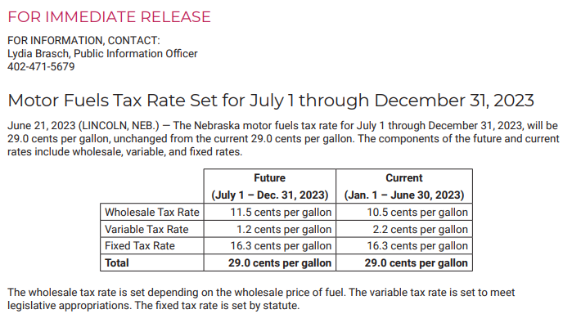
https://revenue.nebraska.gov/motor-fuels
Slide 12
Notes:
7/27/2023 Updated slide with current screenshots and information
1/23/2023 Updated with screen shot from Dept of Revenue (the new letter is not posted yet on their website).
8/16/2022 Updated Motor Fuels Tax Rate and added Dept of Revenue web link.
1/31/2020 Updated Motor Fuels Tax Rate
8/14/2019 Added slide

Slide 13
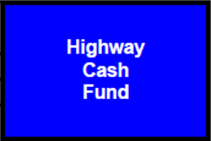
§39-2215
Main Distribution of HTF
53 1/3% to NDOT Less State Aid Bridge Funds
23 1/3% to Counties Less State Aid Bridge Funds
23 1/3% to Municipalities
All for road purposes (nothing else!)
STATE HIGHWAY TRUST FUND
If no bonds are issued NDOT’s share goes to Highway Cash Fund MONTHLY
Counties and Municipalities share goes to Highway Allocation Fund MONTHLY
Slide 13
Notes:
1/31/2020 Updated. Added yellow highlights for locals’ percentages, and green highlight for bottom note.
AFTER some funds are taken off the top: motor fuel tax enforcement and collection, license plate fund, grade crossing protection funds ($30k/ml)
§39-2215
(6) Except as provided in subsection (7) of this section, the balance of the Highway Trust Fund shall be allocated fifty-three and one-third percent, less the amount provided for in section 39-847.01 [State Aid Bridge Fund], to the Department of Transportation, twenty-three and one-third percent, less the amount provided for [State Aid Bridge Fund], to the various counties for road purposes, and twenty-three and one-third percent to the various municipalities for street purposes. If bonds are issued …, and if no bonds are issued …, the portion allocated to the department shall be credited monthly to the Highway Cash Fund. The portions allocated to the counties and municipalities shall be credited monthly to the Highway Allocation Fund and distributed monthly as provided by law. Vehicles accorded prorated registration pursuant to section 60-3,198 shall not be included in any formula involving motor vehicle registrations used to determine the allocation and distribution of state funds for highway purposes to political subdivisions.

Slide 14
$
Funding
Main Sources
Counties and Municipalities
Highway Allocation Fund (HAF) Distributions
Local (Motor Vehicle Fee, Property Tax, Wheel Tax, Bonds, etc.)
State (Federal Funds Buyout, State-aid Bridge, etc.)
Federal (mainly FHWA)
https://treasurer.nebraska.gov/tm/aid-to-counties.aspx
Slide 14
Notes:
8/14/2019 Updated with web link to Treasurer’s “Aid to Counties” website.

Slide 15
§39-2401 Highway
Allocation Fund (HAF)
Consists of . . .
Typically the MAIN FUNDING SOURCE for counties and municipalities
Counties and Municipalities are required to provide MATCHING FUNDS
County and Municipal share of Hwy Trust Fund
The State’s General Fund money if available
State taxes on motor vehicles from the sale or lease for periods of more than thirty-one days of motor vehicles, trailers, and semitrailers (5 1/2 cents) per §77-27,132 State Sales and Use Taxes
5 cents goes to
½ cent goes directly into
Any interest earned on invested funds
HAF (MUNICIPALITY) FUNDS
HAF (COUNTY) FUNDS
Slide 15
Notes:
9/3/2021 Updated reworded the two sub-bullets to mainly clarify that the ½ cent goes directly into the HAF.
1/31/2020 Updated. Added arrows to clarify.
Section 39-2401. Highway Allocation Fund; created; investment. There is hereby established the Highway Allocation Fund. There shall be paid into such fund the amounts disbursed from time to time from the Highway Trust Fund as provided by law together with such sums as may be appropriated thereto from the General Fund and proceeds of sales and use taxes credited to the Highway Allocation Fund under section 77-27,132 [see p. 32-33]. Any money in the fund available for investment shall be invested by the state investment officer pursuant to the Nebraska Capital Expansion Act and the Nebraska State Funds Investment Act.
-- Turn to p. 32, middle of page --
Ch. 66, Art 4, Sec. 148
Highway Allocation Funds Distribution

Slide 16
Two Other Taxes
Are Currently Adding to the HAF
Additional sales tax revenue
Fixed Gas Tax
HAF (MUNI) FUNDING
HAF (COUNTY) FUNDING
The “Incremental Tax”
Slide 16
Notes:
7/26/2023 Removed reference to the Build Nebraska Act because that pertains only to state highways. Now it Is called“additional sales tax revenue” Instead of the Build Nebraska Act.
9/3/2021 updated by re-characterizing the taxes in the title – the Fixed Gas Tax (or “Incremental” tax) is not a temporary tax. So, the title is changed from “temporary” to “other.”

Slide 17
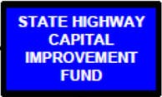
(also relates to Chapter 39 Article 27) for state highways
Additional sales tax revenue
§77-27,132(2)(c)
Revenue generated from statewide sales tax at a rate of ¼ of 1 cent
Started July 1, 2013, sunsets July 1, 2042
85% of ¼ of 1 cent to the State Highway Trust Fund, then to the State HCI Fund
15% of ¼ of 1 cent to the Highway Allocation Fund
(Build NE Act)
HAF (MUNI) FUNDING
HAF (COUNTY) FUNDING
Note: The build Nebraska Act pertains only to state highways; it does not pertain to the 15 per cent that goes to counties and municipalities.
Slide 17
Notes:
7/26/2023 Changes according to LB727/LB706 (2023), All bonds must be paid off by 2042. Deleted reference to LB84, 2011 on the slide. Updated 77-27,122 in the notes.
7/27/2023 Correctly cites the main reference to statutes which is chapter 77 (not Chapter 39, Article 27), added State Highway Trust Fund box, and changed sunset date to 2042. Updated, in the general notes, statute language for §77-27,132.
6/23/2021 added note regarding how much money BNA generates for locals.
6/23/2021 from NDOT website (https://dot.nebraska.gov/projects/bna/) the Build Nebraska Act is expected to generate $1.2 Billion over the 20 years starting 2013 before sunset in 2033. 15% results in $180 Million going to local agencies. That’s $9 Million per year average, split 50/50 between counties and municipalities, or $4.5 million to each group.
§77-27,132. updated 7/27/2023
Revenue Distribution Fund; created; use; collections under act; disposition.
(1) There is hereby created a fund to be designated the Revenue Distribution Fund which shall be set apart and maintained by the Tax Commissioner. Revenue not required to be credited to the General Fund or any other specified fund may be credited to the Revenue Distribution Fund. Credits and refunds of such revenue shall be paid from the Revenue Distribution Fund. The balance of the amount credited, after credits and refunds, shall be allocated as provided by the statutes creating such revenue.
(2) The Tax Commissioner shall pay to a depository bank designated by the State Treasurer all amounts collected under the Nebraska Revenue Act of 1967. The Tax Commissioner shall present to the State Treasurer bank receipts showing amounts so deposited in the bank, and of the amounts so deposited the State Treasurer shall:
(a) For transactions occurring on or after October 1, 2014, and before October 1, 2027, credit to the Game and Parks Commission Capital Maintenance Fund all of the proceeds of the sales and use taxes imposed pursuant to section 77-2703 on the sale or lease of motorboats as defined in section 37-1204, personal watercraft as defined in section 37-1204.01, all-terrain vehicles as defined in section 60-103, and utility-type vehicles as defined in section 60-135.01;
(b) Credit to the Highway Trust Fund all of the proceeds of the sales and use taxes derived from the sale or lease for periods of more than thirty-one days of motor vehicles, trailers, and semitrailers, except that the proceeds equal to any sales tax rate provided for in section 77-2701.02 that is in excess of five percent derived from the sale or lease for periods of more than thirty-one days of motor vehicles, trailers, and semitrailers shall be credited to the Highway Allocation Fund;
(c) For transactions occurring on or after July 1, 2013, and before July 1, 2042, of the proceeds of the sales and use taxes derived from transactions other than those listed in subdivisions (2)(a), (b), and (e) of this section from a sales tax rate of one-quarter of one percent, credit monthly eighty-five percent to the Highway Trust Fund and fifteen percent to the Highway Allocation Fund;

Slide 18
§39-2803, §66-4,145
LB610, 2015
Also refer to: §66-489 and §66-4,148
Fixed Gas Tax (Incremental Tax)
increased from 1½¢ to 6¢ 
  between FY2016 - FY2020
1/3 to NDOT
1/3 to Cities, 1/3 to Counties
Transportation
Infrastructure Bank Fund
(until 2033)
HAF (MUNI) FUNDING
HAF (COUNTY) FUNDING
County bridge match program ($40 million), sunsets 2029, §39-2805
★ 1¢ gas tax generates about $12 Million/Year
Slide 18
Notes:
7/27/2023 Added a recent change in statute that sunsets the county bridge match program in 2029 instead of 2033.
9/3/2021 Updated slide first bullet from “increases” to “increased” since all of the increases have already taken place. There is no sunset provision in LB610 (2015) so these fuel taxes continue until changed again by the Legislature. The Transportation Infrastructure Bank Fund sunsets in 2033 but the ta carries on. Also added the term “Incremental Tax” since financial reports and charts use that term, and the fact that the TIB feeds the county bridge match program (until 2033).
1/31/2020 Updated, added an arrow pointing to cities and counties
8/14/2019 Updated, minor formatting change to “Fixed Gas Tax.”
LEGISLATIVE BILL 610. Introduced by Smith, 14.
A BILL FOR AN ACT relating to motor fuels; to amend sections 66-489, 66-4,105, 66-4,145, 66-4,146, 66-6,107, and 66-6,109, Reissue Revised Statutes of Nebraska; to change excise taxes as prescribed; and to repeal the original sections.
66-4,145.
Additional excise tax.
(1) In addition to the tax imposed by sections 66-489, 66-489.02, and 66-4,140, each producer, supplier, distributor, wholesaler, and importer required by section 66-489 to pay motor fuels taxes shall pay an excise tax in an amount set in subsection (2) of this section on all motor fuels received, imported, produced, refined, manufactured, blended, or compounded by such producer, supplier, distributor, wholesaler, or importer within the State of Nebraska.
(2) The excise tax shall be:
(a) Two and eight-tenths cents per gallon through December 31, 2015;
(b) Three and eight-tenths cents per gallon beginning on January 1, 2016, through December 31, 2016;
(c) Four and eight-tenths cents per gallon beginning on January 1, 2017, through December 31, 2017;
(d) Five and eight-tenths cents per gallon beginning on January 1, 2018, through December 31, 2018; and
(e) Six and eight-tenths cents per gallon beginning on January 1, 2019.

Slide 19
Distributing the HAF
HAF (MUNI) FUNDING
HAF (COUNTY) FUNDING
Counties and Municipalities
Slide 19

Slide 20
66-4,148
Each County
Each Municipality
Distribution of Highway Allocation Funds
  Monthly ½ to counties ($193 Million in FY22)
  Monthly ½ to municipalities ($187 Million in FY22)
Distribution of funds based on the provisions of Chapter 39, Article 25
HAF (MUNI) DISTRIBUTION
HAF (COUNTY) DISTRIBUTION
Slide 20
Notes:
8/16/2022 Updated the allocation amounts to $193M and $187M
9/3/2021 Updated the numbers
8/14/2019 Updated the numbers from https://dot.nebraska.gov/media/13554/projection-book-city-county-fy-2020.pdf
Section 66-4,148. Highway Allocation Fund; distribution of funds. (1) The State Treasurer shall monthly distribute the receipts accruing to the Highway Allocation Fund pursuant to section 66-4,147. One-half of such receipts shall be distributed to the various counties and municipal counties for road purposes and one-half of such receipts shall be distributed to the various municipalities and municipal counties for street purposes.
(2) The distribution of funds to the respective cities, counties, and municipal counties under subsection (1) of this section shall be based on the provisions of Chapter 39, article 25. (Emphasis added)
-- Turn to p. 32, bottom of page --
Ch. 77, Art 27, Sec. 132
Sales & Income Tax Distribution (Sales Tax on Motor Vehicles)
Section 66-4,148. Highway Allocation Fund; distribution of funds. (1) The State Treasurer shall monthly distribute the receipts accruing to the Highway Allocation Fund pursuant to section 66-4,147. One-half of such receipts shall be distributed to the various counties and municipal counties for road purposes and one-half of such receipts shall be distributed to the various municipalities and municipal counties for street purposes.
(2) The distribution of funds to the respective cities, counties, and municipal counties under subsection (1) of this section shall be based on the provisions of Chapter 39, article 25. (Emphasis added)
Source: Laws 1980, LB 722, § 18; Laws 1986, LB 599, § 20; R.S.1943, (1990), § 66-480; Laws 2001, LB 142, § 53

Slide 21
§39-2507
  Distribution of Highway Allocation Funds (HAF) to Counties – 7 Factors
  Rural population of each county as determined by the most recent federal census 20%
  Total population of each county as determined by the most recent federal census 10%
  Lineal feet of bridges twenty feet or more in length and all overpasses in each county as determined by the most recent NDOT inventory 10%
  Total Motor vehicle registrations, other than prorated commercial vehicles, in the rural areas of each county as determined from the most recent information available from the DMV 20%
  Total Motor vehicle registrations, other than prorated commercial vehicles, in each county as determined from the most recent information available from the DMV 10%
  Miles of county and township roads within each county as determined by the most recent inventory available within the NDOT 20%
  Value of farm products sold from each county as determined from the most recent federal Census of Agriculture 10%
HAF (COUNTY) DISTRIBUTION
Slide 21
Notes:
Section 39-2507. Allocation of funds for road purposes; factors used. The following factors and weights shall be used in determining the amount to be allocated to each of the counties or municipal counties for road purposes each year:
(1) Rural population of each county or municipal county, as determined by the most recent federal census, twenty percent;
(2) Total population of each county or municipal county, as determined by the most recent federal census, ten percent;
(3) Lineal feet of bridges twenty feet or more in length and all overpasses in each county or municipal county, as determined by the most recent inventory available within the Department of Transportation, ten percent, and for purposes of this subdivision a bridge or overpass located partly in one county or municipal county and partly in another shall be considered as being located one-half in each county or municipal county;
(4) Total motor vehicle registrations, other than prorated commercial vehicles, in the rural areas of each county or municipal county, as determined from the most recent information available from the Department of Motor Vehicles, twenty percent;
(5) Total motor vehicle registrations, other than prorated commercial vehicles, in each county or municipal county as determined from the most recent information available from the Department of Motor Vehicles, ten percent;
(6) Total miles of county or municipal county and township roads within each county or municipal county, as determined by the most recent inventory available within the Department of Transportation, twenty percent; and
(7) Value of farm products sold from each county or municipal county, as determined from the most recent federal Census of Agriculture, ten percent. (Emphasis added)
Source: Laws 1969, c. 315, § 7, p. 1135; Laws 2001, LB 142, § 42

Slide 22
§39-2508
Monthly Distribution of Highway Allocation Funds (HAF) to Counties
Each County
NDOT computes County Highway Allocation amount monthly, using the seven (7) factors
State Treasurer direct deposits amount with County Treasurer monthly
HAF (COUNTY) DISTRIBUTION
Slide 22
Notes:
Section 39-2508. Allocation of funds for road purposes; Department of Transportation; State Treasurer; duties. The Department of Transportation shall compute the amount allocated to each county or municipal county under each of the factors listed in section 39-2507 and shall then compute the total allocation to each such county or municipal county and transmit such information to the local governing board and the State Treasurer, who shall disburse funds accordingly. (Emphasis added)
– Go to Notebook, white sheet –
“Projected Average Factor Dollar Value For Counties”
Gives an idea of the relative significance of the County Factors

Slide 23
§39-2509
Matching Funds Requirements
Matching Funds Requirements for Monthly HAF Allocations (County)
  First ½ - no matching requirement
  Second ½ - $1 for each $2 received
Match with ANY funds (Local, State or Federal) other than those from HAF – can’t match HAF $ with HAF $
HAF (COUNTY) MATCHING
Notes on Certain Monies from the HAF:
State-Aid Bridge Funds cannot used as local matching funds
Incentive Payments are off the top; no local match is required
Slide 23
Notes:
PIQ19, PIQ26, PVQ4 don’t forget – your jurisdiction can match with ANY money if it isn’t money from the HAF (like incentive payments, or state-aid bridge money)
§39-2509(1) and §39-2519(1)
The main local match formula to know for the exam is
First ½ no match
Second ½ match $1 for every $2 received
Section 39-2509. Matching funds; requirement; exceptions; effect. (1) Each county or municipal county shall be entitled to one-half of the amount allocated to it each year under sections 39-2507 and 39-2508 with no requirement for providing funds locally, but shall be required to match the second one-half on the basis of one dollar for each two dollars it receives with any available funds.
(2) Each county or municipal county which, during the preceding fiscal year, failed to provide locally the minimum required by subsection (1) of this section shall forfeit one dollar for each dollar which it fails to so provide locally. Any amounts forfeited under the provisions of this subsection first shall be made available to the incorporated municipalities, as determined by the county board or the council of the municipal county, within the county …. Such distribution shall be made as provided in sections 39-2507 and 39-2508…

Slide 24
§39-2509(2)
Failure to Meet Minimum HAF Matching Requirements
Option: if because of its levy lid, the county can request an exemption
Option: relinquish the money to one or more incorporated municipalities within the county; municipality provides the match
Forfeiture: $1 for each $1 county fails to provide locally (see Example), distributed to other Counties…which have met the full matching provisions
HAF (COUNTY) MATCHING
Example
HAF distribution to a county for the year = $100,000
Minimum matching requirement = 50% of 2nd ½ of HAF distribution = $25,000
Actual match provided by county = $20,000
Match deficit is $25,000 - $20,000 = $5,000, i.e. local match it failed to provide
County receives $5,000 less HAF distribution the following monthly distribution
The $5,000 must be made available by the county to incorporated municipalities within the county; any un-used is then distributed per §39-2507 and §39-2508 to other compliant counties
Slide 24
Notes:
8/14/2019 Updated minor editorial changes.
Section 39-2509. Matching funds; requirement; exceptions; effect. (1) Each county or municipal county shall be entitled to one-half of the amount allocated to it each year under sections 39-2507 and 39-2508 with no requirement for providing funds locally, but shall be required to match the second one-half on the basis of one dollar for each two dollars it receives with any available funds.
(2) Each county or municipal county which, during the preceding fiscal year, failed to provide locally the minimum required by subsection (1) of this section shall forfeit one dollar for each dollar which it fails to so provide locally. Any amounts forfeited under the provisions of this subsection first shall be made available to the incorporated municipalities, as determined by the county board or the council of the municipal county, within the county …. Such distribution shall be made as provided in sections 39-2507 and 39-2508…

Slide 25
§39-2517
  Distribution of Highway Allocation Funds (HAF) to Municipalities – 3 Factors
  Total Population as determined by the most recent federal census figures annually certified by the Tax Commissioner as provided in §77-3,119 50%
  Total motor vehicle registrations as determined from the most recent information available from the DMV 30%
  Total Miles of traffic lanes of streets as determined by the most recent inventory available within NDOT 20%
HAF (MUNI) DISTRIBUTION
Note: municipalities use lane-miles, counties use roadway miles
Slide 25
Notes:
Section 39-2517. Allocation of funds for street purposes; factors used. The following factors and weights shall be used in determining the amount to be allocated to each of the municipalities … for street purposes each year:
(1) Total population of each incorporated municipality …, as determined by the most recent federal census figures certified by the Tax Commissioner as provided in section 77-3,119, fifty percent;
(2) Total motor vehicle registrations, other than prorate commercial vehicles, in each incorporated municipality …, as determined from the most recent information available from the Department of Motor Vehicles, thirty percent; and
(3) Total number of miles of traffic lanes of streets in each incorporated municipality …, as determined by the most recent inventory available within the Department of Transportation, twenty percent. (Emphasis added)

Slide 26
§39-2518
Monthly Distribution of Highway Allocation Funds (HAF) to Municipalities
Each Municipality
NDOT computes highway allocation amount monthly
State Treasurer direct deposits amount monthly with City / Village Treasurer
HAF (MUNI) DISTRIBUTION
Slide 26
Notes:
Section 39-2518. Allocation of funds for street purposes; Department of Transportation; State Treasurer; duties. The Department of Transportation shall compute the amount allocated to each municipality or municipal county under the factors listed in section 39-2517 and shall then compute the total allocation to each such municipality or municipal county and transmit such information to the local governing body and the State Treasurer, who shall disburse funds accordingly. (Emphasis added)
Go to Notebook, white sheet
“Projected Average Factor Dollar Value For Municipalities”
Gives an idea of the relative significance of the 3 Municipal Factors

Slide 27
§39-2519
Matching Funds Requirements
Matching Funds Requirements for HAF Allocations (Municipality) §39-2519(1)
  Metropolitan or primary class (Lincoln and Omaha) first 1/3 of allocated amount with no match
  Required to match second 1/3 on a $1 to $1 basis
  Required to match final 1/3 on $1 to $2 basis
  1st -2nd Class City or village first ½ no match
  Required to match second half 1 to 2 basis
Match with ANY funds (Local, State or Federal) other than those from HAF – can’t match HAF $ with HAF $
HAF (MUNI) MATCHING
Incentive Payments are off the top; no local match is required
Slide 27
Notes:
PIQ19, PIQ26
Section 39-2519. Matching funds; requirement; exceptions; effect. (1) Each city of the metropolitan or primary class … shall be entitled to the first one-third of its annual allocation with no requirement of matching, but shall be required to match the second one-third, on the basis of one dollar for each dollar it receives, with funds provided locally for street purposes, and shall be required to match the final one-third, on the basis of one dollar for each two dollars it receives, with funds so provided. Each city of the first or second class or village … shall be entitled to one-half of its annual allocation with no requirement of matching, but shall be required to match the second one-half on the basis of one dollar for each two dollars it receives, with any available funds. Any municipality … which during the preceding fiscal year failed to provide the matching funds required by this subsection shall, except as provided in subsection (2) or (3) of this section, forfeit so much of its allocation as it fails to match
Section 39-2519. Matching funds; requirement; exceptions; effect. (1) Each city of the metropolitan or primary class or successor municipal county shall be entitled to the first one-third of its annual allocation with no requirement of matching, but shall be required to match the second one-third, on the basis of one dollar for each dollar it receives, with funds provided locally for street purposes, and shall be required to match the final one-third, on the basis of one dollar for each two dollars it receives, with funds so provided. Each city of the first or second class or village or successor municipal county shall be entitled to one-half of its annual allocation with no requirement of matching, but shall be required to match the second one-half on the basis of one dollar for each two dollars it receives, with any available funds. Any municipality or municipal county which during the preceding fiscal year failed to provide the matching funds required by this subsection shall, except as provided in subsection (2) or (3) of this section, forfeit so much of its allocation as it fails to match. Any amount so forfeited shall be reallocated and distributed to the municipalities or municipal counties which have met the full matching provisions of this subsection. Such reallocation shall be made in the manner provided in sections 39-2517 and 39-2518.
(2) Any municipality or municipal county may accumulate and invest any portion or all of the money it receives for a period not to exceed four years so as to provide funds for one or more specific street improvement projects. Any municipality or municipal county so accumulating funds shall certify to the State Treasurer that the required matching funds are being accumulated and invested each year of the accumulation.
(3) Any municipality may, for any year, certify to the State Treasurer that it relinquishes, to the county in which it is situated in whole or in part or to a county whose border is contiguous with and adjacent to any county which is adjacent to the county in which the municipality is situated in whole or in part, all or a part of the state funds allocated to it for that year. The amount so relinquished shall be available for distribution to such county subject to the same matching as would have been required of the municipality had it not relinquished such funds and without regard to the provisions of sections 39-2501 to 39-2510. Any amount so distributed to the county shall be used exclusively for road purposes within the trade area of the relinquishing municipality as may be agreed upon by the county and municipal governing bodies.
(4) Any municipality may certify to the State Treasurer that it relinquishes, to the county in which it is situated in whole or in part, all or a part of the state funds allocated to it for not to exceed three years. The amount so relinquished shall be available for distribution to such county subject to the same matching as would have been required of the municipality had it not relinquished such funds and without regard to the provisions of sections 39-2501 to 39-2510. Any relinquishment under this subsection shall be made pursuant to an agreement between the relinquishing municipality and the county, to which other political subdivisions may also be parties, which provides for the accumulation and investment by the county of the amount relinquished for not to exceed three years so as to provide funds for one or more specific road improvement projects.
(5) For purposes of this section, provided locally shall include, but not be limited to, money provided for street purposes through the following, except that there shall not be duplication in the following in the determination of the total:
(a) Local motor vehicle or wheel fees or taxes;
(b) Property taxes levied by action of the local governing body for construction, improvement, maintenance, and repair of streets and bridges, curbs, snow removal, street cleaning, grading of dirt and gravel streets and roads, traffic signs and signals, construction of storm sewers directly related to streets, offstreet public parking owned by the municipality or municipal county, and the payment of the principal and interest on general obligation bonds for any of the foregoing;
(c) Special assessments levied for street paving or improvement districts and offstreet public parking owned by the municipality or municipal county;
(d) Local costs in the acquisition of street right-of-way including incidental expenses directly related to such acquisition; and
(e) Any other funds provided solely for street purposes. (Emphasis added)
Source: Laws 1969, c. 316, § 9, p. 1141; Laws 1971, LB 74, § 1; Laws 1972, LB 907, § 1; Laws 1976, LB 724, § 9; Laws 1993, LB 384, § 1; Laws 1997, LB 271, § 16; Laws 2001, LB 142, § 51; Laws 2002, LB 616, § 2

Slide 28
§39-2519(1)
Failure to Meet Minimum HAF Matching Requirements
Forfeit so much of its HAF as it fails to match
Distributed to other municipalities … which have met the full matching provisions
Municipalities can accumulate and relinquish Highway Allocation funds (see the following slides)
Example
Municipality A (not Omaha or Lincoln) HAF total annual distribution = $100,000
Minimum annual matching requirement = 25% of HAF distribution = $25,000
Actual match provided for the previous fiscal year by City A was $20,000
First half (first six months): received $50,000 HAF. Zero match required.
Second half: received $50,000. $25,000 match required ($1 per $2 received).
$20,000 provided is minimum match for $40,000 HAF second half distribution.
City A penalized $10,000, what they failed to match ($50,000 - $40,000).
$10,000 is re-distributed to other municipalities per §39-2517 and §39-2518.
HAF (MUNI) MATCHING
Slide 28
Notes:
Section 39-2519. Matching funds; requirement; exceptions; effect. (1) Each city of the metropolitan or primary class … shall be entitled to the first one-third of its annual allocation with no requirement of matching, but shall be required to match the second one-third, on the basis of one dollar for each dollar it receives, with funds provided locally for street purposes, and shall be required to match the final one-third, on the basis of one dollar for each two dollars it receives, with funds so provided. Each city of the first or second class or village … shall be entitled to one-half of its annual allocation with no requirement of matching, but shall be required to match the second one-half on the basis of one dollar for each two dollars it receives, with any available funds. Any municipality … which during the preceding fiscal year failed to provide the matching funds required by this subsection shall, except as provided in subsection (2) or (3) of this section, forfeit so much of its allocation as it fails to match
Section 39-2519. Matching funds; requirement; exceptions; effect. (1) Each city of the metropolitan or primary class or successor municipal county shall be entitled to the first one-third of its annual allocation with no requirement of matching, but shall be required to match the second one-third, on the basis of one dollar for each dollar it receives, with funds provided locally for street purposes, and shall be required to match the final one-third, on the basis of one dollar for each two dollars it receives, with funds so provided. Each city of the first or second class or village or successor municipal county shall be entitled to one-half of its annual allocation with no requirement of matching, but shall be required to match the second one-half on the basis of one dollar for each two dollars it receives, with any available funds. Any municipality or municipal county which during the preceding fiscal year failed to provide the matching funds required by this subsection shall, except as provided in subsection (2) or (3) of this section, forfeit so much of its allocation as it fails to match. Any amount so forfeited shall be reallocated and distributed to the municipalities or municipal counties which have met the full matching provisions of this subsection. Such reallocation shall be made in the manner provided in sections 39-2517 and 39-2518.
(2) Any municipality or municipal county may accumulate and invest any portion or all of the money it receives for a period not to exceed four years so as to provide funds for one or more specific street improvement projects. Any municipality or municipal county so accumulating funds shall certify to the State Treasurer that the required matching funds are being accumulated and invested each year of the accumulation.
(3) Any municipality may, for any year, certify to the State Treasurer that it relinquishes, to the county in which it is situated in whole or in part or to a county whose border is contiguous with and adjacent to any county which is adjacent to the county in which the municipality is situated in whole or in part, all or a part of the state funds allocated to it for that year. The amount so relinquished shall be available for distribution to such county subject to the same matching as would have been required of the municipality had it not relinquished such funds and without regard to the provisions of sections 39-2501 to 39-2510. Any amount so distributed to the county shall be used exclusively for road purposes within the trade area of the relinquishing municipality as may be agreed upon by the county and municipal governing bodies.
(4) Any municipality may certify to the State Treasurer that it relinquishes, to the county in which it is situated in whole or in part, all or a part of the state funds allocated to it for not to exceed three years. The amount so relinquished shall be available for distribution to such county subject to the same matching as would have been required of the municipality had it not relinquished such funds and without regard to the provisions of sections 39-2501 to 39-2510. Any relinquishment under this subsection shall be made pursuant to an agreement between the relinquishing municipality and the county, to which other political subdivisions may also be parties, which provides for the accumulation and investment by the county of the amount relinquished for not to exceed three years so as to provide funds for one or more specific road improvement projects.
(5) For purposes of this section, provided locally shall include, but not be limited to, money provided for street purposes through the following, except that there shall not be duplication in the following in the determination of the total:
(a) Local motor vehicle or wheel fees or taxes;
(b) Property taxes levied by action of the local governing body for construction, improvement, maintenance, and repair of streets and bridges, curbs, snow removal, street cleaning, grading of dirt and gravel streets and roads, traffic signs and signals, construction of storm sewers directly related to streets, offstreet public parking owned by the municipality or municipal county, and the payment of the principal and interest on general obligation bonds for any of the foregoing;
(c) Special assessments levied for street paving or improvement districts and offstreet public parking owned by the municipality or municipal county;
(d) Local costs in the acquisition of street right-of-way including incidental expenses directly related to such acquisition; and
(e) Any other funds provided solely for street purposes. (Emphasis added)
Source: Laws 1969, c. 316, § 9, p. 1141; Laws 1971, LB 74, § 1; Laws 1972, LB 907, § 1; Laws 1976, LB 724, § 9; Laws 1993, LB 384, § 1; Laws 1997, LB 271, § 16; Laws 2001, LB 142, § 51; Laws 2002, LB 616, § 2

Slide 29
§39-2519 (cont’d)
Accumulation of Funds
§39-2519(2)
May accumulate and invest up to 4 years if certified to State Treasurer
  For one or more specific improvement projects
MUNI ACCUMULATION
Slide 29
Notes:
1/31/2020 Updated – added HAF symbol to make sure students know exactly what funds the slide is referring to.
Any amount so forfeited shall be reallocated and distributed to the municipalities … which have met the full matching provisions of this subsection. Such reallocation shall be made in the manner provided in sections 39-2517 and 39-2518.
(2) Any municipality … may accumulate and invest any portion or all of the money it receives for a period not to exceed four years so as to provide funds for one or more specific street improvement projects. Any municipality … so accumulating funds shall certify to the State Treasurer that the required matching funds are being accumulated and invested each year of the accumulation.
(3) Any municipality may, for any year, certify to the State Treasurer that it relinquishes, to the county in which it is situated in whole or in part or to a county whose border is contiguous with and adjacent to any county which is adjacent to the county in which the municipality is situated in whole or in part, all or a part of the state funds allocated to it for that year. The amount so relinquished shall be available for distribution to such county subject to the same matching …
Any amount so distributed to the county shall be used exclusively for road purposes within the trade area of the relinquishing municipality as may be agreed upon by the county and municipal governing bodies.

Slide 30
§39-2519 (cont’d)
Relinquishment of Municipality HAF Allocations to County §39-2519(3)
One Year
May relinquish to the county if certified to State Treasurer
  All or part of the HAF funds allocated
  One Year
  Any amount so distributed to the county shall be used exclusively for road purposes within the trade area of the relinquishing municipality
MUNI RELINQUISHMENT
Slide 30
Notes:
1/31/2020 Updated – added HAF symbol to make sure students know exactly what funds the slide is referring to.
8/14/2019 Updated underline “trade area” to emphasize
(3) Any municipality may, for any year, certify to the State Treasurer that it relinquishes, to the county in which it is situated in whole or in part or to a county whose border is contiguous with and adjacent to any county which is adjacent to the county in which the municipality is situated in whole or in part, all or a part of the state funds allocated to it for that year. The amount so relinquished shall be available for distribution to such county subject to the same matching …
Any amount so distributed to the county shall be used exclusively for road purposes within the trade area of the relinquishing municipality as may be agreed upon by the county and municipal governing bodies.

Slide 31
§39-2519 (cont’d)
Relinquishment of Municipality HAF Allocations to County §39-2519(4)
Three Years
Relinquishment of all or part of HAF allocations
  State Treasurer must certify
  Pursuant to an (interlocal) agreement
  Cannot exceed 3 years
  Provide funds for one or more specific project(s)
MUNI RELINQUISHMENT
Slide 31
Notes:
1/31/2020 Updated – added HAF symbol to make sure students know exactly what funds the slide is referring to.
(4) Any municipality may certify to the State Treasurer that it relinquishes, to the county in which it is situated in whole or in part, all or a part of the state funds allocated to it for not to exceed three years. The amount so relinquished shall be available for distribution to such county subject to the same matching … Any relinquishment under this subsection shall be made pursuant to an agreement between the relinquishing municipality and the county, to which other political subdivisions may also be parties, which provides for the accumulation and investment by the county of the amount relinquished for not to exceed three years so as to provide funds for one or more specific road improvement projects.
(5) For purposes of this section, provided locally shall include, but not be limited to, money provided for street purposes through the following, except that there shall not be duplication in the following in the determination of the total:

Slide 32
ANY QUESTIONS ABOUT HIGHWAY FINANCE LAW?
Highway Trust Fund
Highway Allocation Fund
Allocation factors (7 county vs. 3 municipal)
Matching Funds Requirements
Accumulation (by Municipality)
Relinquishment (by Municipality, to County)
Use restriction (for road or street purposes)
Chapter 39, Article 25 - Distribution
Slide 32
Notes:
Any Questions about:
Highway Trust Fund?
Highway Allocation Fund?

Slide 33
ADDITIONAL FUNDING SOURCES
BEYOND THE HAF
for
COUNTIES AND MUNICIPALITIES
$ FUNDING $
Slide 33

Slide 34
$
Funding
Main Sources
Counties and Municipalities
Highway Allocation Fund (HAF) Distributions
Local (Motor Vehicle Fee, Property Tax, Wheel Tax, Bonds, etc.)
State (Federal Funds Buyout, State-aid Bridge, etc.)
Federal (mainly FHWA)
Slide 34
Notes:
Local funds are used to match HAF funds and to spend on the Roads or Streets program

Slide 35
Types of Local Funding Sources
  Motor Vehicle Fee
  Property Tax
  General Fund
  Inheritance Tax (counties)
  Wheel Tax (larger cities)
  Borrowed, usually via Bonds
  Special Assessments
  Sales and Use Tax (Local Option Sales Tax)
  Local costs in the acquisition of ROW
  Donations (cost-sharing, volunteer labor, etc.)
§39-2509(3) – Counties
§39-2519(5) - Municipalities
This list is not all inclusive
Slide 35
Notes:
PIQ19, PIQ26
Counties:
(3) For the purposes of this section, providing locally shall include, but not be limited to, providing money for road purposes through the following, except that there shall not be duplication in the following in the determination of the total:
(a) Property taxes levied by action of county and township boards or the council of the municipal county for construction, improvement, maintenance, and repair of roads, bridges, culverts, and drainage structures, for curbs, for snow removal, for grading of dirt and gravel roads, for traffic signs and signals, and for construction of storm sewers directly related to roads and property taxes levied for the payment of the principal and interest on general obligation bonds for any of the foregoing;
(b) Contributions received for road purposes;
(c) Local costs in the acquisition of road right-of-way, including incidental expenses directly related to such acquisition; and
(d) Inheritance taxes allocated for road purposes. (Emphasis added)
Municipalities:
(a) Local motor vehicle or wheel fees or taxes;
(b) Property taxes levied by action of the local governing body for construction, improvement, maintenance, and repair of streets and bridges, curbs, snow removal, street cleaning, grading of dirt and gravel streets and roads, traffic signs and signals, construction of storm sewers directly related to streets, offstreet public parking owned by the municipality or municipal county, and the payment of the principal and interest on general obligation bonds for any of the foregoing;
(c) Special assessments levied for street paving or improvement districts and offstreet public parking owned by the municipality or municipal county;
(d) Local costs in the acquisition of street right-of-way including incidental expenses directly related to such acquisition; and
(e) Any other funds provided solely for street purposes. (Emphasis added)

Slide 36
§60-3,190
MOTOR VEHICLE FEE FUND
(collected when vehicles get registered)
Distributed quarterly by State Treasurer together with the Highway Allocation Fund using the Highway Allocation Fund Distribution Formula
  50% to counties – used to match HAF funds
  50% to municipalities – used to match HAF funds
  Considered local revenue for matching HAF, usually makes up about one-third of agency’s matching funds
  Must be used for roads, bridges and streets
MUNICIPALITY FUNDING
COUNTY FUNDING
Slide 36
Notes:
8/14/2019 Updated – added phrase in parentheses below title.
PIQ19 can be used to match HAF
Replaced the old property tax (to eliminate the practice of registering in another lower-property tax county)
On average this money ends up being about 1/3 of the local agency’s matching funds.
Section 60-3,190. Motor vehicle fee; fee schedules; Motor Vehicle Fee Fund; created; use; investment. (1) A motor vehicle fee is imposed on all motor vehicles registered for operation in this state…
(2) The county treasurer or designated county official shall annually determine the motor vehicle fee on each motor vehicle registered in the county based on the age of the motor vehicle pursuant to this section and cause a notice of the amount of the fee to be mailed to the registrant at the address shown upon his or her registration certificate…
(3) The motor vehicle fee schedules are set out in this subsection and subsection (4) of this section. Except for automobiles with a value when new of less than $20,000, and for assembled automobiles, the fee shall be calculated by multiplying the base fee times the fraction which corresponds to the age category of the automobile as shown in the following table: …

Slide 37
§39-2510 (2)
Applies to Local sales and use taxes  collected from the sales of motor vehicles, trailers, and semitrailers
Local sales and use taxes collected from sales of motor vehicles, trailers, and semitrailers shall be used for roads and streets unless they were collected for other purposes
Example of Other Use: Sales Tax was voted in to pay off bonds for a new regional jail
COUNTY GENERATED FUNDS
★ This is “Local Option Sales Tax, not State aid
Slide 37
Notes:
8/14/2019 Updated to delete reference to reporting this tax on the SSAR certification (because of LB82).
(2) The requirements of subsection (1) of this section also apply to sales and use taxes imposed on motor vehicles, trailers, and semitrailers pursuant to sections 13-319 and 77-27,142, except that such provisions shall not apply in a county or municipal county that has issued bonds
(a) the proceeds of which were used for purposes listed in subsection (1) of this section and for which revenue other than sales and use taxes on motor vehicles, trailers, and semitrailers is pledged for payment or
(b) approved by a vote that required the use of sales and use taxes imposed on motor vehicles, trailers, and semitrailers for a specific purpose other than those listed in subsection (1) of this section, until all such bonds issued prior to January 1, 2006, have been paid or retired. The county or municipal county shall include a certification with the report … (Emphasis added)

Slide 38
§39-2520 (2)
Applies to Local sales and use taxes  collected from the sales of motor vehicles, trailers, and semitrailers
Local sales and use taxes collected from sales of motor vehicles, trailers, and semitrailers shall be used for roads and streets unless they were collected for other purposes
Example: Sales Tax was voted in to pay off bonds for a new swimming pool
MUNI GENERATED FUNDS
★ This is “Local Option Sales Tax, not State aid
Slide 38
Notes:
8/14/2019 Updated to delete reference to reporting this tax on the SSAR certification (because of LB82).
(2) The requirements of subsection (1) of this section also apply to sales and use taxes imposed on motor vehicles, trailers, and semitrailers pursuant to sections 13-319 and 77-27,142, except that such provisions shall not apply in a municipality that has issued bonds (a) the proceeds of which were used for purposes listed in subsection (1) of this section and for which revenue other than sales and use taxes on motor vehicles, trailers, and semitrailers is pledged for payment or (b) approved by a vote that required the use of sales and use taxes imposed on motor vehicles, trailers, and semitrailers for a specific purpose other than those listed in subsection (1) of this section, until all such bonds issued prior to January 1, 2006, have been paid or retired. The municipality shall include a certification with the report … (Emphasis added)
Section 39-2520. Funds received; use restriction; exception. (1) All money derived from fees, excises, or license fees relating to registration, operation, or use of vehicles on the public highways, or to fuels used for the propulsion of such vehicles, shall be expended for payment of highway obligations, cost of construction, reconstruction, maintenance, and repair of public highways and bridges and county, city, township, and village roads, streets, and bridges, and all facilities, appurtenances, and structures deemed necessary in connection with such highways, bridges, roads, and streets, or may be pledged to secure bonded indebtedness issued for such purposes, except for (a) the cost of administering laws under which such money is derived, (b) statutory refunds and adjustments provided therein, and (c) money derived from the motor vehicle operators' license fees or money received from parking meter proceeds, fines, and penalties.
(2) The requirements of subsection (1) of this section also apply to sales and use taxes imposed on motor vehicles, trailers, and semitrailers pursuant to sections 13-319 and 77-27,142, except that such provisions shall not apply in a municipality that has issued bonds (a) the proceeds of which were used for purposes listed in subsection (1) of this section and for which revenue other than sales and use taxes on motor vehicles, trailers, and semitrailers is pledged for payment or (b) approved by a vote that required the use of sales and use taxes imposed on motor vehicles, trailers, and semitrailers for a specific purpose other than those listed in subsection (1) of this section, until all such bonds issued prior to January 1, 2006, have been paid or retired. The municipality shall include a certification with the report under section 39-2120 showing the amount of revenue other than sales and use tax revenue derived from motor vehicles, trailers, or semitrailers that is to be expended for the purposes listed in subsection (1) of this section and the amount of sales and use taxes expected to be collected from sales of motor vehicles, trailers, and semitrailers for that year. (Emphasis added)
Source: Laws 1969, c. 316, § 10, p. 1143; Laws 1971, LB 74, § 2; Laws 1997, LB 271, § 17; Laws 2006, LB 904, § 3.

Slide 39
$
Funding
Main Sources
Counties and Municipalities
Highway Allocation Fund (HAF) Distributions
Local (Motor Vehicle Fee, Property Tax, Wheel Tax, Bonds, etc.)
State (Federal Funds Buyout, State-aid Bridge, etc.)
Federal (mainly FHWA)
Slide 39

Slide 40
Non-local
Funding - State
$ STATE FUNDING $
Federal Fund Purchase Program – FFPP – §39-1307
Additional Sales Tax Proceeds §77-27,132
Train Mile Tax – TMT – grade-separation projects
Major On-System Bridge-MJRB (FFPP)
State Aid Bridge Funds – SABF §39-846 - 847.01
State Recreation Roads – SRR – §39-1390 - 1392
County Bridge Match Program – §39-2805
Requires matching funds!
Slide 40
Notes:
7/27/2023 added web links
5/25/2021 Updated notes field.
FFPP – distributed in March. See LPA website for details. Some of the money is set aside for major on-system bridges (see #4)
BNA – Quarter cent sales tax. 15% of sales tax proceeds go to local agencies, split 50/50 counties/municipalities. Started 2013. Expires 2033.
MJRB - Local Bridge Selection Policy: http://www.transportation.nebraska.gov/gov-aff/pdfs-docs/bridge/bridge-sel-policy-current.pdf
SABF – Only those counties that have bridges contribute to the fund under 39-847.01. If a county has no bridges, the County does not pay into the State Aid Bridge fund. Counties pay per lineal footage of bridges.
From the Controller Division’s Manual:
The State Aid Bridge Fund established by Statute 39‑846 provides a program of state aid for the replacement of county bridges. The State-Aid-Bridge Fund receives $64,000 per month from the Highway Trust Fund, 50% from the Department’s share and 50% from the counties’ share which is proportional from each county based on the lineal feet of bridges twenty feet or more in length and all overpasses in each county.
LB138, 2023 Change the maximum percent a county must provide from 50 per cent to 20 per cent.
SRR – Paid for when registering vehicle. Not to be confused with roads classified as Scenic Recreation. Game & Parks manages. NDOT assists.
Dustless-surfaced roads with direct/immediate access to, or within state parks, recreation areas, veteran cemeteries, or other recreational or historic areas.
County Bridge Match Program – Started July 2016, expires June 2029 – originally 2033 (LB683,2023 and LB818,2023). $40 million for local agencies.

Slide 41
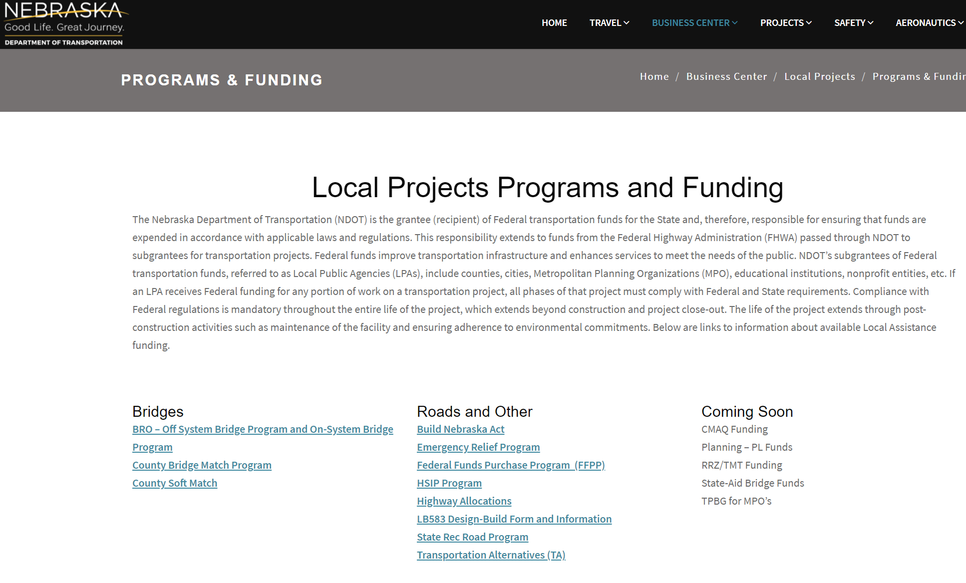
FFPP
https://dot.nebraska.gov/business-center/lpa/projects/programs/
$ STATE FUNDING $
Slide 41
Notes:
5/25/2021 Updated web link and the screen shot.
8/14/2019 Updated web link at top and the screen shot.

Slide 42
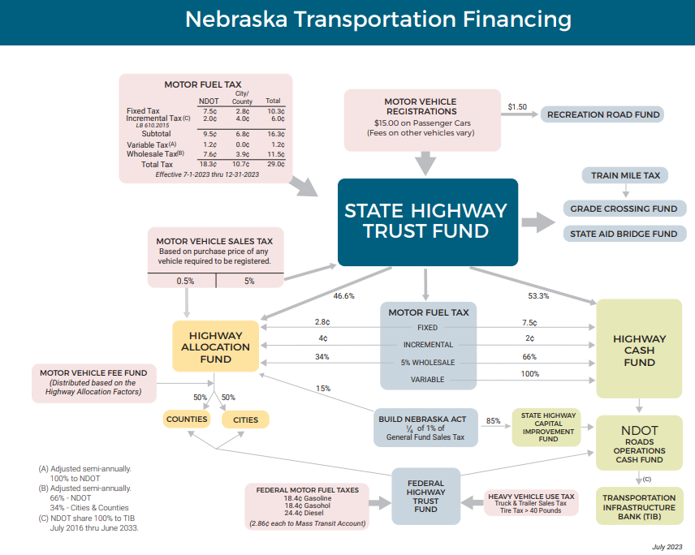
$ STATE FUNDING $
transportation-finance-flowchart.pdf
Slide 42
Notes:
8/26/2022 Updated with July 2022 version of NE Transportation Financing chart
6/23/2021 Updated with latest info from website
8/14/2019 Updated, added web link.
https://dot.nebraska.gov/media/2815/transportation-finance-flowchart.pdf

Slide 43
$
Funding
Main Sources
Counties and Municipalities
Highway Allocation Fund (HAF) Distributions
Local (Motor Vehicle Fee, Property Tax, Wheel Tax, Bonds, etc.)
State (Federal Funds Buyout, State-aid Bridge, etc.)
Federal (mainly FHWA)
Slide 43

Slide 44

Non-local
Funding Programs - Federal
Surface Transportation Program-STP (MAPA & LCLC)
Transportation Alternative Program-TAP
Railroad Hazard Elimination-RRZ
Safety Funds-HSIP
Off System Bridge Program-BRO (counties)
Congestion Mitigation Air Quality-CMAQ (air quality)
Emergency Relief – ER Funding thru FHWA
Community Development Block Grant – CDBG
$ FEDERAL FUNDING $
Slide 44
Notes:
10/13/2021 added web link
5/25/2021 Added notes
Federal On-System is major collector and above functional classifications (Federal system)
Federal Off-System is minor collector and local functional classifications (Federal system)
TAP (trails, SRTS), RRZ (RR viaducts), HSIP, BRO – get your project on the waiting list!
CMAQ - Nebraska doesn’t always have a non-attainment site
ER – thresholds $700k/event, $5k/site. 80%-100% Federal funds, 0%-20% local match. Asset Management – know what you have!

Slide 45


Federal Funding
FEDERAL TAX AT PUMP
18.4 cents per gallon gasoline
24.4 cents per gallon diesel
$
$ FEDERAL FUNDING $
Contact:
Local Projects Section
FHWA Transportation Funds Are Disbursed Only to NDOT
Slide 45
Notes:
7/27/2023 Added the line “Federal tax at pump.”
10/13/2021 added web link

Slide 46
$
Funding
Main Sources
Counties and Municipalities
Highway Allocation Fund (HAF) Distributions
Local (Motor Vehicle Fee, Property Tax, Wheel Tax, Bonds, etc.)
State (Federal Funds Buyout, State-aid Bridge, etc.)
Federal (mainly FHWA)
Slide 46

Slide 47
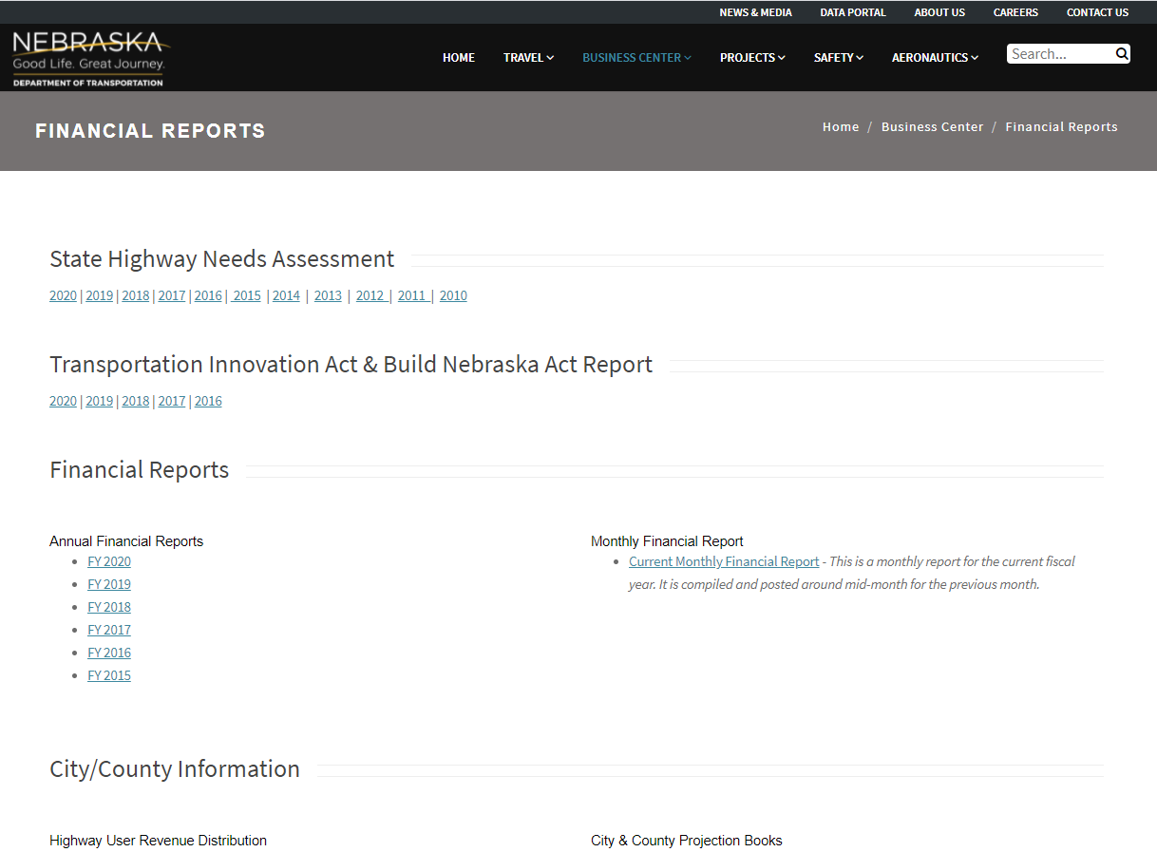
dot.nebraska.gov/business-center/financial-reports/
Slide 47
Notes:
6/23/2021 Updated screen shot

Slide 48
Highway Financing
Questions?
$
TTC-18049-B
Boards - Liaison Services Section
Slide 48

