Slide 1



Study & Testing Strategies

Slide 2
Today we’ll discuss…
  Reading Tips
  Taking Notes
  Study Tips
  Test-Taking Strategies
  Resources

Slide 3
Reading a Manual…
Layered Reading
  General Topics – divide into “chunks”
  Read entire “chunk” or chapter through to end without highlighting or taking notes
  Read through again, taking notes
  Create list of concepts/terms that are emphasized in text

Slide 4
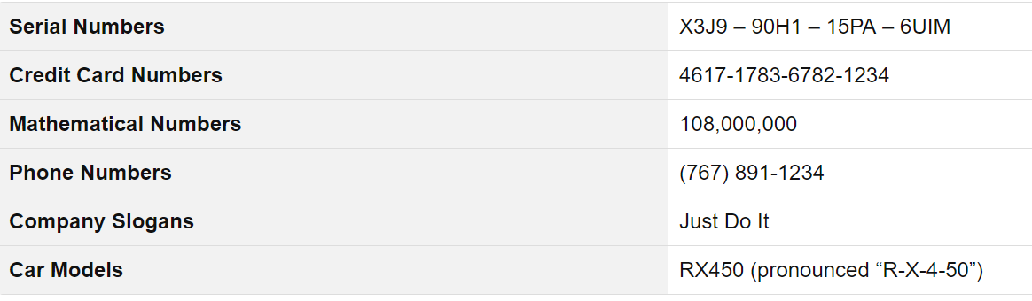
Why “Chunking”?
The optimal size for memorization is 3-4 units.
Examples of 3-4 unit “chunking”
Notes:
You will understand better and learn and retain more if you read and study in smaller chunks, and that you retain that more. Don’t sit in front of the TV and just flip through what you need to learn, and expect to retain it.

Slide 5
Taking Notes
Use highlighters, tabs, diagrams, etc.
Identify RESOURCES
  Manuals
  Websites
  Statues
Organize your notes often, each day
Notes:
This will help you organize your notes for the open notes section of the Exam. Use tabs, highlighters, whatever works best for you so that you an organize the material so you can get to it.

Slide 6
Studying to remember
  Schedule time to study – over time
  Embed the info in your brain using multiple methods
    Writing notes (flash cards)
    Quizzing yourself
    Q & A out loud
    Mental images
  Practice tests and application – REPETITION!

Slide 7
The more methods by which something is learned, the more memory pathways are built.
The more regions of the brain used to store information, the more interconnections.

Slide 8
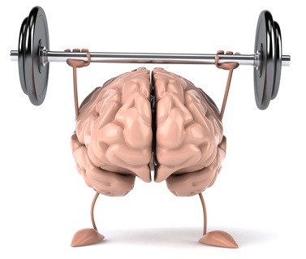
TTC Zone Areas Defined
Advance warning – tells traffic what to expect in work zone ahead
Transition space - moves traffic out of its normal path
Buffer spaces – area that provides protection for traffic and workers
Traffic space – allows traffic to pass through activity area
Work space – set aside for workers, equipment, material storage
Activity area – where work takes place, work space, traffic space, plus buffers
Termination area – where motorist returns to normal driving path

Slide 9



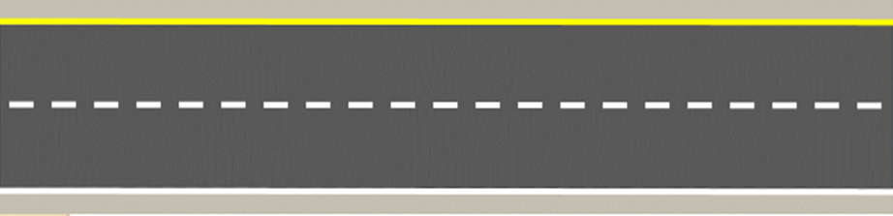


Termination Area
Work Space
Traffic Space
Activity Area
Longitudinal Buffer Space
Component Parts
of a
Work Zone
Transition Area
Advance Warning Area

Slide 10
Activity Area
Sub Component Parts
  Includes:
  Work space
  Traffic space
  Buffer space(s)

Slide 11
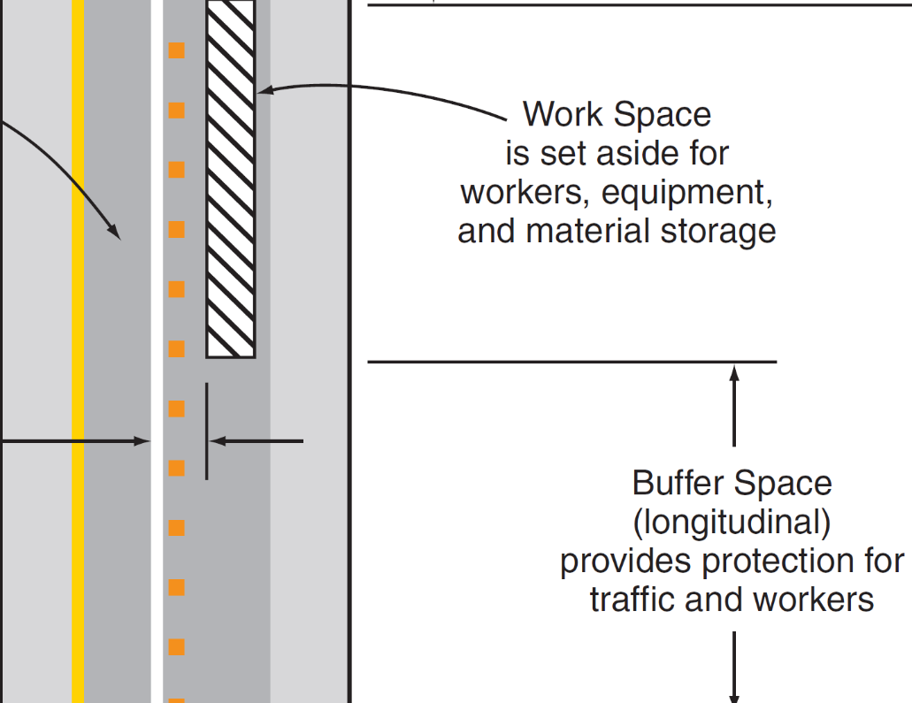
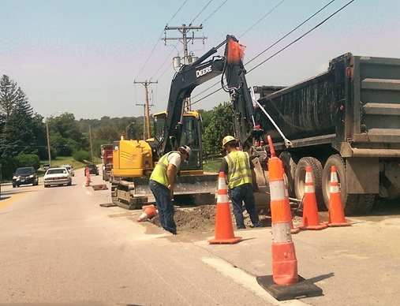
Work Space
All workers, equipment, vehicles and materials

Slide 12
Types of tapers
Merging
Shifting
Shoulder
Downstream
One-Lane, Two-Way

Slide 13
Merging - reduces traffic lanes in the same direction
Shifting - laterally shift while maintaining the same number of lanes
Shoulder – closes a shoulder
Downstream – returns traffic to normal flow
One-Lane, 2-way - allows one lane of roadway to alternately serve traffic traveling in both directions

Slide 14
Exercise 2
Notes:
1. Buffer Space
2. Tangent Device Spacing
3. Taper Length
4. Taper Device Spacing
5. Shoulder Taper Length (9')
6. "A" Sign Spacing
7. "B" Sign Spacing
8. "C" Sign Spacing
9. Downstream Taper Length
10. Downstream Device Spacing
11. End of Road Work Sign Spacing

Slide 15
Exercise 2
Solution
820 ft.
150 ft.
900 ft.
75 ft.
225 ft.
1,000 ft.
1,500 ft.
2,640 ft.
100 ft. max.
20 ft.
500 ft.
Notes:
1. Buffer Space
2. Tangent Device Spacing
3. Taper Length
4. Taper Device Spacing
5. Shoulder Taper Length (9')
6. "A" Sign Spacing
7. "B" Sign Spacing
8. "C" Sign Spacing
9. Downstream Taper Length
10. Downstream Device Spacing
11. End of Road Work Sign Spacing

Slide 16
How many ways did we store and retrieve that info?
Definition – meaning, words
Image
Application & repetition
Social, dialogue
Emotion?

Slide 17
Table 6. Tapers and Flagger Station
Should you spend time memorizing tables of information?
Speed (mph) | *Min. Merging Taper Length (L) in Feet; Width of Offset (W) in Feet |  |  |  | Minimum Number of Devices |  |  |  | Maximum Device Spacing in Feet |  | Buffer in Feet
 | 9’ | 10’ | 11’ | 12’ | 9’ | 10’ | 11’ | 12’ | Along Taper | Along Tangent
≦25 | 95 | 105 | 115 | 125 | 5 | 6 | 6 | 6 | 25 | 50 | 155
30 | 135 | 150 | 165 | 180 | 6 | 6 | 7 | 7 | 30 | 60 | 200
35 | 185 | 205 | 225 | 245 | 7 | 7 | 8 | 8 | 35 | 70 | 250
40 | 240 | 270 | 295 | 320 | 7 | 8 | 9 | 9 | 40 | 80 | 305
45 | 405 | 450 | 495 | 540 | 10 | 11 | 12 | 13 | 45 | 90 | 360
50 | 450 | 500 | 550 | 600 | 10 | 11 | 12 | 13 | 50 | 100 | 425
55 | 495 | 550 | 605 | 660 | 10 | 11 | 12 | 13 | 55 | 110 | 495
60 | 540 | 600 | 660 | 720 | 10 | 11 | 12 | 13 | 60 | 120 | 570
65 | 585 | 650 | 715 | 780 | 10 | 11 | 12 | 13 | 65 | 130 | 645
70 | 630 | 700 | 770 | 840 | 10 | 11 | 12 | 13 | 70 | 140 | 730
75 | 675 | 750 | 825 | 900 | 10 | 11 | 12 | 13 | 75 | 150 | 820
80 | 720 | 800 | 880 | 960 | 10 | 11 | 12 | 13 | 80 | 160 | 910
NO! Know how to USE the table through practice.

Slide 18
Testing Strategies
Answering multiple choice questions
Cover answers while reading question
Read question carefully
Try to answer the question without looking at answers
Uncover & read all answers
Choose best response by
    Searching for correct answer, or
    By process of elimination
Notes:
Primary strategy. Why do you think it is good to cover the answer? It will change the way you read the question. Then if your not sure you use the process of elimination.

Slide 19
Testing Strategies
Other techniques for multiple choice
Skip difficult questions, but flag them to remind you to come back to them
Decoding difficult questions
    Caution words – never, always, or none (circle them?)
    Watch for not, unless, or none
    Try rephrasing question in your own words
If you have to guess, do so strategically
    First cross off answers you know to be wrong
    Re-read question, considering remaining answers only
Notes:
Caution words are a good sign that this is never the answer. In terms of work, if it says never or always that is probably not the answer. We are all going to die right? Try not to guess, try to sort it out, and try to really understand the question. If you narrow it down to 2 choices, at least it’s a 50/50 chance.
IF you KNOW the answer, pick it…don’t use a strategy. Strategies are when you AREN’T SURE.

Slide 20

5 Rules for Acing Multiple Choice Tests
Video
Thomas Frank

Slide 21
Testing Strategies
Other techniques for multiple choice
Example 1
When driving at night, when should you use your high-beam headlights?
  a) always while driving
  b) preferably never
  c) whenever it is safe and legal
  d) only on interstate highways
Notes:
The answer is C. Because A, B & D have caution words. C even sounds like it makes sense.

Slide 22
Testing Strategies
Other techniques for multiple choice
Example 2
Which of the items below are NOT one of the 5 basic requirements traffic control devices must meet in order to be effective (according to the MUTCD)? CIRCLE ONLY ONE
  a) Must fulfill a need
  b) Must command attention
  c) Must give adequate time for proper response
  d) Must convey a clear, simple meaning
  e) Must command respect from road users
  Must be visible at all times
  None of the above
Notes:
F) Must be visible at all times. The word “all” is your clue that

Slide 23
Testing Strategies
Essay Questions
Read question thoroughly & create a bullet list
Create an outline for your response
If the question asks for facts, do not provide your opinion.
Focus on one main idea per paragraph
Notes:
The most of important thing is to organize your thoughts by create a bullet list FIRST. Talk about planning, then gathering my resources, etc. Then WRITE your SA Answer. It also helps the person grading that SA understand what your answer is. If you left something off, and run out of time, you might get some credit for at least having your bullet points there.

Slide 24
Miscellaneous Tips

Slide 25
Open Book Exams
You are evaluated on understanding rather than recall and memorization
Do not underestimate the preparation needed for an open book exam
  Your time will be limited
  Organize in order to quickly find data, quotes, examples, and/or arguments you use in your answers
Notes:
Organize, Organize.

Slide 26
Manage your time!!
Sections
Time element
Number of questions you MUST get right
Notes:
Make sure you understand what time you have for each one of these questions. What’s the minimum number you need to get correct in order to pass each section. So if you don’t pass one, you’ve just failed the entire exam.

Slide 27
Zen
Gather ALL materials the night before
Relax & breathe
Maintain positive attitude
Read directions carefully
If there’s time, review answers you found difficult
Answer questions strategically
  Easy questions
  Questions with biggest point value
Notes:
Test planning and being prepared helps reduce your anxiety. Talk about breathing throughout the exam, and being positive. If someone is complaining about the test on a break, move away from them.

