Slide 1


2016 Standards
Video 08
Finding the Correct Values in the Tables
Nebraska Administrative Code
Title 428
Rules and Regulations of the
Board of Public Roads Classifications and Standards
(Administrative Host: Nebraska Department of Transportation)
County Roads and Municipal Streets
Neb. Rev. Stat. 39-2113
https://dot.nebraska.gov/media/5593/nac-428-rules-regs-nbcs.pdf
Boards - Liaison Services Section
8/8/2019
Notes:
8/8/2019 Updated first and last slides – Administrative Host: Nebraska Department of Transportation, not Nebraska Department of Roads.
8/7/2019 Updated to reflect changes per LB82 (2019). The previous version (PV) was 12/29/2016. Five slides deleted and 11 slides updated. First and last slides updated the Dept logo and the web link. Slide 2 updated NDOR→NDOT. Slides 3 thru 8 deleted. Slide 11 (Slide 17 of the PV) updated NDOR→NDOT on the slide (right-hand side) and the web link on the slide. Slide 13 (Slide 19 on the PV) updated NDOR→NDOT in script and audio media, and the web link on the slide. Changed out the legend and map – the one online seemed clearer than the old one on the slide. Slide 14 (Slide 20 of the PV) updated NDOR→NDOT on the slide (right-hand side, toward bottom) and the web link on the slide. Slide 28 (Slide 34 of the PV) updated to delete reference and web link to Co-NECTAR which is not supported anymore, so two audio media needed updating and another one was deleted. Slide 29 (Slide 35 of PV) updated to delete web link to Co-NECTAR. Slide 31 (Slide 37 of the PV) updated to delete reference and web link to Co-NECTAR and change NDOR→NDOT in one audio media. Slide 32 (Slide 38 of PV) updated contacts information and Dept logo on the slide and NDOR→NDOT in the script and one audio media; two other audio media added along with a link to NDOT’s Map Library. Slide 53 (Slide 59 of PV) Updated to delete reference and web link to Co-NECTAR, revise one audio media and delete one audio media. Slide 57 (Slide 63 of the PV) Hwy Safety Office contact information updated and made more generic, deleted Co-NECTAR link and reference, and instances of NDOR→NDOT requiring two audio media revisions
This is one of a series of videos on Nebraska’s system of
Classifying and applying standards to its highways, roads and streets.
The videos leading up to this one,
Covered the basics of Nebraska’s minimum design standards,
Including the three main elements: tables, notes and definitions. 3R work and 3R requirements were also summarized.
This video uses an example county road project to demonstrate finding the applicable table and determining the standard values for each of the 13 design criteria.

Slide 2
Terminology and Acronyms used in this video
NBCS = Nebraska Board of Public Roads Classifications and Standards = “The Board” = “The Board of Public Roads”
NDOT = Nebraska Department of Transportation
Standards vs. Minimum Design Standards (MDS)
Neb. Rev. Stat. = Nebraska Revised Statutes
NAC = Nebraska Administrative Code
Highways = Roads = Streets (§39-101(3), §60-624)
3R = Resurfacing, Restoration and Rehabilitation
FC = Functional Classification
CFR = Code of Federal Regulations
AASHTO = American Association of State Highway Transportation Officials
Notes:
8/4/2019 Updated to change NDOR to NDOT
First, some terminology and acronyms . . .
NBCS is the Nebraska Board of Public Roads Classifications and Standards; it may also be called the Board of Public Roads, or just The Board.
NDOT is the Nebraska Department of Transportation
Standards refers to the NBCS standards, including design, construction, maintenance and relaxation of standards. MDS refers to the Minimum Design Standards, which address only the design aspect of a work or project. Standards are often termed “minimum” but realize there are maximums (for superelevation, grade) and ranges ( for cross slopes). When we say “minimum” – sometimes it refers to all of those.
Neb. Rev. Stat. refers to the Nebraska Revised Statutes
NAC is the Nebraska Administrative Code. These are regulations, that have the force of law.
The word “Highway” in Nebraska law also refers to roads and streets. Highway means the entire width between the boundary limits of any street, road, avenue, boulevard, or way which is publicly maintained when any part is open to the use of the public for purposes of vehicular travel.
3R is short for resurfacing, restoration and rehabilitation. For more details, see the video dedicated to 3R.
FC is Functional Classification.
CFR is the acronym for the Code of Federal Regulations.

Slide 3
Chapter 2 (428 NAC 2)
Procedures for Standards
Title 428 Chapter 2
Slide 3
428 NAC 2
Notes:
This video provides more details on the Minimum Design Standards
Specifically, for County Roads and Municipal Streets, pages 35-86.
State Highway Standards, pages 5-34, are not covered in this video.

Slide 4

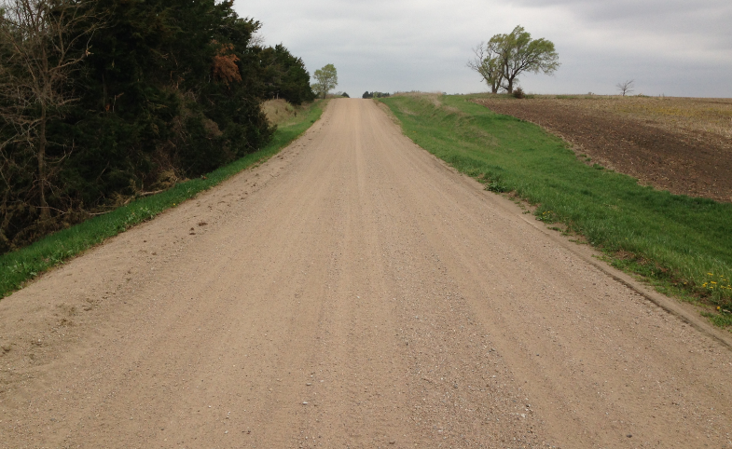

MDS:
Finding a Minimum Design Standards (MDS) Table and Design Criteria Values
PRACTICAL
EXAMPLE
Rural
Gravel Surface
Notes:
This video presents an example of finding the table and design criteria values that apply to a hypothetical county road project.

Slide 5
2016 Standards
Practical Example, Procedure
A Possible Procedure
Step 1: verify area type (rural/urban) standards that apply
Step 2: verify functional classification
Step 3: determine the table(s) that apply to the work/project
Step 4: verify work type (New & Reconstructed and/or 3R)
Step 5: determine minimum design speed
Step 6: determine traffic volume data
Step 7: determine all other design criteria values
Step 8: compare design criteria values to existing facility
Slide 5
Notes:
For the example project,
This screen suggests a methodical way of determining the table that applies
Steps 1-3
And then determining the values for each design criterion
Steps 4-7
The example will then compare those values to the assumed geometrics of the existing facility

Slide 6
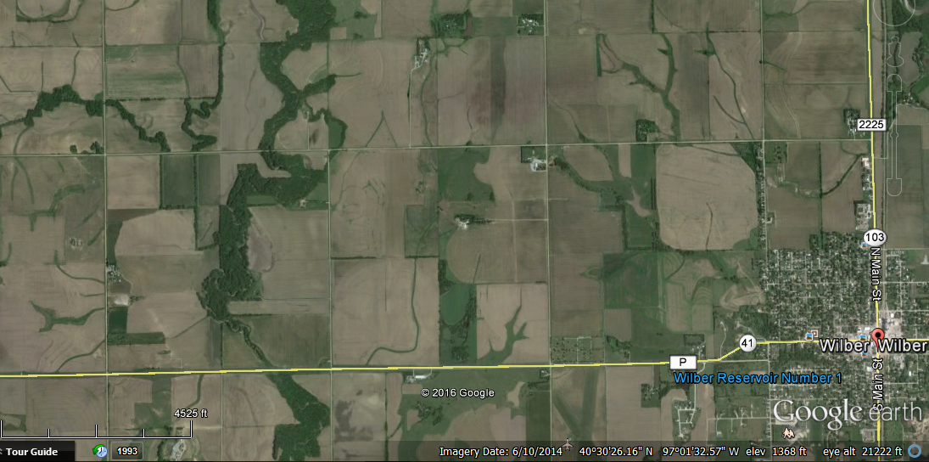
Example – Rural Area
Location:
Saline County Road O (north of Wilber)
8x10 NBS
26’ CBW
3.5 miles
Gravel Surfacing
Rd O
Rd 1900
Route 3025
Google Earth Image 6/10/2014
Slide 6
Notes:
The example is a road north of the city of Wilber in Saline County.

Slide 7
Example #1 – Rural Area, Major Collector
Example – Rural Area, Gravel Road
Saline County Road O (north of Wilber)
Looking West
West of 2200 Inx
2’ 10’ 10’ 2’
20’ Traveled Way
Disclaimer: not actual dimensions
Slide 7
Notes:
Here is a ground level view.
A 20 ft traveled way is assumed, with 2 ft earth shoulders

Slide 8
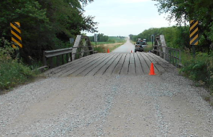
Example – Rural Area
Location:
Saline County Road O north of Wilber
Purpose of Project: Address the existing poor road and base condition.
Anticipated Scope of Project:
Reconstruct the traveled way by removing the existing gravel and base, recompacting, and applying an estimated six inches of gravel over the new base. Replace bridge C007603025 (2.2 miles West of Wilber)
Anticipated Year of Construction: Next Year
Slide 8
Notes:
The road is assumed to be in poor condition.
The scope of the project would involve reconstructing the roadway from the base, up,

Slide 9
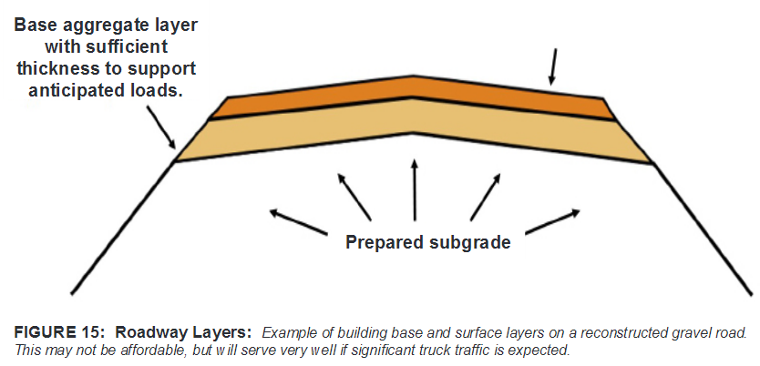
Example #4 – Rural Area
Location:
Saline County Road O north of Wilber
Purpose of Project: Address the existing poor base condition.
Anticipated Scope of Project:
Reconstruct the traveled way by removing the existing gravel and base, recompacting, and applying an estimated three inches of gravel over the new base.
Anticipated Type of Work: Reconstruction
Anticipated Year of Construction: 2017 (next year)
6 inches gravel
Reference: Gravel Roads Construction and Maintenance Guide FHWA Publication No.: FHWA-OTS-15-0002
Slide 9
Notes:
And applying six inches of gravel over the new base.

Slide 10
Finding the Appropriate Table
Finding the Correct Table
Verify the Area type standards
  Urban or Rural
What is the National Functional Classification of the road?
  Other Principal Arterial
  Minor Arterial
  Major Collector
  Minor Collector
  Local
Slide 10
428 NAC 2-001
Notes:
To find the table that applies -
You need to determine two things:
The Area type of standards that apply – Urban or Rural
And The National Functional Classification of the road.
As part of the process for determining the applicable design standards table, we will check Notes 2, 3 and 4.
NOT FOR AUDIO
Pay attention to Notes 2 and 3.
Note 2: Rural area design standards shall be used for new and reconstructed roads and streets when the anticipated posted speed limit is greater than or equal to 50 MPH.
Note 3: Urban area design standards may be used in lieu of rural area design standards in residential and commercial areas lying outside urban area boundaries.

Slide 11

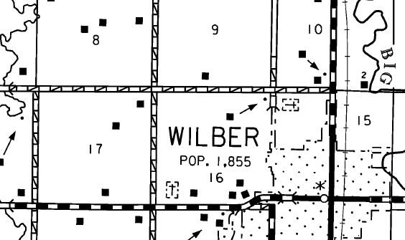
Example – Rural Area, Gravel Road
https://dot.nebraska.gov/media/3261/cntysali.pdf
Step 1a – verify area type (rural or urban)
NDOT Map
Road “O”
Rural
Slide 11
Notes:
8/7/2019 Updated NDOR→NDOT on the slide (right-hand side) and the web link on the slide.
Wilber, with a population of approximately 2,000, is a City of the Second Class.
With the project not being in a or near a city with a population of 5,000 or more,
We know that the project is not in an Urban Area.
Therefore, it is in a Rural Area.

Slide 12
Example – Rural Area, Gravel Road
Step 1b – any reason to apply urban area standards instead of rural area standards?
(Refer to Note 3)
Rural Area Standards
No
428 NAC 2-001.03A2 , Page 42
428 NAC 2-001.03B Note 3, Page 47
Slide 12
Notes:
Before making a final determination on Rural Area standards or Urban Area standards,
Check Note 3 on page 47 of the standards.
Note 3 allows Urban Area standards to be applied in Rural areas that are residential and commercial in character.
As you can see from the aerial view on the screen, the character of the land on both sides of this county road is Rural – there is nothing residential or commercial about it.
With the project being located in a Rural Area, and nothing in Note 3 that would apply to this stretch of road,
we can conclude that Rural Area standards apply

Slide 13
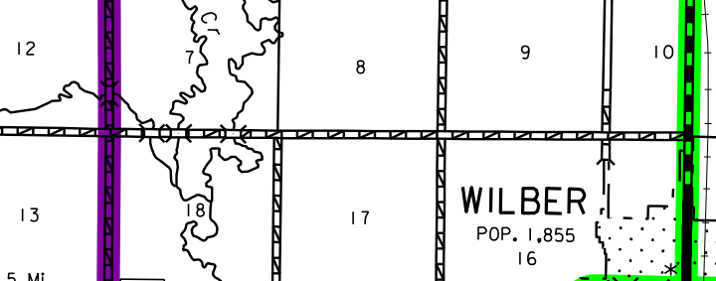
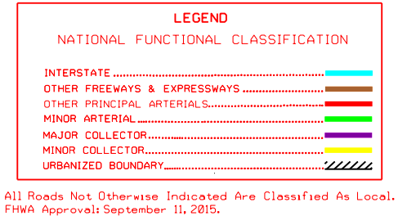
Example – Rural Area
https://dot.nebraska.gov/media/8729/cfuncsalinenfc.pdf
Step 2a – verify National Functional Classification
Local
Slide 13
Notes:
8/7/2019 Updated NDOR→NDOT in script and audio media, and the web link on the slide. Changed out the legend and map – the one online seemed clearer than the old one on the slide.
Find the Saline County NFC map in NDOR’s NDOT’s online Map Library.
The NFC is Local, because the road is not color coded.
Refer to the note below the Legend.

Slide 14
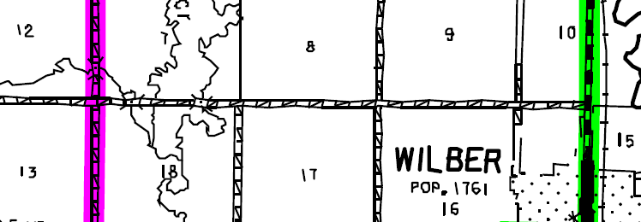
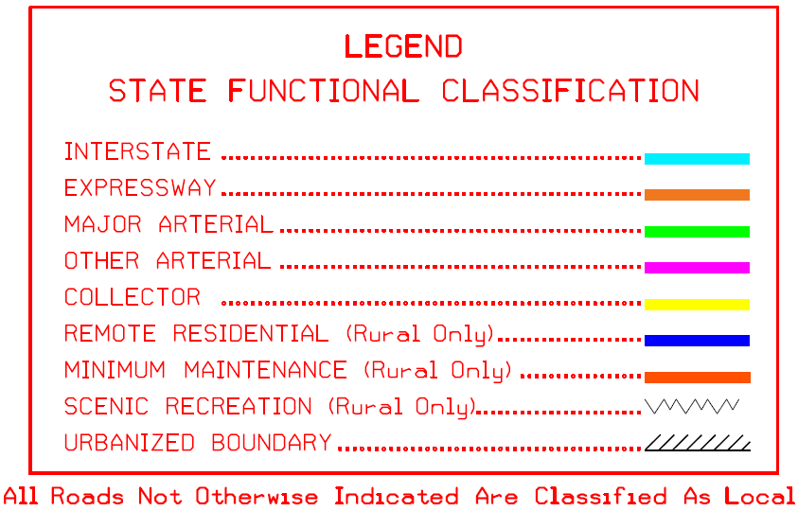
Example – Rural Area
http://www.roads.nebraska.gov/media/4534/sfcsali.pdf
Step 2b – verify State Functional Classification –
Minimum Maintenance? Remote Residential? Scenic-Recreation?
NDOT Map
Local
Slide 14
Notes:
8/7/2019 Updated NDOR→NDOT on the slide (right-hand side, toward bottom) and the web link on the slide.
If you are unsure the road is one of the optional State Functional Classifications
Check the SF Classification Maps for Saline County.
The road is not colored or marked, therefore it is not one of the State’s optional Classifications.
This confirms that the Road is classified as Local on both systems – the National and the State.

Slide 15
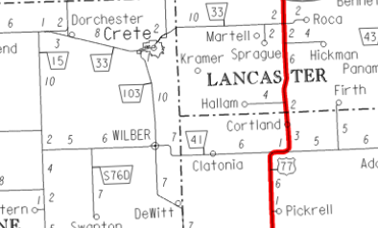
Use State Highway System Standards?
Note 4
Other Principal Arterial
Minor Arterial
Major Collector
Minor Collector
Local
428 NAC 2-001.02
428 NAC 2-001.03
http://www.roads.nebraska.gov/media/2741/nat_hwy_sys.pdf
Slide 15
428 NAC 2-001.03B Note 4, Page 47
Notes:
This screen is a reminder that if the National FC would happen to be OPA,
Or if the road or street is on the National Highway System
Note 4 requires the application of State Highway Standards in subsection 02
Since the classification is Local, that is not the case
subsection 03 applies.
On pages 35-86, Subsection 03 is for county roads and municipal streets

Slide 16
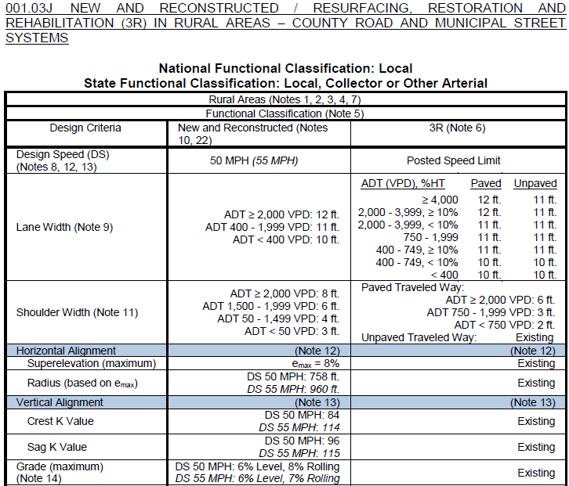
Finding the Correct Table
Example – Rural Area, Local, N&R
Step 3 Find the Table – Rural, Local table, 001.03J, Pgs 69-70
Slide 16
Notes:
Knowing that Rural Area Standards apply,
And the FC is Local
The standards table that applies to this project is found on pages 69 and 70, Table J.

Slide 17
Finding the Correct Table
Example – Rural Area, Local, N&R
Read the notes
Slide 17
Notes:
Be sure to review all notes that apply to the table.
This video reviewed notes 3 and 4 in the context of the example.
The relevance and applicability of other notes will be reviewed as we step through the example.
Refer to the Video on Definitions and Notes for a summary of all notes.

Slide 18
2016 Standards
Practical Example, Procedure
Procedure
Step 1: verify area type (rural/urban) standards that apply
Step 2: verify functional classification
Step 3: determine the correct table(s)
Step 4: verify work type (New & Reconstructed and/or 3R)
Step 5: determine minimum design speed
Step 6: determine traffic volume data
Step 7: determine all other design criteria values
Step 8: compare design criteria values to existing facility
428 NAC 2-001.03J, Pgs 69-70
Slide 18
Notes:
So far, we have done the first three steps and determined the table that applies to the work or project.
The remainder of this video goes through Steps 4 through 8 to determine design criteria values that apply to the work or project.

Slide 19
2016 Standards
Practical Example, Procedure
Procedure
Step 1: verify area type (rural/urban) standards that apply
Step 2: verify functional classification
Step 3: determine the correct table(s)
Step 4: verify work type (New & Reconstructed and/or 3R)
Step 5: determine minimum design speed
Step 6: determine traffic volume data
Step 7: determine all other design criteria values
Step 8: compare design criteria values to existing facility
Slide 19
Notes:
Step 4 is to verify the work type.
Is it more than Maintenance work?
If so, is it a 3R scope, or a New & Reconstructed scope?

Slide 20
Example #4 – Rural Area
Step 4: verify work type (New & Reconstructed and/or 3R)
Purpose of Project: Address the existing poor pavement and base condition.
Anticipated Scope of Project:
Reconstruct the traveled way by removing the existing gravel and base, recompacting, and applying an estimated six inches of gravel over the new base.
Anticipated Year of Construction: Next Year
Slide 20
Notes:
The anticipated scope of the project is to
READ IT

Slide 21
Example – Rural Area
Location:
Saline County Road O north of Wilber
Purpose of Project: Address the existing poor pavement and base condition.
Anticipated Scope of Project:
Reconstruct the traveled way by removing the existing gravel and base, recompacting, and applying an estimated six inches of gravel over the new base. Replace bridge C007603025 (2.2 miles West of Wilber)
Anticipated Year of Construction: Next Year
Slide 21
Notes:
This is a scope of work more than what is defined in Minimum Maintenance standards (pages 88-91).
Referring to page 39 of the standards . . .
Since the base is being removed and an entire new base is being placed for the traveled way,

Slide 22
Example – Rural Area
Location:
Saline County Road O north of Wilber
Purpose of Project: Address the existing poor pavement and base condition.
Anticipated Scope of Project:
Reconstruct the traveled way by removing the existing gravel and base, recompacting, and applying an estimated six inches of gravel over the new base. Replace bridge C007603025 (2.2 miles West of Wilber)
Anticipated Year of Construction: Next Year
Anticipated Type of Work: Reconstruction
Slide 22
Notes:
The type of work is reconstruction, and New and Reconstructed standards apply.
The bridge 2.2 miles west of Wilber would also be replaced; page 37 of the standards indicates that this would also be considered Reconstruction, and New and Reconstructed standards apply.

Slide 23
Minimum Design Standards
Example – Rural Area, Local, N&R
Slide 23
Notes:
That means the standard values for design criteria will come from the middle column of Table J.
Notes 10 and 22 apply to New & Reconstructed work.
Note 10 would not apply to this example project since Saline County is not in the Sandhills Area of Nebraska.
Note 22 potentially allows some design flexibility for very low-volume roads, i.e. fewer than 400 VPD, for the roadway and roadside adjacent to a replacement bridge or structure.

Slide 24
2016 Standards
Practical Example, Procedure
Procedure
Step 1: verify area type (rural/urban) standards that apply
Step 2: verify functional classification
Step 3: determine the correct table(s)
Step 4: verify work type (New & Reconstructed and/or 3R)
Step 5: determine minimum design speed
Step 6: determine traffic volume data
Step 7: determine all other design criteria values
Step 8: compare design criteria values to existing facility
Slide 24
Notes:
Step 5 is to determine the minimum design speed.
Design speed is one of the most important design criteria, since several other design criteria are a function of design speed.

Slide 25
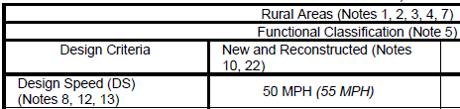
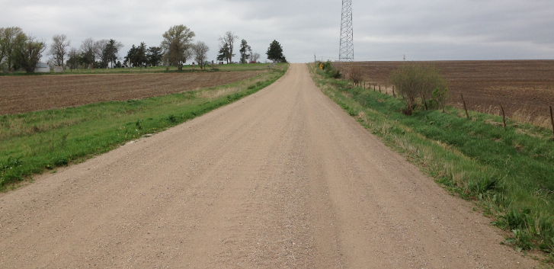
Example – Rural Area, Local, N&R
Step 5 – determine minimum value for Criterion #1: Design Speed
Design Speed = 50 MPH
Road O
428 NAC 2-001.03A6a, Page 45
428 NAC 2-001.03B Note 8, Page 48
§60-6,186(c)
Slide 25
Notes:
Assume for this example that There is no posted speed limit.
State statute 60-6,186 requires that the maximum speed limit shall be 50 MPH upon any highway (road or street) that is not dustless surfaced and not part of the State Highway System.
Therefore, this example uses 50 MPH as the design speed.
Be sure to review the notes associated with Design Speed.
As a reminder, Note 8 requires the Design Speed to be equal to or greater than the anticipated posted speed limit.
A suggestion is to Lay the notes side-by-side with the applicable table and you have everything there in front of you.

Slide 26
Topic #2: The Correct Table
Example – Rural Area, Local, N&R
Slide 26
Notes:
With 50 MPH as the design speed, it means the standard values will be in regular font, and we can ignore the italicized values.

Slide 27
2016 Standards
Practical Example, Procedure
Procedure
Step 1: verify area type (rural/urban) standards that apply
Step 2: verify functional classification
Step 3: determine the correct table(s)
Step 4: verify work type (New & Reconstructed and/or 3R)
Step 5: determine minimum design speed
Step 6: determine traffic volume data
Step 7: determine all other design criteria values
Step 8: compare design criteria values to existing facility
Slide 27
Notes:
Step 6 is to determine the traffic volume for Road O.

Slide 28
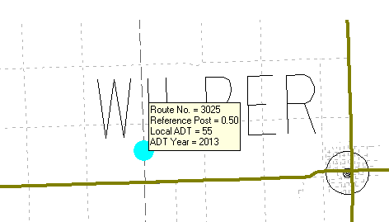
Example – Rural Area, Local, N&R, Unpaved, DS=50
Step 6 – Determine ADT
Rd O
428 NAC 2-001.03A3, Page 42
428 NAC 2-001.03B Note 7, Page 48
Slide 28
Notes:
8/7/2019 Updated to delete reference and web link to Co-NECTAR which is not supported anymore, so two audio media needed updating and another one was deleted.
The county likely has a record of traffic volume, or ADT, for this road.
For this example, however, let’s look at the a hypothetical traffic volume data that is available on NDOR’s website, CoNECTAR. as shown on this screen
The website address is shown on this screen.
Traffic volume data is represented by dots. Position the mouse over the dot, and the data will pop up on the screen.
There are no data points for Road O in this vicinity.
There is a data point for the North-South county road on the west end of the project, 55 ADT in year 2013.
This data is about three years old.

Slide 29
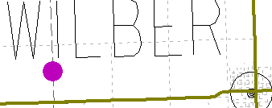

Example – Rural Area, Local, N&R, Unpaved, DS=50
Step 6 – Determine ADT
2013 ADT = 100 VPD
2013 ADT = 300 VPD
Rd O
428 NAC 2-001.03A3, Page 42
428 NAC 2-001.03B Note 7, Page 48
Slide 29
Notes:
8/7/2019 Updated to delete web link to Co-NECTAR which is not supported anymore.
For the sake of not getting into a long discussion about traffic volumes,
Let’s say it would be reasonable that traffic volume would be higher at the east end of Road O,
especially just north of Wilber where residents on the west end of town wanting to head north on State Highway 103 may find it more convenient to get up to Road O via the north-south county road, then east on Road O to its junction with Highway 103.
For this example, assume the ADT is
300 VPD for the ½ mile just north of Wilber,
And 100 VPD for the road west of there.

Slide 30

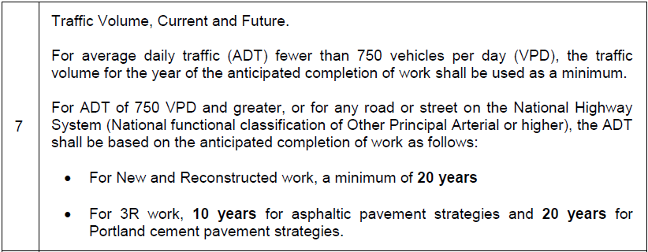
Traffic Volume
Note 7
“Design Year” traffic volumes – not required for this example
Slide 30
428 NAC 2-001.03B Note 7, Page 48
Notes:
Be sure to check to Note 7, which is on Page 48.
The topic for Note 7 is Traffic Volume.
Looking at the bottom part of the note first, with the two bullets:
For roads and streets with a current traffic volume ADT of 750 VPD and more, or for roads functionally classified as Other Principal Arterial or higher, the ADT used as the basis for design standards is required to be estimated, i.e. projected out, for
20 years from the year of the anticipated completion of the work or project, for New & Reconstructed work, or
For 3R work, 10 years from the year of the anticipated completion of the work or project, for asphaltic pavement strategies or 20 years from the year of the anticipated completion of the work or project, for Portland cement pavement strategies.
Now, back to the first sentence.
It says that for lower volume roads, those with fewer than 750 VPD, the note allows use of the ADT for the year of anticipated completion of the work or project. It is not required to project the traffic volume ADT out to the design year for these roads and streets.

Slide 31
Example – Rural Area, Local, N&R, Unpaved, DS=50
Step 6 – Determine ADT
2013 ADT = 100 VPD
2013 ADT = 300 VPD
Assume 1% growth factor:
2017 ADT = 104 VPD
2017 ADT = 312 VPD
428 NAC 2-001.03B
Note 7, Page 48
428 NAC 2-001.03A3, Page 42
428 NAC 2-001.03B Note 7, Page 48
Slide 31
Notes:
8/7/2019 Updated to delete reference and web link to Co-NECTAR which is not supported anymore, and change NDOR→NDOT in one audio media.
The minimum requirement of Note 7 is the traffic volume for the year of the anticipated completion of the work or project.
The data is 3 years old in this case.
The year of anticipated completion is next year.
For this example, let’s assume a 1% annual growth in traffic, for four years
That calculation would result in traffic volumes of
312 VPD for the ½ mile just north of Wilber,
And 104 VPD for the road west of there.
These are the traffic volumes we will use for the purposes of design standards.
For this example, let’s make it simple and assume 312 VPD for the entire project.
There is nothing magic about the 1% growth assumption. You need to know the trends in your area. The NDOR NDOT can provide some guidance.

Slide 32

Traffic Volumes – Assistance
402-472-5748
402-479-4594
Portable traffic counting equipment is available for public employees (city and county staff)
Generates only raw counts (not ADT).
Traffic Analysis Supervisor
Historical data (if available)
Technical advice – how to convert raw counts to ADT
For NDOT Traffic Counts and NDOT Traffic Flow Maps go to:
https://dot.nebraska.gov/travel/map-library/
Slide 32
428 NAC 2-001.03B, related to Note 7
Notes:
8/7/2019 Updated contacts information and Dept logo on the slide and NDOR→NDOT in the script and one audio media; two other audio media added along with a link to NDOT’s Map Library.
This screen shows assistance that is available,
from NE-LTAP for portable traffic counting equipment
And from NDOR NDOT for technical guidance
This help is available only for counties, municipalities and their consultants.
Statewide traffic counts and traffic flow maps can be found on NDOT’s Map Library online at the link shown.

Slide 33
2016 Standards
Practical Example, Procedure
Procedure
Step 1: verify area type (rural/urban) standards that apply
Step 2: verify functional classification
Step 3: determine the correct table(s)
Step 4: verify work type (New & Reconstructed and/or 3R)
Step 5: determine minimum design speed
Step 6: determine traffic volume data
Step 7: determine all other design criteria values
Step 8: compare design criteria values to existing facility
Slide 33
Notes:
Step 7 is to determine values for all other design criteria, now that design speed and traffic volume are determined.

Slide 34
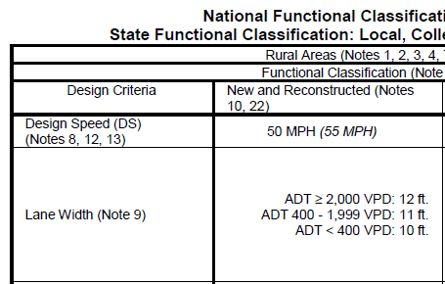
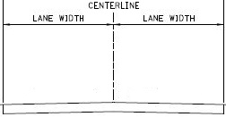
Example – Rural, Local, N&R, Unpaved, DS=50, ADT=312
Step 7 – Determine minimum value for
Criterion #2: lane width
Table 001.03J
Pages 69-70
428 NAC 2-001.03A6b , Page 45
428 NAC 2-001.03B Note 9, Page 49
ADT = 312 VPD
Slide 34
Notes:
The minimum lane width is 10 ft, for traffic volumes fewer than 400 VPD.
Review Note 9, page 49. For this example, the only thing from Note 9 that applies is the clarification that the lane width values apply only to through travel lanes.

Slide 35
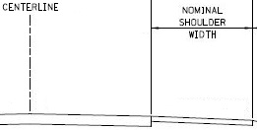


Example – Rural, Local, N&R, Unpaved, DS=50, ADT=312
Step 8 – Determine minimum value for
Criterion #3: shoulder width
Table 001.03J
Pages 69-70
ADT = 312 VPD
428 NAC 2-001.03A6c , Page 45
428 NAC 2-001.03B Note 11, Page 49
Slide 35
Notes:
The minimum shoulder width is 4 ft, for traffic volumes 50 VPD through 1,499 VPD.
Review Note 11, page 49. For this example, the only thing that applies is the clarification that the shoulder width values apply only to non-divided roads and streets.

Slide 36
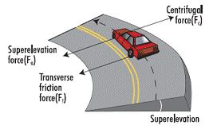
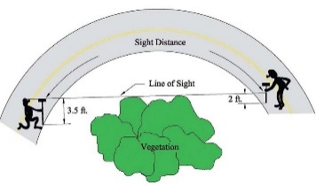

Example – Rural, Local, N&R, Unpaved, DS=50, ADT=312
Step 9 – Determine minimum values for Criteria #4 and #5: horizontal alignment (superelevation and curve radius)
Table 001.03J
Pages 69-70
428 NAC 2-001.03A6d , Page 45
428 NAC 2-001.03B Note 12, Page 50
Slide 36
Notes:
The minimum horizontal radius is 758 ft.
The maximum superelevation is 8%.
Review Note 12, page 50.
Since Rural Area New & Reconstructed values apply, and the ADT is greater than 50 VPD, nothing in Note 12 applies.

Slide 37
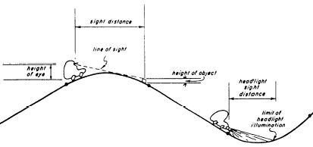

Example – Rural, Local, N&R, Unpaved, DS=50, ADT=312
Step 10 – Determine minimum values for Criterion #6: vertical alignment (K values)
Table 001.03J
Pages 69-70
428 NAC 2-001.03A6e , Page 45
428 NAC 2-001.03B Note 13, Page 50
Slide 37
Notes:
The minimum Crest K value is 84.
The minimum Sag K value is 96.
Review Note 13 page 50.
Since the scope of work is New & Reconstructed and the ADT is greater than 50 VPD, nothing in the note applies to this project.

Slide 38

Example – Rural, Local, N&R, Unpaved, DS=50, ADT=312
Step 11 – Determine value of Criterion #7: grade
Table 001.03J
Pages 69-70
ADT = 312 VPD
428 NAC 2-001.03A6e2 , Page 46
428 NAC 2-001.03B Note 14, Page 51
AASHTO Green Book Section 3.4.1
Slide 38
Notes:
The maximum Grade is 6% for level terrain or 8% for rolling terrain.
For this segment of road, assume rolling terrain, and a maximum of 8% grade.
For definitions of level and rolling terrain, refer to the AASHTO Green Book Section 3.4.1.
Review Note 14 page 51. Since this road has an ADT fewer than 400 VPD and a classification of Local, short tangent lengths (500 ft or less) are allowed an additional 2% grade beyond the value shown in the table.
The other part of Note 14 would not apply since the ADT is greater than 50 VPD
NOT FOR AUDIO
AASHTO Green Book
3.4.1 Terrain
The topography of the land traversed has an influence on the alignment of roads and streets. Topography affects horizontal
alignment, but has an even more pronounced effect on vertical alignment. To characterize variations in topography, engineers
generally separate it into three classifications according to terrain—level, rolling, and mountainous.
In level terrain, highway sight distances, as governed by both horizontal and vertical restrictions, are generally long or can be made to be so without construction difficulty or major expense.
In rolling terrain, natural slopes consistently rise above and fall below the road or street grade, and occasional steep slopes offer some restriction to normal horizontal and vertical roadway alignment.
In mountainous terrain, longitudinal and transverse changes in the elevation of the ground with respect to the road or street are abrupt, and benching and side hill excavation are frequently needed to obtain acceptable horizontal and vertical alignment.
Terrain classifications pertain to the general character of a specific route corridor. Routes in valleys, passes, or mountainous
areas that have all the characteristics of roads or streets traversing level or rolling terrain should be classified as level or
rolling. In general, rolling terrain generates steeper grades than level terrain, causing trucks to reduce speeds below those of
passenger cars; mountainous terrain has even greater effects, causing some trucks to operate at crawl speeds.

Slide 39
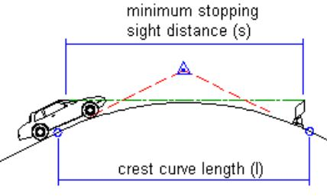
Example – Rural, Local, N&R, Unpaved, DS=50, ADT=312
Step 12 – Determine value of Criterion #8: stopping sight distance
Table 001.03J
Pages 69-70
428 NAC 2-001.03A6f, Page 46
428 NAC 2-001.03B Note 13, Page 50
Slide 39
Notes:
The minimum sight distance is 425 ft.
We have already reviewed notes 12 and 13 and concluded that nothing in those notes apply to this project.

Slide 40

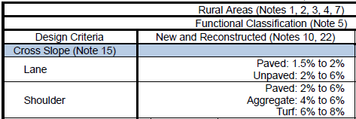
Example – Rural, Local, N&R, Unpaved, DS=50, ADT=312
Step 14 – Determine values of Criterion #9: cross slope
Table 001.03J
Pages 69-70
428 NAC 2-001.03A6g , Page 46
428 NAC 2-001.03B Note 15, Page 51
Slide 40
Notes:
The minimum lane cross slope is 2% and the maximum is 6%.
For an unpaved road, as in this example.
The last paragraph of Note 15 recommends, for unpaved roads, a lane cross slope in the middle of the range – 4% +/-
The minimum turf shoulder cross slope is 6% and the maximum is 8%.

Slide 41
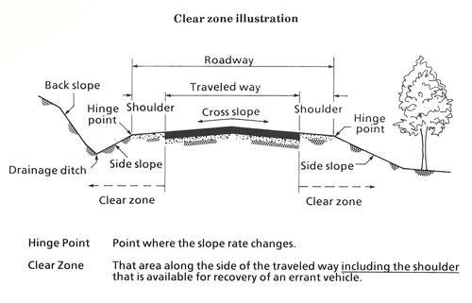
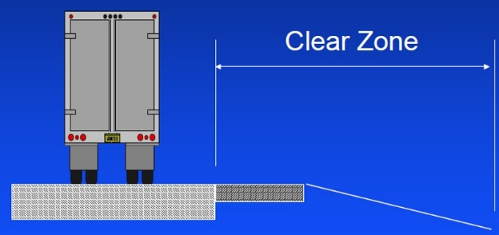

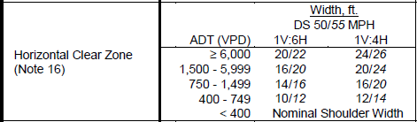
Example – Rural, Local, N&R, Unpaved, DS=50, ADT=312
Step 15 – Determine value of Criterion #10: horizontal clear zone
Table 001.03J
Pages 69-70
ADT = 312 VPD
428 NAC 2-001.03A6k, Page 46
428 NAC 2-001.03B Note 16, Page 52
Slide 41
Notes:
The minimum horizontal clear zone for a traffic volume fewer than 400 VPD is the Nominal Shoulder Width.

Slide 42
Nominal Shoulder Width*
Definitions
Example – Rural, Local, N&R, Unpaved, DS=50, ADT=312
4 ft *
  =
  * Shoulder width indicated in the table
Slide 42
428 NAC 2-001.03A4g, Page 43
Notes:
The Nominal Shoulder Width is defined on page 43 as the shoulder width value shown in the design standards table.
For the example, Rural Area standards with a functional classification of Local, and an ADT of 312 VPD, the shoulder width value in Table J on page 69 is 4 ft.
The nominal shoulder width, therefore, is 4 ft.

Slide 43

Example – Rural, Local, N&R, Unpaved, DS=50, ADT=312
Step 15 – Determine value of Criterion #10: horizontal clear zone
Table 001.03J
Pages 69-70
2017 ADT = 312 VPD
4 ft for this example
428 NAC 2-001.03A6k, Page 46
428 NAC 2-001.03B Note 16, Page 52
Slide 43
Notes:
Review Note 16 on page 52.
If any non-crashworthy or non-break-away obstacles other than those listed in paragraph (a) will be in the HCZ after the project, the county is required to justify it with an engineering study.

Slide 44
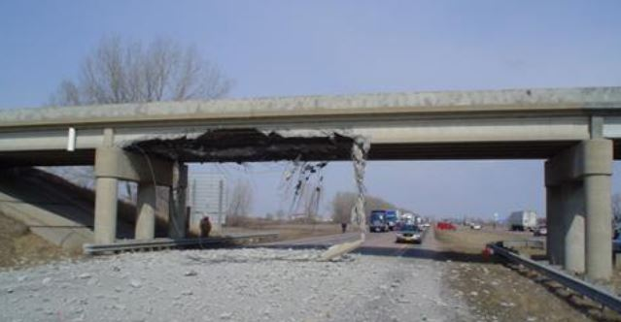
Example – Rural, Local, N&R, Unpaved, DS=50, ADT=312
Step 16 – Determine value of Criterion #11: vertical clearance
Table 001.03J
Pages 69-70
428 NAC 2-001.03A6h , Page 46
428 NAC 2-001.03B Note 17, Page 53
Slide 44
Notes:
The minimum Vertical Clearance is 14.5 ft.
Review Note 17 on page 53
Nothing in the note applies assuming there are no planned underpasses or overpasses, or pedestrian, bicycle or overhead-sign structures.

Slide 45
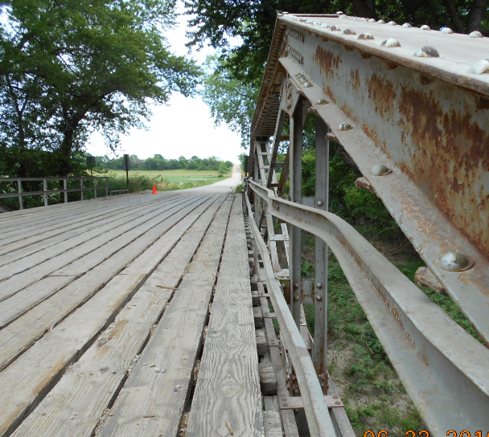
Example – Rural, Local, N&R, Unpaved, DS=50, ADT=312
Location:
Saline County Road O (north of Wilber)
8x10 NBS
26’ CBW
CBC Triple 12x10
SR = 88.7
Built 2003
Steel Truss w/Timber Approaches, 125 ft, CBW=19.5 ft
SR = 33.0, Structurally Deficient, Load Posted
Built 1935, Poor Piling
C007603020
C007603025
3.5 miles
Gravel Surfacing
C007603023
CBC Triple 12x10
SR = 88.7
Built 2003
Google Earth Image 6/10/2014
3 Bridge-size Structures
Slide 45
Notes:
This aerial view shows three structures toward the west end of the project.
For this example, the Steel Truss bridge is assumed to be structurally deficient and in need of replacement.
The other two structures are triple box culverts in good condition.

Slide 46
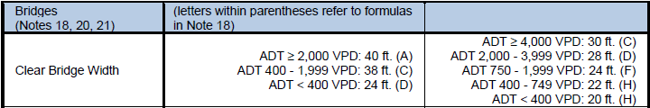
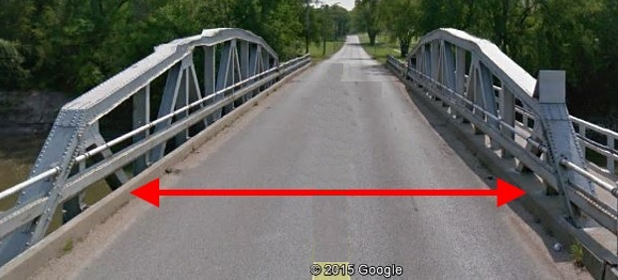
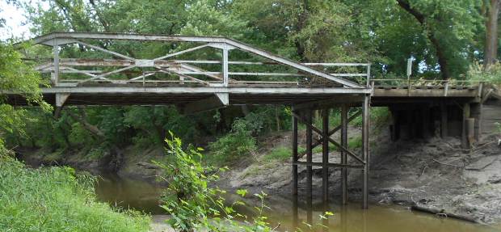
Example – Rural, Local, N&R, Unpaved, DS=50, ADT=312
Step 17 – Determine value of Criterion #12: clear bridge width
Table 001.03J
Pages 69-70
2017 ADT = 312 VPD
Formula D: Approach traveled way width plus 2 ft. (each side). CBW = 2 + 20 + 2 = 24 ft.
Formula H: Approach traveled way width. CBW = 20 ft.
428 NAC 2-001.03A6i, Page 46
428 NAC 2-001.03B Note 18, Page 53, notes 20 and 21, Page 54
Slide 46
Notes:
For a bridge replacement,
The minimum clear bridge width for fewer than 400 VPD is 24 ft. The basis is Formula (D), which is in Note 16 as the approach traveled way plus 2 ft each side. The value listed in the table is also 24 ft.
If there were any structures that required 3R work, the minimum clear bridge width would be 20 ft.
Note 20 applies to Timber Bridges, and Note 21 applies to Low Water Stream Crossings and Fords. Neither note applies to this project.

Slide 47
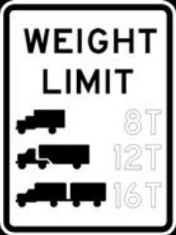
Example – Rural, Local, N&R, Unpaved, DS=50, ADT=312
Step 18 – Determine value of Criterion #13: structural capacity
Table 001.03J
Pages 69-70
3R:
Original Design Loading
If unknown, use HS15
428 NAC 2-001.03A6j, Page 46
428 NAC 2-001.03B, Note 19, Page 54
Slide 47
Notes:
The minimum design structural loading capacity is HL93 for a bridge replacement.
If a structure needed 3R work, the minimum design structural loading capacity is the original design loading.
If that is unavailable, the minimum is HS15. Refer to Note 19.

Slide 48
Finding the Appropriate Values
knowing the Area, NFC and Scope
Minimum Design Standards
What is the scope of work (3R or New and Reconstructed)?
What is the selected Design Speed (New & Reconstructed standards)?
What is the traffic volume? Percentage of Heavy Trucks (%HT)?
Paved or Unpaved?
Curbed or Non-curbed?
Rolling or Level terrain?
Slide 48
428 NAC 2-001.03 Tables, Pages 55-86
Notes:
In summary, Once you have found the standards table that applies to the work or project,
There are several things you need to know in order to find the values for each design criteria
This screen shows the kind of information you need to know.
The type of work is important to know which column of the table applies.
The Design Speed is a key design criterion because several other design criteria are a function of design speed
Several design criteria depend on the traffic volume.
Other information that may be needed are READ THE LAST THREE BULLETS
NOT FOR AUDIO
It is straightforward to find the appropriate values in each table; all values are right there on the table.
design speed: 7 other controlling criteria are function of this
traffic volume: 3 controlling criteria are a function of this
paved: 3 controlling criteria are a function of this
curbed: 1 controlling criterion ( lateral offset to obstruction) a function of this
terrain: one controlling criterion (grade) is a function of this

Slide 49
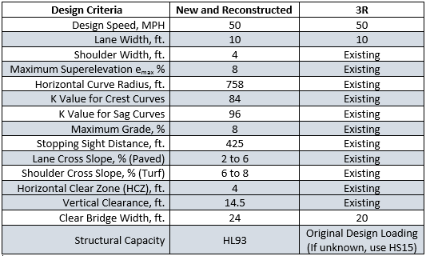
Example – Rural, Local, N&R, Unpaved, DS=50, ADT=312
SUMMARY – Design Standards Values
Slide 49
Notes:
This screen summarizes the Design criteria values that apply to the example project.
PAUSE
These are all of the values determined on the screens leading up to this one.
PAUSE

Slide 50
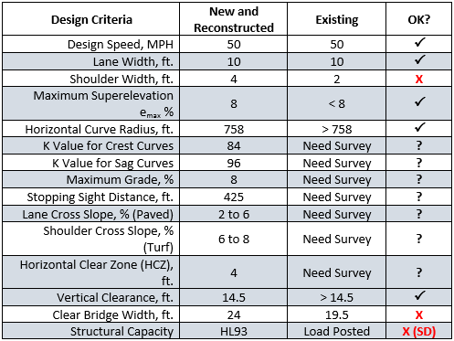
Example – Rural, Local, N&R, Unpaved, DS=50, ADT=312
Slide 50
Notes:
This screen compares standard New & Reconstructed values to the Existing road.
Shoulder widths need to be increased to the standard value of 4 ft, from the assumed existing width of 2 ft
A new bridge will have a minimum CBW of 24 ft compared to the existing steel truss bridge of 19.5 ft.
By the way, the existing bridge does not even meet the 3R standard value of 20 ft CBW.
NOT FOR AUDIO
Compare New & Reconstructed Standards to Existing and check if all is Ok or does any criteria fall short of standards.

Slide 51
Example – Rural, Local, N&R, Unpaved, DS=50, ADT=312
Note 22
Note 22
Note 22
Note 22
Note 22
Note 22
Note 22
Note 22
Note 22
Slide 51
Notes:
For the roadway and roadside in the vicinity of a bridge to be replaced,
Note 22 may allow lower standards, conditionally, for eight design criteria:
lane width, shoulder width, superelevation, horizontal curve radius, K values, grade, stopping sight distance and horizontal clear zone
if there is no significant crash history related to those design criteria
and a cost effective analysis shows that user benefits are greater than the cost of meeting New & Reconstructed standards.

Slide 52
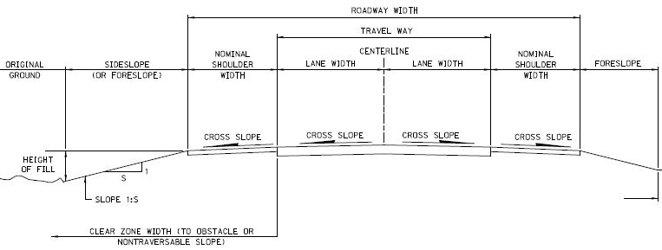
Example – Rural, Local, N&R, Unpaved, DS=50, ADT=312
ROADWAY WIDTH = 28 ft
TRAVELED WAY = 20 ft
4 ft
4 ft
10 ft
10 ft
6 - 8%
2 - 6%
2 - 6%
6 - 8%
Location:
Saline County Road O (north of Wilber)
Geometrics per 2016 Standards
4 ft
Slide 52
428 NAC 2-001.003
Notes:
Standard values are shown for some design criteria on this cross section.

Slide 53
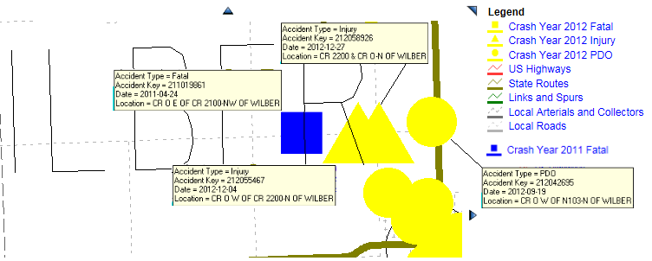
Assumed Crash History 2008-2014
Example – Rural, Local, N&R, Unpaved, DS=50, ADT=312
Slide 53
Notes:
8/7/2019 Updated to delete reference and web link to Co-NECTAR which is not supported anymore, revise one audio media and delete one audio media.
As part of alsmos projects, Crash history is typically reviewed early in the development of a project, in the preliminary engineering phase or even earlier in the planning phase.
In addition to traffic volume data, NDOR’s CoNECTAR website also has Let’s take some hypothetical crash history data.
This screen shows a sample of crash history information from CoNECTAR for the example project.

Slide 54

Fatal Crash in 2011 – Crash Report
Example – Rural, Local, N&R, Unpaved, DS=50, ADT=312
Slide 54
Notes:
More relevant details can be determined from crash reports.

Slide 55
Fatal Crash in 2011 - Description
Example – Rural, Local, N&R, Unpaved, DS=50, ADT=312
Vehicle #1 was traveling westbound on County Road “O.” The driver hit potholes in the north lane of traffic. Driver of Vehicle #1 veered to the right, overcorrected to the left, and lost control of the vehicle crossing the centerline. The vehicle entered the south ditch striking the south embankment, proceeded up the south embankment striking a tree, then rolling onto its top before coming to its point of rest.
Slide 55
Notes:
Details such as an embankment or trees close to the roadway That may affect the scope of work.

Slide 56
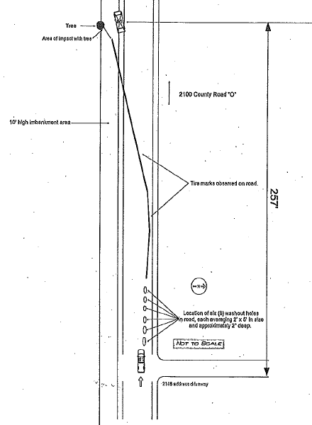
Fatal Crash in 2011 - Schematic
Example – Rural, Local, N&R, Unpaved, DS=50, ADT=312
Slide 56
Notes:
Crash reports provide schematic representations of crashes which may be helpful to road and street designers.

Slide 57

Crash History Info
3R Design Standards
Cost Effective Analysis
Public agencies and its contractors call the NDOT Highway Safety office 402-479-4594 and ask for the
  Highway Safety Data Systems Manager, or
  Crash Analyst Supervisor, or
  Highway Safety Engineer
General public must contact NDOT Communication Division 402-471-4567
Slide 57
Related to Cost Effective Analysis, Page 41
Notes:
8/7/2019 Updated Contact information updated and made more generic, deleted Co-NECTAR link and reference because the NDOT no longer supports it. Also, one instance of NDOR→NDOT requiring two audio media revisions.
Crash History information can be found on NDOR’s website Co-NECTAR
NDOR’s NDOT’s Highway Safety Office is available for guidance, for counties and municipalities.
The general public must contact NDOR’s NDOT’s Communication Division.
NOT FOR AUDIO
Contact per Alan Brown 12/8/2015 phonecon with LeMoyne Schulz
Alan Brown (402.479.4665) is the main contact, or Sean Owings (402.479.4628), or Bob Grant (402.479-4645).
But the data provide by Highway Safety is not for public knowledge. It is only for the requester’s use to accomplish their job.
If someone in the public domain wants accident data, that has to be requested through Communication Division. They have to approve/coordinate any data that goes out to the public with our Legal office. If they determine the data is OK to give out, she will contact me/Sean/Bob for the data.
12/8/2015 e-mail from Alan Brown, Highway Safety Office
If a County Engineer or Superintendent (or someone contracted with them) needs accident data, they can contact me (402.479.4665) or Sean Owings (402.479.4628), or Bob Grant (402.479-4645). I’m including both Sean and Bob as we each can access accident data, but I’m the main person to contact. I just want to include them in case I’m not at work and someone needs data. But the data I give out is not for public knowledge. It is only for the requester’s use to accomplish their job.
If someone in the public domain wants accident data, that has to be requested through Mary Jo Oie. She has to approve/coordinate any data that goes out to the public with our Legal office. If Mary Jo/Legal office determines the data is OK to give out, she will contact me/Sean/Bob for the data.

Slide 58
Minimum Design Standards can be thought of as:
Minimum Design Standards
The lowest limit to build a facility without requesting a relaxation of standards
Standard
Value
(Example)
A few key criteria
ACCEPTABLE RANGE
Design
Flexibility
Slide 58
Notes:
Design standards tend to provide some level of comfort that a roadway built to minimum (standard) values will generally deliver an acceptable, cost-effective level of performance. However, much more goes in to a good quality, well functioning roadway than just designing to minimum design standards.
In a sense, design standards consist of a few key criteria (13 in our standards), chosen by the Board, with minimum values assigned that can trigger requests for relaxation of standards. Requests are a flag that there is a situation out there that cannot meet a standard; the Board is required to review those.
Standards allow some design flexibility. Some values may be on the low end of industry recommended ranges.
It is the responsibility of the design professional to choose a design that is right for the particular road, that is safe for users and functions well operationally, and is cost effective.

Slide 59



Possible Misconception
Minimum Design Standards
Must design to the values in the standards – no more, no less.
In specific circumstances, designer may need to choose values
greater than standard minimum values, or
less than standard maximum values (requires Relaxation)
Slide 59
Notes:
Finally, There may be a misconception to the effect that designers cannot go above and beyond (i.e. be more conservative) Board standard values. Not true!
Realize that Standard values may not be appropriate for all situations: it is sometimes appropriate to go above and beyond minimum standards. That is a design decision.
It is only if a minimum Board standard is not met that a Relaxation of Standards request must be made to the Board.

Slide 60
2016 Standards
Video 08
Finding the Correct Values in the Tables
Nebraska Administrative Code
Title 428
Rules and Regulations of the
Board of Public Roads Classifications and Standards
(Administrative Host: Nebraska Department of Transportation)
County Roads and Municipal Streets
Neb. Rev. Stat. 39-2113
https://dot.nebraska.gov/media/5593/nac-428-rules-regs-nbcs.pdf
Boards - Liaison Services Section
8/8/2019
Notes:
This is one of a series of videos on Nebraska’s system of
Classifying and applying standards to its highways, roads and streets.
This video used an example county road project to demonstrate finding the applicable table and determining the standard values for each of the 13 design criteria.

