Slide 1


State Regulatory Boards
Oversight and Support
Board of Public Roads Classifications and Standards (NBCS) §39-2106 thru §39-2108
Board of Examiners for County Highway and City Street Superintendents (BEX) §39-2304 & §39-2305
Boards - Liaison Services Section
Tab 4
Slide 1
Notes:
9/12/2022 Slide 1 updated with 3-ring-binder Tab number and a minor change to Slide 8.
8/16/2022 Updated slide 9 (congressional districts changed in 2021)
3/9/2022 Updated slides 14 and 17
8/20/2021 Updated slide 16 with minor change
7/13/2021 Updated slide 7 header
6/20/2021 Updated slides 5, 6, and14, added Slide 11 (functions of NBEX) and deleted Slide 16 (obsolete due to LB174 (2021).
5/25/2021 Updated Slide 14 to be clear that a professional engineer (PE) must meet these requirements just the same as a person who passed the exam, and that a person applying for a Class A license must have held the Class B license for two full calendar years.
4/21/2021 Update because of passage of LB174(2021). Slides 6, 7, 8, 9, 12, 14 and 16 were changed either on the slide itself and/or the notes field.
1/30/2020 Added narrative in the notes section of slide 5, added list of county classifications and the NE congressional map on slide 9, added a note on slide 12. Previous version was 8/28/2019.
8/28/2019 Updated Slide 7 – removed references to Tabs (Tab.15, Tab.13)
8/13/2019 Updates made to this presentation some based on LB82 (2019). Previous version dated 8/24/2018. Eight (8) slides updated. Slides 3, 9, 10, 12 thru 14, 16 and 22 were updated.
Handouts – describe to audience

Slide 2
State Regulatory Boards
Oversight and Support
Board of Public Roads Classifications and Standards (NBCS) §39-2106 thru §39-2108
Board of Examiners for County Highway and City Street Superintendents (BEX) §39-2304 & §39-2305
Slide 2
Notes:
The Board of Examiners is one of two Boards created by state statutes for Nebraska’s system of roads and streets.
LB174(2021) changes affecting the BEX, superintendent licensing, and incentive payments
Concise Summary: A superintendent assists (often part of a team and not always the decider), a political jurisdiction (in order to receive incentive payments) must appoint their superintendent, superintendent licenses will no longer distinguish between county and city, a Class A licensee holding a Class B license currently will be issued only a Class A license, the BEX Board no longer has to have a member from Lincoln or Omaha, and
STARTING IN 2022:
for counties with less than 60,000 inhabitants and for any incorporated municipality, appointing a person in its direct employ having a PE license per E&A Regulation Act to perform the duties of a superintendent will serve as Class A license for the purpose of incentive payments,
Counties with 60,000 and more inhabitants automatically get the full Class A incentive payment based on the rural population, and
Superintendents have to be appointed and the appointment has to be documented using the process developed by NDOT.
Superintendents assist counties and municipalities – recognizes that a superintendent is often a key part of a team effort and not on an island, many times there is another person leading an effort (such as budgeting, or human resources). Ref 39-2301.01(4), 39-2307
Changed "employed" to "appointed"; clarified specific sections applicable for counties and for municipalities; added "or is exempt from such licensure requirement . . . " Ref 39-2302 so that entities can get the incentive payment even if a licensed superintendent is exempted by 39-2504 or 39-2514, i.e., those sections are extensively changed, mainly a PE license will now serve as a Class A Superintendent's license (for purposes of incentive payment) without having to take the exam and get a superintendent's license.
BEX Board composition change. Municipal representatives of the BEX Board, (i) strike requirement that one shall be from Lincoln or Omaha, (ii) require that one be from Lincoln, Omaha OR a city of the first class. The BEX Board isn't required to have a representative from Lincoln or Omaha any longer. Ref 39-2304(2)(c)
Extensively revised by eliminating the distinction between county and city licenses. There will be only Class A licenses and Class B licenses. Those licenses now apply to counties and municipalities. Ref 39-2308.03
Added language that PE's licensed under the E&A Regulation Act are automatically eligible for a Class B license, no exam required for them. Ref 39-2601(2)
A county of 60,000 or more (watch LB224-2021 per Casey Sherlock for an increase in the population number) or more inhabitants automatically gets the full incentive payment. STARTING IN 2022. Ref 39-2504(4)
A county of 60,000 or less can appoint a PE licensed under the E&A Regulation Act to perform the duties of a county highway superintendent, and the PE license shall serve as a Class A superintendent’s license for the purpose of incentive payments. STARTING IN 2022 Ref 39-2504(5).
A municipality can appoint and employ a PE, and that the PE license of that person serves the same as a Class A superintendent's license. This does not apply to a consultant PE. Only to a PE in the direct employ o the municipality. STARTING IN 2022. Ref 39-2514(4)

Slide 3


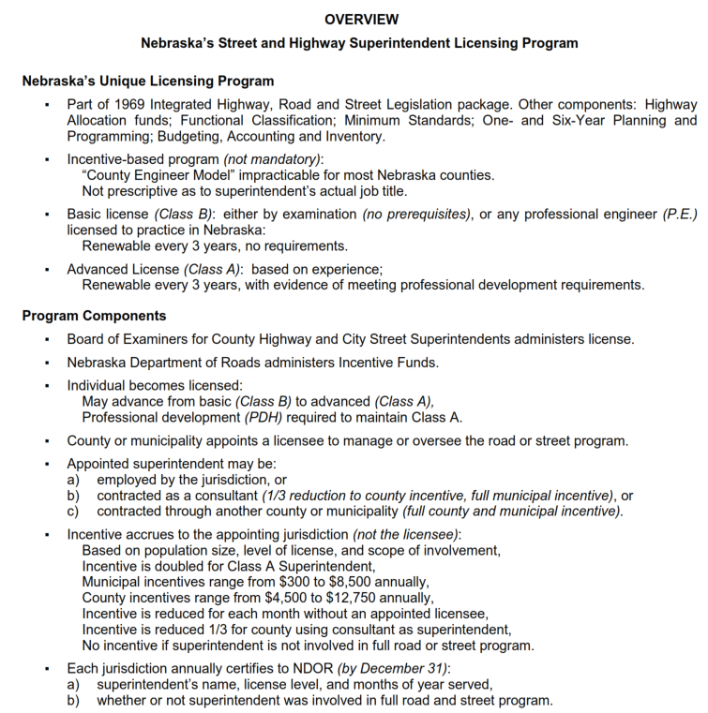
Licensing Program
Reference
Slide 3
Notes:
8/13/2019 Updated, deleted reference to LB733 (text box right-side in 8/24/2018 version) and changed the Overview image since it was recently (Aug 2019) updated.

Slide 4
State Law
Chapter 39
Article 23
Board of Examiners For County Highway and City Street Superintendents (BEX)
&
Highway / Street Superintendents Licenses
Section §39-2301 Act, how cited; legislative findings.
Section §39-2301.01 Terms, defined.
Section §39-2302 County highway or city street superintendents; license required; effect.
- etc. - (Complete listing of Art. 23)
Slide 4
Notes:
ARTICLE 23
BOARD OF EXAMINERS FOR COUNTY HIGHWAY AND CITY STREET SUPERINTENDENTS
Section.
39-2301 Act, how cited; legislative findings.
39-2301.01 Terms, defined.
39-2302 County highway or city street superintendents; license required; effect
29-2304 Board of Examiners for County Highway and City Street Superintendents; created; members; qualifications; appointment; term; vacancy; expenses.
39-2305 Board of examiners; office space; equipment; meetings.
39-2306 Class B license; application; fee; exceptions.
39-2307 Board of examiners; examinations; conduct; test qualifications of applicants for Class B licenses.
39-2308 Class B license; term; renewal.
39-2308.01 Class A license; application; qualifications; fees; term; renewal.
39-2308.02 Class A license; renewal; professional development required
39-2308.03 Licensees; additional licensure; requirements.
39-2309 License; suspension; revocation; grounds; hearing; notice.
39-2310 Funds received under act; use.
39-2311 Rules and regulations.

Slide 5
§39-2301 to §39-2311
State Law
County Highway / City Street Superintendent Act WHY?
  To Safeguard life, health, property
  To further Professional Management of road & street programs
  Provide for Superintendent Licenses
  Create the Board of Examiners (BEX)
GOALS OF BEX
Slide 5
Notes:
6/20/2021 – added “Superintendent” in third bullet, and put a box around the top three bullets to emphasize that these are the main goals of legislation and the NBEX.
1/30/2020 added commentary in the notes field about superintendents being professionals, know what they are doing.
The Legislature wants professionals to oversee our roads and streets, to have the public’s interests (safety, health, property) in mind as they go about their business. People who know what they are doing!

Slide 6
§39-2301.01
State Law
City Street Superintendent means a person who engages in the practice of street superintending for an incorporated municipality
County Highway Superintendent means a person who engages in the practice of highway superintending for a county
Superintendent’s License covers both (per §39-2308.03)
Slide 6
Notes:
6/20/2021 – eliminated first bullet because it’s redundant information (indicates that the NBEX is the Nebraska Board of Examiners, which is on previous slides)
4/21/2021 LB174(2021) changed 39-2308.03 extensively, by eliminating the distinction between county and city licenses. There will now be only Class B and Class A licenses which apply to counties and municipalities.

Slide 7
§39-2301.01(4)
Superintendent Duties
State Law
Street or Highway Superintending means assisting an incorporated municipality or a county in the following:
Developing and annually updating long-range plans or programs based on needs and coordinated with adjacent local governmental units
Developing annual programs for design, construction, and maintenance
Developing annual budgets based on programmed projects and activities
Implementing the capital improvements and maintenance activities provided in the approved plans, programs, and budgets
Managing personnel, contractors, and equipment in support of such planning, programming, budgeting, and implementation operations.
Slide 7
Notes:
4/21/2021 Update because of passage of LB174(2021). The word “assisting” is a key change. Also added “or programs” in paragraph (a).
8/28/2019 Updated – removed references to Tabs (Tab.15, Tab.13)
These duties will be repeated in other parts of the Workshop – SSAR, OneAndSix and Exam

Slide 8
§39-2302
State Law
Highway / Street Superintendent must be licensed and appointed by the governing body to qualify for Incentive Payment
More on Incentive Payments
under Article 25 statutes
Slide 8
Notes:
9/12/2022 added “by the governing body”
4/21/2021 Deleted repetitive word “appointed” just before Highway/Street Superintendent and deleted the bullet (there was only one bullet so don’t need a bullet!). Removed parentheses and add “statutes” last sentence.

Slide 9
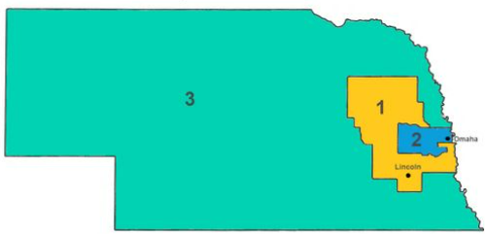
§39-2304
State Law
Board of Examiners (BEX)
  Seven (7) Members appointed by the Governor to four-year terms – must hold a current superintendent license
  Representation:
  4 county - no more than one from each Class of County (23-1114.01)
  3 municipal - no more than one from each Congressional District and:
  - Metropolitan Class, or Primary Class (Omaha or Lincoln), or First Class
  - Second Class
  - Village
Slide 9
Notes:
8/16/2021 updated congressional districts map which changed in 2021 and become effective after 2022 elections.
4/21/2021 changes per LB174-2021. It’s now one rep from Metro/Primary/First whereas it used to be one rep from Metro/Primary. There doesn’t need to be a member representing Lincoln or Omaha anymore.
1/30/2020 Update to add congressional districts map on the slide and the classification of counties list below.
23-1114.01 classification of counties is based on population (numbers are thousands) - THIS WAS COVERED IN 301 HWY LAW PRESENTATION
Class 1 <3
Class 2 3-9
Class 3 9-14
Class 4 14-20
Class 5 20-60
Class 6 60-200
Class 7 >200

Slide 10

Board of Examiners (BEX) Meetings
Seven Meetings per Year
Fourth Friday of Selected Months
at NDOT in Lincoln
https://dot.nebraska.gov/business-center/lpa/boards-liaison/bex/meetings/
Slide 10
Notes:
8/13/2019 Updated web link at bottom of slide.

Slide 11
NBEX Functions
Review qualifications of superintendent candidates
Administer Superintendent Exam 2x/year
License qualified superintendents
Administer PDH’s for Class A licensees
Suspend or Revoke Licenses
Slide 11
Notes:
6/20/2021 new slide – adapted from the former one-day review slides.

Slide 12
§39-2306
State Law
Class B Application Fee $25
Professional Engineer (P.E.) entitled to Class B License without examination
Slide 12

Slide 13

§39-2307
State Law
Examination
Exam tests qualifications of applicants, covers abilities to assist in:
Developing and annually updating long-range plans or programs based on needs and coordinated with adjacent local governmental units;
Developing annual programs for design, construction, and maintenance;
Developing annual budgets based on programmed projects and activities; and
Implementing the capital improvements and maintenance activities provided in the approved plans, programs, and budgets.
BEX Administers Class B License Exam twice a year
Slide 13
Notes:
6/20/2021 added “to assist in” per LB174 (2021) language.
4/21/2021 updated per LB174-2021. Item (5) deleted (“understand principles pertaining to . . . Operations and to management of . . .
1/30/2020 added a note about budgets
8/13/2019 Updated minor edits
#3 budgets doesn’t mean the final budget, necessarily – the Supt works with others, advises needs of road/street dept then others determine the actual, final budget

Slide 14
§39-2308
State Law
Class B License Requirements
Class B License: valid for 3 Years, renewal fee of $30. Qualify by
  passing the Superintendent exam, or
  being licensed under the Engineers and Architects Act (§81-3401 et al)
Slide 14
Notes:
3/9/2022 deleted 2nd bullet (it was the transition period created by LB733 (2017-18) – the 3rd bullet that became the 2nd bullet and now goes away since it is 2022. Changed the 1st bullet to a regular sentence having two sub-bullets.
6/20/2021 under the first bullet added two sub-bullets stating how to quality for a Class B license.
4/21/2021 needs to be updated per LB174-2021 for the Spring, 2022 training.
8/13/2019 Updated, removed reference to LB733 (2017-18) first bullet, deleted 2nd bullet since we are through the transition period, and the third bullet now becomes the second bullet but will go away in 2022. Changes to script also as a result of LB733.
Recommend keeping up your license, so you don’t have to go through the exam again!
8/2/2018: LB733 is not fully implemented yet. The BEX needs to approve changes. This slide reflects the most likely possibility.
8/2/2018: For a transition (the next two years 2019 and 2020), if a person has both a Class A and Class B license, the Class B license will be extended to match up to, or synchronize, with that person’s Class A license without paying the Class B license fees.

Slide 15
§39-2308.01
State Law
Class A License Requirements
Must have held Class B license for at least two full calendar years
Employed and appointed as superintendent at least ½ time basis for at least 2 years within last 6 years; or
4 years experience in work comparable to superintending, at least ½ time basis in the last 8 years
$75 application fee
Valid for 3 years
Renew for 3 years at a cost of $50
Slide 15
Notes:
5/25/2021 Updated slide to be clear that a professional engineer (PE) must meet these requirements just the same as a person who passed the exam and that a person applying for a Class A license must have held the Class B license for two full calendar years. .
4/21/2021 updated per LB174-2021.
8/13/2019 Updated, removed reference to LB733 (2017-18) second bullet
Second sub-bullet point: LB733 of the 2017-18 Legislative session.
Second sub-bullet point: the ½ time in the last 8 years requirement is also in 425 NAC 2 006.02D2, on page 28
006.02D2 Comparable Work Experience. The applicant had at least forty-eight (48) months of
work experience that is comparable to the work experience of appointed and employed county
highway superintendents and city street superintendents, on at least a half-time basis, in the
preceding eight (8) years.
006.02D2(a) Such experience shall include performing work substantially similar to all of
the superintendent duties defined in Subsection 003.04 of this rule, including managerial or
supervisory responsibility over departments, sections or positions engaged in such
comparable work.
006.02D2(b) The following shall constitute comparable work experience:
006.02D2(b)(i) Responsibility for federal, state, municipal or private industry highway,
road or street improvement or maintenance projects, including serving as lead
consultant, project manager, principal designer, design supervisor, budget and resources
manager, or overall manager or administrator, for such projects.
006.02D2(b)(ii) Serving as an appointed and contracted consulting county highway or
city street superintendent or engineer, or in a comparable capacity, including concurrent
service for two or more jurisdictions, if such service included oversight or active advisory
responsibility for substantially all aspects of street or highway superintending as
enumerated in Subsection 003.04.
006.02D2(b)(iii) Training county highway or city street superintendents or engineers, or
persons in comparable capacities.
006.02D2(b)(iv) Other comparable work experience as may be presented to the Board
for its consideration.

Slide 16
§39-2308.02
State Law
Continuing Education Requirements
Class A renewal requires 20 hours of professional development in previous 3 years
Excess of up to 10 hours can be applied to next 3-year period
Class A will not be renewed without completion of professional development hours unless good cause can be shown
Class B does not require professional development hours to be tracked and submitted
Slide 16
Notes:
8/10/2021 updated last bullet by adding “to be tracked and submitted”

Slide 17
Review
State Law
Review - Class B / Entry Level Superintendent License:
  - $25 Fee
  - By examination, unless applicant is a Professional Engineer (P.E.)
  - Renewed (between Oct 1 and Dec 31) for 3 calendar years for $30
Slide 17
Notes:
3/9/2022 deleted in first buttle “(each license)” since there is no distinction between county highway superintendent and city street superintendent.

Slide 18
Review
State Law
Review - Class A / Advanced Level Superintendent License:
  - $75 Fee (each license)
  - By experience and qualification
  - Renewed (between Oct 1 and Dec 31) for 3 calendar years for $50 (each license) with proof of 20 PDH over previous 3 calendar years
Slide 18

Slide 19
§39-2309
State Law
Suspension or Revocation of License - BEX can only act after notice and hearing and only for:
  Fraud or deceit in obtaining license
  Neglect of duty
  Incompetence in the performance of duty
Slide 19
Notes:
It has happened only twice. Both times the person retired.
Penalty could be downgraded from Class A to Class B. Could be losing license altogether.

Slide 20
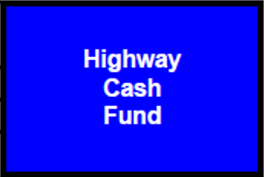
§39-2310 & §39-2311
State Law
Funds received (application and renewal fees) under the County Highway / City Street Superintendents Act is remitted to the State Treasurer for credit to the Highway Cash Fund
The BEX adopted rules and regulations (425 NAC) for the administration of the County Highway and City Street Superintendents Act
Slide 20

Slide 21
BEX Funding
State Law
Funding for the BEX is in NDOT’s budget
§39-2305
office space, furniture, equipment, stationery, and labor (including clerical)
Slide 21
Notes:
The BEX is funded by the NDOT.

Slide 22
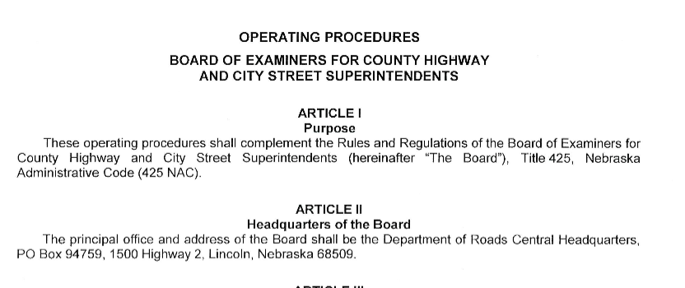
BEX Operating Procedures and Regulations
Reference
https://dot.nebraska.gov/business-center/lpa/boards-liaison/bex/downloads/
Slide 22
Notes:
8/13/2019 Updated web link at the bottom.

Slide 23
State Oversight & Support
Questions?
Board of Public Roads Classifications and Standards (NBCS) 39-2106 thru 39-2108
Board of Examiners for County Highway and City Street Superintendents (BEX) §39-2304 & §39-2305
Boards - Liaison Services Section
Slide 23

