Slide 1
Utility program
District 7 Breakout Session

Slide 2
This Meeting is Being Recorded
Notes:
HDR

Slide 3
Welcome
Before we begin, let’s have a brief safety moment.
In-Person Attendees
Emergency Exits
Tornado Shelter
911 Caller
AED Location
Restrooms
Virtual Attendees
Unmute yourself or use your chat box if you are in an emergency situation.
Notes:
HDR

Slide 4
Agenda
Introductions
High Impact Project Review (by construction year)
Communication and Coordination
Questions and Wrap Up
Notes:
HDR

Slide 5
Introductions
Notes:
All speakers introduce themselves briefly (Dave, section head, HDR facilitators); Attendees can introduce themselves if it’s a small group. If not – skip it!

Slide 6
2024 Utility policy
NDOT rolled out a new utility accommodation policy in 2024.
You can find more information, as well as a webinar about the changes, on the NDOT utility website at https://dot.nebraska.gov/business-center/utilities/.

Slide 7
Recently Completed projects
The following projects were recently completed in District 7.

Slide 8
Recently completed projects
McCook West Bridges
Kansas Line – N-89
Funk – E Jct N-44
E Jct N-44 (MS)
Beaver City East and West
Holdrege – Platte River

Slide 9
Outstanding Cy 2025
The following projects will likely not be completed in 2025

Slide 10
Wellfleet South (LET)
Project Number: NH-83-1(120) Control No: 71232
Project Length: 10.64
Scope of Work:
  Grading

Slide 11
Wellfleet South (LET)
Project Number: NH-83-1(120) Control No: 71232
Status:
Right-of-way: Completed
Construction Timing: 9/3/2024 - 12/31/2025

Slide 12
Wellfleet South (LET)
Project Number: NH-83-1(120) Control No: 71232
Anticipated Utilities Impact:
  Grading
Anticipated Request from Utilities:
  Provide Existing Locations
  Potholing Required
Additional Information:
  Special Provisions Required
Utilities Involved:
  McCook Public Power District
  Lumen
  Consolidated Telephone
All coordination was completed by PM and utilities moved prior to the start date.

Slide 13
Cy 2026
The following projects are anticipated to be let during 2026

Slide 14
In Stratton and West
Project Number: NH-34-2(126) Control No: 71235
Project Length: 7.06
Scope of Work:
  Bridge Repair
  Grading
  Timber structure replacements (with culverts)
  Guardrail
  Storm sewer work

Slide 15
In Stratton and West
Project Number: NH-34-2(126) Control No: 71235
Status: Preparing for Bid
Right-of-way: Complete
Construction Timing: 5/11/2026 - 11/21/2026

Slide 16
In Stratton and West
Project Number: NH-34-2(126) Control No: 71235
Anticipated Utilities Impact:
  Bridge Repair/Replace
Anticipated Request from Utilities:
  Provide Existing Locations
  Coordination with NDOT
Additional Information:
  Special Provisions Required
Utilities Involved:
  Great Plains Communications
  Village of Stratton
  Zayo Group
  Verizon

Slide 17
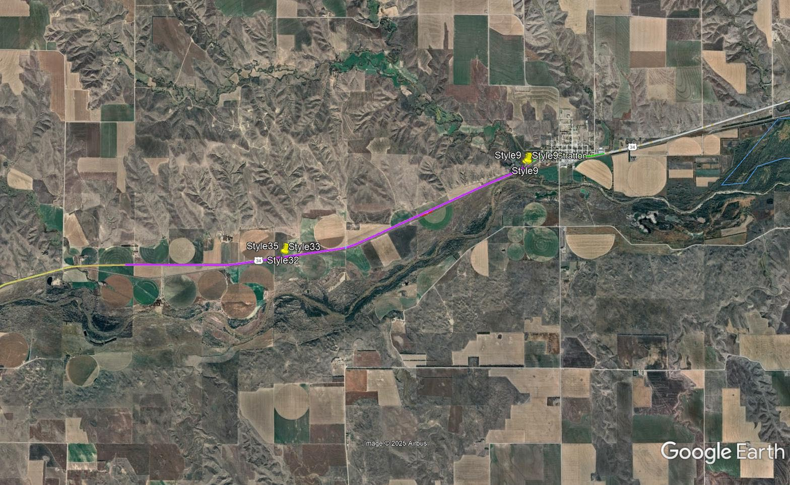

Slide 18
Holbrook - Arapahoe East
Project Number: NH-6-3(132) Control No: 71236
Project Length: 9.87
Scope of Work:
  Bridge Replacement and Bridge Repair
  Access X-ings
  Guardrail

Slide 19
Holbrook - Arapahoe East
Project Number: NH-6-3(132) Control No: 71236
Status: Preparing for Bid
Right-of-way: Not Required
Construction Timing: 2/2/2026 - 8/21/2027

Slide 20
Holbrook - Arapahoe East
Project Number: NH-6-3(132) Control No: 71236
Anticipated Utilities Impact:
  Bridge Repair/Replace
  Access X-ing
  Drop Pipes
Anticipated Request from Utilities:
  Provide Existing Locations
  Coordination with NDOT
  Potholing Required
Additional Information:
  Special Provisions Required
Utilities Involved:
  ATC Communications
  City of Arapahoe
  Black Hills Energy
  Verizon
  Twin Valleys Public Power District
  Zayo Group
  Village of Holbrook
  Pinpoint Communications

Slide 21
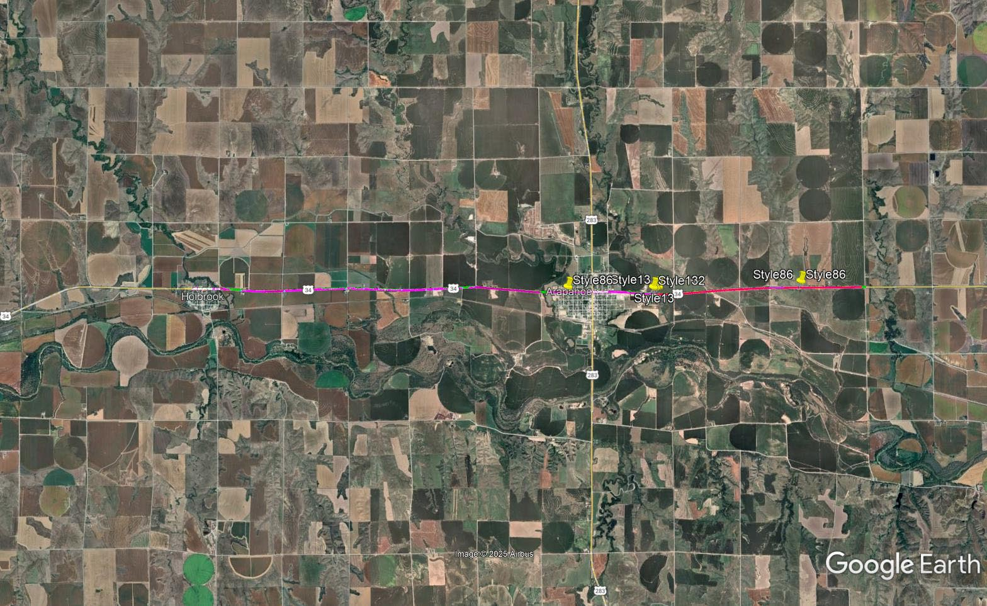

Slide 22
N-46 West
Project Number: NH-6-3(133) Control No: 71237
Project Length: 9.90
Scope of Work:
  Grading
    Drop Pipes
  Guardrail
  Bridge Repair
  Flumes

Slide 23
N-46 West
Project Number: NH-6-3(133) Control No: 71237
Status: Preparing for Bid
Right-of-way: Complete
Construction Timing: 6/15/2026 - 11/25/2026

Slide 24
N-46 West
Project Number: NH-6-3(133) Control No: 71237
Anticipated Utilities Impact:
  Grading
  Guardrail
Anticipated Request from Utilities:
  Provide Existing Locations
  Potholing Required
Additional Information:
  Special Provisions Required
Utilities Involved:
  ATC Communications
  Black Hills Energy
  Frontier Communications
  Lumen
  Pinpoint Communications
  Twin Valleys Public Power District
  Verizon
  Viaero Fiber Network
  Zayo Group

Slide 25
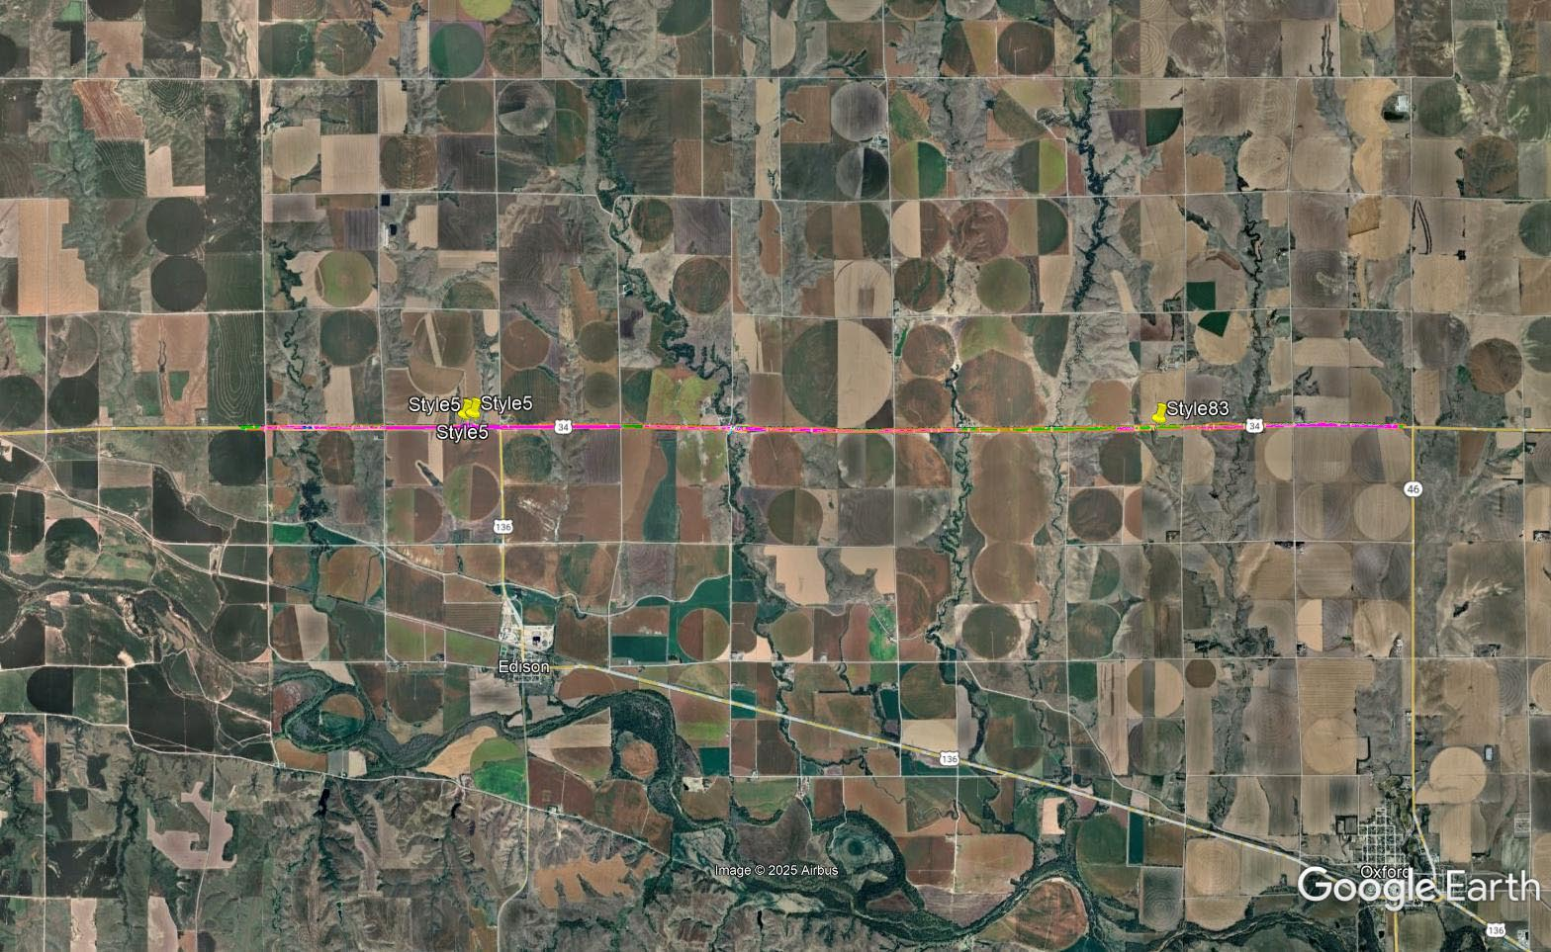

Slide 26
District 7 - CCTV Cameras
Project Number: ITS-STP-D7(102) Control No: 71284
Project Length: 0.00
Scope of Work:
  Install 3 CCTV camera towers with foundations, ground rod installation and trenching/boring for electrical conduit.

Slide 27
District 7 - CCTV Cameras
Project Number: ITS-STP-D7(102) Control No: 71284
Status: Preparing for Bid
Right-of-way: Not Required
Construction Timing: 9/14/2026 - 10/31/2026

Slide 28
District 7 - CCTV Cameras
Project Number: ITS-STP-D7(102) Control No: 71284
Anticipated Utilities Impact:
  Lighting
Anticipated Request from Utilities:
  Provide Existing Locations
  Coordination with NDOT
Additional Information:
  Special Provisions Required
Utilities Involved:
  No conflicts are expected.

Slide 29
JCT us-34 - Mccook
Project Number: NH-6-2(136) Control No: 71256
Project Length: 13.6
Scope of Work:
  Bridge Replacement/Repair
  Grading
  Guardrail
  Access crossing
  Flume
  Culvert extensions
  Potholing

Slide 30
JCT us-34 - Mccook
Project Number: NH-6-2(136) Control No: 71256
Status: Design
Right-of-way: Required
Construction Timing: 9/28/2026 – 12/31/2026

Slide 31
Jct us-34 - Mccook
Project Number: NH-6-2(136) Control No: 71256
Anticipated Utilities Impact:
  Bridge Replacement/Repair
  Grading
  Guardrail
Anticipated Request from Utilities:
  Provide Existing Locations
  Coordination with NDOT
Additional Information:
  Special Provisions Required
Utilities Involved:
  Berexco
  Black Hills Energy
  City of McCook
  Frenchman Valley Co-op
  Great Plains Communications
  Lumen
  Verizon
  Nebraska Public Power District
  Southwest Public Power District
  Viaero Fiber Network
  Village of Culbertson
  Zayo Group

Slide 32
Cy 2027
The following projects are anticipated to be let during 2027

Slide 33
US-6 - Platte River
Project Number: STP-44-1(107) Control No: 71270
Project Length: 11.78
Scope of Work:
  RCB work
  Culvert Extension/Replacements
  Grading
  Guardrail
  Potholing

Slide 34
US-6 - Platte River
Project Number: STP-44-1(107) Control No: 71270
Status: Design
Right-of-way: None
Construction Timing: 5/24/2027- 10/09/2027

Slide 35
US-6 - Platte River
Project Number: STP-44-1(107) Control No: 71270
Anticipated Utilities Impact:
  Bridge Repair
  Culvert Extension/Replacement
  Grading
Anticipated Request from Utilities:
  Provide existing locations
  Coordination with NDOT
Additional Information:
Utilities Involved:
  Black Hills Energy
  Central Nebraska Public Power and Irrigation District
  Charter Communications
  Lumen
  Frontier Communications
  Glenwood Telephone
  Great Plains Communications
  Lumen
  Verizon
  Northwestern Energy
  Nustar Pipeline
  Southern Public Power District
  Tallgrass Energy
  Windstream Communications
  Zayo Group
  Worldwide Fiber Networks
  Kaapa Ethanol
  Nebraska Public Power District
  Level 3 Communications

Slide 36
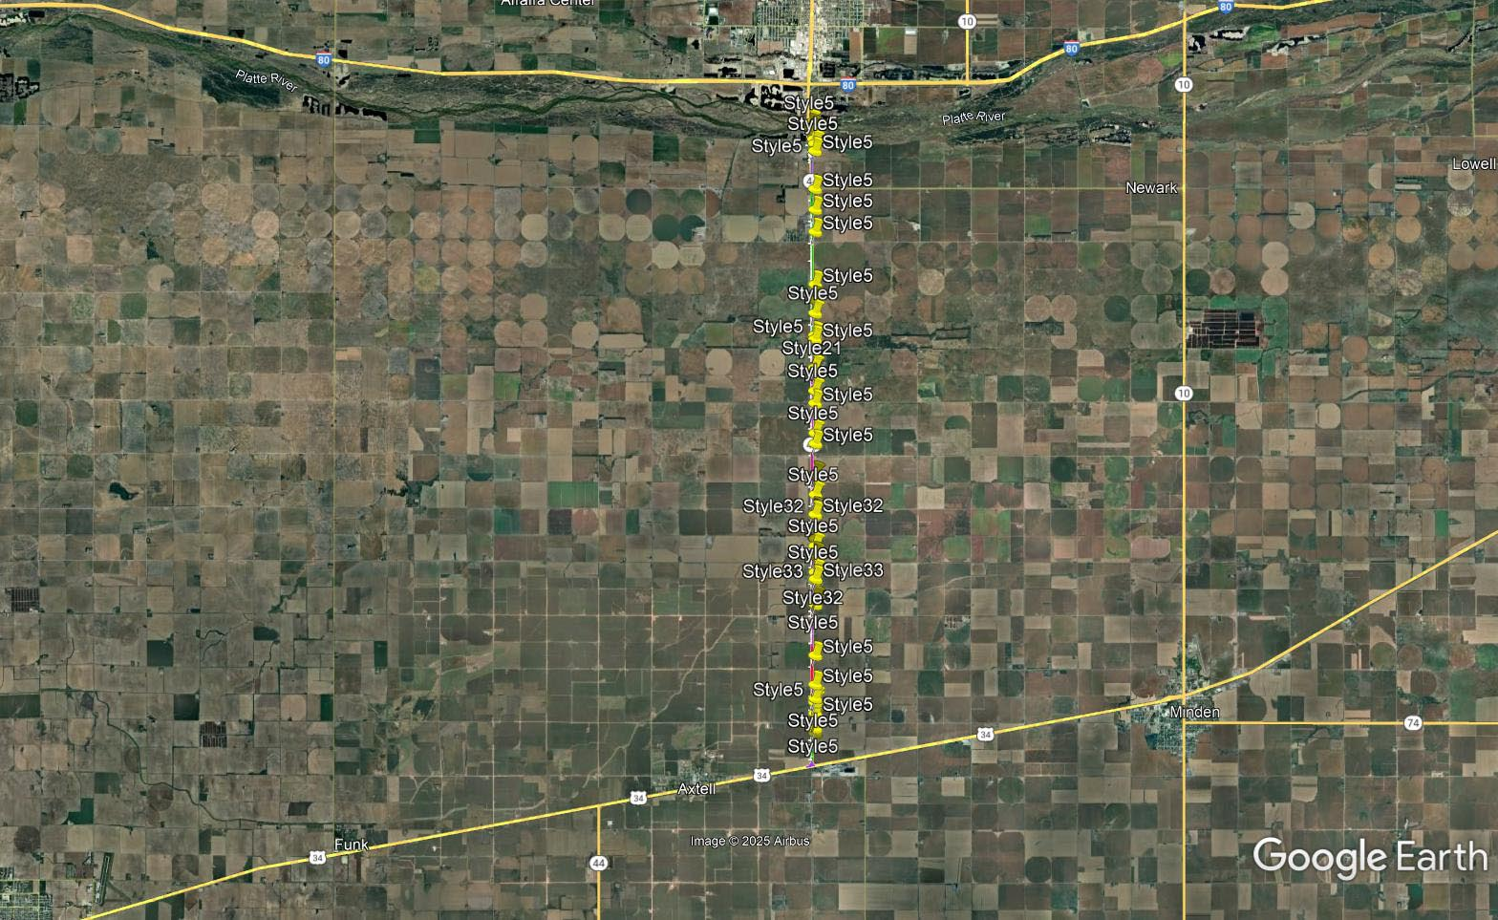

Slide 37
Jct N-89 North & South
Project Number: NH-83-1(123) Control No: 71267
Project Length: 6.90
Scope of Work:
  Culvert Extension

Slide 38
Jct N-89 North & South
Project Number: NH-83-1(123) Control No: 71267
Status: Design
Right-of-way: In Progress
Construction Timing: 7/26/2027 - 10/30/2027

Slide 39
Jct N-89 North & South
Project Number: NH-83-1(123) Control No: 71267
Anticipated Utilities Impact:
  Culvert Extension
Anticipated Request from Utilities:
  Provide existing locations
  Coordination with NDOT
Additional Information:
Utilities Involved:
  Lumen
  McCook Public Power District
  Plains Pipeline

Slide 40
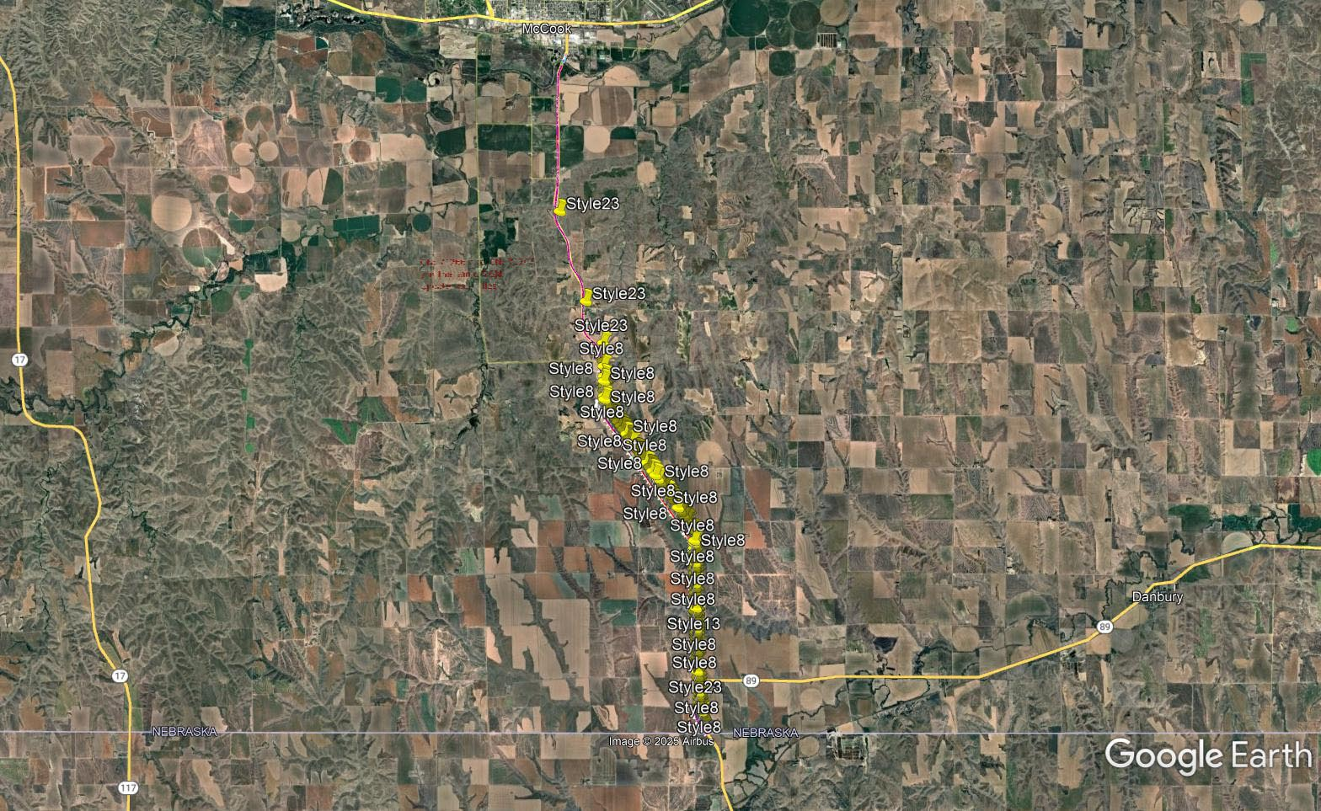

Slide 41
McCook South
Project Number: NH-83-1(122) Control No: 71266
Project Length: 6.90
Scope of Work:
  Culvert Extension/Replacement
  Bridge Repair
  Guardrail
  Grading

Slide 42
McCook South
Project Number: NH-83-1(122) Control No: 71266
Status: Design
Right-of-way: In Progress
Construction Timing: 5/17/2027- 11/27/2027

Slide 43
McCook South
Project Number: NH-83-1(122) Control No: 71266
Anticipated Utilities Impact:
  Culvert Extension/Replacement
  Bridge Repair
Anticipated Request from Utilities
  Provide existing locations
  Coordination with NDOT
Additional Information:
Utilities Involved:
  Black Hills Energy
  City of McCook W-S-SS
  Lumen
  Great Plains Communications
  McCook Public Power District
  Nebraska Public Power District
  Pinpoint Communications
  Plains Pipeline

Slide 44
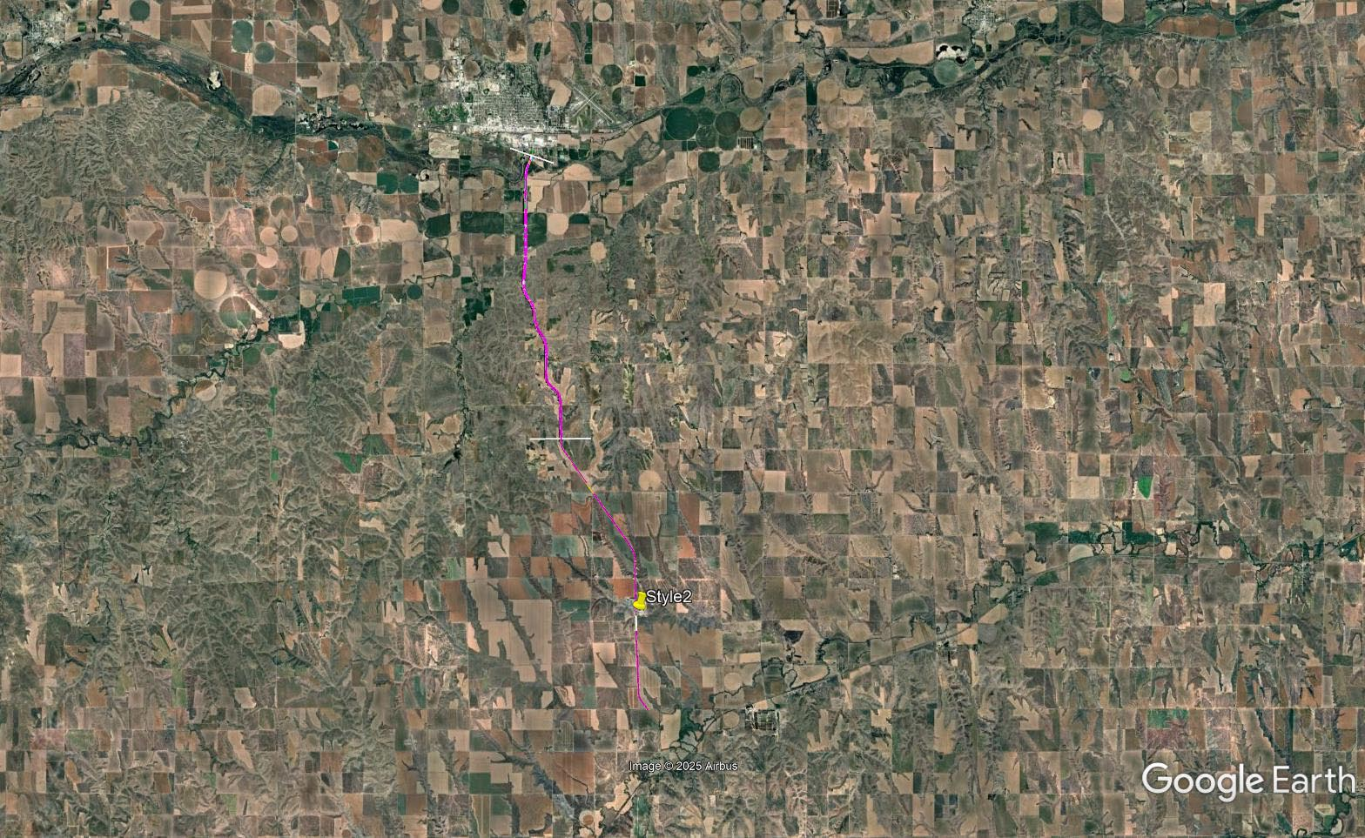

Slide 45
Questions & Wrap Up
Notes:
HDR

Slide 46
Any final Questions?
Ask them now!
If you have questions after this meeting, or would like to view more detailed project maps, please reach out to your utility coordinator.
Notes:
HDR

Slide 47
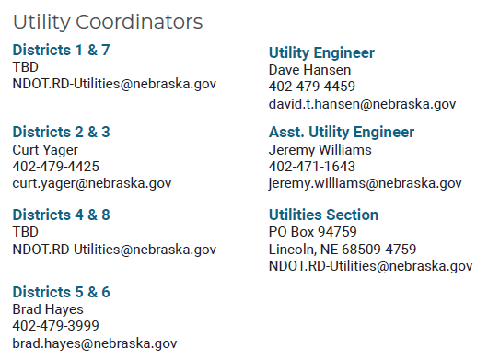
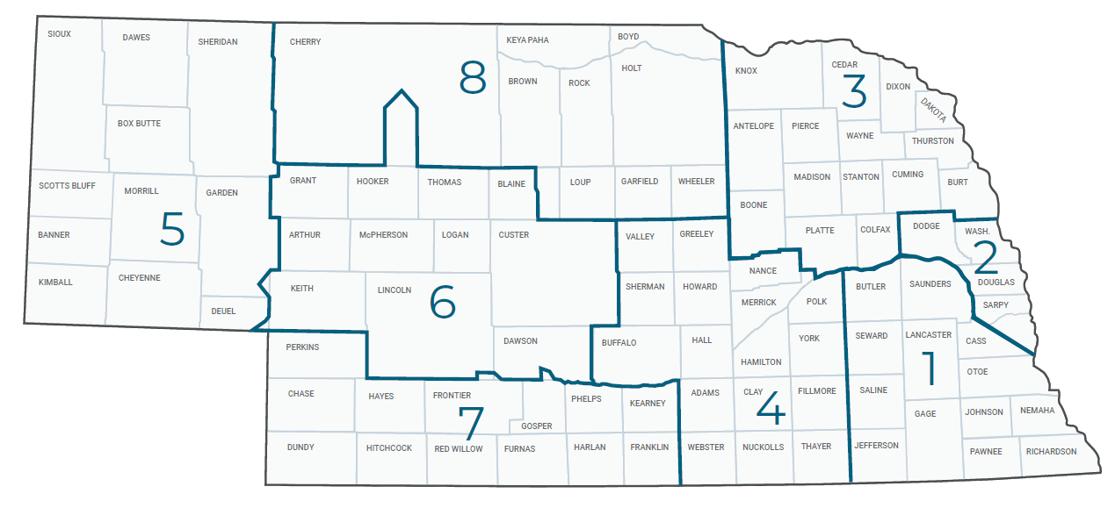
Have a Question about a project your Utility is involved in?
Contact your district’s utility coordinator!
Notes:
HDR

Slide 48
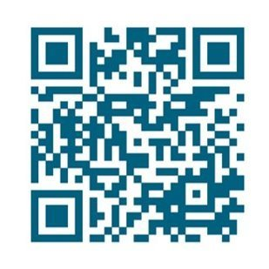
We need your feedback
Your valuable feedback helps these meetings – and NDOT’s utility coordination program – be better.
Use your phone’s camera to scan this QR code or use our paper survey.
Notes:
HDR

Slide 49
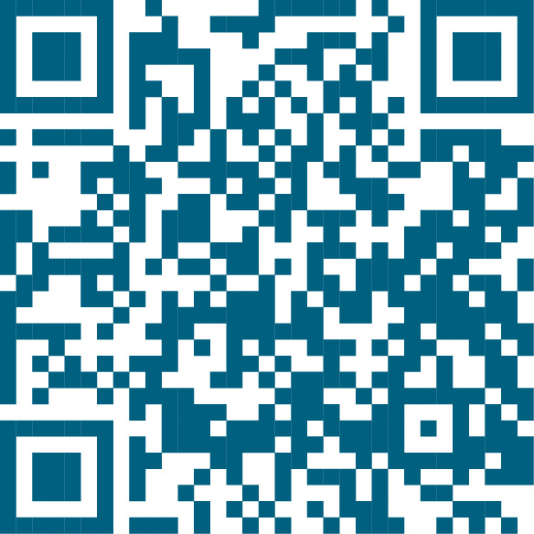
Visit our Website
Visit NDOT.info/utility for more information on:
Utility accommodation
Permitting
Coordination
Project information
Reimbursements
Additional information
Scan the QR Code to view the 2026 Program Book!
Notes:
HDR

Slide 50
Thank You
Notes:
HDR

