Slide 1


INCENTIVE PAYMENTS
Section 39-25_ _ Incentive Payments
Boards - Liaison Services Section
Tab 5
Slide 1
Notes:
9/13/2022 Slide 8 remove animations
9/12/2022 Slide 1 updated with 3-ring-binder Tab number
3/9/2022 Updated Slides 3, 16 and 17
8/22/2021 Updated Slide 8 (added big red X)
8/20/2021 Updated slide 16 – minor change.
6/20/2021 Updated slides 5 and 11
4/21/2021 Corrected statute references in notes field of Slide 8. Changes to Slides 6 and 7 per LB174-2021 (counties 60,000+ get Class A Incentive Payment automatically starting 2022). Slide 17 changed to latest certification form.
4/11/2021 Added Slide 8 showing Classes of Counties
1/30/2020 Update, slide 5 bullet (3) updated. Previous version was 8/13/2019.
8/13/2019 Updates made to this presentation some based on LB82 (2019). Previous version dated 2/21/2018. Three slides updated and one added. Slides 5, 10 and 15 were updated. Slide 16 was added.
Handouts – describe to audience
LB174(2021) changes affecting the BEX, superintendent licensing, and incentive payments
Concise Summary: A superintendent assists (often part of a team and not always the decider), a political jurisdiction (in order to receive incentive payments) must appoint their superintendent, superintendent licenses will no longer distinguish between county and city, the BEX Board no longer has to have a member from Lincoln or Omaha, and
STARTING IN 2022:
for counties with less than 60,000 inhabitants and for any incorporated municipality, appointing a person in its direct employ having a PE license per E&A Regulation Act to perform the duties of a superintendent will serve as Class A license for the purpose of incentive payments,
Counties with 60,000 and more inhabitants automatically get the full Class A incentive payment based on the rural population, and
Superintendents have to be appointed and the appointment has to be documented using the process developed by NDOT.
Added language that PE's licensed under the E&A Regulation Act are automatically eligible for a Class B license, no exam required for them. Ref 39-2601(2)
A county of 60,000 or more (watch LB224-2021 per Casey Sherlock for an increase in the population number) or more inhabitants automatically gets the full incentive payment. STARTING IN 2022. Ref 39-2504(4)
A county of 60,000 or less can appoint a PE licensed under the E&A Regulation Act to perform the duties of a county highway superintendent, and the PE license shall serve as a Class A superintendent’s license for the purpose of incentive payments. STARTING IN 2022 Ref 39-2504(5).
A municipality can appoint and employ a PE, and that the PE license of that person serves the same as a Class A superintendent's license. This does not apply to a consultant PE. Only to a PE in the direct employ o the municipality. STARTING IN 2022. Ref 39-2514(4)
Counties with populations 60,000 and more, and growth % since 2010:
Douglas 581,199 +12.08%
Lancaster 324,216 +13.30%
Sarpy 193,464 +21.13%
Hall 61,487 +4.56%
Counties with populations less than 60,000
Buffalo 50,273 +8.87%
Dodge 36,245 -1.17%
Scotts Bluff -5.54%
Madison -0.12%
Lincoln -4.98%
Platte +4.74%
Adams -0.85%
Cass +4.47%
Summary: In the eyes of the law, what does street or highway Superintending entail? (39-2301.01 definition) means assisting an incorporated municipality or a county in the following
Developing and annually updating long-range plans
Developing annual programs for design, construction and maintenance
Developing annual budgets based on annual programs
Implementing capital improvements and maintenance activities
Managing personnel, contractors and equipment in support of the above
Superintending (§39‑2301.01, Terms, defined) means assisting an incorporated municipality or a county in the following
(a) Developing and annually updating long-range plans based on needs and coordinated with adjacent local governmental units;
(b) Developing annual programs for design, construction, and maintenance;
(c) Developing annual budgets based on programmed projects and activities;
(d) Implementing the capital improvements and maintenance activities provided in the approved plans, programs, and budgets; and
(e) Managing personnel, contractors, and equipment in support of such planning, programming, budgeting, and implementation operations.
Duties – for incentive payments (§39‑2502) (County) a person who assists the county with the following:
(1) Developing and annually updating a long-range plan or program based on needs and coordinated with adjacent local governmental units;
(2) Developing an annual program for design, construction, and maintenance;
(3) Developing an annual budget based on programmed projects and activities;
(4) Submitting such plans, programs, and budgets to the local governing body for approval; and
(5) Implementing the capital improvements and maintenance activities provided in the approved plans, programs, and budgets.
Duties – for incentive payments (§39‑2512) (Municipality) a person who assists the municipality with the following:
(1) Developing and annually updating a long-range plan or program based on needs and coordinated with adjacent local governmental units;
(2) Developing an annual program for design, construction, and maintenance;
(3) Developing an annual budget based on programmed projects and activities;
(4) Submitting such plans, programs, and budgets to the local governing body for approval; and
(5) Implementing the capital improvements and maintenance activities provided in the approved plans, programs, and budgets.
Not duties, but here for reference:
Exam – testing ability to assist in (§39‑2307)
(1) Developing and annually updating long-range plans or programs based on needs and coordinated with adjacent local governmental units;
(2) Developing annual programs for design, construction, and maintenance;
(3) Developing annual budgets based on programmed projects and activities; and
(4) Implementing the capital improvements and maintenance activities provided in the approved plans, programs, and budgets.

Slide 2
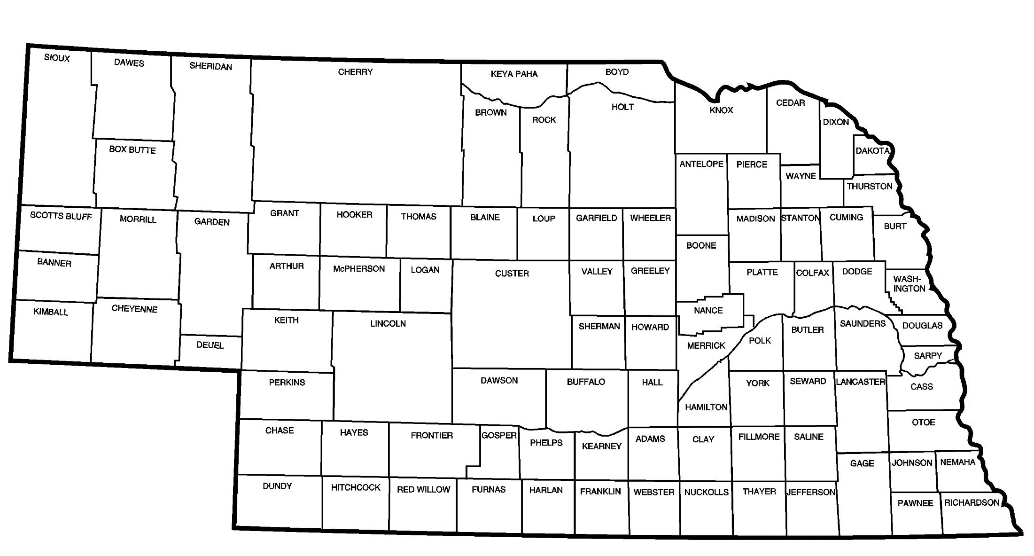

Purpose of Incentive Payments
Provide encouragement to appoint licensed superintendents to manage the road or street program
Slide 2
Notes:
Municipalities are not required to have a superintendent
Not all counties are required to have a superintendent
This system in lieu of having a professional engineer for each entity – Nebraska is a low-population state.

Slide 3
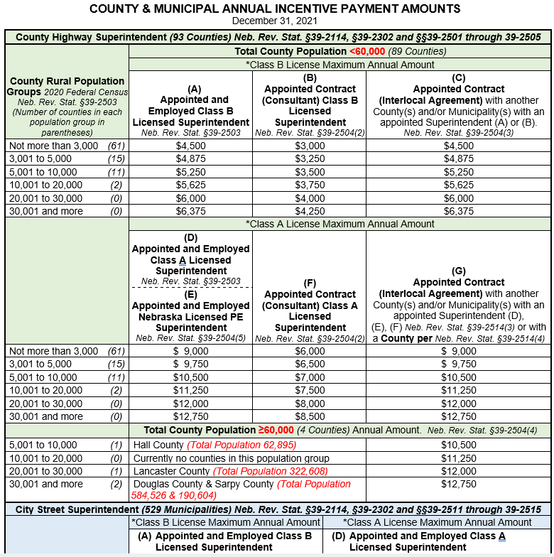
Ref: Table of Payments
Slide 3
Notes:
3/9/2022 Updated with form dated 12/31/2021.
Numbers in parentheses are the number of entities.
The population statistics for Counties are only the rural (outside of corporate (limits) population.

Slide 4


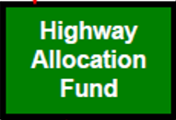
Chapter 39, Article 25
State Law
Distribution of Incentive Payments
to Political Subdivisions
NOTE: Chap. 39, Art. 25 is divided into separate, parallel sections for:
- Counties: “(a)” covering §39-2501 thru §39-2510
- Municipalities: “(b)” covering §39-2511 thru §39-2520
Incentive Payments are paid (off the top), before making distribution of Highway Allocation Funds to Counties (§39-2501) and Municipalities (§39-2511), in February of each year
There is no requirement to match Incentive Payments
Slide 4
Notes:
Article 25
Distribution to Political Subdivisions
Payments based on calendar months.
a) COUNTIES
NOTE: Chap. 39, Art. 25 is divided into separate, parallel sections for:
- Counties: “(a)” covering 39-2501 thru 39-2510
- Municipalities: “(b)” covering 39-2511 thru 39-2520
Section 39-2501. Incentive payments for road purposes; priority. Before making distribution of funds allocated to the counties or municipal counties for road purposes, incentive payments shall first be made as provided in sections 39-2502 to 39-2505. (Emphasis added)
See “Distribution of State Highway Trust Fund” diagram in Notebook (lower left of diagram)

Slide 5

§39-2502
State Law
Incentive Payments
Conditional Duties of Appointed County Hwy Superintendent
Incentive Payment is made to each county having an Appointed Employed Licensed Superintendent for the prior calendar year, who assists with the following duties:
Developing annually a long-range plan (OneAndSix)
Developing an annual program for design, construction, and maintenance of public roads and streets
Developing an annual budget for that program
Submitting 1-3 above to the local governing body for approval
Implementing 1-3 above
Project No.
C-46(1)A
C-46(2)
COUNTY
Slide 5
Notes:
6/20/2021 deleted “the county” (doesn’t lose meaning by cutting) and eliminated #6 and “SSAR” in #3 – it’s time to get rid of them – word’s out that submittals to NBCS are no longer necessary except the annual certification.
4/21/2021 Update – per LB174-2021 – superintendents ASSIST with these items.
1/30/2020 Update – added the crossed-out “SSAR” back into bullet (3) for some reason it got deleted last time
8/13/2019 Updated by deleting “SSAR” in (3) and lining thru (6) to drive home the point of LB82.
Section 39-2502. County highway superintendent, defined; duties; incentive payment. An incentive payment shall be made to each county having in its employ a county highway superintendent licensed under the County Highway and City Street Superintendents Act, during the calendar year preceding the year in which payment is made. … [C]ounty highway superintendent means a person who actually performs the following duties:
(1) Developing and annually updating a long-range plan based on needs and coordinated with adjacent local governmental units;
(2) Developing an annual program for design, construction, and maintenance;
(3) Developing an annual budget based on programmed projects and activities;
Section 39-2502. County highway superintendent, defined; duties; incentive payment. An incentive payment shall be made to each county having in its employ a county highway superintendent licensed under the County Highway and City Street Superintendents Act, during the calendar year preceding the year in which payment is made. For purposes of sections 39-2501 to 39-2510, county highway superintendent means a person who actually performs the following duties:
(1) Developing and annually updating a long-range plan based on needs and coordinated with adjacent local governmental units;
(2) Developing an annual program for design, construction, and maintenance;
(3) Developing an annual budget based on programmed projects and activities;
(4) Submitting such plans, programs, and budgets to the local governing body for approval;
(5) Implementing the capital improvements and maintenance activities provided in the approved plans, programs, and budgets; and
(6) Preparing and submitting annually to the Board of Public Roads Classifications and Standards the county's one-year plans, six-year plans, or annual metropolitan transportation improvement programs for highway, road, and street improvements under sections 39-2115 to 39-2117, 39-2119, and 39-2119.01 and a report showing the actual receipts, expenditures, and accomplishments compared with those budgeted and programmed in the county's annual plans as set forth in section 39-2120. (Emphasis added)
Source
Laws 1969, c. 315, § 2, p. 1133; Laws 1976, LB 724, § 7; Laws 2003, LB 500, § 15; Laws 2007, LB 277, § 7.September 1, 2007
Cross References: County Highway and City Street Superintendents Act, see section 39-2301.

Slide 6
§39-2503
State Law
Incentive Payments
Factors Determining the Amount
Incentive Payment to county based on:
Level of license of the superintendent employed, Class A or B
Rural population of the county as determined by the most recent (decennial – every 10 years) federal census
Counties population 60,000 and more automatically qualify for Class A incentive payment, starting 2022. §39-2504(4)
See the following table. Note that Class A is double Class B
COUNTY
Slide 6
Notes:
4/21/2021 Update – deleted “Maximum” as in Maximum Incentive Payment. LB174-2021 in 39-2504(4) automatically provides the Class A incentive payment for counties with a populating of 60,000 or more.
Section 39-2503. Incentive payment; amount. The incentive payment to the various counties and municipal counties shall be based on the level of license of the county highway superintendent employed by the county and on the rural population of each county or municipal county, as determined by the most recent federal census, according to the following table:

Slide 7
State Law
§39-2503 (cont’d)
Incentive Payments
Amounts Distributed to Qualifying Counties
County Incentive Payment Amounts
Rural Population | Class B License Payment | Class A License Payment
Not more than 3,000 | $4,500.00 | $9,000.00
3,001 to 5,000 | $4,875.00 | $9,750.00
5,001 to 10,000 | $5,250.00 | $10,500.00
10,001 to 20,000 | $5,625.00 | $11,250.00
20,001 to 30,000 | $6,000.00 | $12,000.00
30,001 and more | $6,375.00 | $12,750.00
COUNTY
60,000 and more automatically get Class A License Payment starting 2022
Slide 7
Notes:
4/21/2021 updated per LB174-2021.
2019 statistics from US Census Bureau Note that 70% (65 of 93) are in Class 1 and Class 2
0 – 3,000 – 27 (Franklin, Brown, Perkins, Hitchcock, Frontier, Pawnee, Greeley, Gosper, Garfield, Boyd . . . McPherson, Blaine, Arthur)
3,001 – 5,000 – 10 (Furnas, Morrill, Valley, Nuckolls, Chase, Kimball, Nance, Webster, Harlan, Sherman)
5,001 – 10,000 – 30 (Wayne, Hamilton, Phelps, Cheyenne, Cuming, Dawes . . . Boone, Johnson, Thayer)
10,001 – 20,000 – 9 (Seward, Otoe, Saline, York, Box Butte, Custer, Red Willow, Colfax, Holt)
20,001 – 30,000 – 6 (Cass, Dawson, Saunders, Gage, Washington, Dakota)
30,001 – etc - 11 (Douglas, Lancaster, Sarpy, Hall, Buffalo, Dodge, Scotts Bluff, Madison, Lincoln, Platte, Adams)

Slide 8


State Law
Incentive Payments
Don’t go by
Designated Classes
7 Classes - By Population §23-1114.01
Class 1 – less than 3,000
Class 2 – 3,000 – 8,999
Class 3 – 9,000 – 13,999
Class 4 – 14,000 – 19,999
Class 5 – 20,000 – 59,999
Class 6 – 60,000 – 199,999
Class 7 – 200,000 and more
COUNTY
Slide 8
Notes:
9/13/2022 removed animations
8/22/2021 Added a big red X to emphasize that these classes do not apply to incentive payments.
4/11/2021 New slide – to contrast incentive payment table with counties’ designated classes as created by 23-1114.01
23-1114.01 – states that the purpose of creating classes of counties is to fix the salaries of certain officers and their deputies.
23-1114.02 to 23-1114.07 set salaries by county class for clerk, treasure, sheriff, attorney and appointive full-time veterans service officer
SO INCENTIVE PAYMENTS DO NOT GO BY COUNTY CLASS, THEY GO BY THE POPULATION GROUPS IN 39-2503
Note that 39-2503 incentive payments to counties are a function of population but does not use the same populations as the 7 classes
39-2503 goes by rural populations and there are six categories: <3,000, 3,001-5,000, 5,001-10,000, 10,001-20,000, 20,001-30,000, >30,000.
Note that 39-2507 allocation of funds to counties has two factors depending on populations: rural population and total population.
2019 statistics from US Census Bureau Note that 69% (64 of 93) are in Class 1 and Class 2
Class 1 – 27 (Franklin, Brown, Perkins, Hitchcock, Frontier, Pawnee, Greeley, Gosper, Garfield, Boyd . . . Grant, McPherson, Blaine, Arthur)
Class 2 – 37 (Cheyenne, Cuming, Dawes, Cedar, Knox, Keith, Butler, Richardson . . . . Nance, Webster, Harlan, Sherman)
Class 3 - 9 (York, Box Butte, Custer, Red Willow, Colfax, Holt, Wayne,. Hamilton, Phelps)
Class 4 – 3 (Seward, Otoe, Saline)
Class 5 – 13 (Buffalo, Dodge, Scotts Bluff, Madison, Lincoln, Platte, Adams, Cass, Dawson, Saunders, Gage, Washington, Dakota)
Class 6 – 2 (Sarpy and Hall)
Class 7 – 2 (Douglas and Lancaster)

Slide 9
§39-2504
State Law
Reduced Incentive Payments
Conditions for Reductions to Qualifying Counties
Reduced Incentive Payment
  Appointed licensed superintendent for only a portion of the calendar year
  Two or more successive appointed licensed superintendents for the calendar year
    Prorated by full calendar months for lack of superintendent or gap between superintendents
  Contract (not an employee) licensed superintendent 2/3 payment
  Contract Interlocal Agreement with another government agency (county, city, village) NO REDUCTION
COUNTY
Slide 9
Notes:
The most LeMoyne has seen is four superintendents in one year.
Section 39-2504. Incentive payment; reduction; when; consulting engineer; when; contracting with another political subdivision; payment. (1) A reduced incentive payment shall be made to any county or municipal county having in its employ either (a) a licensed county highway superintendent for only a portion of the calendar year preceding the year in which the payment is made or (b) two or more successive licensed county highway superintendents for the calendar year preceding the year in which the payment is made. Such reduced payment shall be in the proportion of the payment amounts listed in section 39-2503 as the number of full months each such licensed superintendent was employed is of twelve [i.e. prorated for lack of superintendent or gap between superintendents].
(2) Any county or municipal county that contracts for the services of a consulting engineer licensed under the County Highway and City Street Superintendents Act or any other person licensed under the act to perform the duties outlined in section 39-2502 rather than employing a licensed county highway superintendent shall be entitled to an incentive payment equal to two-thirds the payment amount provided in section 39-2503 or two-thirds of the reduced incentive payment provided in subsection (1) of this section, as determined by the Department of Transportation pursuant to section 39-2505.
(3) Any county or municipal county that contracts with another county or municipal county or with any city or village for the services of a licensed county highway superintendent as provided in section 39-2114 shall be entitled to the incentive payment provided in section 39-2503 or the reduced incentive payment provided in subsection (1) of this section [i.e. the basic incentive payment]. (Emphasis added)

Slide 10
§39-2505
State Law
Incentive Payments
Disbursement
Annual Incentive Payment to Counties
January - NDOT certifies incentive payments to State Treasurer
February 15 (on or before) - State Treasure direct deposits amount with County Treasurer
Result for Counties if they do not employ their own superintendent (assuming a full year with the same superintendent):
    - 2/3 of full amount if county has a consulting superintendent §39-2504(2);
    - no reduction if county uses another jurisdiction’s superintendent by interlocal agreement §39-2504 (3)
COUNTY
Slide 10
Notes:
Section 39-2505. Incentive payments; Department of Transportation; certify amount; State Treasurer; payment. The Department of Transportation shall, in January of each year … determine and certify to the State Treasurer the amount of each incentive payment … The State Treasurer shall, on or before February 15, make the incentive payments … (Emphasis added)
Result for Counties if they do not employ their own superintendent:
1/3 reduction if county has a consulting superintendent (subsection (2) above);
no reduction if county uses another jurisdiction’s superintendent by contract (subsection (3) above). Even if it is a consultant (non-employee)

Slide 11

§39-2512
State Law
Incentive Payments
Conditional Duties of Appointed City Street Superintendent
Incentive Payment is made to each municipality having an Appointed Employed Licensed Superintendent for the prior calendar year, who assists with the following duties:
Developing annually a long-range plan or program (OneAndSix)
Developing an annual program for design, construction, and maintenance
Developing an annual budget for that program
Submitting 1-3 above to the local governing body for approval
Implementing 1-3 above
Project No.
C-46(1)A
C-46(2)
MUNICIPALITY
Slide 11
Notes:
6/20/2021 Replaced “actually performs” with “assists with” and eliminated #6 and “SSAR” in #3 – it’s time to get rid of them – word’s out that submittals to NBCS are no longer necessary except the annual certification.
8/13/2019 Updated by deleting “SSAR” in (3) and lining thru (6) to drive home the point of LB82.
(1) Developing and annually updating a long-range plan based on needs and coordinated with adjacent local governmental units;
(2) Developing an annual program for design, construction, and maintenance;
(3) Developing an annual budget based on programmed projects and activities;
(4) Submitting such plans, programs, and budgets to the local governing body for approval;
(5) Implementing the capital improvements and maintenance activities provided in the approved plans, programs, and budgets; and
(6) Preparing and submitting annually to the Board of Public Roads Classifications and Standards the one-year plans, six-year plans, or annual metropolitan transportation improvement programs of the municipality … and a report showing the actual receipts, expenditures, and accomplishments compared with those budgeted and programmed in the annual plans of the municipality … (Emphasis added)

Slide 12
§39-2513
State Law
Incentive Payments
Amounts Distributed to Qualifying Municipalities
Incentive Payment to Municipality based on
  level of license, A or B
  municipal population as determined by the most recent (annual, in December) federal census figures certified by the Tax Commissioner
See the following table. Note that Class A is double Class B
MUNICIPALITY
Slide 12
Notes:
Section 39-2513. Incentive payment; amount. The incentive payment to the various municipalities or municipal counties shall be based on the level of license of the city street superintendent employed by the municipality or municipal counties and on the population of each municipality or urbanized area of each municipal county, as determined by the most recent federal census figures certified by the Tax Commissioner …, according to the following table:

Slide 13
State Law
§39-2513 (cont’d)
Incentive Payments
Amounts Distributed to Qualifying Municipalities
Municipal Incentive Payment Amounts
Population | Class B License Payment | Class A License Payment
Not more than 500 | $300.00 | $600.00
501 to 1,000 | $500.00 | $1,000.00
1,001 to 2,500 | $1,500.00 | $3,000.00
2,501 to 5,000 | $2,000.00 | $4,000.00
5,001 to 10,000 | $3,000.00 | $6,000.00
10,001 to 20,000 | $3,500.00 | $7,000.00
20,001 to 40,000 | $3,750.00 | $7,500.00
40,001 to 200,000 | $4,000.00 | $8,000.00
200,001 and more | $4,250.00 | $8,500.00
MUNICIPALITY
Slide 13
Notes:
Compare to County incentive payment amounts:
Rural Population Class B Class A
Not more than 3,000 $4,500.00 $9,000.00
3,001 to 5,000 $4,875.00 $9,750.00
5,001 to 10,000 $5,250.00 $10,500.00
10,001 to 20,000 $5,625.00 $11,250.00
20,001 to 30,000 $6,000.00 $12,000.00
30,001 and more $6,375.00 $12,750.00

Slide 14
39-2514
State Law
Reduced Incentive Payments
Conditions for Reductions to Qualifying Municipalities
Reduced Incentive Payment
  Appointed licensed superintendent for only a portion of the calendar year
  Two or more successive appointed licensed superintendents for the calendar year
    Prorated by full calendar months for lack of superintendent or gap between superintendents
  Contract licensed superintendent NO REDUCTION
  Contract Interlocal Agreement with another government agency (county, city, village) NO REDUCTION
MUNICIPALITY
Slide 14
Notes:
Section 39-2514. Incentive payment; reduction; when; consulting engineer; when; contracting with another political subdivision.
(1) A reduced incentive payment shall be made to any municipality or municipal county having in its employ either
(a) a licensed city street superintendent for only a portion of the calendar year preceding the year in which the payment is made or
(b) two or more successive licensed city street superintendents for the calendar year preceding the year in which the payment is made. Such reduced payment shall be in the proportion of the payment amounts listed in section 39-2513 as the number of full months each such licensed superintendent was employed is of twelve [i.e. prorated for periods when no licensed superintendent]
Section 39-2514. Incentive payment; reduction; when; consulting engineer; when; contracting with another political subdivision.
(1) A reduced incentive payment shall be made to any municipality or municipal county having in its employ either
(a) a licensed city street superintendent for only a portion of the calendar year preceding the year in which the payment is made or
(b) two or more successive licensed city street superintendents for the calendar year preceding the year in which the payment is made. Such reduced payment shall be in the proportion of the payment amounts listed in section 39-2513 as the number of full months each such licensed superintendent was employed is of twelve [i.e. prorated for periods when no licensed superintendent]

Slide 15
§39-2515
State Law
Incentive Payments
Disbursement
Annual Incentive Payment to Municipalities
January - NDOT certifies incentive payments to State Treasurer
February 15 (on or before) - State Treasure direct deposits amount with Municipality Treasurer
Result for Municipalities if they do not employ their own superintendent (assuming a full year with the same superintendent):
    - No reduction if municipality has a consulting superintendent §39-2514(2);
    - No reduction if municipality contracts with another jurisdiction’s superintendent by interlocal agreement §39-2514(3)
MUNICIPALITY
Slide 15
Notes:
Section 39-2515. Incentive payments; Department of Transportation, certify amount; State Treasurer; payment. The Department of Transportation shall, in January of each year commencing in 1970, determine and certify to the State Treasurer the amount of each incentive payment … The State Treasurer shall, on or before February 15, make the incentive payments… (Emphasis added)
Incentive Result for Municipalities if they do not employ their own superintendent:
No reduction if municipality has a consulting superintendent (subsection (2) above);
No reduction if municipality uses another jurisdiction’s superintendent by contract (subsection (3) above).

Slide 16
Incentive Funds Annual Certification
Annual certification, to NDOT, of your appointed licensed superintendent for previous calendar year
For your town or county to receive Incentive Funds, your superintendent must be licensed, appointed and actively assisting in or performing the statutory duties (is responsible for them)
One-page form, due Dec. 31. Form is mailed to clerks from NDOT Boards - Liaison Services. Funds disbursed by February 15
The appointed superintendent must be involved in the total road / street program
Slide 16
Notes:
3/9/2022 3rd bullet added “Boards”
8/10/2021 Added “Annual” in Header
4/21/2021 Update per LB174-2021. Bullet 2 added “assisting.”
8/13/2019 Updated script.
Show them copy of certification form
The Clerk goes into OnBase and certifies the identity of the appointed licensed superintendent

Slide 17
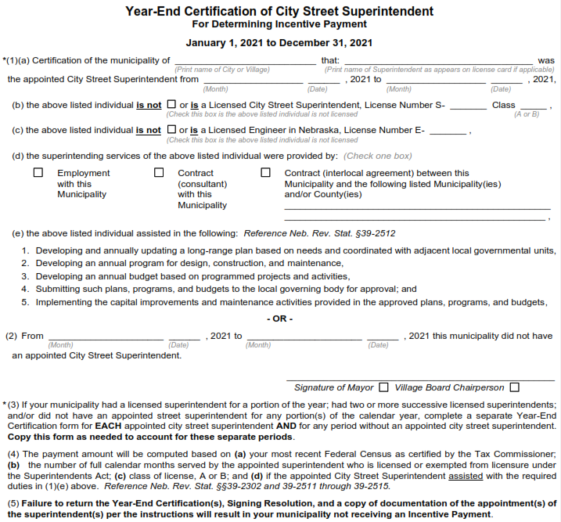
Incentive Funds Certification
Slide 17
Notes:
3/9/2022 Updated with 2021 end of year certification form for annual incentive payments.
4/21/2021 Updated with 2020 end of year certification form for annual incentive payments.
8/13/2019 Added slide to show sample Year-End Certification of Superintendent form.
Show them copy of certification form – slide shows the top part of the certification form
The Clerk goes into OnBase and certifies the identity of the appointed licensed superintendent

Slide 18
INCENTIVE PAYMENTS
Section 39-25_ _ Incentive Payments
Questions?
Boards - Liaison Services Section
Slide 18

