Slide 1
Superintendents Exam Preparation
Nebraska County Highway and City Street Superintendents
Please sign the Sign-in sheet
Boards - Liaison Services Section
Tab 7
September 11, 2022
Notes:
9/11/2022 Slide 1 updated with 3-ring-binder Tab number,
8/16/2022 updated slide 5 with new congressional district map
3/9/2022 hid slide 3 – instead, refer to agenda as distributed, also updated slide 6
10/11/2021 added slide (Slide 2) – short review of BEX info from previous day.

Slide 2



Highway Law, BEX, Incentive Payments
QUESTIONS?
Slide 2
Notes:
10/11/2021 Added slide to see if there are any questions about yesterday afternoon’s material.

Slide 3
Day 3 Agenda
NBCS Overview
Classification
Standards
Transportation Asset Management
Bridge Inspections
1- and 6-Year Planning
Records Management
Classification & Standards – Class Exercise
Relaxation of Standards
Slide 3
Notes:
Plans used for plan reading questions:
In McCook
Johnson SE
Wayne NW

Slide 4


State Oversight & Support provided by two State Regulatory Boards
Board of Public Roads Classifications and Standards (NBCS) 39-2106 thru 39-2108
Board of Examiners for County Highway and City Street Superintendents (BEX) 39-2304 & 39-2305
Boards - Liaison Services Section
Slide 4
Notes:
6/20/2021 Updated slides 3, 4
5/25/2021 Updated Slide 3, by correcting the first bullet.
4/24/2021 Updated Slide 4 to include Practical Design programs and strategies.
4/21/2021 Added Slide 7 – Authority to Conduct Business adopted by Board on 9/24/2020. Changed Slide 2 per LB174-2021 language in 39-2106(c).
4/18/2021 Added slide 5 – inventory of public roads in Nebraska
1/30/2020 Updated slide 2.
8/13/2019 Updates made to this presentation some based on LB82 (2019). Previous version dated 2/21/2018. Three slides updated. Slides 3 thru 5 were updated.
Handouts – describe to audience
The Board of Public Roads Classifications and Standards is one of two Boards created by state statutes for Nebraska’s system of roads and streets.

Slide 5
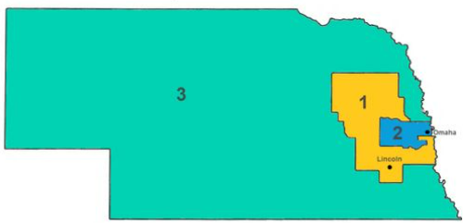
State Law
§39-2106
Board of Public Roads Classifications and Standards (NBCS)
  Eleven (11) Members
  2 NDOT
  3 County – three different county classifications (§23-1114.01)
  1 Licensed County Highway Superintendent
  2 County Board Members
  3 Municipal – City Engineers, Village Engineers, Public Works Directors, City Mangers, City Administrators, Street Commissioners, or Licensed Street Superintendents
  1 municipality of population less than 2,500
  1 municipality of population 2,500-50,000
  1 municipality of population greater than 50,000
  3 Lay Citizens - one from each Congressional District
Appointed by the Governor to 4-year terms and approved by the Legislature.
Slide 5
Notes:
8/16/2022 updated congressional district map, which becomes effective after the 2022 elections.
4/21/2021 Updated per LB174-2021. Municipal members can also be city engineer, village engineer, city manager, city administrator, or street commissioner.
1/30/2019 Changed second bullet (statute actually says one from Classes 1-2, one from Classes 3-4, and one from Classes 5-7. In municipal populations removed “Lincoln or Omaha” because Grand Island is now in that mix. Added congressional district map. Added in notes field the classification of counties.
23-1114.01 classification of counties is based on population (numbers are thousands)
Class 1 <3
Class 2 3-9
Class 3 9-14
Class 4 14-20
Class 5 20-60
Class 6 60-200
Class 7 >200
Members – changes by LB174(2021)
Municipal representatives – added job titles such as city engineer, village engineer, public works director, city manager, city administrator, street commissioner, city street superintendent licensed pursuant to the County Highway and City Street Superintendents Act
Section 39-2106. Board of Public Roads Classifications and Standards; established; members; number; appointment; qualifications; compensation; expenses. … there is hereby established the Board of Public Roads Classifications and Standards which shall consist of eleven members to be appointed by the Governor with the approval of the Legislature. … two shall be representatives of the Department of Transportation, three shall be representatives of the counties, one of whom shall be a licensed county highway superintendent … and two of whom shall be county board members, three shall be representatives of the municipalities who shall be either public works directors or licensed city street superintendents …, and three shall be lay citizens who shall represent the three congressional districts … The county members on the board shall represent the various classes of counties
The municipal members of the board shall represent municipalities of the following sizes by population: One shall be a representative from a municipality of less than two thousand five hundred population; one shall be a representative from a municipality of two thousand five hundred to fifty thousand population; and one shall be a representative from a municipality of over fifty thousand population. In making such appointments, the Governor shall consult with … appropriate … officials and … organizations …
Members of such board shall receive no compensation …, except that the lay members shall receive [a per diem] …, and all members shall be reimbursed for their actual and necessary expenses … [which] … shall be paid by the Department of Transportation. (Emphasis added)
Section 39-2106. Board of Public Roads Classifications and Standards; established; members; number; appointment; qualifications; compensation; expenses. To assist in developing the functional classification system, there is hereby established the Board of Public Roads Classifications and Standards which shall consist of eleven members to be appointed by the Governor with the approval of the Legislature. Of the members of such board, two shall be representatives of the Department of Transportation, three shall be representatives of the counties, one of whom shall be a licensed county highway superintendent in good standing and two of whom shall be county board members, three shall be representatives of the municipalities who shall be either public works directors or licensed city street superintendents in good standing, and three shall be lay citizens who shall represent the three congressional districts of the state. The county members on the board shall represent the various classes of counties, as defined in section 23-1114.01, in the following manner: One shall be a representative from either a Class 1 or Class 2 county; one shall be a representative from either a Class 3 or Class 4 county; and one shall be a representative from either a Class 5, Class 6, or Class 7 county. The municipal members of the board shall represent municipalities of the following sizes by population: One shall be a representative from a municipality of less than two thousand five hundred population; one shall be a representative from a municipality of two thousand five hundred to fifty thousand population; and one shall be a representative from a municipality of over fifty thousand population. In making such appointments, the Governor shall consult with the Director-State Engineer and with the appropriate county and municipal officials and may consult with organizations representing such officials or representing counties or municipalities as may be appropriate. At the expiration of existing term, one member from the county representatives, the municipal representatives and the lay citizens shall be appointed for a term of two years; two members from the county representatives, the municipal representatives and the lay citizens shall be appointed for terms of four years. One representative from the Department of Transportation shall be appointed for a two-year term and the other representative shall be appointed for a four-year term. Thereafter, all such appointments shall be for terms of four years each. Members of such board shall receive no compensation for their services as such, except that the lay members shall receive the same compensation as members of the State Highway Commission, and all members shall be reimbursed for their actual and necessary expenses incurred in the performance of their official duties as provided in sections 81-1174 to 81-1177 for state employees. All expenses of such board shall be paid by the Department of Transportation. (Emphasis added)
Source: Laws 1969, c. 312, § 6, p. 1122; Laws 1971, LB 100, § 1; Laws 1981, LB 204, § 61
Section 39-2107. Board of Public Roads Classifications and Standards; office space; furniture; equipment; supplies; personnel. The Department of Transportation shall furnish the Board of Public Roads Classifications and Standards with necessary office space, furniture, equipment, and supplies as well as necessary professional, technical, and clerical assistants.
Source: Laws 1969, c. 312, § 7, p. 1123
Section 39-2108. Board of Public Roads Classifications and Standards; proceedings; subject to Administrative Procedure Act. All proceedings of the Board of Public Roads Classifications and Standards shall be subject to the provisions of the Administrative Procedure Act.
Source: Laws 1969, c. 312, § 8, p. 1123
Cross Reference: Administrative Procedure Act, see section 84-920.

Slide 6
NBCS DUTIES
AND RESPONSIBILITIES
State Law
Set State Aid Bridge Fund Priorities (§39-847)
Develop Functional Classification Specific Criteria (§39-2109) → 428 NAC 1
Render Decisions on Functional Classification Appeals (§39-2111)
Develop Minimum Standards (§39-2113) → 428 NAC 2
Render Decisions on Relaxation of Standards Requests (§39-2113)
Slide 6
Notes:
3/9/2022 Added regulation to 2nd and 4th bullets
6/20/2021 Updated slide by eliminating the last bullet (interlocal agreements not submitted to NBCS any longer).
5/25/2021 Updated slide. Unlined the first bullet – should not have been lined thru; the NBCS still determines state-aid bridge fund priorities. Also corrected the state statute reference. Note that 39-810(1)() no longer requires submittal of contracts over $20,000 to be reported to the NBCS.
8/13/2019 Updated to reflect current duties as a result of LB82 (2019). First and Sixth bullets on this slide lined thru.

Slide 7
NBCS DUTIES
AND RESPONSIBILITIES
(continued)
State Law
Penalties (§39-2121 et al)
Make Random Inspections of Construction Projects (§39-2122)
“Practical Design” – Cooperate with NDOT, counties and municipalities to develop, support, approve, and implement programs and project strategies that provide additional flexibility in the design and maintenance standards. (§39-2113(7))
Slide 7
Notes:
6/20/2021 Eliminated first two bullets (OneAndSix and SSAR receive/review no longer done).
4/24/2021 Updated to include Practical Design programs and strategies.
8/13/2019 Updated to remove duties as a result of LB82 (2019). First and second bullets lined thru.
Practical Design will be discussed tomorrow when we discuss NBCS Standards.

Slide 8
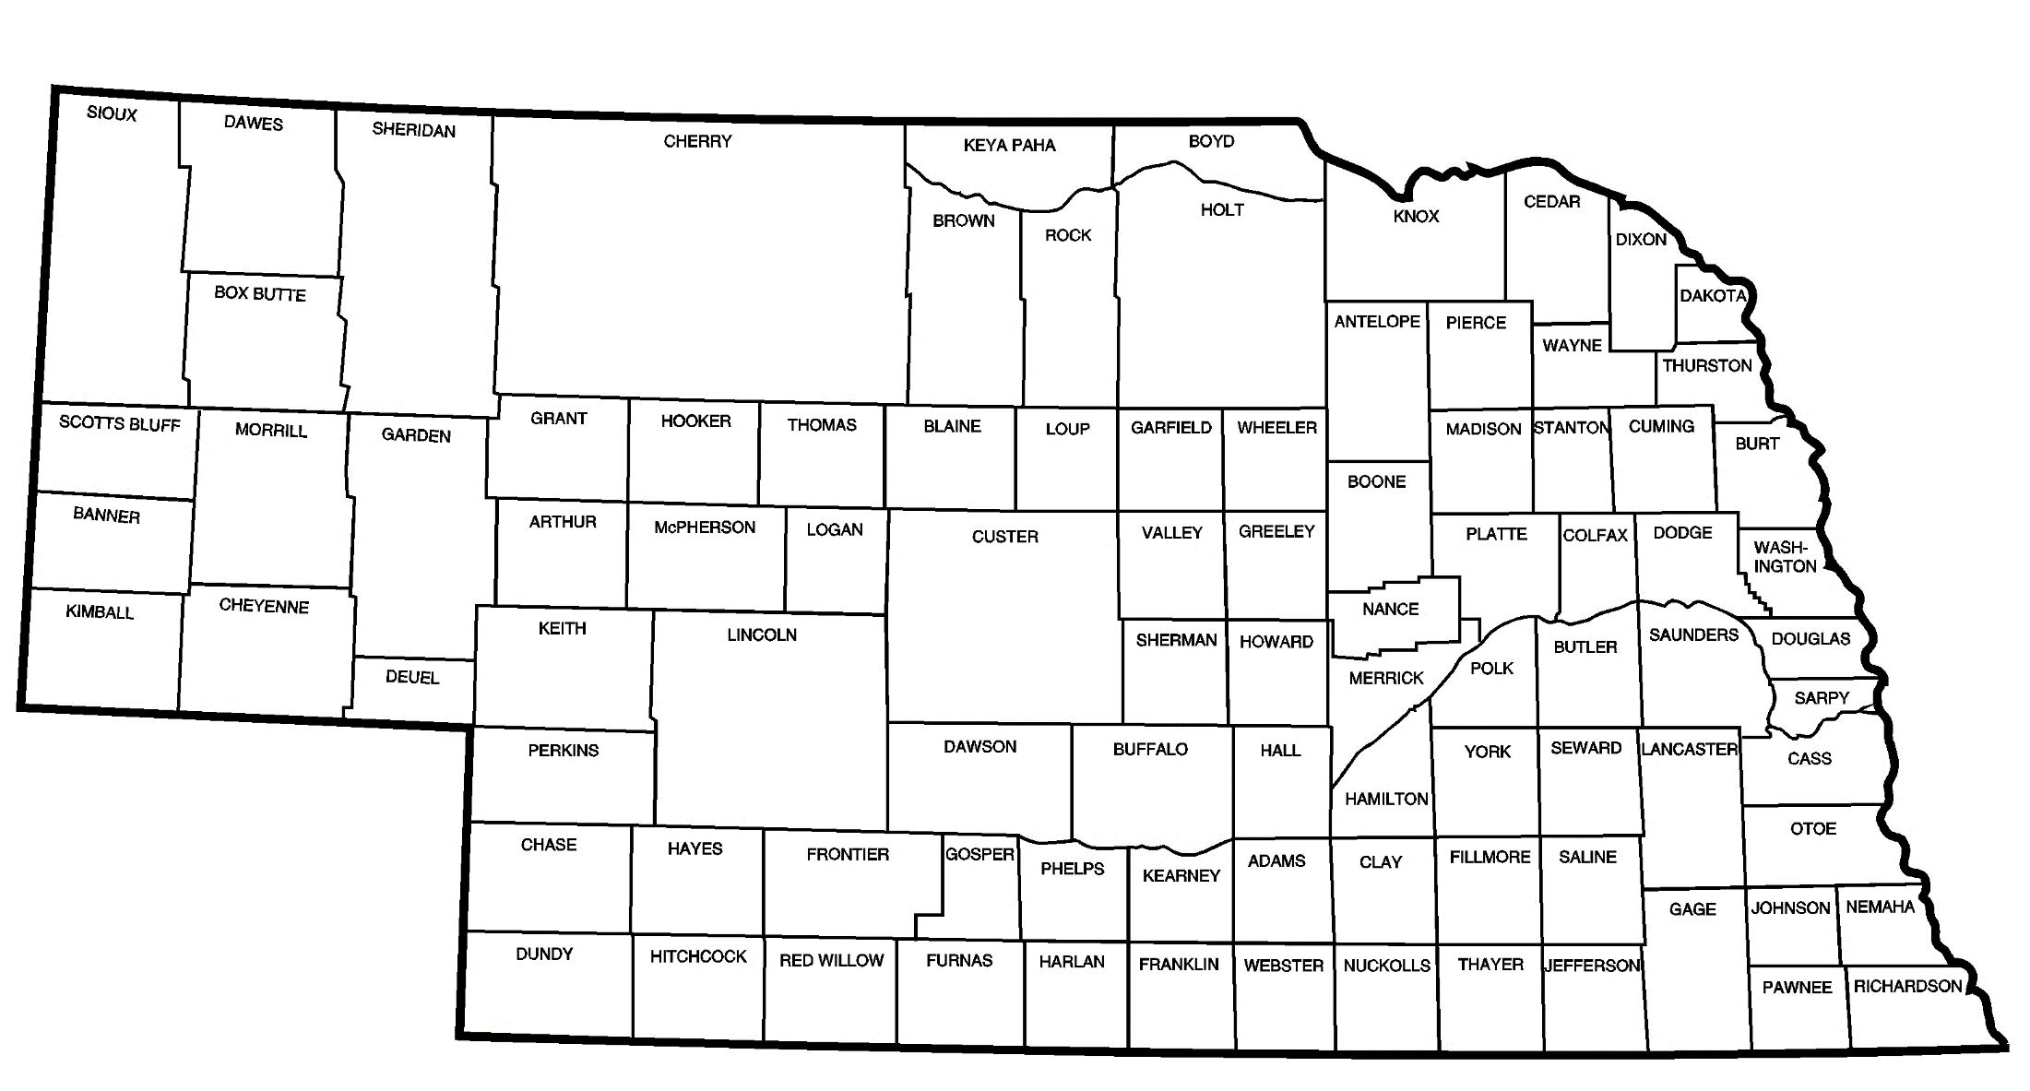
NBCS – All Public Roads in the State
Approximately
80,000 miles of county roads
6,000 miles of municipal streets
10,000 miles of state highways
96,000 miles of public roadways
Notes:
4/18/2021 Added slide

Slide 9

The NBCS Meetings
Up to Twelve Meetings per Year
Third Friday of Selected Months
at NDOT in Lincoln
https://dot.nebraska.gov/business-center/lpa/boards-liaison/nbcs/meetings/
Slide 9
Notes:
8/13/2019 Updated weblink at bottom

Slide 10



Working with the NBCS
Communications, Questions, Requests by Phone , Email or Mail
https://dot.nebraska.gov/media/114875/nbcs-authority-conduct-business.pdf
Routine – Board Secretary answers on behalf of Board
Non-routine – MUST be in writing or electronic.
Board Secretary may involve Professional Support, Board Chair and Counsel as needed to resolve.
Reported to Board at subsequent meeting(s).
Not satisfied with response? Take issue to the full Board for resolution.
ndot.blshelp@nebraska.gov
NDOT
Boards-Liaison Services
PO Box 94759
Lincoln, NE 68509
402-479-4436
Slide 10
Notes:
4/21/2021 added slide Authority to Conduct Business (adopted by Board at its 9/24/2020 meeting)
Non-routine examples: relaxation of standards requests and inquiries about design standards.
STATE OF NEBRASKA
Board of Public Roads Classifications and Standards (NBCS)
September 24, 2020
Authority to Conduct Business for the Board as it Relates to Communications, Questions and Information Requests of the Board and Staff.
Intent: To establish, for the sake of managing communications and for transparency, a more formal process to receive and respond to questions and inquires of the NBCS.
Routine communications, questions and requests can be discussed and resolved quickly electronically or telephonically by the Secretary of the Board (Secretary) and need not involve the Board. Non-routine communications, questions and requests for information (examples are relaxation of standards requests and inquiries about design standards) should be sent in writing (hard-copy) or electronically (e-mail to ndot.blshelp@nebraska.gov or file-sharing) to the Secretary of the Board for review and determination of proper handling, filing, responding and or answering etc.
Non-routine communications, questions etc, that require a response are to be handled as follows:
The Secretary of the Board (Secretary) shall answer all communications and questions that are within his/her experience and knowledge to resolve. All responses to non-routine communications shall be in writing (hard-copy) or electronic (e-mail or file-sharing), to the requesting individual or entity.
The Nebraska Department of Transportation (NDOT) shall provide supplemental/additional professional engineering (Professional Support) support to the Secretary, and the Secretary shall be authorized to confer with, and request reviews/evaluations, and recommendations from Professional Support on issues that are not routine and are less common, that require additional effort to research and answer. The Secretary, if in agreement, will respond and communicate directly to the individual or entity in writing, as above in 2.a.
For those issues, questions and requests where the Secretary and Professional Support do not agree, or are not sure of an appropriate response, both shall confer with the Chair of the Board and/or Counsel for a proper response, and either the Chair or Secretary shall respond back to the individual or entity, as above in 2.a and b.
Any issues, questions and requests not resolved to the satisfaction of the individual or entity in any of the above steps, may be taken to the full Board for resolution.
All non-routine communications, questions and requests for information will be reported to the Board at any subsequent meetings, for the purpose of transparency in the conduction of the business of the Board. These may not have all details; they may be summaries, relevant portions of communications, and /or listings.

Slide 11
NBCS Funding
State Law
Funding for the NBCS is in NDOT’s budget
§39-2107
office space, furniture, equipment, and supplies as well as necessary professional, technical, and clerical assistants
Slide 11

Slide 12
State Oversight & Support provided by two State Regulatory Boards
Board of Public Roads Classifications and Standards (NBCS) 39-2106 thru 39-2108
Board of Examiners for County Highway and City Street Superintendents (BEX) 39-2304 & 39-2305
Questions?
Boards - Liaison Services Section
Slide 12

