Slide 1
Agenda
MILLARD HIGHLANDS along i-80
Noise Stakeholder Meeting
6:00 pm – OPEN HOUSE AND BALLOT DROP-OFF
6:30 pm – PRESENTATION
7:00 pm – AUDIO DEMONSTRATION
7:15 pm – Q&A STATIONS
NH-80-9(125) MILLARD HIGHLANDS ALONG I-80; C.N. 22975
Notes:
Intro slide until presentation begins.

Slide 2
MILLARD HIGHLANDS ALONG i-80
Noise Stakeholder Meeting
Noise Abatement Information and Voting
June 10, 2025
NH-80-9(125) MILLARD HIGHLANDS ALONG I-80; C.N. 22975
Notes:
(Speaker: Adam Behmer) Begin presentation. Please be seated.

Slide 3
Introductions
NH-80-9(125) MILLARD HIGHLANDS, OMAHA; C.N. 22975
Notes:
Speaker: Adam Behmer. Introduce Team: District Engineer Brian Johnson, NDOT Environmental Project Manager-Sammi Kerrisun, NDOT Noise Specialist-Aaron Bedea & FHU Project Manager Kody Unstad

Slide 4
MILLARD HIGHLANDS ALONG I-80
Nebraska Department of Transportation (NDOT)
Brian Johnson – NDOT Roadway Design Aaron Bedea – NDOT Noise, Air, and Hazardous Materials Specialist Sammi Kerrisun - NDOT Environmental Project Manager
Felsburg Holt & Ullevig
Adam Behmer-Noise Specialist Kody Unstad – Environmental Project Manager Peyton Saar – Communications Specialist
NH-80-9(125) MILLARD HIGHLANDS ALONG I-80; C.N. 22975
Notes:
Speaker: Adam Behmer. Introduce Team: District Engineer Brian Johnson, NDOT Environmental Project Manager-Sammi Kerrisun, NDOT Noise Specialist-Aaron Bedea & FHU Project Manager Kody Unstad and Peyton Saar Communication specialist

Slide 5
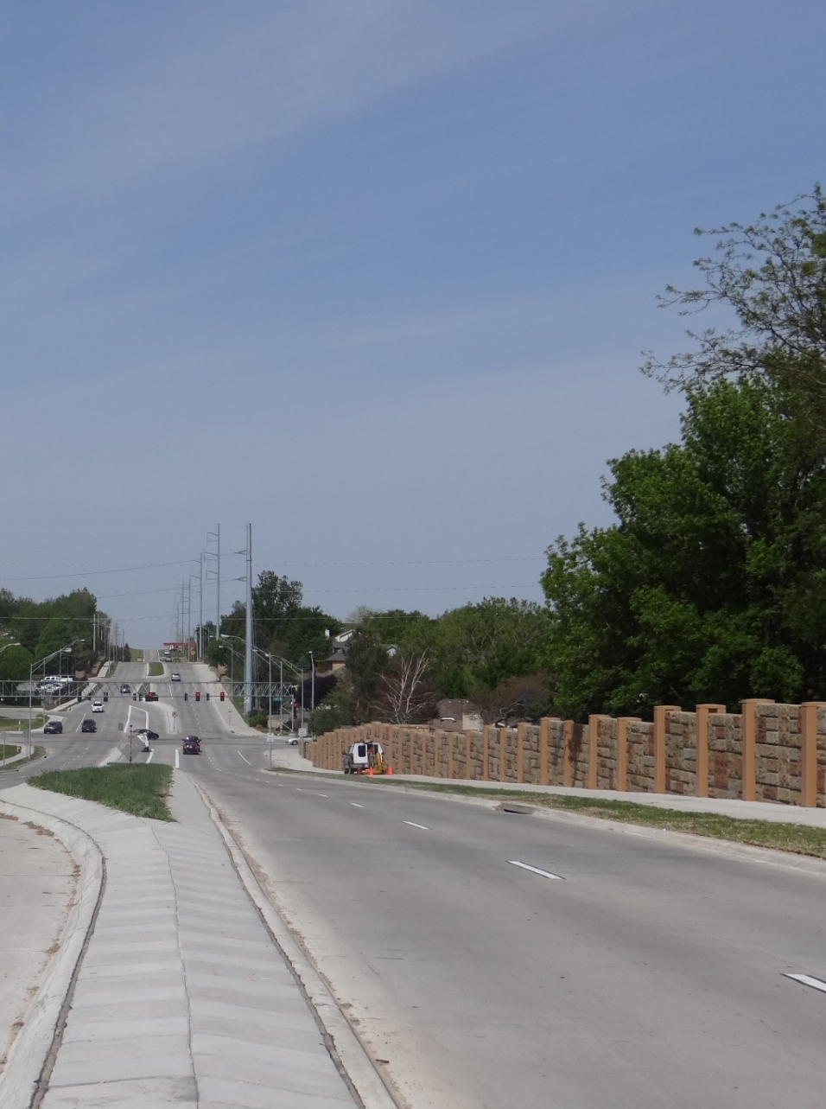
MILLARD HIGHLANDS ALONG I-80
Purpose of Tonight’s Meeting:
To provide benefited stakeholders information about proposed noise walls To provide an opportunity to ask questions For benefitting persons to vote on constructing noise walls
Following the Presentation & Audio Demonstration:
Adjourn to Stations showing proposed walls General Q & A about the project and walls Vote before you leave
NH-80-9(125) MILLARD HIGHLANDS ALONG I-80; C.N. 22975
Notes:
Speaker: Adam Purpose of tonight’s meeting is engage with benefitted stakeholders who would receive at least a 5-dBA decrease from 2044 noise levels if a noise wall is constructed. Provide an opportunity to ask questions after the presentation. Submit ballots if not already submitted. Stations will allow stakeholders to engage with project Team. Provide comments.

Slide 6
Project Overview
Notes:
(Speaker TBD: Behmer transition to NDOT (Brian). Discuss the two projects and provide some additional background.

Slide 7
background
N-50 Ramp, Omaha NH-MTIS-80-9(201); 22850
The N-50 Ramp, Omaha project would widen the westbound lane of Interstate 80 (I-80) by adding an auxiliary driving lane and new shoulder, culvert work, bridge widening and bridge repairs, replacing and constructing widened approach slabs.
The Purpose of the project is:
To preserve the transportation asset, improve the reliability of the transportation system and perpetuate the mobility of the traveling public.
The Need for the project is:
Based on the condition of the existing roadway and increase in future traffic.
NH-80-9(125) MILLARD HIGHLANDS ALONG I-80; C.N. 22975
Notes:
(Speaker: Brian) Project description text. Purpose and Need.

Slide 8
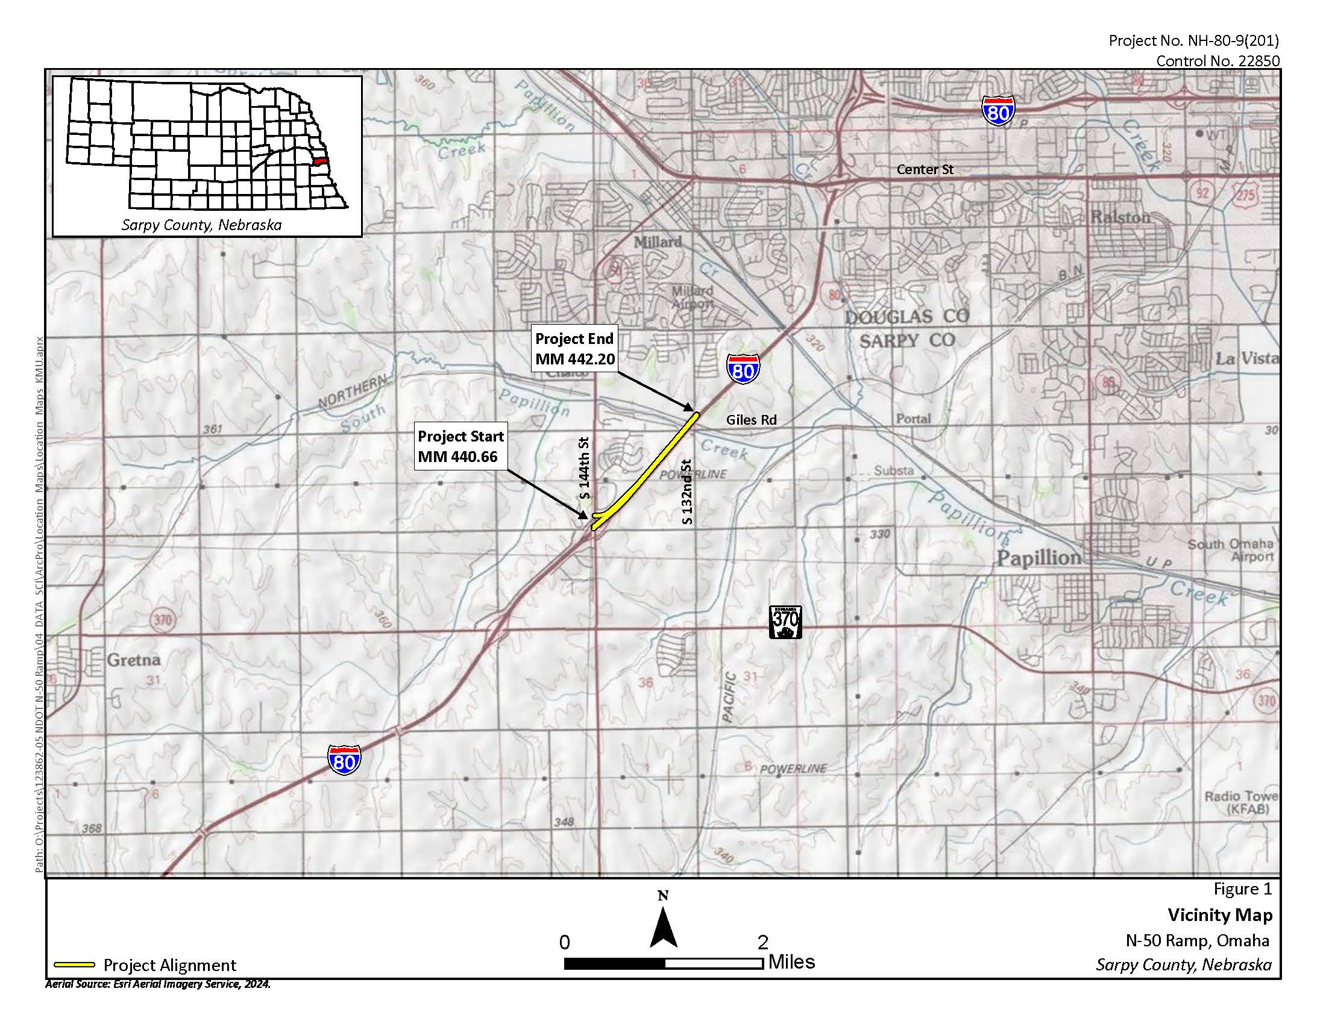
Project Location
N-50 Ramp, Omaha; C.N. 22850
The N-50 Ramp, Omaha project involves construction along the westbound lane of I-80 spanning from mile marker (MM) 443.08 to MM 444.45.
This segment includes the interchange at Nebraska Highway 50 (N-50) / 144th St and I-80, a high-traffic area serving both local and through traffic.
NH-80-9(125) MILLARD HIGHLANDS ALONG I-80; C.N. 22975
Notes:
(Speaker: Brian) N-50 Ramp, Omaha is located from approximately 144th to Giles on I-80

Slide 9
background
Millard Highlands along I-80 NH-80-9(215); 22975
N-50 Ramp, Omaha, required a noise study as part of the environmental review.
The Purpose of the Millard Highlands along I-80 project is:
To engage directly with benefitted noise stakeholders impacted by N-50 Ramp, Omaha.
NDOT must complete a noise abatement stakeholder meeting to assess if there is enough support from benefitted noise stakeholders for construction of a noise wall.
The Need for the Millard Highlands along I-80 project is:
The result of a noise analysis that determined a noise wall was economically reasonable and that benefitted stakeholders should determine if it is constructed.
This includes two (2) rounds of mailed ballots (initial and final notice) and a noise stakeholder information meeting.
NH-80-9(125) MILLARD HIGHLANDS ALONG I-80; C.N. 22975
Notes:
(Speaker: Brian) As part of the environmental review process for N-50 Ramp, Omaha a noise study was conducted. Part of that noise study included the examination of noise barriers and to assess if benefitted stakeholders support the construction of a noise wall. To determine if there is support, ballots and a stakeholder meeting is had. Essentially, this meeting, voting and determining if there is sufficient support is the Millard Highlands along I-80 is the project. Thus it has different purpose and need than the N-50 Ramp, Omaha project.
Specifically, the purpose of Millard Highlands is to engage with benefitted stakeholders that are impacted by N-50. And the need of the project is due to noise study indicating that a noise wall was economically reasonable and that benefitted stakeholders should determine if a wall is constructed.

Slide 10
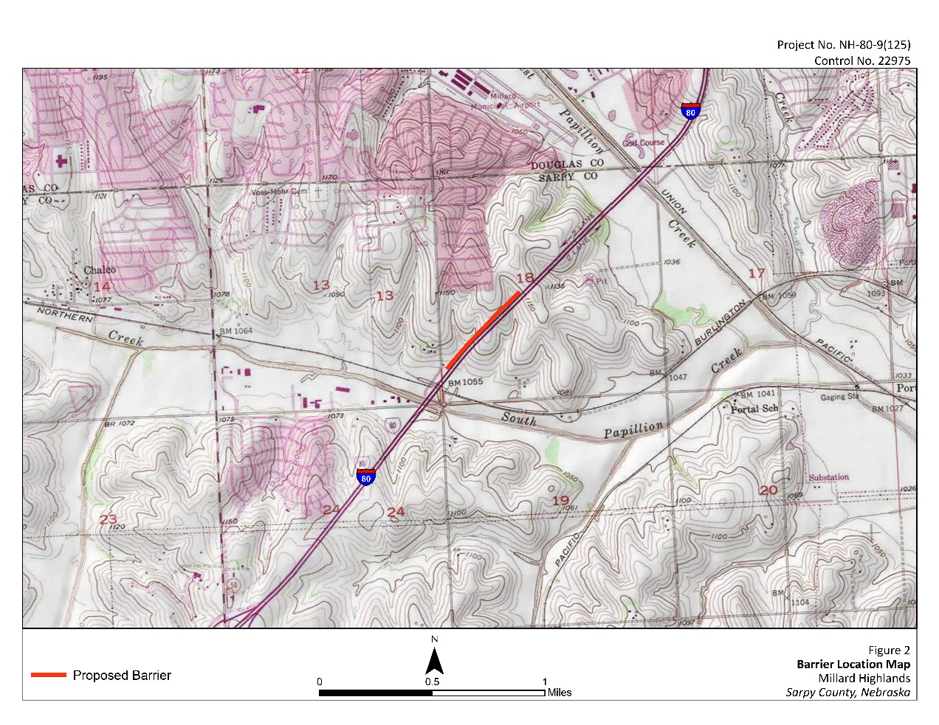
Project Location
Millard Highlands along I-80; C.N. 22975
The Millard Highlands along I-80 project involves the potential construction of a noise wall located north of I-80 and south of Centech Plaza, between approximately MM 442.20 and MM 442.67.
NH-80-9(125) MILLARD HIGHLANDS ALONG I-80; C.N. 22975
Notes:
(Speaker: Brian) Potential noise wall located north of I-80 and south of Centech Plaza, between approximately MM 442.20 and MM 442.67.

Slide 11
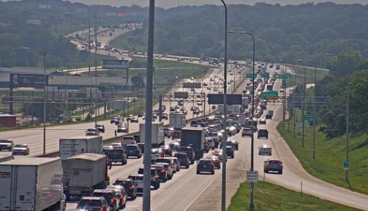
Noise analysis
Federal Highways Administration (FHWA) requirement for Type 1 projects.
  Projects that create
    new highway segments
    significant alterations to existing highways that may increase traffic noise levels.
Conducted in accordance with FHWA and NDOT policies.
Modeled noise levels using current and future traffic volumes to determine noise impacts.
Receiver is impacted if noise level is 66 decibels (dBA) or higher, or 15 dBA or higher than existing.
Evaluate noise abatement for impacted areas.
NH-80-9(125) MILLARD HIGHLANDS ALONG I-80; C.N. 22975
Notes:
(Speaker: Behmer)

Slide 12
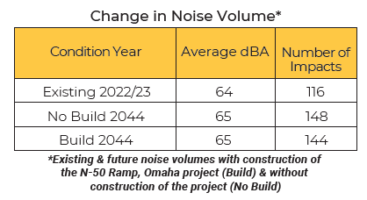
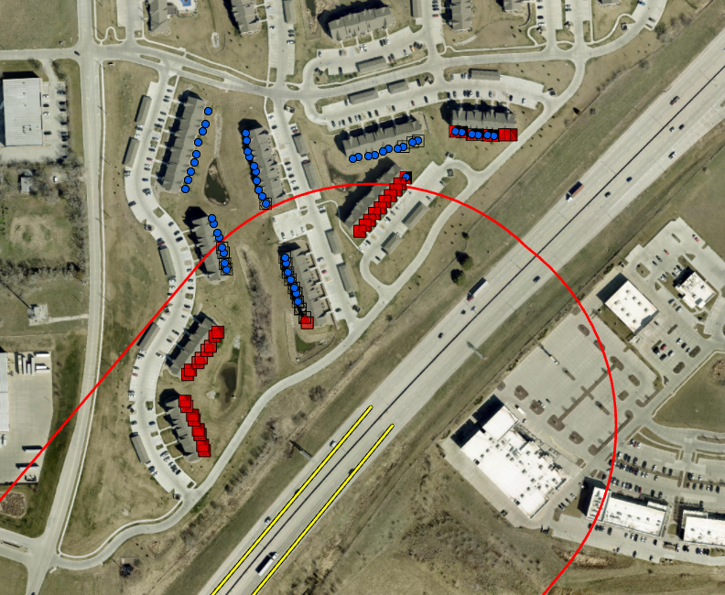
Noise analysis
Noise barriers evaluated using NDOT Noise Analysis and Abatement Policy
https://dot.nebraska.gov/projects/environment/noise-air/
NH-80-9(125) MILLARD HIGHLANDS ALONG I-80; C.N. 22975
Notes:
(Speaker: Behmer) Our noise study modeled noise conditions at 310 locations. Within 600 feet from the pavement’s edge.
Results of the noise analysis show current noise levels currently average 64 dba and are impacting 116 residences and future conditions will slightly increase to 65 dba and will impact 144 residences. Future noise levels would be as high as 72 dba.
Because we found that impacts would occur the NDOT/FHWA policy now requires that noise abatement be reviewed.
To find more information on NDOT’s noise policy and guidance see website

Slide 13
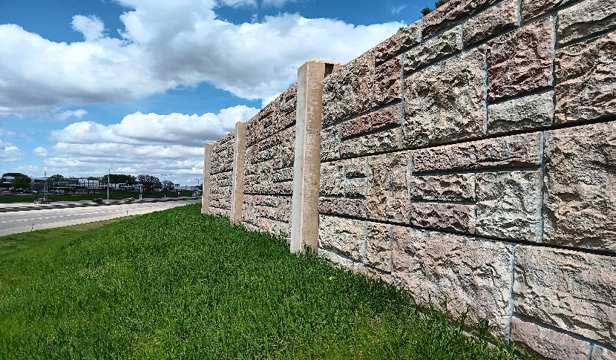
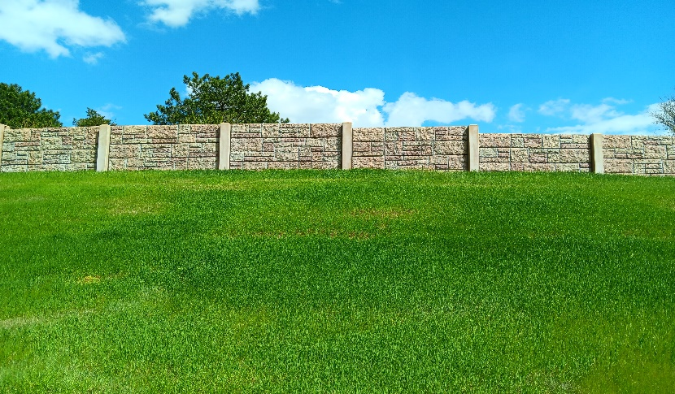
Millard highlands along I-80
Abatement Evaluation
1. Examined walls with noise modeling software.
2. Abatement was considered for outdoor areas of frequent use.
3. Noise walls must be “feasible and reasonable” to be constructed.
4.Reasonableness considers the preferences of affected owners and residents.
NH-80-9(125) MILLARD HIGHLANDS ALONG I-80; C.N. 22975
Notes:
Speaker: Behmer
Stepwise process to evaluate noise walls. Must go through an evaluation based on effectiveness and benefits vs cost. Feasibility is an initial test and reasonableness is secondary set of criteria. Reasonableness includes the input from the public and stakeholders.

Slide 14


Millard Highlands along i-80
Feasibility & ReasonableNess
Achieve 5 dBA minimum design goal reduction for 60% of front-row impacted locations.
Achieve 7 dBA minimum design goal reduction for 50% of front-row impacted locations.
Cost benefit index less than $61,400/benefitted stakeholder.
Supported by at least 75% of benefitted stakeholder responding.
  ( Ballots may be turned in tonight)
NH-80-9(125) MILLARD HIGHLANDS ALONG I-80; C.N. 22975
Notes:
Speaker: Behmer Read bullets. Provide details on cost benefit index. Different value based on size of wall and noise levels.

Slide 15
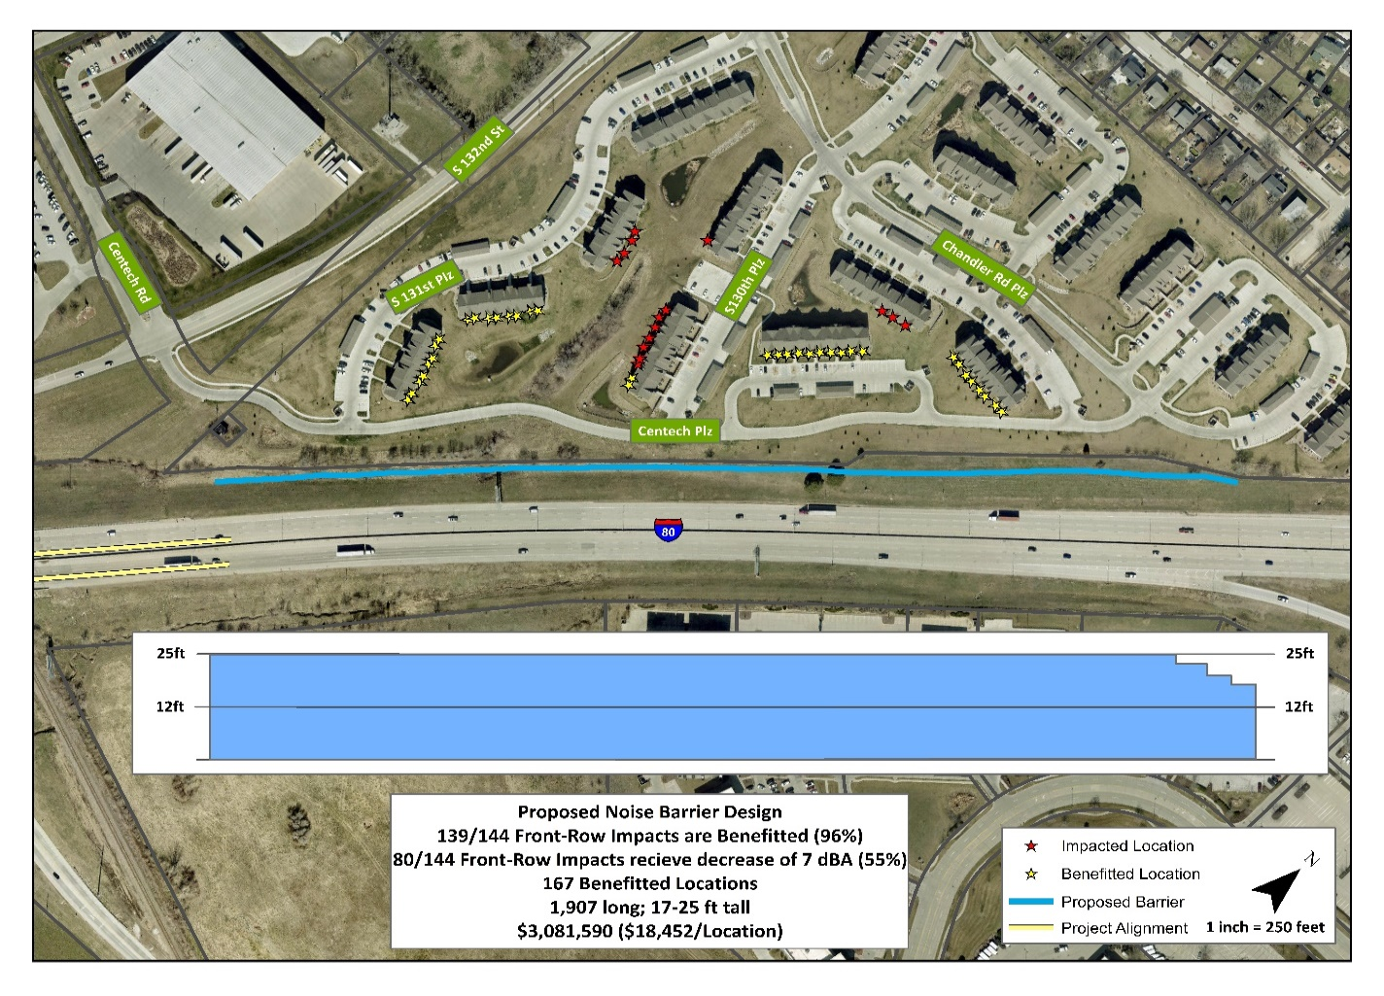
Millard Highlands along i-80
Proposed Noise Barrier
1 wall found to be feasible and reasonable to this point—final step in decision is preferences vote. Wall would vary in height but is 17-25 feet tall. Wall would be approximately 1,900 feet in length.
NH-80-9(125) MILLARD HIGHLANDS ALONG I-80; C.N. 22975
Notes:
Speaker: Behmer 167 residences would receive at least a 5dba decrease. And these are the benefitted stakeholders.

Slide 16
Millard Highlands along i-80
Proposed Wall Design
Permanent Right-of-Way acquisition not needed for noise walls. May need temporary construction easements. May need permanent maintenance easements. Routine wall maintenance access.
Wall is funded through project from federal funds, not by owners or tenants. Preliminary cost is approximately $3 million dollars Final design may vary slightly from what is shown today.
NH-80-9(125) MILLARD HIGHLANDS ALONG I-80; C.N. 22975
Notes:
Speaker: Behmer 96 FRIP would receive 5dba decrease. 55% 7dba decrease

Slide 17
Millard Highlands along i-80
Schedule
1. Final decision on noise walls after voting. Voting closes July 10, 2025.
2. Stakeholders notified of outcome.
3. Construction scheduled to be let to contractor bid Fall 2026.
4. Noise walls would be built after N-50 Ramp, Omaha improvements.
NH-80-9(125) MILLARD HIGHLANDS ALONG I-80; C.N. 22975
Notes:
Speaker: Behmer What is the schedule moving forward from tonight. The next step will be to count votes until July 10 when voting closes. From that point a decision will be made and a finalized noise study documenting that decision will be completed. Stakeholders will be notified at this time. If approved a detailed schedule for construction would be developed, and let to bid in the Fall of 2026. However, the noise wall would not be constructed, if approved, until after completion of N-50 Ramp project.

Slide 18
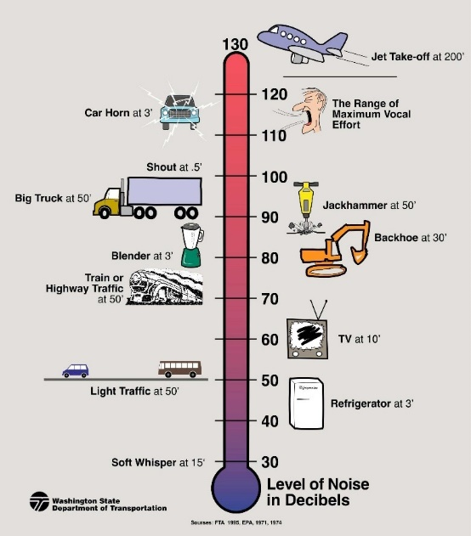
Millard Highlands along i-80
Noise Reduction Demonstration
6 dBA reduction 10 dBA reduction
NH-80-9(125) MILLARD HIGHLANDS ALONG I-80; C.N. 22975
Notes:
Speaker: Adam
Before we conclude a demonstration of what noise reduction would sound like. https://forcetechnology.com/en/articles/auralisation-road-noise/auralisation-changes-of-noise-3-6-10-db

Slide 19
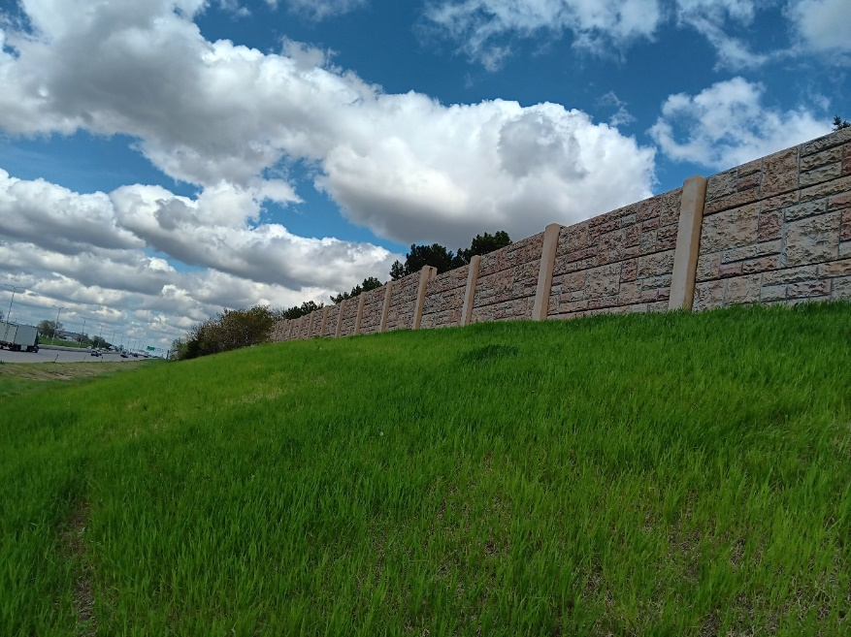
Millard Highlands along i-80
Aaron Bedea NDOT Noise and Air Specialist 1500 Nebraska Parkway Lincoln, NE 68509 Telephone (402) 479-4312 Aaron.bedea@nebraska.gov Sammi Kerrisun Environmental Project Manager 1500 Nebraska Parkway Lincoln, NE 68509 Telephone (402) 479-3192 Sammi.kerrisun@nebraska.gov
NDOT and FHWA thank you for your participation!
NH-80-9(125) MILLARD HIGHLANDS ALONG I-80; C.N. 22975
Notes:
Speaker: Behmer Thank you for attending and voting. NDOT and FHU staff will be here to answer any questions and continue collecting ballots. If you would like to contact NDOT please reach out to Aaron or Sammi.

