Slide 1
Utility program
District 8 Breakout Session

Slide 2
This Meeting is Being Recorded
Notes:
HDR

Slide 3
Welcome
Before we begin, let’s have a brief safety moment.
In-Person Attendees
Emergency Exits
Tornado Shelter
911 Caller
AED Location
Restrooms
Virtual Attendees
Unmute yourself or use your chat box if you are in an emergency situation.
Notes:
HDR

Slide 4
Agenda
Introductions
High Impact Project Review (by construction year)
Communication and Coordination
Questions and Wrap Up
Notes:
HDR

Slide 5
Introductions
Notes:
All speakers introduce themselves briefly (Dave, section head, HDR facilitators); Attendees can introduce themselves if it’s a small group. If not – skip it!

Slide 6
2024 Utility policy
NDOT rolled out a new utility accommodation policy in 2024.
You can find more information, as well as a webinar about the changes, on the NDOT utility website at https://dot.nebraska.gov/business-center/utilities/.

Slide 7
Cy 2026
The following projects are anticipated to be let during 2026

Slide 8
Brewster East
Project Number: STP-91-3(108) Control No: 80873
Project Length: 9.52
Scope of Work:
  Full Depth Pavement
  Culvert Extension/Replacement
  Grading

Slide 9
Brewster East
Project Number: STP-91-3(108) Control No: 80873
Status: Design
Right-of-way: In Progress
Construction Timing: 4/1/2026 - 11/30/2026

Slide 10
Brewster East
Project Number: STP-91-3(108) Control No: 80873
Anticipated Utilities Impact:
Anticipated Request from Utilities:
Additional Information:
Utilities Involved:
  Custer Public Power District
  Consolidated Telephone Company
  Hamilton Telecommunications

Slide 11
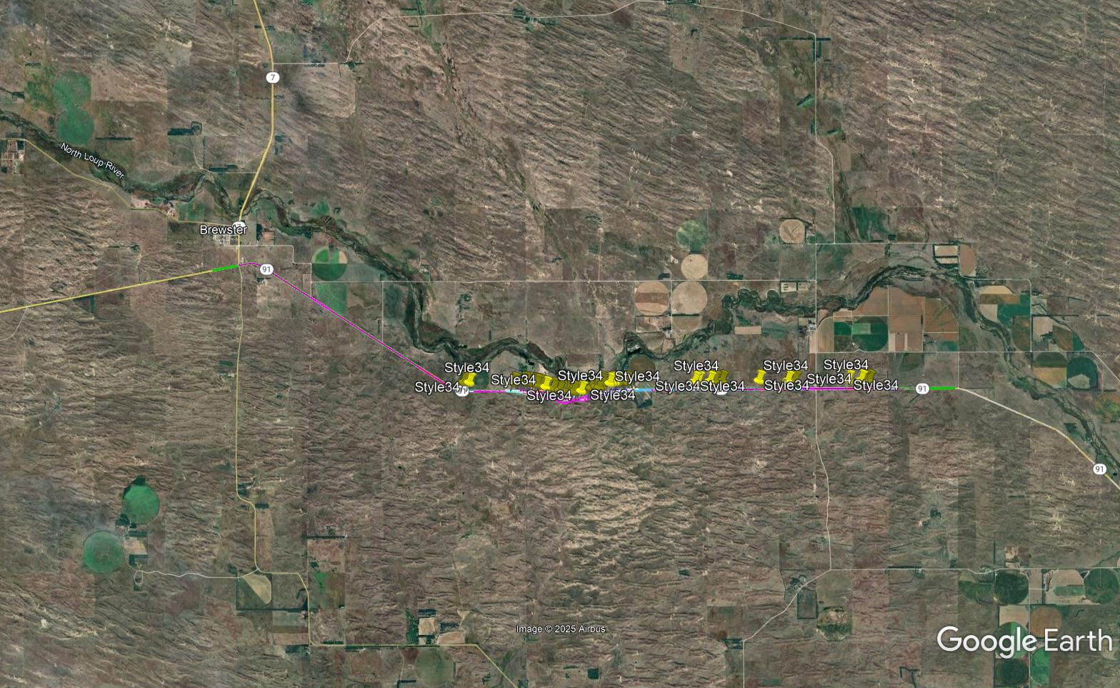

Slide 12
Cy 2027
The following projects are anticipated to be let during 2027

Slide 13
Merritt Reservoir South
Project Number: STP-97-4(109) Control No: 80617
Project Length: 7.70
Scope of Work:
  Resurfacing
  Culvert Extension/Replacement
  Grading

Slide 14
Merritt Reservoir South
Project Number: STP-97-4(109) Control No: 80617
Status: Design
Right-of-way: In Progress
Construction Timing: 4/1/2027 - 11/30/2027

Slide 15
Merritt Reservoir South
Project Number: STP-97-4(109) Control No: 80617
Anticipated Utilities Impact:
Anticipated Request from Utilities:
Additional Information:
Utilities Involved:
  Lumen
  Consolidated Telephone Company

Slide 16
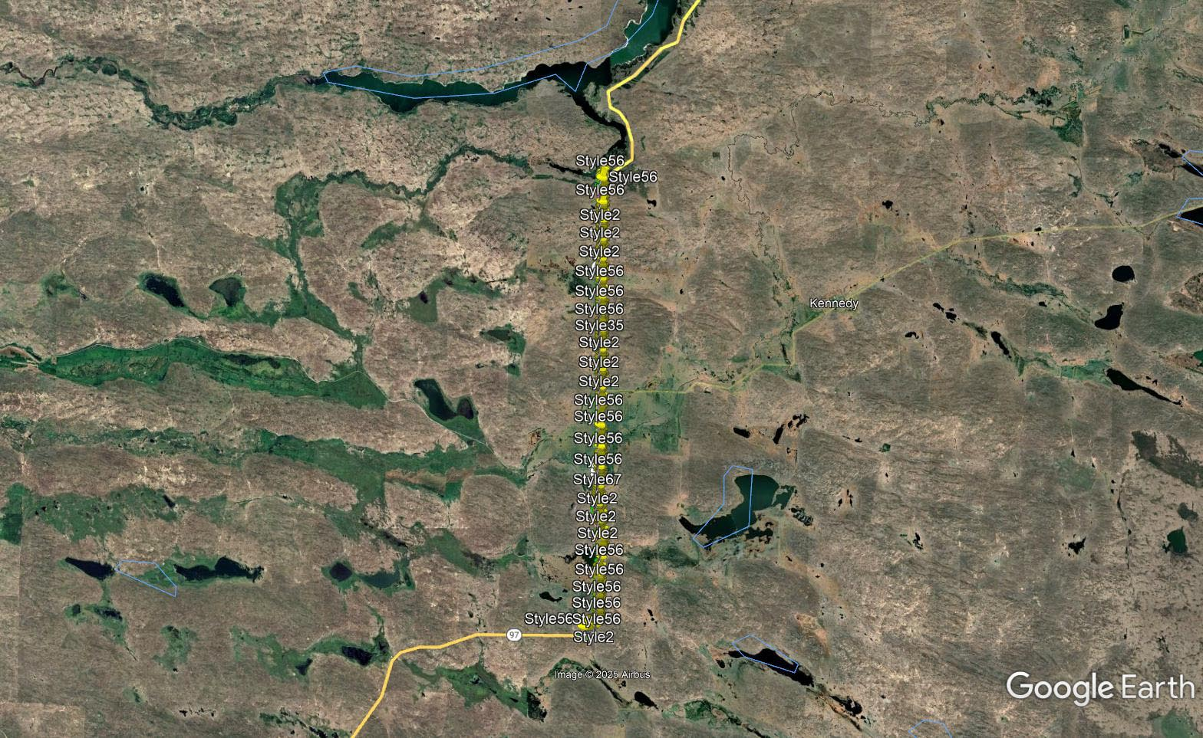

Slide 17
O'Neill North
Project Number: NH-281-4(133) Control No: 81113
Project Length: 13.05
Scope of Work:
  Culvert Extension/Replacement
  Pavement Reconstruction

Slide 18
O'Neill North
Project Number: NH-281-4(133) Control No: 81113
Status: Design
Right-of-way: Not Required
Construction Timing: 4/1/2027 - 10/31/2027

Slide 19
O'Neill North
Project Number: NH-281-4(133) Control No: 81113
Anticipated Utilities Impact:
Anticipated Request from Utilities:
Additional Information:
Utilities Involved:
  Black Hills Energy
  City of O’Neill – Sewer and Water
  Great Plains Communications
  Lumen
  Nebraska Public Power District
  Niobrara Valley Electrical Membership
  OPTK Networks
  Tallgrass Energy
  Three River Telco
  Viaero

Slide 20
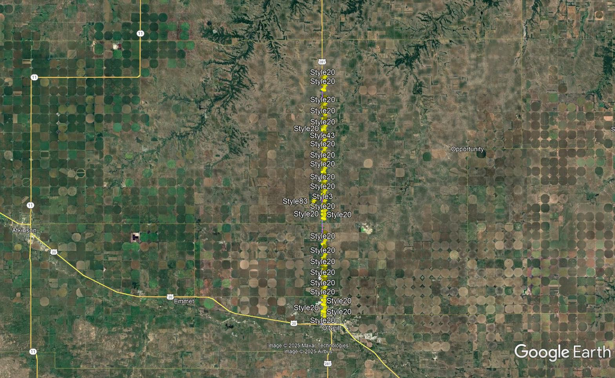

Slide 21
District 8 Cameras & RWIS Replacement
Project Number: ITS-NH-STP-D8(105) Control No: 81151
Project Length: 0.00
Scope of Work:
  Installation/replacement of highway cameras

Slide 22
District 8 Cameras & RWIS Replacement
Project Number: ITS-NH-STP-D8(105) Control No: 81151
Status: Design
Right-of-way: Not Required
Construction Timing: 4/1/2027 - 10/31/2027

Slide 23
District 8 Cameras & RWIS Replacement
Project Number: ITS-NH-STP-D8(105) Control No: 81151
Anticipated Utilities Impact:
Anticipated Request from Utilities:
Additional Information:
Utilities Involved:
  Black Hills Energy
  Consolidated Telephone Company
  Fastwyre Broadband
  Great Plains Communications
  Hamilton
  K&M Telephone
  KBR Rural Public Power District
  Lumen
  Northeast NE Telecommunications
  Nebraska Public Power District
  Panhandle Rural Electrical Membership
  Three Rivers Telephone Company
  Viaero
  Village of Newport

Slide 24
District 8 Cameras & RWIS Replacement
Project Number: ITS-NH-STP-D8(105) Control No: 81151

Slide 25
S-16B - US-20
Project Number: NH-83-4(124) Control No: 81114
Project Length: 10.27
Scope of Work:
  Bridge Repair

Slide 26
S-16B - US-20
Project Number: NH-83-4(124) Control No: 81114
Status: Design
Right-of-way: Not Required
Construction Timing: 6/1/2027 - 11/6/2027

Slide 27
S-16B - US-20
Project Number: NH-83-4(124) Control No: 81114
Anticipated Utilities Impact:
Anticipated Request from Utilities:
Additional Information:
Utilities Involved:
  Ainsworth Irrigation District
  Great Plains Communications
  KBR Rural Public Power District
  Lumen

Slide 28
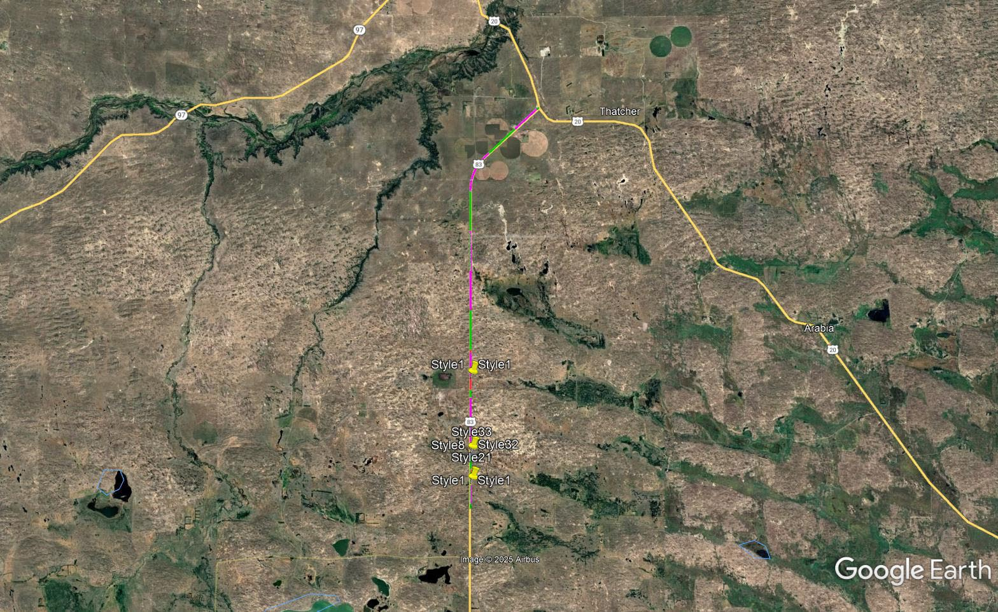

Slide 29
Questions & Wrap Up
Notes:
HDR

Slide 30
Any final Questions?
Ask them now!
If you have questions after this meeting, or would like to view more detailed project maps, please reach out to your utility coordinator.
Notes:
HDR

Slide 31
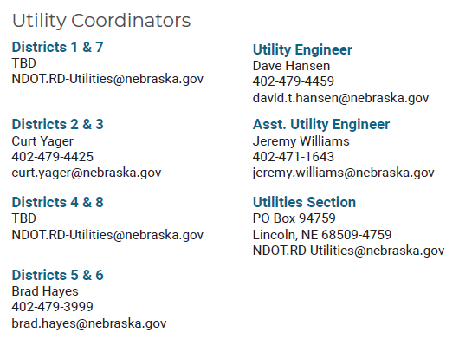
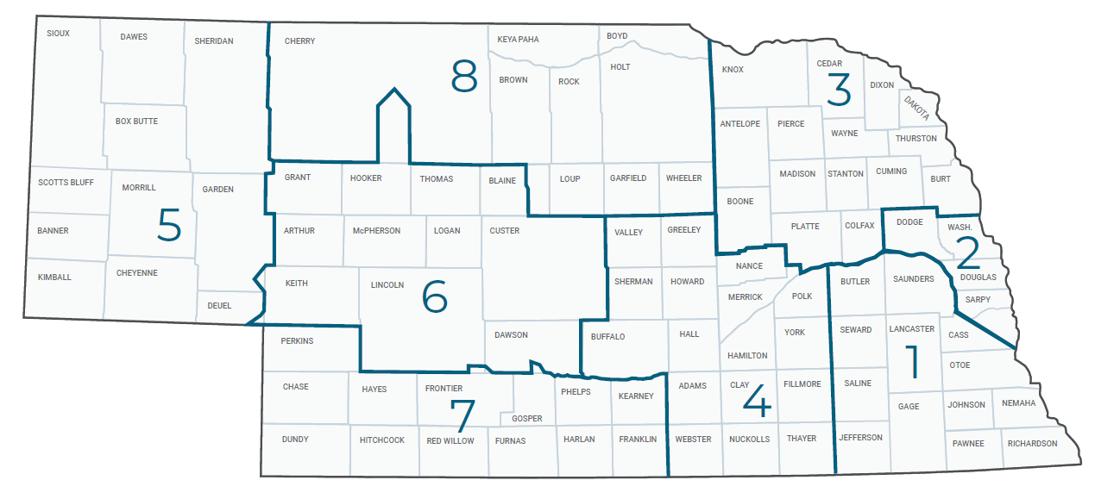
Have a Question about a project your Utility is involved in?
Contact your district’s utility coordinator!
Notes:
HDR

Slide 32
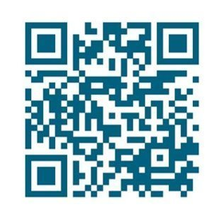
We need your feedback
Your valuable feedback helps these meetings – and NDOT’s utility coordination program – be better.
Use your phone’s camera to scan this QR code or use our paper survey.
Notes:
HDR

Slide 33
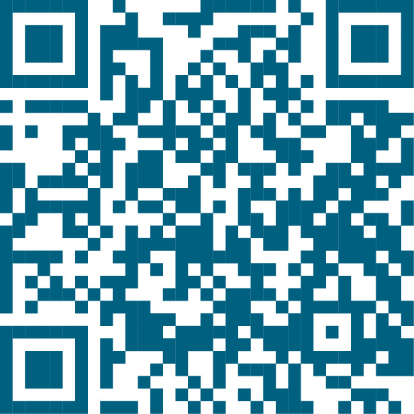
Visit our Website
Visit NDOT.info/utility for more information on:
Utility accommodation
Permitting
Coordination
Project information
Reimbursements
Additional information
Scan the QR Code to view the 2026 Program Book!
Notes:
HDR

Slide 34
Thank You
Notes:
HDR

