Slide 1
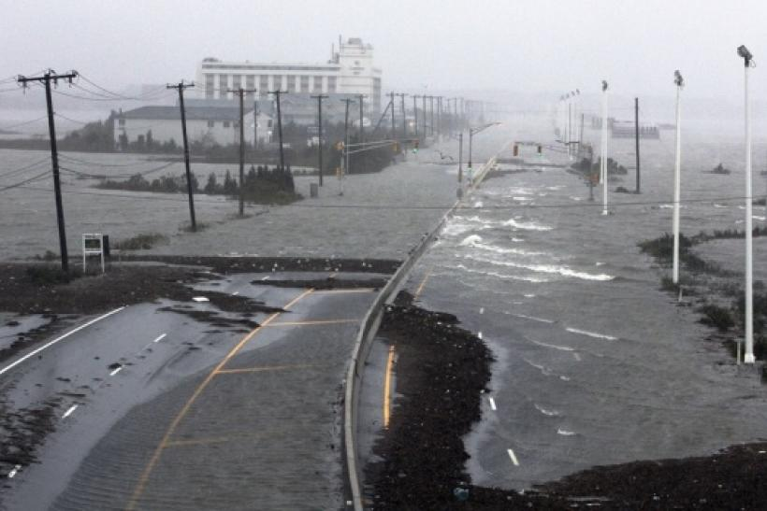

Winter Weather,
Crashes,
and Winter Severity
Curtis L. Walker, Ph.D., A.M.ASCE, NCAR Project Scientist
Jesse Schulz, NDOT Meteorologist
Mark R. Anderson, Ph.D., UNL Professor of Atmospheric Science
22 September 2021
Notes:
NOTE: Background image can be used as is or changed for a particular presentation in the “Slide Master” button found under the “View” tab.

Slide 2

INVESTIGATION OF WEATHER CONDITIONS AND THEIR RELATIONSHIP TO CRASHES
Mark R. Anderson and Aemal J. Khattak
Muhammad Umer Farooq and John Cecava
University of Nebraska-Lincoln
Curtis Walker (NCAR)
https://dot.nebraska.gov/media/114448/investigation-of-weather.pdf

Slide 3
Objectives
Correlate motor vehicle crashes to weather conditions prevalent at crash times
Investigation limited to when winter weather conditions could be a factor in crashes
Statistical analyses to identify what weather conditions cause the greatest safety concerns

Slide 4
Additional Objectives
Using snowfall data, investigate whether knowing the forecasted snowfall amount could be a precursor to the number and type of crash
For example, if a 3-4 inch snowfall is forecasted what is the probability that there will be a crash? Fatality?
Consider winter storm severity index (NEWINS) values at the NDOT District level and any crash within the District would have the same value

Slide 5
Data Filtration Process and Results
NE Crash Data
Study years: 2008-2018
Consider injury/fatality crashes, not property-damage-only (PDO)
NDOT Raw Crash Data
Applying Winter Weather Filters
NDOT Winter Season Data (October of previous year-May of subsequent year)
Reduction in Cases
2008-2009 15,806
2009-2010 21,382
2010-2011 15,964
2011-2012 10,752
2012-2013 13,447
2013-2014 12,652
2014-2015 13,541
2015-2016 14,379
2016-2017 13,184
2017-2018 9,018
Further Filtering Variable of Interest
Var 1: Road Surface Condition
Var 2: Weather Condition I
Var 3: Weather Condition II
Var 4: Road Classification
Var 5: Alcohol Use
Var 6: Accident Severity
Var 1 as Snow, Ice, Slush, Wet: Var 2 as Blowing Snow, soil, dirt or Sand, Clear, Cloudy, Fog, Smog, Rain, Snow, Sleet, Severe Cross Winds, Not stated: Var 3 as Blowing Snow, Soil, Dirt or Sand, Clear, Cloudy, Fog, Smog, Rain, Snow, Sleet, Severe Cross Winds, Not stated
2008-2009 552 (3.5%)
2009-2010 815 (3.8%)
2010-2011 641 (4.1%)
2011-2012 297 (2.8%)
2012-2013 474 (3.5%)
2013-2014 350 (2.8%)
2014-2015 301 (2.3%)
2015-2016 344 (2.4%)
2016-2017 327 (2.5%)
2017-2018 411 (4.6%)
Var 4 as Highway, Highway Ramp, Interstate Mainline, Interstate Ramp, Interstate Rest Area/Scale: Var 5 as No Alcohol Use: Var 6 Possible Injury, Visible Injury, Disabling Injury, Fatal
Acquisition of Final Number of Crashes with percent Reduction for Each Year
Further Filtering Variable of Interest
In Var 1, wet was kept if Var 2 and Var 3 were snow or ice

Slide 6
Meteorological Data
Weather observations collected for each case
  Snowfall data (CoCoRaHS, COOP)
    6-hourly reports
    Daily observations
  Snow depth data
  Radar data
  Automated weather observations (ASOS)
    Temperature
    Visibility
    Winds
  Weather system parameters
    Storm type
    Moisture source

Slide 7
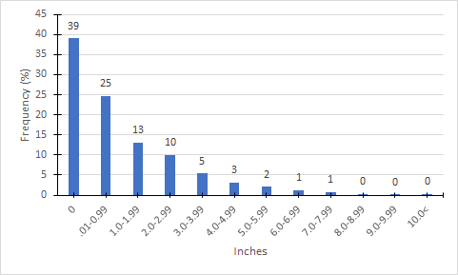
Total Frequency of Crashes with the Daily Snowfall Amount on Crash Day

Slide 8
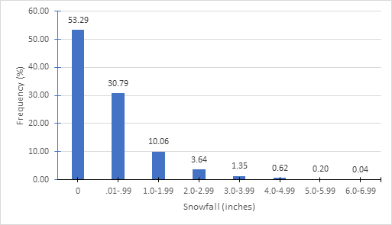
Results
About 50% of crashes happened without snowfall occurring
30% of the crashes occurred with less than 1-inch snow reported during the six-hour time period.
Total frequency of crashes with the snowfall amount that occurred in the six-hour timeframe of when the crash happened

Slide 9
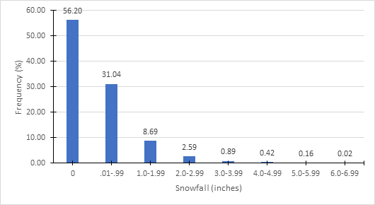
Results
Over 50% of crashes happened with no snowfall occurring during six- hours prior to crash
30% of the crashes happened with less than 1-inch snow reported in the previous six-hour time period.
Total Frequency of Crashes with the Snowfall Amount that Occurred Six Hours Prior to the Crash

Slide 10
Nebraska Winter Severity Index (NEWINS) Crash Analysis
https://dot.nebraska.gov/media/12698/final-report-m054.pdf

Slide 11
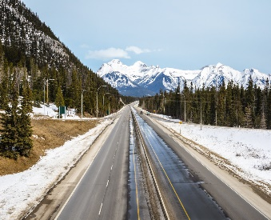
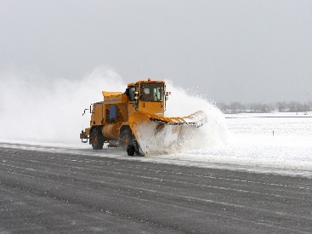
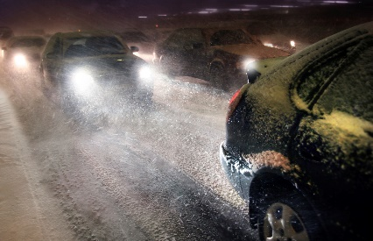
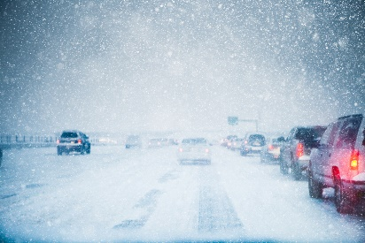

Parameter | Category
 | Trace (1) | Marginal (2) | Slight (3) | Enhanced (4) | Moderate (5) | High (6)
Road Access | No Impact | No Impact | Minimal road closures | Occasional road closures | Numerous Road Closures | Significant Road Closures
Road Conditions | Wet Roads | Wet Roads | Spotty snow and ice covered roads, otherwise wet | Roads partially covered with snow and ice | Roads completely covered with snow and ice | Impassable Roads Covered with snow and ice
Traffic Speeds | No Impact | No Impact | Minimal speed reductions | Considerable speed reduction | Significant speed reduction | Significant speed reduction
Treatment Operations | No Deployment | Minimal Deployment | Partial Deployment | Full Deployment | Full Deployment | Full Deployment with Possible Operation Suspension
Winter Maintenance Performance Objective | Met | Met | Likely Met | Unlikely Met | Not Met | Not Met
Storm Classification Road Impacts

Slide 12
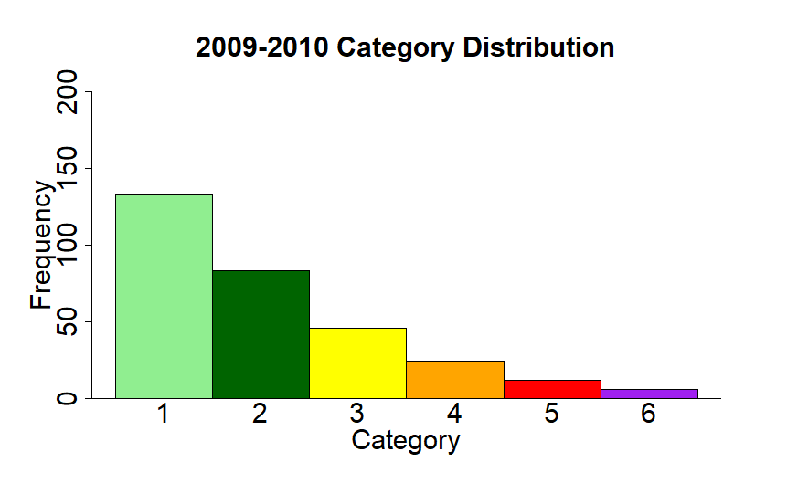
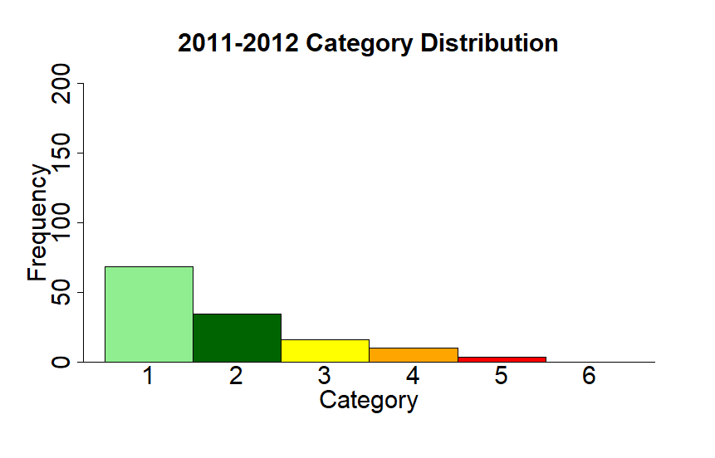

Slide 13
NEWINS Event Relationship to Crashes
NEWINS Category | Total Injury/Fatality Crashes | Fatality Crashes
Cat 1 | 942 | 17
Cat 2 | 1001 | 20
Cat 3 | 551 | 19
Cat 4 | 399 | 4
Cat 5 | 167 | 1
Cat 6 | 22 | 0
Total Crashes | 3082 | 61

Slide 14
Crash Relationship to NEWINS Events
Identifier | Percentage of Event Crashes
Crashes During NEWINS Event | 52.1%
Crashes Not During NEWINS Event | 24.1%
NEWINS Events With No Crashes | 23.8%

Slide 15
Crash Relationship to NEWINS Events (Adapted from Table 4.12)
Identifier | Percentage of Event Crashes | Future Goals
Crashes During NEWINS Event | 52.1%
Crashes Not During NEWINS Event | 24.1%
NEWINS Events With No Crashes | 23.8%

Slide 16
Colorado Low vs Alberta Clipper Characteristics
Colorado Low (CL)
Heavier, denser snow
Slower moving system
Usually higher snowfall totals
Blowing and drifting during event
Typically warmer temperatures
1-12” (Highly variable)
Rain/Snow line difficult to forecast
Southwesterly flow
Alberta Clipper (AC)
~2-5” per event
Typically colder temperatures
Blowing and drifting during and after the event
Less dense snowfall
Faster moving events
Northwesterly flow

Slide 17
Total Frequency of Crashes with Respect to Crash Severity with Weather System Data
Weather System Type | Injury/Fatality Crashes | Fatality Crashes
Colorado Low | 1902 | 38
Alberta Clipper | 1217 | 21
Other | 1392 | 34
Total | 4511 | 93

Slide 18
Conclusions
This research focused on understanding how winter weather conditions contributed to the occurrence of vehicular crashes in Nebraska from the 2008-2009 winter season through the 2017-2018 winter season.
Overall, the key finding of the analysis was most winter-weather related vehicular crashes were associated with relatively minimal winter weather conditions.
This highlights the need for winter maintenance operations activities to continue well after a storm has exited the region and also the need for continued messaging of hazardous weather conditions.

Slide 19
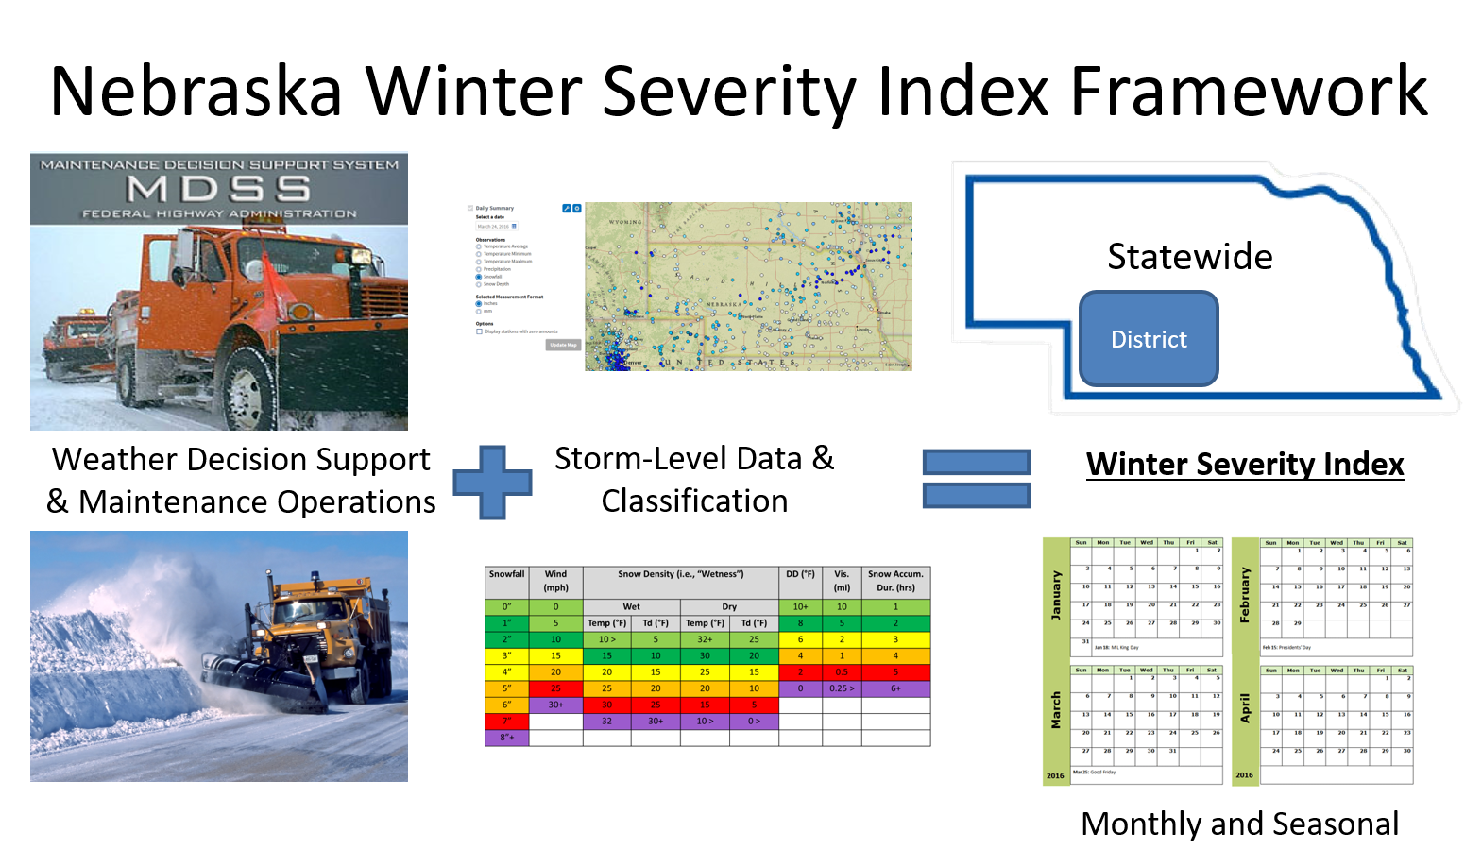

Slide 20
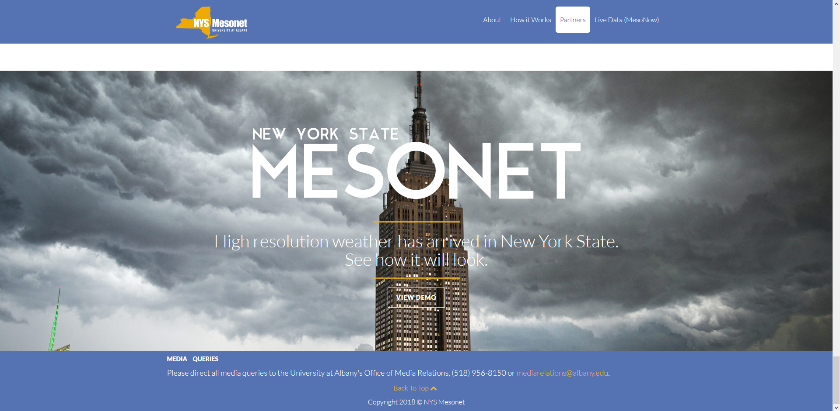
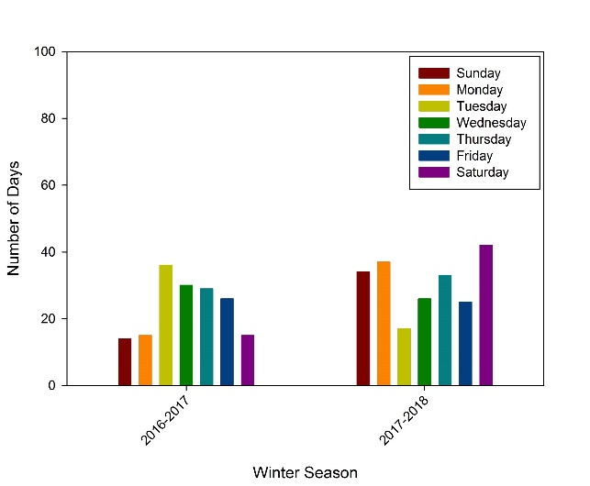
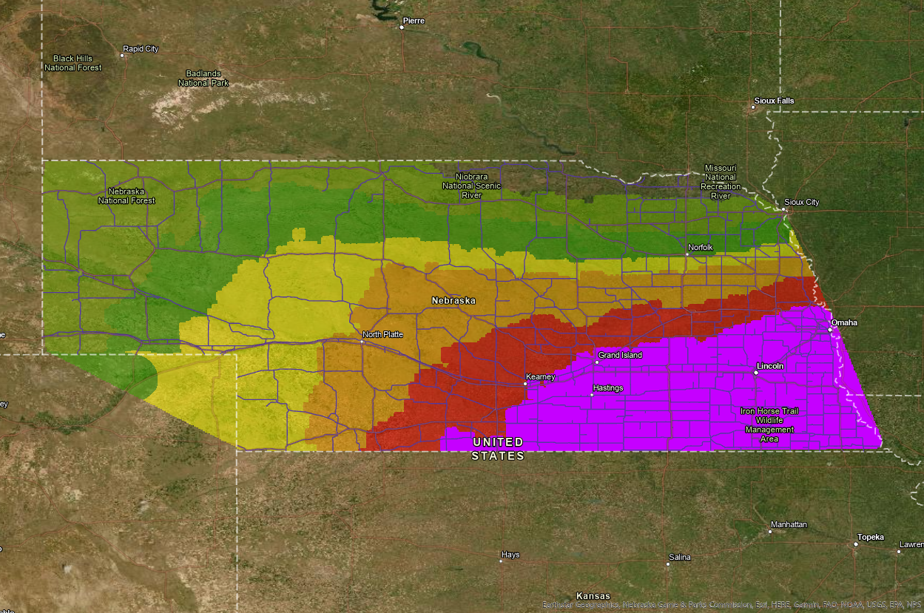
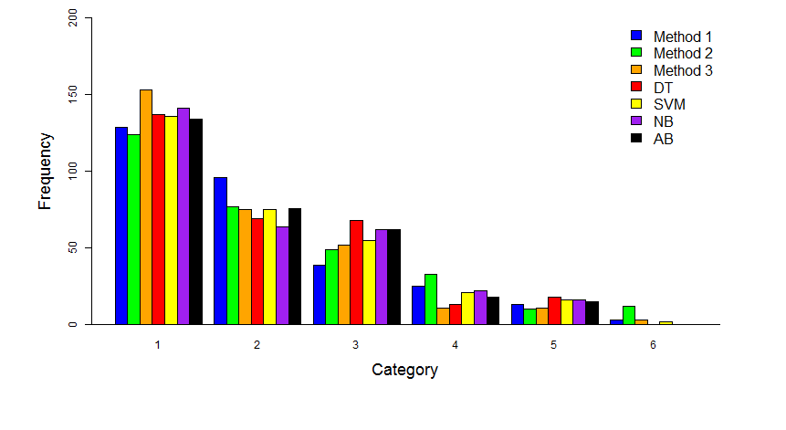
Future Winter Severity Index Possibilities
1) Higher Resolution Input Data | 2) Impact Metrics (e.g., Day of Week)
3) Storm Prediction/Forecast | 4) Sensitivity Analyses

Slide 21
Future Winter Severity Index Possibilities
1) Higher Resolution Input Data | 2) Impact Metrics (e.g., Day of Week)
3) Storm Prediction/Forecast | 4) Sensitivity Analyses

Slide 22
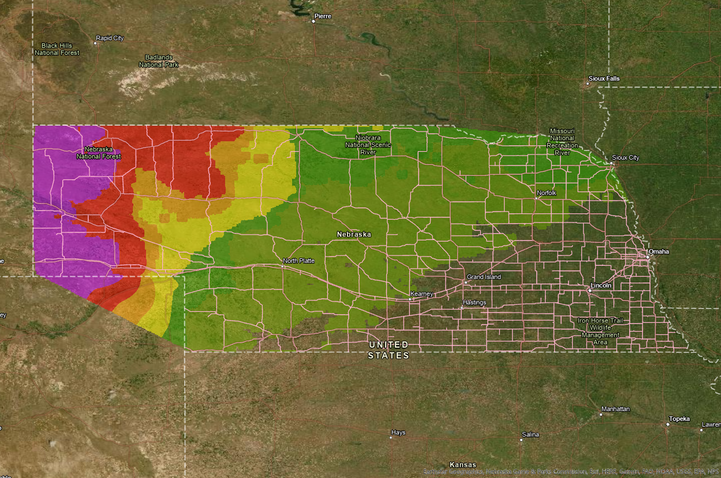
NEWINS Forecast
Maps that could be used for social media/public outreach

Slide 23
Superintendent Area 24 Hour NEWINS Forecast
Morning Rush Hour
Evening Rush Hour
6
5
4
3
2
1
NEWINS Forecast Severity
1 3 6 9 12 15 18 21 24
Forecast Hour

Slide 24
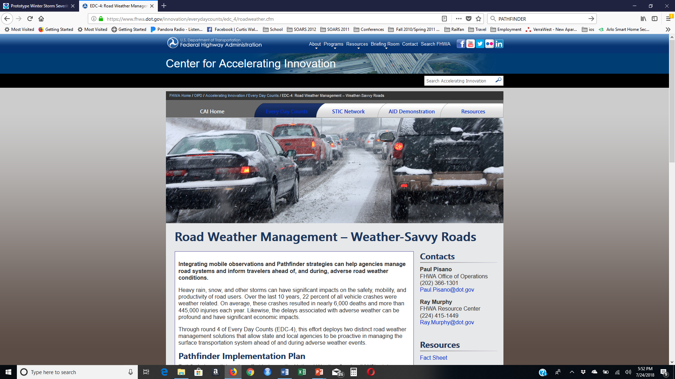
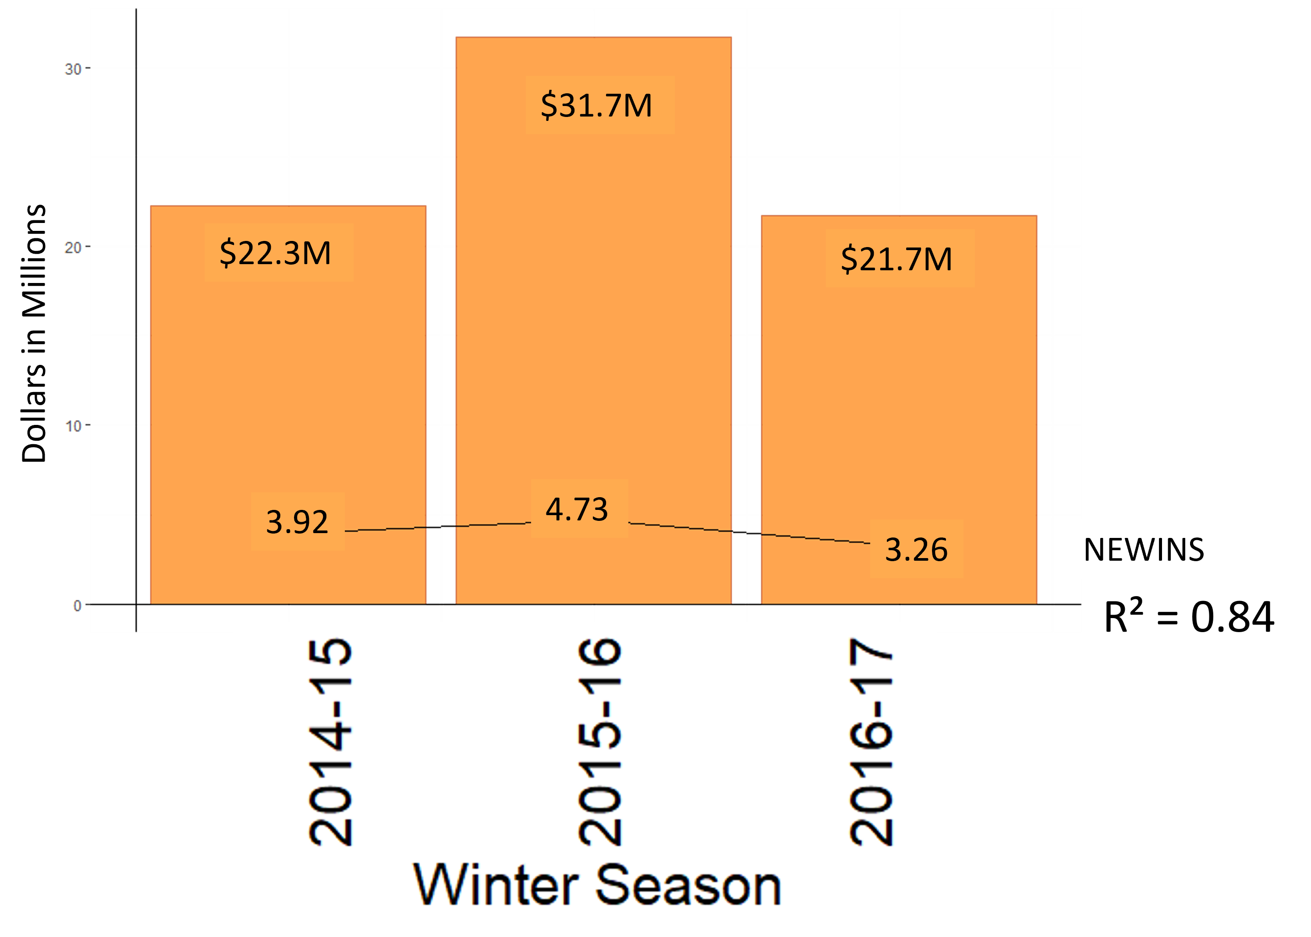
NEWINS Forecast Benefits
Pathfinder/Public Messaging
Able to forecast material usage/cost
Able to forecast man hour and on-call schedule

Slide 25
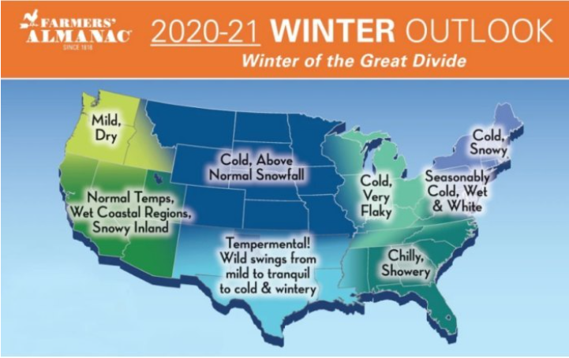

Slide 26
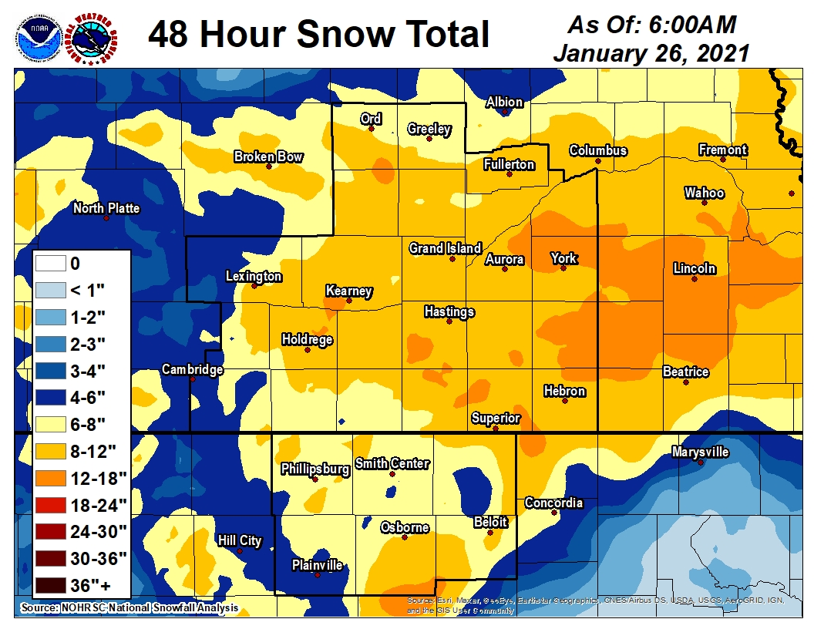
2020-21 Pathfinder
4 pathfinder events
January 24th 2021
3 pathfinder event for wind

Slide 27
Review of Last Winter

Slide 28
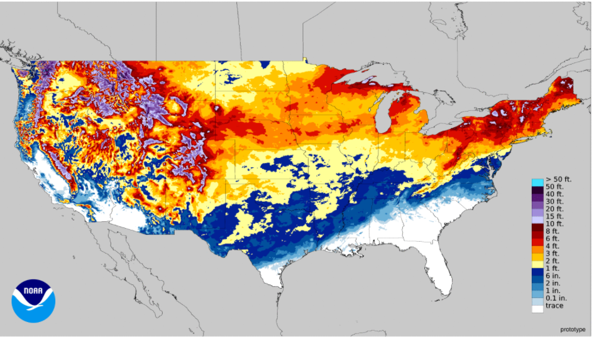
2020-21 Snowfall
NDOT District | Snowfall(in) | Difference
1 | 45.9 | +11.2
2 | 56.2 | +17.3
3 | 58.2 | +12.5
4 | 57.9 | +14.8
5 | 76.6 | +4.5
6 | 48.6 | +0.4
7 | 45.6 | +6.3
8 | 66.4 | +15.8

Slide 29
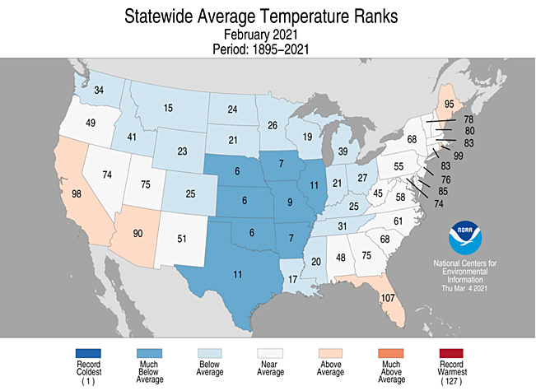
2020-21 Cold Temperatures

Slide 30
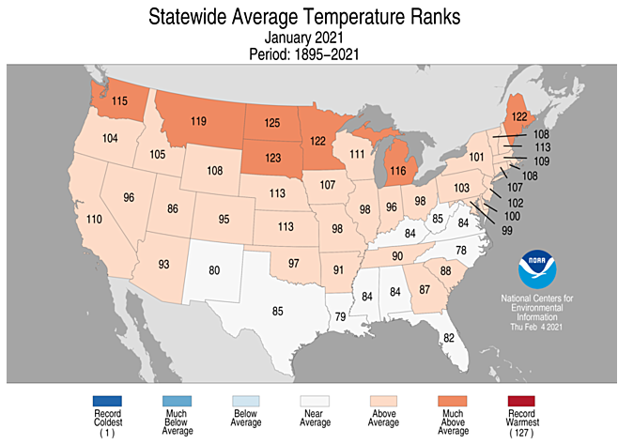
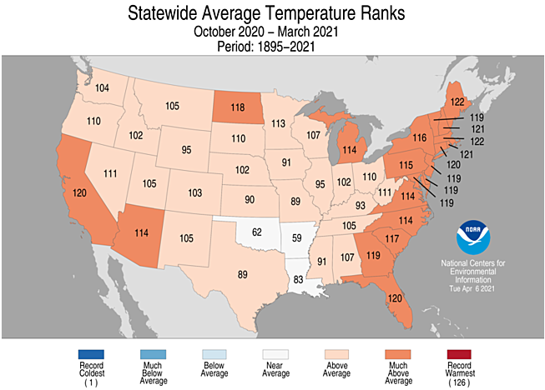
2020-21 Cold Temperatures

Slide 31
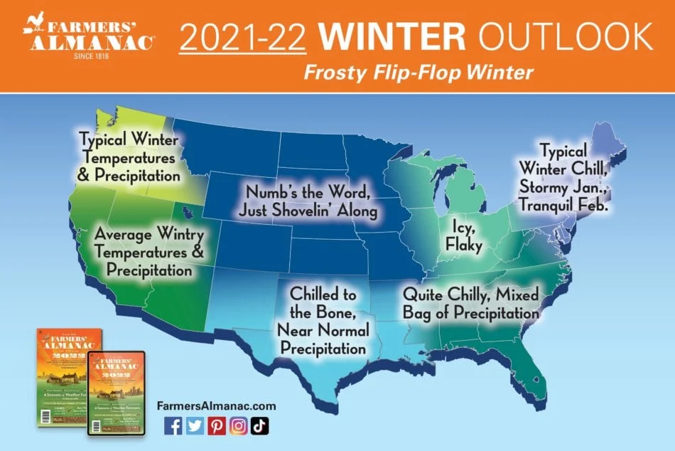

Slide 32
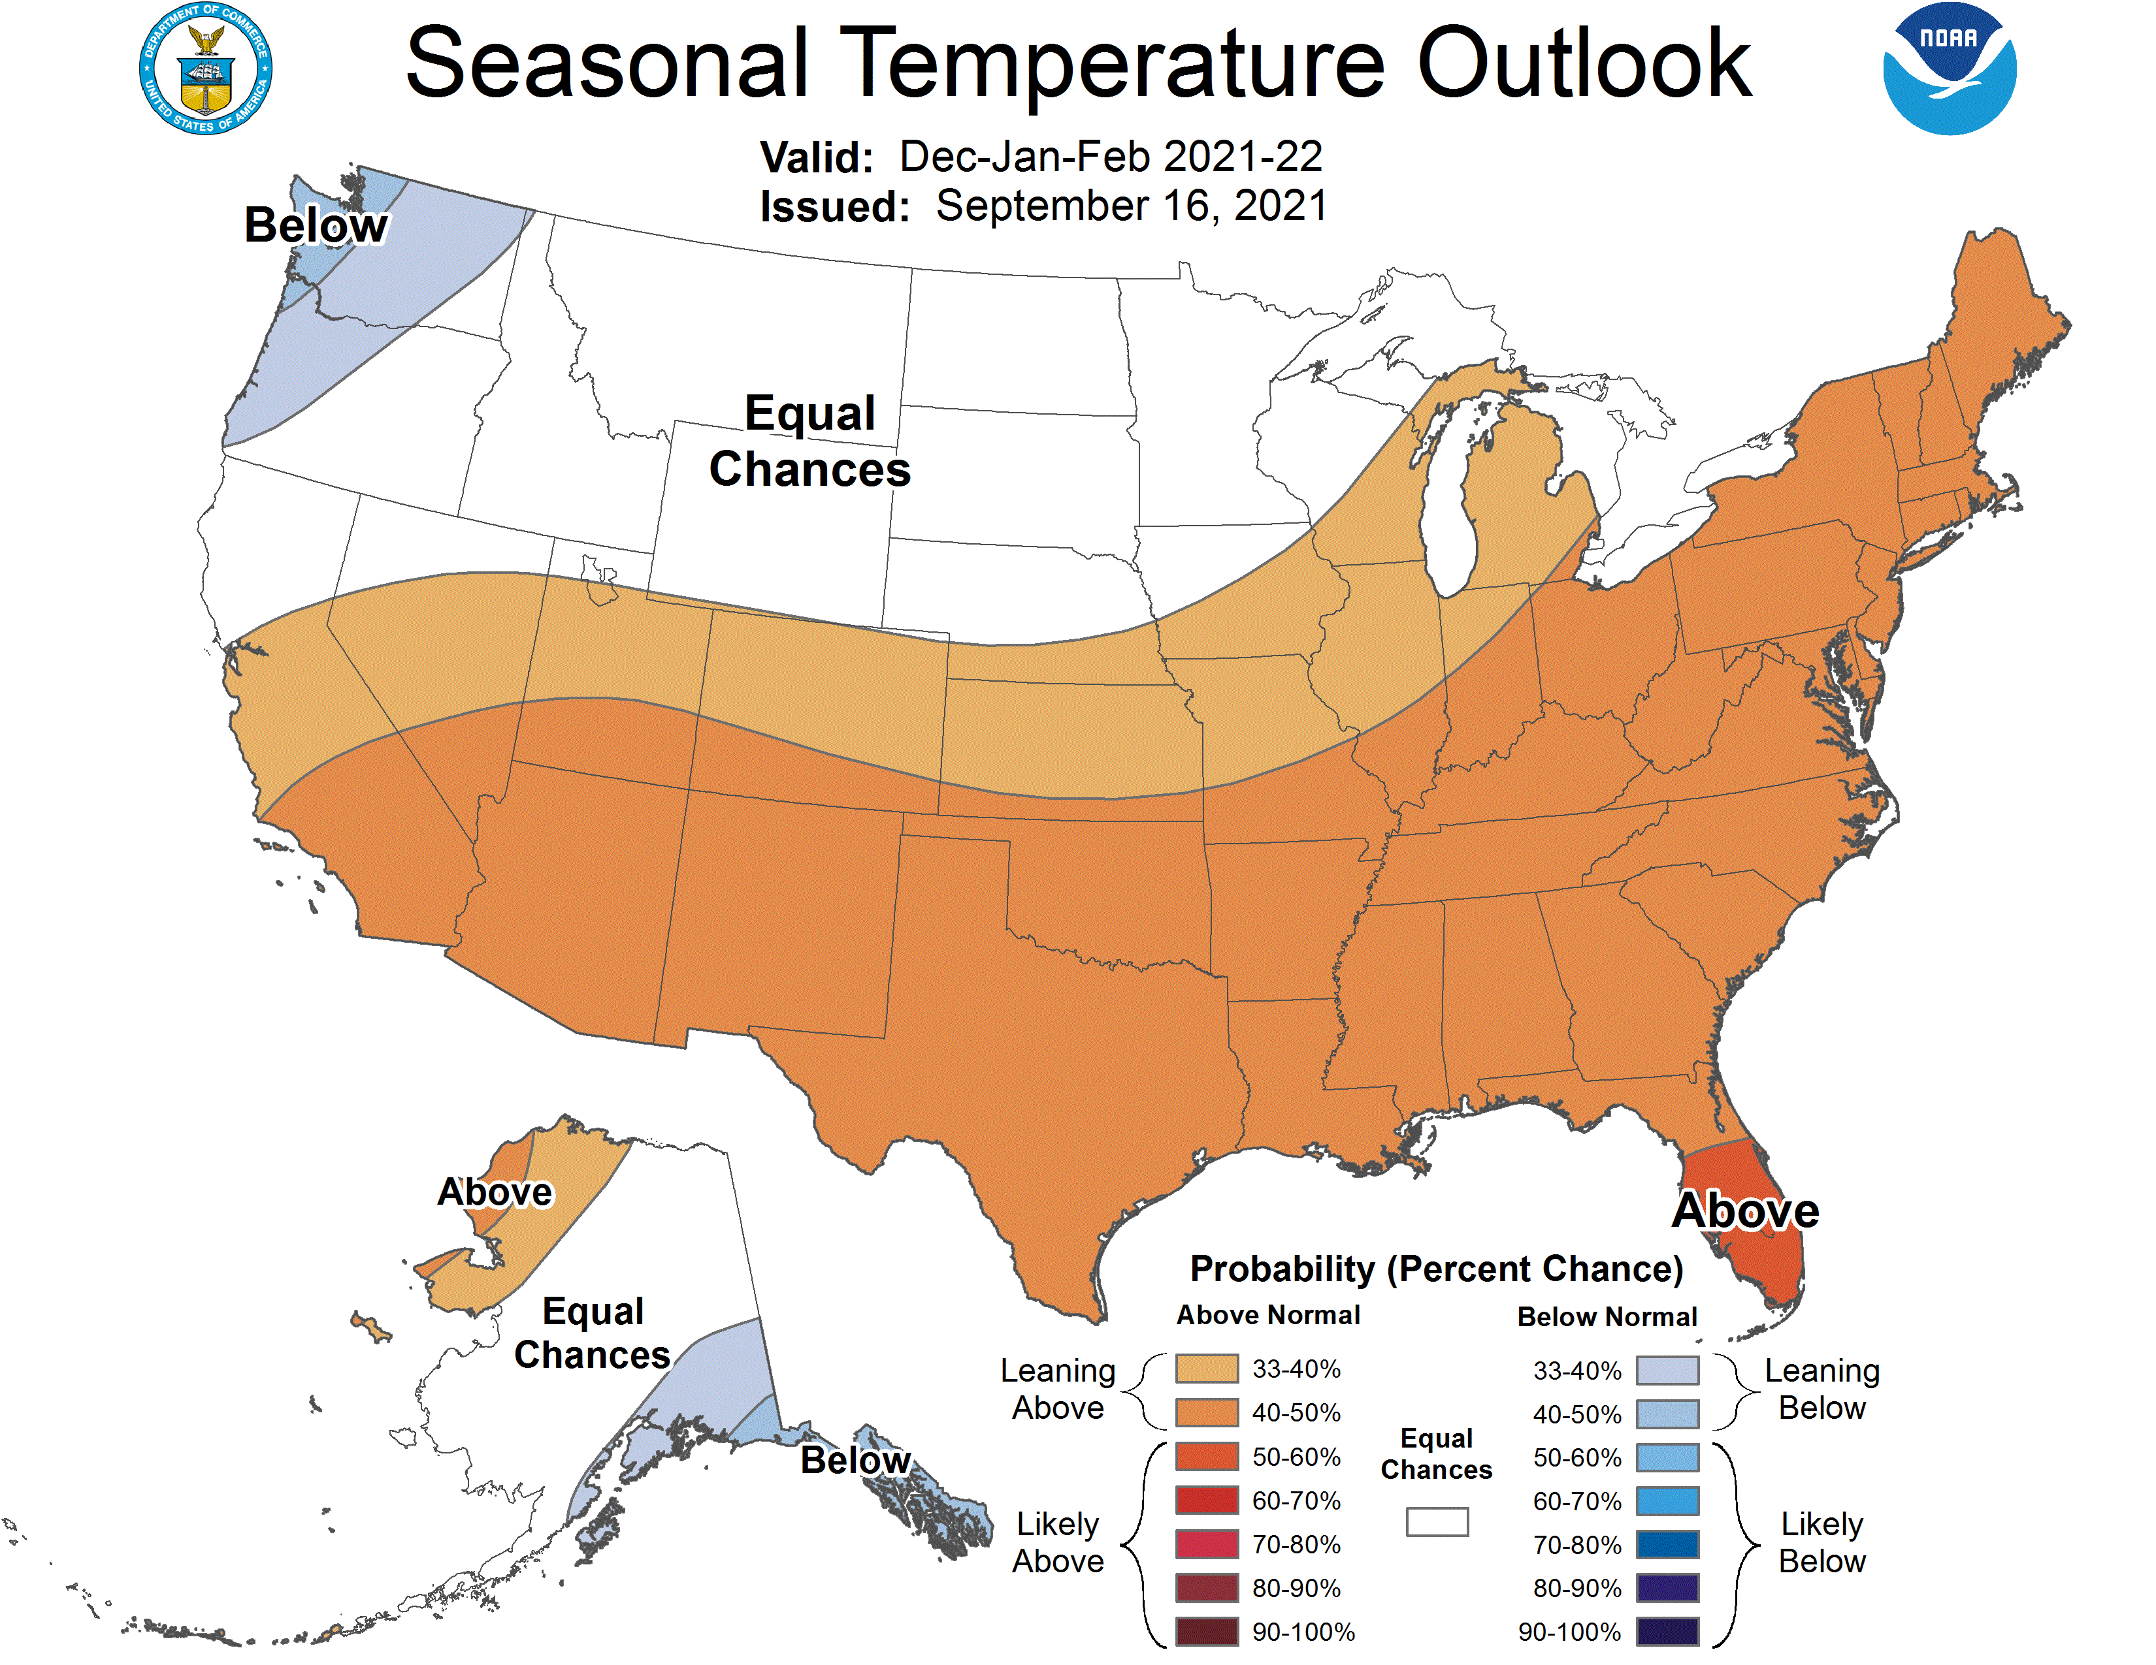
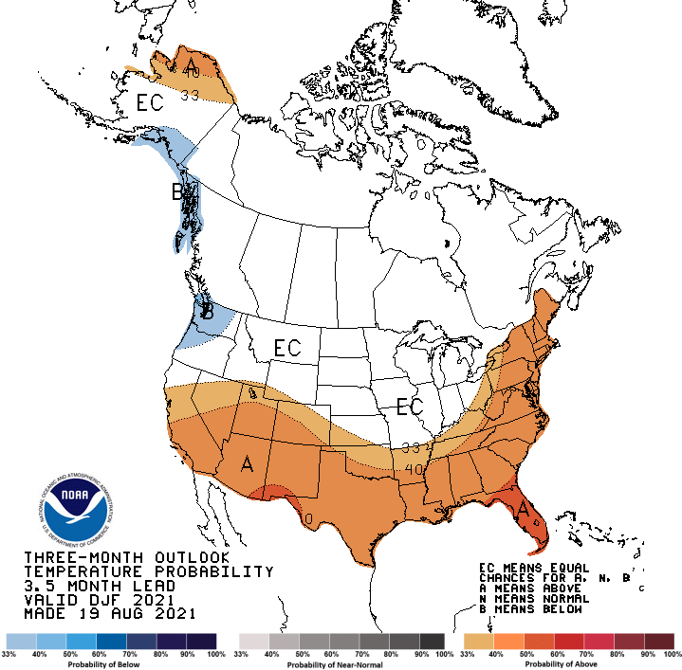
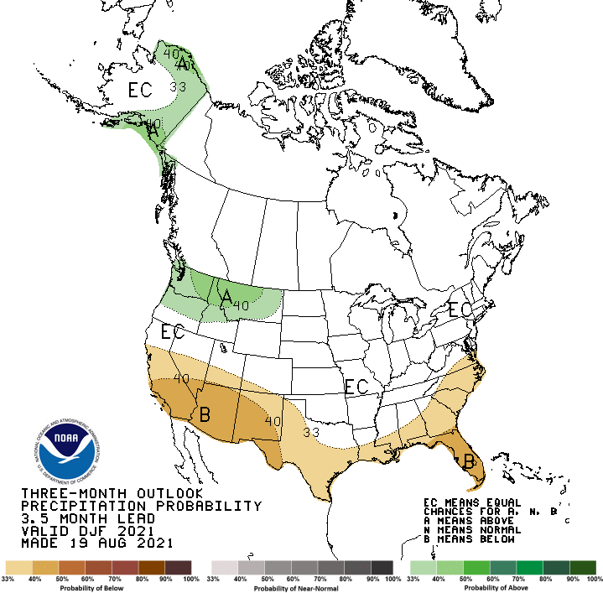
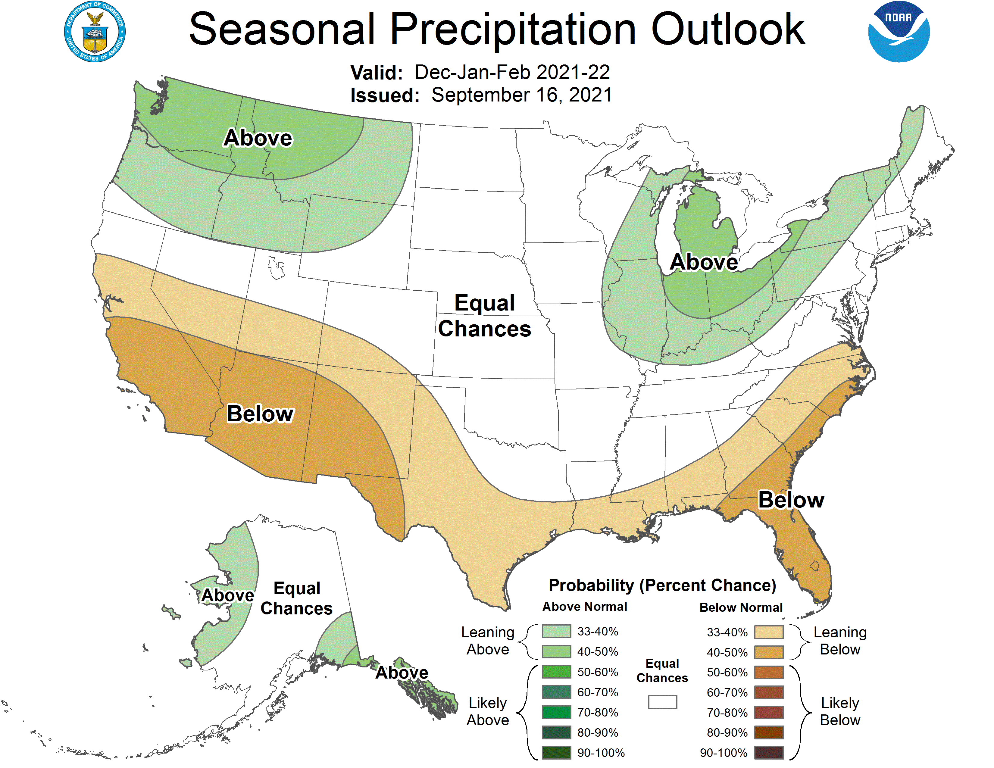
NOAA Climate Prediction Center
Dec 2021-Feb 2022 Outlook (as of Sept 16th)

Slide 33
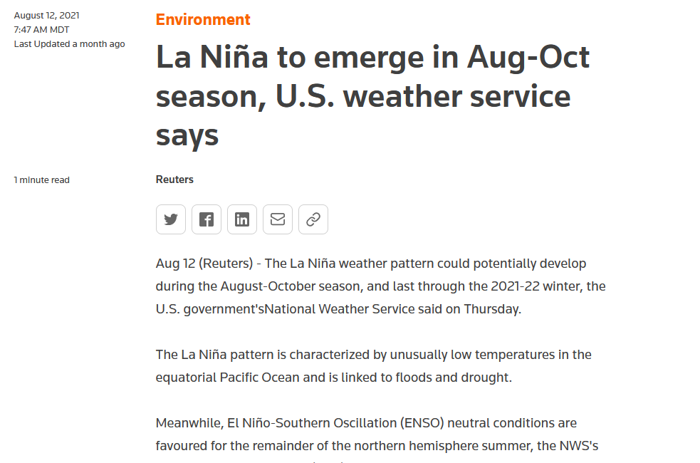

Slide 34
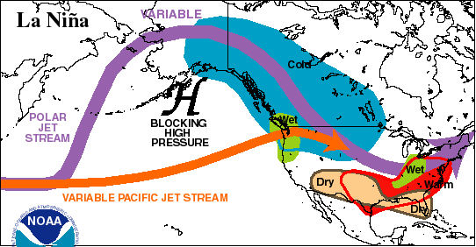

Slide 35
NEWINS El-Nino/La-Nina Comparisons
Year | WSI Anomaly Rank | ENSO Phase
2018-19 | 1 | El-Nino
2009-10 | 2 | El-Nino
2010-11 | 3 | La-Nina
2007-08 | 4 | La-Nina
2020-21 | 5 | La-Nina
2017-18 | 6 | La-Nina
2019-20 | 7 | Neutral
2012-13 | 8 | Neutral
2008-09 | 9 | La-Nina
2015-16 | 10 | El-Nino
2013-14 | 11 | Neutral
2006-07 | 12 | El-Nino
2014-15 | 12 | El-Nino
2016-17 | 14 | La-Nina
2011-12 | 15 | La-Nina
ENSO adapted from: http://ggweather.com/enso/oni.htm

Slide 36
NOAA Climate Prediction Center
Dec 2021-Feb 2022 Outlook (as of August 19th)

Slide 37
Winter 2021-22 in Nebraska
Transition from the start of the season to the end with warm start cold finish. Snowfall should be about average; 40” in the West to 25” in the East
More Alberta Clippers –cold temperatures and windy conditions, smaller snowfalls in any one event
Maybe one of two big Colorado type storms. Transition from warm to cold temperatures will be the issue for snowfall amounts.
Strong temperature gradient to the south (Kansas) makes this more difficult for the southern districts than northern districts

Slide 38
Thank You, Questions?
Dr. Curtis Walker, walker@ucar.edu
Dr. Mark Anderson, mra@unl.edu
Jesse Schulz, jesse.schulz@nebraska.gov
NDOT Weather-Related Crash Report https://dot.nebraska.gov/media/114448/investigation-of-weather.pdf
38

