Slide 1


2016 Standards
Definitions and Notes
Video 06
428 NAC 2
MDS Definitions and Notes
Nebraska Administrative Code
Title 428
Rules and Regulations of the
Board of Public Roads Classifications and Standards
(Administrative Host: Nebraska Department of Transportation)
County Roads and Municipal Streets
Neb. Rev. Stat. 39-2113
https://dot.nebraska.gov/media/5593/nac-428-rules-regs-nbcs.pdf
Boards - Liaison Services Section
8/6/2019
Notes:
8/6/2019 Updated to reflect changes per LB82 (2019). The previous version was 2/24/2017. Six slides deleted, and three slides revised. The previous version was 2/24/2017. First and last slides updated web link and NDOT logo. Slide 2 updated (NDOR→NDOT). Slides 3 thru 8 (of the 2/24/2017 version) deleted, two of them because of LB82. Slide 33 (slide 39 in the 2/24/2017 version) references NDOR and needed an audio media change.
This is one of a series of videos on Nebraska’s system of
Classifying and applying standards to its highways, roads and streets.
This video addresses definitions and notes used in County Roads and Municipal Streets design standards.

Slide 2
Terminology and Acronyms used in this video
NBCS = Nebraska Board of Public Roads Classifications and Standards = “The Board” = “The Board of Public Roads”
NDOT = Nebraska Department of Transportation
Standards vs. Minimum Design Standards (MDS)
Neb. Rev. Stat. = Nebraska Revised Statutes
NAC = Nebraska Administrative Code
Highways = Roads = Streets (§39-101(3), §60-624)
3R = Resurfacing, Restoration and Rehabilitation
FC = Functional Classification
CFR = Code of Federal Regulations
AASHTO = American Association of State Highway Transportation Officials
Notes:
First, some terminology and acronyms . . .
NBCS is the Nebraska Board of Public Roads Classifications and Standards; it may also be called the Board of Public Roads, or just The Board.
NDOT is the Nebraska Department of Transportation
Standards refers to the NBCS standards, including design, construction, maintenance and relaxation of standards. MDS refers to the Minimum Design Standards, which address only the design aspect of a work or project. Standards are often termed “minimum” but realize there are maximums (for superelevation, grade) and ranges ( for cross slopes). When we say “minimum” – sometimes it refers to all of those.
Neb. Rev. Stat. refers to the Nebraska Revised Statutes
NAC is the Nebraska Administrative Code. These are regulations, that have the force of law.
The word “Highway” in Nebraska law also refers to roads and streets. Highway means the entire width between the boundary limits of any street, road, avenue, boulevard, or way which is publicly maintained when any part is open to the use of the public for purposes of vehicular travel.
3R is short for resurfacing, restoration and rehabilitation. For more details, see the video dedicated to 3R.
FC is Functional Classification.
CFR is the acronym for the Code of Federal Regulations.

Slide 3
Chapter 2 (428 NAC 2)
Procedures for Standards
Title 428 Chapter 2
Slide 3
428 NAC 2
Notes:
This video provides more details on the Minimum Design Standards
Specifically, for County Roads and Municipal Streets, pages 35-86.
State Highway Standards, pages 5-34, are not covered in this video.

Slide 4
Design Standards
County Roads and Municipal Streets
Main Elements
Definitions
Definitions (39) pages 37-46
Notes (22)
Tables (15)
Slide 4
428 NAC 2-001.03A, Pages 37-46
Notes:
The first topic is definitions included in the design standards.
In Nebraska, there are 93 counties and over 500 municipalities affected by the design standards.
Because there are so many entities involved,
the NBCS felt that all those involved need to have a common understanding of the Terminology used in the standards.
There are 39 definitions provided in the County Road and Municipal Street standards.
They are found on pages 37-46.
This video discusses several key definitions but does not cover all 39.
Those who use these design standards should review all of the definitions on pages 37-46
To get an understanding of which terms are defined, the meaning of each term, and how they fit together.
The types of work – New, Reconstructed, 3R and Maintenance are good examples of how terms complement one another and fit together.
.

Slide 5

Six Groups of Definitions
Definitions
New
Reconstructed
3R
001.03A1 (Pg 37) – Types of Work
001.03A2 (Pg 42) – Areas
001.03A3 (Pg 42) – Traffic Volume
001.03A4 (Pg 42) – The Roadway
001.03A5 (Pg 44) – Structures and Crossings
001.03A6 (Pg 45) – Design Criteria
Urban
Rural
ADT
Heavy Trucks
Slide 5
428 NAC 2-001.03A1 thru 001.03A6, Pages 37-46
Notes:
This screen shows how definitions are grouped into six categories.
001.03A1 – pages 37-42 – Types of Work (8): New, Reconstruction, 3R, Thresholds, Work Segments, Safety Conscious Design, Cost-Effective Analysis, Constrained Situation.
001.03A2 – page 42 – Areas (2): Urban, Rural areas.
001.03A3 – page 42 – Traffic Volume (2): ADT, Heavy Trucks.
001.03A4 – page 42 – terms for the Roadway (11): Roadway, Base, Traveled Way, Lane, Auxiliary Lane, Shoulder, Nominal Shoulder Width, Curbed Section, Non-curbed Section, Tangent, Roadside.
001.03A5 – page 44 – Structures and Crossings (5): Bridge, Culvert, Non-buried Structure, Low Water stream Crossing, Ford.
001.03A6 – page 45 – Design Criteria (11): Design Speed, Lane Width, etc. (all 13 are covered but there are 11 definitions because both Superelevation and HC Radius are included under Horizontal Alignment definition and both K-values and Grade are included under Vertical Alignment definition).

Slide 6

Types of Work
Definitions
New – build on new alignment, e.g. across an open field
Reconstruction – rebuild on existing alignment
3R – asset preservation
Maintenance – definition is on Page 88
(428 NAC 2-001.03A1a, Page 37)
(428 NAC 2-001.03A1b, Page 37)
(428 NAC 2-001.03A1c, Pgs 37-38)
(428 NAC 2-003 Pg 88, Neb Rev Stat §39-101 and §60-630)
Boundaries between each – see other videos
Armor coating of, or placing asphalt millings on, an existing aggregate surface is paving
- That’s reconstruction
- Must be to N&R standards (or get a relaxation)
Slide 6
428 NAC 2-001.03A1, Pages 37-42
Notes:
Because the 2016 Design Standards are the first to include CR and MS standards for 3R work,
There are five pages devoted to defining types of work, how to apply the standards to those types of work, and related terms.
The NBCS wanted to give as clear a picture as possible for a 3R scope of work, and enable users to get a good sense of what the Board believes is a 3R scope of work compared to New & Reconstructed work and to Maintenance work.
This screen provides a summary of the Types of Work.
New construction means building on new alignment, such as across an open field.
Reconstruction is rebuilding a road or street, generally on the existing alignment. It could be replacing a culvert, even if it is in kind, or it could be armor coating or placing asphalt millings on an existing aggregate surface.
3R is about preserving the road or street, extending its life, and possibly making some improvements without re-building to the highest standards.
Maintenance is defined in the Minimum Maintenance standards on page 88
For more details about thresholds between a 3R scope of work and the other types (Reconstructed and Maintenance), as well as terms such as Safety Conscious Design, Cost Effective Analysis, and Constrained Situation, see the video on 3R Standards, and also the Bridges & Structures videos.
NOT FOR AUDIO
001.03A1a page 37 (New construction)
001.03A1b page 37 (Reconstruction)
001.03A1c pages 37-38 (3R)
001.03A1d pages 39-40 (Thresholds/Boundaries between 3R and other types of work)

Slide 7
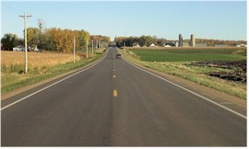
Traveled Way
Definitions
For the thru movement of vehicles
Does not include shoulders or bicycle lanes
Slide 7
428 NAC 2-001.03A4c, Page 43
Notes:
The Traveled Way is the portion of the roadway for the movement of vehicles, exclusive of shoulders and bicycle lanes.
It is important to know this for several reasons.
Some reasons are:
(1) Minimum clear bridge widths is a function of the approach traveled way width
And (2) A non-curbed shoulder, starts at the edge of the traveled way
As does the horizontal clear zone

Slide 8
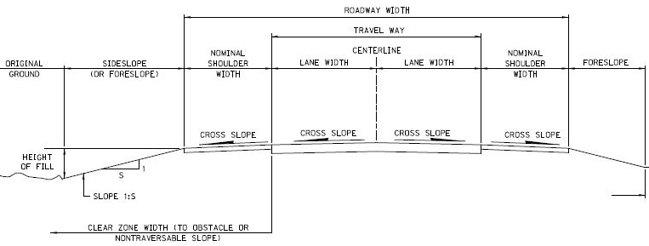
Roadway
Definitions
Traveled Way Plus Shoulders
ROADWAY WIDTH
TRAVELED WAY
Slide 8
428 NAC 2-001.03A4a, Page 42
Notes:
The Roadway is the portion of a road or street including shoulders, for vehicular use.
It is the Traveled Way plus the shoulders.

Slide 9
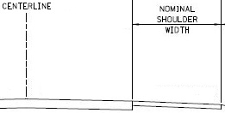
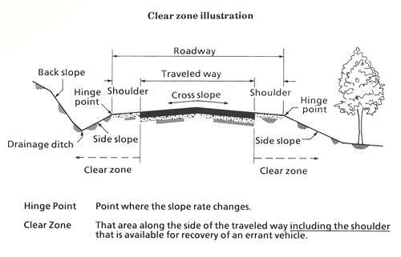
Nominal Shoulder Width
Definitions
  =
  Shoulder width indicated in the table
Slide 9
428 NAC 2-001.03A4g, Page 43
Notes:
The Nominal Shoulder Width is defined on page 43 as the shoulder width value shown in the design standards table.
For example, if Rural Area standards apply, and the functional classification of the road is Local, with an ADT of 800 VPD, the shoulder width value in Table J on page 69 is 4 ft. The nominal shoulder width, therefore, is 4 ft.
Where this becomes relevant is in the Horizontal Clear Zone width, for some roads and streets with a very low volume of traffic.

Slide 10
Horizontal Clear Zone
Definitions
  Unobstructed, Traversable Area
  Beyond the Edge of Traveled Way
428 NAC 2-001.03A6k, Page 46
Slide 10
Notes:
The Horizontal Clear Zone, defined on page 46, is an unobstructed, traversable area provided beyond the edge of traveled way for the recovery of errant vehicles.
It includes shoulders and auxiliary lanes unless the auxiliary lane functions like a through travel lane.

Slide 11
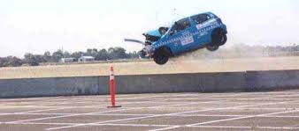
Roadside Design
County Roads and Municipal Streets
Minimum Design Standards
Roadside Design
428 NAC 2-001.03A6k, Page 46
428 NAC 2-001.03B Note 16, Page 52
Slide 11
Notes:
One of the criterion included, for the first time for county roads and municipal streets, in the 2016 standards, is the Horizontal Clear Zone.
Because it is the first time, this video provides a short introduction to roadside design.
NOT FOR AUDIO
Widths are given as a range in the RDG but standards must choose (chosen on the low end for maximum flexibility)
Replaces Fixed Obstacle Clearance

Slide 12

Minimum Design Standards
Roadside Design
The main reference for establishing a clear roadside recovery area for errant vehicles
Slide 12
Notes:
The RDG, an AASHTO publication, is the main source and guidance.

Slide 13
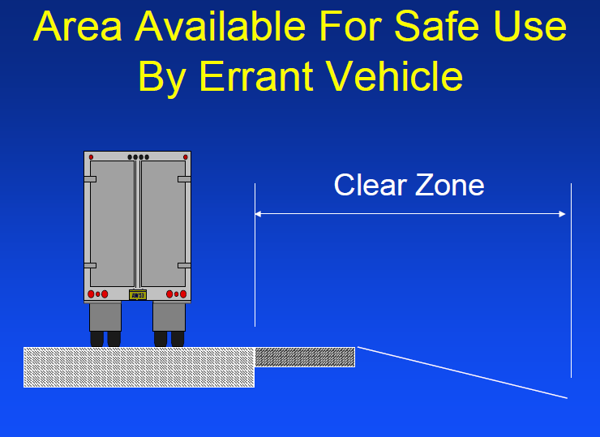

Minimum Design Standards
Roadside Design
Thru Travel Lane (or Auxiliary Lane that functions like a thru travel lane)
Horizontal
428 NAC 2-001.03A6k, Page 46
428 NAC 2-001.03B Note 16, Page 52
Notes:
The HCZ is an area that is made available for a run-off-the-road vehicle.
NOT FOR AUDIO
Bill Gulick (KY DOT)

Slide 14
Horizontal Clear Zone (HCZ)
Minimum Design Standards
Roadside Design
Purpose: Recovery area for errant vehicles
Minimum Width in Tables apply to New and Reconstructed work
Width starts at edge of Traveled Way (or auxiliary lane that functions as a thru travel lane)
  See Tables - New and Reconstructed Work
428 NAC 2-001.03A6k, Page 46
428 NAC 2-001.03B Note 16, Page 52
Slide 14
Notes:
There are minimum HCZ widths that apply to New and Reconstructed work.
The width starts at the edge of the Traveled Way.
NOT FOR AUDIO
Replaces 2010 standards Fixed Obstacle Clearance

Slide 15
Minimum Design Standards
Horizontal Clear Zone (HCZ)
Roadside Design
Obstacles
Trees
Utility Poles
Culverts
Steep slopes
etc.
Tab 14-11 handout
428 NAC 2-001.03A6k, Page 46
428 NAC 2-001.03B Note 16, Page 52
Notes:
This screen shows a common cross section, Showing the horizontal clear zone is relation to other components of the facility
The HCZ provides space from the edge of the traveled way to obstacles such as trees, utility poles, drainage culverts, steep side slopes, and other obstacles.
NOT FOR AUDIO
Bill Gulick (KY DOT)

Slide 16
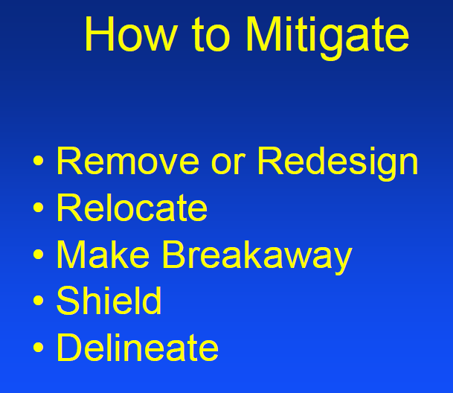
Minimum Design Standards
Roadside Design
Obstacles
428 NAC 2-001.03A6k, Page 46
428 NAC 2-001.03B Note 16, Page 52
Notes:
It is best to simply remove obstacles within the HCZ
Or redesign them
Relocating them farther away from the traveled way is the next best option
If the obstacle needs to remain within the HCZ, it could be designed to be breakaway and therefore provide much less resistance to a vehicle coming into contact with it
Shielding an obstacle is a possibility, realizing that the shielding itself becomes an obstacle, hopefully a relatively safer obstacle
Delineation of an obstacle would be a last resort, but better than nothing.
NOT FOR AUDIO
Bill Gulick (KY DOT)

Slide 17
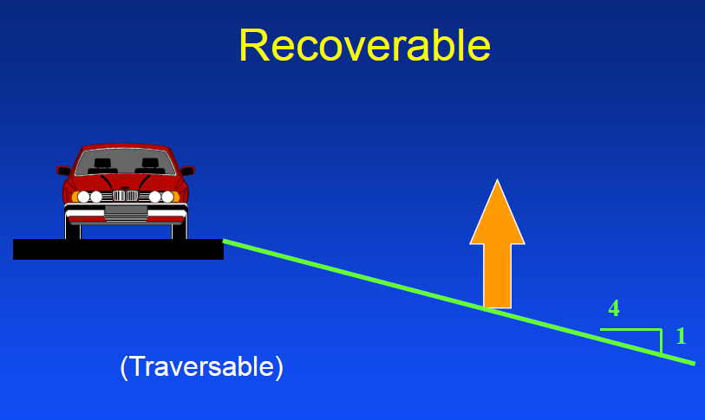
Minimum Design Standards
Slopes
Roadside Design
428 NAC 2-001.03A6k, Page 46
428 NAC 2-001.03B Note 16, Page 52
Notes:
Some terminology . . .
In order for a vehicle to have a chance at not rolling over during a run-off-the-road event, the side slopes within the HCZ must be traversable.
Vehicles can recover, i.e. re-gain control and steer back onto the roadway, from slopes that are 4H:1V and flatter.
This screen shows a recoverable slope.
It is also traversable.
NOT FOR AUDIO
Bill Gulick (KY DOT)

Slide 18
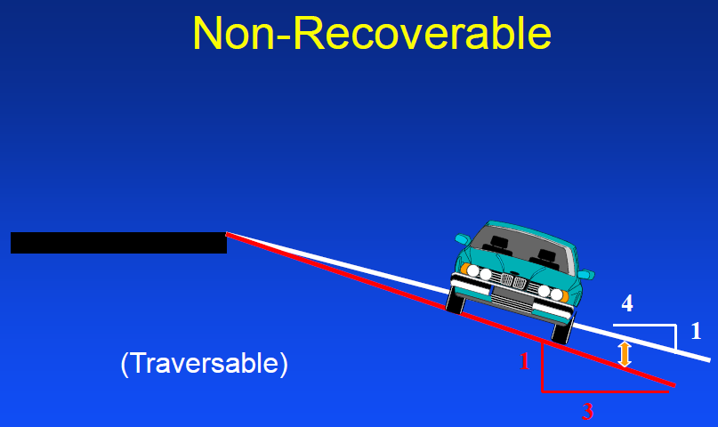
Minimum Design Standards
Slopes
Roadside Design
428 NAC 2-001.03A6k, Page 46
428 NAC 2-001.03B Note 16, Page 52
Notes:
Slopes that are steeper than 4H:1V, down to 3H:1V, are still “traversable” but are “non-recoverable” i.e. the vehicle should not roll, but generally won’t be able to steer back onto the roadway.
NOT FOR AUDIO
Bill Gulick (KY DOT)

Slide 19
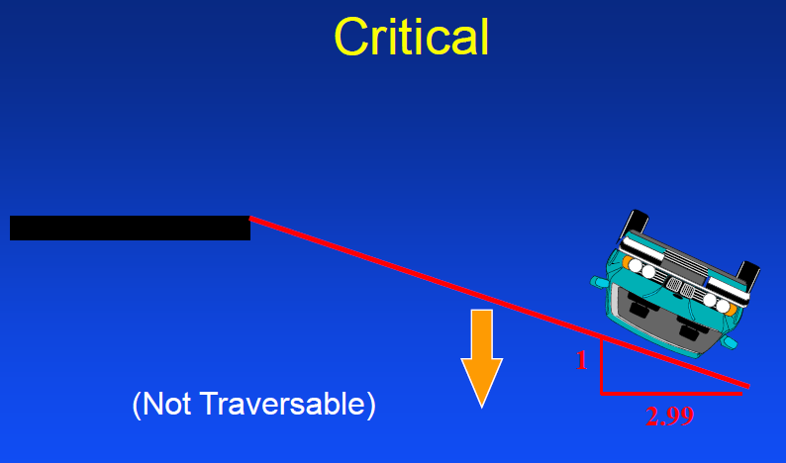
Minimum Design Standards
Slopes
Roadside Design
428 NAC 2-001.03A6k, Page 46
428 NAC 2-001.03B Note 16, Page 52
Notes:
Slopes steeper than 3H:1V will generally not stop a vehicle from rolling.
These slopes are non-traversable. And are called Critical slopes
NOT FOR AUDIO
Bill Gulick (KY DOT)
Slopes
Recoverable – 1V:4H and flatter
Non-recoverable – 1V:3H to 1V:4H
Critical – steeper than 1V:3H
No more cross sections in the standards! They allowed critical slopes.

Slide 20

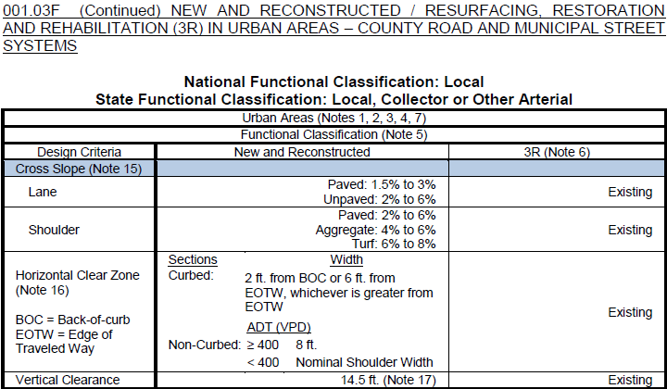
“Existing” in the Tables
Note 6 – “Existing”
Horizontal Clear Zone
3R Value: Existing
Means Existing Design Feature
Not the same as whatever is out there, and not a free pass
Legal Immunity?
  Likely: Features on previous plan(s)
  Not Likely: Maintenance work
Consider risks
428 NAC 2-001.03B Note 6, Page 47
428 NAC 2-001.03C-N, Pages 55-78
Slide 20
Notes:
Turn to any of the tables from pages 55 thru 78.
Look in the right column, which has values for 3R criteria.
Notice that the word “Existing” is used often.
It is not in the Definitions part of the standards, which are pages 37-46.
Note 6 on page 47 refers to, and defines, “Existing” as “existing design features.”
The NBCS would like to further clarify this.
What this refers to are the original previous design plans for the road or street.
The term “existing” therefore is not necessarily whatever is out there.
The term “Existing” does not include a feature on a road or street that was not preserved and maintained to the original or as-constructed condition.
A tree that is allowed to grow in the HCZ, or a utility pole that was allowed to be added to the HCZ, is not considered “Existing”, it is not grandfathered in by Note 6.
There may be legal immunity for features on previous design plans,
And maybe no legal immunity for poor maintenance and upkeep.
NOT FOR AUDIO
Similar to slide shown in the 3R segment
Explanation of “Existing” as a value – requested by 12/21/2015 dry run group
Examples: trees and utility poles
Per Jeff Schroeder and Matt Gaffey phone conversation 12/8/2015
Existing Design Feature (per plans) is grandfathered.
Anything beyond that (tree grows up in HCZ, utility pole is installed) is not grandfathered.
There is legal immunity with respect to design work.
There is no legal immunity with respect to maintenance work.

Slide 21
Design Standards
County Roads and Municipal Streets
Main Elements
Definitions
Definitions (39) pages 37-46
Notes (22)
Tables (15)
Slide 21
428 NAC 2-001.03A, Pages 37-46
Notes:
More definitions are provided in the Bridges and Structures videos.
There are several that are not covered in this video series;
it is recommended that you review all of the definitions on pages 37-46.

Slide 22
Design Standards
County Roads and Municipal Streets
Main Elements
Notes
Definitions (39)
Notes (22) – pages 47-54
Tables (15)
Slide 22
428 NAC 2-001.03B, Pages 47-54
Notes:
A previous video in this series introduced notes – 2, 3 and 4 – which are necessary to account for when finding the table that applies to a work or project.
And we just talked about the word “Existing” as defined in Note 6.
The remainder of this video addresses Notes in general,
and provides a brief summary of each of the first 17 notes in the county road and municipal street design standards.

Slide 23
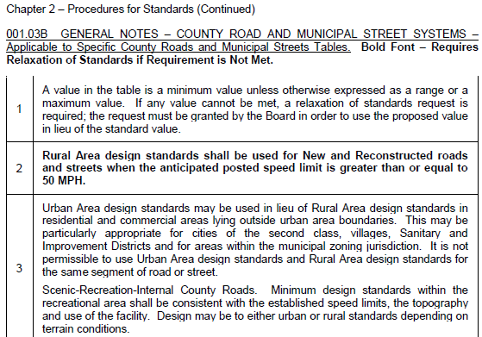
Notes
  Referenced in Standards Tables
  Each note addresses one topic or subject
  Notes 1 – 7 are general notes
  Other Notes are ordered by criteria - same order as in the tables (mostly)
Slide 23
428 NAC 2-001.03B, Pages 47-54
Notes:
Notes are referenced in Design Standards tables, and are numbered sequentially.
Each note addresses one topic or subject. All information pertinent to that topic or subject is included in the note, which makes it easier and more efficient to find information on any given topic or subject.
The first seven notes address broader topics, such as functional classification, 3R work, traffic volumes and which standards to apply.
The remaining Notes address the 13 criteria. The notes are in the same order as criteria are listed in the tables – from top to bottom.
NOT FOR AUDIO
First Bullet: look at a table, any table, and see the references to notes
Second Bullet: e.g. Traffic Volumes to use can be found in note 7, everything about Horizontal Alignment in Note 12, etc.
Third Bullet: look at a table, any table, and go top to bottom

Slide 24
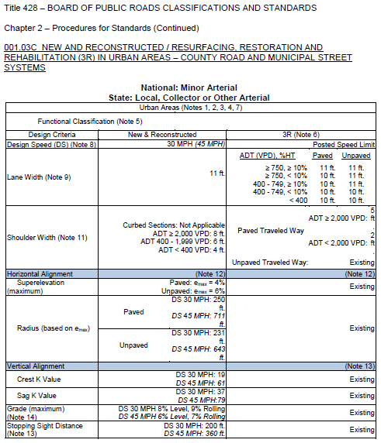
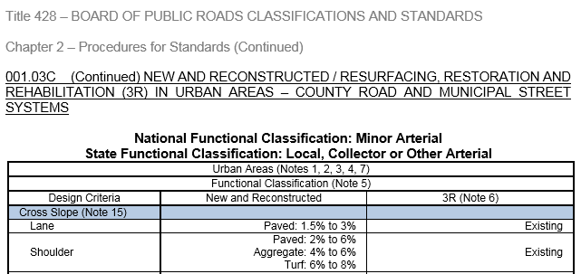
MDS Tables - Notes
Slide 24
Notes:
This screen shows Table C, one of the Urban Area design standards, on pages 55 and 56 – in order to briefly demonstrate how notes are referenced in design standards tables.
Notes that apply are called out in parentheses throughout each table. Notes 1, 2, 3, 4 and 7 – in parentheses at the top of the table just after the words “Urban Areas” - apply to the entire table shown on the screen. Note 6, positioned at the head of the 3R column, applies to the all of the 3R criteria. Note (8), positioned next to Design Speed, applies only to the Design Speed criterion, for both New & Reconstructed and 3R criteria. Note (9) works the same way, only for Lane Width.
As do Notes 13 and 14 at the bottom of the screen.
NOT FOR AUDIO
Once you determine standards you need (area and national functional classification) for your segment of road or street, you find the table that you need. On that table are the criteria and standards that apply, and only those that apply (other than what is in the Notes). Less confusion, fewer mistakes, and easier to document relaxation of standards requests.

Slide 25


Types of Statements in Notes
Notes - General
Mandatory
Lower requirements, with conditions
Permissive statements (i.e. not required)
Guidance (recommended or desired but not mandatory)
Information (instructions, clarifications, definition, context)
Slide 25
428 NAC 2-001.03B, Pages 47-54
Notes:
Notes have several different types of statements.
They are a mixture of requirements, instructions, guidance, clarifications, and recommendations.
Some
Are mandatory requirements (need a relaxation of standards if not met)
Allow design flexibility, conditionally, relative to what is required in the standards table,
Are recommendations, not requirements
Are simply information – an instruction, clarification, definition, or providing context.
It would not be appropriate to request a relaxation of standards for permissive statements, guidance, instructions, clarifications, definitions or contextual statements.
It would be appropriate to request a relaxation of standards for mandatory requirements, or requirements with conditions.
NOT FOR AUDIO
Examples corresponding to slide:
Mandatory: Note 2 (using rural area design standards for high speed roads)
Conditional Relaxation: Notes 12 (Horizontal Alignment), 13 (Vertical Alignment) and 14 (Grade)
Permissive: Note 3 (using urban design standards in lieu of rural) or Note 10 (Sandhills soils)
Guidance: Note 13 Note 18 (rehabilitated bridges)
Informational: Note 1 (minimums and maximums, need Relaxation if can’t meet), Note 9 (defines gutter line)

Slide 26

Notes
Appropriate Relaxation Requests
Notes - General
Mandatory
Less restrictive requirements, with conditions
Permissive statements (i.e. not required)
Guidance (recommended or desired but not mandatory)
Information (instructions, clarifications, definition, context)
Slide 26
428 NAC 2-001.03B, Pages 47-54
Notes:
County Roads and Municipal Streets notes provide a visual cue for requirements that would be appropriate to include in a relaxation of standards request, if the application of the requirement is not feasible because of peculiar, special or unique local situations.
Any text in bold font provides a visual cue that it is mandatory. If the requirement cannot be met, the county or municipality must request a relaxation of standards from the NBCS.
On the other hand, Text in regular font would not be considered appropriate for a relaxation of standards.

Slide 27
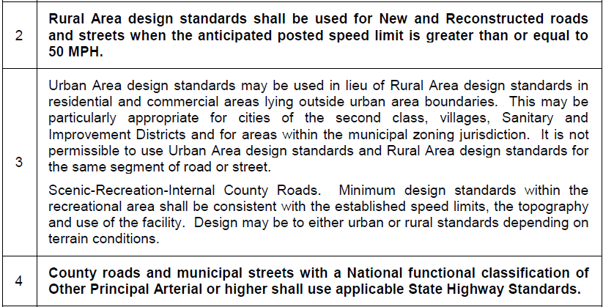
Examples
Mandatory versus Permissive
Slide 27
428 NAC 2-001.03B, Notes 2-4, Page 47
Notes:
In these examples,
Note 2 indicates that Rural Area design standards must be used if the anticipated posted speed limit is 50 MPH or greater.
Note 4 requires the use of State Highway Standards for all roads and streets functionally classified as Other Principal Arterial.
Notes 2 and 4 are mandatory and are therefore in bold font. If they cannot be met, the county or city must request a relaxation of standards from the NBCS prior to construction.
On the other hand, Note 3 is permissive – it allows the use of urban area design standards for certain situations. It would not be appropriate to request a relaxation of standards from the NBCS for this Note. It is a decision to be made and documented by the county or municipality.
NOT FOR AUDIO
It also has relaxed requirements for scenic-recreation roads within the boundaries of a recreational area.

Slide 28
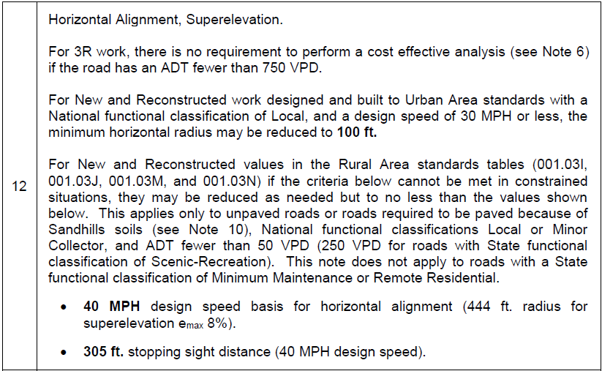
Example
Less Restrictive Requirements (Conditional)
Slide 28
428 NAC 2-001.03B, Note 12, Page 50
Notes:
In this example,
Focusing on the bottom half of Note 12, the note for horizontal curves, it allows lower standards for design speed and stopping sight distance, if there is a constrained situation, and the functional classification is Local or Minor Collector, and there is a very low-volume of traffic.
The design speed and stopping sight distance requirements in bold font are only allowed under the conditions expressed in the note, and if those requirements cannot be met, the county is required to submit a relaxation of standards request to the NBCS prior to construction.

Slide 29
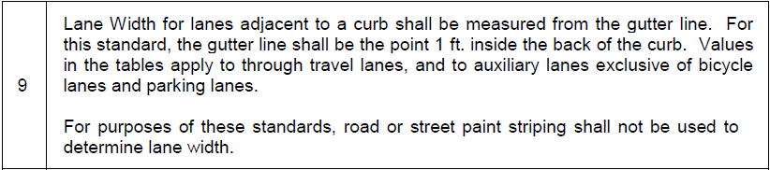
Example
Information, Clarification, Definition
Note 9
Not appropriate to request a relaxation of standards
Slide 29
428 NAC 2-001.03B, Note 9, Page 49
Notes:
In this example,
Note 9 provides information and clarification as to where lane widths are to be measured from, for the purposes of design standards,
It Defines where the gutter line is, relative to the back of curb
and provides clarification that lane widths in the tables do not apply to bicycle lanes and parking lanes.
The last sentence clarifies that paint striping does not determine lane width.
Nothing in this note would be appropriate to bring to the NBCS as a relaxation of standards.

Slide 30
Notes – Index
Horizontal Alignment
Vertical Alignment
Grade
Cross Slope
Horizontal Clear Zone
Vertical Clearance
Clear Bridge Width
Structural Capacity
Timber Bridges
Low Water Stream Crossings/Fords
Roadway adjacent to structure replacements
Relaxation of Standards
Rural tables (≥ 50 MPH)
Urban tables for Rural areas
Other Principal Arterial → State Hwy Standards
Functional Classification
3R safety conscious design
Traffic Volume
Design Speed
Lane Width
Sandhills Soils
Shoulder Width
Design Criteria
428 NAC 2-001.03B, Pages 47-54
Slide 30
Notes:
This screen is a quick summary of each note – an index of sorts.
The bold red font indicates that it is a design standards criterion.
There are 11 notes dedicated to design standards criteria.
If you are wondering why not 13, since there are 13 design criteria.
There is no separate note for Stopping Sight Distance (notes 12 and 13 include SSD)
Horizontal alignment includes two controlling criteria (curve radius and superelevation)
Read the entire note!
Lay the notes side-by-side with the table that applies to the work or project and you have everything there in front of you.

Slide 31
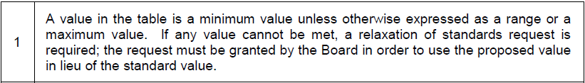
Relaxation of Standards
Note 1
Required if a standard value in the applicable table cannot be met
Required if mandatory parts of notes, expressed in bold font, cannot be met
Slide 31
428 NAC 2-001.03B Note 1, Page 47
Notes:
The purpose of Note 1 is to convey that if any value in the table that applies to the work or project cannot be met, a relaxation of standards request is required, and the request must be granted by the NBCS to use the proposed value in lieu of the standard value.
Just above Note 1, in the heading, notice the instruction that Notes in bold font would also require a relaxation of standards if not met.
Note 1 also clarifies that, although these are termed minimum design standards, values may also be expressed as maximum, or as a range of values.

Slide 32
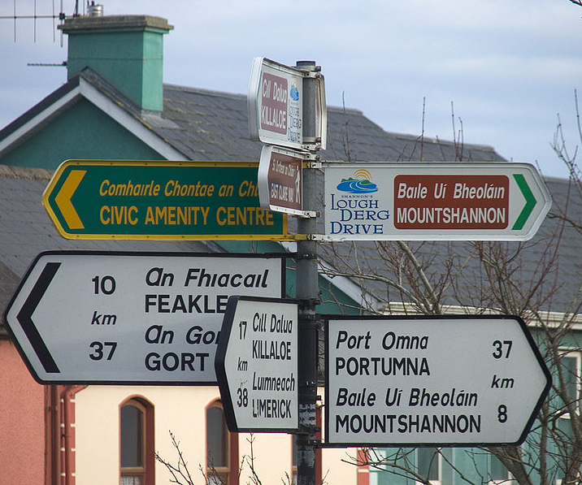
Which Tables to Use
Notes 2, 3 and 4 – Page 47
https://en.wikipedia.org/wiki/File:Irishroadsign.jpg
Rural tables required for posted speeds ≥ 50 MPH
Urban tables conditional use outside the Urban Boundary, in Rural areas
Other Principal Arterial → State Hwy Standards
Attribution: Steve Ford Elliot
Slide 32
428 NAC 2-001.03B Notes 2-4, Page 47
Notes:
Notes 2, 3 and 4 were covered in the previous video – finding the correct table.
Note 2 requires the use of Rural Area Standards for high speeds – i.e. posted speeds of 50 MPH and greater
Note 3 allows the use of Urban Area standards in Rural Areas under certain conditions.
Note 4 requires that State Highway standards be used if the National Functional Classification is Other Principal Arterial or a higher classification.

Slide 33

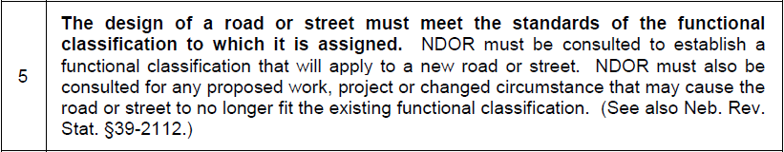
Functional Classification
Note 5
Slide 33
428 NAC 2-001.03B Note 5, Page 47
Notes:
8/6/2019 Updated NDOR→NDOT in script and audio media. Can’t do it on the slide because that’s just the way the 2016 Standards read.
Note 5 requires, in the bold font, that a road or street meet the design standards for the functional classification of that road or street.
The last two sentences of the note – the part in regular font – requires the NDOR NDOT to assign the functional classification for a new road or street, doing so in consultation with the county or municipality. Also, the Nebr DOT re-assigns functional classifications to existing roads and streets.

Slide 34
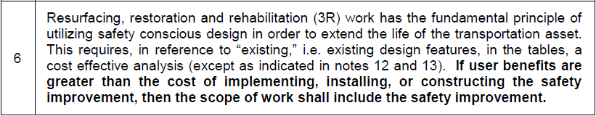
Safety Conscious Design
Note 6
3R Standards
Integrates a Cost Effective Analysis and potential safety improvements, along with a work or project to extend the life of the road or street.
428 NAC 2-001.03B Note 6, Page 47
428 NAC 2-001.03A1f, Page 41, Safety Conscious Design
428 NAC 2-001.03A1g, Page 41, Cost Effective Analysis
Slide 34
Notes:
Earlier in this video, the term “Existing” was discussed in connection with Note 6 and 3R standard values.
Note 6 is actually a broader note, dealing with the subject of Safety Conscious Design.
It is defined on page 41 of the standards.
It goes hand-in-hand with 3R design work, requiring Cost Effective Analyses and potentially requiring safety improvements to be added to the scope of 3R works or projects.
Cost Effective Analysis is also defined on page 41 of the standards. A review of crash history is part of a cost effective analysis.

Slide 35

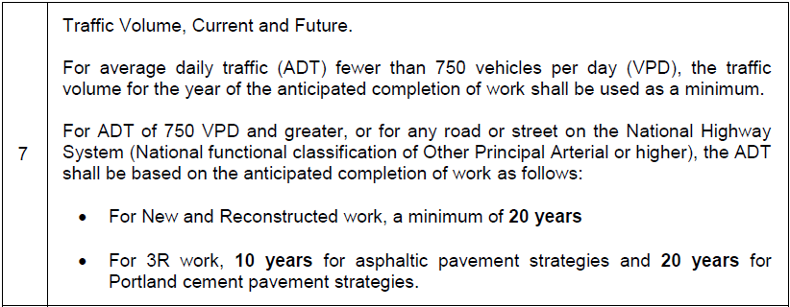
Traffic Volume
Note 7
DESIGN YEAR
Slide 35
428 NAC 2-001.03B Note 7, Page 48
Notes:
The topic for Note 7 is Traffic Volume,
Traffic Volume can be measured, or counted, using a device such as a rubber-hose counter, and industry-standard adjustment factors applied, to estimate an average daily traffic, or ADT. For busy city streets, sometimes the Design Hourly Volume, or DHV, is important to know; however, Nebraska's design standards do not include any criteria that are a function of DHV and is left up to the entity’s designer. For some road and street design work and design standards, Knowledge of the volume of heavy trucks is important, and is usually expressed as a percentage of the ADT.
Especially for busier roads, traffic volume information needs to be updated occasionally because it can change over time, depending on several factors that can affect the volumes and mix of traffic on the network of roads and streets. These may include new residential and commercial development, adding capacity to the existing network, or building new roads and streets.
The frequency of traffic volume updates varies as a function of such changes and the rate that they occur, possibly at some pre-determined frequency for busier roads, or some prompted by some other requirement such as a Federal-aid project.
It is important to know the specific year associated with traffic volume information. Nebraska’s minimum design standards are based on what is called the year of the anticipated completion of work/project, and the design year. The Year of Anticipated Completion of Work or project is the year that construction is anticipated to be finished and the road or street opened to traffic. The Design Year is the anticipated life of the project in years, beyond the opening of traffic; standards assume a life of 10 to 20 years, depending on the type of work and the type of surfacing; 20 years for New & Reconstructed work, and, for 3R work 10 years for asphalt paving and 20 years for Portland cement concrete paving. Traffic numbers for both the Year of Anticipated Completion of the Work/Project and the Design Year are projections, based on historical traffic volume estimates and trends.
Some design standards criteria are a function of traffic volume. Typically, they are based on Design Year traffic volumes.
Looking at the bottom part of the note first, with the two bullets:
For roads and streets with a current traffic volume ADT of 750 VPD and more, or for roads functionally classified as Other Principal Arterial or higher, the ADT used as the basis for design standards is required to be estimated, i.e. projected out, to the Design Year as mentioned earlier. for
20 years from the year of the anticipated completion of the work or project, for New & Reconstructed work, or
For 3R work, 10 years from the year of the anticipated completion of the work or project, for asphaltic pavement strategies or 20 years from the year of the anticipated completion of the work or project, for Portland cement pavement strategies.
The first sentence of the note recognizes that the traffic volume for many lower volume roads and streets remains about the same over time. For those, the Board of Public Roads does not require Design Year traffic projections. The Board established the cutoff at 750 VPD for the current traffic level.
For roads and streets with a current ADT fewer than 750 VPD, the Board allows the ADT for the year of anticipated completion of the work or project to be used for design standards.
As always, designers need to be aware that these are minimum design standards. If a significant traffic generating development is planned for a lower volume road, it would be prudent to go ahead and make a traffic volume projection to the Design Year, and use that as a basis for determining minimum design values.

Slide 36

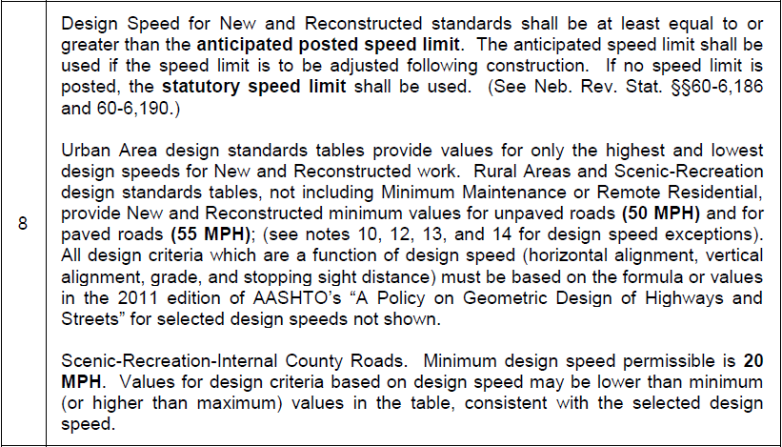
Design Speed
Note 8
Slide 36
428 NAC 2-001.03B Note 8, Page 48
Notes:
Note 8 covers the first design criteria: design speed. Some consider design speed to be the most important design criteria; several other design criteria are a function of design speed.
In the first paragraph, design speed is required to be equal to or greater than the speed limit that is anticipated to be posted following construction, or the statutory speed limit in statutes 60-6,186 and 60-6,190.
The second paragraph addresses the different design speeds and how they are presented in the standards tables.
The first sentence points out that, in the Urban Area standards tables, the minimum (lowest allowed) design speed is listed along with the maximum (highest allowed) design speed.
The last sentence says that any design criterion that is a function of design speed must be based on the applicable AASHTO formula or value. The values for the minimum and maximum deign speeds are shown in design standards tables,. For design speeds in between the lowest and highest, designers need to, for any criteria that is a function of design speed, refer to the AASHTO Green Book and calculate or look up the appropriate value.
Let’s look at an example.
NOT FOR AUDIO
Same requirements, with additional information and guidance. Stopping sight distance is included as a criteria in the proposed tables. Like 001.16(4), Note 8 refers to Neb. Rev. Stat. §60-6,190.
Key Controlling Criteria
Many criteria calculated based on design speed
Urban Tables
Design speed between values shown in table
Rural and Scenic-Recreation Tables
50 MPH and 55 MPH
ADT < 50 VPD, Constrained Situations
ROW and Environmental Impacts, Terrain and Costs
Refer to notes 12, 13 and 14

Slide 37
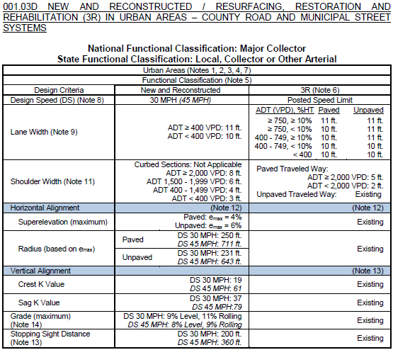
Design Speed
Note 8 – Example – Table D
428 NAC 2-001.03B Note 8, Page 48
428 NAC 2-001.03D, Pages 57-58
Slide 37
Notes:
This screen shows Table D, Urban Area design standards table, on pages 57 and 58. It is for the National Functional Classification of Major Collector.
30 MPH is the minimum design speed, and 45 MPH is the maximum design speed allowed for this set of standards.
45 MPH is the maximum allowed for all four of the Urban Area design standards tables.
Standards criteria that are a function of design speed are shown on this screen.
The values associated with the lowest design speed are in regular font,
The values associated with the highest design speed are in italics font.
Each table provides all of the values for the lowest design speed and the highest design speed. If the design speed is in between, the values that are a function of design speed will also be in between the values shown in the table for their respective criterion.
Let’s do an example.
Assume the street is paved, will have a superelevation of 4%, and the design speed is 35 MPH.

Slide 38

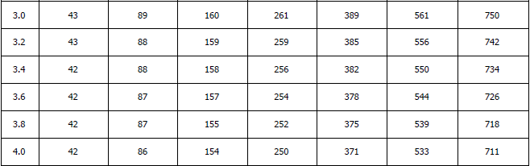
Criteria that Depend on Design Speed
Note 8 – Example – Urban, 35 MPH
428 NAC 2-001.03B Note 8, Page 48
AASHTO Green Book, 6th Edition, 2011, Table 3-13b
Slide 38
Notes:
For horizontal radius (assuming 4% superelevation) . . .
The designer could refer to Table 3-13b of the AASHTO Green Book, 6th Edition, Minimum Radii and Superelevation for Low Speed Urban Streets.
It sets the minimum radius at 371 ft for a 4% superelevation.
That compares to the 30 MPH value of 250 ft and the 45 MPH value of 711 ft.
371 ft is in between those values, which is what we would expect.

Slide 39
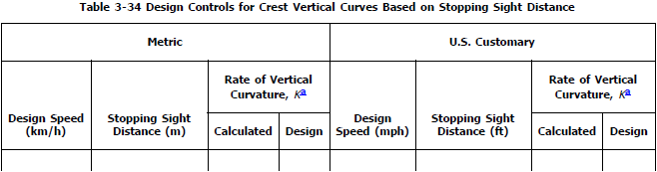
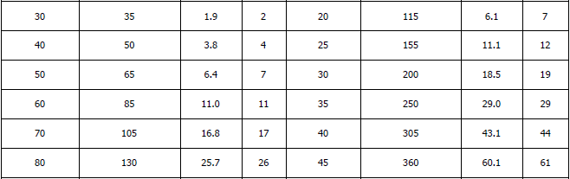
Criteria that Depend on Design Speed
Note 8 – Example – Urban, 35 MPH
428 NAC 2-001.03B Note 8, Page 48
AASHTO Green Book, 6th Edition, 2011, Table 3-34
Slide 39
Notes:
For Crest Vertical Curves . . .
The designer could refer to Table 3-34 of the AASHTO Green Book, 6th Edition, Design Controls for Crest Vertical Curves Based on Stopping Sight Distance.
It sets the minimum K value at 29.
That compares to the 30 MPH value of 19 and the 45 MPH value of 61.
29 is in between those values, which is what we would expect.

Slide 40

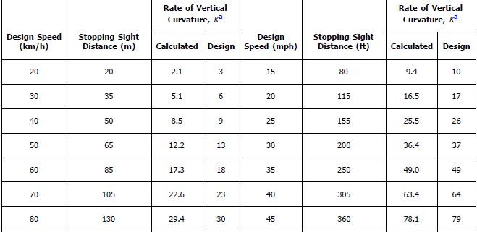
Criteria that Depend on Design Speed
Note 8 – Example – Urban, 35 MPH
428 NAC 2-001.03B Note 8, Page 48
AASHTO Green Book, 6th Edition, 2011, Table 3-36
Slide 40
Notes:
For Sag Vertical Curves . . .
The designer could refer to Table 3-36 of the AASHTO Green Book, 6th Edition, Design Controls for Sag Vertical Curves.
It sets the minimum K value at 49.
That compares to the 30 MPH value of 37 and the 45 MPH value of 79.
49 is in between those values, which is what we would expect.

Slide 41
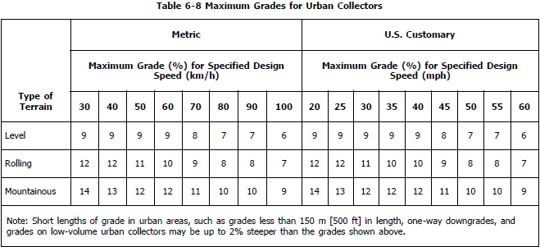
Criteria that Depend on Design Speed
Note 8 – Example – Urban, 35 MPH
428 NAC 2-001.03B Note 8, Page 48
AASHTO Green Book, 6th Edition, 2011, Table 6-8
Slide 41
Notes:
For maximum grade . . .
The designer could refer to Table 6-8 of the AASHTO Green Book, 6th Edition Maximum Grade for Urban Collectors.
It sets the maximum grade at 9% for level terrain and 10% for rolling terrain.
That compares to the 30 MPH values of 9% for level terrain, and 11% for rolling terrain, and to the 45 MPH values of 8% for level terrain and 9% for rolling terrain.

Slide 42
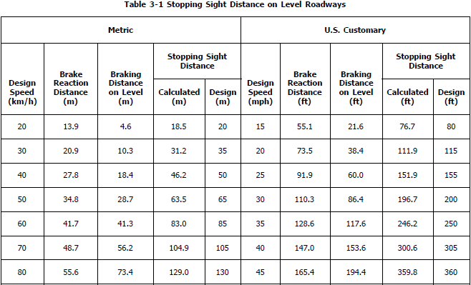
Criteria that Depend on Design Speed
Note 8 – Example – Urban, 35 MPH
428 NAC 2-001.03B Note 8, Page 48
AASHTO Green Book, 6th Edition, 2011, Table 3-1
Slide 42
Notes:
For Stopping Sight Distance . . .
The designer could refer to Table 3-1 or Table 6-3 of the AASHTO Green Book, 6th Edition, Stopping Sight Distance on Level Roadways.
It sets the minimum SSD value at 250.
That compares to the 30 MPH value of 200 and the 45 MPH value of 360.
250 is in between those values, which is what we would expect.

Slide 43
Design Speed
Note 8
Slide 43
428 NAC 2-001.03B Note 8, Page 48
Notes:
The second sentence of the second paragraph says that Rural Area and Scenic-Recreation design standards tables have 50 MPH design speed for unpaved roads and 55 MPH design speed for paved roads.
Values associated with the 55 MPH design speed are in italics font in those tables, similar to the 45 MPH values in the Urban Area standards tables.
NOT FOR AUDIO
Same requirements, with additional information and guidance. Stopping sight distance is included as a criteria in the proposed tables. Like 001.16(4), Note 8 refers to Neb. Rev. Stat. §60-6,190.
Key Controlling Criteria
Many criteria calculated based on design speed
Urban Tables
Design speed between values shown in table
Rural and Scenic-Recreation Tables
50 MPH and 55 MPH
ADT < 50 VPD, Constrained Situations
ROW and Environmental Impacts, Terrain and Costs
Refer to notes 12, 13 and 14

Slide 44
Design Speed
Note 8
Slide 44
428 NAC 2-001.03B Note 8, Page 48
Notes:
Finally, Note 8 allows roads functionally classified as Scenic-Recreation, and are roads internal to a recreation area, to have a minimum design speed of 20 MPH.
NOT FOR AUDIO
Same requirements, with additional information and guidance. Stopping sight distance is included as a criteria in the proposed tables. Like 001.16(4), Note 8 refers to Neb. Rev. Stat. §60-6,190.
Key Controlling Criteria
Many criteria calculated based on design speed
Urban Tables
Design speed between values shown in table
Rural and Scenic-Recreation Tables
50 MPH and 55 MPH
ADT < 50 VPD, Constrained Situations
ROW and Environmental Impacts, Terrain and Costs
Refer to notes 12, 13 and 14

Slide 45
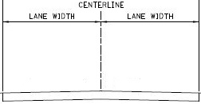
Lane Width
Note 9
Slide 45
428 NAC 2-001.03B, Note 9, Page 49
Notes:
Note 9 was covered earlier in this presentation in the example of a note that provides information, clarification and definition.

Slide 46
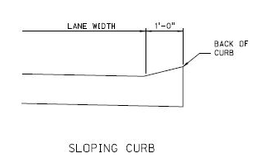
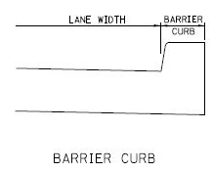
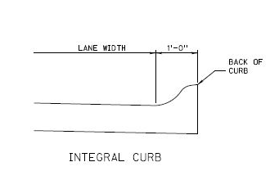
Note 9
Lane Width – Curbed Sections
THROUGH
THROUGH
Gutter Line
Could be Curb and Gutter
= Edge of Traveled Way
THROUGH
Slide 46
428 NAC 2-001.03B, Note 9, Page 49
Notes:
This screen depicts the gutter line as defined in Note 9.
It is one foot from the back-of-curb. It could be any kind of curb – sloping, barrier or integral.
The gutter line, assuming the lane is a through travel lane, is the edge of the Traveled Way [PAUSE A LITTLE HERE SO THE VIEWER CAN ABSORB IT]

Slide 47

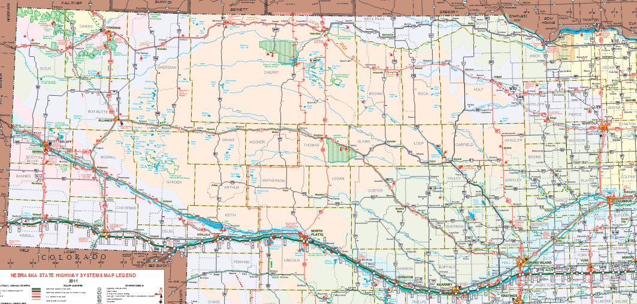
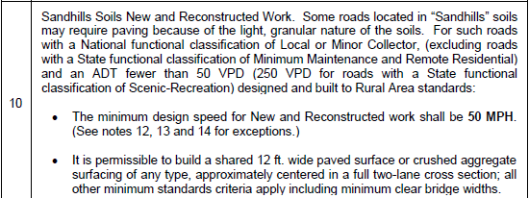
Sandhills Soils
Note 10
Slide 47
428 NAC 2-001.03B, Note 10, Page 49
Notes:
Note 10 recognizes that some roads in the Sandhills area of Nebraska, generally the north central part of the state, because of the unique characteristics of Sandhills soils, may require paving in lieu of gravel.
The note allows a design speed of 50 MPH for such paved roads, under the following conditions:
Rural Area standards are applied, and
The ADT is fewer than 50 VPD (or, in the case of Scenic-Recreation roads, 250 VPD), and
The national functional classification is Minor Collector or Local (not including those that have the optional SFC of Minimum Maintenance or Remote Residential).
Notes 12, 13 and 14 allow lower design speeds, under certain conditions.
Note 10 also allows one shared 12 ft wide lane – with paving or crushed aggregate surfacing – in the Sandhills area of Nebraska. But it still needs to be a full two-lane cross section and bridges and structures still must meet the minimum design standards.

Slide 48
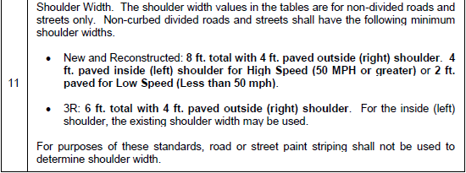
Shoulder Width
Note 11
Slide 48
428 NAC 2-001.03B, Note 11, Page 49
Notes:
Note 11 informs the user that shoulder width values in the tables are for non-divided roads and streets only,
The note provides minimum shoulder width requirements for non-curbed divided roads and streets, for both New & Reconstructed work and 3R work.
The last sentence clarifies that paint striping does not determine shoulder width. You may recall a similar sentence in Note 9 for Lane Width.

Slide 49
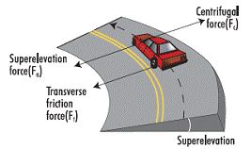
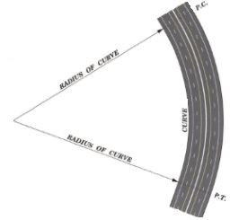
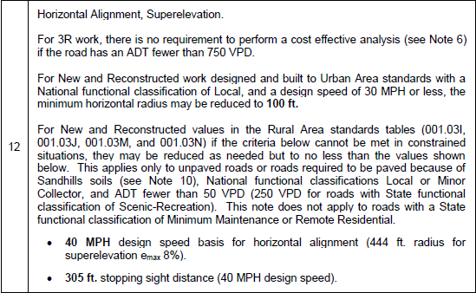
Horizontal Alignment
Note 12
428 NAC 2-001.03B, Note 12, Page 50
428 NAC 2-001.03A1h, Constrained Situation, Page 42
Slide 49
Notes:
Note 12 addresses Horizontal Alignment and Superelevation standards for roads and streets.
The first sentence says that, for 3R work, a cost effective analysis is not a minimum requirement if the traffic volume is less than 750 VPD.
Where Urban Area standards apply, the second sentence allows a minimum horizontal radius of 100 ft under the following conditions:
The National Functional Classification is Local, and
The design speed is 30 MPH or less.
The bottom part of the note allows some design flexibility, under certain conditions, if a constrained situation occurs when and where Rural Area standards are applied.
A Constrained Situation is defined on page 42 as a site-specific condition such as terrain, right-of-way, social impact, environmental impacts, and/or cost that may make meeting a design standard impractical.
A horizontal curve is allowed a design speed as low as 40 MPH under these conditions:
Rural Area standards apply, and
The road is not paved (or paved because Note 10 allowed it), and
National Functional Classification of Minor Collector or Local (not including those that have the optional SFC of Minimum Maintenance or Remote Residential), and
The traffic volume is less than 50 VPD (or, in the case of Scenic-Recreation roads, 250 VPD).
The lower design speed applies also to stopping sight distance.

Slide 50
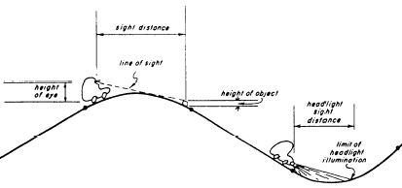
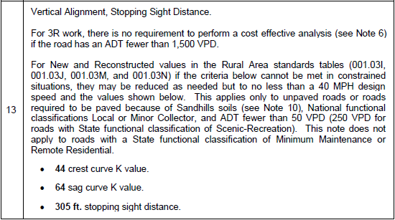
Vertical Alignment
Note 13
428 NAC 2-001.03B, Note 13, Page 50
428 NAC 2-001.03A1h, Constrained Situation, Page 42
Slide 50
Notes:
Note 13 addresses Vertical Alignment standards for roads and streets.
The first sentence says that, for 3R work, a cost effective analysis is not a minimum requirement if the traffic volume is less than 1,500 VPD.
The bottom part of the note allows some design flexibility, under certain conditions, if a constrained situation occurs when and where Rural Area standards are applied.
A vertical curve is allowed lower K values – 44 for a crest curve and 64 for a sag curve under these conditions:
Rural Area standards apply, and
The road is not paved (or paved because Note 10 allowed it), and
National Functional Classification of Minor Collector or Local (not including those that have the optional SFC of Minimum Maintenance or Remote Residential), and
The traffic volume is less than 50 VPD (or, in the case of Scenic-Recreation roads, 250 VPD).
The lower design speed applies also to stopping sight distance.

Slide 51

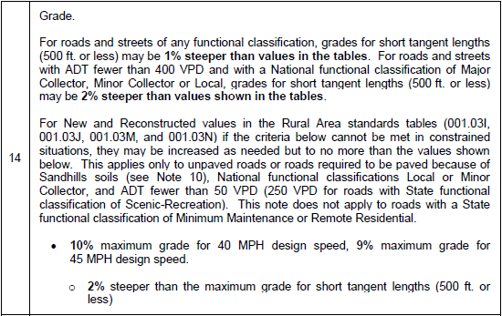
Maximum Grade
Note 14
428 NAC 2-001.03B, Note 14, Page 51
428 NAC 2-001.03A1h, Constrained Situation, Page 42
Slide 51
Notes:
Note 14 addresses Maximum Grade standards for roads and streets.
The first paragraph allows slightly steeper grades for short tangent lengths of a road or street.
The bottom part of the note allows some design flexibility, under certain conditions, if a constrained situation occurs when and where Rural Area standards are applied.
Steeper grades, as shown, are allowed under these conditions:
Rural Area standards apply, and
The road is not paved (or paved because Note 10 allowed it), and
National Functional Classification of Minor Collector or Local (not including those that have the optional SFC of Minimum Maintenance or Remote Residential), and
The traffic volume is less than 50 VPD (or, in the case of Scenic-Recreation roads, 250 VPD).

Slide 52

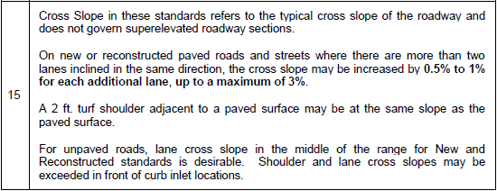
Cross Slope
Note 15
Slide 52
428 NAC 2-001.03B, Note 15, Page 51
Notes:
Note 15 addresses Cross Slope standards for roads and streets.
The first paragraph is a clarification that cross slope standards do not apply to superelevated roadway sections.
The second paragraph allows some design flexibility for lanes that are inclined in the same direction.
The third paragraph allows a 2 ft turf shoulder next to a paved surface to be the same slope as the paved surface.
The first sentence in the last paragraph is a recommendation, not a requirement, that cross slope for unpaved roads be in the middle of the range of values listed in the standards table.
The second sentence in the last paragraph allows design flexibility for cross slopes in front of curb inlet locations.

Slide 53
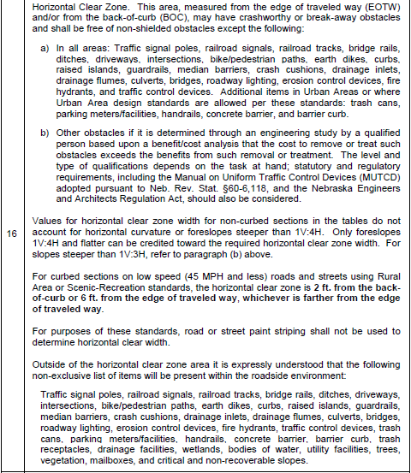
Note 16 - HCZ
428 NAC 2-001.03B, Note 16, Page 52
Slide 53
Notes:
Note 16 on page 52 addresses Horizontal Clear Zone standards for roads and streets.
It is an extensive note, taking up the entire page.
It starts by defining where the HCZ is measured from:
The Edge of the Traveled Way, or
The back-of-curb.
It also says that there may be crashworthy or break-away obstacles in the HCZ, and must be free of non-shielded obstacles except for what is listed in paragraph (a)

Slide 54
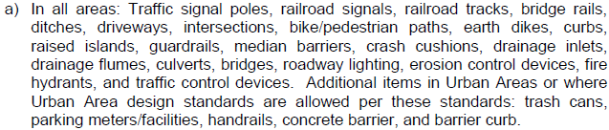
Note 16 - HCZ
428 NAC 2-001.03B, Note 16, Page 52
Slide 54
Notes:
Paragraph (a) of Note 16 is a list of obstacles allowed by NBCS design standards to be within the Horizontal Clear Zone for county roads and municipal streets, without coming to the NBCS for a relaxation of standards.
There are 22 obstacles listed for all areas – urban and rural.
There are an additional 5 obstacles listed for Urban areas, or where Urban area standards are allowed by Note 3.
Side slopes steeper than 1V:3H are considered obstacles.

Slide 55
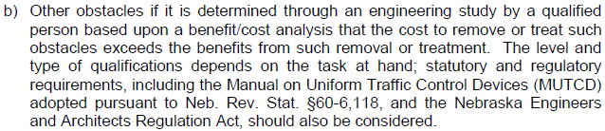
Note 16 - HCZ
428 NAC 2-001.03B, Note 16, Page 52
Slide 55
Notes:
Paragraph (b) of Note 16 allows some design flexibility in that an obstacle – not included in the paragraph (a) list – may remain in the HCZ if costs to remove or treat it exceed the benefits of removing or treating it, as long as an engineering study is done by a qualified person and that study includes a cost/benefit analysis.
It would not be appropriate to request a relaxation of standards, and engineering studies are not to be submitted to the NBCS, unless the engineering study determines that the benefits of removing or treating the obstacle exceed the costs of removing or treating it, and the county or municipality determines that, for other than cost reasons, the obstacle cannot be removed and there is no other feasible solution.

Slide 56

Note 16 - HCZ
428 NAC 2-001.03B, Note 16, Page 52
Slide 56
Notes:
The paragraph starting “Values for HCZ width . . . “ indicates that only foreslopes 1V:4H and flatter can be credited toward the required horizontal clear zone width.
These are considered traversable slopes.

Slide 57
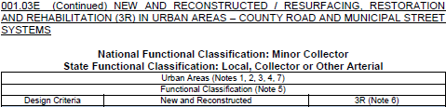

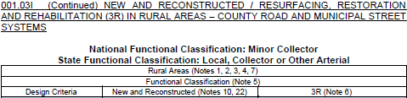

Horizontal Clear Zone
Note 16 - HCZ
428 NAC 2-001.03E Pages 59-60
428 NAC 2-001.03B, Note 16, Page 52
428 NAC 2-001.03I Pages 67-68
Slide 57
Notes:
To demonstrate how HCZ widths are expressed in the tables,
This screen shows two examples, which are excerpts from the standards –
the top is Table E, Urban Minor Collector, from page 60
The bottom is Table I, Rural Minor Collector, from page 68
In the URBAN TABLE, There are values for
A Curbed section: 2 ft from the back-of-curb, or 6 ft from the edge of the traveled way, whichever is greater from the edge of the traveled way.
A Non-curbed section: 8 ft. from the edge of the traveled way, for roads and streets with a traffic volume of 400 VPD and greater,
and the Nominal Shoulder Width for roads and streets with fewer than 400 VPD.
The Nominal Shoulder Width is the shoulder width presented in the standards table for the road or street. If you turn back one page to page 59, for an ADT less than 400 VPD, you will see that the value for this Urban example is 3 ft.
Regarding curbed sections, let’s quickly review some relevant information previously mentioned in this video:
The Traveled Way is defined on page 43 of the standards, as the portion of the roadway for the movement of vehicles, and it doesn’t include shoulders or bicycle lanes. You can see the traveled way in the cross section at the upper left.
What about Curbed Sections?
Note 9, says that lane width is measured from the gutter line, which is defined as one ft inside the back-of-curb.
Assuming the lane adjacent to the curb is a through lane, the gutter line is therefore one ft. inside the back-of-curb, and that becomes the Edge of Traveled Way for a curbed section.
If there is an auxiliary lane – such as a parking lane or a bicycle lane – adjacent to the curb, the auxiliary lane is part of the horizontal clear zone. That is a case when the 2 ft back-of-curb requirement may govern HCZ width for a curbed section.
At the bottom of the screen, In the RURAL TABLE, from page 68 of the design standards, The New & Reconstructed HCZ values are a function of design speed, traffic volume and side slope. The table provides two values, depending on the design side slope.
You need to know the traffic volume – refer to Note 7 for details – and the design speed, then enter the table and find the two minimum values for HCZ.
For example, let’s say the design speed is 50 MPH and the traffic volume is 1,000.
The values provided in the table are 14 ft – in the event the design slope is 1V:6H – and 16 ft – in the event the design slope is 1V:4H.
In the event the side slope is between 1V:6H and 1V:4H it is recommended to use to the minimum width required for 1V:6H.
If the design speed is 55 MPH instead of 50 MPH, the standard HCZ width would be wider – 16 ft for 1V:6H or 20 ft for 1V:4H.

Slide 58

Note 16 - HCZ
428 NAC 2-001.03B, Note 16, Page 52
Slide 58
Notes:
The paragraph highlighted on the screen addresses curbed sections on low-speed roads and streets, which are posted 45 MPH or less, where Rural Area standards apply,
The HCZ width requirement is 2 ft from the back-of-curb or 6 ft from the edge of the traveled way, whichever is farther from the edge of the traveled way.

Slide 59
Note 16 - HCZ
428 NAC 2-001.03B, Note 16, Page 52
Slide 59
Notes:
The last sentence clarifies that paint striping is not necessarily where the horizontal clear zone begins. You may recall a similar sentence in Note 9 for Lane Width and Note 11 for Shoulder Width.

Slide 60
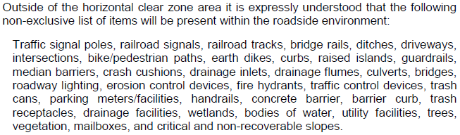
Note 16 - HCZ
428 NAC 2-001.03B, Note 16, Page 52
Slide 60
Notes:
The last part of Note 16 provides a list of obstacles that may be present beyond the horizontal clear zone.
It is information only. Although it may be of service in legal proceedings.

Slide 61


Vertical Clearance
Note 17
60-6,289. Vehicles; height; limit; height of structure; damages.
Slide 61
428 NAC 2-001.03B, Note 17, Page 53
Notes:
Note 17 addresses Vertical Clearance for roads and streets.
The first sentence clarifies that the minimum vertical clearance applies to the entire roadway. Remember, the roadway is the traveled way plus the shoulders.
The second sentence clarifies that the minimum vertical clearance values in the tables pertain to underpasses. The values do not pertain to such things as overhead tree branches and utility lines. Those are commonly addressed by ordinances or resolutions.
The third sentence addresses vertical clearance to pedestrian, bicycle and overhead sign structures, requiring the clearance to be at least one ft greater than the value in the table.
The last sentence is a cautionary note to account for state statute 60-6,289 when building a new overhead structure or when doing 3R work on or under a structure

Slide 62


Bridges and Structures Notes
Notes 18 - 22
For notes 18 through 22
See the video “Bridges and Structures”
Slide 62
428 NAC 2-001.03B Notes 18-22, Pages 53-54
Notes:
Notes 18 through 22 are all related to bridges and structures,
And are addressed in the two-part video on Bridges and Structures.

Slide 63
Notes – Index
Horizontal Alignment
Vertical Alignment
Grade
Cross Slope
Horizontal Clear Zone
Vertical Clearance
Clear Bridge Width
Structural Capacity
Timber Bridges
Low Water Stream Crossings/Fords
Roadway adjacent to structure replacements
Relaxation of Standards
Rural tables (≥ 50 MPH)
Urban tables for Rural areas
Other Principal Arterial → State Hwy Standards
Functional Classification
3R safety conscious design
Traffic Volume
Design Speed
Lane Width
Sandhills Soils
Shoulder Width
Design Criteria
428 NAC 2-001.03B, Pages 47-54
Slide 63
Notes:
To summarize Notes in the County Roads and Municipal Streets Standards,
The first seven notes address broader topics, such as functional classification, 3R work, traffic volumes and which standards to apply.
Notes 2, 3 and 4 were covered in the previous video – finding the correct table.
This video addressed notes 1, and 5 through 17.
Notes 18 through 22 are covered in the two-part video on Bridges and Structures.

Slide 64


2016 Standards
Video 06
MDS Definitions and Notes
County Roads and Municipal Streets
Neb. Rev. Stat. 39-2113
https://dot.nebraska.gov/media/5593/nac-428-rules-regs-nbcs.pdf
Boards - Liaison Services Section
8/6/2019
Notes:
This is one of a series of videos on Nebraska’s system of
Classifying and applying standards to its highways, roads and streets.
This video presented key definitions that are used in the design standards, and most of the notes referred to in the design tables.

