Slide 1


Managing Nebraska’s
Public Roads and Streets
Transportation Asset Management (TAM)
Boards - Liaison Services Section
Notes:
10/13/2021 Updated – added weblinks to slides 4 (TAM definition), 10 (the Ten Commandments) and 14 (TAM Resources)
4/24/2021 Updated – added notes to slides 6 and 7 regarding disasters and emergency relief funds.
1/31/2020 Updated. Slide 7 deleted notes because they were repeated from an earlier slide. Switched slides 12 and 13 around. Slide 15 (last slide) added “Your Experience?” to possibly generate some real-life discussion. Previous version dated 2/1/2019.
8/14/2019 Updated, minor changes. Previous version dated 2/1/2019.
Handouts – describe to audience
Since one of local government’s main reasons for existing is to provide constituents with services – streets and roads, water, possibly others such as electricity – how assets for those services are managed has a tremendous effect on the budget, the good will of constituents, and the overall health and well-being of the community!
Transportation Asset Management is not required by statute, rule or regulation in Nebraska. However, state statutes emphasize good management of roads and streets, and this video is offered in that light.
TAM is important for many reasons.
One example – disaster hits – your political jurisdiction can claim emergency funding – it really helps to know what you have so that you can claim as much of that funding as you can.
NOT FOR AUDIO
Slide source material: NHI Executive Summary presentation
There is a life-cycle to everything, even signs! Which signs are critical, in terms of risk? How often will you check their condition? When will they need to be replaced? How much will it cost to replace them?

Slide 2
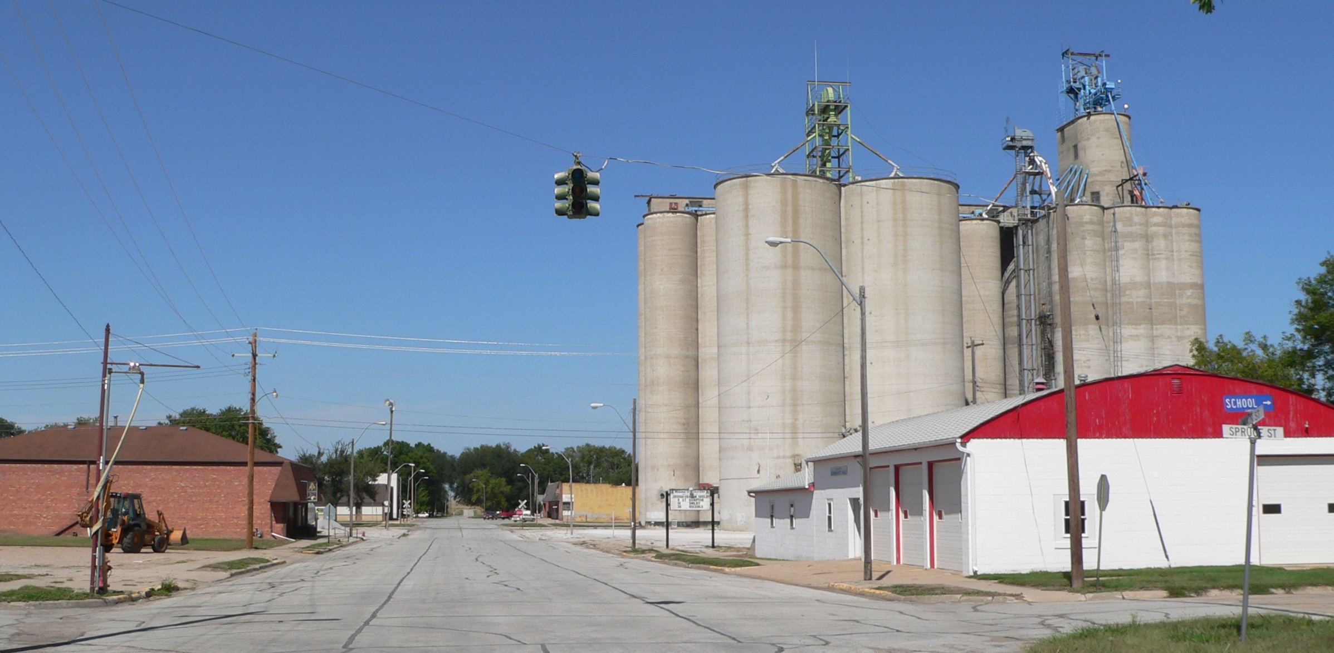
Physical Assets
Pavement
Bridges
Culverts
Curbs
Signs & Signals
Pavement Markings
Guardrails
Sidewalks/Ramps
Street Lights
You can’t manage what you don’t know you own
Slide 2
Notes:
What is an asset?
Generally, in the context of your agency, assets include people, equipment, buildings, land, and other components needed to provide a function or to deliver a service or a product to residents and taxpayers. The emphasis of this video is on physical assets – things.
Transportation Assets range from minor, low-cost, low-risk things such as street identification signs, to higher-cost, higher-risk assets like stop signs and traffic signals, to high-cost assets – pavement, for example.
This picture shows a typical small Nebraska town in which you can see several assets (street signs, stop sign, streetlights, pavement and curbs, curb ramps, and so on). You can go beyond transportation assets and include storm sewer, water and sanitary, electric lines, and more. Some of these are under ground. And some of these you may not even know where they are located!!
Assets are essential to protecting public health as well as for economic development.
It’s a lot to keep track of but You can’t manage what you don’t know you own.
Who manages all of this?
Ultimately, the council or board, the mayor and administration, employees and extended staff – contractors and consultants.
NOT FOR AUDIO
Slide source material: NE-LTAP (Megan), Community Signing, 2/20/2017 draft version
Image Source: https://upload.wikimedia.org/wikipedia/commons/0/08/Rising_City,_Nebraska_Main_Street_4.JPG

Slide 3
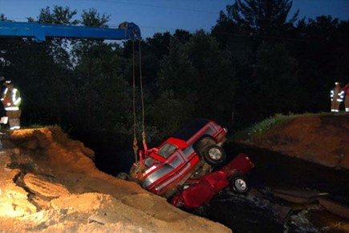
Got Insurance?
Slide 3
Notes:
Lack of good Asset Management programs can result in disastrous situations.
The screen shows an example where a county that did not have an Asset Management program was involved in a million dollar lawsuit due to a culvert washout.
The Asset that wasn’t managed properly was a minimum maintenance road that wasn’t inspected, then vacated with the county retaining ownership.
Neither the culvert nor the ROW were inspected for condition nor were the signs installed correctly at the time of the crash.
Tens of thousands of dollars were spent defending the county in this case. This could have been prevented by turning public rights-of-way back to the adjacent landowners. Similar liability situations could occur with equipment, pavement management, structures, culverts, and other assets if not managed properly.

Slide 4
Transportation Asset Management
Daily Business
& Long-Term
Data Driven: Continuous Inventory & Physical Condition Assessment
An ongoing systematic process
of recommending the most timely
and cost-effective way of preserving, replacing, upgrading and operating
physical road- and street-assets.
Result: organized, logical approach to decision-making
Slide 4
Notes:
Another way of saying it is ‘a process for maintaining a desired level of customer service at the lowest appropriate cost.” (Ref: EPA AM presentation)
NOT FOR AUDIO
Slide source material: NE-LTAP (Megan), Community Signing, 2/20/2017 draft version

Slide 5
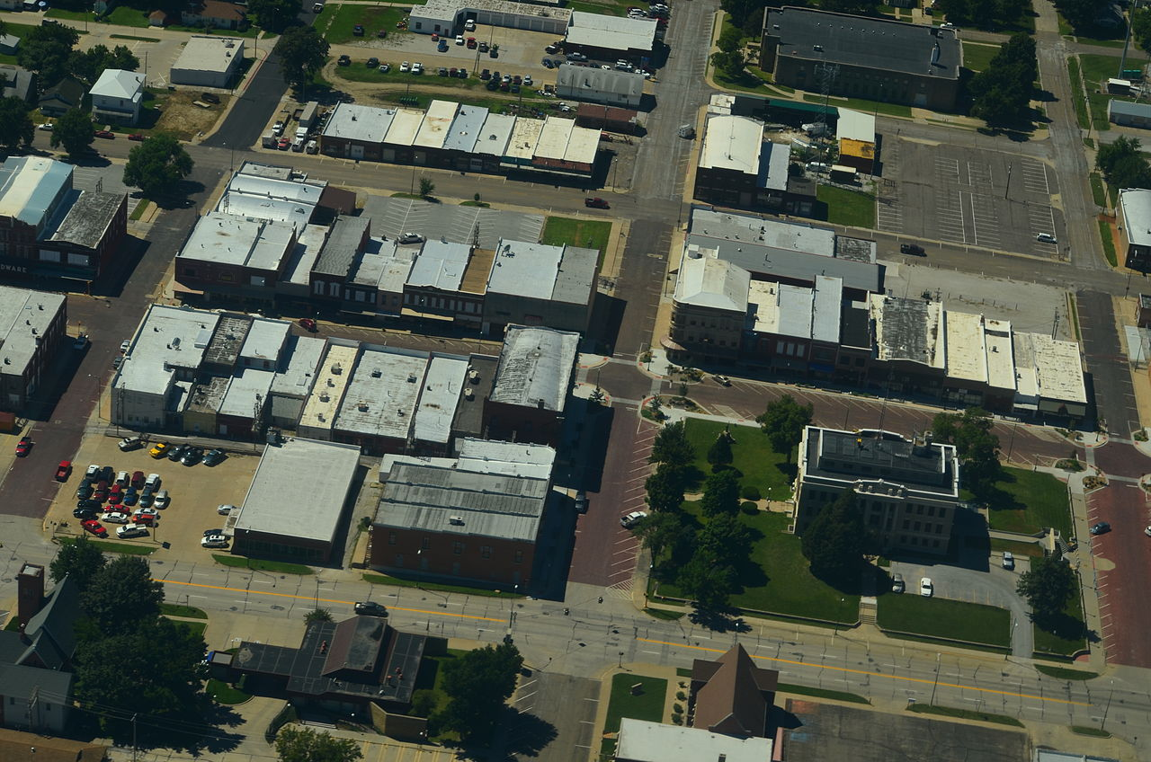
Asset Performance
Big Picture View:
  How is the whole system performing?
  How can it be improved?
Slide 5
Notes:
AM provides a big picture view for an asset, say street surfacing, or for a group of assets, say transportation or public works, enabling performance to be tracked and improved continually.
NOT FOR AUDIO
Slide source material: NE-LTAP (Megan), Community Signing, 2/20/2017 draft version
Image Source: https://upload.wikimedia.org/wikipedia/commons/thumb/c/cb/Aerial_View_of_Falls_City,_Nebraska_9-2-2013.JPG/1280px-Aerial_View_of_Falls_City,_Nebraska_9-2-2013.JPG

Slide 6
Assets Intelligence
Location (maps, spreadsheet, GIS)
Condition
Risk/Liability
Repair/replace costs
FACTS
Slide 6
Notes:
The focus of this video is describing what is TAM, and why use this approach? The When , well, it is a continual process. As far as the who does it, and the how, it must be a sustainable effort done by the agency’s staff and must be supported at the highest levels of the organization.
Your agency may already be doing some elements of a full-fledged TAM system.
The intent of this presentation is certainly not to be critical if your agency does not currently have an Asset Management program, only to introduce its concepts and let you decide if it is an approach that could help improve the performance of your road or street department.
Thinking of your infrastructure, do you know
Exactly what assets your local government owns, where they are all located, their condition, when they need to be repaired or replaced, how much money you will need to pay the bills?
And documentation showing all of that information,
that is readily accessible?
Have you identified critical assets and thought about how you will manage risks in the event of a failure? OR A DISASTER.
are you concerned about liability created by the failure, or absence, of an asset?
Is your community able to have reasoned and open discussions about spending on your infrastructure . . . based on facts?
When you have employee turnover, how much knowledge is lost and how difficult will the transition be?
Transportation Asset Management addresses all of these concerns!

Slide 7
TAM Improves
Decision-making (planning based on documented facts, reasonable options when to replace, where to replace)
Risk management (critical assets)
Accountability
The bottom line (contain costs, network approach, proactive, long-term thinking)
Succession (transitions, documented info)
Public Confidence (expectations, taxes)
MANAGEMENT
Slide 7
Notes:
4/24/2021 added note below regarding disasters and emergency relief funds.
Applying for, and receiving, emergency relief funds for a disaster can be a function of knowing what exactly you have out there, and its condition. And you never know when a disaster might strike, so this is a constant process!!

Slide 8


Managing an Asset
Asset Preservation Approach – Extend the Life!
(much less expensive fixes)
Traditional Worst-First Strategy (expensive!)
Good
Pavement Condition
Poor
Time, Years
Slide 8
Notes:
An asset preservation approach, with appropriate lower-cost preservation work done to extend the life of the pavement, usually proves to be much less expensive than a worst-first strategy, which involves a rapidly deteriorating pavement followed by an expensive reconstruction project.
The key to managing the asset in this case is to know its condition and apply the appropriate fix at the right time and right location.
NOT FOR AUDIO
Slide source material: NHI Executive Summary presentation

Slide 9

Implementation of Asset Management Principles
Any agency can implement asset management, regardless of:
  Asset condition
  Available funding
  Technological resources
No one way to implement
Use existing information
Slide 9
Notes:
Your agency can begin to gradually phase in and implement an asset management program right now.
It can be tailored for your community and can build on existing information.
This is not a solution in search of a problem – if your system is running fine, if it’s working for you, then stick with it
NOT FOR AUDIO
Slide source material: NHI Executive Summary presentation

Slide 10

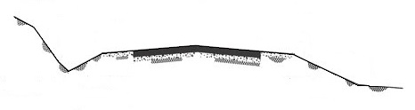
The Ten Commandments
General Information
Get water away and keep it away
Build on a firm foundation
Use good materials
Properly compact the soils underneath
Make room for snow
Build for traffic loads and traffic volumes
Before paving, follow above commandments
Look underneath a surface problem
Maintain, maintain, maintain
Keep good records
Slide 10
Basics of a Good Road, New York LTAP Center, Cornell Local Roads Program
Notes:
Puddles mean problems. Avoid building a flat road or street! (I-18)
A road wears out from the top but falls apart from the bottom.
Pay me now or pay me later.
Loose soils lead to a loose wallet.
Snow is just another form of water – keep it away also.
Don’t skate on thin ice.
Don’t build a new house on a crumbling foundation.
A layer of makeup doesn’t change the wrinkles underneath.
We may have a throw-away society, but don’t include roads and streets!
The superintendent is God of the Road, but a god that doesn’t liver forever.
Water is the arch-enemy (the devil himself). Water on and underneath weakens the base and subgrade, causing cracks, potholes, etc. Surface drainage system has 4 components: crown, shoulders, ditches, culverts. Grades should be at least 1% (should not build a flat road!) to allow drainage but not greater than 10%. Puddles mean problems.
The base determines the service life of a road or street. A road wears out from the top, but falls apart from the bottom.
Use well-graded soils, good quality aggregates, and blended or crushed gravel. Pay me now or pay me later.
The denser the soils, the stronger the soils. Achieve optimum moisture and good compaction during construction. Loose soils lead to a loose wallet.
Wider ditches allow for more snow storage and higher water flows. Cut down backslopes on the north and west sides. Design for winter maintenance. Good width for roads allow plows on the road with oncoming traffic. Good sight distance should be available (75 to 100 feet for each 10 MPH. Meet minimum standards for sure, but also see if you need a little extra width. Snow is another form of water (see #1) – keep it away too.
Design a road to handle anticipated loads – whether its gravel, a chip seal, cold mix asphalt, hot mix asphalt or Portland cement concrete. Don’t skate on thin ice!
It is likely a mistake and a huge waste of money to simply apply paving on top of a gravel road. The subgrade and base must be designed and built properly before applying pavement. It is foolhardy to build a new house on a crumbling foundation.
Again, it could be a waste of money to simply re-surface. The real problem might be water getting into the base or subgrade, a base that is too thin, or poor materials used in the base or subgrade. A layer of makeup doesn’t change the wrinkles underneath.
Regular maintenance preserves your investment and prevents or delays major costly rehabilitation work. For example, cutting brush, trees and grass, cleaning ditches and culverts, and keeping channels at bridges clear of debris will allow water to get away and stay away. In our throw-away society, roads and streets cannot be thrown away!
Good record keeping is vital to planning, communicating facts to elected officials and constituents, and succession from one superintendent to the next. A Superintendent is “the god of the road” but a god who doesn’t live forever!

Slide 11
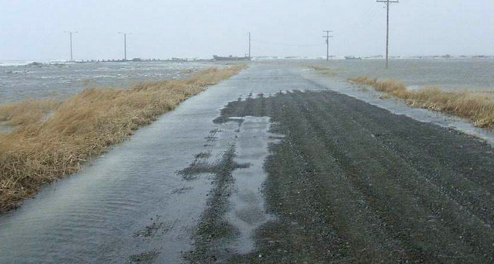
General Information
Referring to the 1st Commandment
Keep Water Away (Drainage)
Adequate cross slope, some grade (level could be a problem), and drainage facilities
Recommendation: generally, leave design work for drainage (bridge and hydraulic design, sizing culverts) to a professional.
Resulting damages may be the responsibility of the county or municipality!
Slide 11

Slide 12
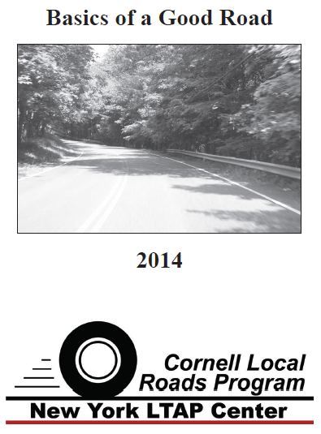
General Information
Tab 14-1 handout
Slide 12

Slide 13
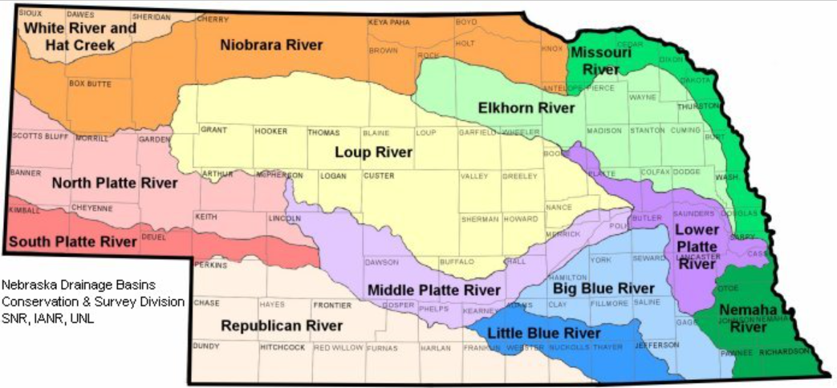
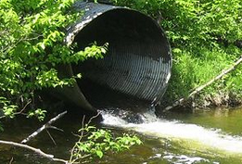
General Information
Drainage – Superintendent May Need to Explain Size of Structure
If asked, “How did you size that culvert pipe?”
The size of a culvert pipe is based on several factors, such as the size of the area that drains to it, its surface characteristics (topography, soil type, etc.), land use (farmland, urban, etc.) and the amount of rainfall assumed. We also have a policy of a minimum ___ inches diameter pipe for driveways and ___ inches for roads.
Slide 13
Notes:
The five basic reasons you can give to help explain the size of a culvert pipe to a citizen. Saying that the pipe must be at least equal to the pipe upstream can also be helpful.
III-6
Area: more area means more flow
Topography: map of a land’s surface features – mountains, hills, creeks, , lakes, bumps/lumps, roads, streets, etc.) COUNTOURS OF THE LAND
Soil Type: clayey, sandy, silty, loess, etc.
Rainfall: duration and intensity

Slide 14
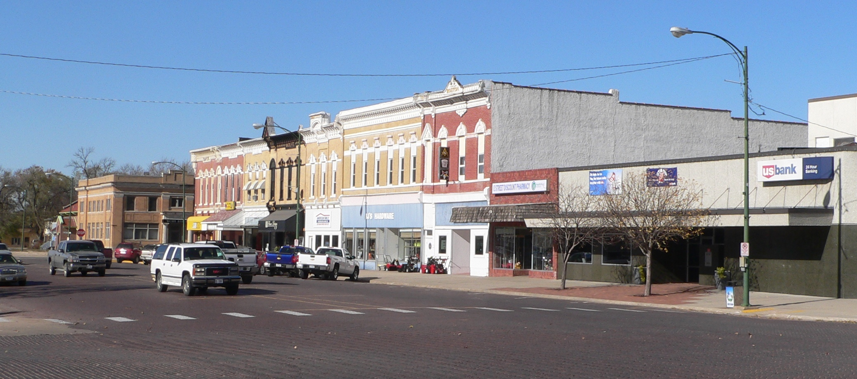
Additional Resources
www.fhwa.dot.gov/asset
mtu.adobeconnect.com/p8czppjifce
https://www.epa.gov/dwcapacity/reference-guide-asset-management-tools
ltap.unl.edu
Slide 14
Notes:
10/13/2021 Updated – added weblinks to slides 10 and 14
These are some additional resources for AM
The first bullet shows the Federal Highway Administration’s asset management website, which has a lot of resources.
The second reference is to a Michigan Tech University webinar which introduces Transportation Asset Management concepts and provides a good introduction to the topic.
The third bullet is the Environmental Protection Agency’s asset management website, which comes more from the viewpoint of the water and wastewater side of public works.
The last bullet is for resources on Nebraska LTAP’s website.
https://www.publicworkstraining.com/
NOT FOR AUDIO
Slide source material: NE-LTAP (Megan), Community Signing, 2/20/2017 draft version
Image Source: https://upload.wikimedia.org/wikipedia/commons/6/65/David_City,_Nebraska_E_from_5th.JPG

Slide 15
Managing Nebraska’s
Public Roads and Streets
Transportation Asset Management (TAM)
QUESTIONS?
YOUR EXPERIENCE?
Boards - Liaison Services Section

