Slide 1


2016 Design Standards
Video 04
Minimum Design Standards: Introduction
Nebraska Administrative Code
Title 428
Rules and Regulations of the
Board of Public Roads Classifications and Standards
(Administrative Host: Nebraska Department of Transportation)
County Roads and Municipal Streets
Neb. Rev. Stat. 39-2113
https://dot.nebraska.gov/media/5593/nac-428-rules-regs-nbcs.pdf
Boards - Liaison Services Section
8/8/2019
Notes:
8/8/2019 Updated first and last slides – Administrative Host: Nebraska Department of Transportation, not Nebraska Department of Roads.
8/4/2019 Updated to reflect changes per LB82 (2019). The previous version was dated12/22/2016. Slides 3 thru 8 (of the 12/22/2016 version) deleted. First and Last slides changed logo from NDOR to NDOT logo. Slide 2 updated NDOR to NDOT. Slide 7 (slide 13 in the12/22/2016 version) changed NDOR to NDOT and update web links. Slide 12 (slide 18 in the (12/22/2016 version) changed NDOR to NDOT.
This is one of a series of videos on Nebraska’s system of
Classifying and applying standards to its highways, roads and streets.
This video introduces Nebraska’s Minimum Design Standards for County Roads and Municipal Streets,
identifies the required design criteria,
And shows how the tables of criteria are set up
For those design standards.

Slide 2
Terminology and Acronyms used in this video
NBCS = Nebraska Board of Public Roads Classifications and Standards = “The Board” = “The Board of Public Roads”
NDOT = Nebraska Department of Transportation
Standards vs. Minimum Design Standards (MDS)
Neb. Rev. Stat. = Nebraska Revised Statutes
NAC = Nebraska Administrative Code
Highways = Roads = Streets (§39-101(3), §60-624)
3R = Resurfacing, Restoration and Rehabilitation
FC = Functional Classification
CFR = Code of Federal Regulations
AASHTO = American Association of State Highway Transportation Officials
Notes:
8/4/2019 Updated to change NDOR to NDOT
First, some terminology and acronyms . . .
NBCS is the Nebraska Board of Public Roads Classifications and Standards; it may also be called the Board of Public Roads, or just The Board.
NDOT is the Nebraska Department of Transportation
Standards refers to the NBCS standards, including design, construction, maintenance and relaxation of standards. MDS refers to the Minimum Design Standards, which address only the design aspect of a work or project. Standards are often termed “minimum” but realize there are maximums (for superelevation, grade) and ranges ( for cross slopes). When we say “minimum” – sometimes it refers to all of those.
Neb. Rev. Stat. refers to the Nebraska Revised Statutes
NAC is the Nebraska Administrative Code. These are regulations, that have the force of law.
The word “Highway” in Nebraska law also refers to roads and streets. Highway means the entire width between the boundary limits of any street, road, avenue, boulevard, or way which is publicly maintained when any part is open to the use of the public for purposes of vehicular travel.
3R is short for resurfacing, restoration and rehabilitation. For more details, see the video dedicated to 3R.
FC is Functional Classification.
CFR is the acronym for the Code of Federal Regulations.

Slide 3
Chapter 2 (428 NAC 2)
Procedures for Standards
Title 428 Chapter 2
Slide 3
428 NAC 2
Notes:
This video, and the following videos, provide more details on the Minimum Design Standards

Slide 4


State Highway Design Standards
428 NAC 2-001.02 (Page 5)
Minimum Design Standards
Separate Standards
County Roads and Municipal Streets Design Standards
428 NAC 2-001.03 (Page 35)
http://www.sos.ne.gov/rules-and-regs/regsearch/Rules/Roads_Dept_of/Title-428/Chapter-2.pdf
Slide 4
Notes:
It is important to understand that State Highway design Standards are separate and distinct from County Roads and Municipal Streets design standards.
In Section 001
Subsection 02, pages 5-34, addresses State Highway System design standards.
Subsection 03, pages 35-86, addresses County Roads and Municipal Streets design standards,.
Which is the focus of this video.

Slide 5

What is a Standard?
Standards
  a level of quality or attainment
  an ideal or a basis in terms of which something can be evaluated or judged
Notes:
A Standard can be defined as A level of quality, or attainment,
Or an ideal or basis in terms of which something can be evaluated or judged

Slide 6
Minimum Design Standards are
NBCS Standards
Attributes established as acceptable by NBCS
428 NAC 2-001
Slide 6
Notes:
The NBCS expresses the level, ideal, or basis, as attributes, mostly as key criteria, and sets values for each criteria depending on the general category (urban or rural), functional classification and other factors.
NOT FOR AUDIO
Standard: attributes (dimensions, speed and design loading) established as acceptable by an authority (NBCS). [A means of determining what a thing should be. Etymology: extendere (Latin), metaphoric, the royal standard coming to stand for royal authority in matters like setting weights and measures. Hence the meaning "authoritative or recognized exemplar of quality or correctness" (late 15c.). Synonyms: criterion, gauge, yardstick, touchstone. ]

Slide 7
Design Standards - Scope
County Roads and Municipal Streets
Minimum Design Standards
Only certain key criteria –
for safe and efficient operation
  Impractical to set standards for every possible design element or situation
http://www.sos.ne.gov/rules-and-regs/regsearch/Rules/Roads_Dept_of/Title-428/Chapter-2.pdf
or
https://dot.nebraska.gov/media/5593/nac-428-rules-regs-nbcs.pdf
which is a link on the following website:
https://dot.nebraska.gov/business-center/lpa/boards-liaison/nbcs/downloads/
Slide 7
428 NAC 2-001
Notes:
8/4/2019 updated (see italics below) and, in the slide itself updated the web link to 428 NAC 1 and 428 NAC 2
As it would be impractical to set standards for every design element or every situation that can be encountered,
The NBCS selected only certain, key criteria to include in the minimum design standards.
These criteria have been shown to affect safe and efficient operation of highways, roads and streets.
The Minimum Design Standards can be found online in two places:
The Secretary of State’s website under Rules and Regulations. It may be easiest to Browse Rules and Regulations by Agency. The Agency to select is RoadsTransportation, Once you are in the Transportation list, select Title 428. The MDS are in Chapter 2 of Title 428.
Another place to find NBCS standards is the Nebraska Department of Roads DOT’s website using either of the two other web links shown at the bottom of the screen. under Business Center, City/County Information, select Boards-Liaison Services Section, then select Minimum Design Standards. The link to select is “Adopted Minimum Standards (March 25, 2016).
The video following this one has more detailed information on the NBCS Minimum Design Standards.

Slide 8
NBCS Standards
Why Have Design Standards?
  Safer design, driver expectations, reliability
  A primary means to achieve a high-quality product
  Determine systemwide needs
  Required by Authority
    23 CFR 625
    Neb.Rev.Stat. §39-2113
    Local Ordinances and Laws
Slide 8
Notes:
Minimum design standards try to achieve
Safer designs,
Meet driver expectations
And Improve the reliability of the highway, road and street network
Standards are a primary means of achieving a high-quality product,
although there is a lot more to designing a road or street than just meeting minimum standards.
Standards are a way of benchmarking system-wide needs
And standards are required by authority, by
The Federal government
The Nebraska Legislature
And possibly local ordinances and laws as well.
NOT FOR AUDIO
Jim Knott’s 2009 slide
Meeting standards:
is a primary means by which a resultant high-quality roadway will be produced. [NOT 100% FOOLPROOF AND NOT THE ONLY MEANS! – GOOD DESIGN WORK IS THE ONLY MEANS!] Designers are trained to use accepted controlling criteria throughout the project development process.
decreases the probability that safety or traffic operational problems will develop. Using design values that lie within typical ranges thus provides some quality control and a reduced risk.

Slide 9


§39-2113
Minimum Design Standards
MDS
State Law
http://www.nebraskalegislature.gov/laws/browse-chapters.php?chapter=39
NBCS develops Minimum Design Standards for each Functional Classification
The standards, except those for Scenic-Recreation, shall be such as to assure that each segment of highway, road or street will satisfactorily meet the requirements of the area it serves and the traffic patterns and volumes which it may reasonably be expected to bear
  Design
  Construction
  Maintenance
Design standards apply to work that is to be done on a highway, road or street
★ Design with more parkway-like features, minimize environmental disruption
Slide 9
Notes:
The NBCS is responsible, via State Statute 39-2113, for developing minimum design standards for each functional classification.
The overall goal as expressed in the statute is assuring that each segment on the public system of highways, roads and streets will satisfactorily meet the requirements of the area it serves and the traffic patterns and volumes which it may reasonably be expected to bear.
Design standards for highways, roads and streets apply to works and projects– that are to be done.
When a standard becomes effective through the rulemaking process, it is not the intention of the NBCS that all highways, roads and streets immediately meet those standards. Rather, the design standards must be met whenever work more than maintenance is done.
NOT FOR AUDIO
From file MDS Slides - delete Slide.11
Section 39-2113. Board of Public Roads Classifications and Standards; minimum standards; rule for relaxing; request for review; decision. (1) In addition to the duties imposed upon it by section 39-2109, the Board of Public Roads Classifications and Standards shall develop minimum standards of design, construction, and maintenance for each functional classification set forth in sections 39-2103 and 39-2104. Except for scenic-recreation road standards, such standards shall be such as to assure that each segment of highway, road, or street will satisfactorily meet the requirements of the area it serves and the traffic patterns and volumes which it may reasonably be expected to bear.
(2) The standards for a scenic-recreation road and highway classification shall insure a minimal amount of environmental disruption practicable in the design, construction, and maintenance of such highways, roads, and streets by the use of less restrictive, more flexible design standards than other highway classifications. Design elements of such a road or highway shall incorporate parkway-like features which will allow the user-motorist to maintain a leisurely pace and enjoy the scenic and recreational aspects of the route and include rest areas and scenic overlooks with suitable facilities.

Slide 10
Design Standards
County Roads and Municipal Streets
The 3 Main Elements
Minimum Design Standards
(39)
(22)
(15)
Definitions
Notes
Tables
Slide 10
428 NAC 2-001.03 Pages 35-86
Notes:
There are 3 main elements the make up the minimum design standards:
Definitions
Notes
And Tables
The rule includes 39 definitions, on pages 37-46.
The NBCS wanted to define the types of work (to distinguish 3R work from Reconstructed work and Maintenance work), and other terms that are used throughout the standards in order to be clear and to avoid confusion.
The rule includes 22 notes, on pages 47-54.
And 15 tables, which have required criteria - and values associated with each criterion.
Definitions and Notes are addressed in another video in this series.
NOT FOR AUDIO
There are 39 definitions (there were none in the 2010 standards). Needed definitions for the types of work (to distinguish 3R from the others), bridge, roadway and traveled way, and others that are used throughout standards in order to bring some clarity and avoid confusion.
22 notes (there were 26 notes in the 2010 standards – 9 municipal and 17 rural). Some 2010 notes eliminated, and there are several new notes.
15 tables (there were 3 tables in the 2010 standards) - 2016 standards have 4 urban, 4 rural, 4 Scenic-Recreation, LWC, Min Maintenance, and Remote Residential. Each table is its own functional classification, so once you get to the correct table, all of the criteria is right there. You just lay the notes right along side and you have all of the requirements right in front of you.

Slide 11


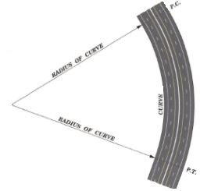
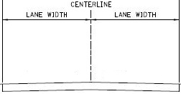
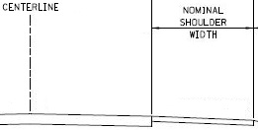
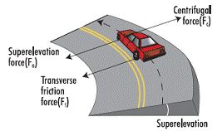
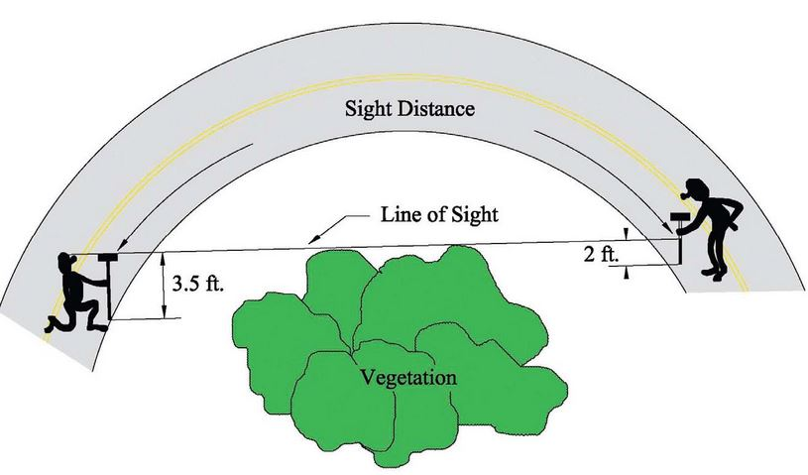
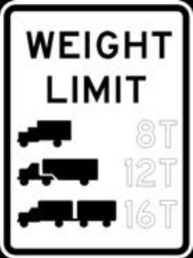
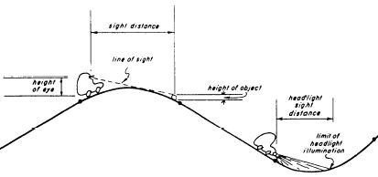
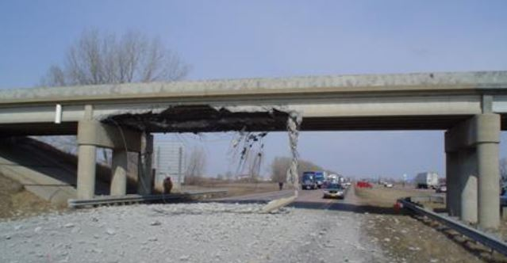
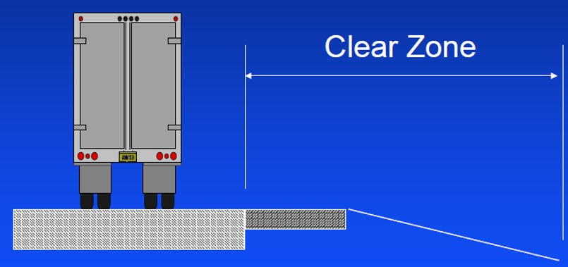
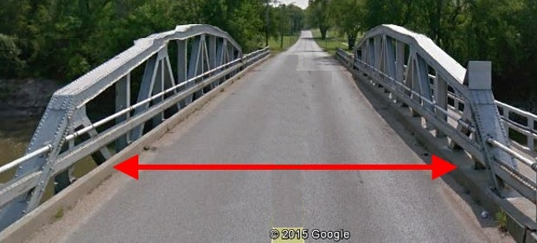

Minimum Design Standards Criteria
13 Design Criteria in the Tables
Design Speed
Lane Width
Shoulder Width
Horizontal Alignment (radius)
Superelevation
Vertical Alignment (K Values)
Maximum Grade
Stopping Sight Distance
Cross Slope
Vertical Clearance
Clear Bridge Width
Structural Capacity
Horizontal Clear Zone
428 NAC 2-001.03A6, Pages 45-46
Slide 11
Notes:
County Roads and Municipal Streets design standards include 13 criteria:
READ THEM
Definitions for each criterion are found on pages 45 and 46 of the rule.
The first 12 criteria may be referred to as “controlling criteria.” This will be discussed on the next screen.
NOT FOR AUDIO
All of these criteria are in the first 12 tables – the Urban Areas, Rural Areas and Scenic-Recreation tables.
Not all of them are in Low Water Stream Crossings and Fords, Minimum Maintenance and Remote Residential tables.
The criteria are the same for New and Reconstructed work, and for 3R work.
There are values for each criterion in the tables.
Each value is expressed as a minimum, a maximum or a range.
Every criterion is covered in a note. The notes are on pages 47-54 of the rule.
Fundamental criteria for road building. Bold font indicates criteria now in the tables that were not in the 2010 standards.

Slide 12

Controlling Criteria
General Information
Publ. Number FHWA-SA-07-011
23 USC 625: Design Standards for Highways
Slide 12
Notes:
8/4/2019 Updated to change NDOR to NDOT.
A resource for background information on design criteria is FHWA’s publication Mitigation Strategies for Design Exceptions, July 2007.
This publication identifies 13 design criteria as having substantial importance for the safe and efficient operation of highways, roads and streets. These are called controlling criteria.
In May, 2016, the FHWA reduced this to 10 controlling criteria. This will would have consequences only on Federal-aid projects; for further questions, discuss this with NDOR’s NDOT’s Local Projects Section as needed. [NOT FOR AUDIO: Vertical Alignment, Lateral Offset to Obstruction and Clear Bridge eliminated. On low-speed facilities, only Design Speed and Design Loading Structural Capacity apply. Reference: FHWA Mooney’s 5/5/2016 letter HIPA-20. ]
Highway design criteria have been established through years of practice and research, and form the basis by which roadway designers achieve a balanced design. The criteria are intended to deliver an acceptable, generally cost-effective level of performance (traffic operations, safety, maintainability, and constructability). The criteria are updated and refined as research and experience increase knowledge in the field of highway engineering, traffic operations, and safety.
NOT FOR AUDIO
Resources for Controlling Criteria; these may change per recently proposed rulemaking (Federal Register Vol 80 No 194, also see NCHRP Report 783)
From FHWA’s Mitigation Strategies for Design Exceptions, July 2007 publication:
Highway design criteria have been established through years of practice and research, and form the basis by which roadway designers achieve a balanced design. The criteria are intended to deliver an acceptable, generally cost-effective level of performance (traffic operations, safety, maintainability, and constructability). The criteria are updated and refined as research and experience increase knowledge in the field of highway engineering, traffic operations, and safety.

Slide 13
Design Standards
County Roads and Municipal Streets
Main Elements
Minimum Design Standards
Definitions (39)
Notes (22)
Tables (15)
Slide 13
428 NAC 2-001.03 Pages 55-86
Notes:
The next screens introduce the Tables in the County Road and Municipal Street system minimum design standards.

Slide 14
2016 Design Standards
15 Tables
Minimum Design Standards
4 – Urban Areas
4 – Rural Areas
4 – Scenic-Recreation
1 – Low Water Stream Crossings and Fords
1 – Minimum Maintenance Roads
1 – Remote Residential Roads
Slide 14
428 NAC 2-001.03 Pages 55-86
Notes:
There are 15 tables.
READ THE SLIDE
In the rule, they are in the order shown on the screen, starting on page 55, with the last table (Remote Residential Roads) on page 86
If you are wondering why there are four tables each for urban, rural and scenic-recreation . . .
NOT FOR AUDIO
2016 standards have 4 urban tables, 4 rural, 4 Scenic-Recreation, LWSC& Fords, Min Maintenance, and Remote Residential. Each table is its own functional classification, except for LWSC & Rods, so once you get to the correct table, all of the criteria is right there. You can lay the associated notes right along side and you have all of the minimum design standards right in front of you. This video will briefly introduce tables.

Slide 15
2016 MDS
County Roads and Municipal Streets
MDS Tables and the NFC
4 Tables each for Urban, Rural and Scenic-Recreation
  Minor Arterial
  Major Collector
  Minor Collector
  Local
3 other tables - Low Water Stream Crossings and Fords, Remote Residential Roads, and Minimum Maintenance Roads
2016 MDS organized by NATIONAL FUNCTIONAL CLASSIFICATION
(NFC)
Slide 15
428 NAC 2-001.03 Pages 35-86
Notes:
County Road and Municipal Street design standards are keyed off of the National functional classification
the AASHTO green book and other industry references are organized the same way
Recall from the video on the basics of functional classification,
that the National Highway System has seven functional classifications
The four listed on this slide, plus three higher classifications: Other Principal Arterials, Other Freeways and Expressways, and Interstate.
Those higher classifications, except for some of the Other Principal Arterials, are on the State Highway System; sub-section 002 of the MDS, pages 5-34, apply to those classifications. This video series does not address sub-section 002.
County roads and municipal streets generally have one of the four national functional classifications shown on this screen.
Remember also from the video on Functional Classification basics that Scenic-Recreation is the only classification that goes with another classification, thus any rural road with one of the classifications shown on this screen can also have the dual classification of Scenic-Recreation.
Because there are four functional classifications covered in the MDS for county roads and municipal streets, and each functional classification has its own set of design standards, there are four tables for Urban Areas, four for Rural Areas, and four for Scenic-Recreation. Refer to pages 55-78.

Slide 16
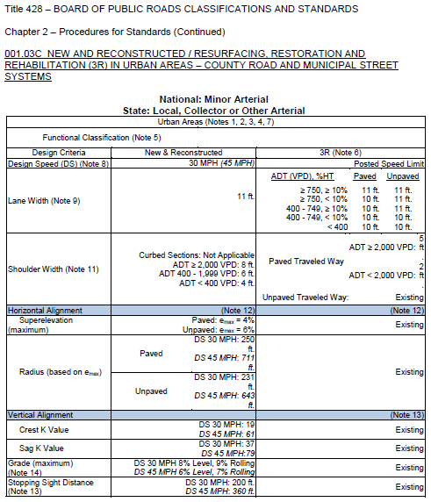
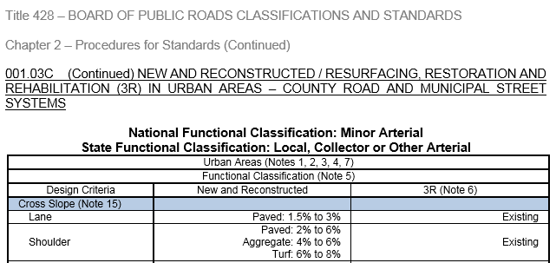
MDS Tables Format
Slide 16
Notes:
This screen shows the format of the 12 tables for Municipal, Rural and Scenic-Recreation, pages 55-78.
Some of the characteristics of these tables are as follows:
Each is two pages.
Each has its own part letter. The table on the slide is part C. It is the first table in sub-section 03. The tables following are D, E, F and on up to N on pages 77-78.
Each table is identified at the top. Since the 12 tables have criteria and values for New & Reconstructed work and 3R work, and all of them apply to county road and municipal street systems, the key identifier at the top is, in this example “Urban Areas”.
The National Functional Classification is identified above the table.
The State Functional Classification is also identified above the table. As discussed in the Functional Classification basics video, there is not always a one-to-one correlation between the National FC system and the State FC system. Therefore, in these 12 tables, all of the State FC’s that could apply are listed.
As for the table itself, the area is always identified – Urban Areas for the Urban tables, and Rural Areas for the Rural and Scenic-Recreation tables (roads classified as Scenic-Recreation are located in Rural areas).
Notes that apply are called out in parentheses throughout each table. Notes 1, 2, 3, 4 and 7 – in parentheses at the top of the table just after the words “Urban Areas” - apply to the entire table shown on the screen. Note 6, positioned at the head of the 3R column, applies to the all of the 3R criteria. Note (8), positioned next to Design Speed, applies only to the Design Speed criterion, for both New & Reconstructed and 3R criteria. Note (9) works the same way, only for Lane Width.
The left column lists the criteria.
The middle column has values for those criteria, for New & Reconstructed work.
The right column has values for those criteria, for 3R work.
That is the general layout of the first 12 tables in the CR and MS MDS.
NOT FOR AUDIO
County Roads and Municipal Streets tables 03C-03O are two pages long. 03P (Min Maint) is 5 pages long. 03Q Remote Residential is one page.
Once you determine standards you need (area and national functional classification) for your segment of road or street, you find the table that you need. On that table are the criteria and standards that apply, and only those that apply (other than what is in the Notes). Less confusion, fewer mistakes, and easier to document relaxation of standards requests.

Slide 17
The Other Three (3) Tables
MDS Tables Format
Low-Water Stream Crossings and Fords, Table 03O, pages 79-80
Minimum Maintenance, Table 03P, pages 81-85
Remote Residential, Table 03Q, page 86
Slide 17
428 NAC 2-001.03, Tables, Pages 79-86
Notes:
The other three tables begin on page 79 and end on page 86. When you look at these, you will realize that they are a different format than the first twelve tables. There are not as many design criteria, and the presence of signage requirements make them very different from the other tables.
Low-Water Stream Crossings and Fords is the only table that is not a functional classification. However, it needs its own table in order to establish minimum standards requirements for such crossings.
Minimum Maintenance and Remote Residential are two of the optional state functional classifications. If you have a road with either of these classifications, the applicable minimum standards would be either Table P or Q depending on if the road is classified as Minimum Maintenance or Remote Residential; on the National system the same road is likely to have a functional classification of Local, but the minimum standards in Table 03J on pages 69-70 would not apply to that road.
However, for that same road, if the county chooses to meet or exceed the minimum design standards for National Functional Classification Local, Table 03J on pages 69-70, a relaxation of standards request is not required. This does not apply, however, to low-water stream crossings or fords.

Slide 18
§39-2113
Different requirements for Minimum Maintenance County Roads
MDS
http://www.nebraskalegislature.gov/laws/browse-chapters.php?chapter=39
State Law
  Sufficient for farm machinery and occasional passenger and commercial vehicles
  Must be signed in accordance with NBCS regulations. Such signs must conform to the requirements of the MUTCD (§60-6,118)
  - Warn public of lower maintenance & Low Water Stream Crossings
  County may remove defective bridge, culvert or other structure to protect public safety and not replace it
Slide 18
428 NAC 2-001.03P Pages 81-85
Notes:
State law requires Minimum Maintenance County Roads
to provide for a level of minimum maintenance sufficient to serve farm machinery and the occasional or intermittent use by passenger and commercial vehicles
And signs at entry points and regular intervals to adequately warn drivers of the lower level of maintenance effort relative to other public roads.
It also allows the County to remove a defective bridge, culvert or structure, and, if appropriate, not have to replace it.
NOT FOR AUDIO
(3) The standards developed for a minimum maintenance road and highway classification shall provide for a level of minimum maintenance sufficient to serve farm machinery and the occasional or intermittent use by passenger and commercial vehicles. The standards shall provide that any defective bridges, culverts, or other such structures on, in, over, under, or part of the minimum maintenance road may be removed by the county in order to protect the public safety and need not be replaced by equivalent structures except when deemed by the county board to be essential for public safety or for the present or future transportation needs of the county. The standards for such minimum maintenance roads shall include the installation and maintenance by the county at entry points to minimum maintenance roads and at regular intervals thereon of appropriate signs to adequately warn the public that the designated section of road has a lower level of maintenance effort than other public roads and thoroughfares. Such signs shall conform to the requirements in the Manual on Uniform Traffic Control Devices adopted pursuant to section 60-6,118.

Slide 19
§39-2113
Different requirements for Remote Residential County Roads
MDS
http://www.nebraskalegislature.gov/laws/browse-chapters.php?chapter=39
State Law
  Access to remote residences, farms and ranches by passenger and commercial Vehicles
  Allows for one-lane traffic - where sight distance is adequate to warn motorists of oncoming traffic
  Must be signed in accordance with NBCS regulations to warn public of one-lane road. Such signs must conform to the requirements of the MUTCD (§60-6,118)
Slide 19
428 NAC 2-001.03Q Page 86
Notes:
State law requires Remote Residential County Roads
To have a level of maintenance sufficient to provide access to remote residences, farms and ranches by passenger and commercial vehicles
To allow for one-lane traffic as long as there is adequate sight distance and signs that warn the traveling public that it is a one-lane road.
NOT FOR AUDIO
(4) The standards developed for a remote residential road classification shall provide for a level of maintenance sufficient to provide access to remote residences, farms, and ranches by passenger and commercial vehicles. The standards shall allow for one-lane traffic where sight distance is adequate to warn motorists of oncoming traffic. The standards for remote residential roads shall include the installation and maintenance by the county at entry points to remote residential roads of appropriate signs to adequately warn members of the public that they are traveling on a one-lane road. Such signs shall conform to the requirements in the Manual on Uniform Traffic Control Devices adopted pursuant to section 60-6,118.

Slide 20

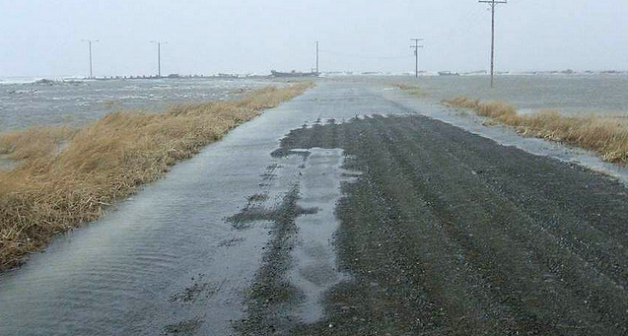
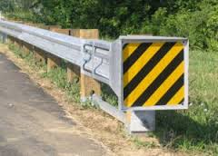

Criteria MDS do not include:
General Information
Design Standards - Limitations
Lateral Offset to Obstruction
Design Flood
Barrier Crashworthiness
Pavement Service Life
Q₁₀₀ ….Q₂
Slide 20
Notes:
This screen, and the next, present important design considerations that county roads and municipal streets design standards do not address.
Lateral Offset to Obstruction – a distance from the edge of the traveled way to a vertical roadside element such as trees, utility poles, walls, barriers, sign or signal supports, and curbs.
Design Flood – Your county or municipality probably has a POLICY dealing with the appropriate level of flooding for various situations or areas. Q is a letter used to denote a design flood, and you will see it on plans expressed as Q2, Q10, Q20, etc. Quite often it is best to have an engineer licensed in Nebraska size your culverts and bridges.
Barrier Crashworthiness
And Pavement Service life
Are other important criteria not covered in design standards.

Slide 21
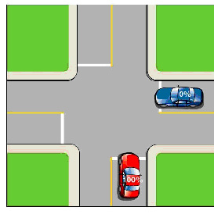

MDS do not include requirements for
Minimum Design Standards
Design Standards - Limitations
Intersections, Roundabouts (slow approach speeds)
Access Management
Alleys, driveways
Lighting, Signing, Marking
Medians
Number of Lanes
Surfacing Type
Americans with Disabilities Act (ADA)
  Curb Ramps
  Federal law - must be followed
Slide 21
Notes:
The MDS do not include several other requirements
READ THEM
None of these are covered in this video series with the exception of the Americans with Disabilities Act
And signing requirements for Minimum Maintenance Roads, Remote Residential Roads, and Low Water Stream Crossings and Fords

Slide 22
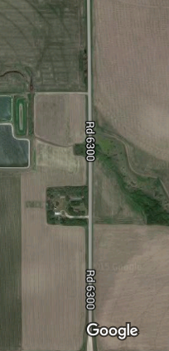
Application of Design Standards
Minimum Design Standards
Mill 4” Fill 4”
3R Standards
Replace Culvert
New & Reconstructed Standards
Mill 2” Fill 2”
Maintenance Standards
Slide 22
428 NAC 2-001.03A1e, Page 40
Notes:
Segments of a work or project could have different work scopes.
The hypothetical project on this screen starting at the bottom shows a maintenance overlay, at the top is a mill and overlay 3R scope of work, and in the middle is a culvert replacement – a New & Reconstructed type of work.
This is acceptable; see page 40 of the Minimum Design Standards.
It is not allowable to
mix and match different standards within a work segment.
Or to apply urban standards on one side of the road and rural standards on the other side of the road.

Slide 23
Review and Questions
Classification and Standards
428 NAC 2-001.03
Procedures for Standards
County Roads and Municipal Streets
Slide 23
Notes:
This final segment is a short review of what was discussed in this video, with questions.
When it comes time to answering a review question, you have the option of pausing the video before the answer is given.

Slide 24
Review Questions
Notes from the State Highway System design standards, subsection 2, may also be used for county roads and municipal streets, subsection 3? T or F
All county roads and municipal streets are not required to be brought up to current design standards within the 6-year plan period. T or F
What is the level of design flood required by the NBCS minimum design standards for a city street classified as Local?
There is no design flood requirement in the NBCS minimum design standards
Slide 24
Notes:
False. Subsection 2, the State Highway Design Standards, are separate from Subsection 3, County Roads and Municipal Streets design standards. The only connection is that county roads and municipal streets with a national functional classification of other principal arterial must use State Highway design standards. Other than that, nothing from either subsection applies to the other.
True. State Statute 39-2101 originally envisioned all roads and streets being brought up to New & Reconstructed standards over a 20 year period. That was in 1969. The same statute also recognized that funding is not always available.
There is no minimum design flood requirement in the NBCS MDS.

Slide 25
2016 Design Standards
Video 04
Minimum Design Standards: Introduction
Nebraska Administrative Code
Title 428
Rules and Regulations of the
Board of Public Roads Classifications and Standards
(Administrative Host: Nebraska Department of Transportation)
County Roads and Municipal Streets
Neb. Rev. Stat. 39-2113
https://dot.nebraska.gov/media/5593/nac-428-rules-regs-nbcs.pdf
Boards - Liaison Services Section
8/8/2019
Notes:
This concludes the Minimum Design Standards: its Main Elements and Controlling Criteria.
This is one of a series of videos on Nebraska’s system of
Classifying and applying standards to its highways, roads and streets.
This video introduced Nebraska’s Minimum Design Standards for County Roads and Municipal Streets,
identified the required design criteria,
And showed how the tables of criteria are set up
For those design standards.

