Slide 1
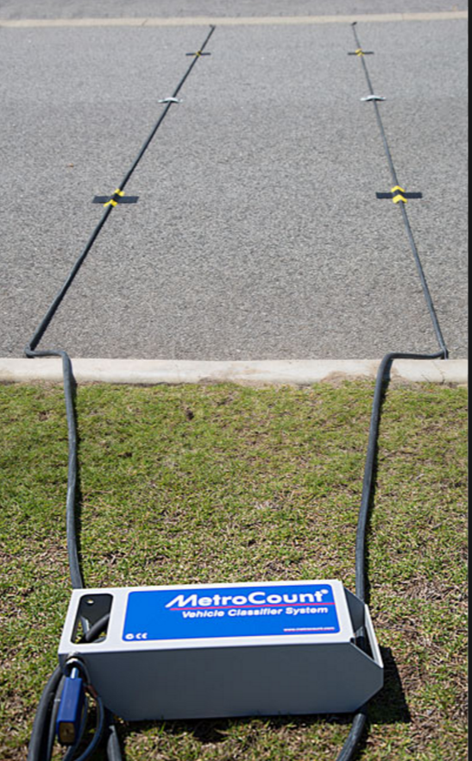
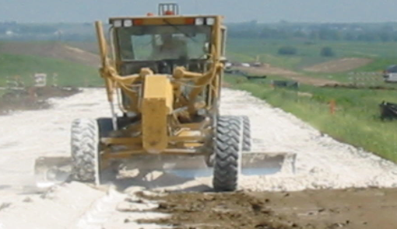
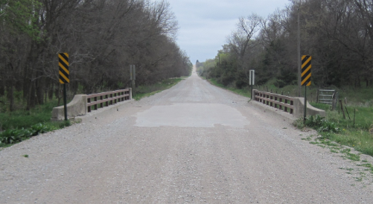
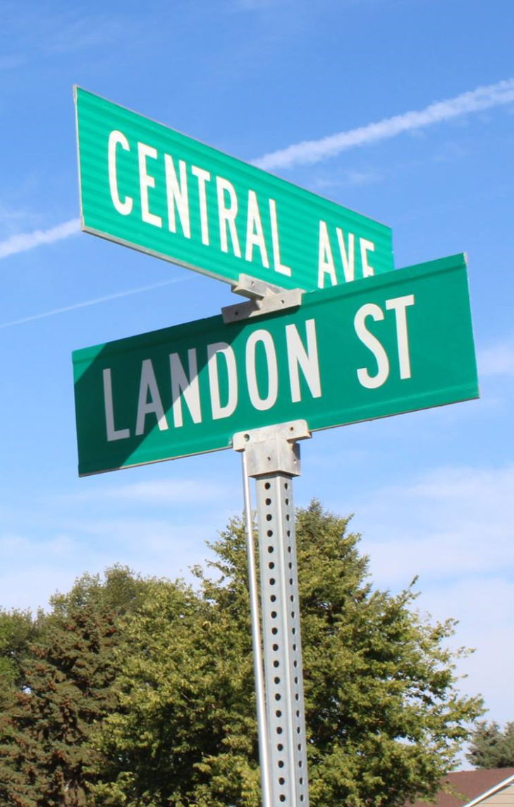
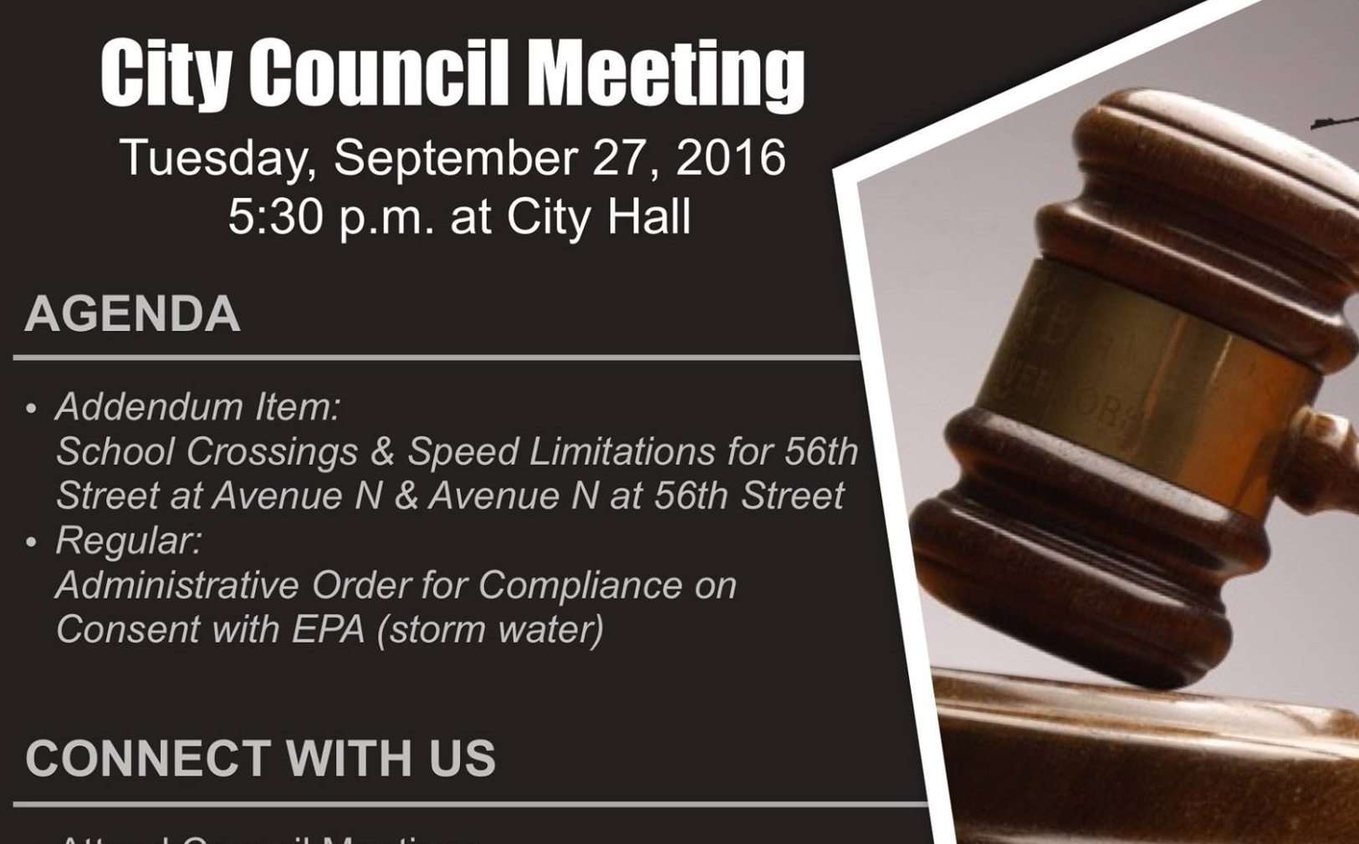
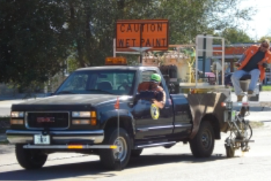

Managing Nebraska’s
Public Roads and Streets
Transportation Asset Management
Boards - Liaison Services Section
http://dot.nebraska.gov/business-center/lpa/boards-liaison/training/
1/5/2018
Video E
Notes:
Welcome to “Managing Nebraska’s Public Roads and Streets Planning and Reporting.”
This video focuses on the managing of assets, for counties and municipalities.
Since one of local government’s main reasons for existing is to provide constituents with services – streets and roads, water, possibly others such as electricity – how assets for those services are managed has a tremendous effect on the budget, the good will of constituents, and the overall health and well-being of the community!
This is the fifth topic in a series of videos the purpose of which is to summarize Nebraska’s management of public roads and streets as directed by state law and also by rule and regulation.
Transportation Asset Management is not required by statute, rule or regulation in Nebraska. However, state statutes emphasize good management of roads and streets, and this video is offered in that light.
The target audience is county highway and city street superintendents, and those aspiring to attain those positions. Elected officials and anyone interested in the management of the state’s public roads and streets are also encouraged to view this.
NOT FOR AUDIO
Slide source material: NHI Executive Summary presentation
There is a life-cycle to everything, even signs! Which signs are critical, in terms of risk? How often will you check their condition? When will they need to be replaced? How much will it cost to replace them?
What?
Who?
Why?
How?

Slide 2
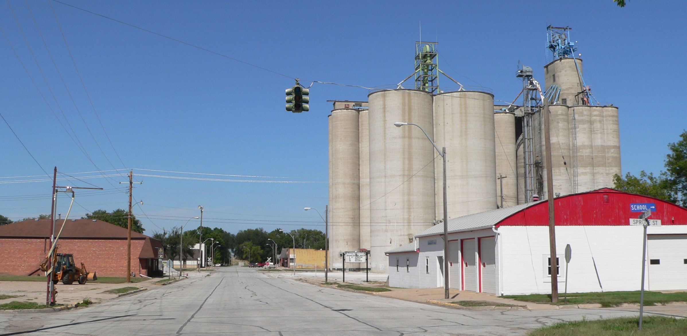
Physical Assets
Pavement
Bridges
Culverts
Curbs
Signs & Signals
Pavement Markings
Guardrails
Sidewalks/Ramps
Street Lights
You can’t manage what you don’t know you own
Slide 2
Notes:
What is an asset?
Generally, in the context of your agency, assets include people, equipment, buildings, land, and other components needed to provide a function or to deliver a service or a product to residents and taxpayers. The emphasis of this video is on physical assets – things.
Transportation Assets range from minor, low-cost, low-risk things such as street identification signs, to higher-cost, higher-risk assets like stop signs and traffic signals, to high-cost assets – pavement, for example.
This picture shows a typical small Nebraska town in which you can see several assets (street signs, stop sign, street lights, pavement and curbs, curb ramps, and so on). You can go beyond transportation assets and include storm sewer, water and sanitary, electric lines, and more. Some of these are under ground. And some of these you may not even know where they are located!!
Assets are essential to protecting public health as well as for economic development.
It’s a lot to keep track of but You can’t manage what you don’t know you own.
Who manages all of this?
Ultimately, the council or board, the mayor and administration, employees and extended staff – contractors and consultants.
NOT FOR AUDIO
Slide source material: NE-LTAP (Megan), Community Signing, 2/20/2017 draft version
Image Source: https://upload.wikimedia.org/wikipedia/commons/0/08/Rising_City,_Nebraska_Main_Street_4.JPG

Slide 3
Transportation Asset Management
(TAM)
Focus of this video
What is TAM?
Why use the TAM approach?
TAM requires constant attention
Who is responsible for TAM?
Is TAM appropriate for your agency?
Slide 3
Notes:
The focus of this video is describing what is TAM, and why use this approach? The When , well, it is a continual process. As far as the who does it, and the how, it must be a sustainable effort done by the agency’s staff, and must be supported at the highest levels of the organization.
Your agency may already be doing some elements of a full-fledged TAM system.
The intent of this video is certainly not to be critical if your agency does not currently have an Asset Management program, only to introduce its concepts and let you decide if it is an approach that could help improve the performance of your road or street department.

Slide 4
Infrastructure - Current Practices
Assets – what and where they are, their condition, when to repair/replace and the cost?
Documentation
Critical assets – failure, managing risks
Reasoned and open discussions about infrastructure spending
Employee turnover – lost knowledge, transition difficulties
readily accessible
liability
based on facts?
Transportation Asset Management addresses all of these concerns
Slide 4
Notes:
Thinking of your infrastructure, do you know
Exactly what assets your local government owns, where they are all located, their condition, when they need to be repaired or replaced, how much money you will need to pay the bills?
And documentation showing all of that information,
that is readily accessible?
Have you identified critical assets and thought about how you will manage risks in the event of a failure?
are you concerned about liability created by the failure, or absence, of an asset?
Is your community able to have reasoned and open discussions about spending on your infrastructure . . . based on facts?
When you have employee turnover, how much knowledge is lost and how difficult will the transition be?
Transportation Asset Management addresses all of these concerns!

Slide 5
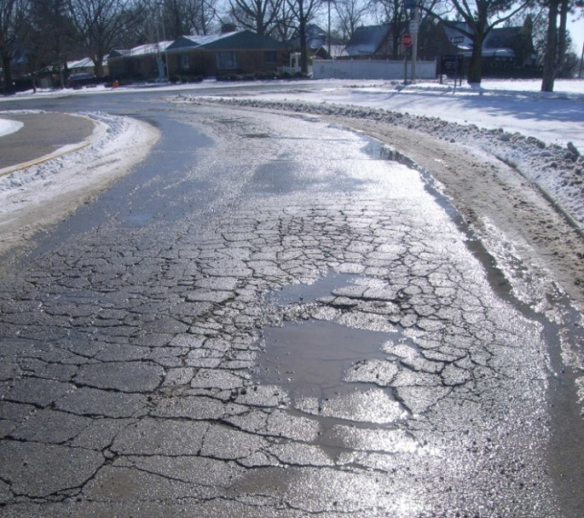
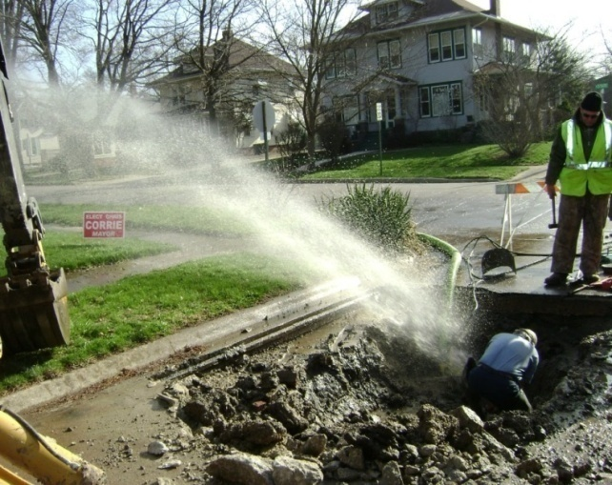
Sound Familiar?
Infrastructure deteriorates with age
Public expects the same level of service for less money
Photo from: http://environmentalalmanac.blogspot.com/2009/12/monticello-program-conserves-water-on.html
Slide 5
Notes:
Key Message: The economic and political environment can be difficult for elected officials and staff.
The nature of man-made things is that they deteriorate with age.
Infrastructure across our country is aging and failing at an alarming rate.
Many taxpayers expect the same or better level of service for the same or less money, even if costs go up.
NOT FOR AUDIO
Slide source material: NHI Executive Summary presentation

Slide 6
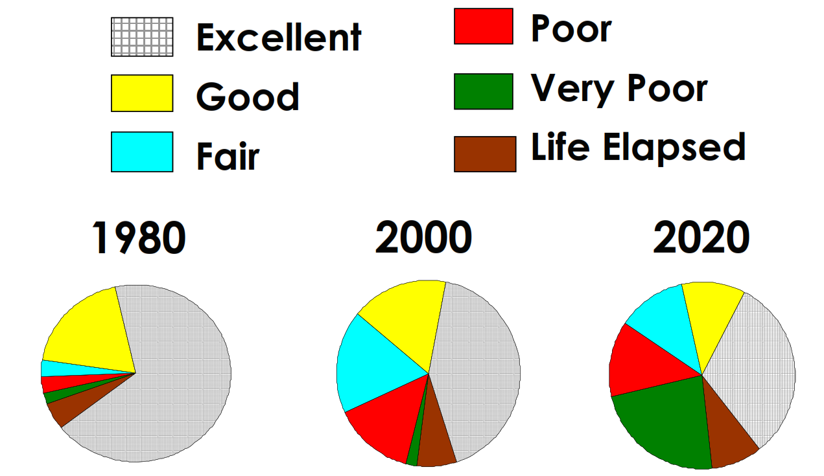
Asset Condition Over Time
Slide 6
Notes:
As you see on this screen, the condition of assets usually changes over time. The darker colors – the poor conditions, or the expected life has been exceeded – grow larger over time especially if not managed well.
An emphasis on a disciplined, organized asset management approach has emerged as a response to the realization that there is often a funding gap between the current condition of assets and the investment needed to maintain or replace those assets.
The initial investment is just the start of spending. Anything you buy or build, must be maintained over time. There are costs associated with that, which for some assets may be several times the initial investment!
NOT FOR AUDIO
Image Source: EPA’s AM presentation

Slide 7

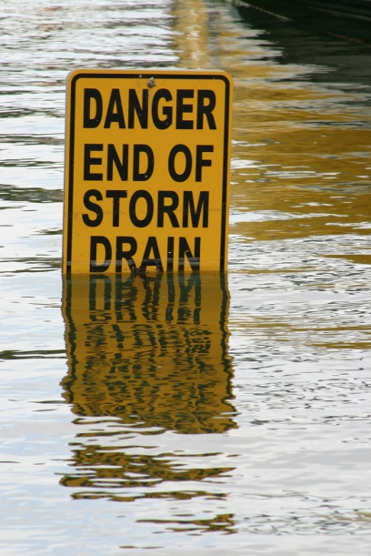
Not Actively Managing Assets?
Replacing Worst Assets First?
Creates a Potential for
Loss of credibility
Loss of revenue
Increased costs
Rapid deterioration
Risk/Liability
Loss of institutional knowledge
Slide 7
Notes:
Subjective and short-sighted decision-making can lead to loss of public funds and a loss of credibility.
Not having documentation of assets can get the city in a bind because of employee turnover.
With all of the problems elected officials and staff deal with these days, you don’t need problems compounded by not being proactive in your management of assets.
Managing assets properly is very important to elected and city officials and city staff, and, obviously, residents of the city and those who use those assets.
NOT FOR AUDIO
Slide source material: NHI Executive Summary presentation

Slide 8
Pavement Deterioration
Good
Pavement Condition
Maintenance or 3R
Reconstruction
Poor
Time, Years
Slide 8
Notes:
The next two screens show an example of strategically managing an asset, in this case pavement.
This is a pavement deterioration curve. Pavement condition is represented on the vertical axis. Time is represented on the horizontal axis, in years.
After a pavement is newly built, or reconstructed, it deteriorates gradually but usually stays in excellent to good shape for a few years, then begins to deteriorate more rapidly – the steeper part of the curve in the middle.
The bottom right part of the curve represents a pavement in poor condition.
At some point, there are structural distresses – the base is failing – called the critical distress point. At that point, reconstruction is required.
Above that dashed line, less expensive maintenance or resurfacing strategies can be used to extend the life of the pavement, as demonstrated on the next screen.
NOT FOR AUDIO
Slide source material: NHI Executive Summary presentation

Slide 9


Managing a Pavement Asset
Asset Preservation Approach – Extend the Life!
(much less expensive fixes)
Traditional Worst-First Strategy (expensive!)
Good
Pavement Condition
Poor
Time, Years
Slide 9
Notes:
An asset preservation approach, with appropriate lower-cost preservation work done to extend the life of the pavement, usually proves to be much less expensive than a worst-first strategy, which involves a rapidly deteriorating pavement followed by an expensive reconstruction project.
The key to managing the asset in this case is to know its condition and apply the appropriate fix at the right time and right location.
NOT FOR AUDIO
Slide source material: NHI Executive Summary presentation

Slide 10
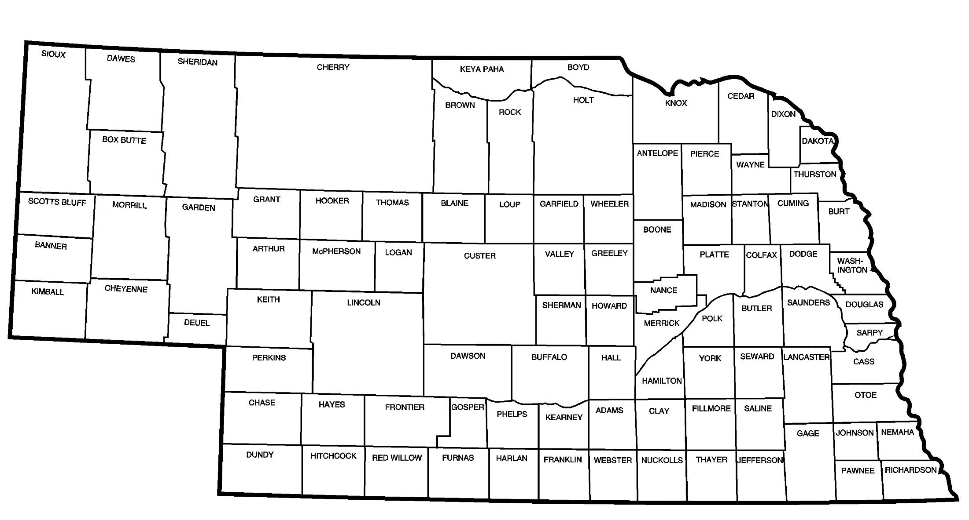
Example
Composite County – Median Figures
800 centerline miles of roads
  767 miles unpaved
    717 miles gravel or crushed aggregate
    50 miles minimum maintenance
  33 miles paved
7,000 LF bridge-size structures
Slide 10
Notes:
Let’s take a look at a hypothetical example, using recent county data, and some typical spending assumptions. The county data are median values and therefore do not represent any particular county. The cost assumptions may not be what your particular entity currently pays. Focus on the concept presented here, not the particular numbers. You can plug in your own numbers, and do a quick analysis for your own county or municipality, without knowing the condition of your facility; this will show the problem with the worst-first approach to asset management.
Among Nebraska counties, 800 centerline miles of roads is the median figure. The vast majority are unpaved roads – the median is 767 miles. This example assumes that 50 of those unpaved miles are minimum maintenance. There are usually some paved roads outside of corporate limits – the median figure is 33 miles of paved roads. The median number of lineal feet of bridge-size structures in Nebraska is about 7,000 LF; these are bridges with an opening of 20 feet or more along the centerline of the road.

Slide 11

Example (Continued)
Assumed Costs, Per Year, Over the Long Term
Roads
  Unpaved
    Gravel or crushed aggregate: $1,800/mi/yr
    Minimum maintenance: $0/mi
  Paved – spread cost evenly over 15 years
    Reconstruction: $600,000/mi, Life Span: 15 years, $40,000/mi/yr
Bridges/Structures – spread cost evenly over 60 years
  Bridge-size
    Replace: $4,200/LF, Life Span: 60 years, $70/LF/yr
Slide 11
Notes:
Now let’s look at what those facilities cost to maintain, and replace, over the long term.
This example assumes a cost of $1,800/mi to maintain a gravel or aggregate road over the long term – many years. The historical cost for your agency may be different. You may find that the $1,800 per mile figure is either low or high in your experience; that is OK, pay more attention to the analysis than the actual numbers.
To keep the example as simple as possible, roads classified as Minimum Maintenance are assumed to have a negligible cost.
For this example, for paved roads the pavement life is assumed to be 15 years, with little or no maintenance done during those 15 years. The cost of reconstruction is assumed to be $600,000 per mile. That results in an annual cost of $40,000/c-l-mile/year.
Bridge-size structure replacements are assumed to cost $4,200/LF, with a 60-year life span. That results in an annual cost of $70/LF/yr.

Slide 12
Example (Continued)
Estimated Long-Term Costs
Roads
  Unpaved
    717 mi x $1,800/mi/yr = $1.29 million/yr
  Paved
    33 mi x $40,000/mi/yr = $1.32 million/yr
Bridges/Structures
  Bridge-size
    7,000 LF * $70/LF/yr = $0.49 million/yr
Other: assume $0.20 million
TOTAL = $3.3 million/yr
Slide 12
Notes:
Applying those assumed cost figures to the median county network of roads, results in the following average annual costs.
717 miles of gravel and aggregate roads (including labor, equipment, gravel and supplies), is about $1.3 million.
If the worst-first approach is used for the paved roads, an average annual budget of approximately $1.3 million is required.
Replacement of 7,000 LF of bridge-size structures annually would run about $500,000 per year on the average.
None of this accounts for replacing bridges and structures with an opening less than 20 feet along the centerline of the road, or other expenses! Assuming another $200,000 for those, the total is
Approximately $3.3 million.

Slide 13
Example (Continued)
Median Nebraska County – Conclusion
Annual Budget (2017)*: $2.8 million
Average Annual Need: - $3.3 million
← Previous screen
ANNUAL DIFFERENCE: ($0.5 million)
TRUST
* Includes HAF Distributions: $1.1 million (median County distribution)
Slide 13
Notes:
The roads budget, for the county that received the median amount of HAF distributions in FY 2017, was $2.8 million. That’s a deficit of $500,000, or 15% of $3.3 million of identified needs.
Notice that the total budget annual need, $3.3 million, is triple the $1.1 million in HAF distributions received! This is not unusual, considering the extent of annual needs for a county road network.
Again, this is an example scenario. You can do this kind of an analysis using actual numbers and cost estimates for your county or municipality.
If your bank account grew by that much each year, you would be extremely happy! But if you were going into debt by that much each year, well, you can see that at some point, quicker that you think because of the double-digit rate, there will be some serious problems. The local government may need to close bridges and roads; user costs may go up because rough roads cause more maintenance on vehicles, or safety could be compromised. By not using simple maintenance strategies at the right time and right place, opportunities are missed.
At some point, when this all comes to light, the public will likely lose trust in the leadership of the entity.

Slide 14
Infrastructure Management
Use of less expensive resurfacing/rehabilitation/restoration strategies when appropriate
Preserve, extend life
Know your facilities – condition, needs
Proactive management
Slide 14
Notes:
Using strategies that extend the life of your facilities becomes not just a good thing to do, but essential!! Using strategies to extend the life of pavements – crack sealing, seal coat, overlay, mill/fill, addressing issues with bridge-size structures right away to increase their life spans, and a program to inspect and properly maintain smaller structures are important to the long-term health of your entity’s road and street network!
Managing your facilities – by knowing what you have, their condition, and extending their life as much as possible – is critical and essential for your county or municipality!
In some cases, asset management may not get your entity out of the hole, but applying asset management principles and strategies over time will help soften the blow.

Slide 15
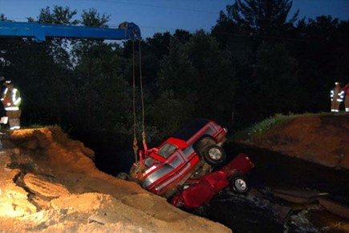
Got Insurance?
Slide 15
Notes:
Lack of good Asset Management programs can result in disastrous situations.
The screen shows an example where a county that did not have an Asset Management program was involved in a million dollar lawsuit due to a culvert washout.
The Asset that wasn’t managed properly was a minimum maintenance road that wasn’t inspected, then vacated with the county retaining ownership.
Neither the culvert nor the ROW were inspected for condition nor were the signs installed correctly at the time of the crash.
Tens of thousands of dollars were spent defending the county in this case. This could have been prevented by turning public rights-of-way back to the adjacent landowners. Similar liability situations could occur with equipment, pavement management, structures, culverts, and other assets if not managed properly.

Slide 16
Local Governments . . .
Pavement Condition
Condition Pavement Index Percent of
Category Range Network
Good 70 - 100 29%
Satisfactory 50 - 69 17%
Fair 25 – 49 25%
Poor < 25 29%
Information on Tillamook County extracted from the Tillamook County Public Works Road Asset Management Plan produced by PBS Consulting in January 2009.
. . . Seeking a Different Approach
Slide 16
Notes:
Because of deteriorating asset conditions and lack of money to maintain assets, many counties and cities across the country seek a different way of doing business.
NOT FOR AUDIO
Slide source material: NHI Executive Summary presentation

Slide 17
Transportation Asset Management
Daily Business
& Long-Term
Data Driven: Continuous Inventory & Physical Condition Assessment
An ongoing systematic process
of recommending the most timely
and cost-effective way of preserving, replacing, upgrading and operating
physical road- and street-assets.
Result: organized, logical approach to decision-making
Slide 17
Notes:
TAM – what is it? READ THE SLIDE.
Another way of saying it is ‘a process for maintaining a desired level of customer service at the lowest appropriate cost.” (Ref: EPA AM presentation)
NOT FOR AUDIO
Slide source material: NE-LTAP (Megan), Community Signing, 2/20/2017 draft version

Slide 18
Traditional vs. Transportation Asset Management
A Difference in Approaches
Operations → Assets
Short-term → Long-term
Immediate → Sustainable
Reactive → Proactive
Project Oriented → Network Management
Slide 18
Notes:
AM shifts the focus from Operations to Assets, it takes the Long view vs. the Short-term view, it is about a sustainable approach - not immediate results. It is a change from reactive to proactive, and from project-management to network-management.
NOT FOR AUDIO

Slide 19
Transportation Asset Management:
A Business Model
Goals
Return-on-Investment
Efficiency
Accountability
Slide 19
Notes:
AM originated in private industry and is Used in many industries with a substantial asset base: electric power, telephone, trucking, railroads
You have likely heard the mantra “Run government like a business!” In some ways it can’t work like that, but AM gets you closer.
Think of TAM as way of providing some “business discipline.”
NOT FOR AUDIO
AM Originated in private industry: W. E. Demming, Malcolm Baldridge
A prescribed level of service at the lowest possible cost
Slide source material: NE-LTAP (Megan), Community Signing, 2/20/2017 draft version

Slide 20
Transportation System - Goals
Keeping assets in as good or better condition than it is now.
Developing and implementing a capital improvement plan based on need.
Containing the costs of planning, building, operating, and maintaining the facilities.
Slide 20
Notes:
Transportation Asset Management affects the goals shown on this screen.
Maintaining assets
Continual planning, based on need
And containing costs
Part of the emphasis of asset management is on "more information on which to base decisions" which leads to more accountability for officials charged with making those decisions.
It is directed toward defined performance goals. Assets have a solid return on investment or face changes-similar to the way in which private industry focuses on market share and rate of return.
NOT FOR AUDIO
Source: https://www.fhwa.dot.gov/asset/if08008/amo_02.cfm

Slide 21
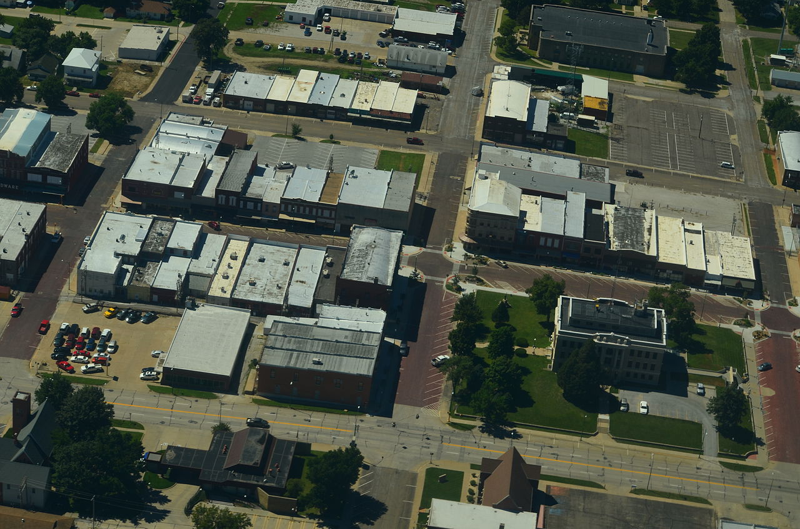
Asset Performance
Big Picture View:
  How is the whole system performing?
  How can it be improved?
Slide 21
Notes:
AM provides a big picture view for an asset, say street surfacing, or for a group of assets, say transportation or public works, enabling performance to be tracked and improved continually.
NOT FOR AUDIO
Slide source material: NE-LTAP (Megan), Community Signing, 2/20/2017 draft version
Image Source: https://upload.wikimedia.org/wikipedia/commons/thumb/c/cb/Aerial_View_of_Falls_City,_Nebraska_9-2-2013.JPG/1280px-Aerial_View_of_Falls_City,_Nebraska_9-2-2013.JPG

Slide 22

Implementation of Asset Management Principles
Any agency can implement asset management, regardless of:
  Asset condition
  Available funding
  Technological resources
No one way to implement
Use existing information
Slide 22
Notes:
Your agency can begin to gradually phase in and implement an asset management program right now.
It can be tailored for your community, and can build on existing information.
This is not a solution in search of a problem – if your system is running fine, if it’s working for you, then stick with it
NOT FOR AUDIO
Slide source material: NHI Executive Summary presentation

Slide 23
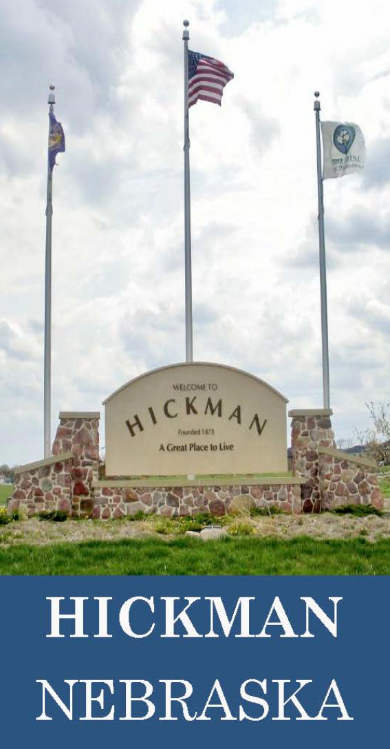
Applying Asset Management
Issues
Succession Planning
Liability
Labor Costs
http://beehiveindustries.com/wp/wp-content/uploads/2015/07/case-studies-HICKMAN-printready.pdf
Slide 23
Notes:
The city of Hickman has an Asset Management program. They were motivated to improve their succession planning, to bring new leadership and staff up-to-speed much quicker by having an up-to-date inventory of their assets.
In addition, the city has benefited from its asset management data to prove its diligence and avoid a legal liability judgment and, by having an organized system, is saving crew time.
This does not mean that TAM is appropriate for all entities. It must be a sustainable effort. It requires time, effort and money to build and maintain a database and analyze the data, needs employees to have the time available and be assigned the responsibilities, needs a champion, and needs top level support.
NOT FOR AUDIO
http://beehiveindustries.com/wp/wp-content/uploads/2015/07/case-studies-HICKMAN-printready.pdf
Silas Clarke, City Manager

Slide 24
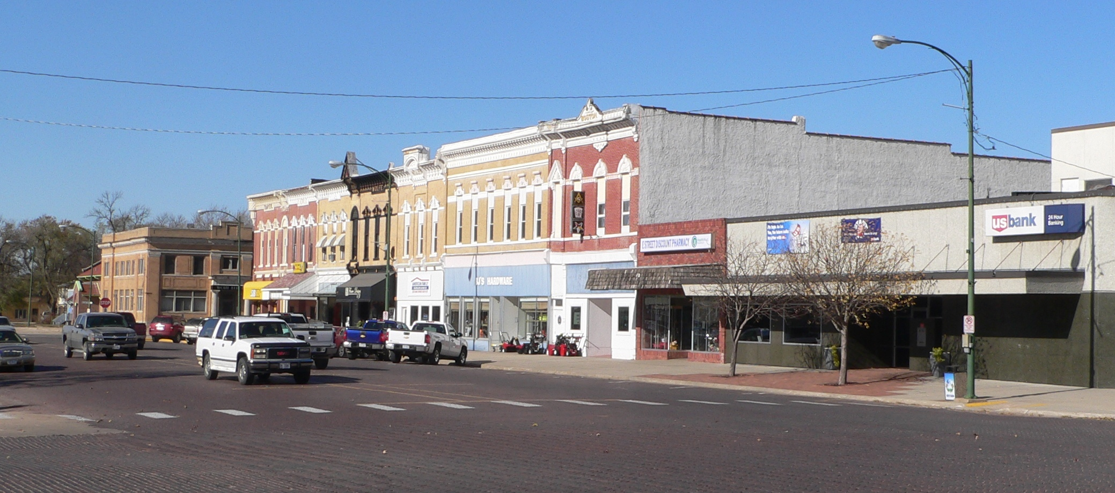
Additional Resources
Asset Management
www.fhwa.dot.gov/asset
mtu.adobeconnect.com/p8czppjifce
https://www.epa.gov/dwcapacity/reference-guide-asset-management-tools
ltap.unl.edu
Slide 24
Notes:
These are some additional resources for AM
The first bullet shows the Federal Highway Administration’s asset management website, which has a lot of resources.
The second reference is to a Michigan Tech University webinar which introduces Transportation Asset Management concepts and provides a good introduction to the topic.
The third bullet is the Environmental Protection Agency’s asset management website, which comes more from the viewpoint of the water and wastewater side of public works.
The last bullet is for resources on Nebraska LTAP’s website.
NOT FOR AUDIO
Slide source material: NE-LTAP (Megan), Community Signing, 2/20/2017 draft version
Image Source: https://upload.wikimedia.org/wikipedia/commons/6/65/David_City,_Nebraska_E_from_5th.JPG

Slide 25
Managing Nebraska’s
Public Roads and Streets
Transportation Asset Management
Boards - Liaison Services Section
http://dot.nebraska.gov/business-center/lpa/boards-liaison/training/
1/5/2018
Video E
Notes:
This was the fifth topic in a series of videos the purpose of which is to summarize Nebraska’s management of public roads and streets as directed by state law and also by rule and regulation.
It was a brief introduction to Transportation Asset Management.
The concepts that were presented are not required by Nebraska rule and regulation. However, state statutes do emphasize good management of roads and streets, and this video was offered in that light.
Although the Transportation Asset Management approach may not be sustainable for all entities, especially those that are small and lack resources, it is powerful approach, that helps plan maintenance work and capital improvement projects, allows smoother leadership transitions, helps in liability situations, and can be a time saver for employees.

